Slide 1
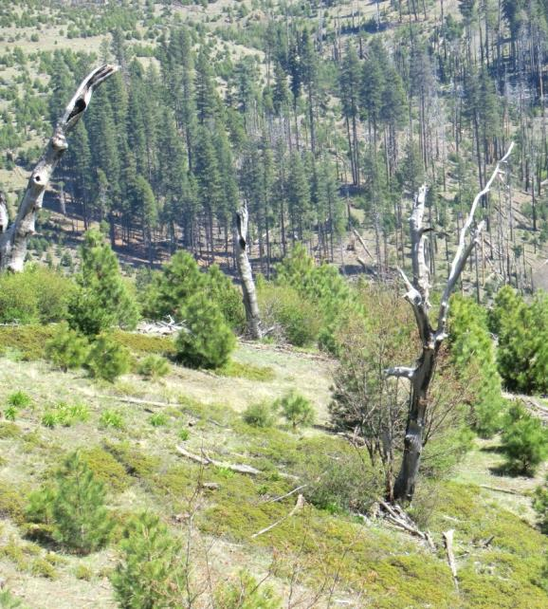
Does thinning California black oak basal sprouts following severe fires yield ecosystem dividends?
Power Fire, El Dorado NF
Jonathan W. Long, USDA FS PNW Research Station
Amador-Calaveras Consensus Group Symposium
November 8, 2017
Jackson, CA

Slide 2
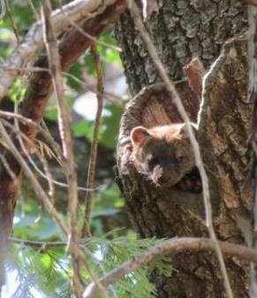
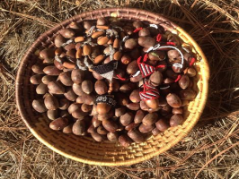
Significance of Large California Black Oaks
Large, well-insulated cavities for fisher dens and spotted owl nests
Large quantities of high quality acorns
Resistance to fire*
Skinner (1995) found that black oak stems>8” DBH survived prescribed burns

Slide 3
Age (years) | Diameter (inches) | Acorn production (pounds)* | Other properties
~10 | ~2 | ~0 | Can produce acorns
30 | 5 | ~0
50 | 9 | 5 | Stems survive Rx fire
80 | 13 | 20 | Heart rot incidence increases
100 | 17 | 60 | Heart rot in 40% of trees 110-120 years
150 | 24 | 100
200 | 32 | 140
From McDonald (1990) Silvics of North America and Skinner (1995)
Notes:
If trees can get to 2”/10 years, then they can begin to produce acorns and have a chance of surviving a low-intensity fire. But trees need to be large/mature (i.e., typically ~>12” DBH minimum) to provide these services in significant amounts. McDonald (1990) notes that by the time a natural black oak stand is 85 years old, the proportion of trees infected by heart rot begins to increase rapidly, with 40% of trees infected by 120 years. Consequently, trees typically need to be much older (150-200 years) to be consistent producers and provide good wildlife habitat.

Slide 4
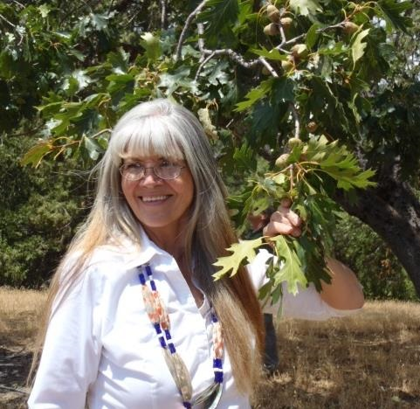
Desired Condition for Black Oaks from Tribal Perspective: What does it look like and how can we measure it? PSW-GTR-252

Slide 5
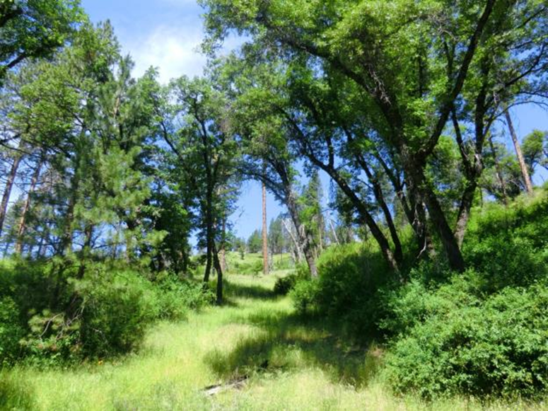
Low-severity burn in Power Fire

Slide 6
Mature Oaks At Risk
Black oak stem that survived the Power Fire but is now highly vulnerable to fire

Slide 7
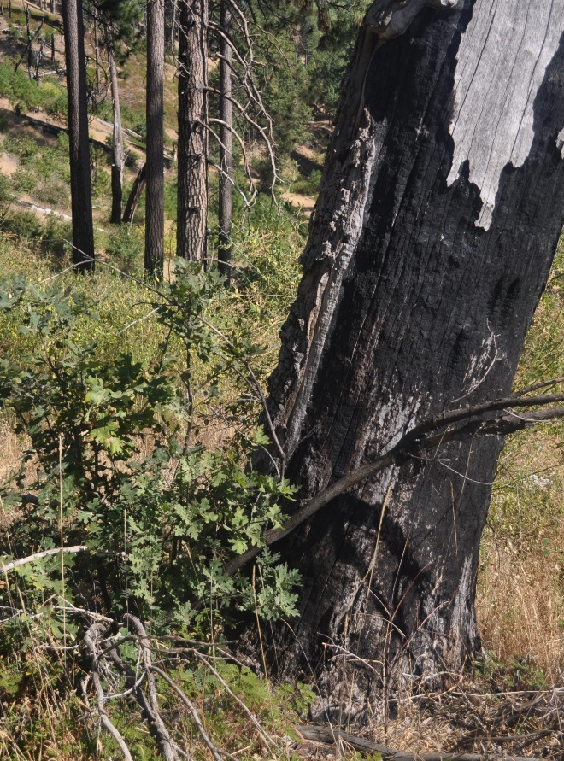
Impacts from Severe Wildfire
High– and moderate-severity fire often kills the above-ground stems of black oak trees,
The trees typically resprout (right)
But such top-kill results in decades of lost services from acorn production and wildlife habitat
Sprouting top-killed oak in Power Fire
Notes:
Oak stems generally do not survive crown fires; Cocking et al. found survival associated with lack of invading conifers.

Slide 8
Fate of Black Oaks in Different Burn Severities in the Rim Fire
Notes:
These results are broadly consistent with other fires—80-90% top-kill, 0-15% full kill, 0-15% top survival

Slide 9
Hammett et al. Fire Ecology (2017)
High-severity fires may give a competitive advantage to black oak that sprouts following top-kill
Greater oak crown volume for sprout clumps with no live conifer overstory
An estimated ~45% of sprout clumps would produce acorns 12 years after fire-induced re-sprouting, although production and viability of those acorns were not evaluated
BUT complete top-kill of sprout clumps (~100%) in reburns within the fire return interval (12 years)
This may reduce the availability of mature black oak trees
Twice top-killed black oaks (Storrie Fire 2000, and Chips Fire 2012)
Notes:
Stems aren’t large enough to survive frequent reburns

Slide 10
California Black Oak declining in recent FIA Data
Black oak increased in basal area (by ~1 m²/ha) in the central Sierra between 1930 and 2000 (McIntyre et al. 2014)
But it had a small decline in basal area (-0.2 m²/ha) over its entire range in the last decade due to fire
Notes:
McIntyre et al. (2014) reported a slight increase in black oak basal area from 1930 Wieslander survey to 2000s FIA data. 67.45 million square feet basal area = 6.266 million m2. 1/6 of basal area on S-T. Three top forests for black oak all showed large declines. Half of basal area on the San Bernardino NF lost.

Slide 11
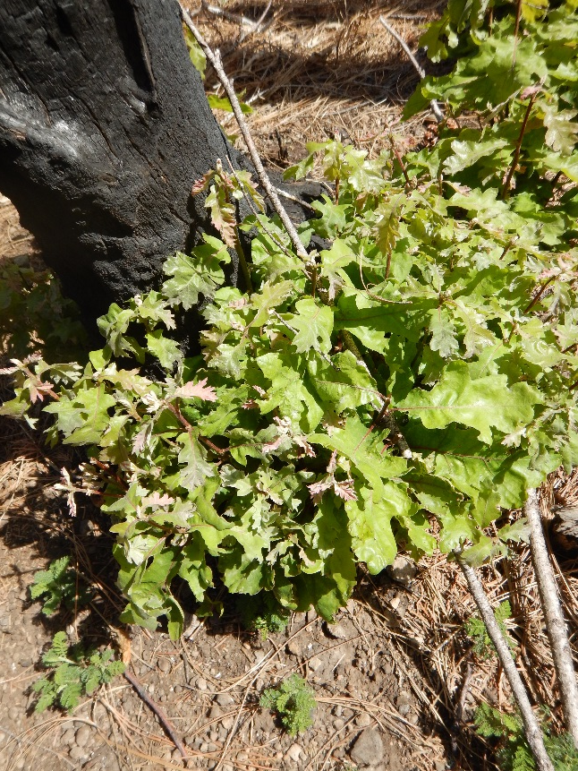
“Cleaning the Stool”
All-Natural Colon Cleanse

Slide 12
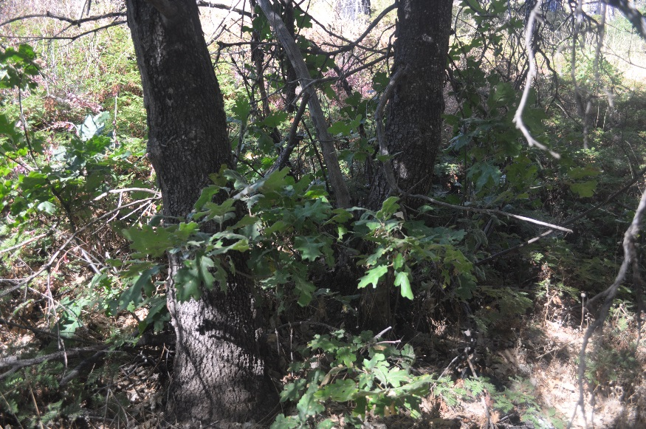
A Treatment Hypothesis
Selectively cut resprouts (“stool cleaning”) to accelerate crown development and enhance acorn production?
Local knowledge of black oak & studies of black oak and other oaks suggest that thinning could enhance growth of residual stems
However, such cutting can trigger more basal resprouts and/or branches that could also offset accelerated growth of the main stems

Slide 13
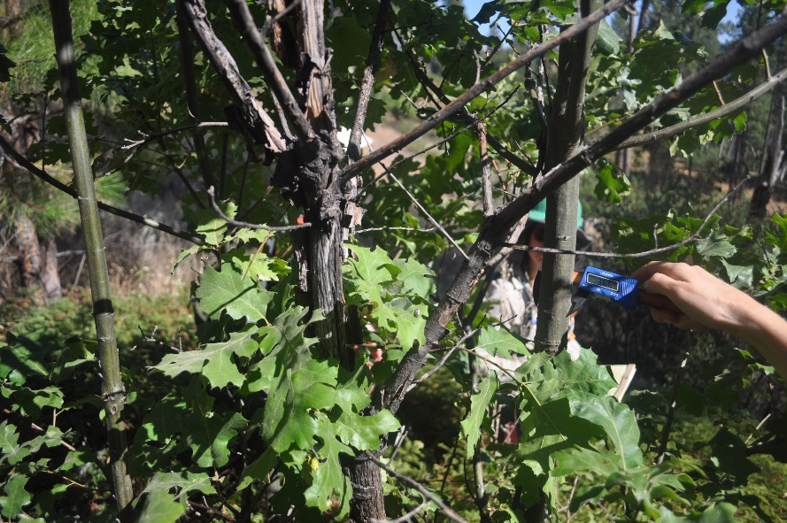
Uncertainties
Number of stems to retain?
Some studies suggest leaving only the largest stem
Others suggest reserving 3-4 stems to reduce further resprouting (Espelta et al. 2003 from Spain, and McDonald and Tappeiner 2002 from California
When?
Studies suggest waiting at least 4 years, or perhaps 8-19 years before thinning
Where? Signs of “good producer” trees?

Slide 14
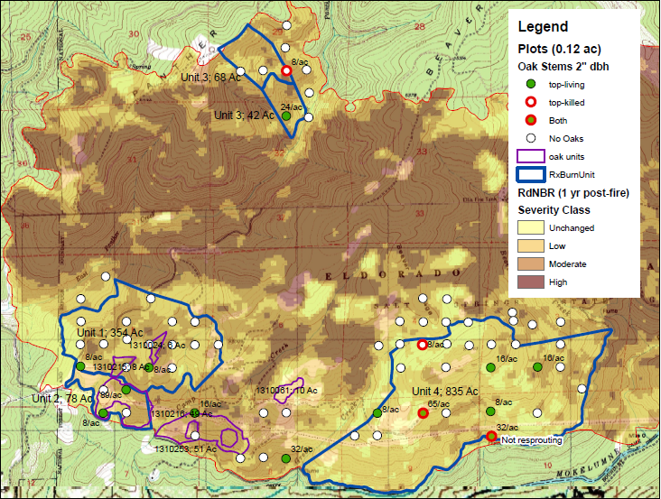
Field Studies of Thinning Sprouts Underway to Evaluate Effects
Across Northern California, led by Pascal Berrill
Added specific monitoring at the Power Fire through a research partnership
Notes:
Note that Malcolm North’s study of prescribed fire effects is targeting areas burned at low severity, whereas sprout treatments are likely to be more relevant in high burn severity areas. Nevetheless, we can study effects of prescribed burns on oaks. Preliminary work revealed that oaks were too patchy to sample adequately in a plot-based design.

Slide 15
Power Fire units (#1310253): close to a road, areas of gentle slope, and many top-killed black oaks

Slide 16
Implications
Monitoring on the Power Fire as part of larger Sierra Nevada research study will answer questions regarding effectiveness of thinning resprouts, especially if followed up over the long term
How can interpretation of other monitoring and research data consider trends in large black oaks in relation to fires and treatments?
Important to track both top-kill and complete kill
Further study of trends in large hardwoods based upon FIA data in the works
Research highlights connections between forest conditions and cultural/ethnobotanical resources and wildlife habitat (i.e. ecosystem services in socioecological systems)

Slide 17
Relevance to Ecological Monitoring Questions
Question | Espeically consider
6 How did treatments affect the tree density and species composition in all size classes? | Trends in large black oaks (12-24”, >24”)
7 Were treatments successful in promoting diverse plant forms or species of plants? | Trends in large black oaks
8 How did focus treatments improve cultural resource conditions? | Acorn production
9 Did restoration and conservation actions protect cultural resources from disturbance? | Survival of large black oaks following fires
10 How did project actions protect, promote, and make accessible species with ethnobotanical importance? | Trends in large black oaks
12 Did wildfire result in impacts to culturally sensitive areas? | Acorn gathering areas
16 Did project activities improve growing conditions for hardwoods? | Growth of black oaks
25 Did forest treatments impact habitat of mature Forest Sensitive species across projects? | Large black oaks with cavities

Slide 18
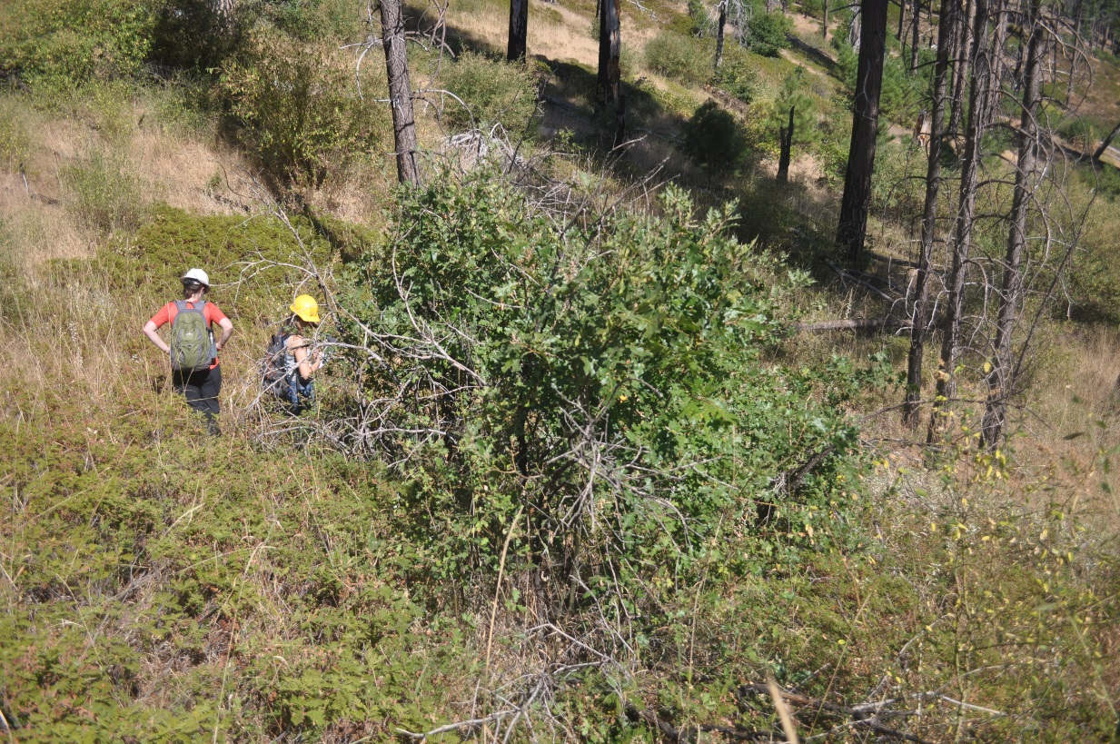
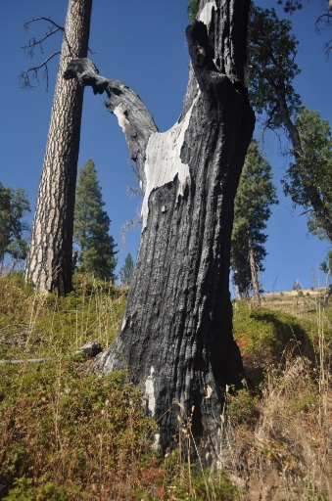
Summary
Mature oaks provide valuable ecosystem services that may be threatened by severe fires
Where high severity patches are particularly large and extensive, management interventions to accelerate stem growth may be a priority
Effectiveness of thinning sprouts in post-fire conditions requires study, especially regarding:
Rate of new branch formation in response to thinning
Rates of treated and untreated oaks in growth and acorn production

Slide 19
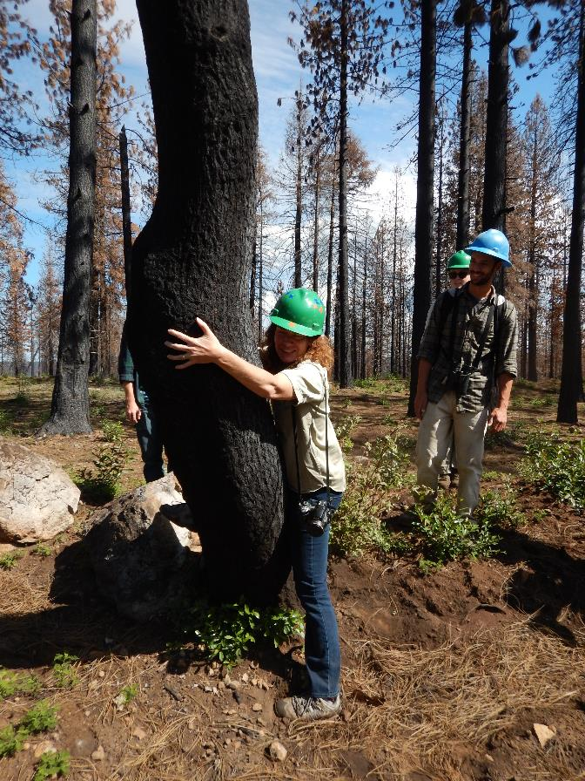
Thank you
Many staff from the Eldorado National Forest
R5 Ecology:
Becky Estes
Shana Gross
Research colleagues and collaborators:
Jamie Lydersen
Malcolm North
Pascal Berrill
Ethan Hammett
Angela White

