Slide 1
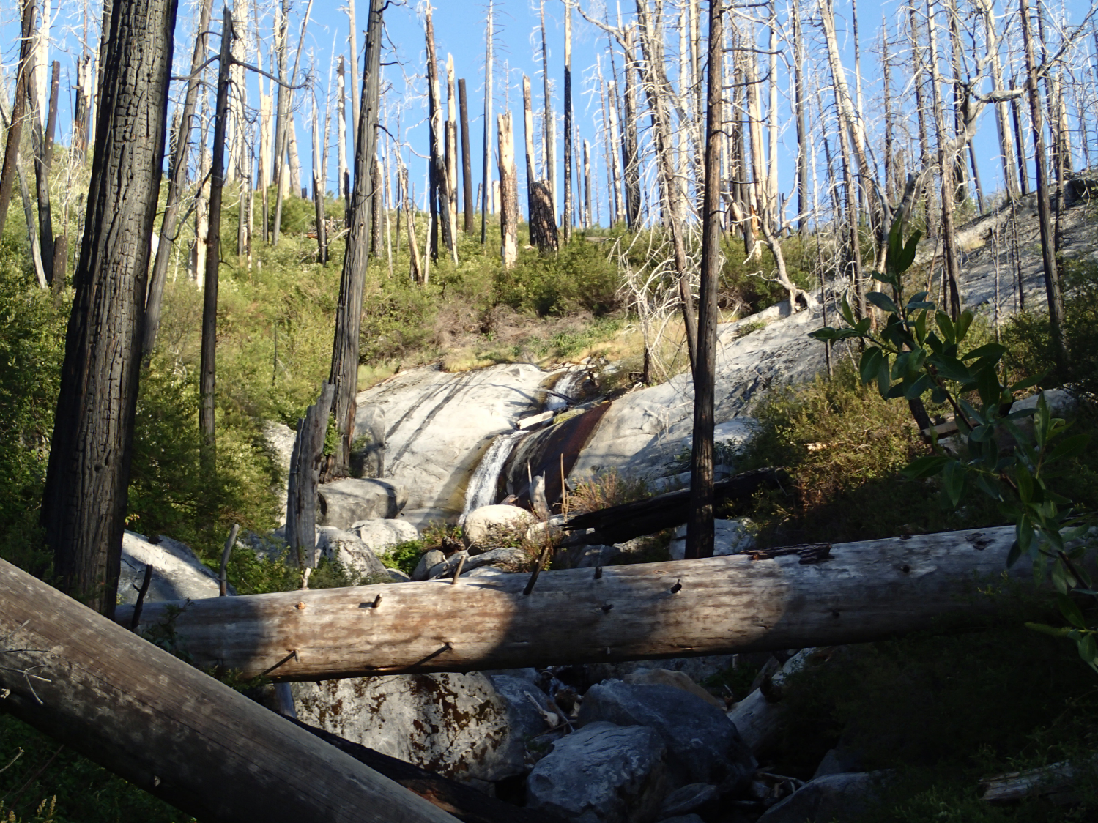
Monitoring bats in the Power Fire: Ecological implications for post-fire restoration
Zack Steel – November 8th, 2017
Notes:
Self intro – fire/wildlife ecologist
Overview of work in Power since 2014 with point blue – birds and bats – focus on the bats here, what we did, what we found, future directions

Slide 2
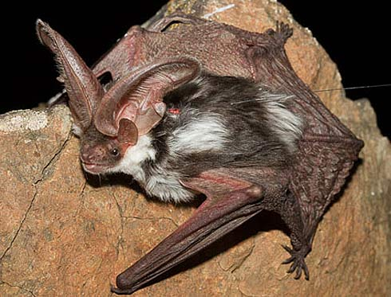
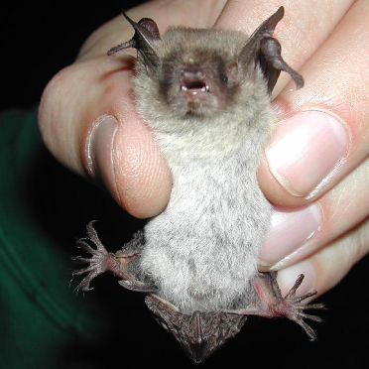
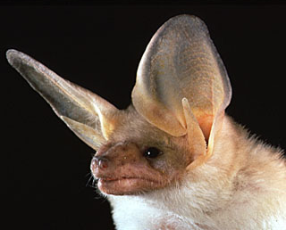
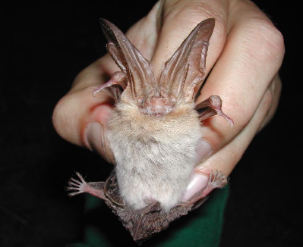
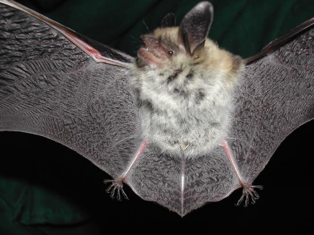
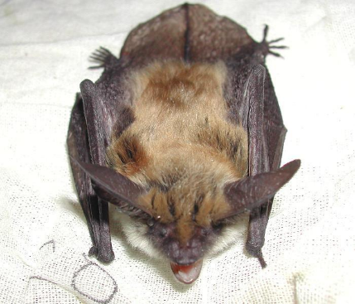
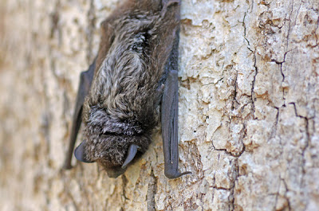
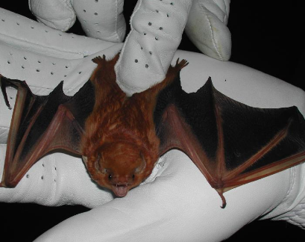
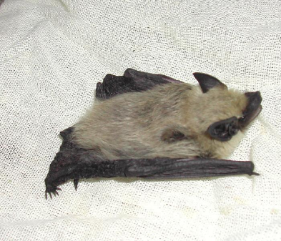
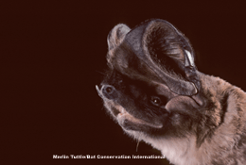
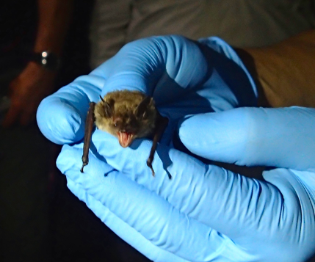
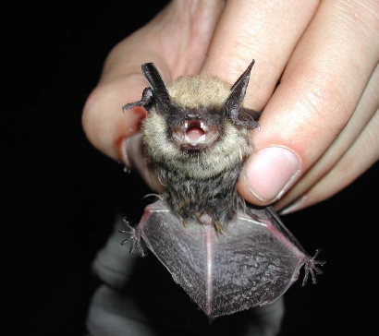
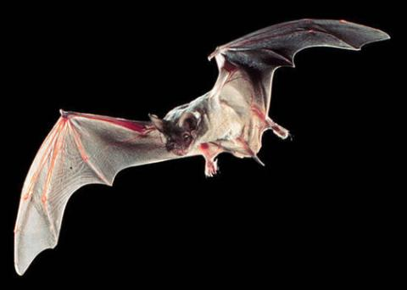
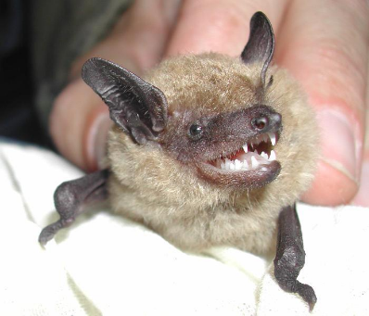
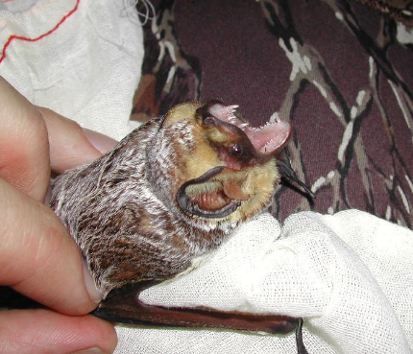
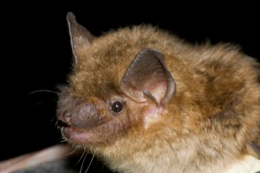
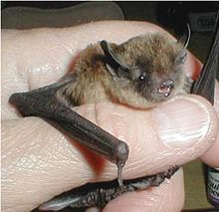
Spotted bat
Photo – factzoo.com
Pallid bat
Photo - Bat Conservation International
Townsend’s big-eared bat
Photo - USGS
Common Name | Scientific Name
big brown bat | Eptesicus fuscus
California myotis | Myotis californicus
fringed myotis | Myotis thysanodes
hoary bat | Lasiurus cinereus
little brown bat | Myotis lucifugus
long-eared myotis | Myotis evotis
long-legged myotis | Myotis volans
Mexican free-tailed bat | Tadarida brasiliensis
pallid bat* | Antrozous pallidus
silver-haired bat | Lasionycteris noctivagans
small-footed myotis | Myotis ciliolabrum
spotted bat | Euderma maculatum
Townsend's big-eared bat* | Corynorhinus townsendii
western mastiff bat | Eumops perotis
western pipistrelle | Parastrellus hesperus
western red bat* | Lasiurus blossevillii
Yuma myotis | Myotis yumanensis
Fringed myotis
Photo - USGS
Yuma myotis
Photo - USGS
Western red bat
Photo - USGS
Western pipistrelle
Photo - USGS
Silver-haired bat
Photo – Explore Missouri
Long-eared Myotis
Photo - USGS
Western mastiff bat
Photo – AZ Desert museum
Small-footed myotis
Photo - USGS
Mexican free-tailed bat
Photo – Ron Groves
Big brown bat
Photo - USGS
California myotis
Photo – Zack Steel
Hoary bat
Photo - USGS
Big brown bat
Photo – Bat Conservation
Long-legged myotis
Photo – Wikipedia
Notes:
17 species of bats can be found in the Sierra. All insectivorous, but occupy a range of habitat types. Highlight some important ones: common species – Mexican Free-tailed; Silver-haired; Ca Myotis. Sensitive species: Pallid bat; Townsends big-eared; western red.
Pallid bat – forages low or on the ground. Uses a combination of echolocation and auditory cues. Eat large insects, scorpions, small vertebrates.
Townsend’s – Specializes in moths, “whisper bat”, can be difficult to record echolocation. Some moth species (tiger moths) can hear bats and ‘jam’ their echolocations. Also difficult to catch in mist nets.
Finged myotis – Favorite food source is beetles and can glean insects from vegetation (woodboring beetles?)
20% of mammals world-wide are bats
Most images taken from USGS website; san diego survey - https://www.werc.usgs.gov/ProjectSubWebPage.aspx?SubWebPageID=5&ProjectID=183
Mexican free-tailed bat image - http://www.statesymbolsusa.org/symbol-official-item/texas/state-mammal/mexican-free-tailed-bat
Silver-haired bat - http://naturalmissouri.blogspot.com/2011/04/silver-haired-bat.html

Slide 3
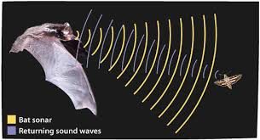
Acoustic surveys & echolocation
askabiologist.asu.edu
Notes:
Describe how echolocation works and how we are taking advantage to survey bats

Slide 4
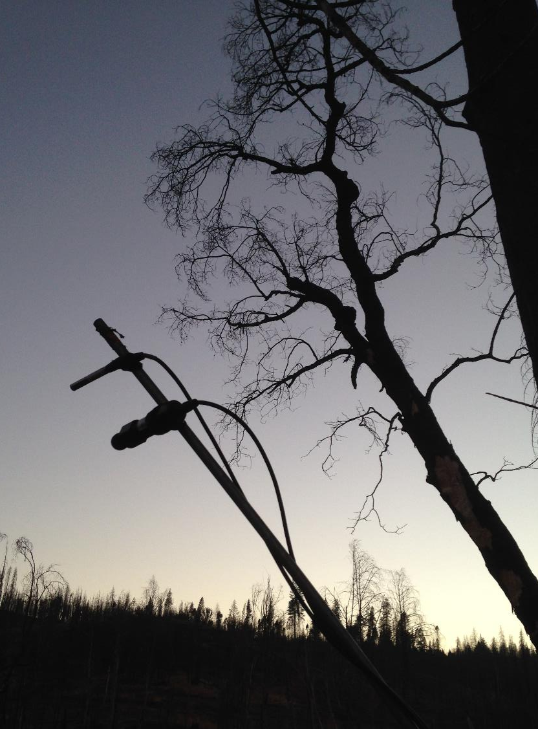
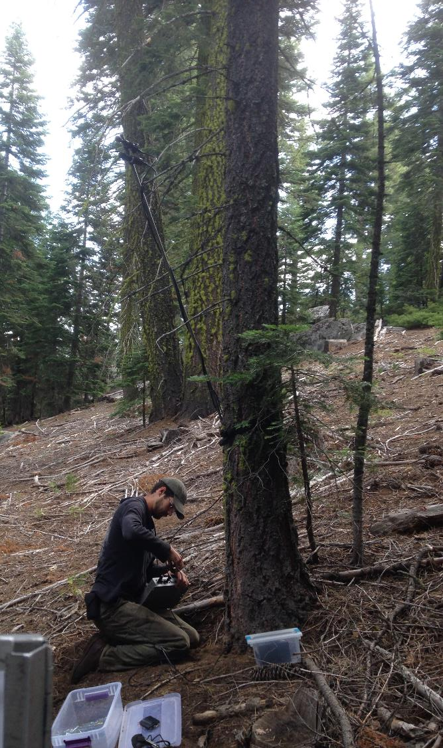
Automated Recording Units
Notes:
Describe how the recording technology works. Photos of deployments. Have an ARU on hand to show.

Slide 5
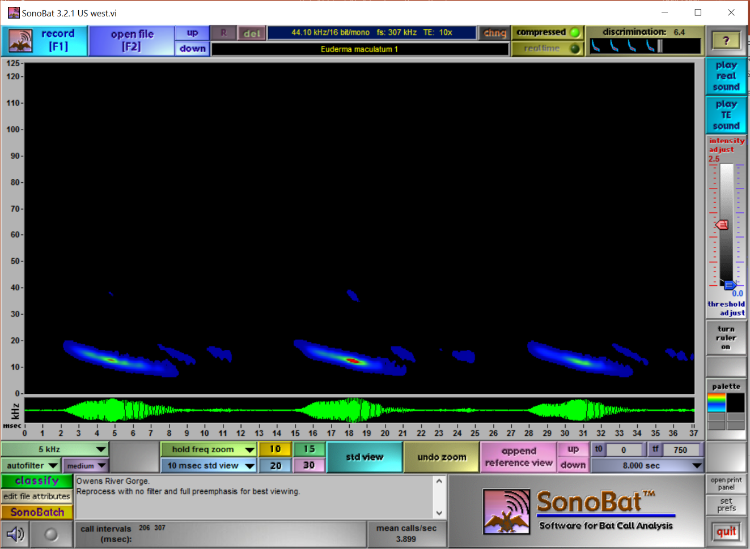
Pass Classification
Spotted bat
Photo – factzoo.com
Notes:
Spectogram
Get example of another species (spotted bat - Euderma maculatum)

Slide 6
Pass Classification
Long-legged myotis
Photo – Wikipedia
Notes:
SonoBat pulls a bunch of metrics based on the frequency, timing and pattern of the call and make a automatic classification. You can also compare to reference calls such as this one.
This is a Myotis evotis (Long-eared Myotis)

Slide 7
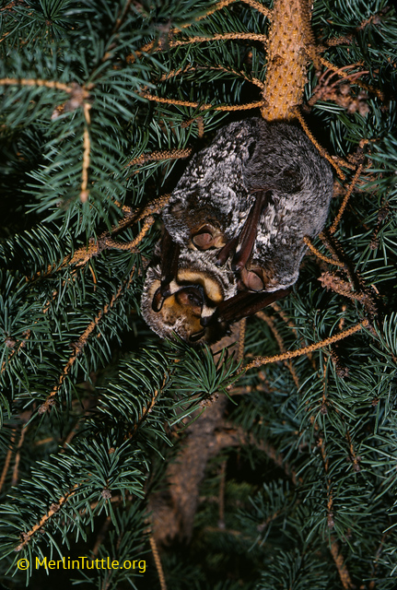
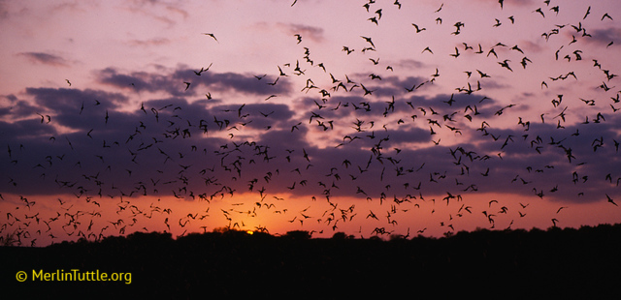
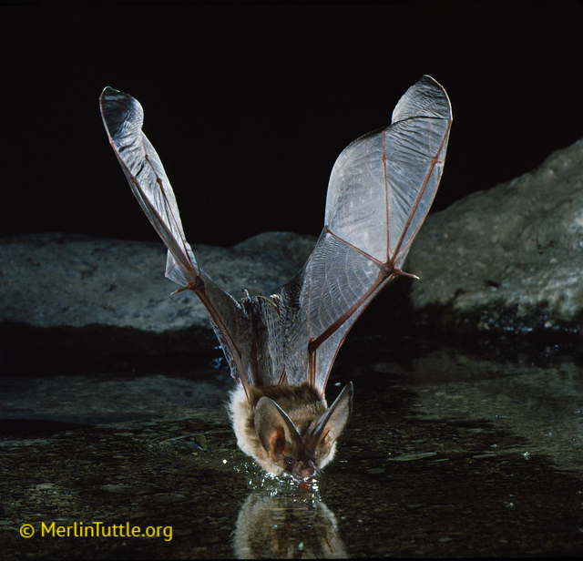
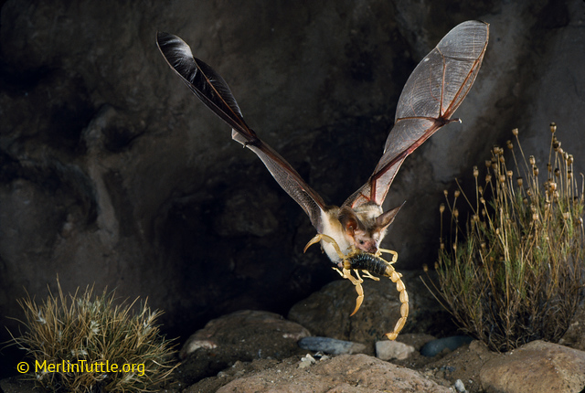
Bat Use of Forests
Commuting
Drinking
Foraging
Insect habitat
Roosting
Foliage
Snags
Notes:
With our study we are probably best approximating foraging habitat quality and perhaps roosting habitat quality indirectly

Slide 8
Broad monitoring goals
Understand patterns of bat use in Sierra Nevada forests
Understand how the bat community uses post-fire landscapes
Inform forest and wildlife management in Eldorado NF and the Sierra Nevada
Big brown bat
Photo - USGS

Slide 9
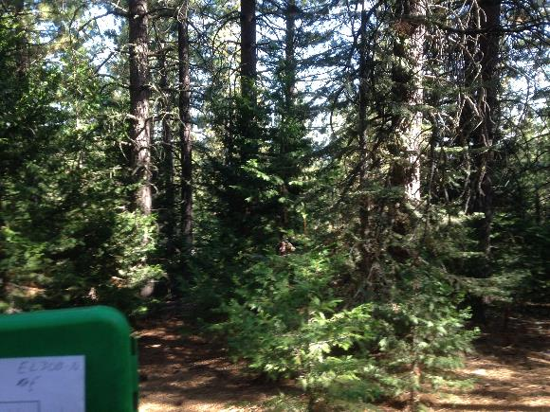
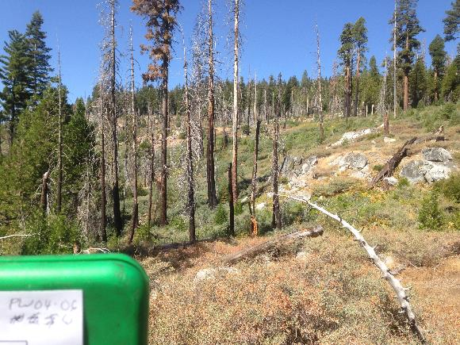
Specific Questions / Monitoring Goals
Burned vs. Unburned
Notes:
Burned vs. unburned
Within burned – different levels of severity
Within high severity – managed or not

Slide 10
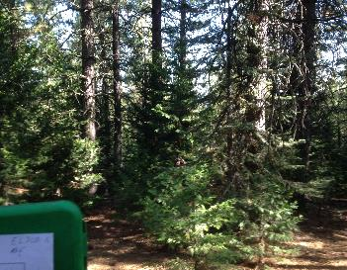
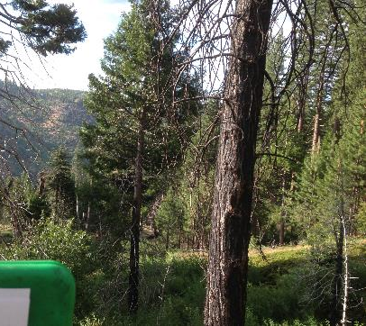
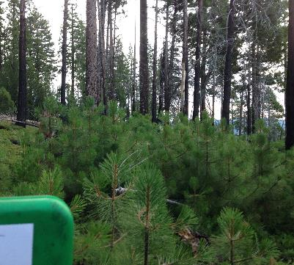
Specific Questions / Monitoring Goals
Burned vs. Unburned
Burn Severity
Notes:
Burned vs. unburned
Within burned – different levels of severity
Within high severity – managed or not

Slide 11
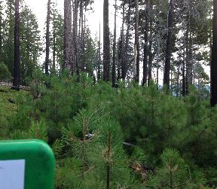
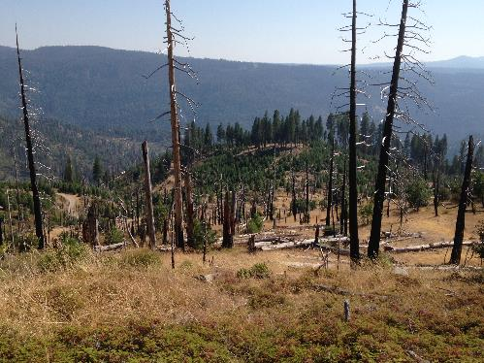
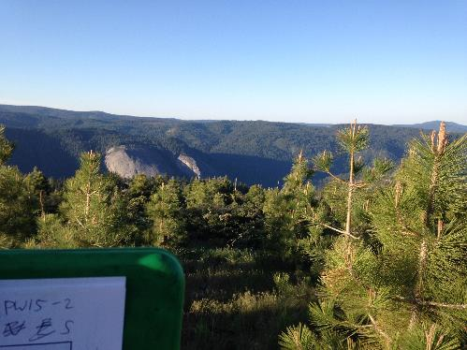
Specific Questions / Monitoring Goals
Unburned vs. burned
Species Richness
Species activity levels (passes/night)
Burn Severity
Unmanaged vs. managed
Notes:
Burned vs. unburned
Within burned – different levels of severity
Within high severity – managed or not

Slide 12
Relevant ACCG Ecological Monitoring Questions
2) Did the quality/quantity of habitat for Threatened and Endangered and Forest Service Sensitive and other desired species change?
3) Did the local abundance/distribution of TE and FS Sensitive and other desired species change?
25) Did forest treatments impact habitat of mature Forest Sensitive species across projects?
Pallid bat
Photo - Bat Conservation International
Townsend’s big-eared bat
Photo - USGS
Fringed myotis
Photo - USGS
Notes:
How habitat quality, abundance and distribution have changed? In particular due to wildfire and forest treatments.

Slide 13
Study Design: Birds and Bats
Fogg, A.M, Z.L. Steel and R.D. Burnett. 2017. Avian Monitoring in Freds and Power fires: Final Report.
Point Blue Conservation Science, Petaluma, CA.
Notes:
Bird point-transects were placed diagonally along a vegetation pot grid so that some points would be coincident with other past and ongoing monitoring projects within forest service lands and the two fire. Points represent the gradient of burn severity that occurred within the two fires and within areas that have received post-fire reforestation treatments including salvage logging, shrub abatement and plantings. Transects are typically comprised of 10 point count locations, spaced at least 250m apart (283m usually), which an observer can cover in a morning. In total this gave us 24 transects and a total of 224 point count locations.

Slide 14
Power Fire
Notes:
Map of greater area with power fire in context
Some general details about size and when it burned
Google image taken 6/22/16
Size of power – 17,000 acres
2004 burn
Large burn with relatively large high severity areas. Can still see fire “scare” here, but these are mostly open forests and shrublands 13 years later

Slide 15
Study Design
Sampling Category | Locations | Survey Nights
Reference | 11 | 215
Low Severity | 8 | 133
Moderate Severity | 13 | 176
High Severity – No management | 9 | 170
High Severity – Reforestation | 8 | 174
Total | 49 | 868
May – Sept 2014-17
~2 week deployments
Surveys every or every-other night
Notes:
Bat survey points were randomly selected from existing bird survey points to leverage vegetation data and potentially look at co-occurrences of bird and bat species.
The random selection was stratified by four groups: 1) Unburned reference (MIS) points; 2) Low/Moderate severity; 3) High severity unsalvaged; 4) Hi severity salvaged.

Slide 16
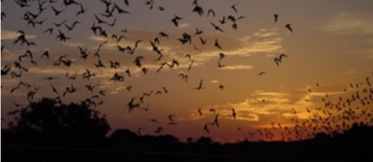
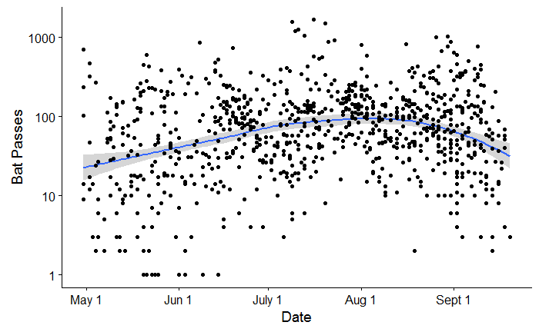
Seasonality
Spring – arrive at summer habitats; establish maternal colonies.
June/July - Females give birth to 1 or 2 young, which become volant (can fly) ~ 1 month later.
Fall - Hibernate and/or migrate to winter habitats.
Notes:
Rise early in the early season as species arrive, peak mid-summer as young become volant, decline late summer as individuals start to leave
Tree roosting bats most consistently migrate – Hoary bats, silver-haired & western red
Hybernation: non-hibernating at rest heart rate 300-400 bpm; during hibernation 10bpm

Slide 17
(Un)Burned forests - Richness
Notes:
More species in burned areas, probably because there is more habitat heterogeneity in these areas. [photos of that heterogeneity]

Slide 18
(Un)Burned forests – Activity Level Common Species
Notes:
Tabr & Myca – most common
Significant differences for:
silver-haired bat (lano)
Mexican free-tailed bat (tabr)

Slide 19
(Un)Burned forests – Activity Level Uncommon Species
Notes:
Fringed myotis (myth) is significantly different
Talk about sensitive species in and around Power. Coto may also just be hard to detect. Anpa too, although we’ve seen them much more. At end talk about bringing in data from other fires and dealing with detectability issues.
Townsend’s – 1 obs in unburned forest (3 in Rim)
Pallid bat – 96 in Power; 6 in unburned (handful in other fires; few in other forests)
Conservative numbers from automated software – manual review may confirm more detections. E.g. for Coto there are 14 possible calls in the ENF/Power region.

Slide 20
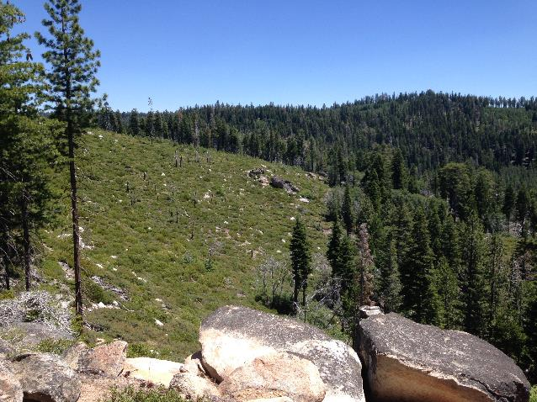
Effect of Burn Severity
Notes:
Bat survey points were randomly selected from existing bird survey points to leverage vegetation data and potentially look at co-occurrences of bird and bat species.
The random selection was stratified by four groups: 1) Unburned reference (MIS) points; 2) Low/Moderate severity; 3) High severity unsalvaged; 4) Hi severity salvaged.

Slide 21
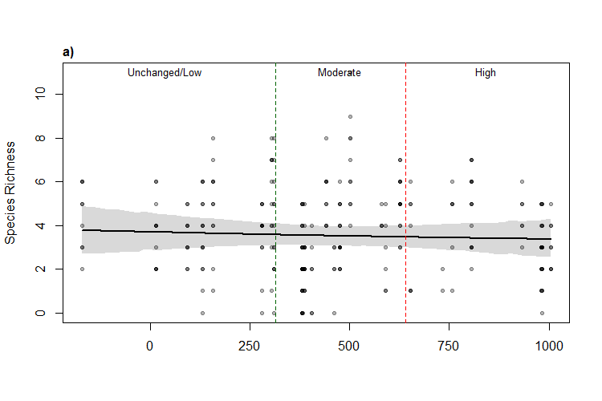
Burn Severity - Richness
Burn Severity (RnDBR)
Notes:
[Just surveys from within the burned area]

Slide 22
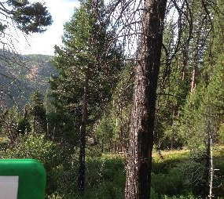
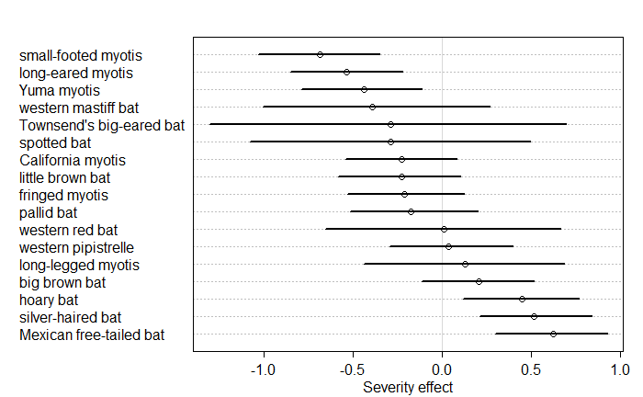
Burn Severity – Activity Level
Notes:
Hoary and Mexican free-tailed are large bats, may avoid cluttered areas. Silver-haired bats roost in tree cavities so may benefit from snags created by fire (but no clear signal from salvage analysis here).
[Just data from within burned area]

Slide 23
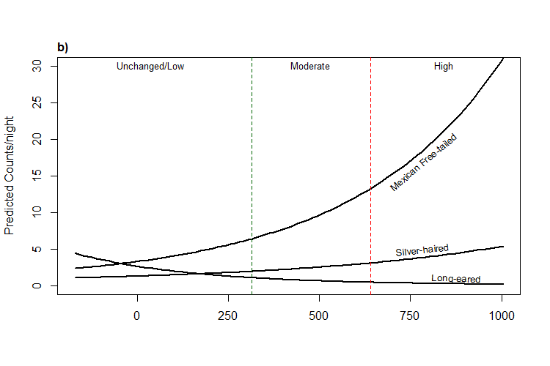
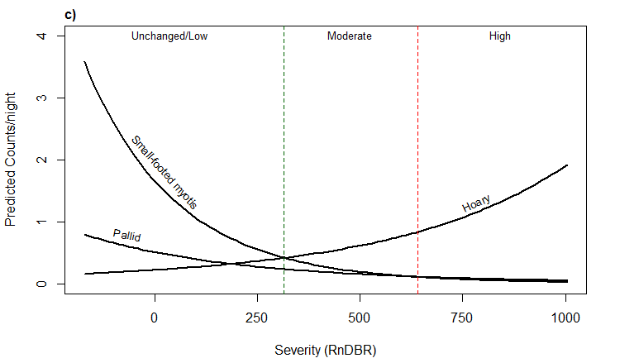
Mexican free-tailed bat
Photo – Ron Groves
Long-eared Myotis
Photo - USGS
Silver-haired bat
Photo – Explore Missouri
Small-footed myotis
Photo - USGS
Notes:
Hoary and Mexican-free tailed bats have high wing-loadings – fast with poor maneuverability in cluttered environments

Slide 24
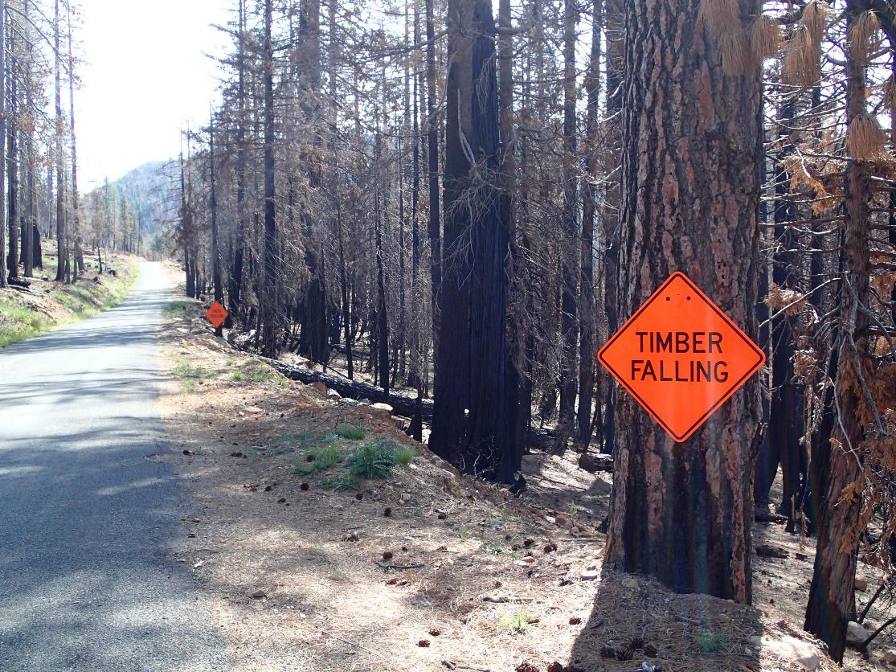
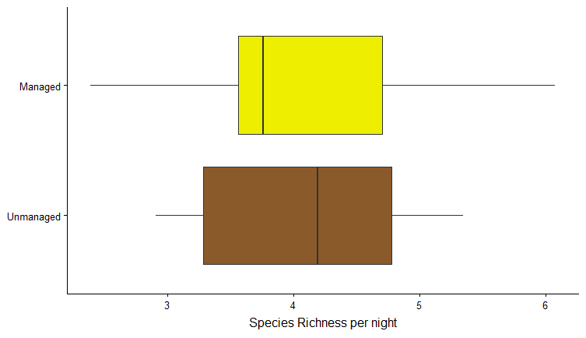
Management Effects - Richness
Notes:
Potential effects of salvage and reforestation. Three ways these species use the landscape:
Commuting – just passing through, we wouldn’t expect a difference
Feeding – Does management affect the insect community 10 yrs after it happened?
Roosting – Does salvage affect roosting habitat – maybe for those species that roost in tree cavities or crevices under bark
[Just data from within high severity areas]

Slide 25
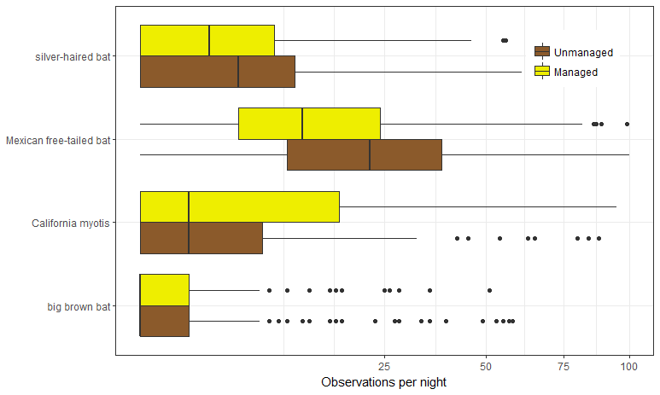
Management Effects – Common Species
Notes:
[Just data from within high severity areas]

Slide 26
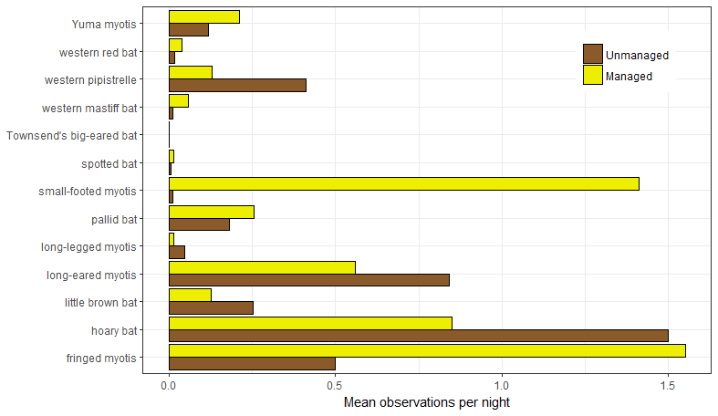
Management Effects – Rare Species
Notes:
[Just data from within high severity areas]
Why no strong effects?
Enough roosting habitat in the area?
Roost quality of snags has declined with TSF?
Acoustic surveys don’t measure roost habitat quality well, better proxy for foraging habitat quality?
Small-footed myotis may be responding to successful reforestation; importantly they also are more active in lower severity areas.

Slide 27
Take-home points
Having fire on the landscape is important to the full bat community
The variation of burn effects is also important with species composition changing with severity
A decade after salvage logging in Power there are few obvious effects
Small-footed myotis
Photo - USGS

Slide 28
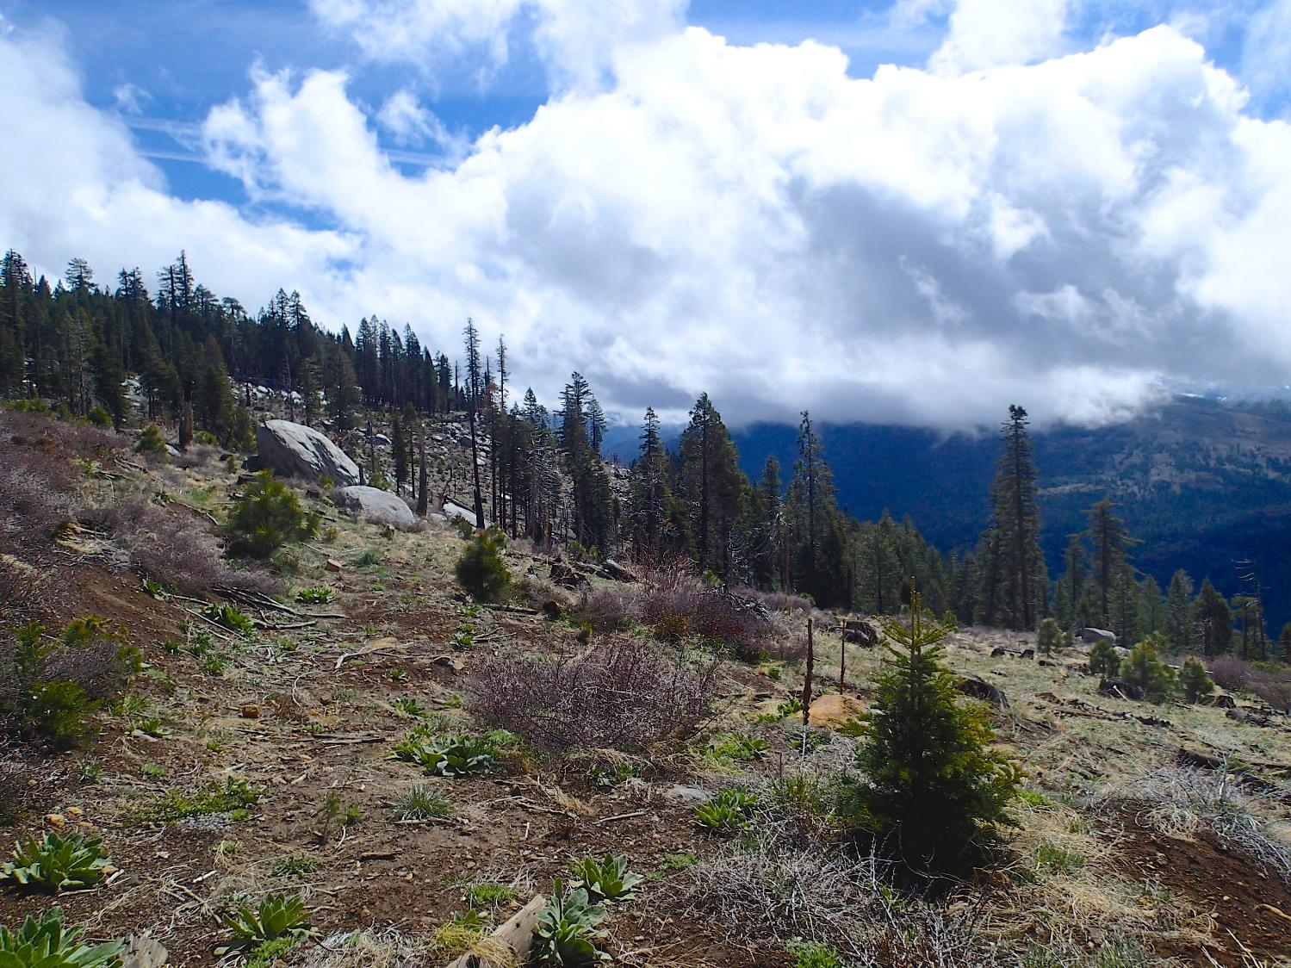
Future Directions
Pallid bat
Photo - Bat Conservation International
Townsend’s big-eared bat
Photo - USGS
Complementary studies – Rim, Storrie, & Chips. Improved understanding of rare species habitat needs.
Expanded analyses: occupancy, seasonality, important covariates (e.g. distance to water)
Focus on habitat structure & planned reforestation projects in Power.
Notes:
Townsend’s – 1 obs in unburned forest (3 in Rim)
Pallid bat – 96 in Power; 6 in unburned (handful in other fires; few in other forests)
Also looking at Rim and the Sorrie/chips fires – Gives us two “old” fires ~10YSF and two “young” fires, as well some different parts of the Sierra Mixed conifer zone.

Slide 29
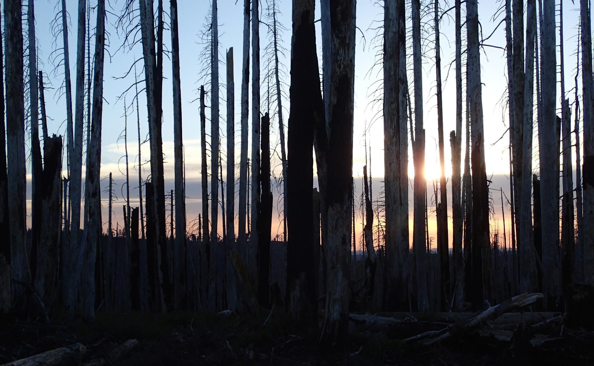
Steel, Z. L. and H. D. Safford. 2017. Acoustic inventory and monitoring of bat species in the Power Fire burn area – 2014, 2015, and 2016 field season. Prepared for Eldorado National Forest, California, USDA Region 5.
Campos, B. R., R. D. Burnett, and Z. L. Steel. 2017. Bird and bat inventories in the Storrie and Chips fire areas 2015-2016: Final report to the Lassen National Forest. Point Blue Conservation Science, Petaluma, CA. Point Blue Contribution No. 2142.
Acknowledgements
El Dorado National Forest & University of California, Davis
Alissa Fogg, Brent Campos, Josh Stagner, Jade Ajani, Tim Forrester, Hugh Safford
zlsteel@ucdavis.edu

Slide 30
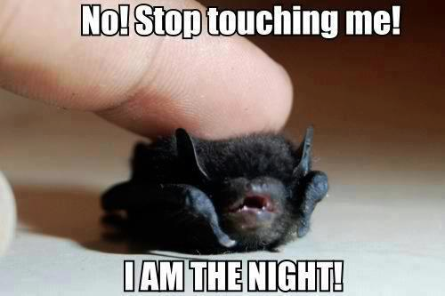
Questions?

