Slide 1
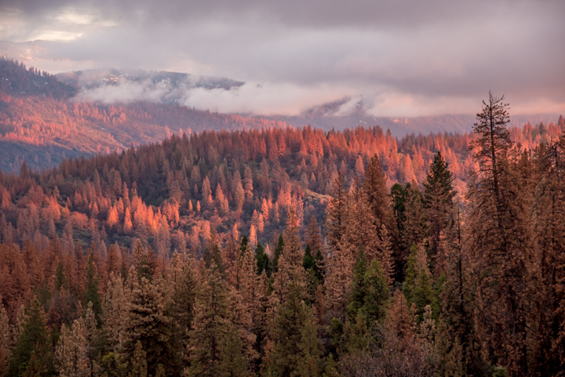
CA water: Sierra Nevada Forests and Headwaters
Martha Conklin, UC Merced
Topics in this talk
Sierra Nevada hydrology
Measuring snowpack
Estimating evapotranspiration
Thinning impacts
Linking headwater to groundwater
Photo: Margot Wholey
Dec 14, 2015

Slide 2
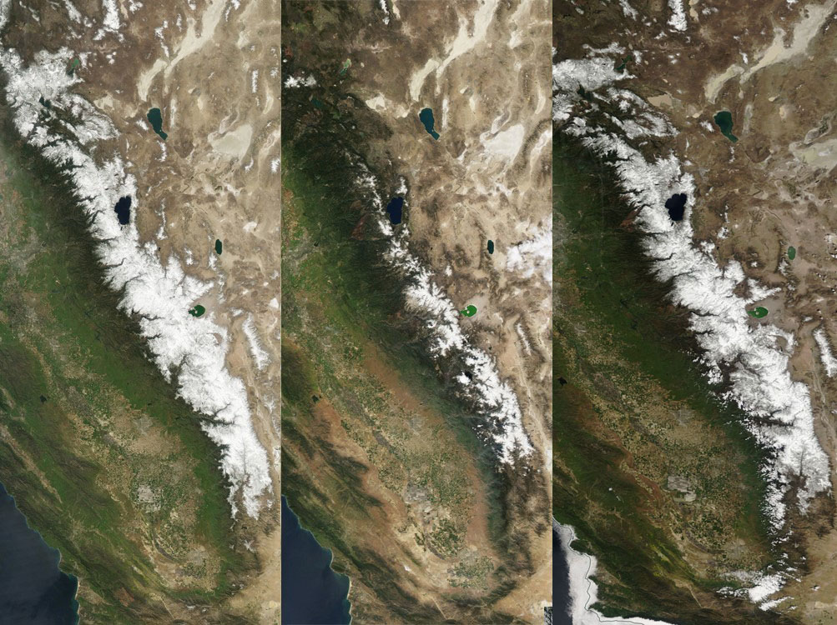
Hydrologic context
Extremes are part of California’s climate
Extremes in the past 100-1000 yr may not be a sufficient guide to the future; droughts may be longer and we are hotter
https://earthdata.nasa.gov/labs/worldview
Mar 27, 2010
Mar 29, 2015
Apr 3, 2017

Slide 3
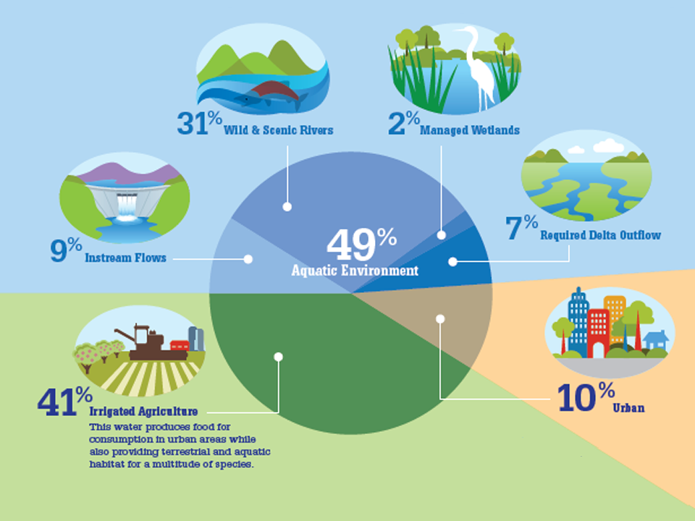
Applied water use
Precip: 200 MAF
Applied: 80 MAF
Water supplies:
Agriculture: 80% (33 MAF)
Urban 20% (8 MAF)
Data from DWR, adapted from Nor. Cal. Water Assn.

Slide 4
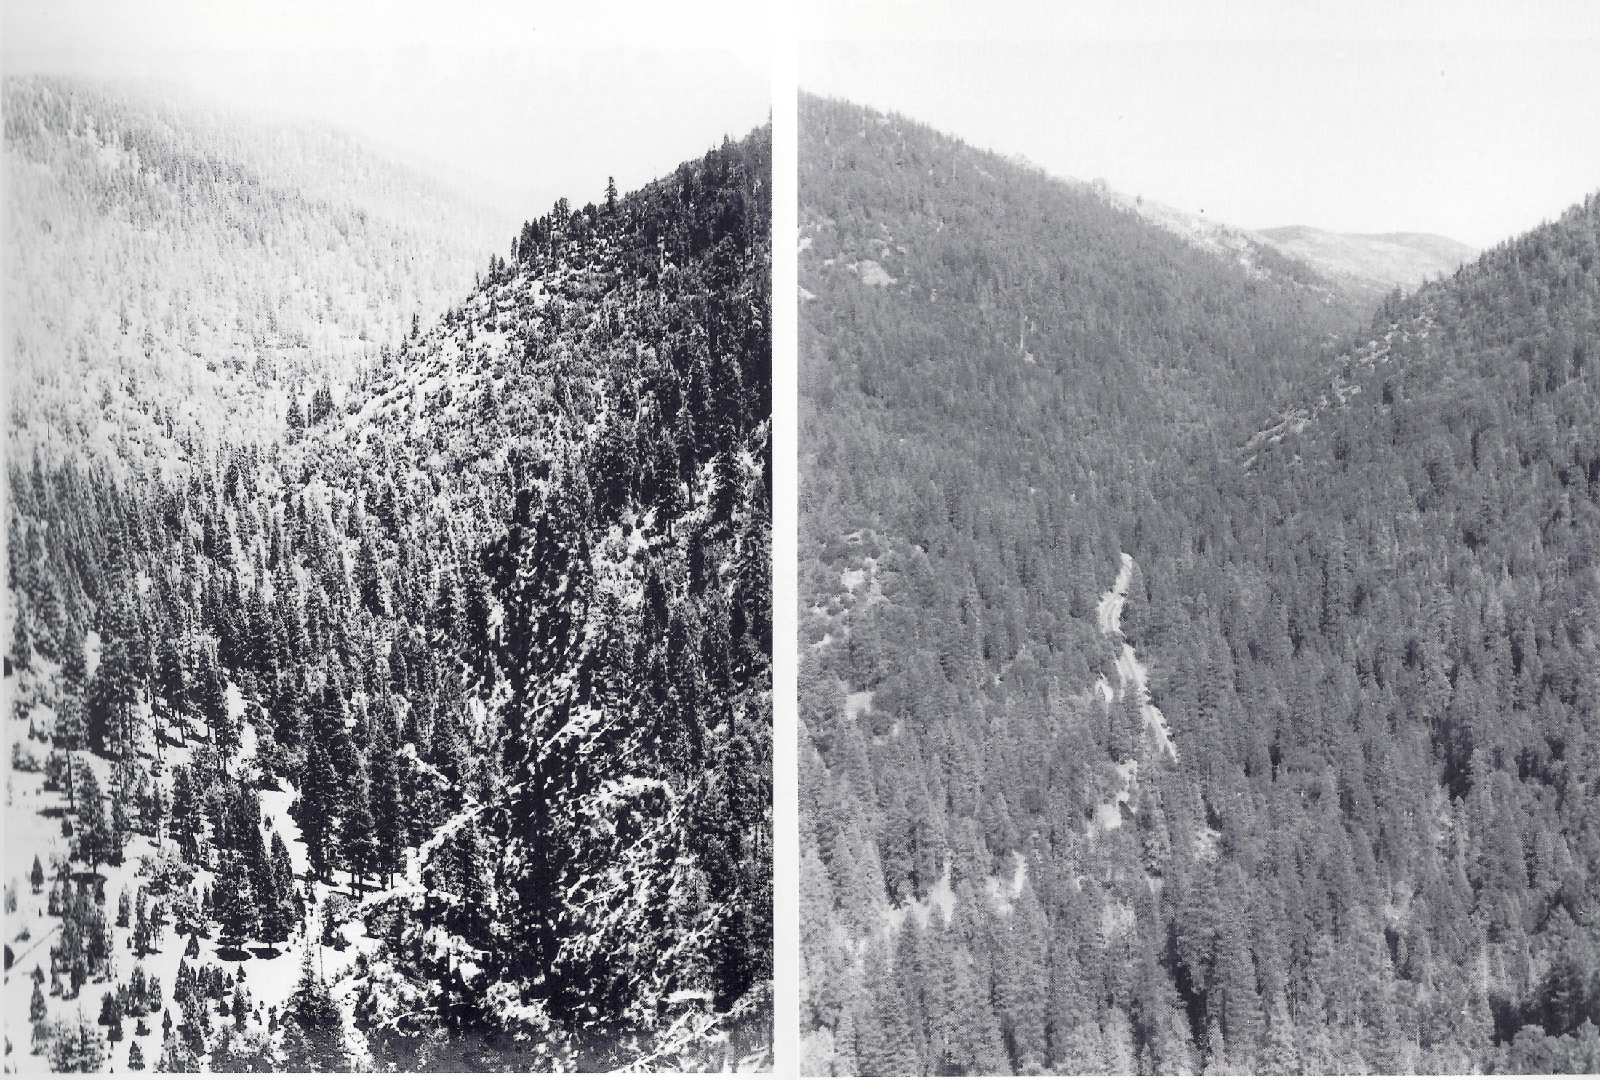
Century-long experiment: suppressing fire
1896
Kyburz, S. Fork American R., 5000’
1993
We now know this was a bad idea; & sustainable solutions remain elusive
Photos from G. Gruell
Notes:
Photo on left: Kyburz, South Fork of the American River. Circa 1896.
Elevation: 5,000 ft. Photo courtesy of El Dorado County Historical Museum. "This site on the upper South Fork of the American River remained unlogged in the 1890s because of its remoteness. The tree cover in the canyon bottom consists primarily of ponderosa line. Young trees are conspicuous in openings. Hardwoods including black oak, live oakl, and scrub oak occupy the rocky terrain.
Photo on right: Kyburz, South Fork of the American River. September 7, 1993 (apprx 97 years later) "The camera point for this repeat photograph was a rock ledge high on the slope the 1896 photographer apparently used. California Route 50 now cuts through the scene. Sumps in this area imply light cutting after 1896; local residents probably felled trees periodically. The canopy of mixed conifer and oak has increased markedly; the trees have encroached on former openings. Photo by George Gruell
HWY 50 going to Lake Tahoe

Slide 5
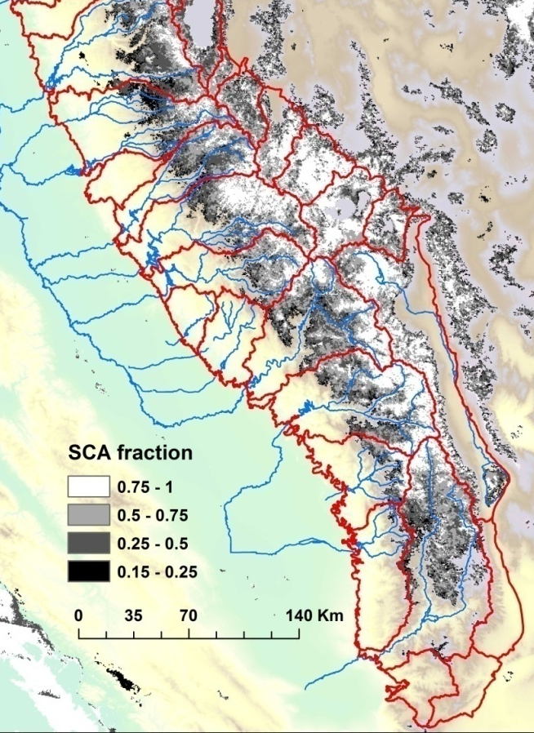
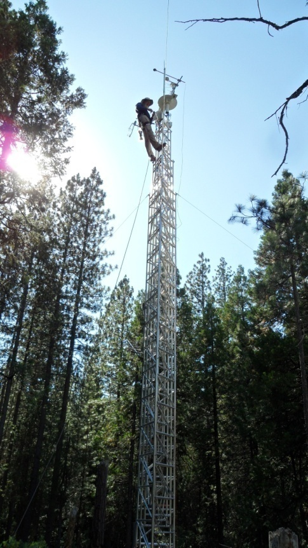
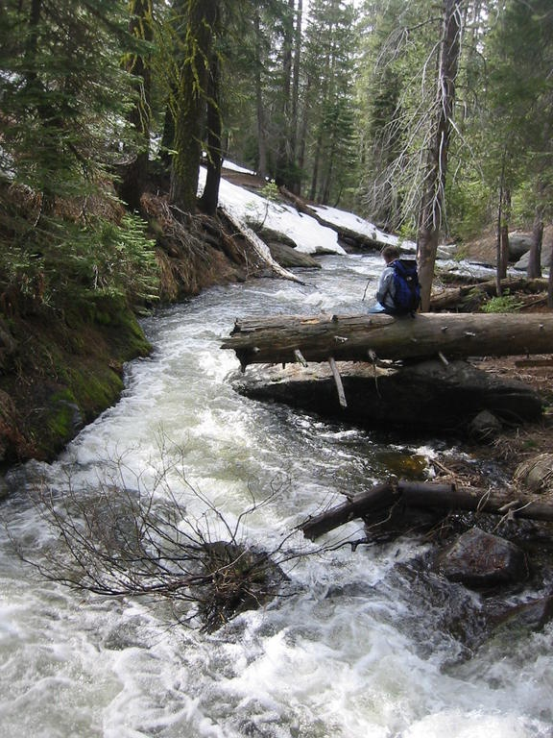
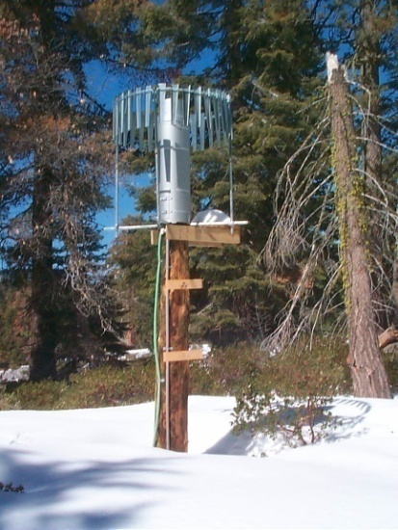
Basic water balance
Precipitation = Evapotranspiration + Runoff + ΔStorage
=
+
snow & rain
Evapotranspiration refers to evaporation, sublimation plus water use by vegetation

Slide 6
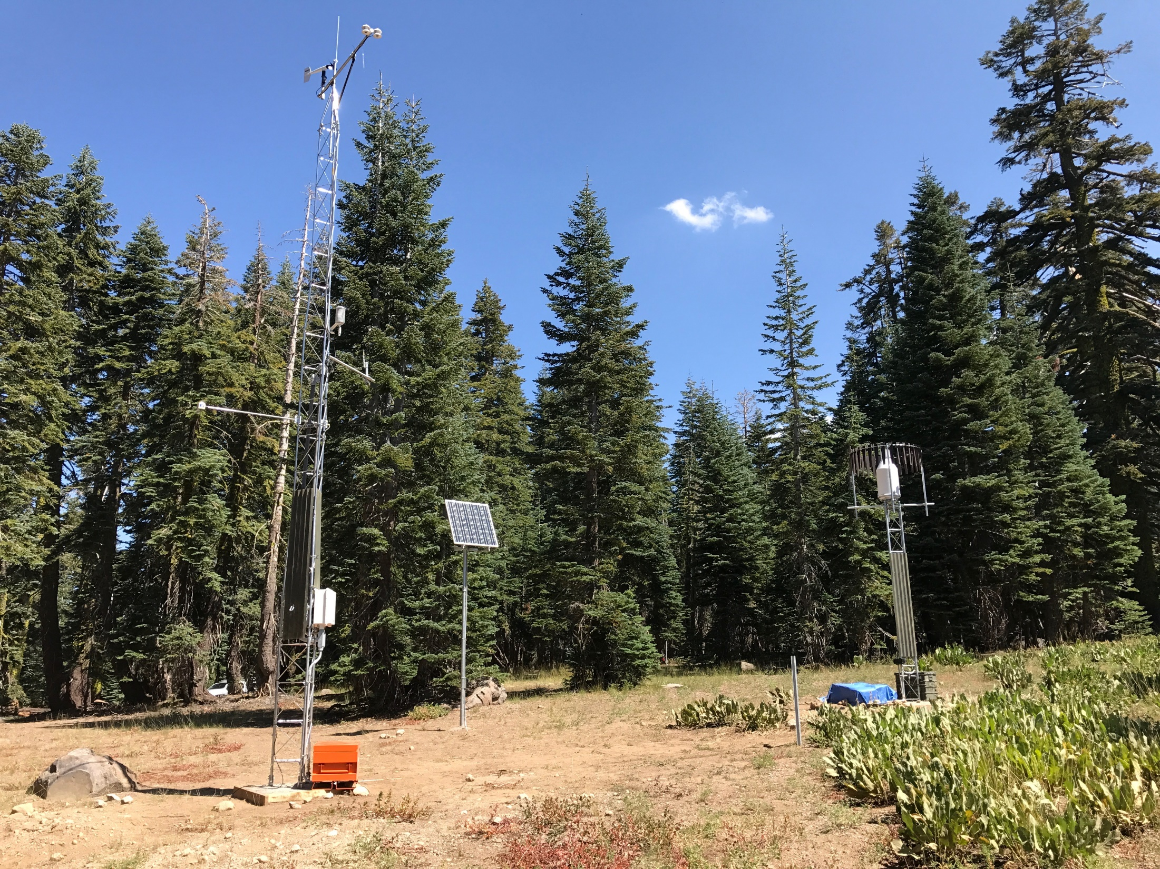
Topics in this talk
Sierra Nevada hydrology
Measuring snowpack
Estimating evapotranspiration
Thinning impacts
Linking headwater to groundwater
Notes:
Top of Water Gulch. Met station 10 m or 30 ft. Precip gauge is about 10 ft.

Slide 7
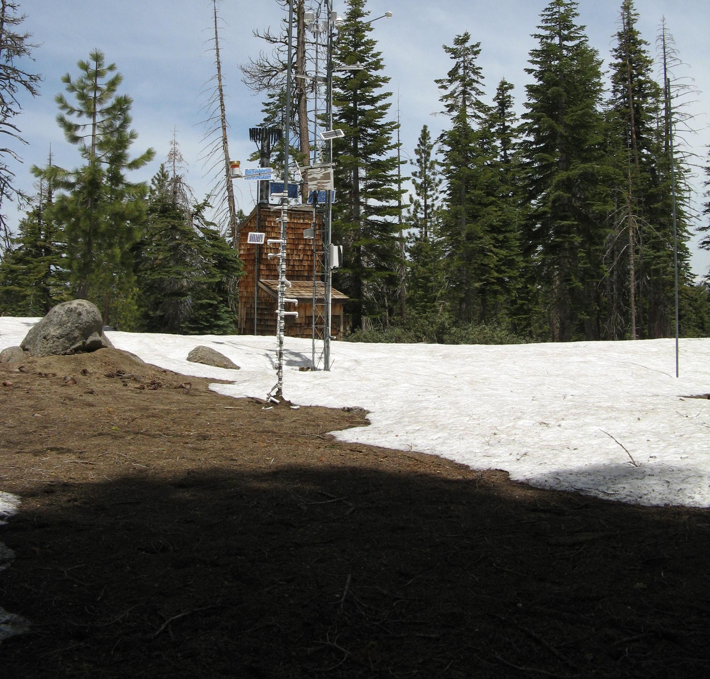
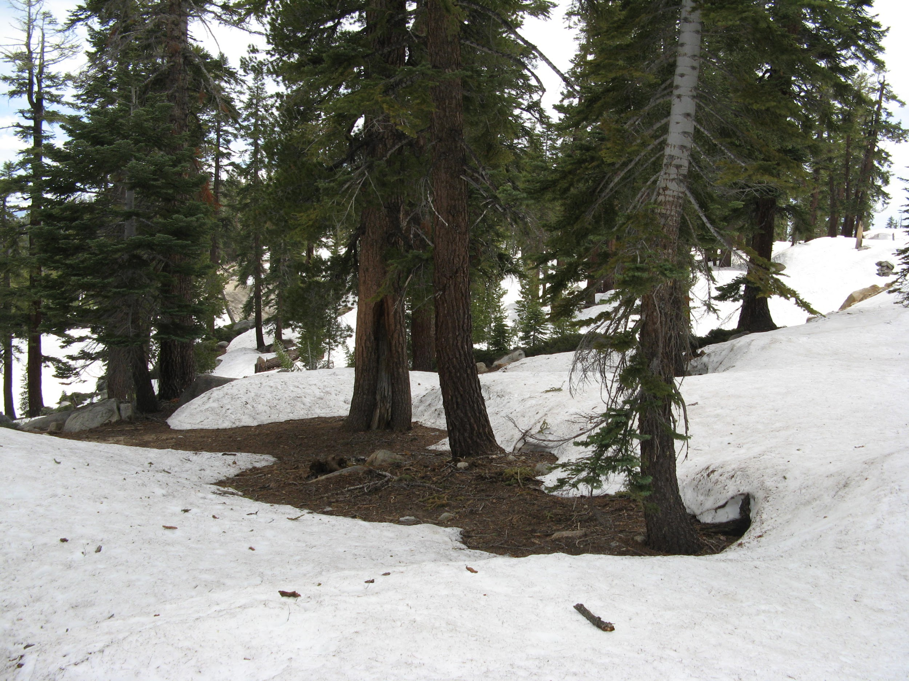
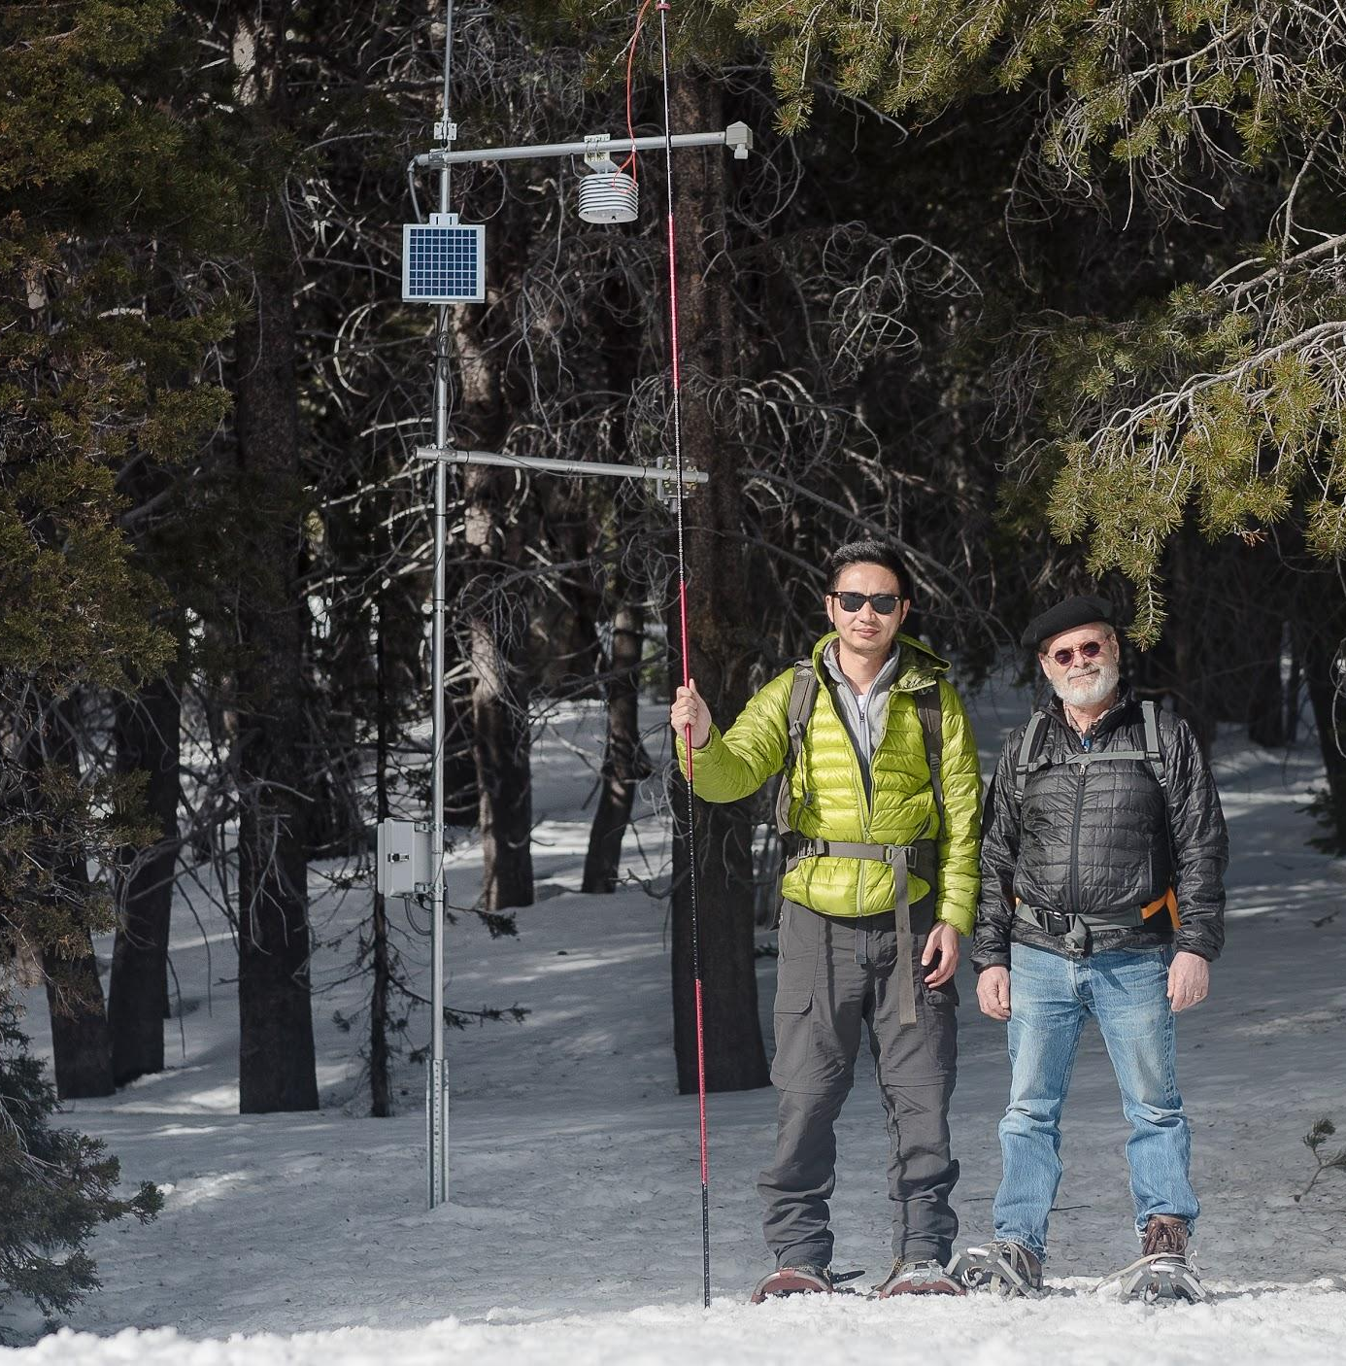
Basin-scale wireless-sensor network: capturing spatial trends in snow deposition & melt: snow depth, temperature, relative humidity & soil moisture

Slide 8
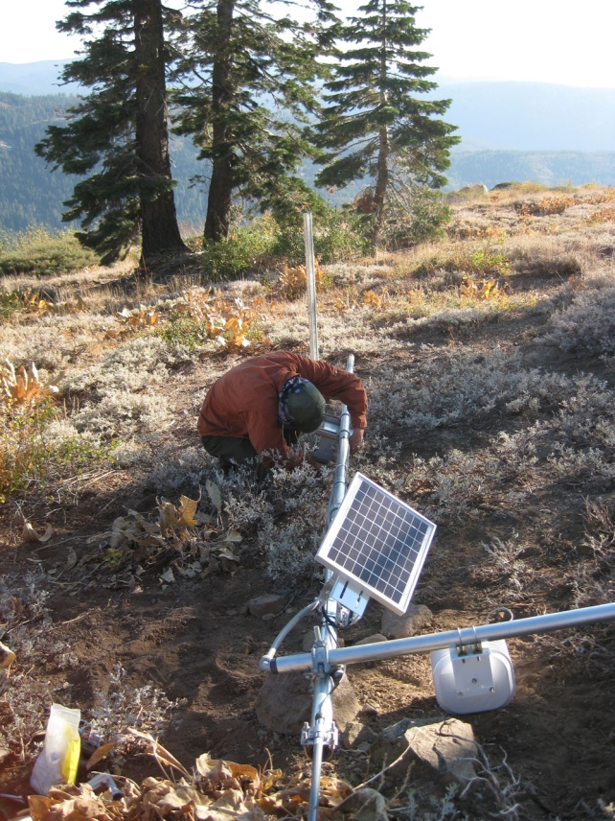
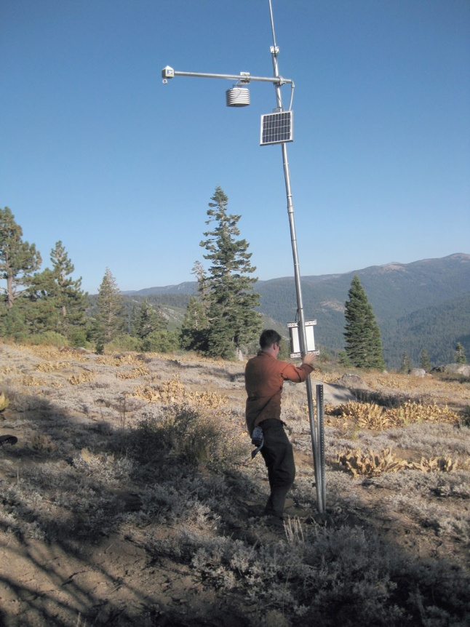
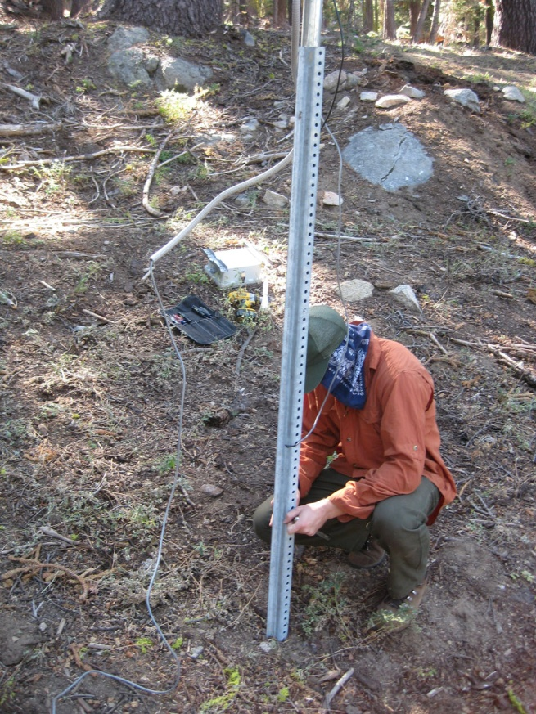
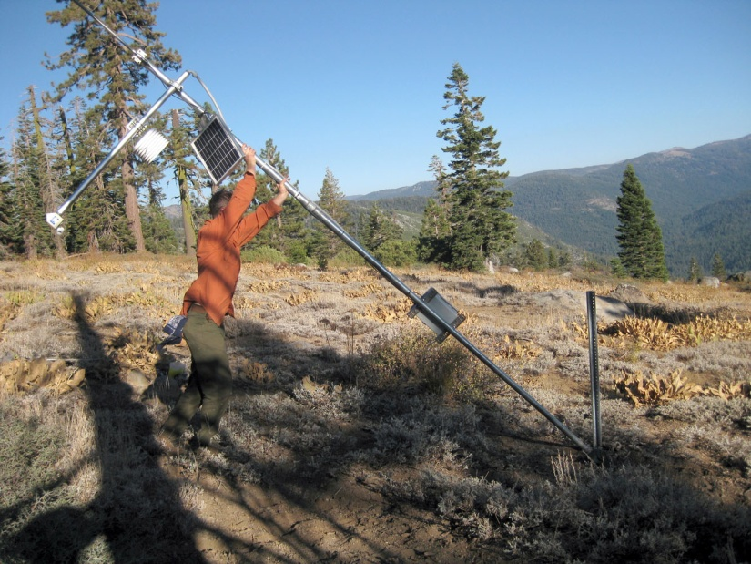
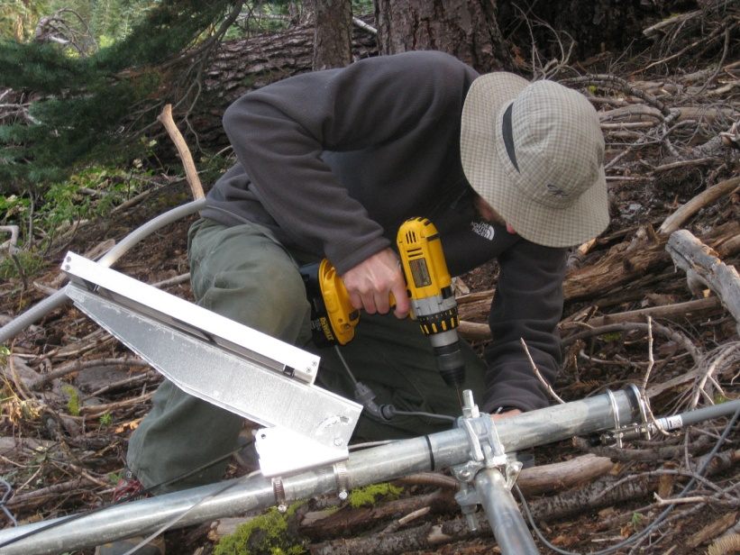
Node construction at Alpha site

Slide 9
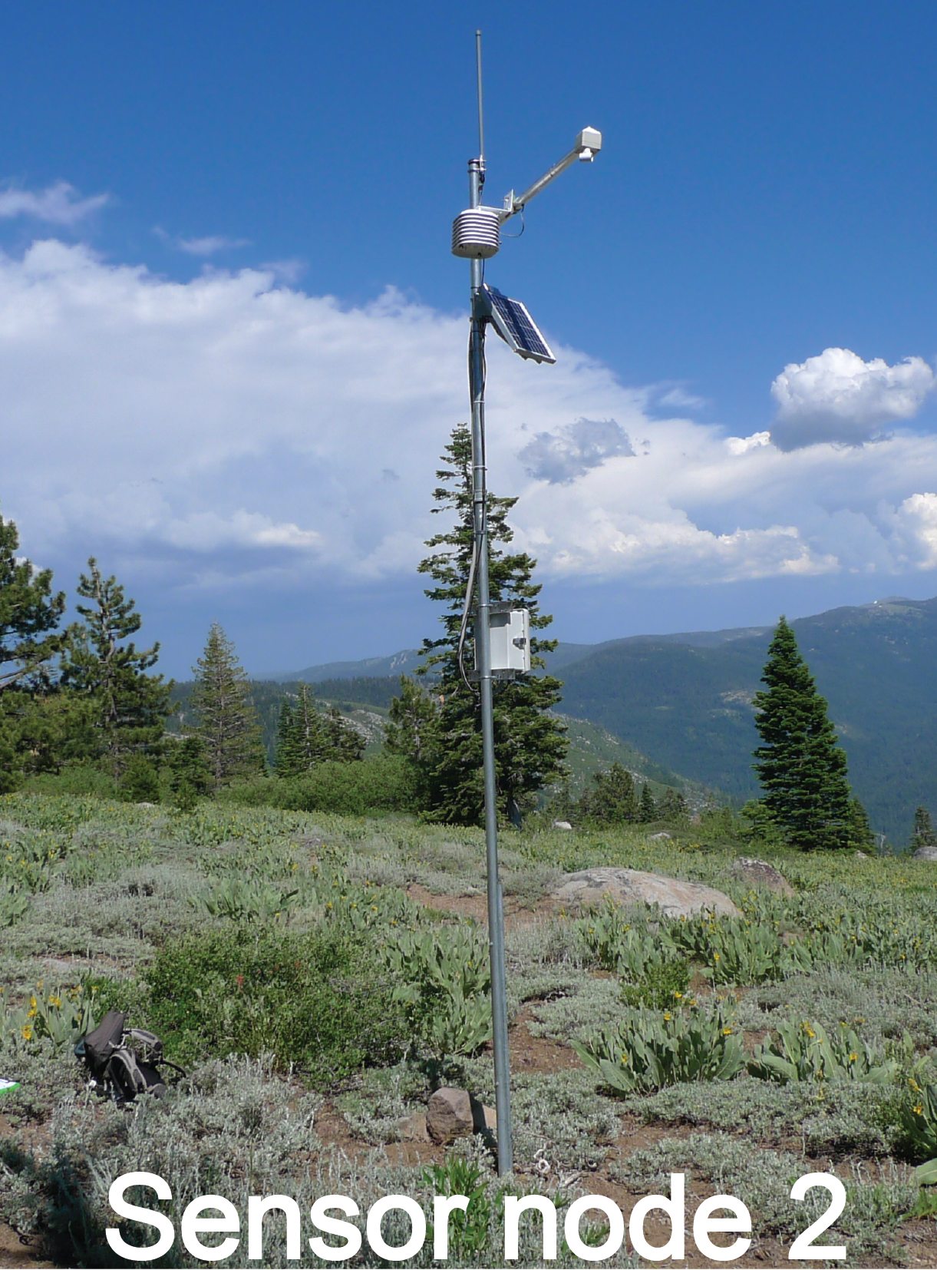
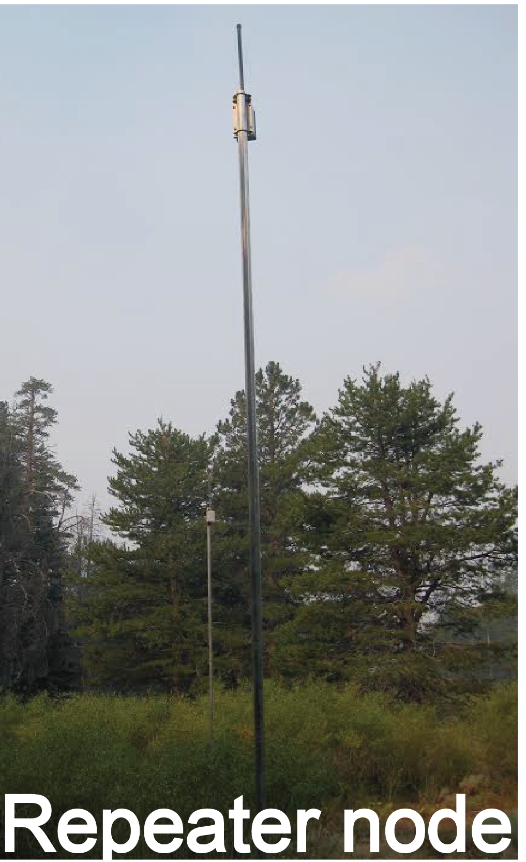
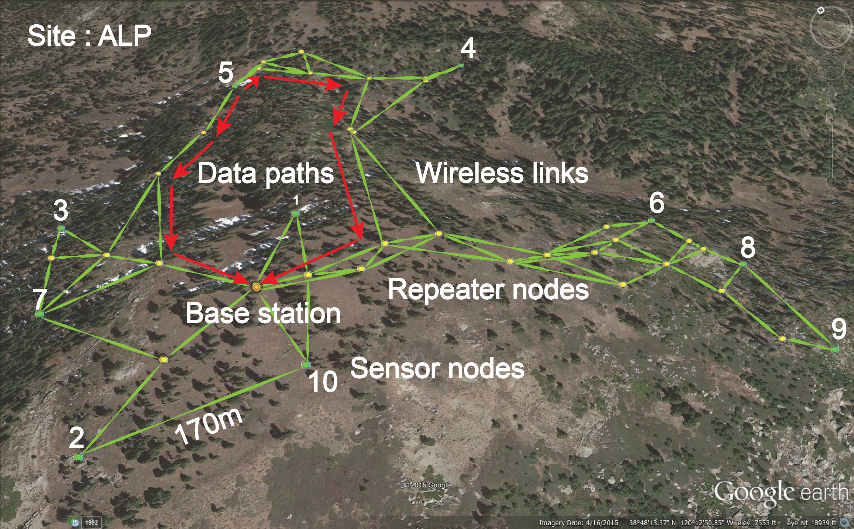
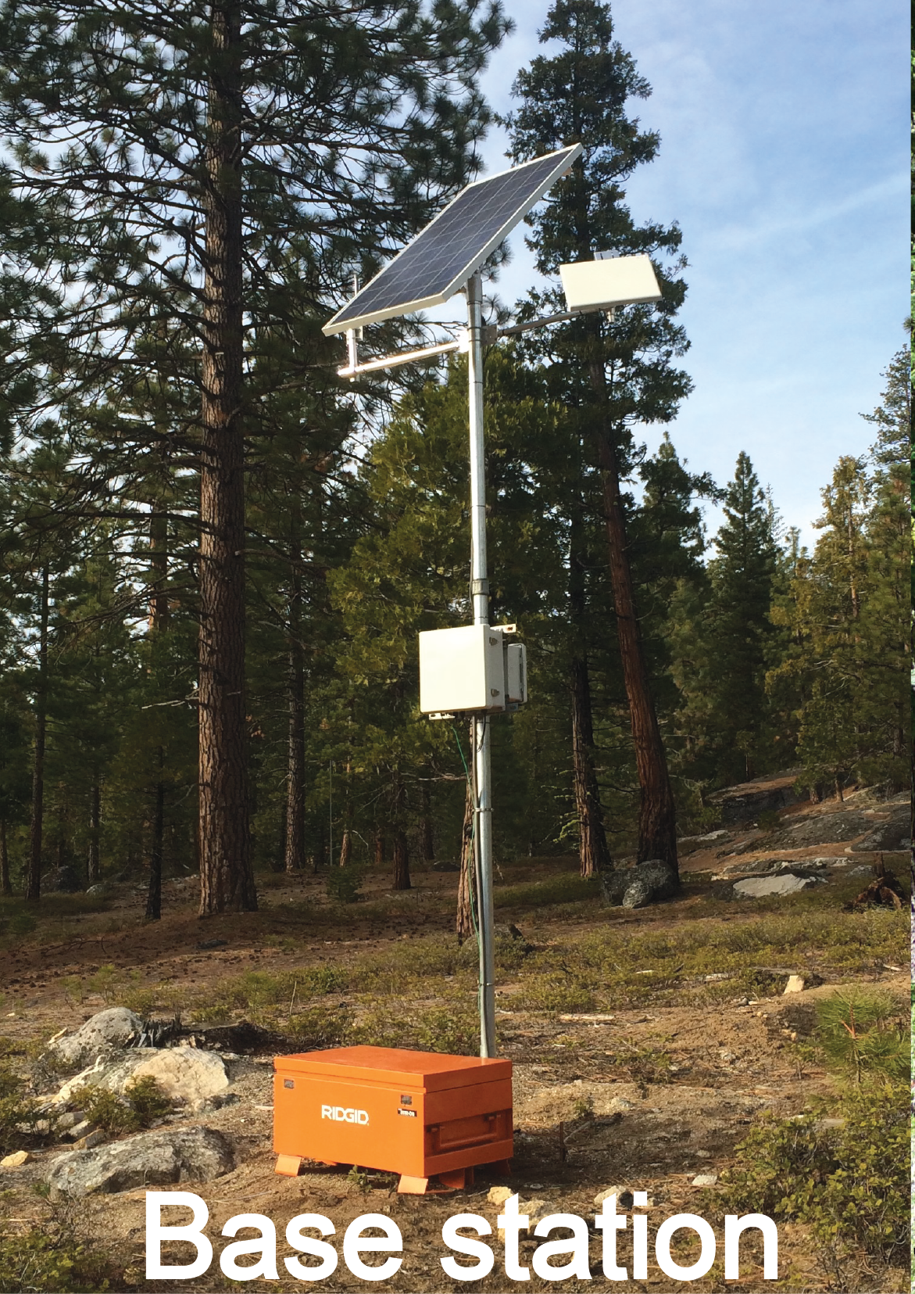
American River Hydrologic Observatory
Notes:
Design and composition of WSN (wireless sensor network). This cluster is spread out to capture the slope, aspect and canopy differences. Note redundancies in the signal path. Sensor nodes measure snow depth, relative humidity and temperature. Every cluster has 2-3 soil moisture sensors. Most clusters have radiometers.

Slide 10
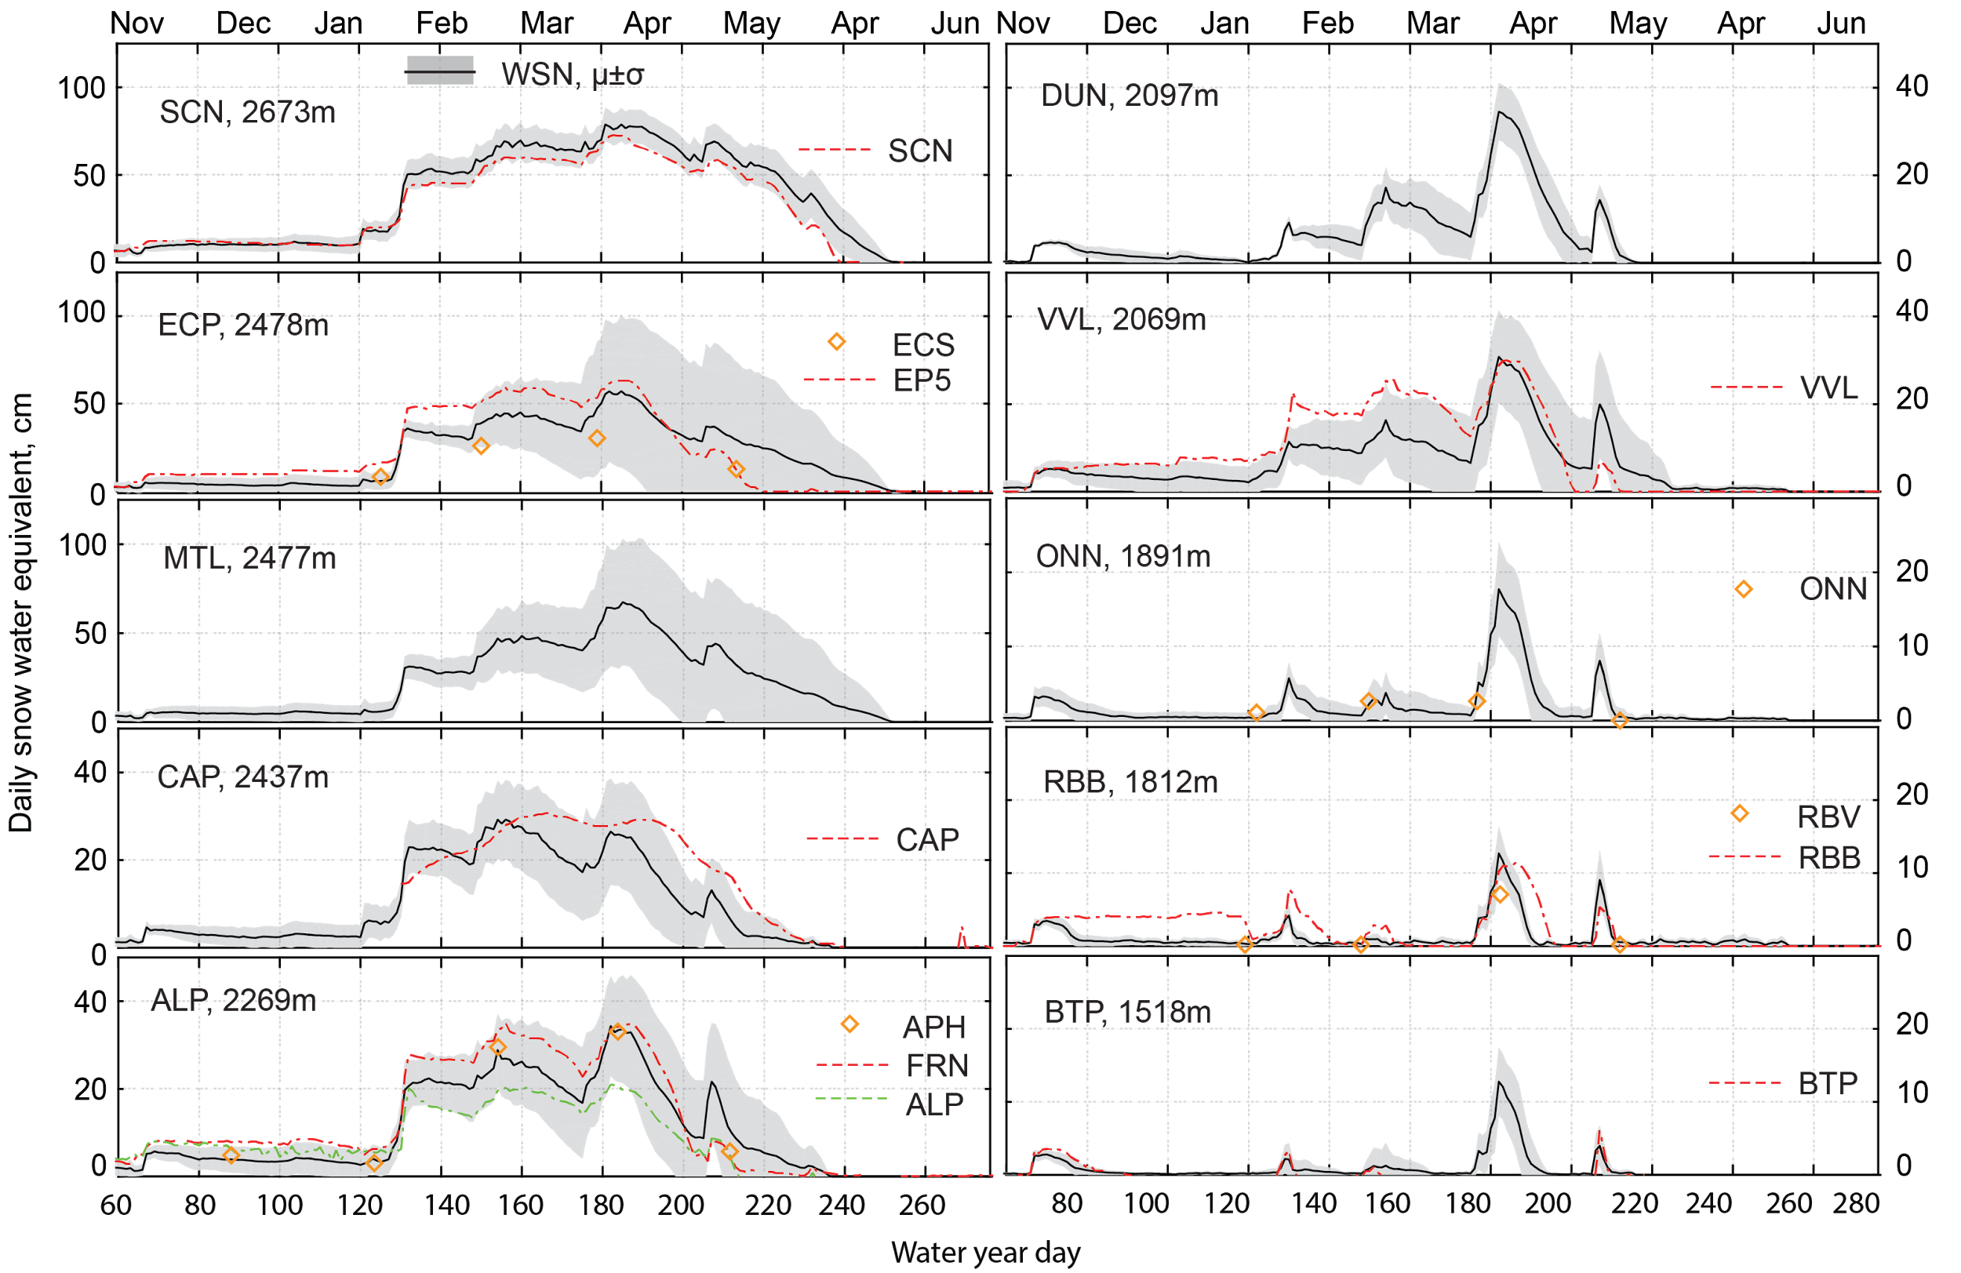
Snow water equivalent data for 2014 – American River Hydrologic Observatory
SCN 2673m
DUN 2097m
WSN μ±σ
ECP 2478m
VVL
2069m
MTL 2477m
ONN 1891m
Daily snow water equivalent, cm
CAP
2437m
RBB 1812m
ALP 2269m
BTP 1518m
Water year day
Notes:
Dashed line snow pillows (identified) and diamond snow courses. The gray shows the spatial distribution of snow water equivalent. Note the immediate melat after storms until 2000 m.

Slide 11
Snow water equivalent data for 2014 – American River Hydrologic Observatory
SCN 2673m
DUN 2097m
WSN μ±σ
ECP 2478m
VVL
2069m
Take home points:
Large spatial variability
Snow pillows tend to be in open areas:
more snow and earlier melt
Snow courses are not measured frequently enough to capture temporal variability
MTL 2477m
ONN 1891m
Daily snow water equivalent, cm
CAP
2437m
RBB 1812m
ALP 2269m
BTP 1518m
Water year day
Notes:
Dashed line snow pillows (identified) and diamond snow courses. The gray shows the spatial distribution of snow water equivalent. Note the immediate melat after storms until 2000 m.

Slide 12
5 wireless sensor networks
2 meteorological stations
4 basins

Slide 13
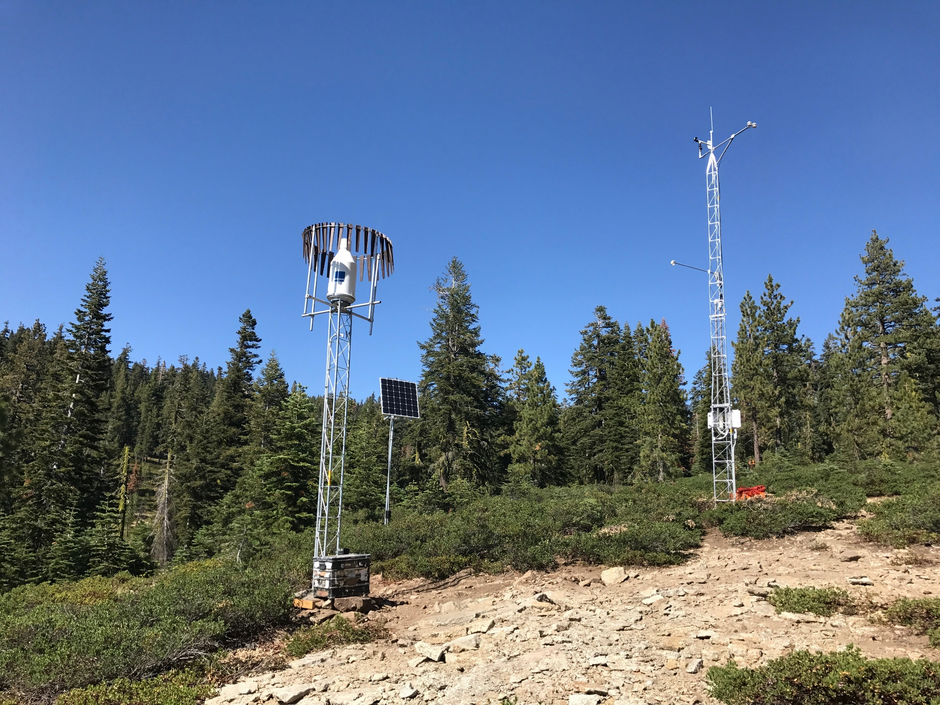
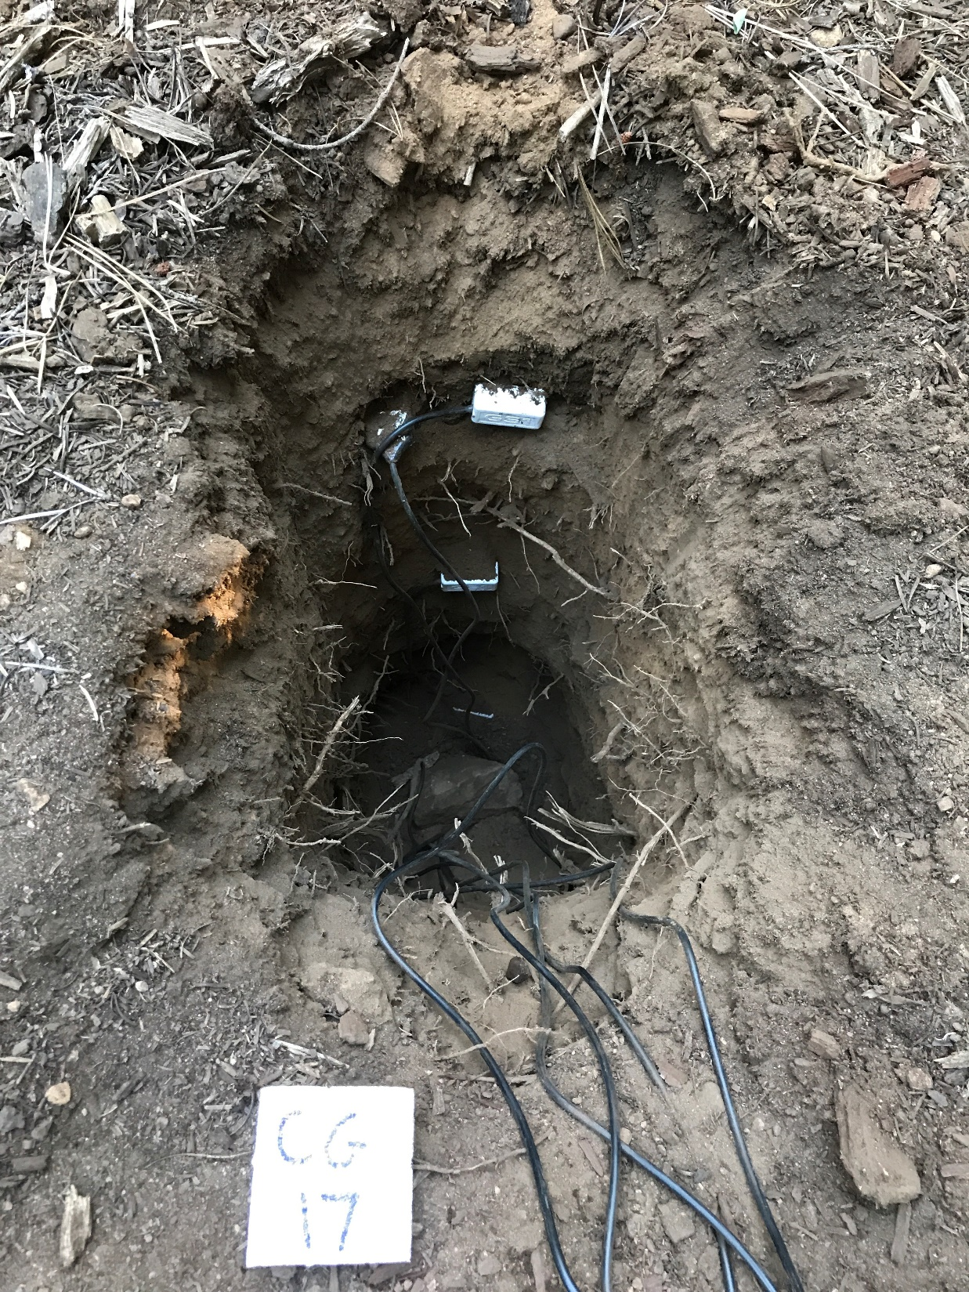
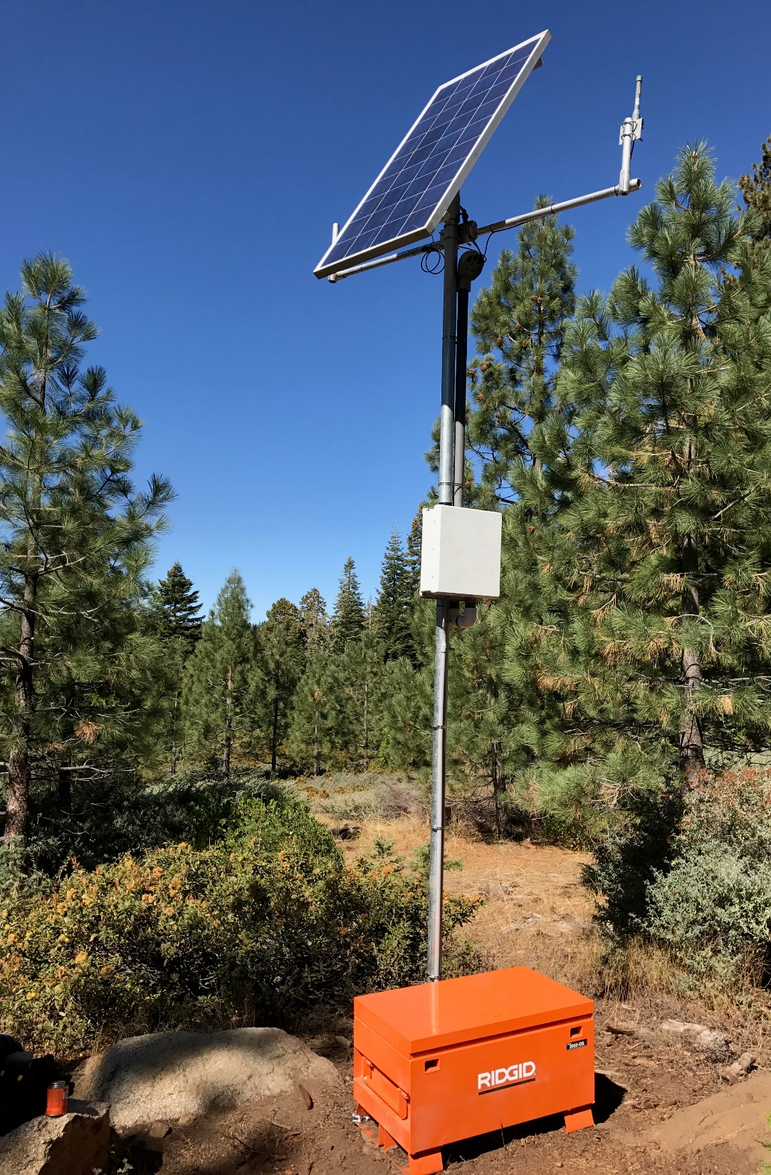
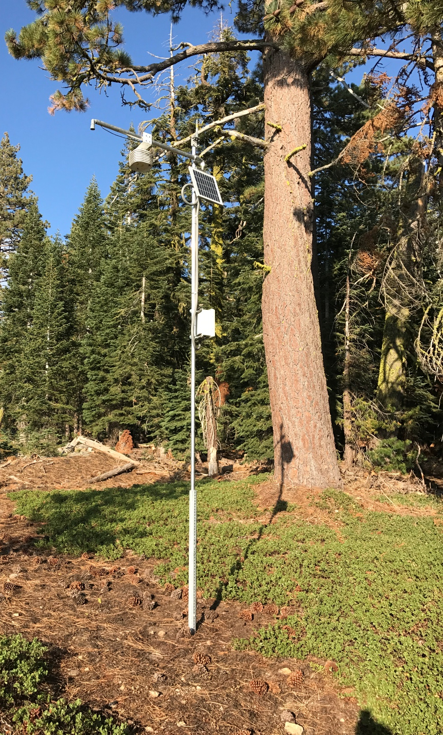
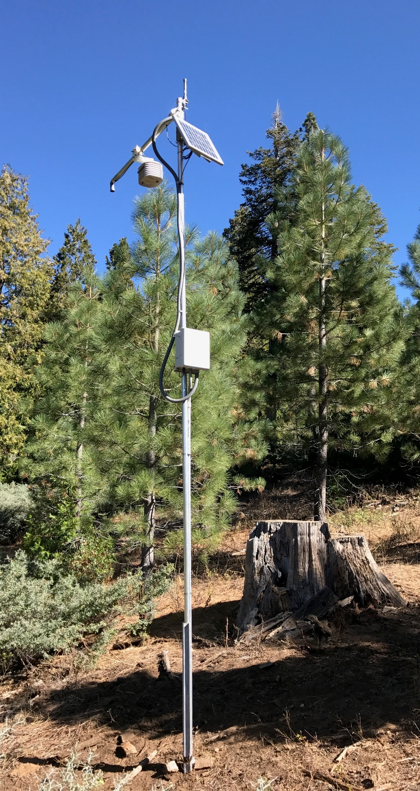
Lower meteorological station,
Middle Gulch
Components of the Hemlock
wireless sensor networks:
Middle and Cottonwood Gulches
Base station
Measurement nodes
Installing soil moisture probes

Slide 14
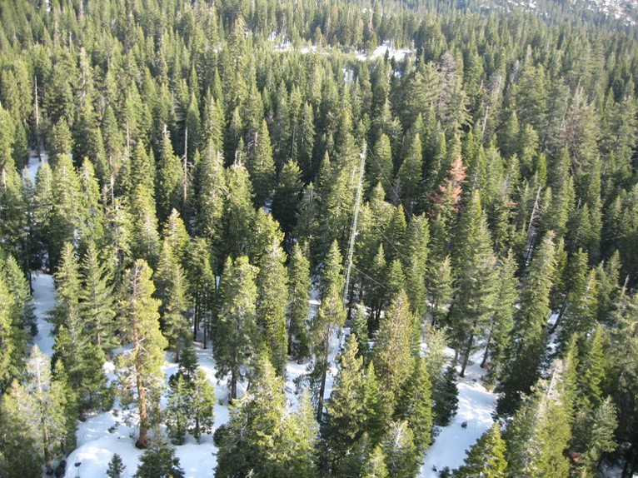
Topics in this talk
Sierra Nevada hydrology
Measuring snowpack
Estimating evapotranspiration
Thinning impacts
Linking headwater to groundwater
Notes:
Forests shade the snowpack, allowing up to 6 months of storage in our “water towers”

Slide 15
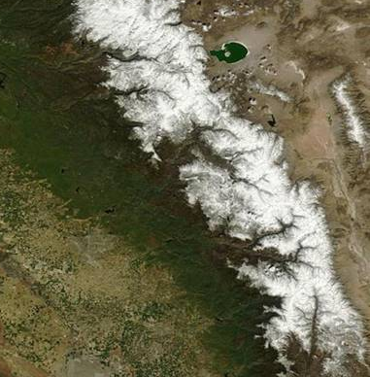
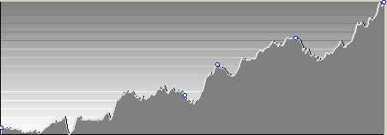
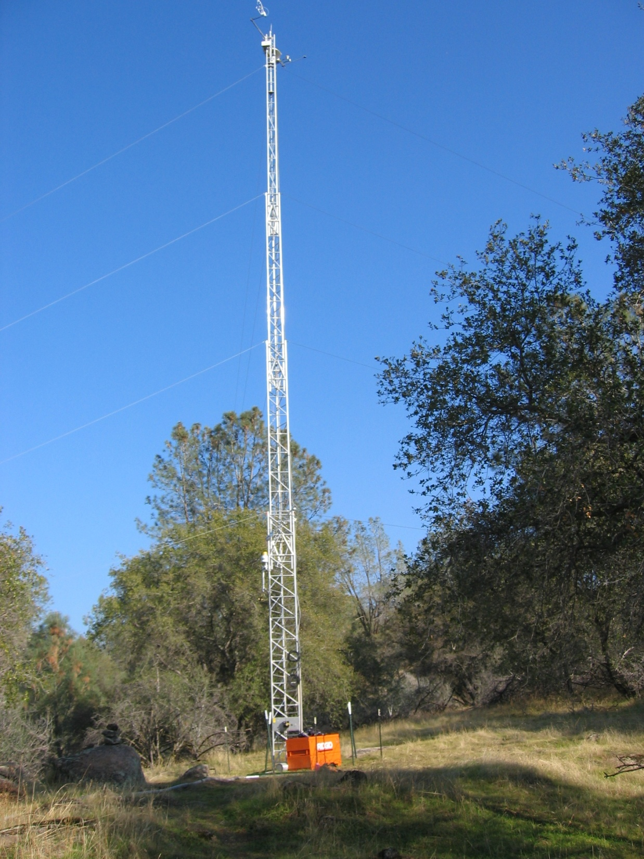

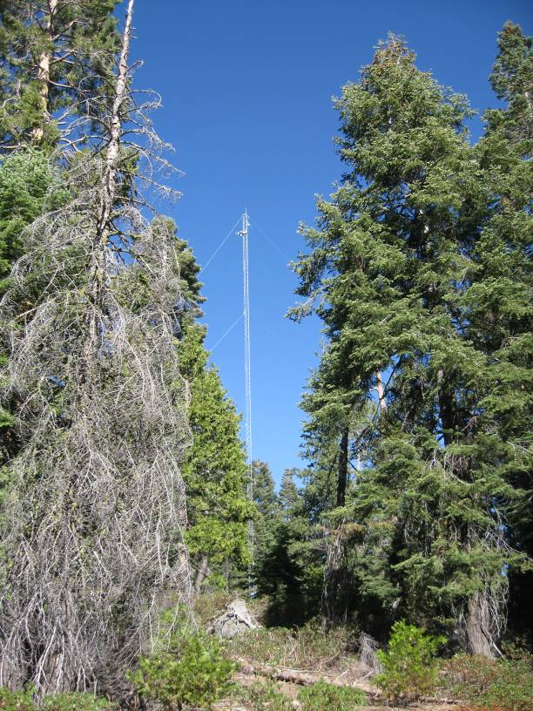
Field research – measurements
MODIS image
Elev., m
3000
E-W transect of flux towers
Merced
2400
1800
1200
600
Shorthair Creek
2700 m
Soaproot Saddle
1100 m
San Joaquin Experimental Range
400 m
CZO Providence
2000 m
Southern Sierra Critical Zone Observatory
Ground measurements of precipitation, evapotranspiration, discharge, soil-moisture storage, snowpack storage
(Shorthair not available)
Notes:
CZO = Southern Sierra Critical Zone Observatory

Slide 16
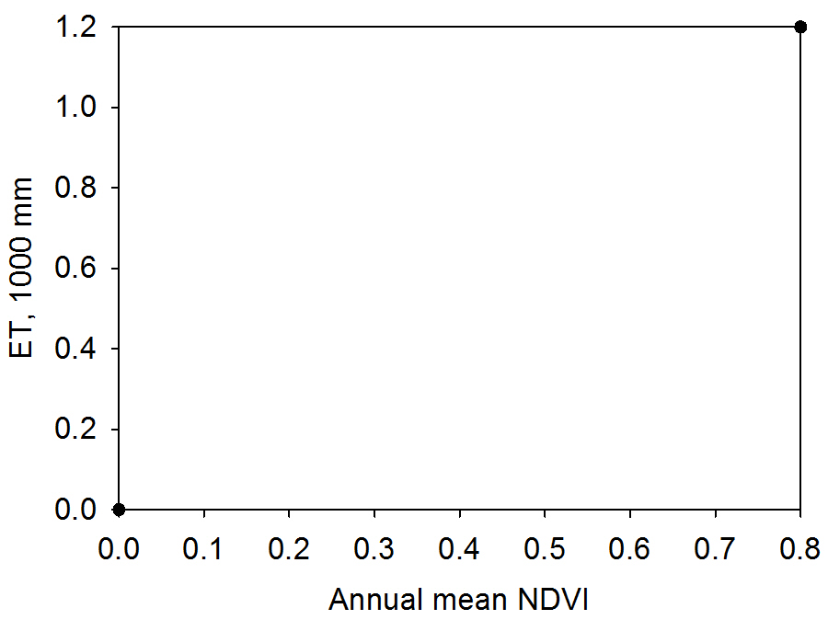
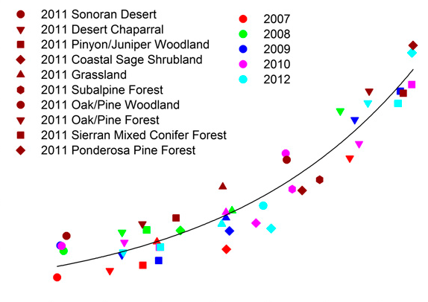
Scaling evapotranspiration (ET)
Annual ET measured by flux towers, correlated with satellite NDVI (greenness)
R² = 0.9
“greenness”
ET calculated across the Sierra using this calibration
Goulden & Bales, 2014
Notes:
Bidirectional interaction: high leaf area index (LAI) causes high ET through leaf gas exchange; high ET feeds back to high LAI through water balance/NPP. (NPP = Net Primary Productivity)
NDVI thus a signal of annual ET: high NDVI indicates high LAI; high LAI indicates high NPP; high NPP indicates high ET. (NDVI is a greenness index from satellite)
Feedback of ET & NPP to LAI develops over a few yr, hence NDVI measured in a given year reflects ET over last few yr.
Annual ET over the last few yr is that needed to support the current LAI.

Slide 17
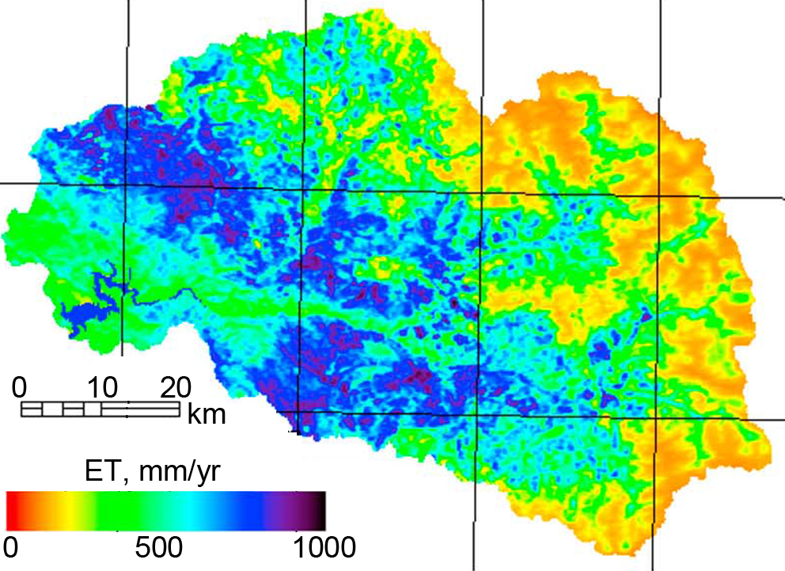
Scaling ET across Kings R. basin
Mixed conifer
High Sierra
Oak
Significant advances in measurements in past 5-10 yr can better inform decision making
Evapotranspiration across the southern Sierra using ET-NDVI correlation from flux towers
Goulden & Bales, 2014

Slide 18
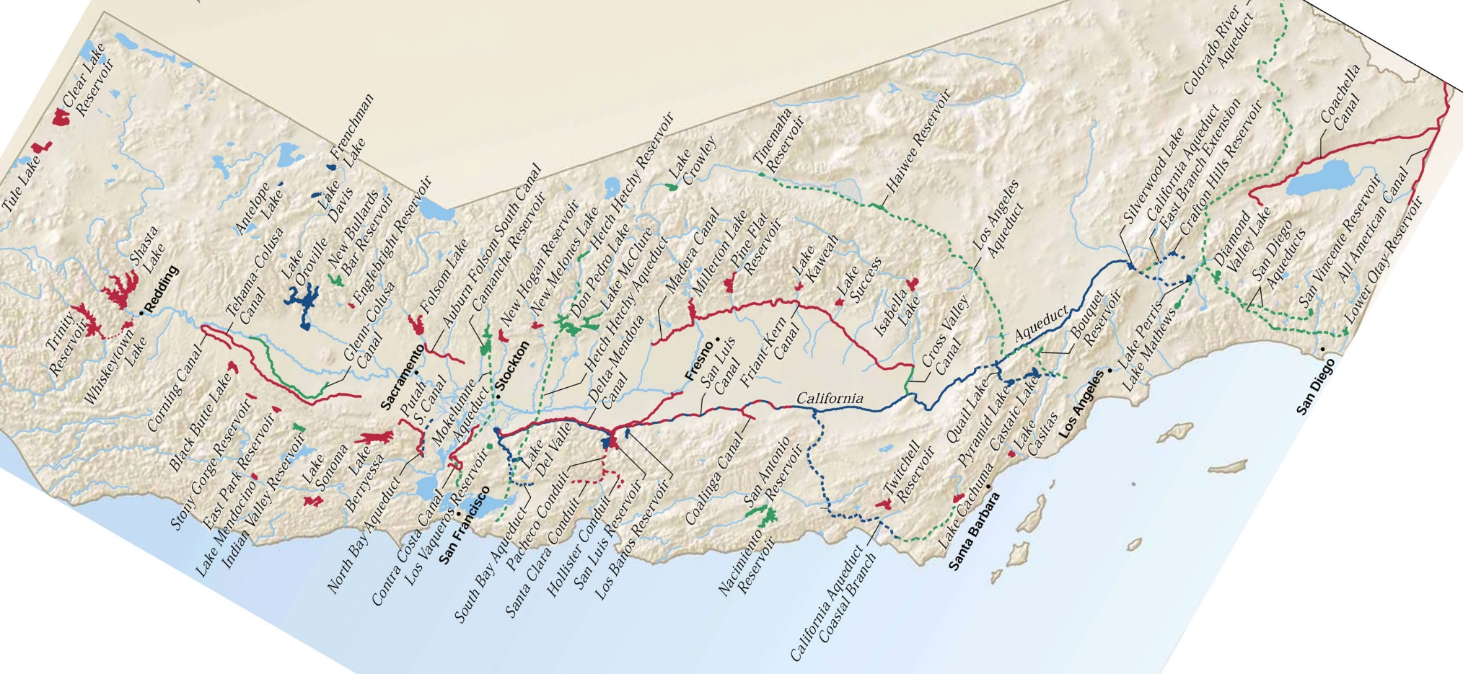
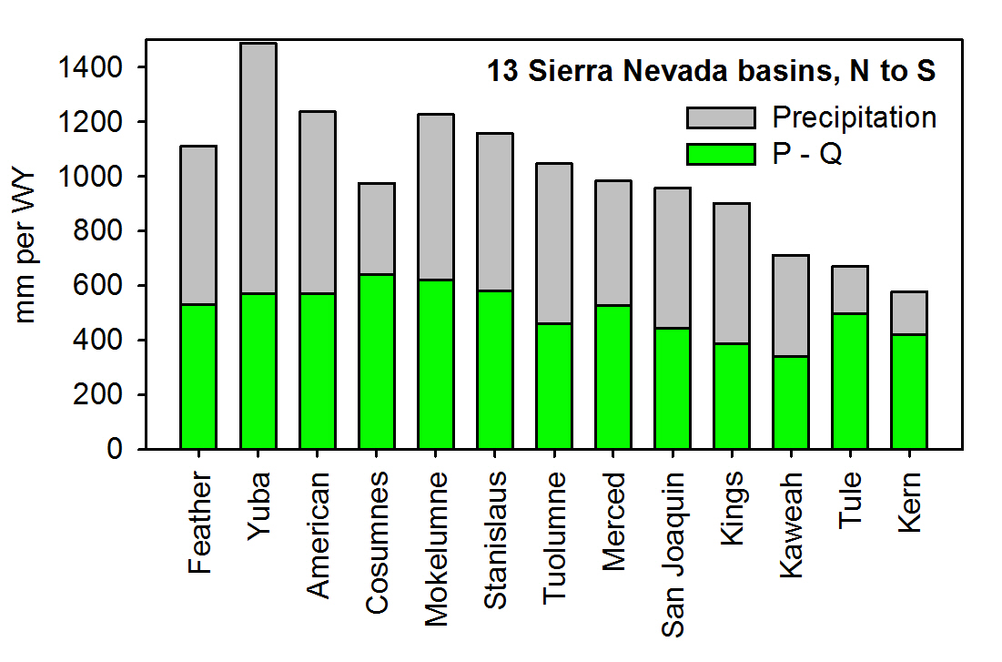
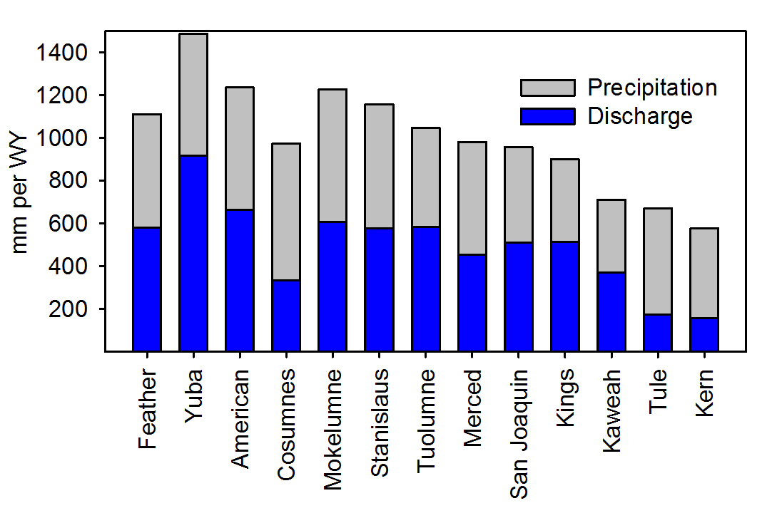
Evapotranspiration
We can measure & manage evapotranspiration on a basin-wide basis
N
Sierra Nevada
Precipitation =
Runoff +
Evapotranspiration
Map from CA Water Plan, 2013

Slide 19
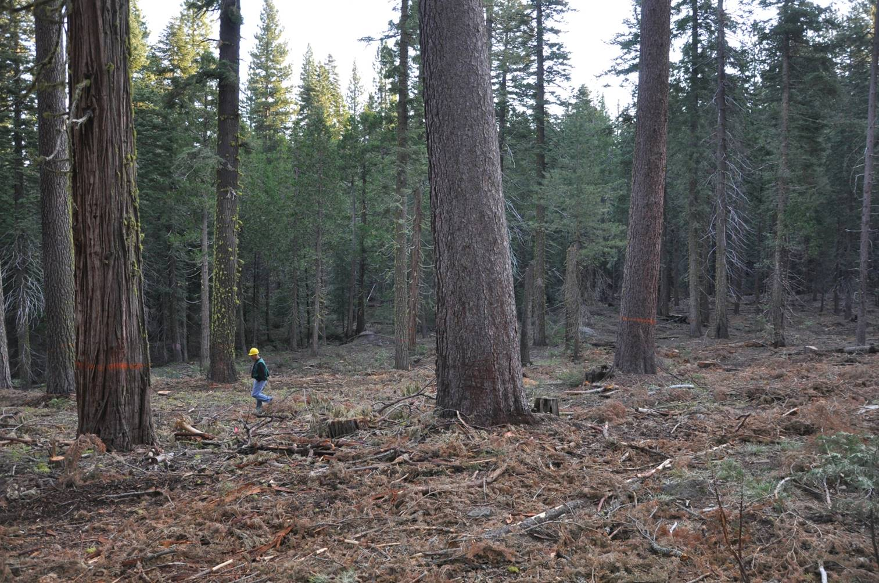
Management response:
restore (thin) forest → reduce ET
Topics in this talk
Sierra Nevada hydrology
Measuring snowpack
Estimating evapotranspiration
Thinning impacts
Linking headwater to groundwater
Thinned unit w/ control in background
E. Knapp photo

Slide 20
Stanislaus
Control
Even thin
Basal-area decrease = 40-50%
Variable thin
1 km
150-200
mm/yr
0.8
950
0.8
Control, ub
Control, b
0.7
0.7
Even, ub
Even, b
NDVI
ET, mm yr⁻¹
0.6
570
Variable, ub
Variable, b
0.6
Control
0.5
0.5
Even thin
Variable thin
0.4
340
0.4
1985
1995
2005
2015
2.0
Year
Mean water-year
precipitation
10³ mm
1.0
J. Roche, 2017, in preparation
1985
1995
2005
2015
Notes:
1. NDVI change for control even, variable STEF elevation=1800m
Points: interannual variability in NDVI; drought and white fir mortality in STEF in 1990’s; potential impact of homogenizing with L8 in 2012
2. approximate ET – non linear scale
3. change in ET of 150-200 mm per year
4. slight increase in change and extension due to burning in some plots

Slide 21
Bear Trap Basin response to thinning (Last Chance - SNAMP)
snow
soil storage
Modeled Changes following thinning
evapotranspiration
Modeled Changes following thinning
streamflow
Saska et al. , 2017
Notes:
Melt is sooner (SWE) – shows amount.
Soil storage goes up particularly in late spring
ET goes down during winter & spring. Late summer increase in ET.
Stream flow is higher due to lower ET and increased snow and early subsurface contributions. Note that increased flows occur when we have the least precision for measuring them.
ALSO: thinning for Last Chance provided a fire break for the American Fire

Slide 22
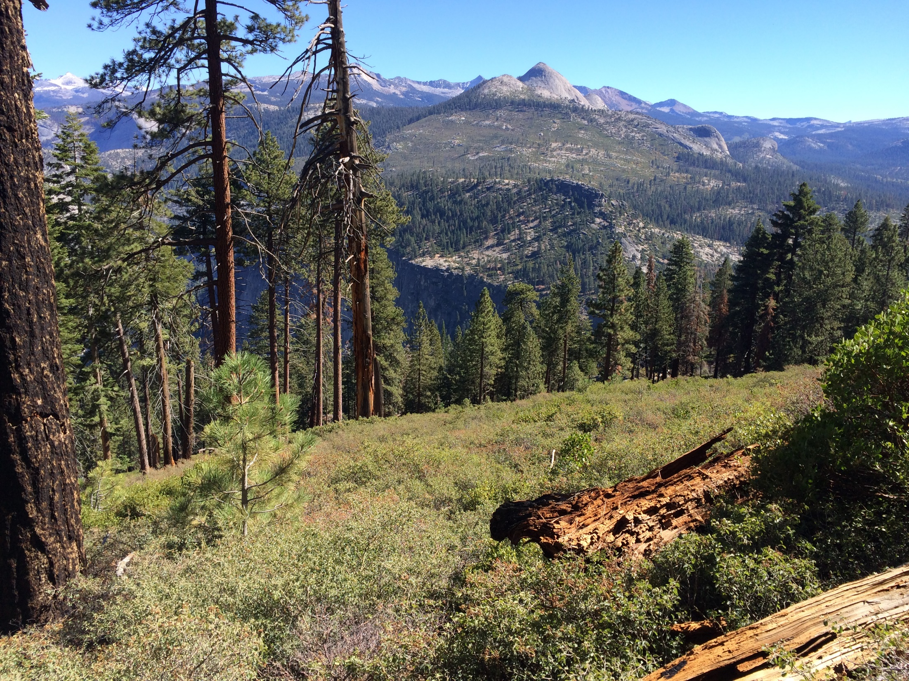
Net impacts are largest for wet years & increased flow would be in wettest time of year
Central SN: Intensive thinning corresponds to a significant reduced ET & modeled increased stream flow in normal snow year
Impacts of thinning reduced by water limitation & recovery rate
Notes:
… in drought years; 5% on average
Reflect on the role of fire to mitigate climate impacts, potentially increase yield (or at least sustain yield), decrease health and wildlife impacts of destructive high intensity wildfire
Recent work by Gabrielle Boisrame that has shown that the Illilouette basin in Yosemite has at least sustained flow rates relative to other similar watersheds where flow rates have decreased in association with little fire

Slide 23
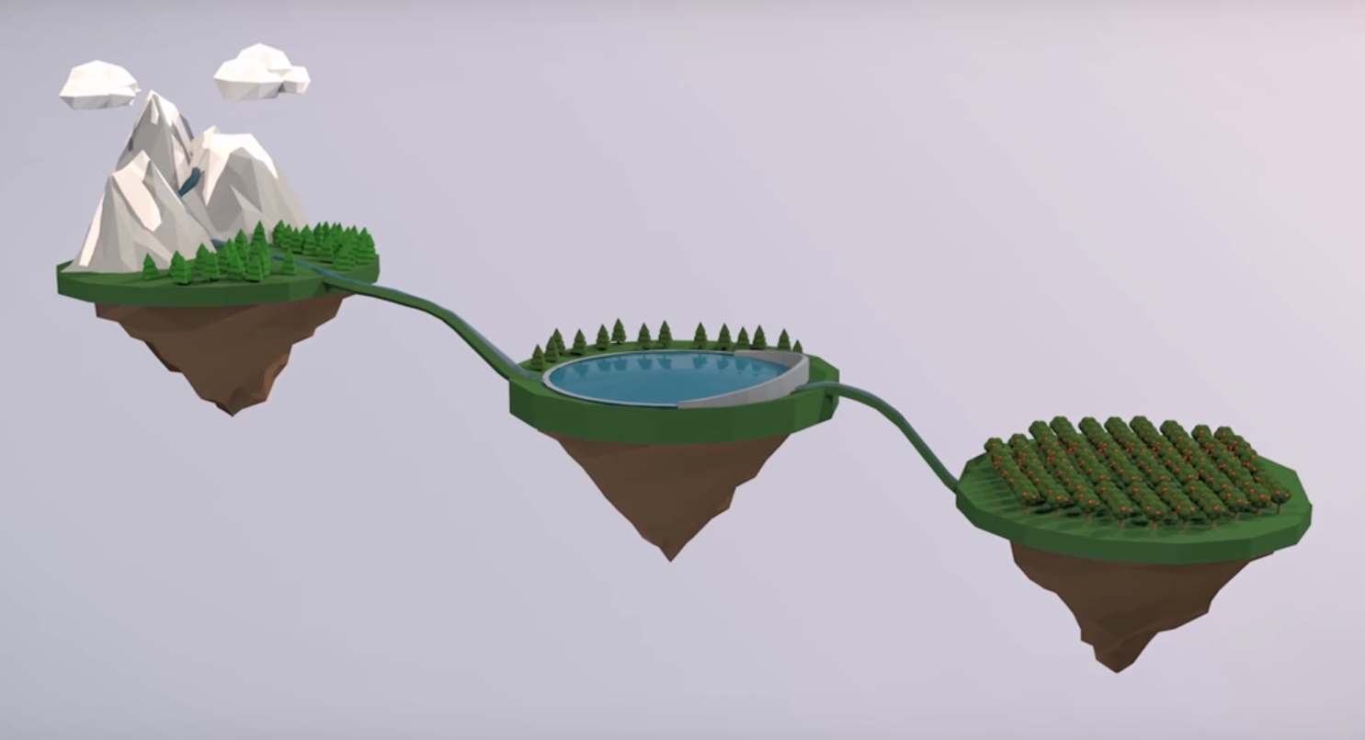
Reconnecting a fragmented system
Water in the balance – UC TV Sustainable California
Notes:
Mountains are our “water towers” traditionally storing water for up to 6 months (due to shading provided by forests)

Slide 24
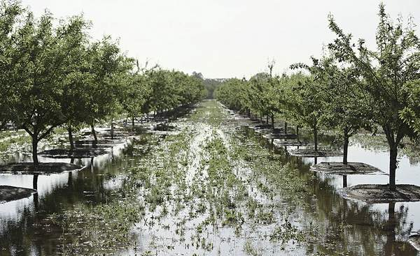




Water Security
Water security is a major challenge facing California
Integrated water systems designed to manage natural infrastructure & groundwater recharge is key to future water security
Recharging groundwater in winter
NSF Southern Sierra
Critical Zone Observatory
Capitolpress.com
Notes:
Flooded San Joaquin Valley almond orchard

