Slide 1
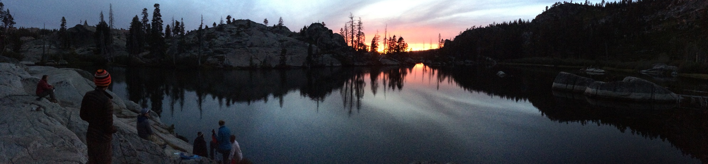
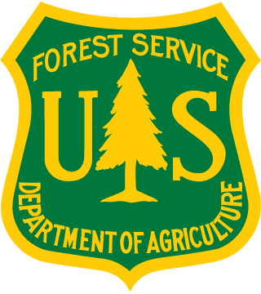
Reconciling Expansion of Restorative Burning with Protecting Public Health from Smoke Impacts: Caples Creek Watershed Case Study
Wednesday, November 8, 2017
Amador-Calaveras Consensus Group Monitoring & Science Symposium
Becky Estes, Ph.D.
US Forest Service
Central Sierra Province Ecologist

Slide 2
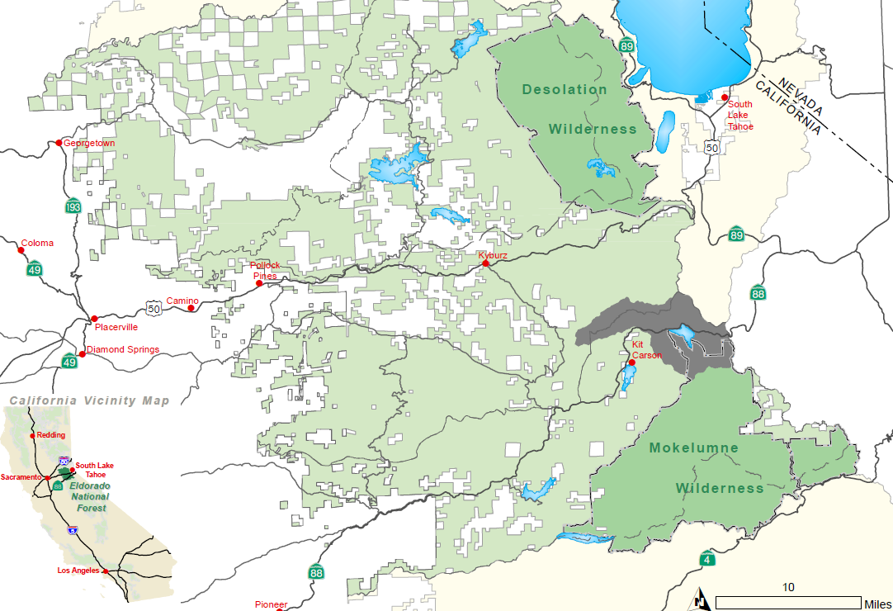
Caples Creek Watershed
Sixth field watershed located 30 miles east of Placerville, California
Watershed is 20,236 acres and is part of the larger South Fork American River Watershed
Watershed provides the primary water supply for more than 110,000 people
Lake
Tahoe

Slide 3
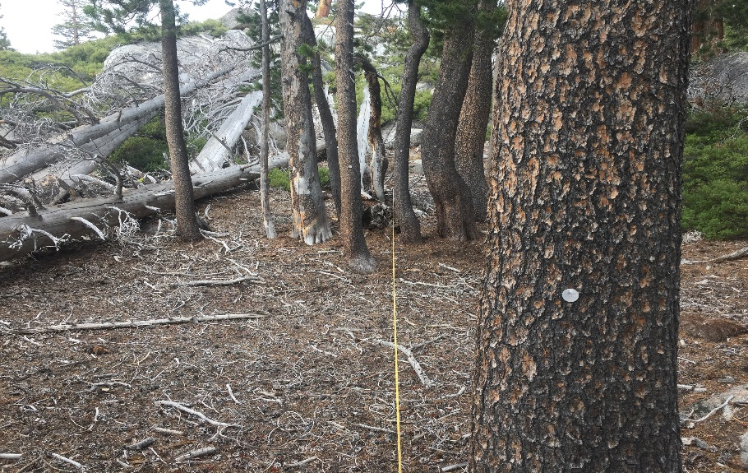
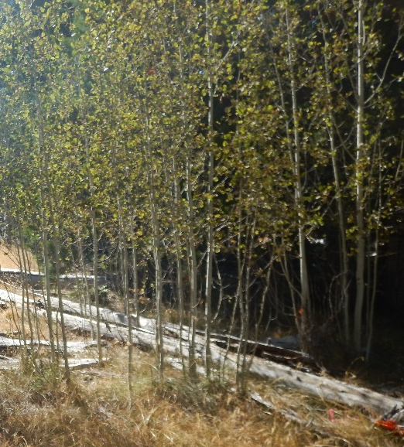
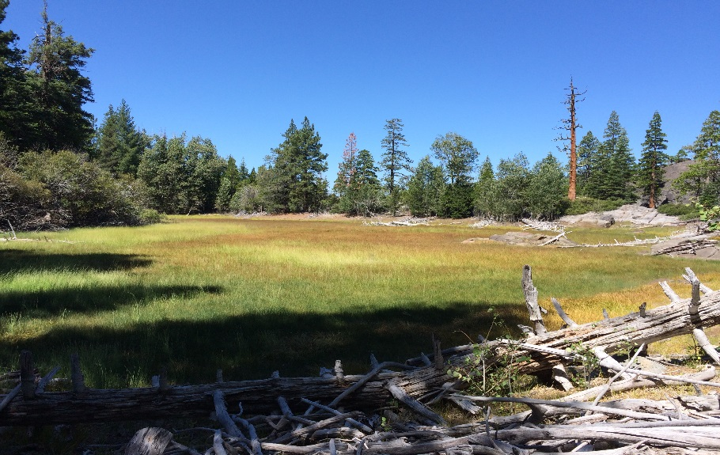
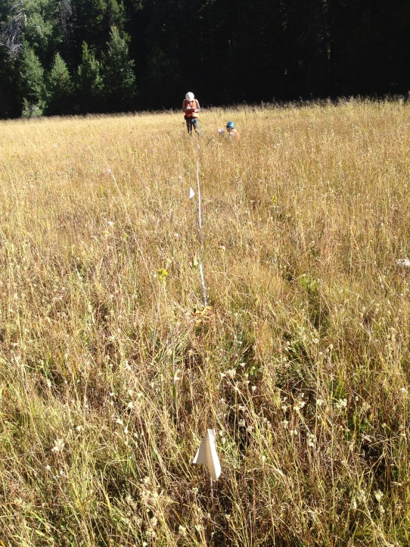
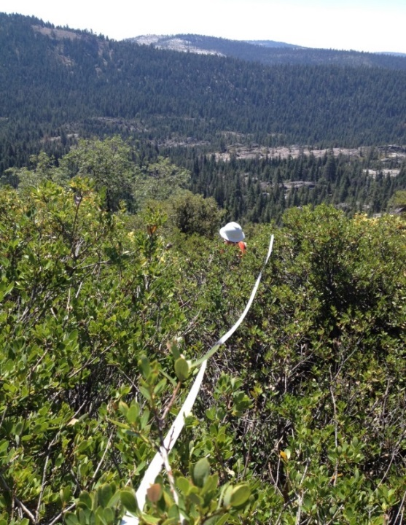
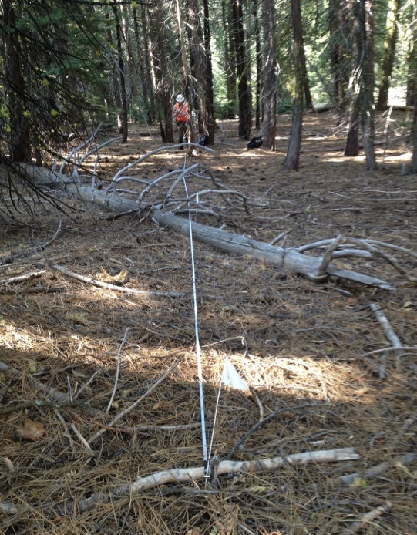
Caples Creek Watershed Ecosystem Diversity

Slide 4
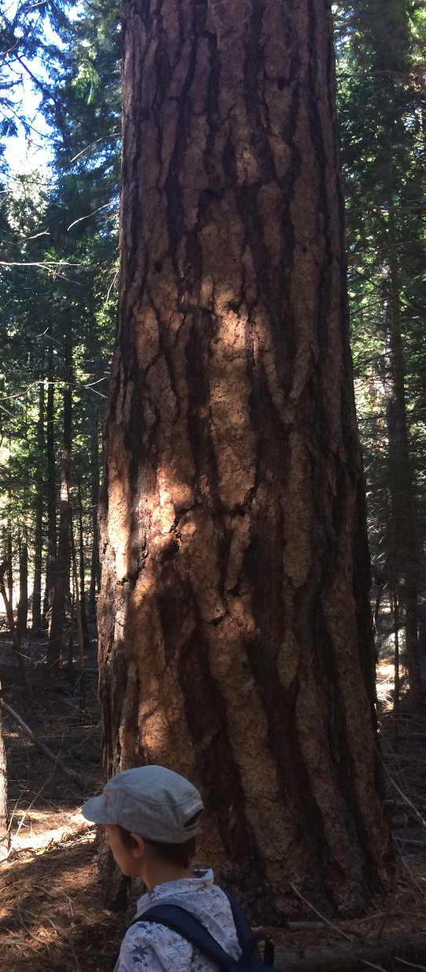
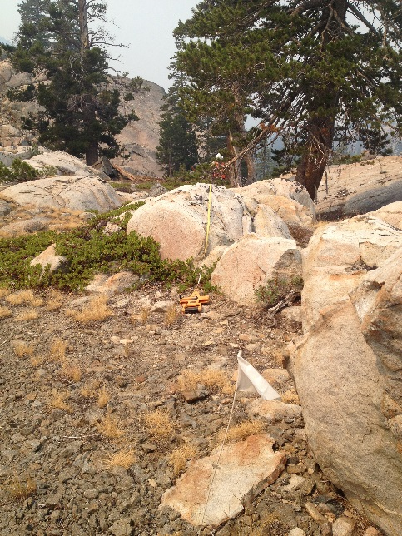
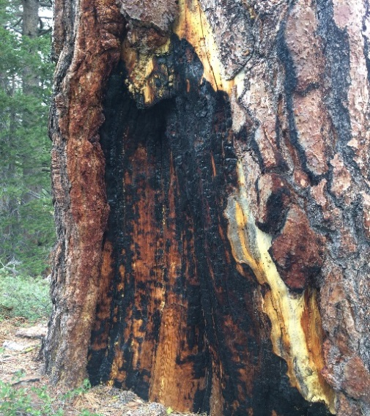
Caples Creek Watershed Fire History
Pre-European Fire Return Interval
Forest Type | Mean | Median | Mean Min | Mean Max | Number of Sources
Yellow pine | 11 | 7 | 5 | 40 | 24
Dry mixed conifer | 11 | 9 | 5 | 50 | 37
Moist mixed conifer | 16 | 12 | 5 | 80 | 53

Slide 5
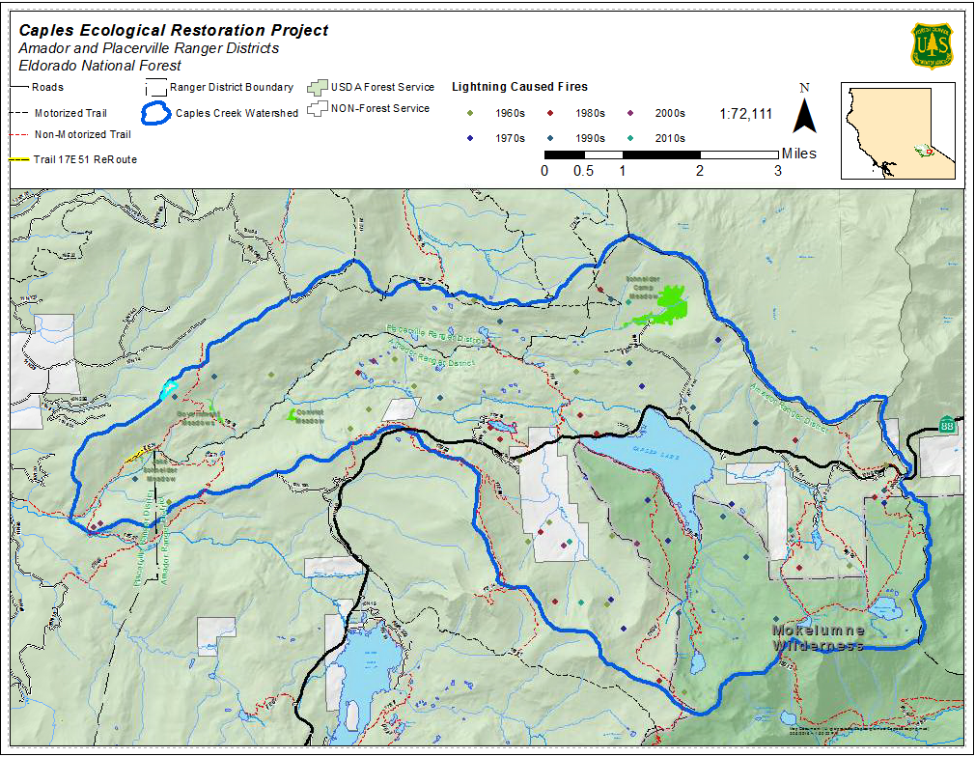
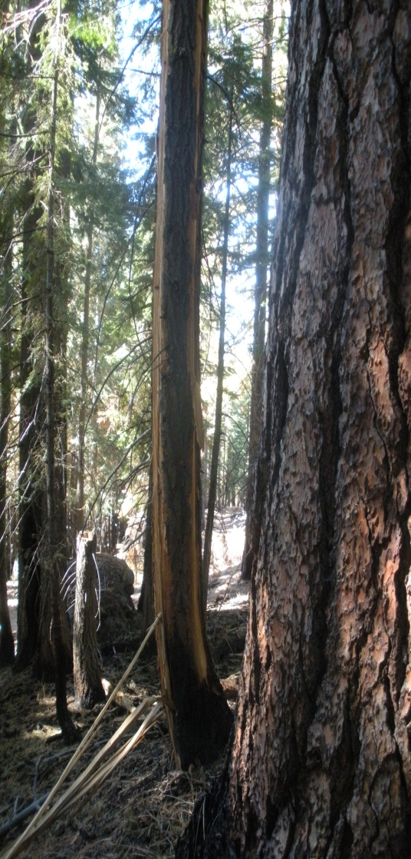
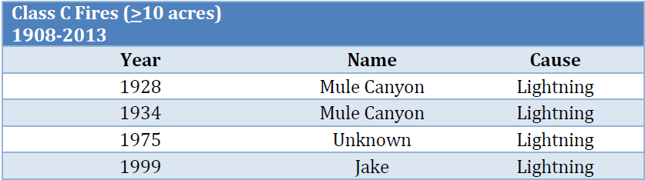
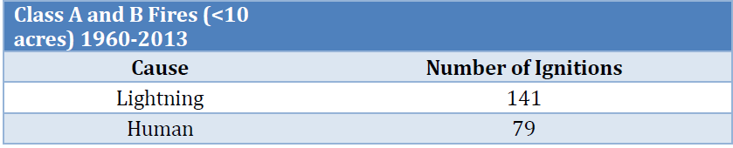
Caples Creek Watershed Lightning Ignition

Slide 6
Fire Return Interval Departure
Moderate Departure
High Departure
Notes:
Location of project
Ecology of Landscape
Fire History – fire return intervals, fire scars in the landscape
Fire Departure –
Effects on vegetation etc. images of downed trees, fuel loading, alterations in vegetation
Caples Project – objectives
RX burn plan – overview and map

Slide 7
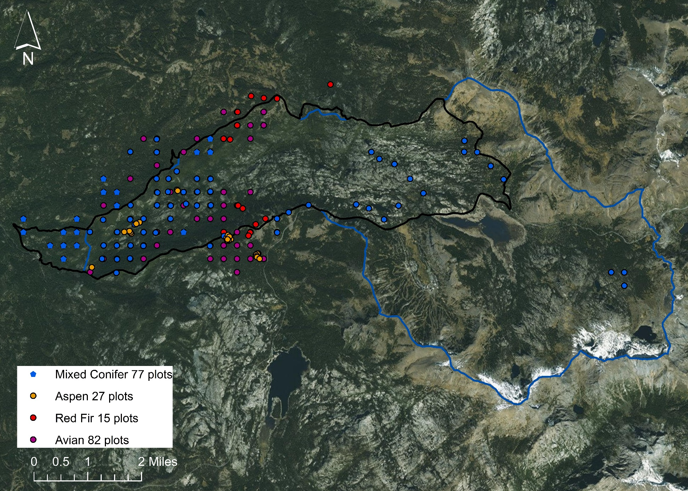
Monitoring Plots in the Caples Creek Watershed

Slide 8
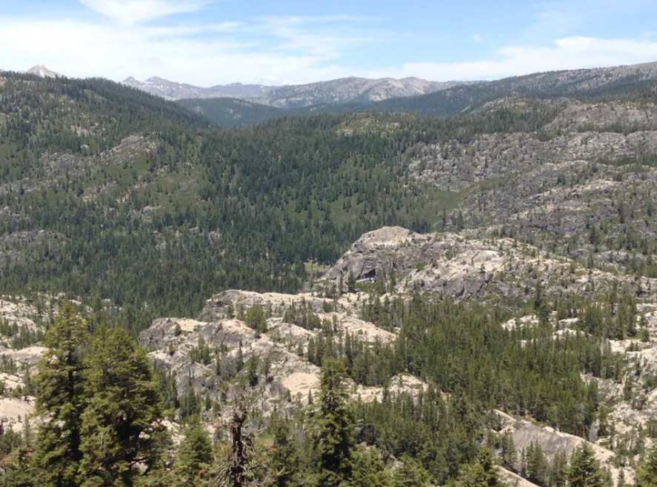
Methodology
  The ecological condition of the mixed conifer forests were evaluated using the Natural Range of Variability (NRV) concept;
  Mean NRV was compared to current conditions in the Sierra Nevada (Forest Inventory Analysis Plot (FIA) data and in the Caples Creek Watershed (Common Stand Exam Protocol);
  NRV sources included historical inventory data, contemporary reference information, modelling approaches, other historical accounts, data from peer reviewed sources, and USDA Forest Service data (e.g., Region 5 FRID database) and technical reports.

Slide 9
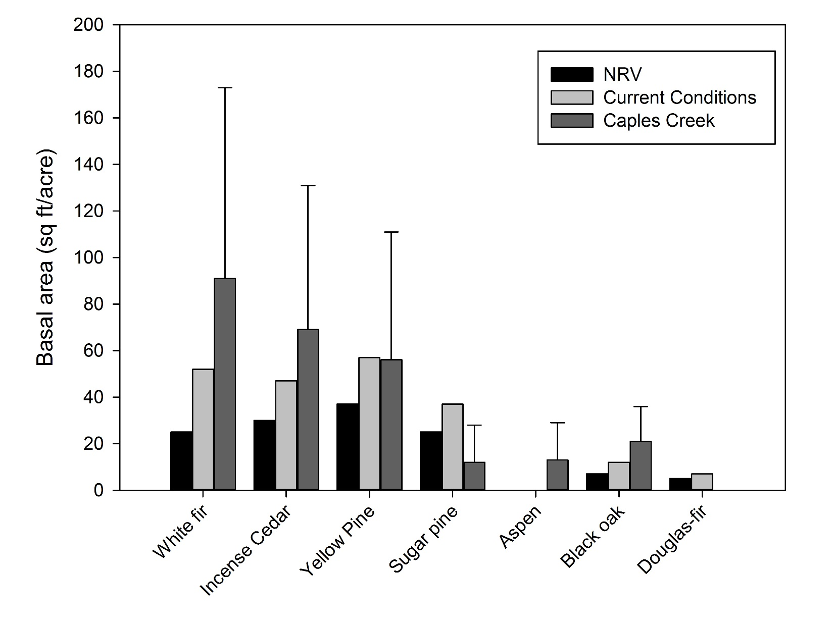
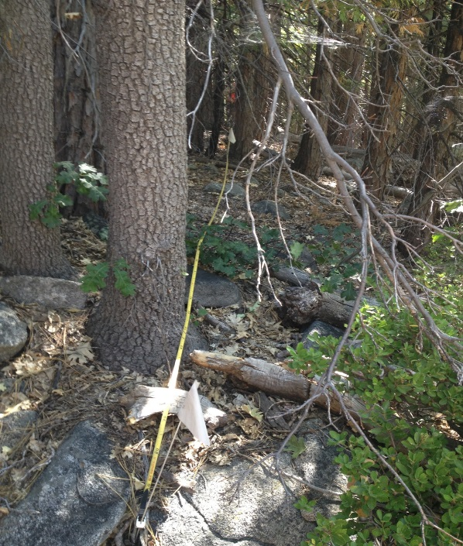
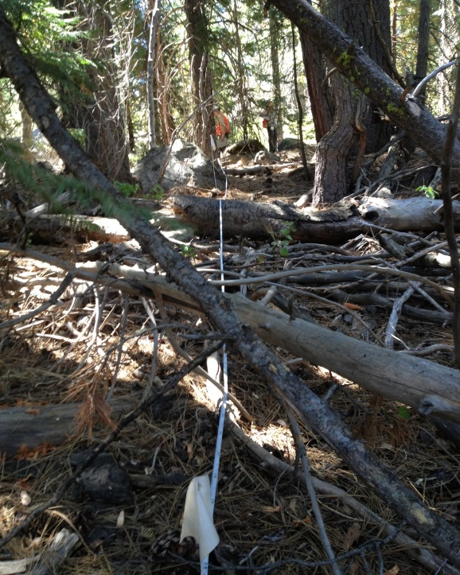
Caples Creek Watershed Conditions
Stand Variable | NRV | Sierra Nevada | Caples Creek
Tree Density (trees/acre)* | 61 ± 37ª | 181 ± 63^{b} | 168 ± 146^{b}
Small tree (<8 inch dbh) density (no./acre) | 34 ± 23ª | 255 ± 128^{b} | 80 ± 74^{c}
Canopy cover (%) | 37 ± 14 ª | 46 ±22 ^{b} | 75 ± 30 ^{c}
Snag density (trees/acre) | 5 ± 3 ª | 17 ± 28 ^{b} | 36 ± 29 ^{c}
Fuel loading 1-100-hr fuels (tons/acre) | 1.4 ± 1.3 ª | 3.0 ± 1.02 ^{b} | 4.0 ± 6.9 ^{b}
Fuel loading 1000-hr fuels (tons/acre) | 6.3 ± 3.8 ª | 9.3 ± 5.2 ^{b} | 16.2 ± 30.9 ^{b}
Fuel loading litter and duff depth (inch) | 0.6 ± 0.4 ª | n/a | 3.0 ± 2.0 ^{b}
Large tree (≥31 inch dbh) density (no./acre) | 17 ± 11ª | 10 ± 10^{b} | 11 ± 4^{b}
Mean diameter (inch) | 22 ± 4 ª | 9 ^{b} | 12 ± 6 ^{c}
Basal area (ft²/acre) | 145 ± 91ª | 143 ± 89ª | 168 ± 134ª
Tree regeneration (trees /acre) | 143 ± 131 ª | n/a | 188 ± 178 ª
Shrub cover (%) | 18 ± 2 ª | n/a | 21 ± 32 ª
Herbaceous plant cover (%) | 12 ± 7 ª | n/a | 10 ± 27 ª
Mean (±SD) stand variables in mixed conifer stands summarizing the Natural Range of Variability (NRV), current Sierra Nevada (FIA) conditions and current Caples Creek conditions. Letters that were similar were not significantly different using an α level of 0.05. Red text indicates an increased departure and blue text indicates decreased departure.

Slide 10
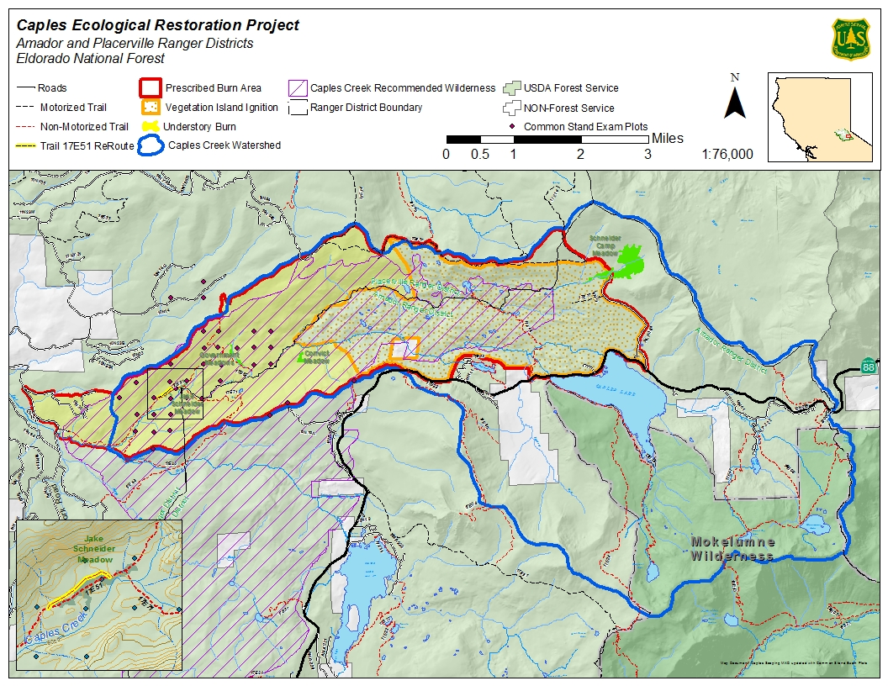
Caples Creek Restoration Project
Improve watershed and forest health
Reduce hazardous fuel accumulation
Meadow restoration
Improve conditions for aspen and oak
Improve public safety

Slide 11
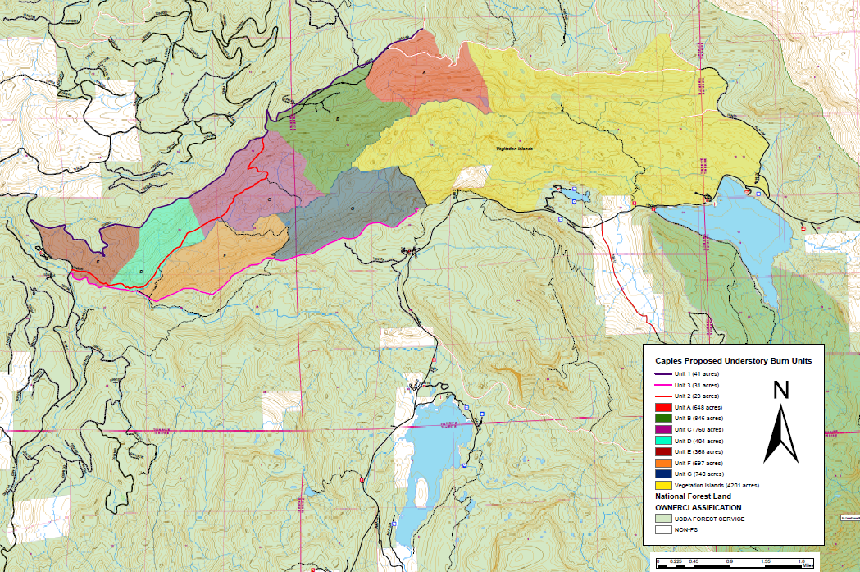
Caples Creek Restoration Project
Proposed 8,800 acres of prescribed burning
4,400 acres of burning in lower elevations (western portion of the project area)
4,400 acres of vegetative island burning in the higher elevations (eastern portion of the project area)

Slide 12
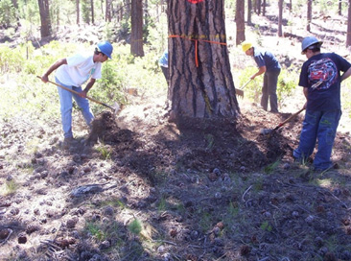
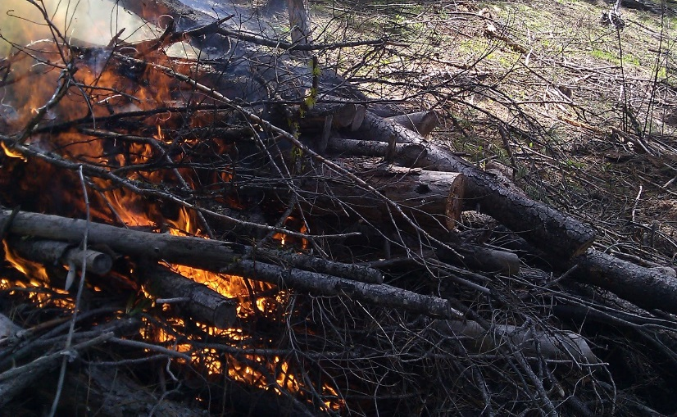
Caples Creek Restoration Project
Site Preparation
Infrastructure Protection
Old Growth Tree Raking
Fire Line Construction
Remove ladder fuels and pile
Prescribed Burning
Pile Burning
Understory Burning (Hand/Aerial)
Vegetation Island Burning (Aerial)

Slide 13
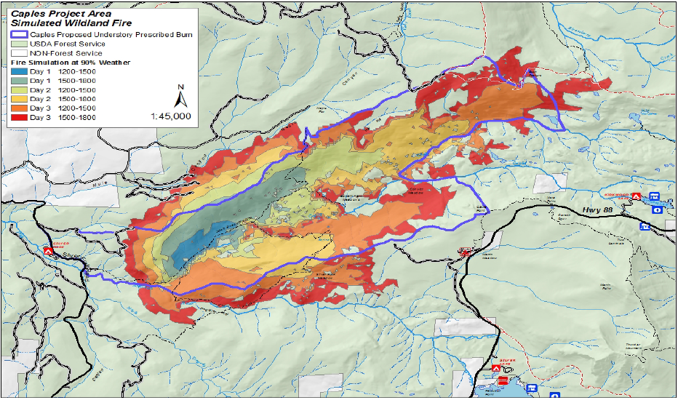
Caples Creek Watershed WFDSS Fire Simulation
WFDSS Fire Simulation at 90 percentile weather conditions for the watershed
Current, untreated fuel condition
Potential for aggressive and intense surface fire behavior, crown fire potential and containment difficulty

Slide 14
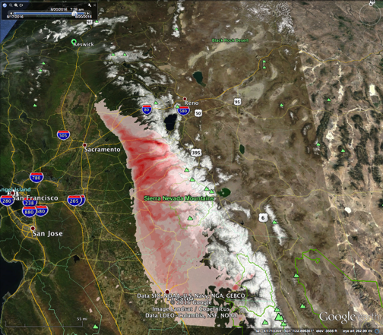
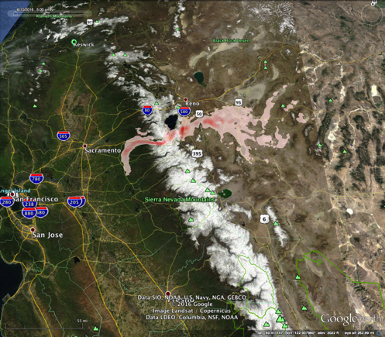
Potential (Modeled) Smoke from WF vs. a Proposed Rx fire in the Caples Creek watershed
(Near Lake Tahoe)
August Wildfire (Aug 20, 2016, 1000 acres/day; 1100 tons PM_{2.5})
Spring Rx (June 9, 2016; 500 acres/day; 350 tons PM_{2.5})
Reno
Reno
Placerville
Lake Tahoe
Lake Tahoe
Fire Origin
Placerville
Fire Origin
*Note that BlueSky is an experimental computer model that tries to predict smoke at the surface—This used here for illustration purposes only.
Smoke concentrations should not be as taken as literal predictions of concentrations at monitors, but as indicators of relative intensity and
probability of having an impact. Areas that are more red are likely to see more smoke, all other things being equal, but look at the
differences between scenarios, not the absolute concentrations.

Slide 15
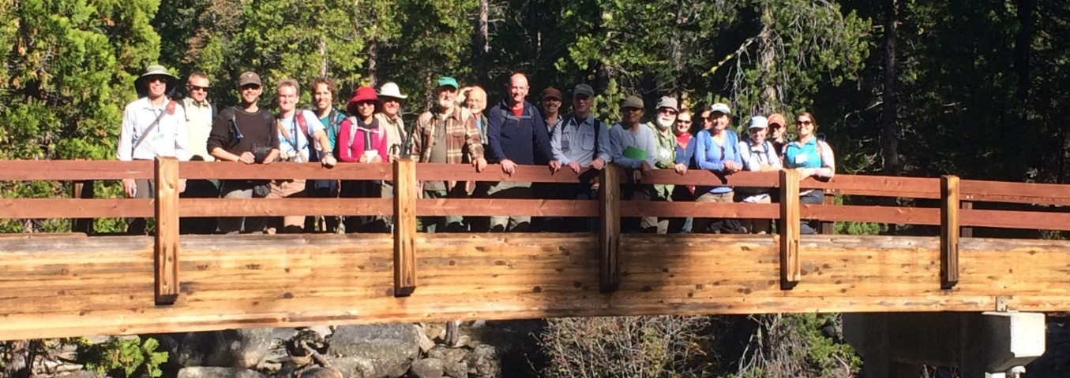
Acknowledgements
Teresa Riesenhuber
Robert Allen
Duane Nelson
Eldorado National Forest
Partnerships
Eldorado Irrigation District
Sierra Forest Legacy
South Fork American River Cohesive Strategy
Sierra Nevada Conservancy
Amador-Calaveras Consensus Group

