Slide 1
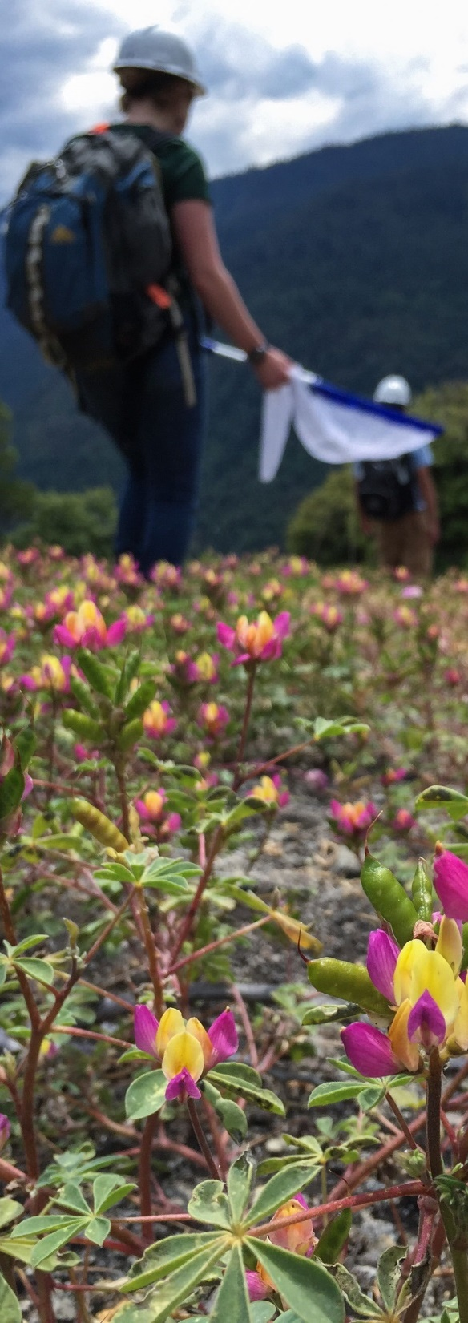
Bumble Bee use of montane chaparral and riparian vegetation after wildfire in the central Sierra Nevada
Helen L. Loffland, Rodney B. Siegel, Julia S. Polasik, Erin Elsey, Chuck Loffland, Gretchen LeBuhn and Morgan W. Tingley
Alma Schrage 2015

Slide 2
OBJECTIVES
Record abundance and diversity of bumble bees in the post-fire landscape.
Describe habitat use patterns.
Describe bumble bee/plant species associations.
Provide guidance for post-fire land management.

Slide 3
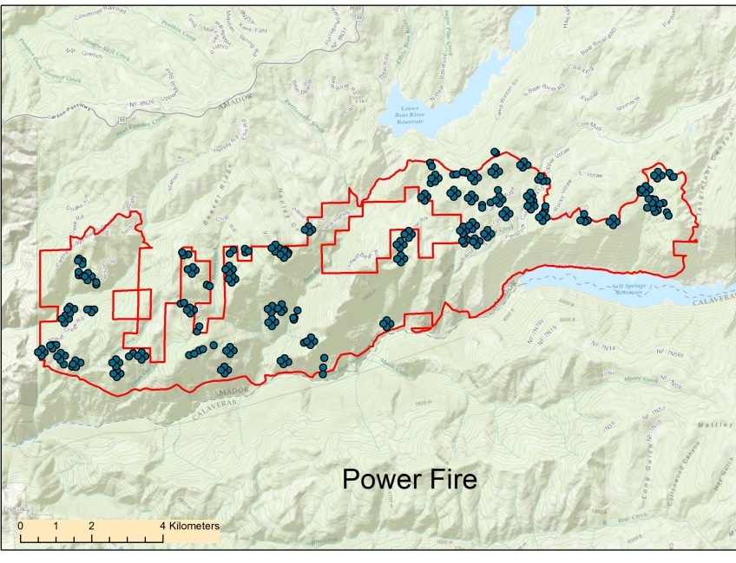
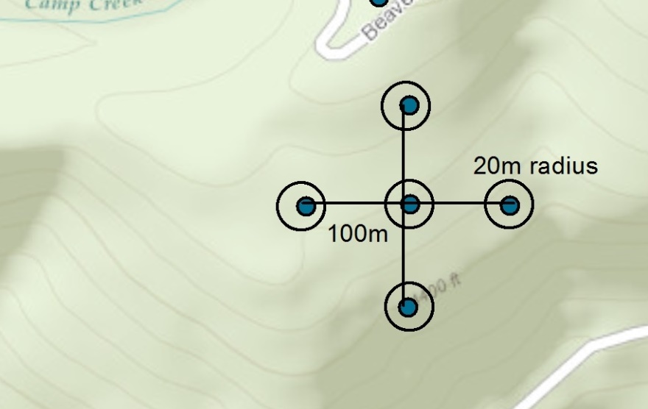
Study Area & Design
Notes:
2 fires 30 km apart burned at the same time 12 years ago.
study design involving 20 m circular radius plots distributed randomly located across fire perimeter, plus approx 10% additional added in riparian zones using stratified random method
Most plots in 5 plot clusters 100m on center– total of 495 plots

Slide 4
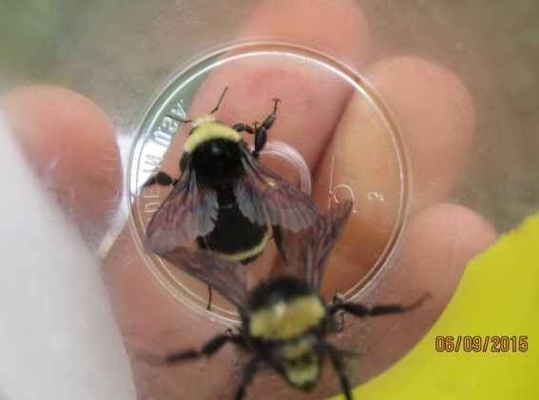
Field Methods
Plots surveyed twice May – August, 2015 & 2016.
16-min active plot search.
Bumble bees captured, cooled, identified, photographed and released.
Recorded plant species on which bumble bees were captured.
Recorded top 5 blooming plant species within plot and estimated bloom density.
Recorded vegetative cover for plot.
Notes:
Plots surveyed twice between May and August in both 2015 and 2106.
16-min active plot search.
Bumble bees captured, placed in a plastic vial, cooled in an icechest,
After the plot search is complete we identified, photographed and released.
Recorded plant species on which bumble bees were captured.
On every visit we recorded top 5 plants with the most abundant blooming infloresences, within plot and estimated bloom density for those plants.
Recorded vegetative cover for plot: by species for shrubs and basic taxonomic groups for trees and herbaceous plants.

Slide 5
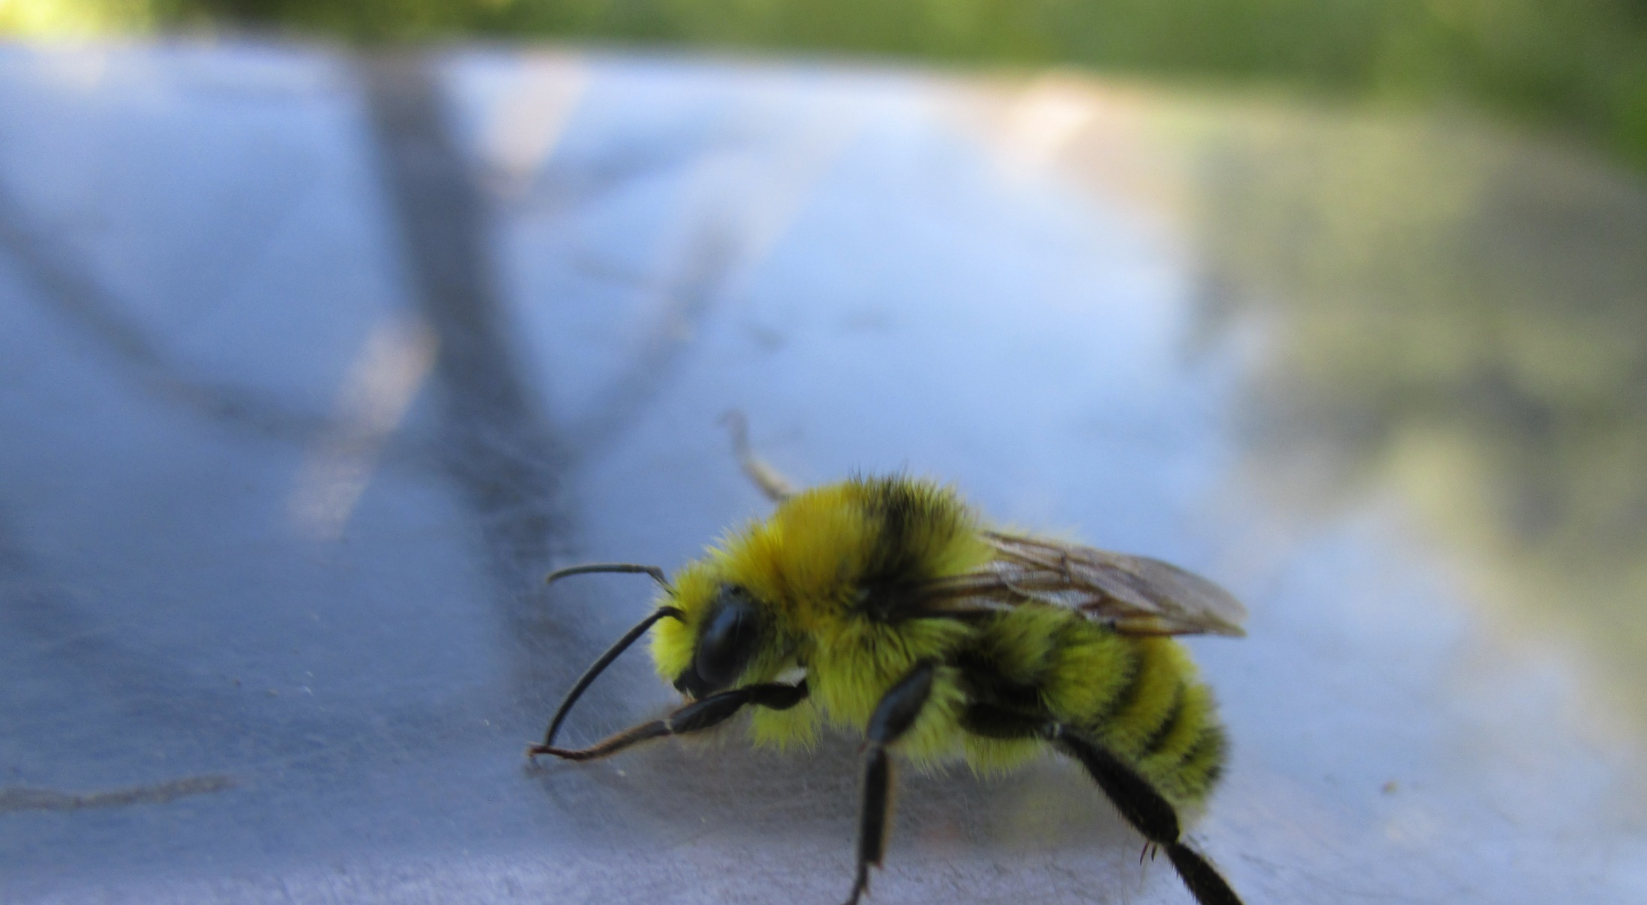
Methods: Bayesian hierarchical modeling of abundance and species richness
$$\log\left(λ_{jk}\right)=γ_{0}+γ_{1}{plottype}_{j}+γ_{2}{jday}_{jk}+γ_{3}{year}_{j}+γ_{4}{elev}_{j}$$
$logit\left(ψ_{i,j}\right)={β0}_{i}+{cluster}_{i,j}+{β1}_{i}{\text{upland}}_{j}+{β2}_{i}{\text{elev}}_{j}+{β3}_{i}{shrub}_{j}+{β4}_{i}{\text{overstory}}_{j}+{β5}_{i}{herb}_{j}+{β6}_{i}{whitethorn}_{j}+{β7}_{i}{bearclover}_{j}$ $+ {β8}_{i}{deerbrush}_{j}$ $+{β9}_{i}{manzanita}_{j}$ $+{β10}_{i}{year}_{j}$
Notes:
We created a Bayesian Hierarchical community model to examine probability of overall species richness and also applied that model to assess the probability of occurrence for each individual species
We used the “cluster” variable to account for possible pseudo replication in our clusters of 5 survey stations, and
We used 10 environmental covariates:
upland (versus riparian),
elevation,
percent cover of shrubs (all species pooled),
total overstory from trees,
all herbaceous plant categories pooled,
We then added species-specific cover for mountain whitethorn and bearclover, deerbrush and green leaf manzanita.
Percent cover of individual shrub species were included as distinct variables because they were by far the most abundant chaparral species in our study area, and anecdotal observations indicated substantial disparity in the presence of foraging bumble bees on these species. In addition management of plantations focuses largely on these shrub species.

Slide 6
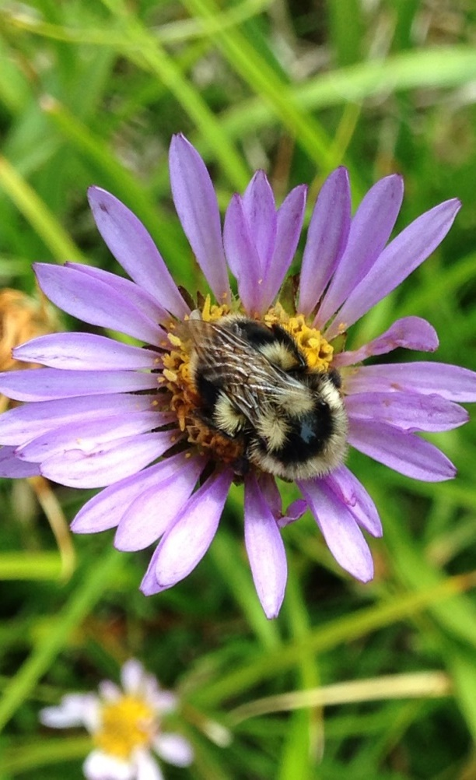
Methods: plant species use versus availability
Chi-squared goodness-of-fit test of the distribution & Bonferroni Z-statistic
H0: bumble bees will forage on plants at rates proportional to their frequency on the landscape
Alma S charge 2015
Notes:
WE then examined whether any plant species we used by bumble bees in greater frequency than expected based on their availability within the landscape
We defined usage as the proportion of all bee captures that occurred on a given plant species
We defined availability as the proportion of times that each plant species was identified as one of the 5 flowering plant species with the most inflorescences blooming in a plot on the day of a survey across all plots and surveys.

Slide 7
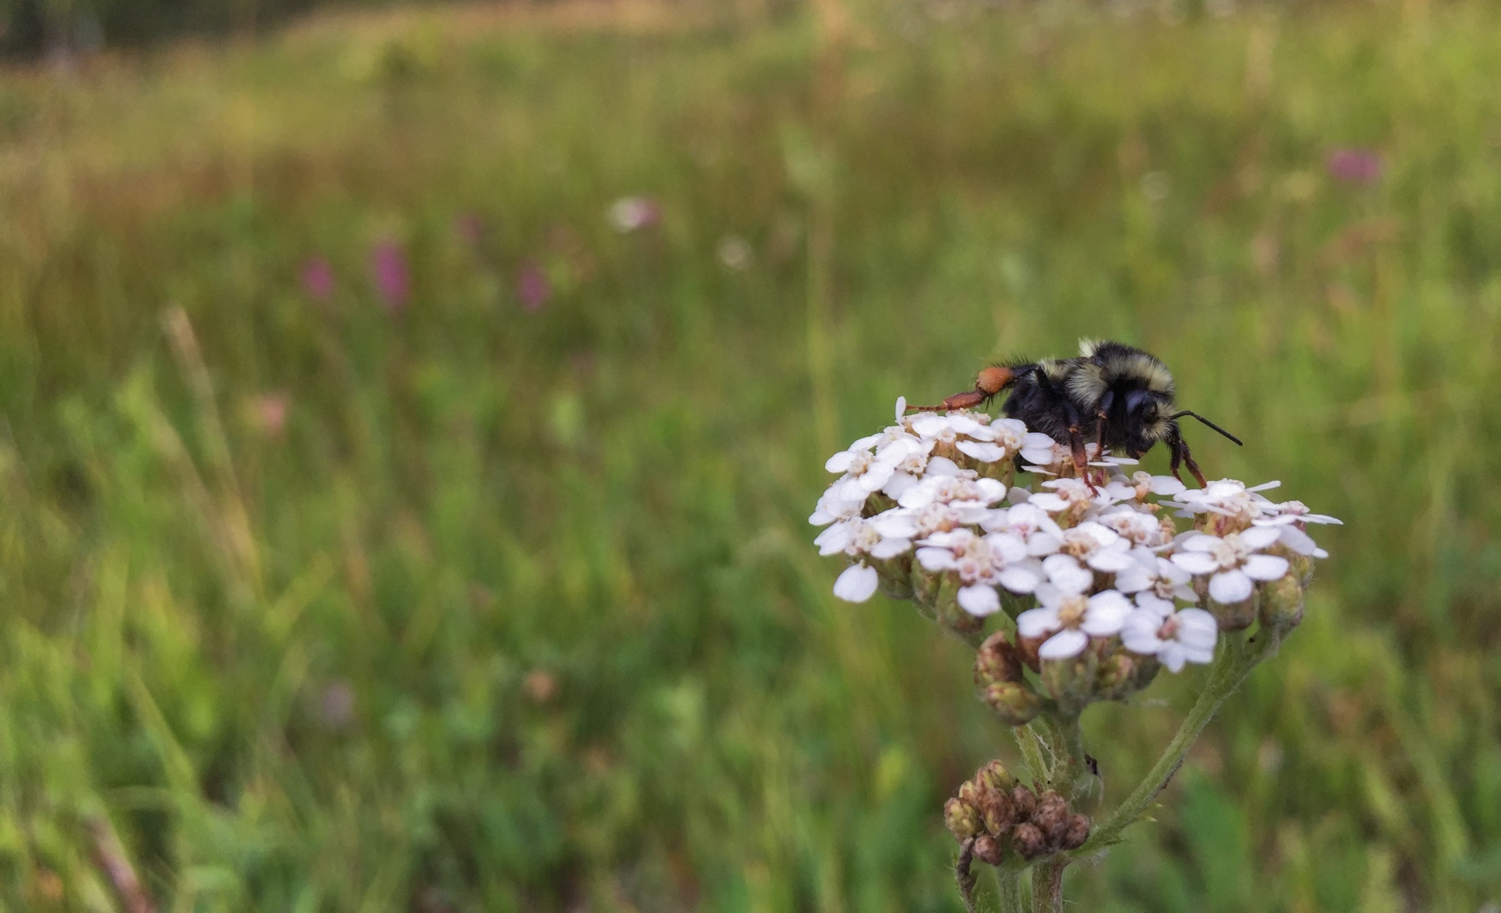
RESULTS
1,952 surveys on 495 plots
413 upland plots
82 riparian plots
Captured 2,494 bumble bees from 12 species
Alma Schrage 2015
Notes:
1,952 surveys on 495 plots
413 upland plots
82 riparian plots
We made the final determination of which plots were riparian vs. upland after reviewing in the field and by assessing presence and cover of water and other riparian obligate plant taxa.
Captured 2,494 bumble bees from 12 species
Twice as many captured in 2016 as in 2016 despite even effort.

Slide 8
Notes:
Of the 2, 494 bees we captured the Vast majority were from 3 species vosnesenskii (69%)and vandykei (12%),, and melanopygus (10%) but a healthy smattering of 9 others. 5 with fewer than 10 individuals and 4 with between 40 and 100 encountered, mixtus, flavifrons, californicus, insularis
including 2 parasitic cuckoo species.

Slide 9
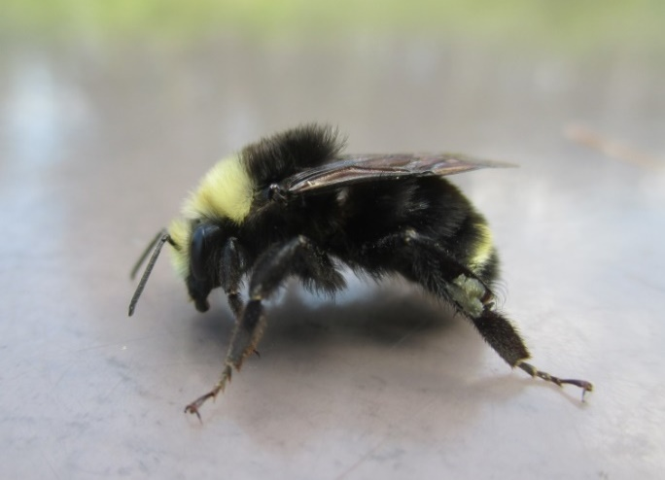
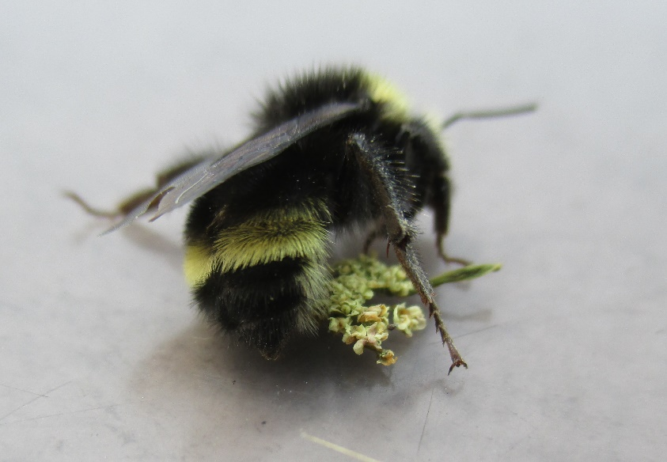
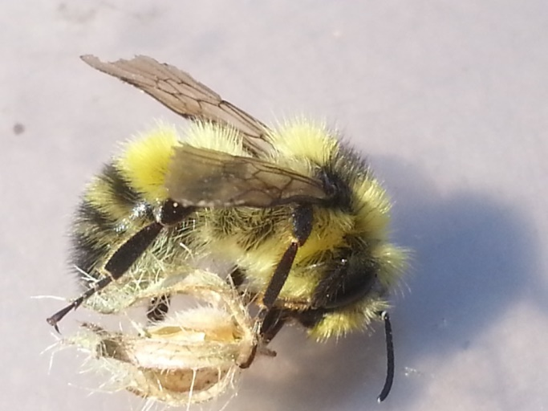
B. vosnesenskii
B. vandykei
B. rufocinctus
B. flavifrons
Notes:
Here are a few examples of the species we captured.
Vosnesenskii and vandykei the 2 most abundant (look very similar – yellow stripe on abdomen on terga 2 versus terga 3).
rufocinctus has orange stripe
Flavifrons stripy yellow and black.
Bumbles are nice study species because unlike other bee taxa, generally can ID to species with a handlens while in the field. By looking at color pattern, cheek length, leg characteristics.

Slide 10
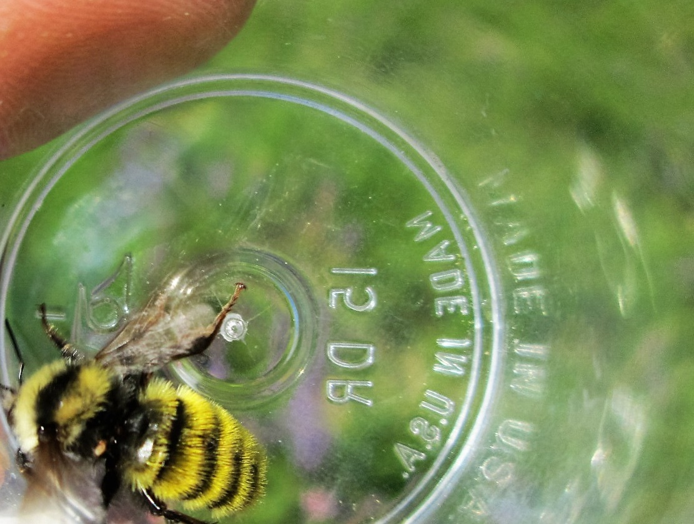
Results: Bumble Bee Abundance
Helen Loffland 2016

Slide 11
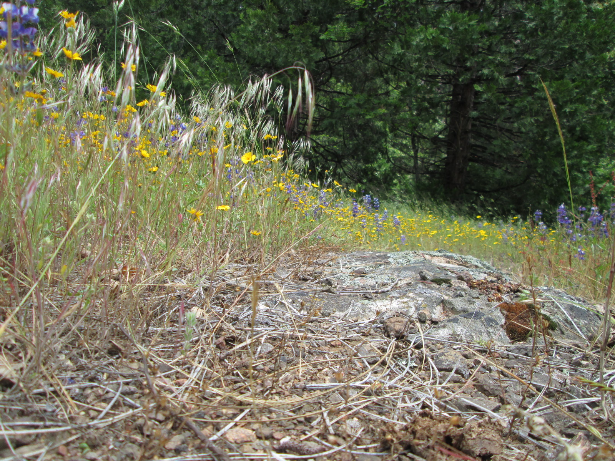
Results: Species Richness Community Model
Notes:
So, here are the results of the hierarchical model for richness. 5 variables highlighted in yellow were important covariates of occupancy
across the entire bumble bee community.
The other variables that were strongly predictive variables for species richness were elevation with richness increasing up the mountain, and total herbaceous cover. Also of interest was the strongly negative relationship with Greenleaf manzanita. Although we observed many foraging incidents on bearclover, the relationship was only weakly positive.

Slide 12
Results: species models
Notes:
Here are some figures displaying these relationships.
Liklihood of occupancy increased with elevation for 6 species (but not for the most common)
Modeling of occurrence for each species found that riparian sites significantly associated with occupancy for 5 species (black lines), but not our most common vos and vandkyei,
But for our most common species, bear clover was strongly predictive for Vos occupancy

Slide 13
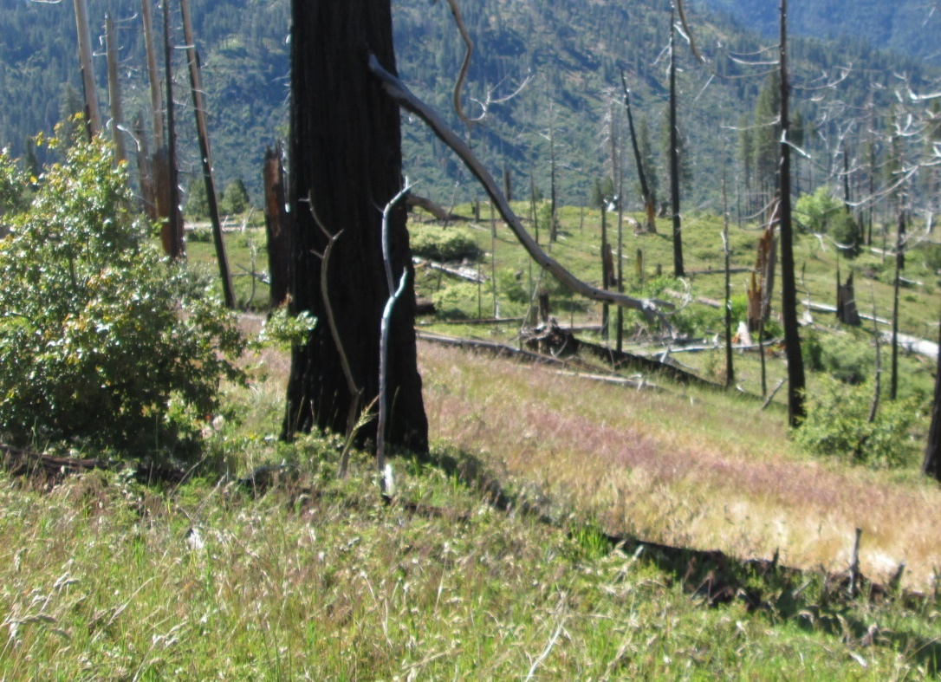
Results: species models
Helen Loffland 2016

Slide 14
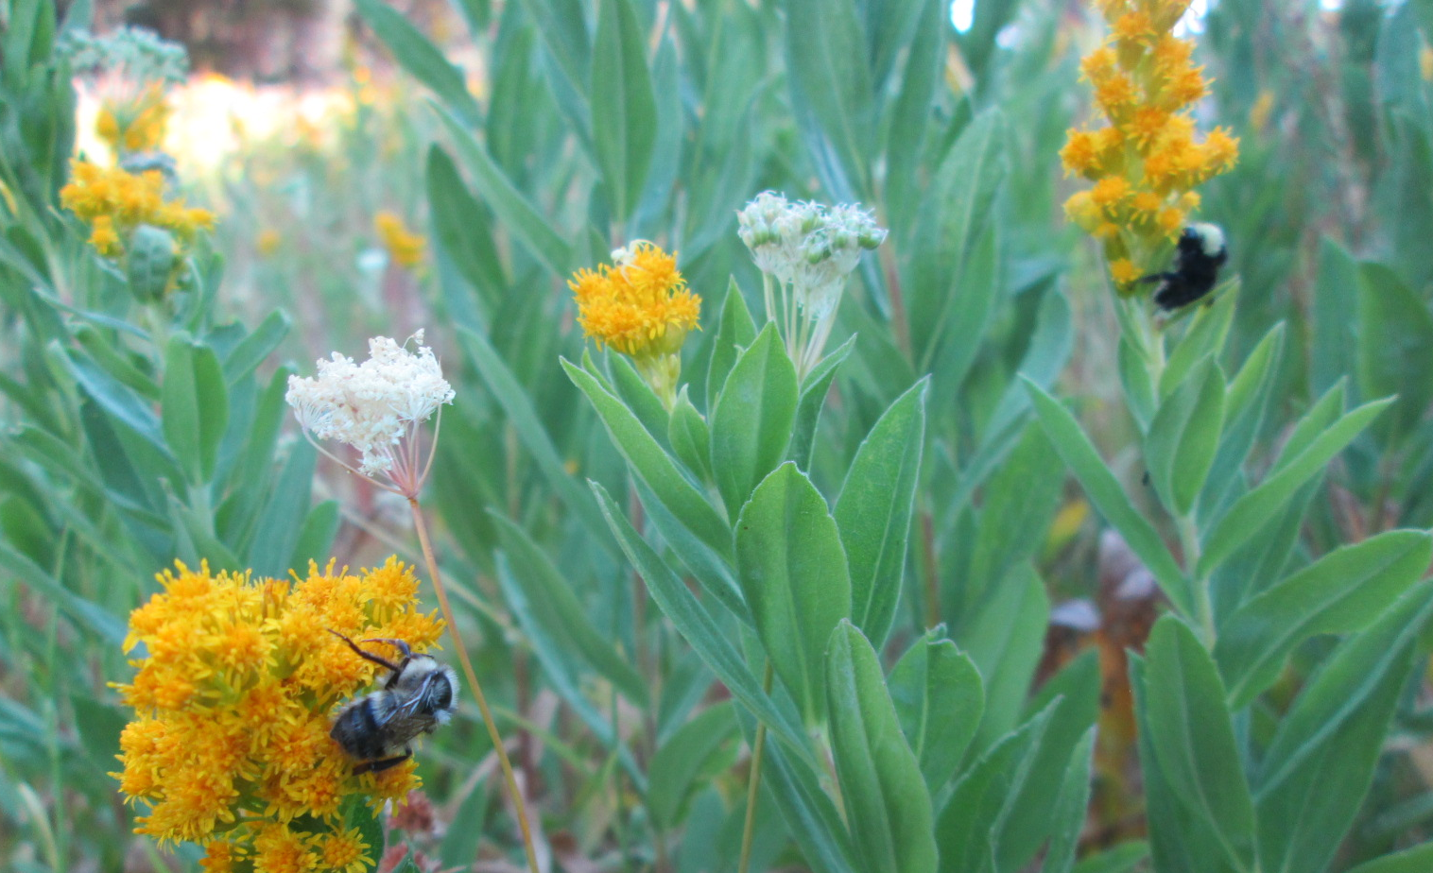
Results: species models
Helen Loffland 2016
Notes:
3 most common species predicted by lower canopy closure (but less common species not)
7 species strongly predicted by total herbaceous cover

Slide 15
Results: Floral Resources
Common Name | Scientific Name | # Bumble Bees
Phacelia complex | Phacelia hastata, P. heterophylla, P. egena | 445
Bearclover | Chamaebatia foliolosa | 390
Bull Thistle | Cirsium vulgare | 182
Stickseed complex | Hackelia nervosa, H. velutina | 151
Sneezeweed | Helenium bigelovii | 99
Parish's Yampah | Perideridia parishii | 85
Brewer's Monardella | Monardella breweri | 74
Swamp Onion | Allium validum | 66
Canada Goldenrod | Solidago canadensis | 58
Pennyroyal | Monardella odoratissima | 52
Helen Loffland 2016
Notes:
Okay, now for results on how these bees used foraging resources.
109 plant species or species complexes were documented being used by foraging bumbles. These top 10 had more than 50 foraging incidents. Most commonly used is a complex of 3 forb in phacelia genus with 445 uses, followed by bearclover at 390, and non-native plant bull thistle with 182 detections of use.

Slide 16
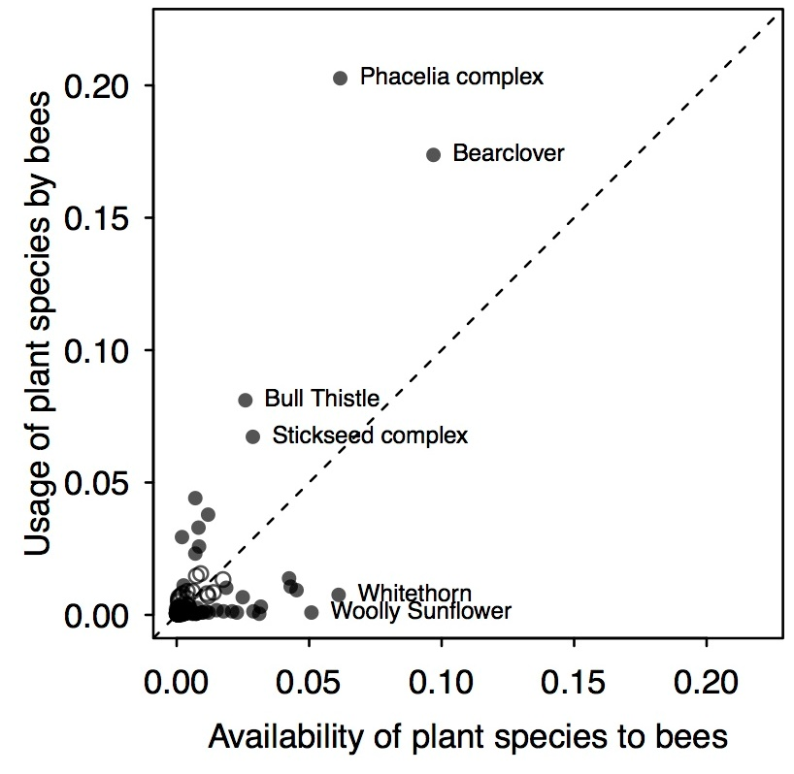
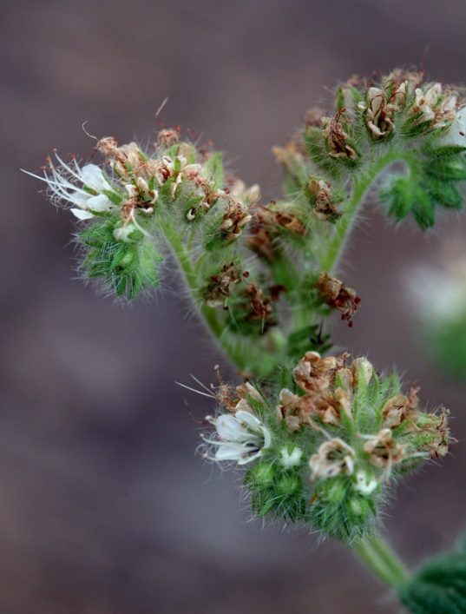
Results: use vs. availability
Bearclover
Steve Matson 2016
Deerbrush
Whitethorn
Keir Morse 2009
Notes:
We had interesting results when we compared use vs availability in foraging. Plant Species shown Above the dotted line means it is used more often than expected based on plant availability alone. These are plants that bumble bees seek it out and prefer it over more abundant blooms available at the same time.
WE found Bumble bees foraged on 11 plant species significantly more than expected based on their availability, and foraged on 36 species of plants significantly less than expected based on their availability across plots
First, three phacelia species that intergrade were the complex that was most frequently used but also the most preferred for foraging given its availability.
If we look at the chaparral shrub species, we see that bear clover is in fact used more than expected based on availability). What is really interesting here is the relative use of this shrub when compared with deer brush and whitethorn, both very abundant and blooming during the same time. These two ceanoths are used significantly less than expected based on their availability.

Slide 17
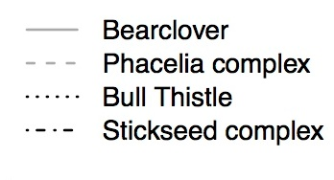
Timing of plant use
Notes:
These results triggered more questions about the 4 most frequently used (and significantly preferred) forage plants. We looked at timing of use and found that Bearclover provides important forage during may and june. As bearclover blooms fade, phacelia and stickseed begin to bloom. Then stickseed fades and bull thistle increases to join phacelia. These types of patterns of foraging and bloom period suggest that management can not focus on single plant species but rather needs to provide foraging opportunities throughout the spring/summer/fall. Bearclover may be valuable because it blooms before many forbs emerge and bloom. Likewise, uninterrupted stands of bearclover may not provide forage during mid/late summer without patches of herbaceous vegetation intermixed.

Slide 18
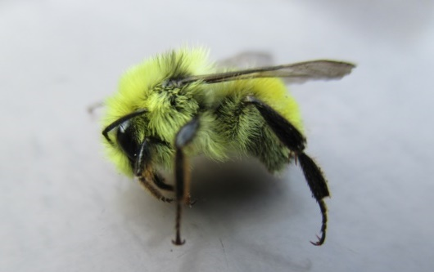
Discussion
Although riparian areas have greater species diversity, upland areas also provide important foraging resources.
Within upland areas, Bearclover is selected for foraging over other chaparral shrub species.
Greater cover from herbaceous plants results in greater abundance and diversity of bumble bees.
A mosaic of many plant species provide diverse foraging resources across time and space.
Notes:
Although Riparian Areas result in somewhat greater species diversity, upland areas also provide some of the most highly preferred and abundant foraging resources.
Within upland areas, Bearclover is selected for foraging over other chaparral shrub species.
Greater cover from herbaceous plants results in greater abundance and diversity of bumble bees. Phacelia was highly preferred foraging taxa.
A mosaic of bear clover and a variety of herbaceous vegetation with diversity in bloom periods may provide the greatest availability of foraging resources.

Slide 19
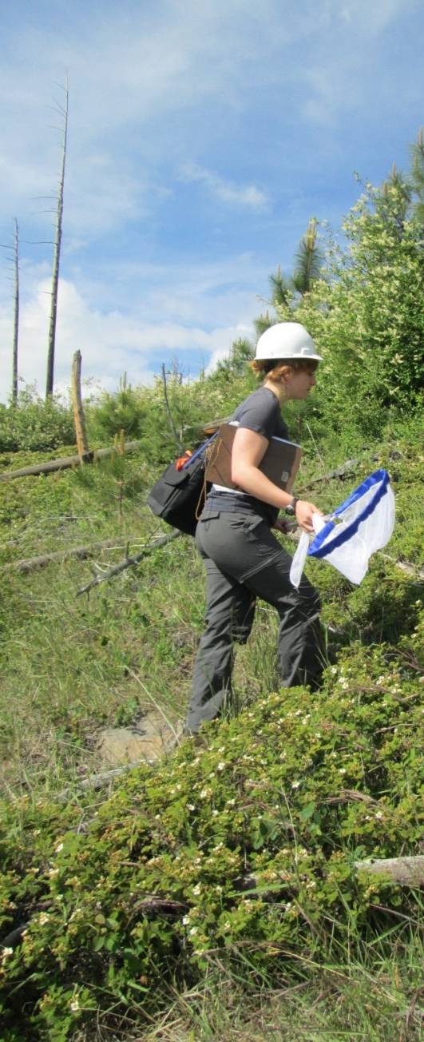
Management Recommendations
Post-fire reforestation:
Maintain areas of shrub and herbaceous vegetation.
Use targeted herbicide applications to avoid treatment of non-target shrubs and forbs.
Postpone mechanical treatment or herbicide applications until after Bearclover bloom period.
Notes:
Post-fire plantations:
Retain patches of Bearclover where possible.
If bearclover is to be removed in plantations, Postpone mechanical treatment or herbicide applications until after Bearclover bloom period.
Use only targeted herbicide applications to avoid treatment of non-target shrubs and forbs, especially Silverleaf Phacelia

Slide 20
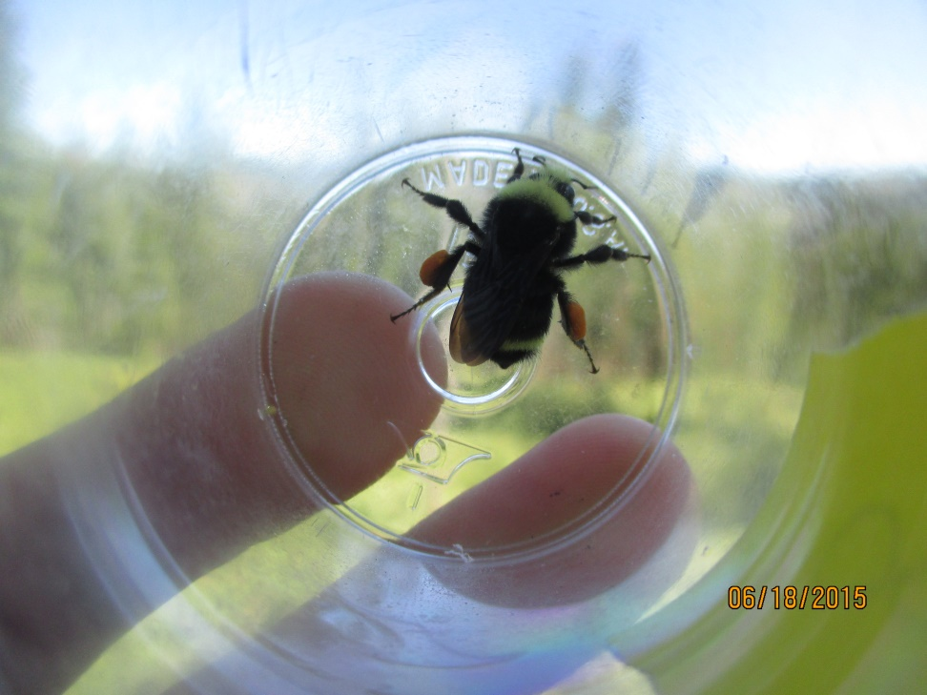
Acknowledgements
Eldorado National Forest
UCD museum of entomology
Robbin Thorpe
Madeline Finley
Sean Lewis
Stacy Kempher
Zach Smith
Micheal Finnell
Katie Burns
Keleigh Diestch
Brendan Tinsley

