Slide 1
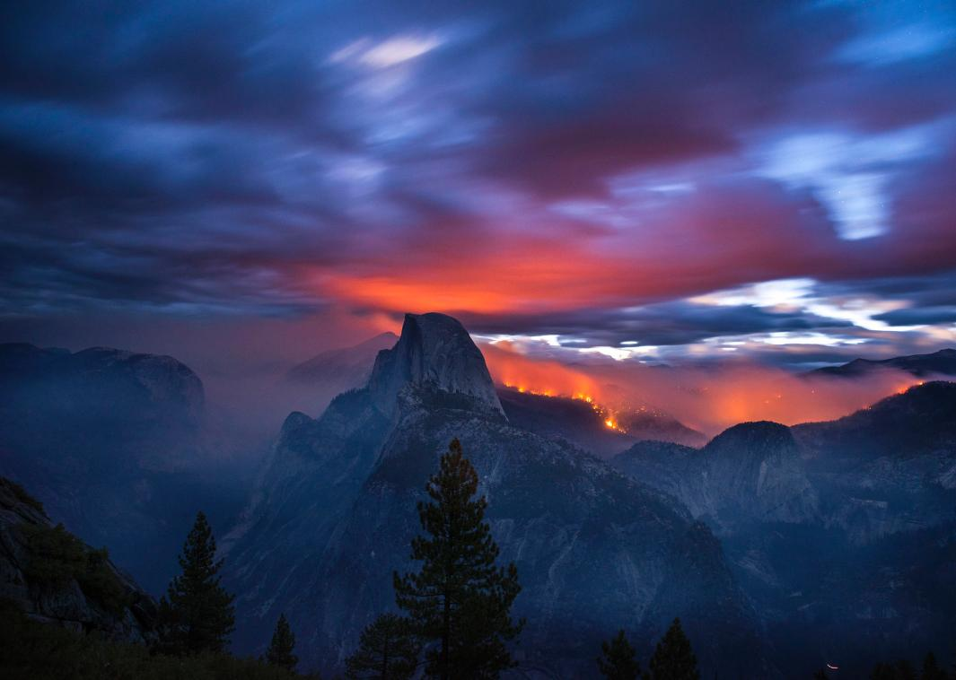
Planning and Implementation of Prescribed Burns in the Power Fire
Malcolm North, Max Odland, Jamie Lydersen, and Brian Smithers
Special thanks: Jesse Plummer and Paul Leusch, Eldorado NF

Slide 2
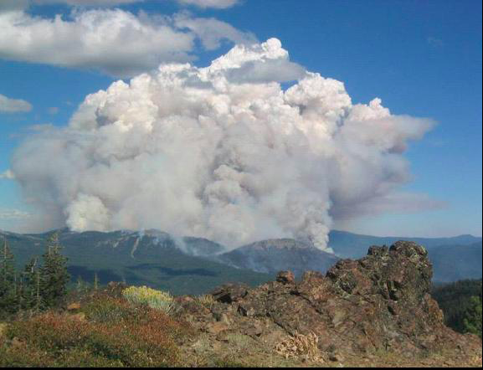
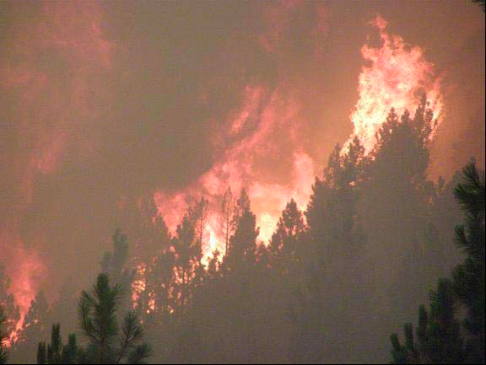
Consequences of Fire Suppression
Suppression only postpones: fuel loads increase and escaped ignitions occur during extreme weather
Since the start of effective suppression in the 1920s, in the contiguous U.S., 16 of the 20 largest wildfires have occurred in just the last 14 years
If fire is inevitable the choice is between beneficial fire mostly on your terms vs. triaging ‘Act of God’ events

Slide 3
Current Pace and Scale on National Forests
Historical Rate of Fire | 487,486 acres/year
Current Rates of Treatment* (1998-2008) | 36,854
Mechanical treatment | 28,598
Prescribed fire | 8,256
→ Current treatment is 7.6% of historical rate
Annual Deficit = 450,000 acres/year
Wildfire, not forest management, is by far the largest change agent in the Sierra Nevada
North, M.P., B.M. Collins, and S.L. Stephens. 2012. Using fire to increase the scale, benefits and future maintenance of fuels treatments. Journal of Forestry 110: 392-401.
Notes:
NPS treats a similar percentage 17% (11,279 ac compared to historic of 65,084 ac) but uses managed fire and has only 15% of acres burning at high severity (within Yosemite National Park)
Miller et al. 2012. Differences in wildfires among ecoregions and land management agencies in the Sierra Nevada region, California, USA. Ecosphere 3: article 80.

Slide 4
The Fire “Debt” or Backlog is Much Greater
At current rates, 66% of NF Lands will never get treated

Slide 5
Current Pace and Scale of Western Sierra Nevada Wildfire
During 1990-2009, wildfire burned on average about 100,000 ac/yr
2010-Present: on track for 200,000+ac/yr
Current rate is 4X greater than 1950s
Average fire size has more than doubled
% high severity has also doubled

Slide 6
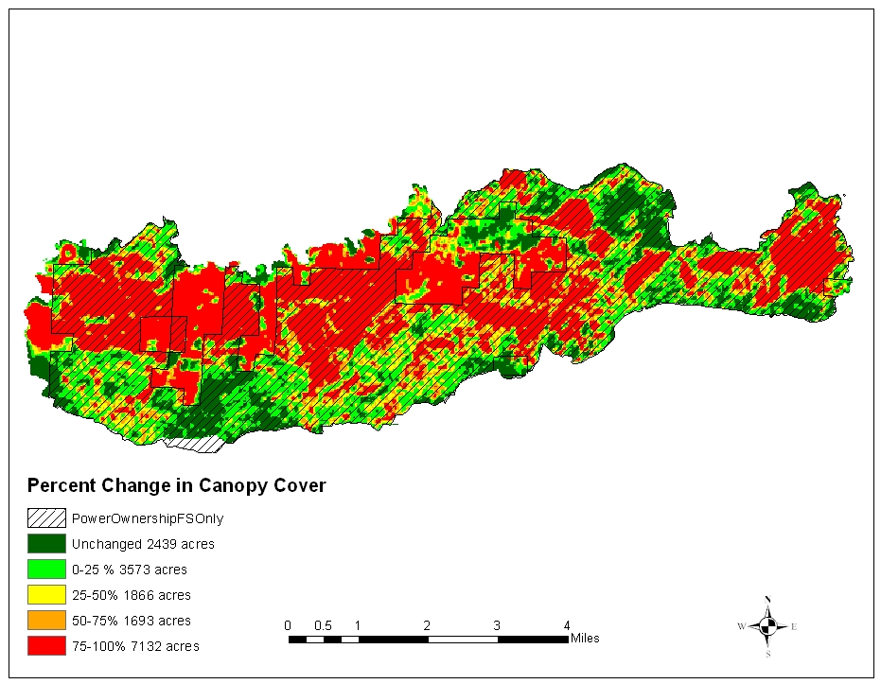
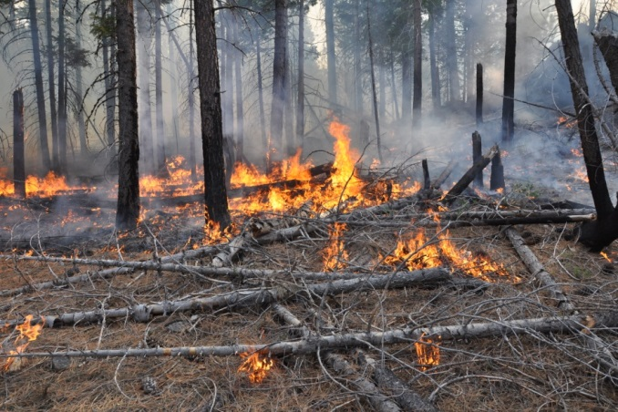
Power Fire
Approximately 50% of Power Fire burned at high severity. While much greater then historical levels (about 5-15%), 50% of footprint is unchanged, low and moderate severity.
Figure 6 from Estes, B. and S. Gross. 2015. “Power Fire Ecological Framework”

Slide 7
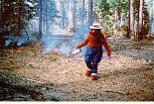
landscape recommendations:
Prescribed Fire
Develop a fire strategy which details key locations for managing future fires and facilitating prescribed fire.
In areas, that weren’t salvaged, prescribed fire might be a good tool in areas that are too steep to consider mechanical treatments. If these areas burned at high severity, prescribed fire may begin to reintroduce some heterogeneous conditions.
In fire-prone areas, favor rapid development of fire-resistant stand structures insuring reforestation strategies allow for rapid reintroduction of fire into the burned landscape at various scales.
Areas that burned at low & moderate fire severity should be excluded from post-fire treatment (i.e. thinning & revegetation) & maintained through a robust prescribed fire treatment program to maintain the beneficial effects from the fire.
Estes and Gross. 2015.
Figure 13. Ecological framework for the Power fire area with proposed treatment units in the current decision that were not identified as previously treated.

Slide 8
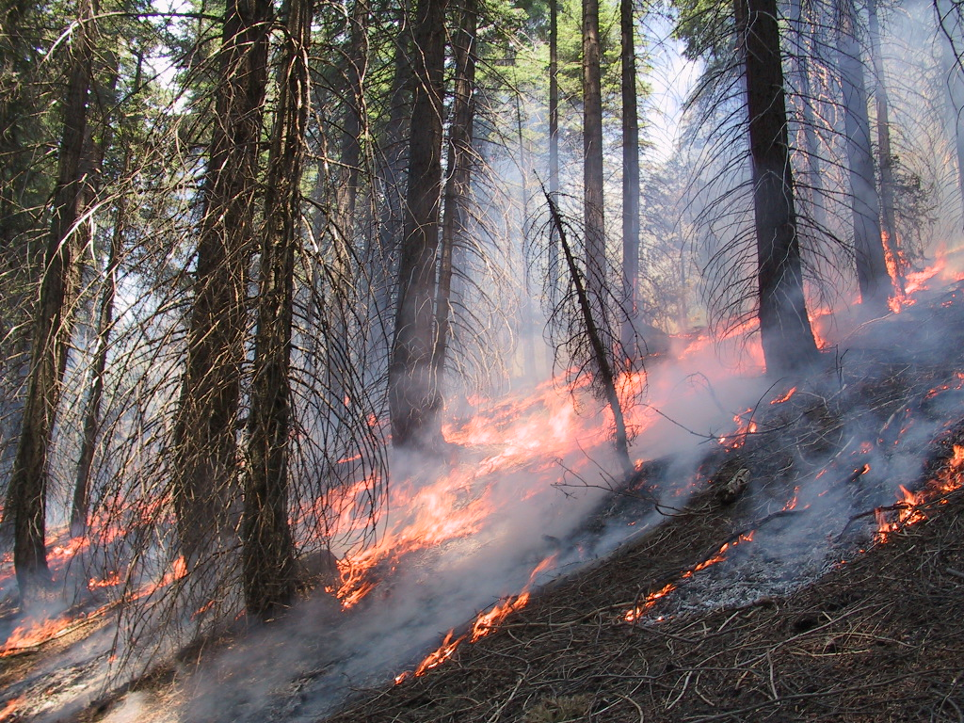
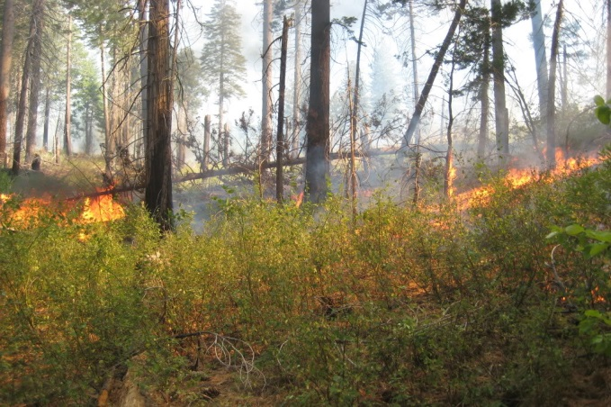
Rx Fire Ecological Objectives:
If possible, high-severity patches are <150 ac and average 2-10 ac in size.
Variable overstory mortality with higher levels and larger patches on steeper slopes and ridge tops.
Reduce surface and ladder fuels such that wildfire would not crown under <95% weather conditions
Increase understory plant richness, evenness and cover
Burn sufficiently patchy such that 10-20% of tree regeneration survives

Slide 9
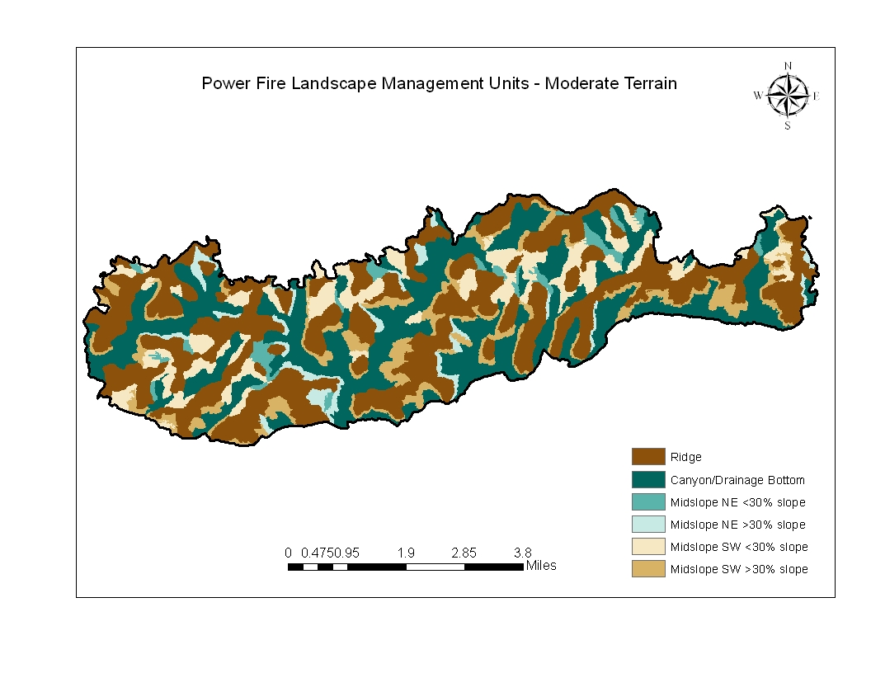
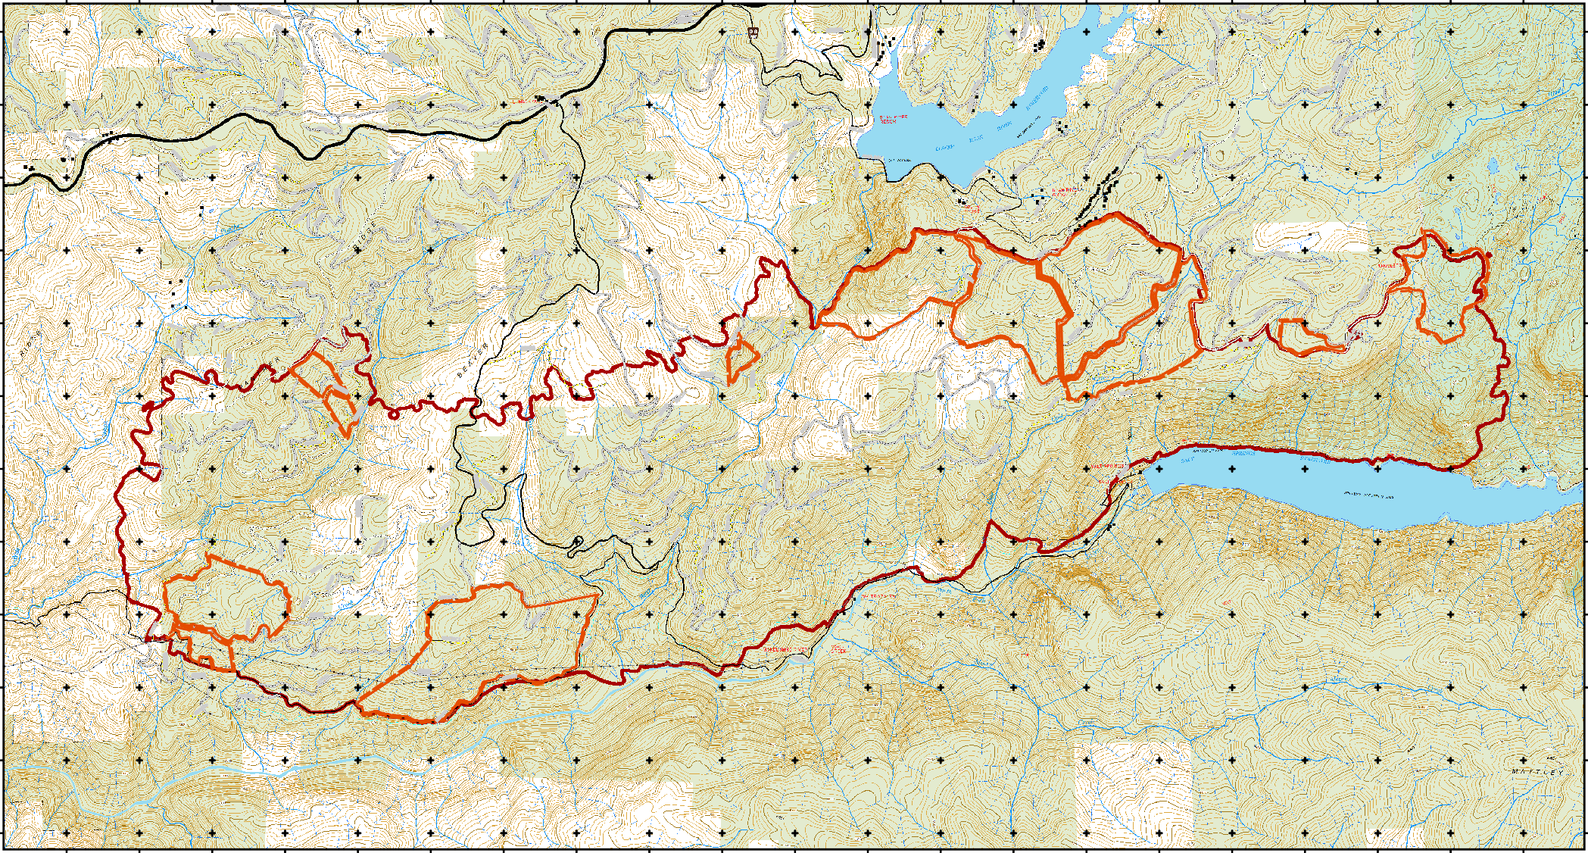
Rx Burn Units and Acreage
Units 4 and 6 are the first objectives (no frog issues)
Units 10 and 11 may be next
Unit 8
588 ac
Unit 11
291 ac
Unit 6
445 ac
Unit 3
68 & 32 ac
Unit 10
65 ac
Unit 7
484 ac
Unit 9
396 ac
Unit 5
39 ac
Unit 1
354 ac
Unit 4
835 ac
Unit 2
78 ac

Slide 10
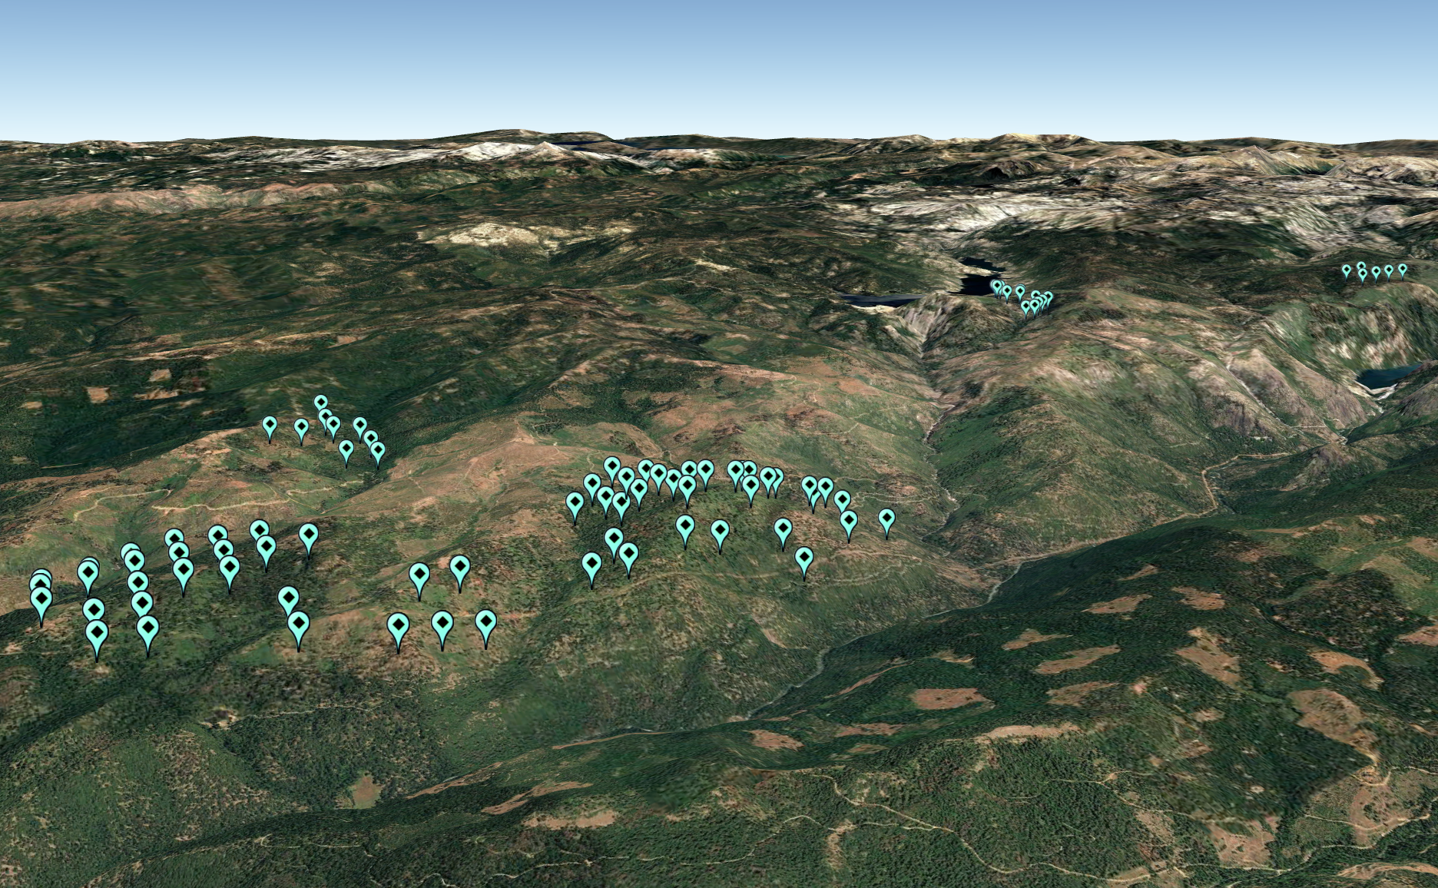
Plot Locations

Slide 11
Tree Basal Area and Stem Density by Plot Elevation
Avg. BA
Avg. Stem Density
= 92 Stems/acre

Slide 12
Tree Regeneration Density by Plot Elevation
Avg Total Regen 154 stems/ac

Slide 13
Fuel Loads by Size Class and Plot Elevation
Avg Total Fuel 27 tons/ac

Slide 14
Understory Plant Richness and Shrub Cover by Plot Elevation
Note: Generally inverse relation between shrub cover and understory richness

Slide 15
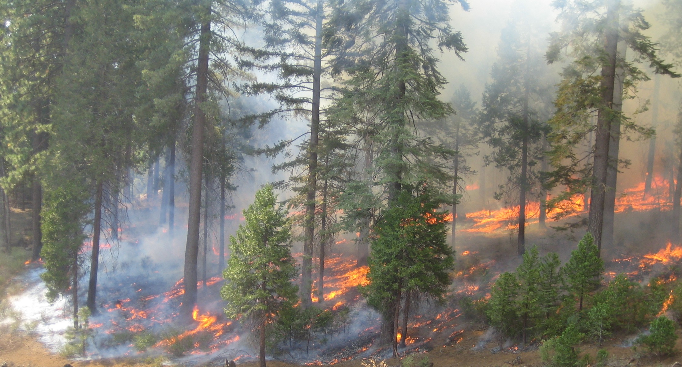
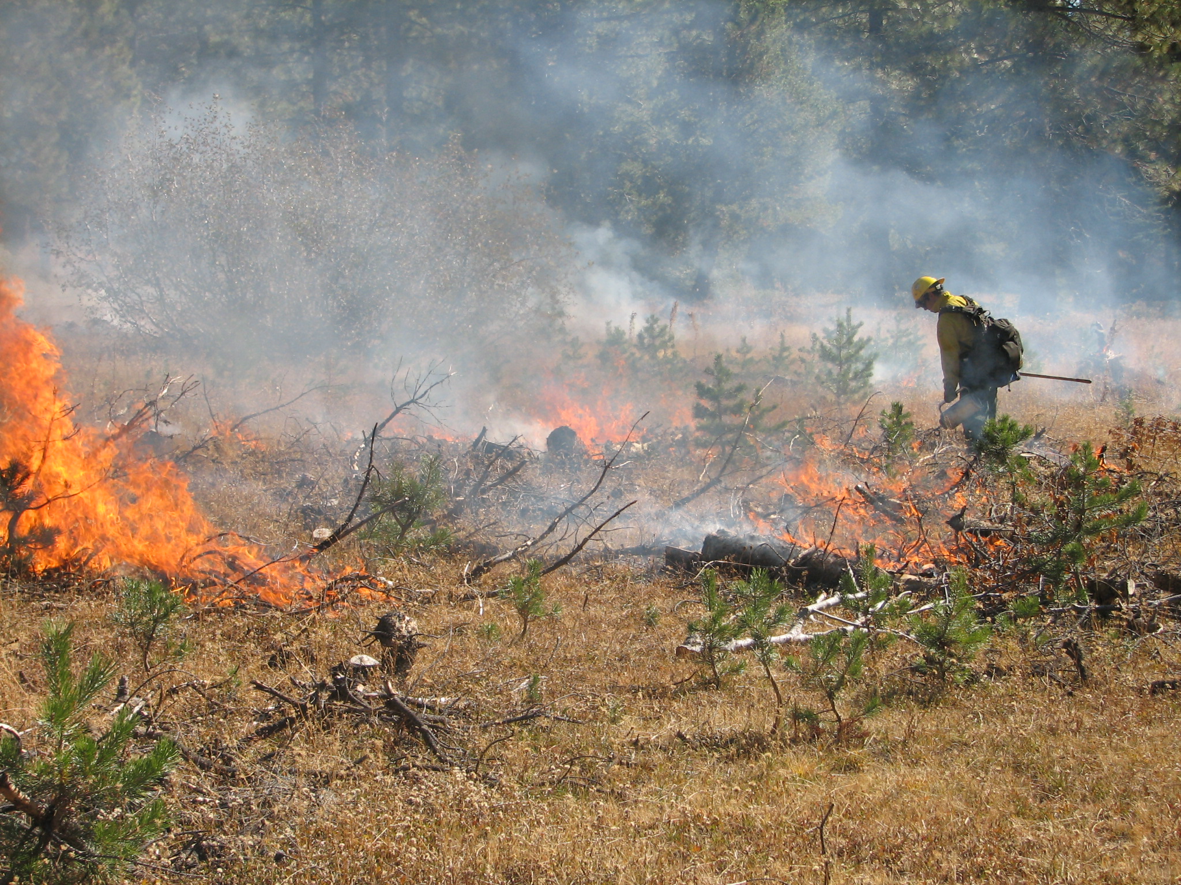
Summary:
Treating wildfire low to moderate severity burn areas with prescribed fire has tremendous potential for accelerating the pace and scale of treatments.
2nd entry fire, however, often burns through highly variable fuel loads (snags, logs, shrubs, etc.) and different physiographic conditions with a range of severities
How does 2nd entry fire behavior 1) vary with different soils, topography and stand conditions? 2) increase resilience and habitat diversity? and 3) what site factors and fire conditions will foresters need to manage for optimal outcomes?

