Slide 1
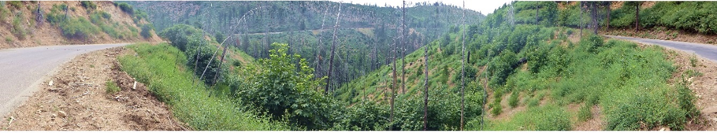

Power Fire GRAIP Watershed Road Assessment
Amador Calaveras Consensus Group
October 8, 2017
Tom Black, Natalie Cabrera, Richard Cissel, Charlie Luce, Erik Smith and Nathan Nelson
Notes:
Forest roads are the primary source of management related fine sediment delivery to streams in many forested landscapes. To understand the road related risks in the area of the Power Fire, we conducted a road inventory and modeling project using the GRAIP model.

Slide 2
Project Goals
Monitor the hydro-geomorphic impacts of roads in and around the Power Fire area in 2014
Provide support for the prioritization of road restoration
Document road erosion rates and sediment delivery processes
Notes:
The goals of the project are
to document and monitor the sources of erosion and sediment from the roads.
to prioritize the sediment delivery sources to maximize the effectiveness of road restoration work.
And to learn about the rates of the different processes that cause the sediment delivery

Slide 3
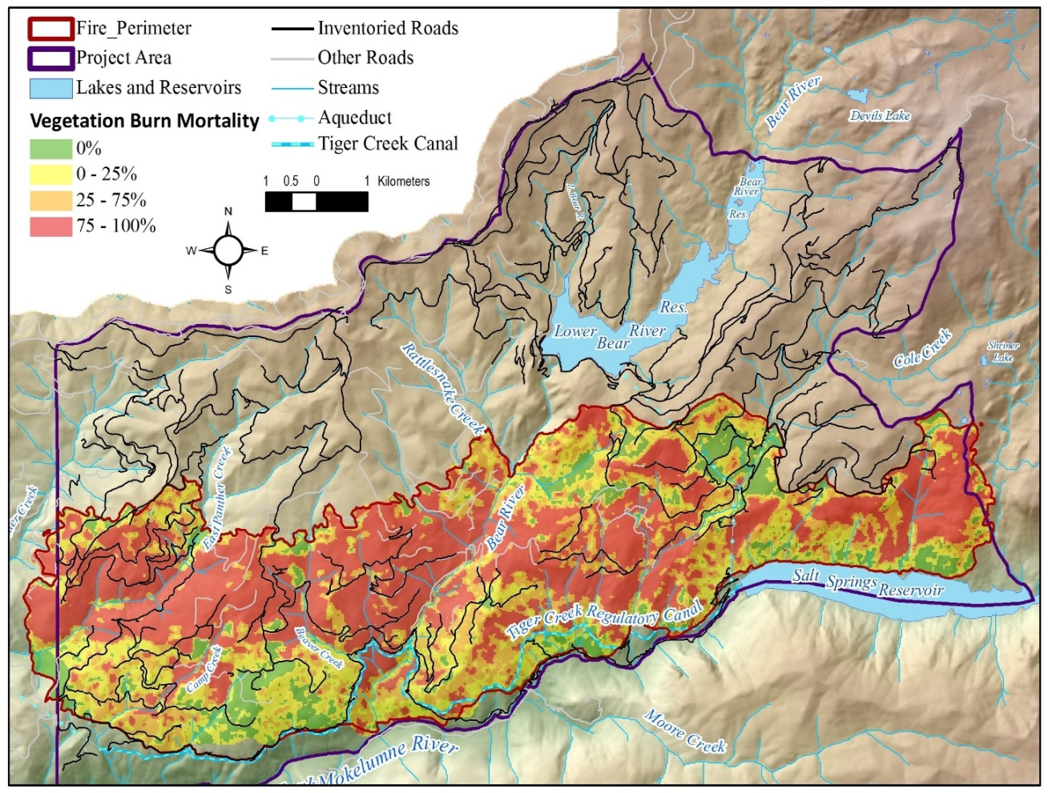
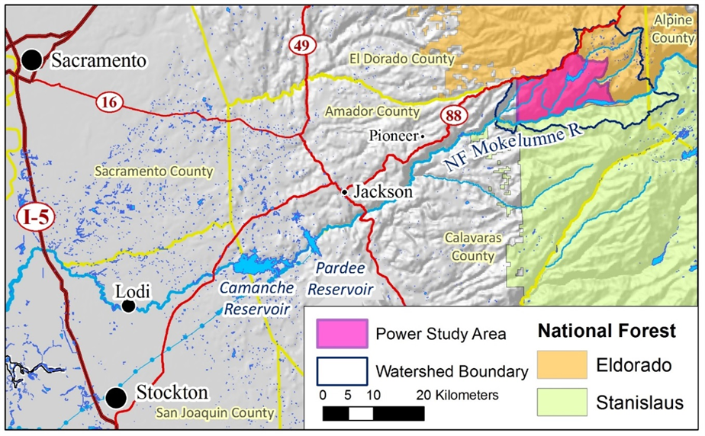
Power Fire GRAIP Watershed Roads Assessment
The Power Fire burned over 17,000 acers in Oct 2004
The project area encompasses 160 km² (62 mi², 39,540 acres) in the North Fork Mokelumne River
Affecting 16.2 miles of perennial streams, and 21.9 miles of seasonal streams
Notes:
the Power fire burned about 17,000 acers in 2004 near the headwaters of the Mokelumne. The burned area included 16 miles of perennial stream and 22 miles of non-perennial stream. In 2014 and 2015 we inventoried 209 miles of road in the watershed and 4657 drainage locations.

Slide 4
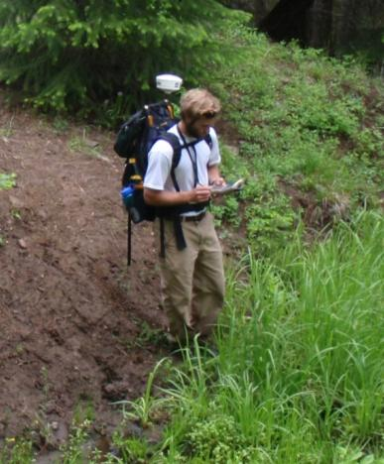
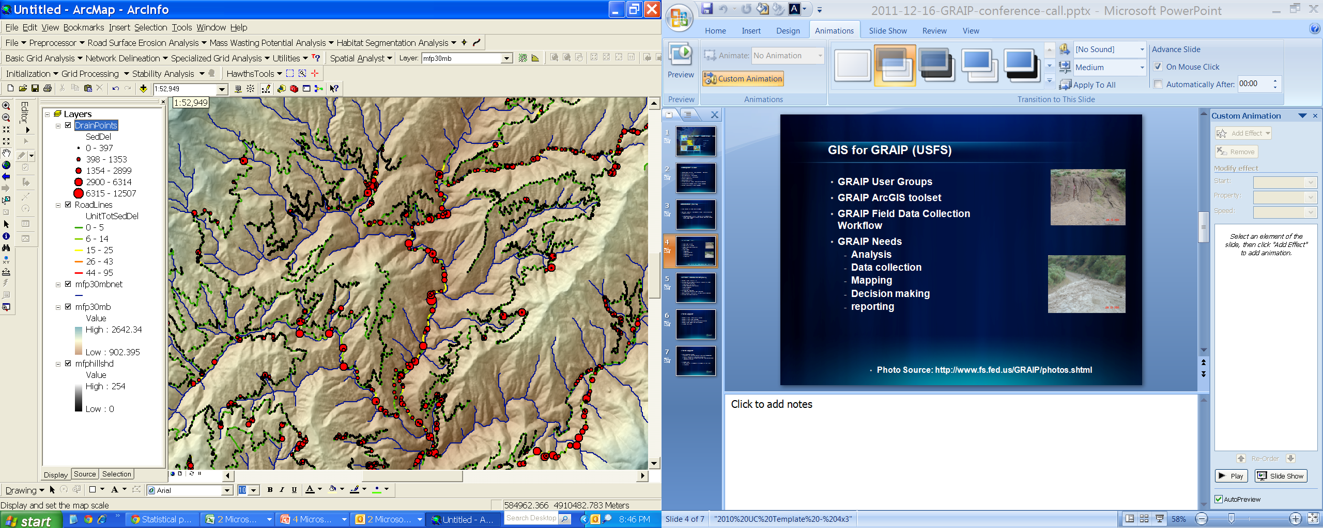
GRAIP Road Inventory and Model
Geomorphic Roads Analysis and Inventory Package
  A detailed road inventory procedure
  A set of GIS tools to analyze road-related risks
Quantifies Road Related:
  Sediment production and delivery to streams
  Hydrologic connectivity
  Landslides
  Gullies
  Stream crossing failure risks
  Infrastructure condition
WWW.FS.FED.US/GRAIP
Notes:
To carry out the work we used GRAIP, which is the Geomorphic Roads Analysis and Inventory Package.
Sediment production and delivery to streams
Hydrologic connectivity
Landslides
Gullies
Stream crossing failure risks
Infrastructure condition

Slide 5

GRAIP Road Sediment Inventory
E= B x L x S x V x R
E Sediment production (Kg/yr.)
B Erosion base rate
L Flow path length
S Flow path slope
V Vegetation factor
R Road surface factor
Road Segment
Drain Point
Notes:
A crew collects a detailed road inventory including the length and slope of the road, surfacing and vegetation cover to drive the surface erosion model shown here. They walk down below the drainage location to see if the road sediment drains to a stream.
based on Luce and Black 1999.

Slide 6
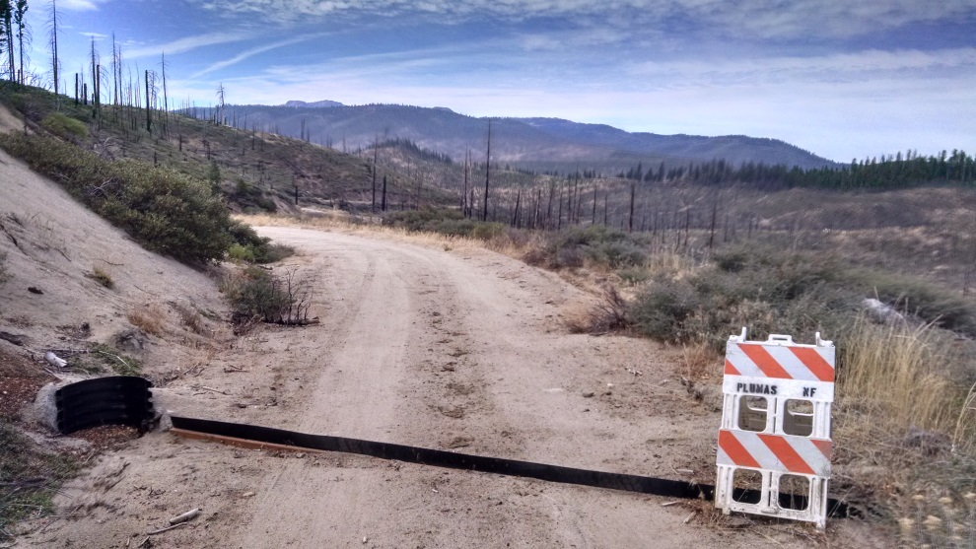
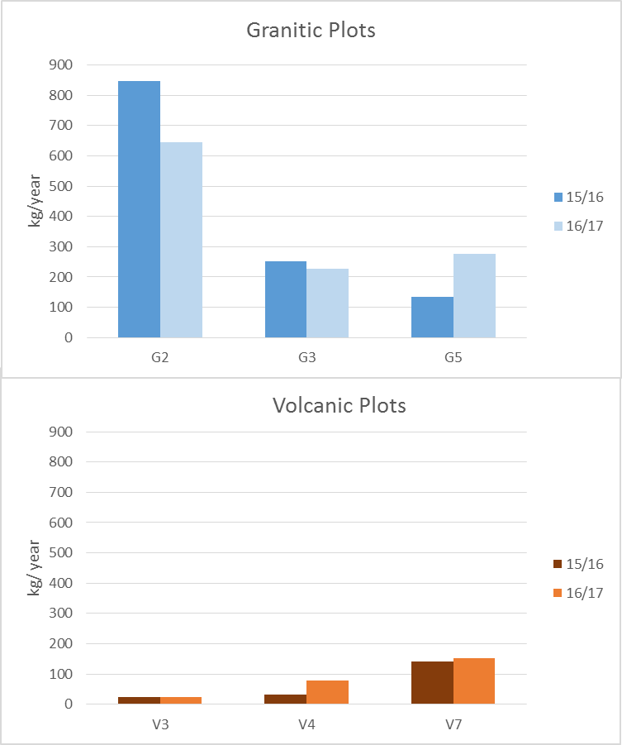
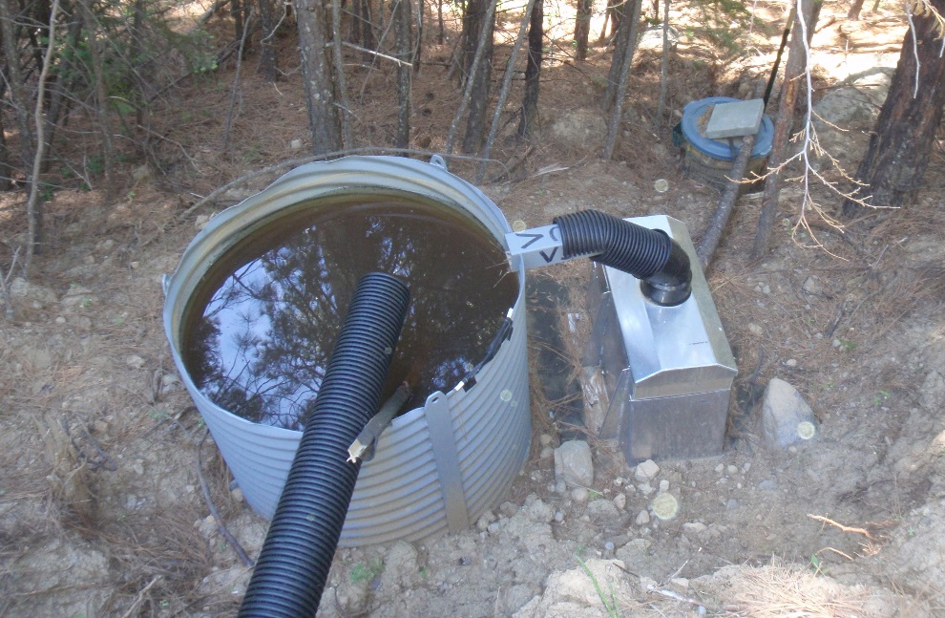
Road Sediment Plots
Notes:
Six sediment plots were installed in 2015, 3 on volcanic soils and 3 on granitic soils to establish the base road rates for the model. Granite sites produced more than 5 times as much as the volcanic sites. Plots are 80 meters long and capture all of the runoff and sediment from the road in a settling tank with a tipping bucket and a splitter sending the split fraction to a second tank.

Slide 7
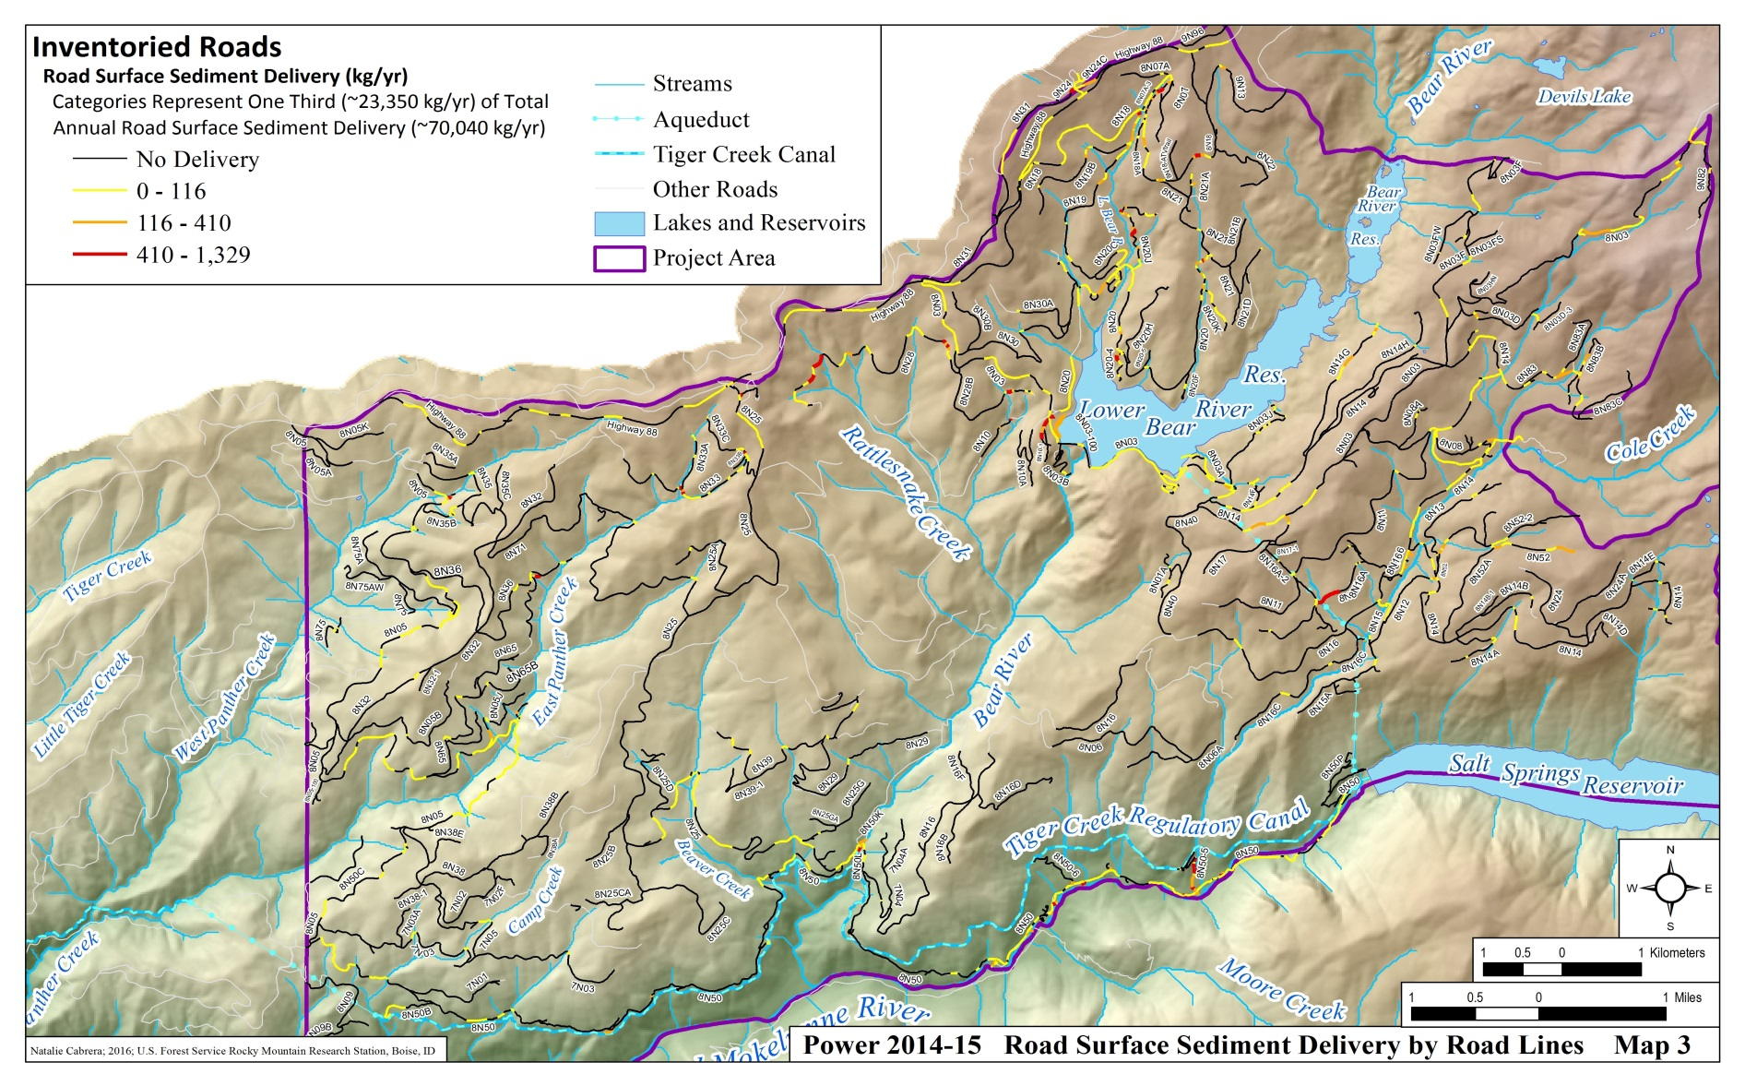

Power Fire GRAIP Watershed Roads Assessment
The GRAIP model was used to predict risk and impacts from
337 km (209 mi) of roads surveyed
Road to stream hydrologic connectivity (16%)
60% of roads connected within
50 ft. of stream
Notes:
The inventory determined that overall 16% of road length were hydrologically connected to the stream network. If the road was within 15 m (50 ft.) of a stream channel, 60% (5.9 km, 3.7 mi) were hydrologically connected.

Slide 8
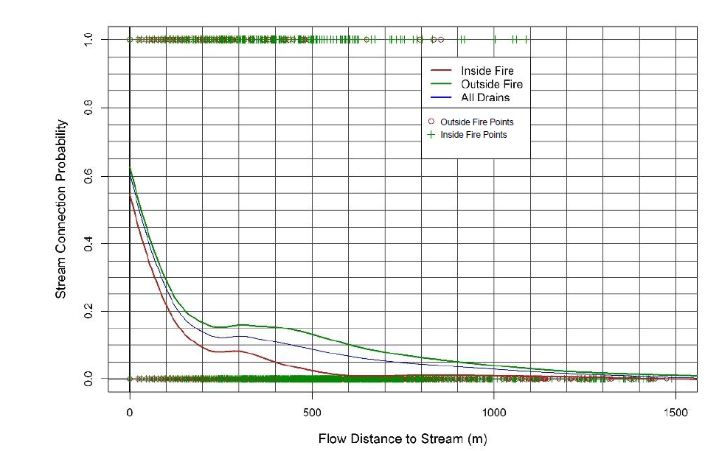
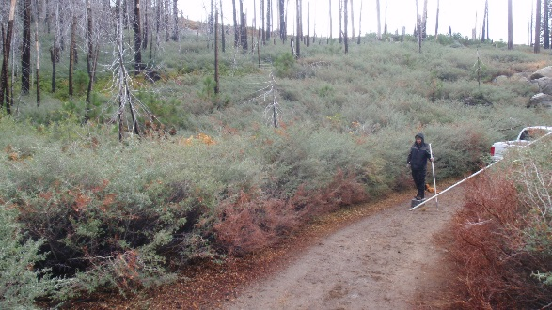
Road to Stream Connection Inside vs. Outside the Fire
Power Fire GRAIP Watershed Roads Assessment
Stream
Connected
Drain points inside the fire were slightly less connected to the stream in 2014 than those outside the fire.
Not Stream
Connected
Notes:
We considered how connected the roads and streams were inside and out side the fire in 2014. For the 1,743 points inside the perimeter and 2,914 outside the fire we looked at the downhill distance to a stream and if the point was observed to be stream connected. We used a local fit method to calculate the probability of connection at each distance. Counterintuitively at most distances the drains in the fire area were slightly less connected to the stream, possibly because of the greater understory vegetation on the burned slopes

Slide 9
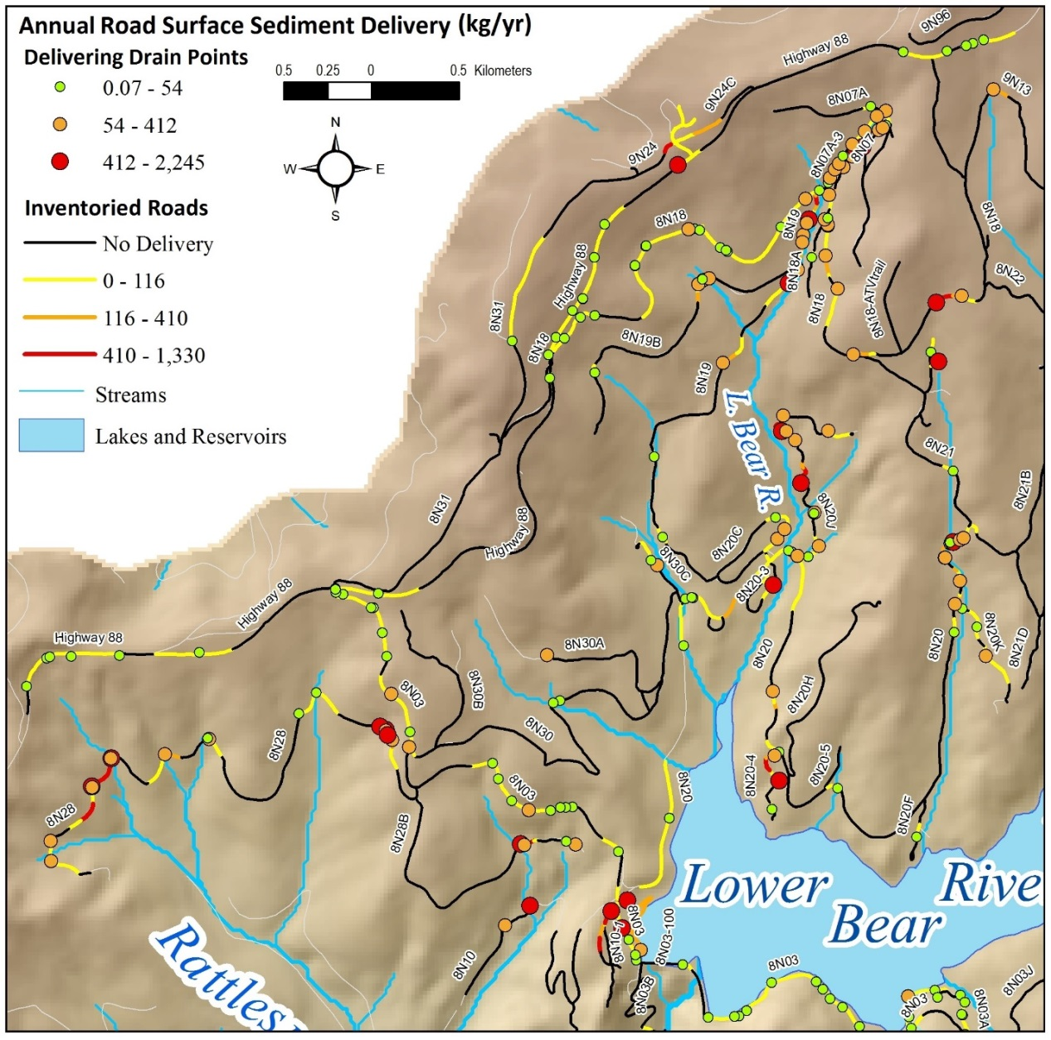
Power Fire GRAIP Watershed Roads Assessment
The GRAIP model was used to predict risk and impacts from
337 km (209 mi) of roads surveyed
Road to stream hydrologic connectivity (16%)
Sediment production and delivery to streams
Notes:
The model predicts sediment production and delivery for each road segment and drainage location. Road surface sed delivery is shown here by the colored road lines and drain point delivery is shown by the colored circles.

Slide 10
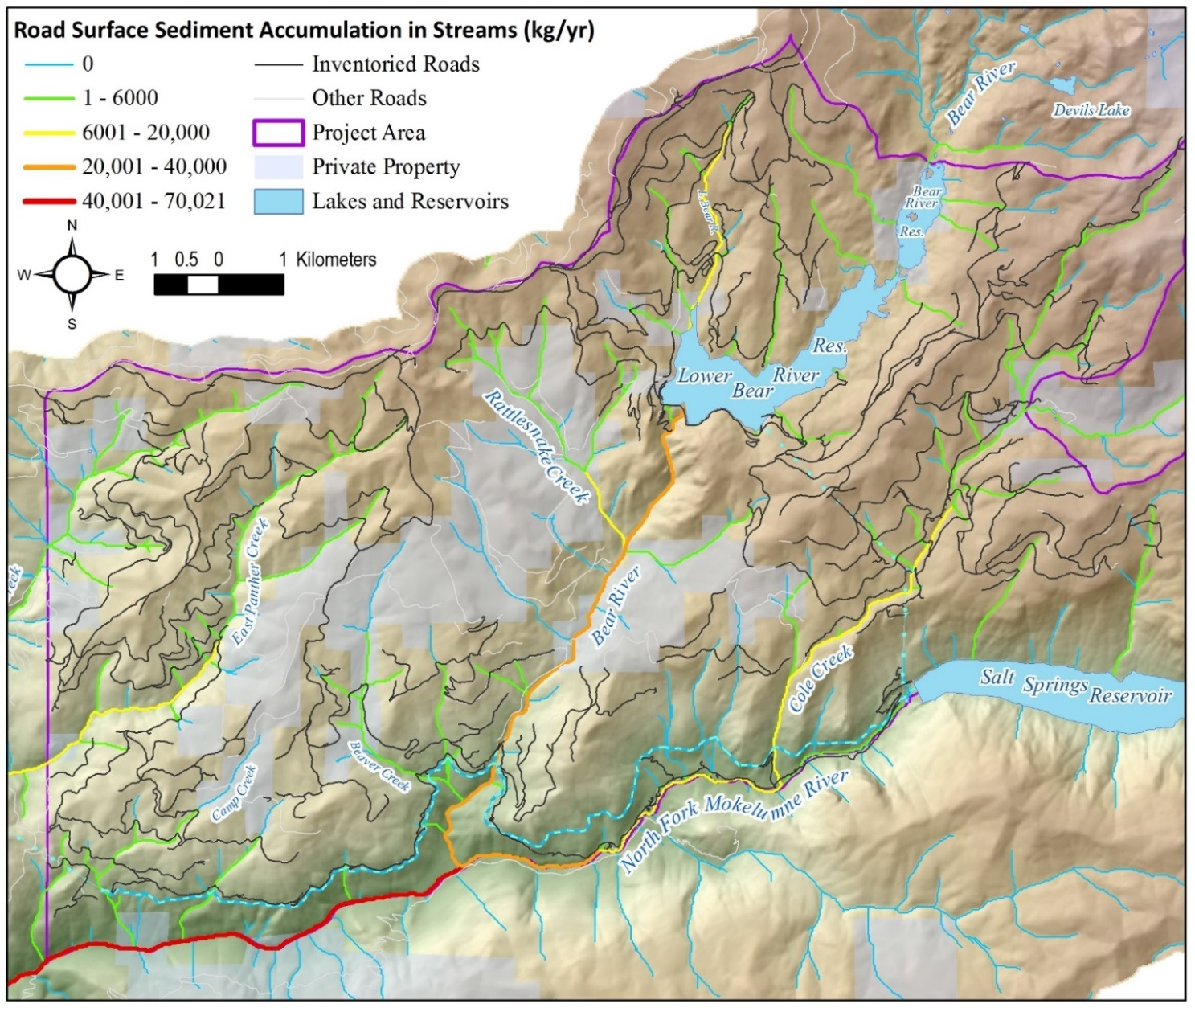
Power Fire GRAIP Watershed Roads Assessment
The GRAIP model was used to predict risk and impacts from
337 km (209 mi) of roads surveyed
Road to stream hydrologic connectivity
Sediment production and delivery to streams
Downstream sediment accumulation
Notes:
Road sediment is accumulated in the downstream direction through the channel network.

Slide 11
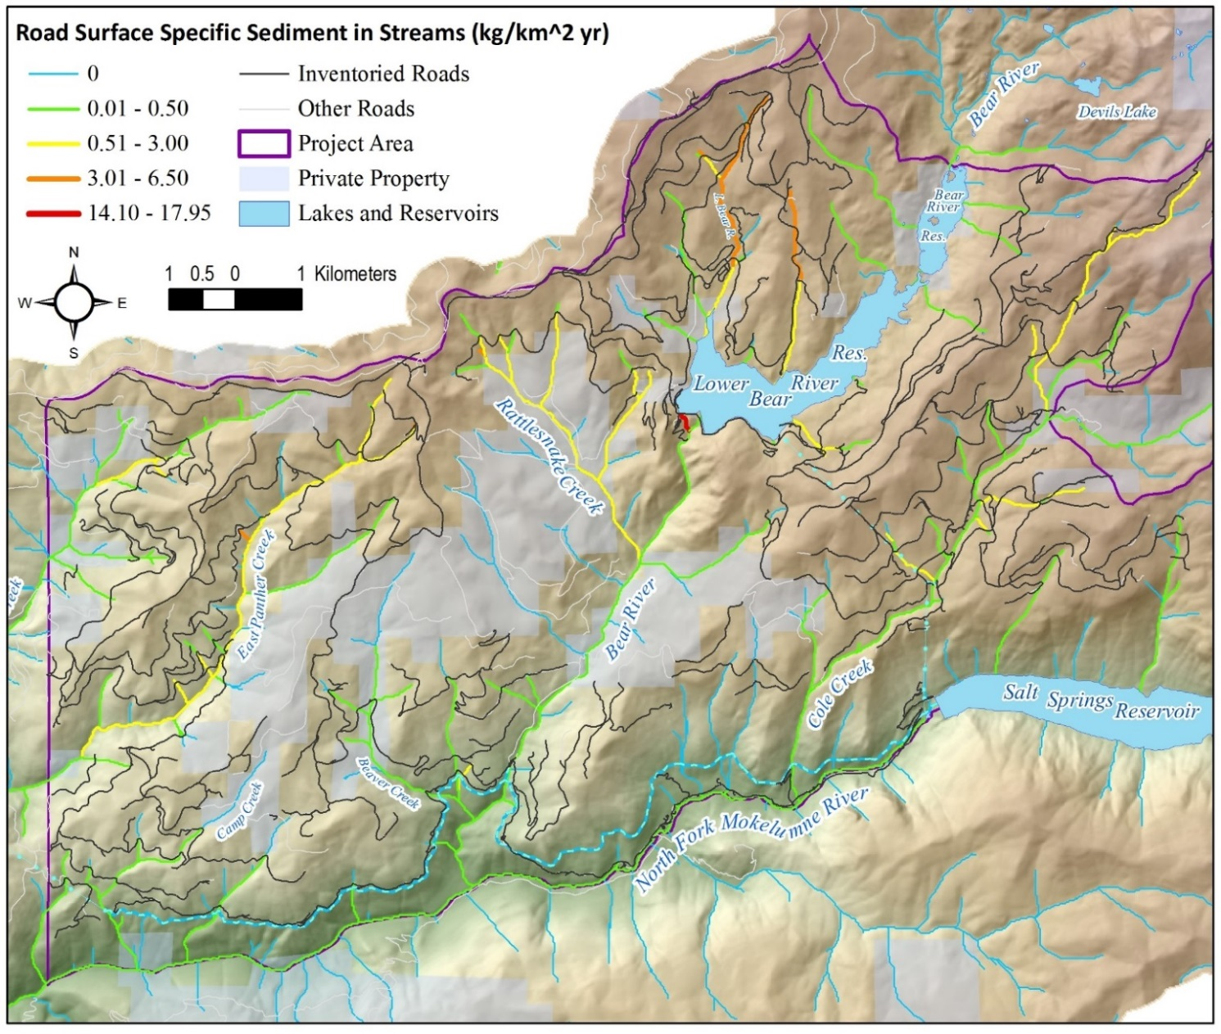
Power Fire GRAIP Watershed Roads Assessment
The GRAIP model was used to predict risk and impacts from
337 km (209 mi) of roads surveyed
Mg/km^2/yr.
Road to stream hydrologic connectivity
Sediment production and delivery to streams
Downstream sediment accumulation
Fire
Notes:
Sediment delivered to the stream is normalized by watershed area to show areas likely to be more heavily impacted by road sediment such as the area below Bear River Reservoir

Slide 12
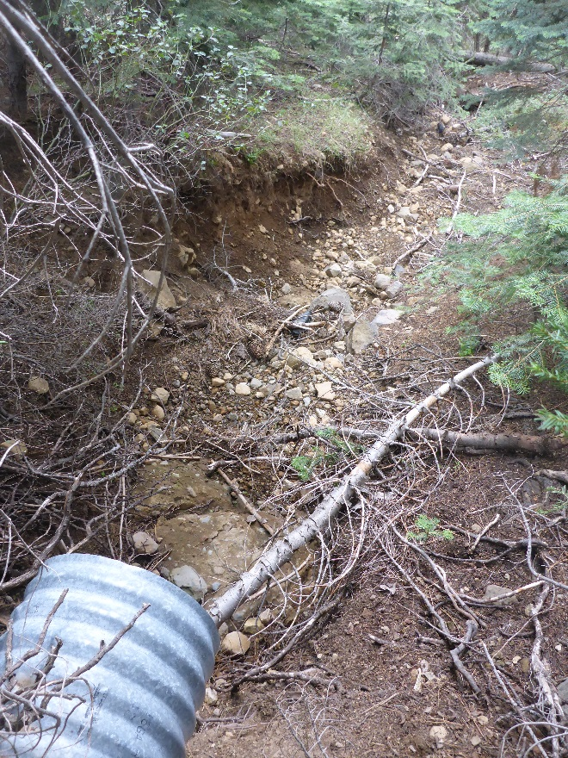
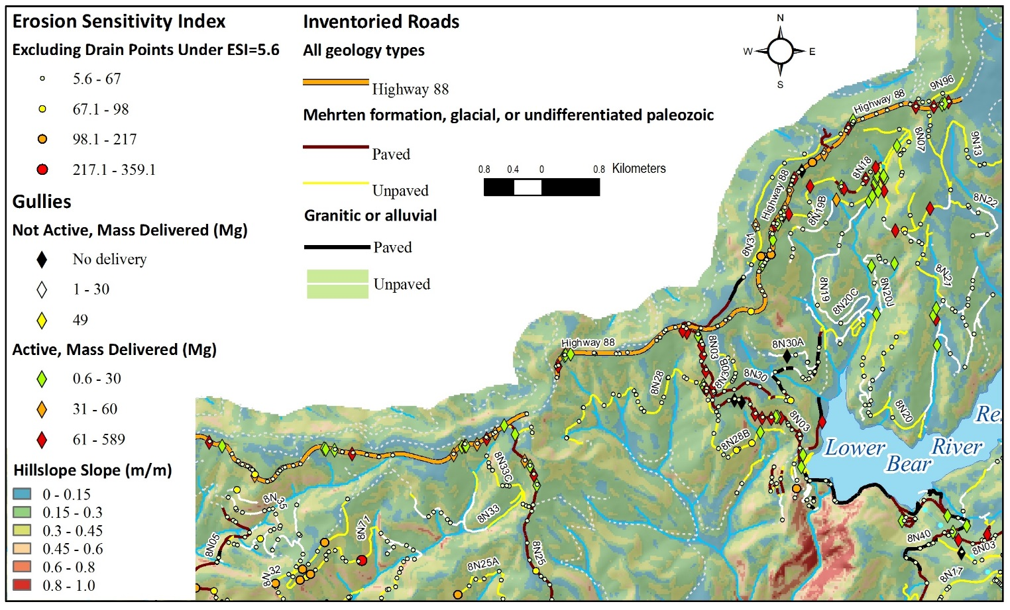
Power Fire GRAIP Watershed Roads Assessment
Gullies
Notes:
We mapped 218 gullies associated with the road which delivered 9,300 Mg of sediment to the streams. Acrive gullies are shown by colored diamonds. Gullying was strongly associated with HWY 88, paved roads such as the 8N03 and the ridge capping Mehrten volcanics formation. Fire did not have as much influence on gulley locations as expected after 10 years.

Slide 13
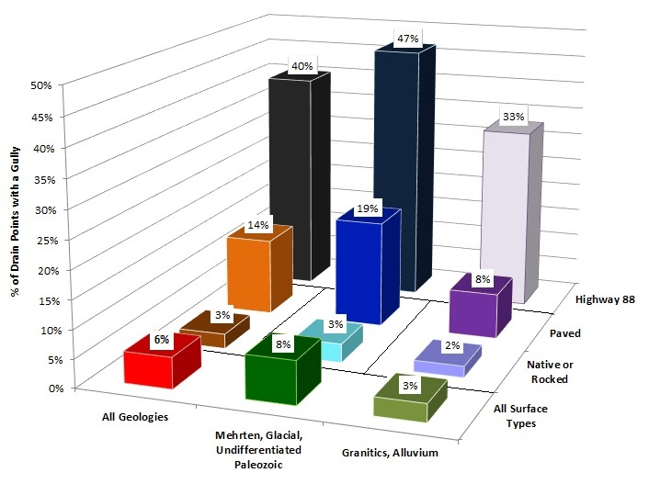
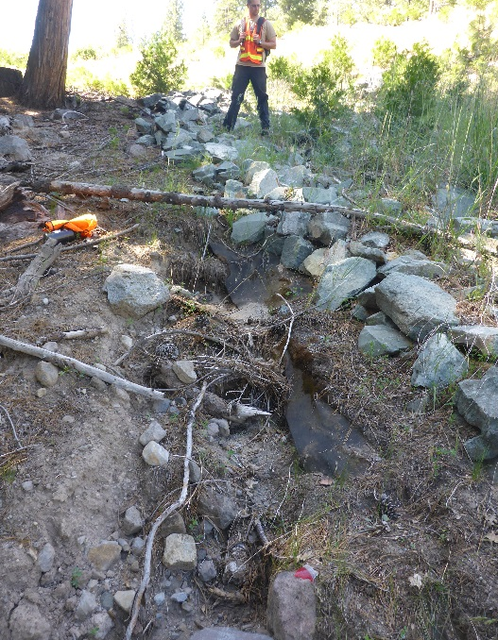
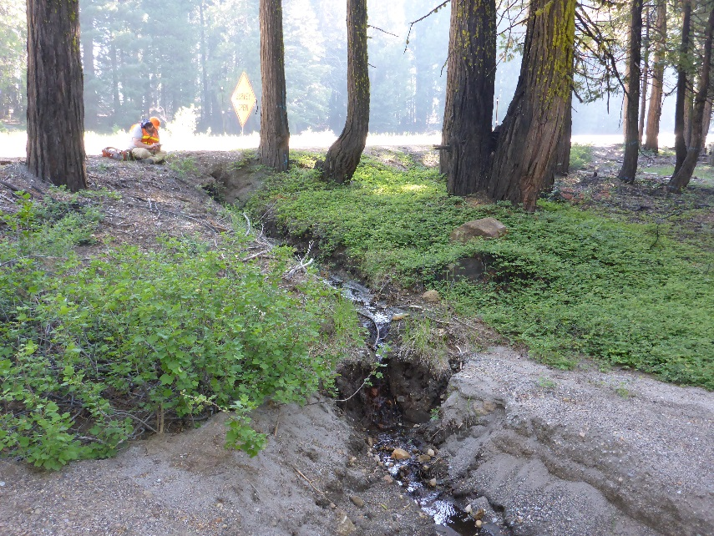
Power Fire GRAIP Watershed Roads Assessment:
Frequency of Gullies
Percent of Drains with a Gully
Hwy 88 and paved roads high gullying rates
Native and gravel roads had lower rates
Gullies were stream connect 60% of the time
Notes:
Drainage from the highway onto the Mehrten caused a gully at 47% of locations. Road drainage gullies in general connected to the stream channel 60% of the time. Gullies were not common on unpaved and gravel surfaced roads.

Slide 14
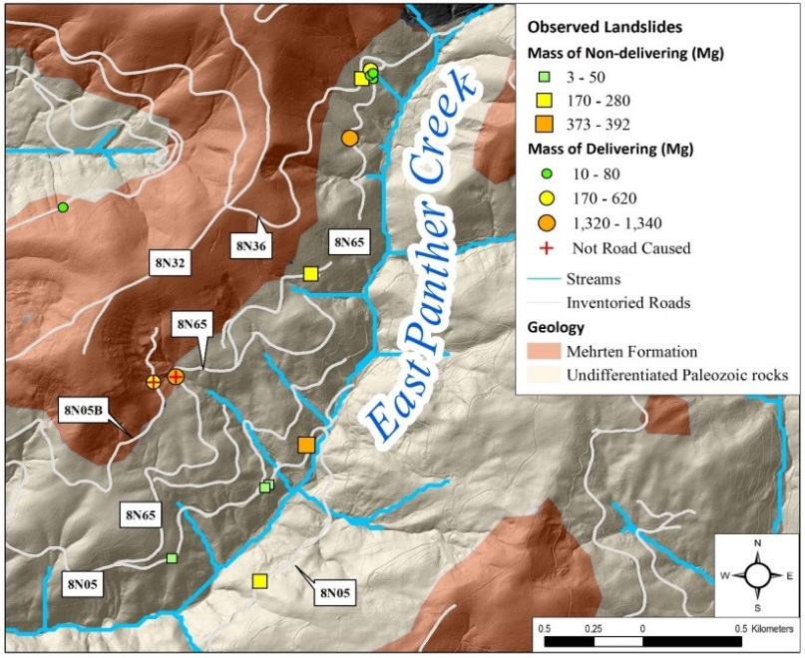
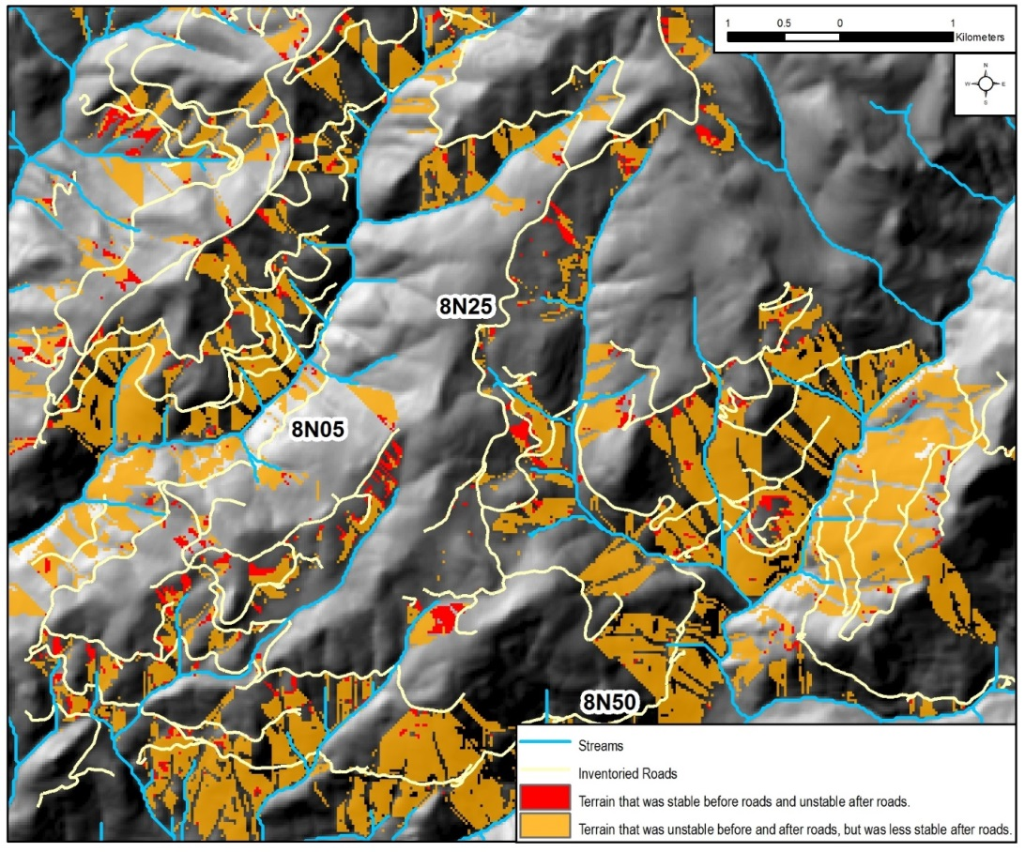

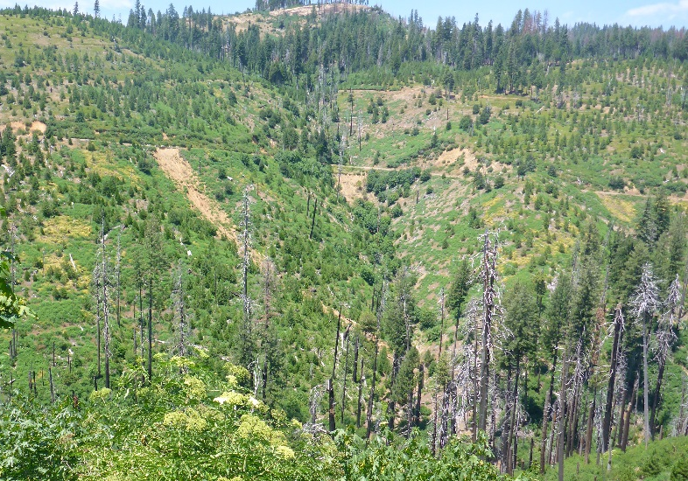
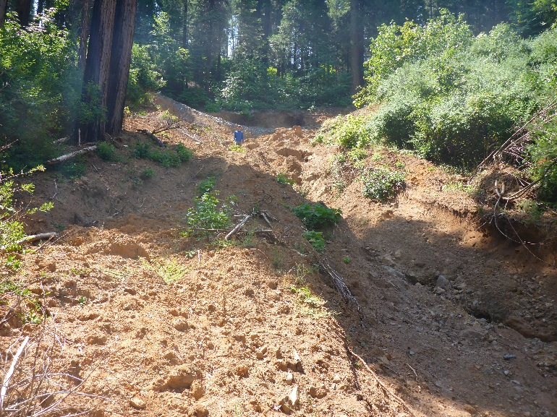
Power Fire GRAIP Watershed Roads Assessment
The GRAIP model and SINMAP was used to predict landslide risk from roads
Notes:
We mapped 20 road caused landslides and modeled their likelihood of occurrence. Landslides in the study area were concentrated in the East Panther Creek watershed. Landslides along 8N05 were activated in the wet winters of 2004/2005 and were reactivated in 2016/17.
Precipitation the two winters following the Power Fire were 128% and 145% of average and likely played a role in instability in the area. The majority (80%) of landslides observed in the survey occurred in areas predicted by SINMAP to be inherently unstable.

Slide 15
Total Road Sediment Eroded
Total Road Sediment Delivered to Streams
Among road related sediment sources, gullies produced and delivered the most sediment.
Road surfaces produced nearly the same amount of sediment mass as gullies, but delivered less sediment.
Fill erosion and landslides delivered similar amounts of sediment as road surfaces.
Notes:
Among road related sediment sources, gullies produced 42% of the sediment from all sources. Road surfaces produced nearly the same amount of sediment mass
as gullies, but delivered much less sediment. Gullies delivered 66% of the total to streams.
Fill erosion and landslides delivered similar amounts of sediment as road surfaces.

Slide 16
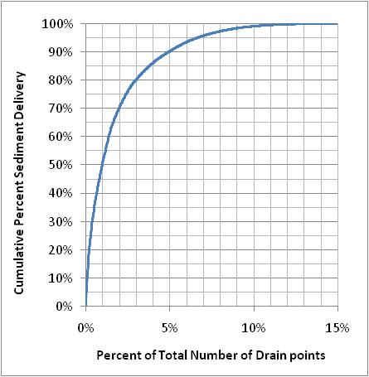
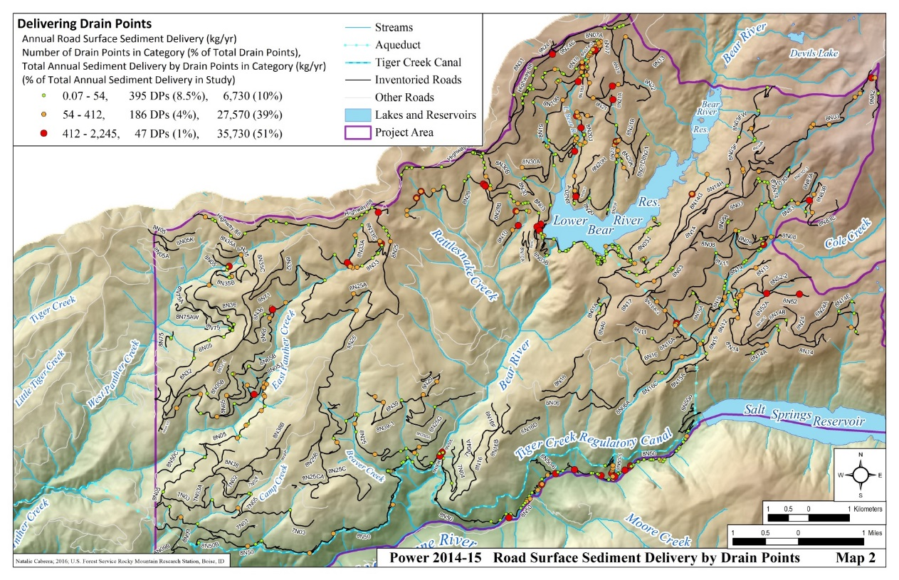
90% of delivered road surface fine sediment
was delivered through 5% of drain points.
Notes:
One of the most powerful results of the inventory is that only 5% of the drainage locations delivered 90% of the road surface erosion. Less than 10% of points deliver 98% of all erosion when gully and landslide mass is included. This allows for very targeted management treatments to reduce sediment delivery.

Slide 17
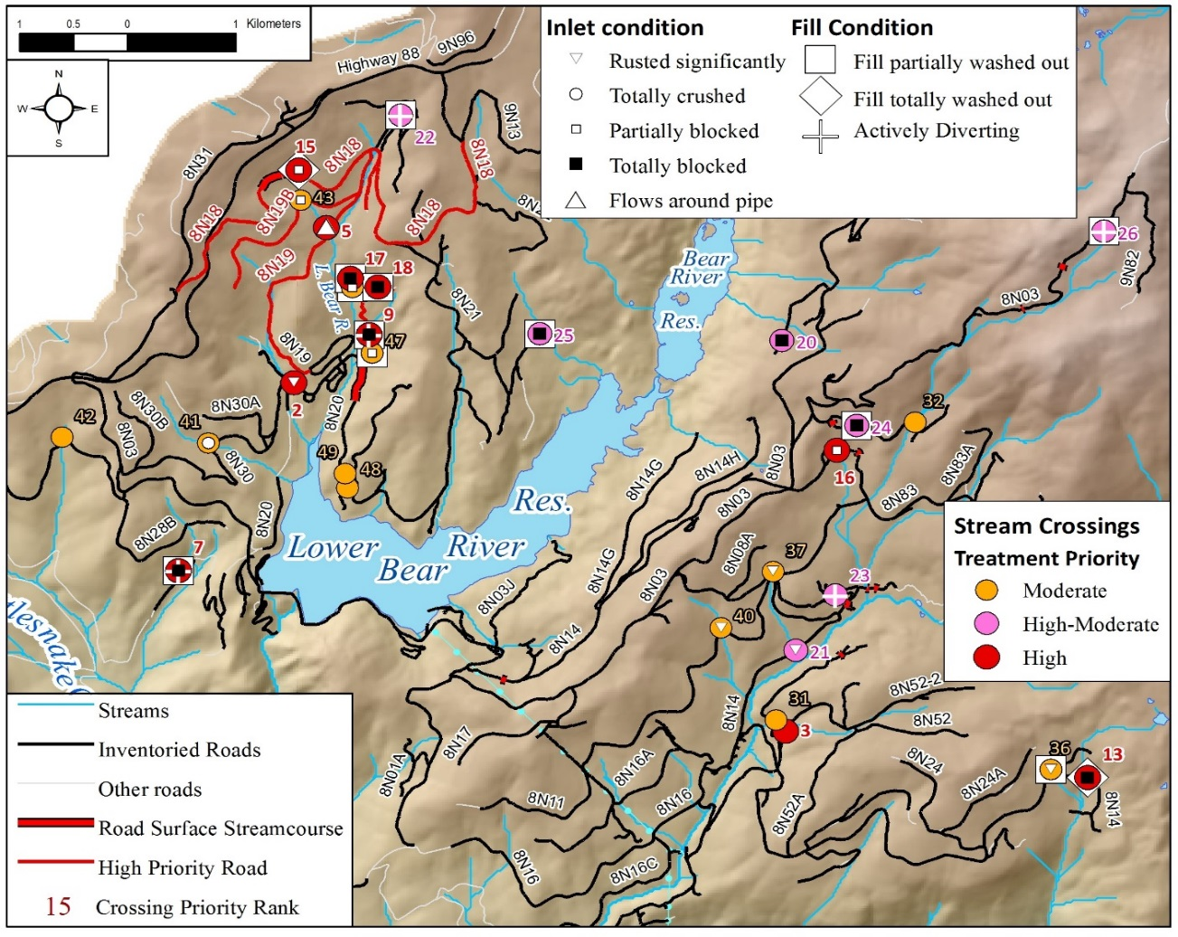
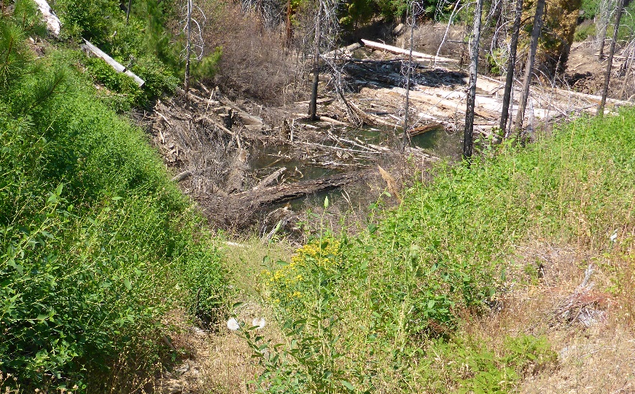
Power Fire GRAIP Watershed Roads Assessment
Stream Crossing Risks
Road to stream hydrologic connectivity
Sediment production and delivery to streams
Downstream sediment accumulation
Risks of shallow landslides caused by roads
Gully initiation risk below drain points
Risks to road-stream crossings
At 216 stream crossings, 41% had potential to divert down the road
44,000 MG of fill at risk
Notes:
We evaluated road stream crossings that were or could become plugged by wood or sediment and potentially overtop or divert a stream down a road. The priority map is shown here. Several of these high risk crossings plugged and failed in the winter 2016/2017.

Slide 18
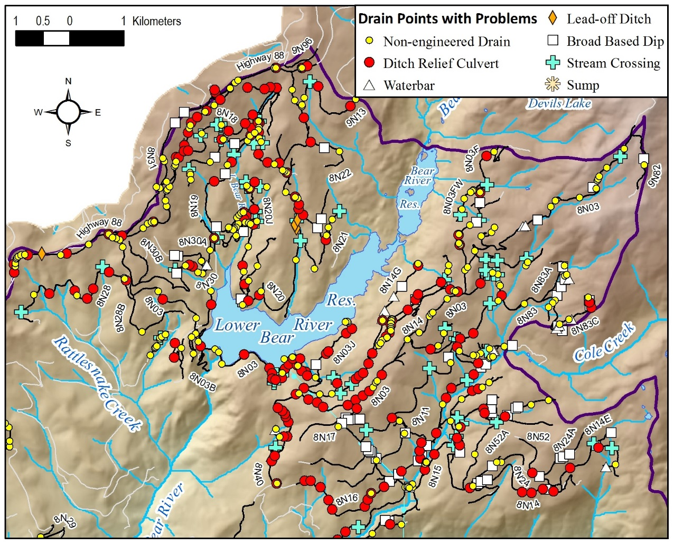
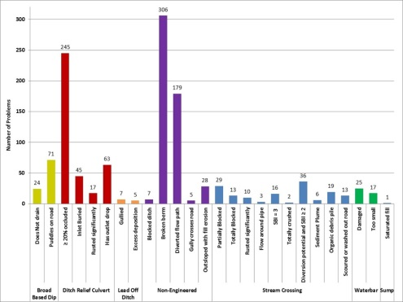
Power Fire GRAIP Watershed Roads Assessment
The GRAIP model was used to predict risk and impacts from
337 km (209 mi) of roads surveyed
Road to stream hydrologic connectivity
Sediment production and delivery to streams
Downstream sediment accumulation
Risks of shallow landslides caused by roads
Gully initiation risk below drain points
Risks to road-stream crossings
Problems with existing drain points (25%).
Notes:
All drainage locations were evaluated for performance, the non-performers are shown here. Ditch relief culverts with >20% blockage very common

Slide 19
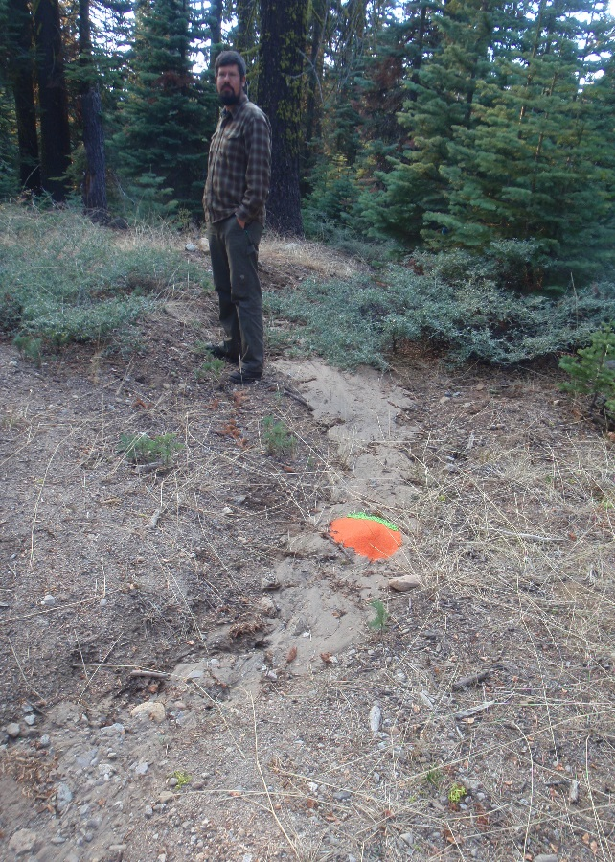
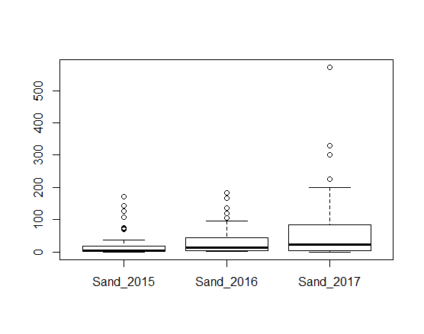
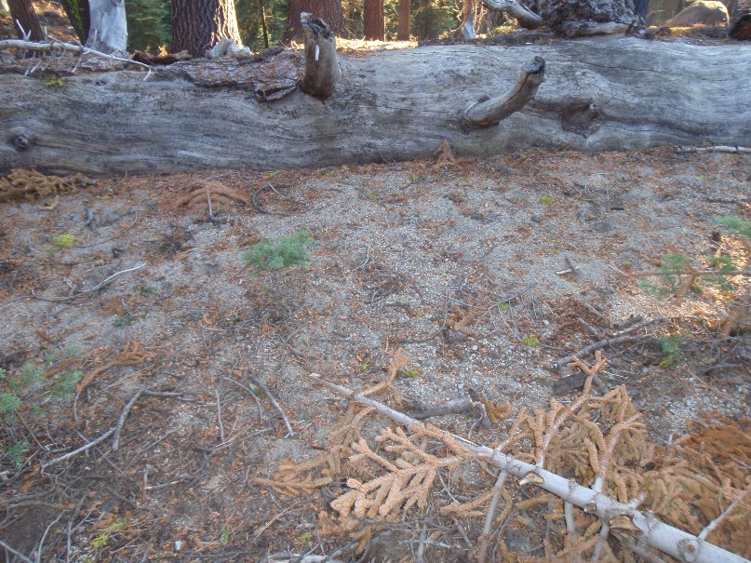
Road Sediment Transport Distance
Distance below drain (ft.)
Median- 6
Mean- 25
13
38
23
76
Notes:
To study how far and how often road sediment was able to move below the road we applied a colored 1 mm sand tracer each year and measured the farthest transported detectable particle. We began the study in the drought years and measured through 2017 which was wet. The mean distance was 25 ft. in 2015 and 76 in 2017. The 75% percentile of transport distance was 18 when dry and 90 ft. in wet year, with many long flowing outliers.

Slide 20
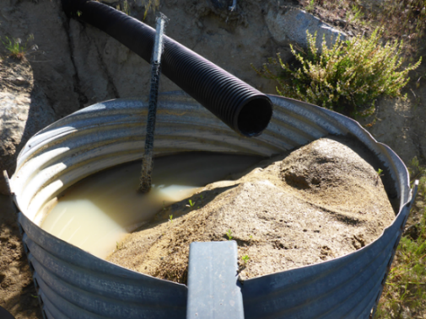
Conclusions
Much of the post-fire hillslope response including gullies and landslides happened in 2004 and 2005 before we arrived, 2017 re-activated a few locations.
Of the road sediment sources, gullies produced and delivered the most sediment 9,300 Mg. Paved roads and highway 88.
Road surfaces produced nearly the same amount of sediment mass as gullies, but delivered less sediment.
Fill erosion and landslides delivered (1,740 Mg) similar amounts of sediment as road surfaces.
5% of drains delivered 90% of road surface fine sediment.
Sediment delivery was observed at 17% of drainage locations
In 2014/2015 14% of eroded surface sediment from roads
reached the stream.
Notes:
Although much geomorphic activity occurred before we arrived, We were able to produce prioritization maps and tables that took advantage of the fact that 5% of drainage locations delivered 90% of sediment.

Slide 21
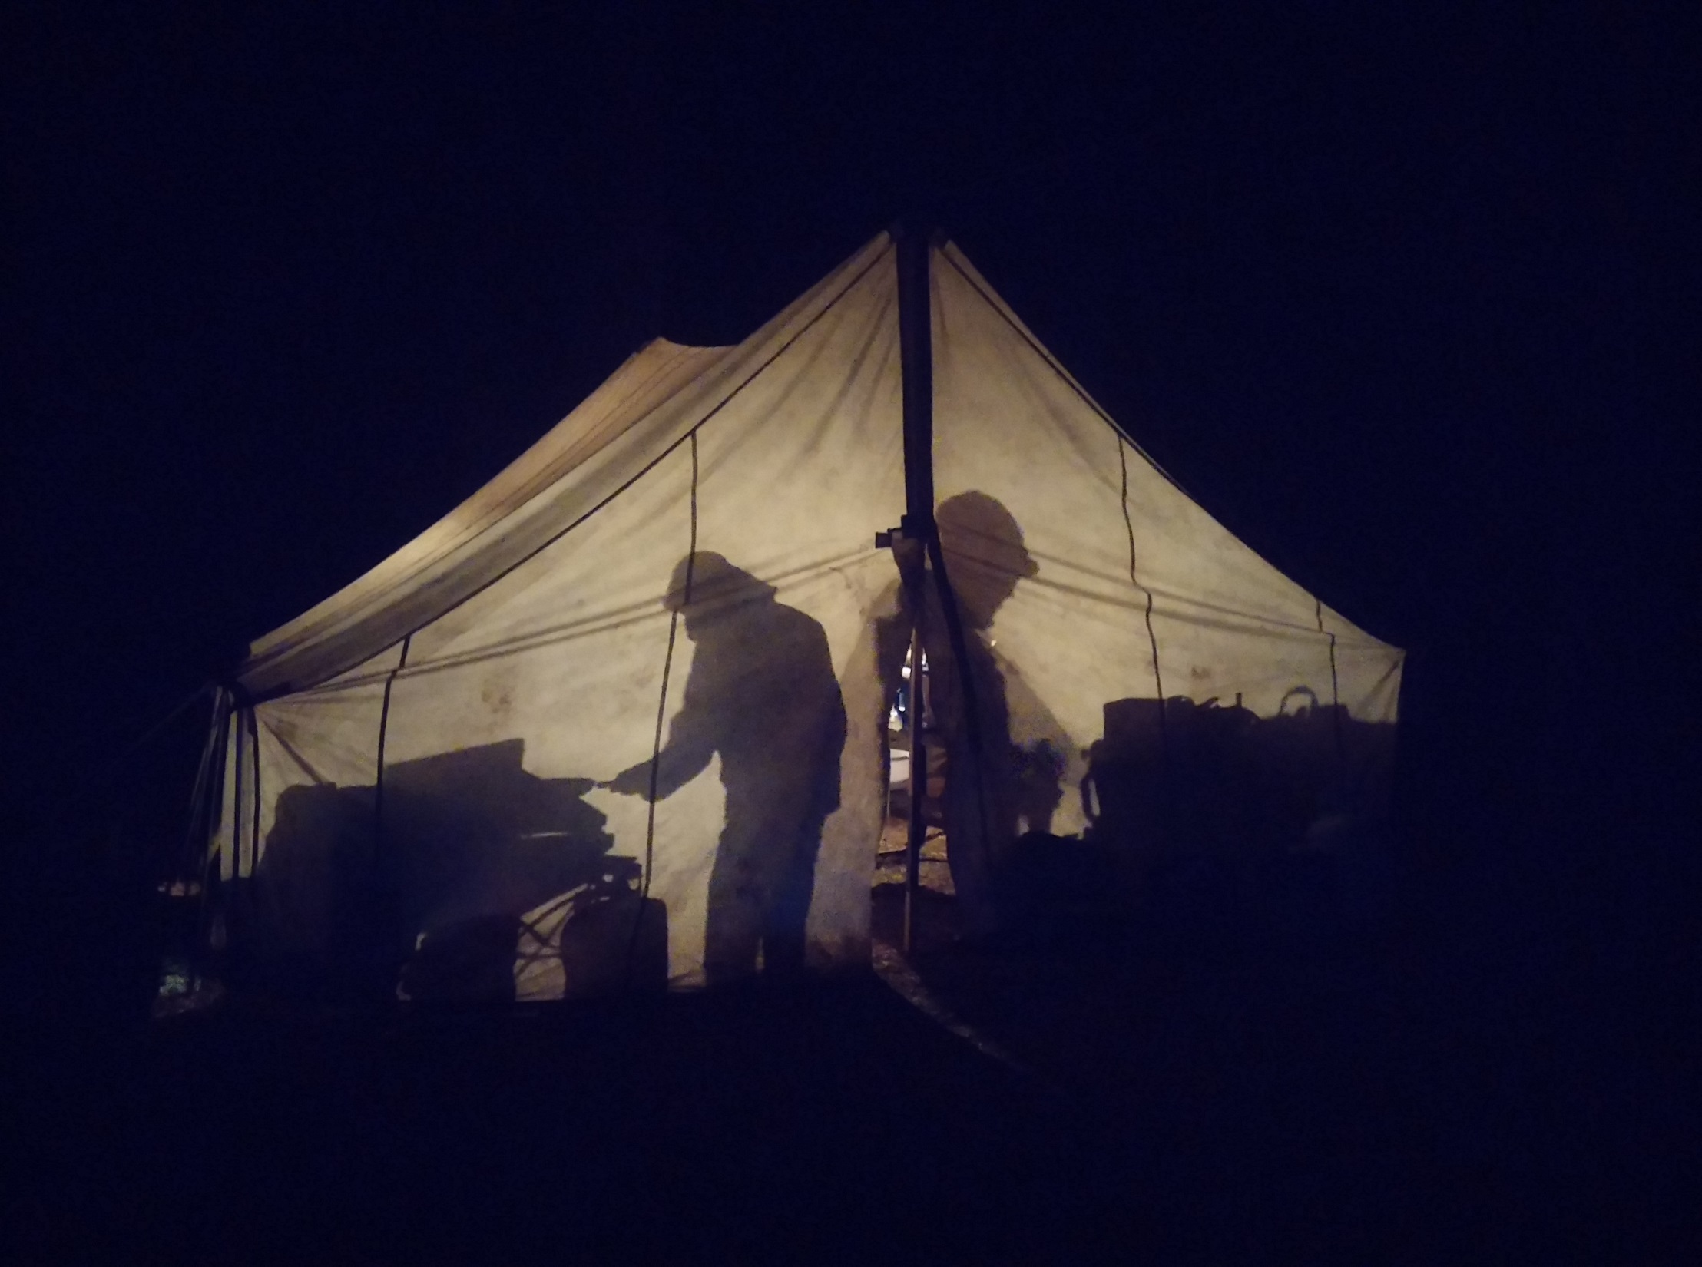
Questions

Slide 22
Predicted warmer winters with a longer snow free period will allow more winter road use which may increase sediment issues and require different seasonal travel management.

Slide 23
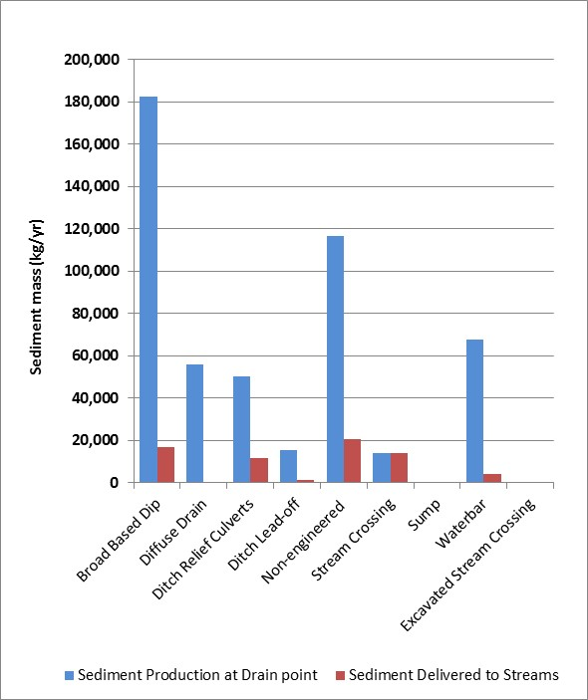
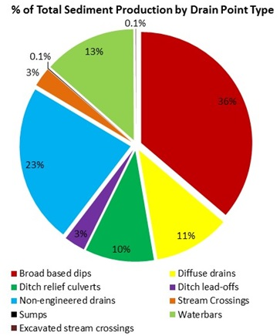
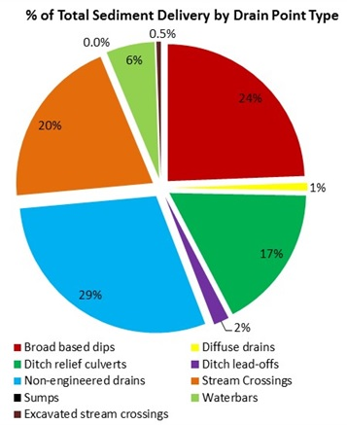
Diffuse drains were the most effective drain point type at reducing hydrologic connectivity. Waterbars and lead off ditch drains were also very effective. Reduction of stream connectivity should be focused on drain point types that represented the highest percentage of total sediment delivered: non-engineered drains, broad based dips, ditch relief culverts and stream crossings.

Slide 24
Summary table of GRAIP road-related risk predictions in the Power study watersheds.
Impact/Risk Type
Road-Stream Hydrologic Connectivity | 54 km (34 mi), 16% of road length, and 778 (17%) drain points were stream connected
Fine Sediment Delivery | 70 Mg/year, 14% of all fine sediment produced from road surfaces delivered to streams
Landslide Risk | Estimated 1,740 Mg delivered to streams, (51% of all road related landslide sediment produced);
Gully Risk | Estimated 9,300 Mg of gully sediment delivered (80% of all gully sediment produced); An average of 50% of all drainage locations exceed ESI_{crit} threshold for paved roads in Mehrten Formation, glacial deposit, and undifferentiated Paleozoic geology types
Stream Crossing Risk
- plug potential | 16 sites (8%) with elevated risk (SBI of 3)
- fill at risk | 27,970 m³, 44,750 Mg
- diversion potential | 104 sites (41%) with diversion potential
Drain Point Problems | 1,148 drain points (25% of all) with problems; 1,640 Mg of road derived fill erosion delivered (70% of all fill erosion sediment produced)

Slide 25

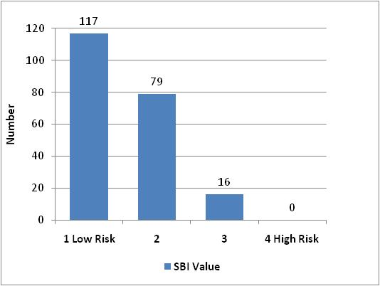
Table 14. Blocking rate in percent for different culvert plug conditions by SBI category.
Plug Conditions | Blocking Rate for each SBI (%)
 | 1 | 2 | 3
Partially and totally blocked | 16 | 23 | 12
Totally blocked pipes only | 3 | 6 | 6
Stream crossing fill failure risk factors

Slide 26
Sediment delivery variability
Notes:
We have looked at sediment delivery functions for watersheds across the Est and found similar SDR functions. They vary by region and road design and when you are close to the stream it matters

