Slide 1
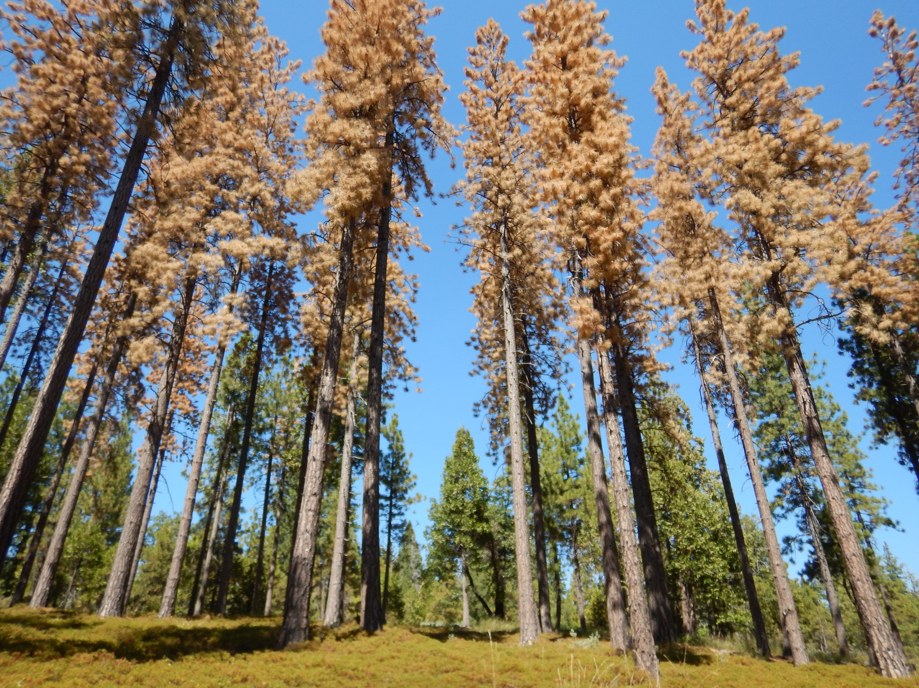
Density matters – forest thinning treatments reduce drought stress and tree mortality in the Sierra Nevada Christina Restaino, UC Davis Becky Estes, Shana Gross, Marc Meyer Amarina Weunschel, Hugh Safford (US Forest Service)
Notes:
Add pictures from science friday

Slide 2
Were forests more resistant to the recent bark beetle epidemic in the Sierra Nevada?
treated

Slide 3
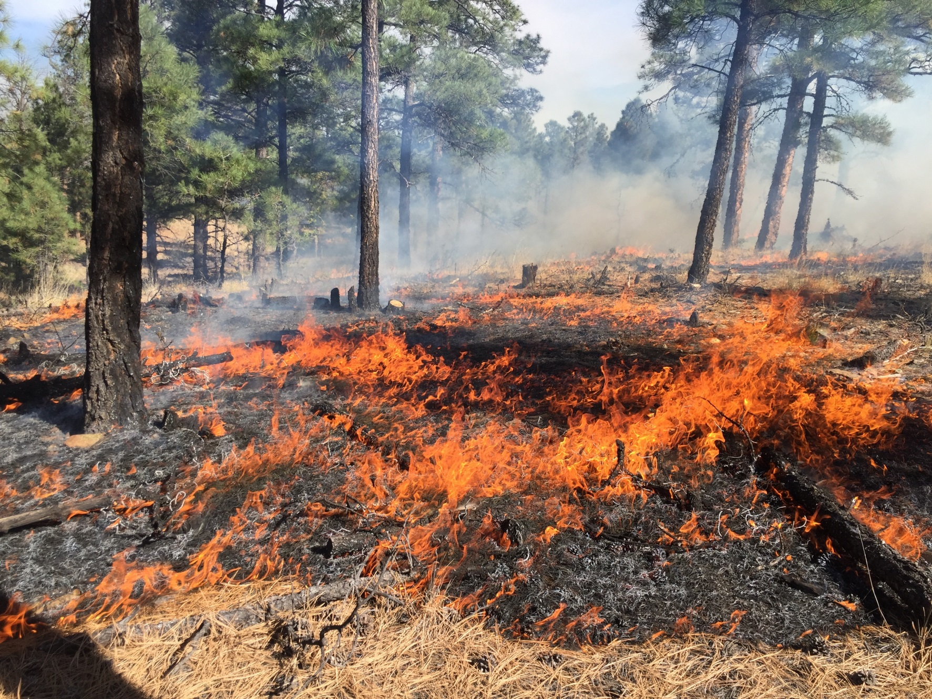
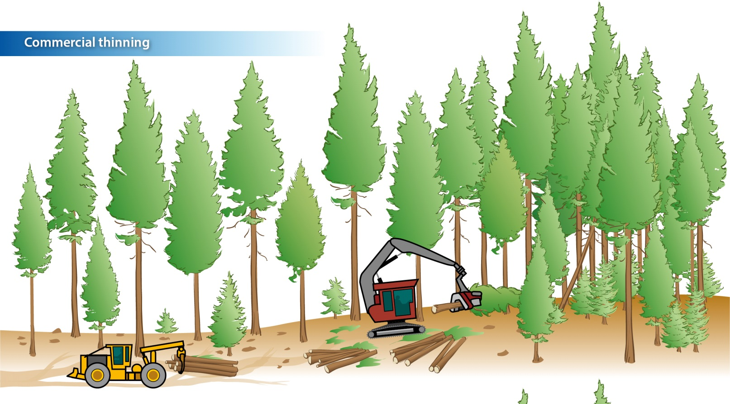
Actions to restore forests to more historical conditions (i.e. reduce stand density)

Slide 4
Untreated
Treated
Yosemite National Park, Photo: Marc Meyer

Slide 5
Untreated
Treated
Sierra National Forest, Photo: Marc Meyer

Slide 6
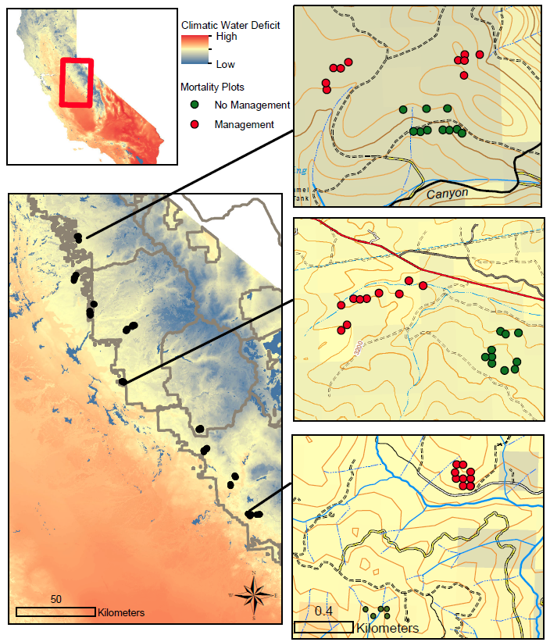
Eldorado NF – 46 plots
Stanislaus NF – 84 plots
Yosemite NP – 67 plots
Sierra NF – 114 plots
Total = 311 plots
Untreated = 158
Treated = 153

Slide 7
Higher density (TPA) in untreated stands
TPA = Trees per acre

Slide 8
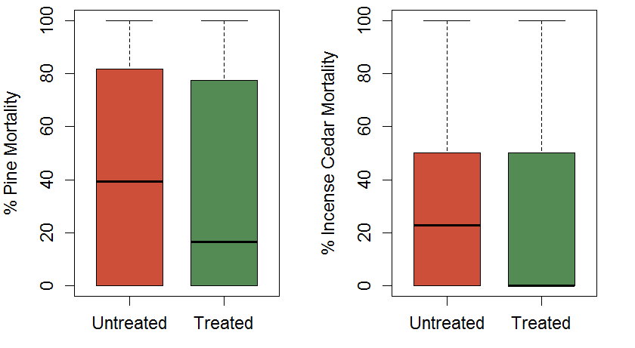
Higher tree mortality in untreated units
Higher density → Higher tree mortality

Slide 9
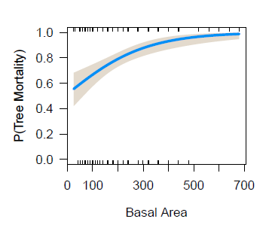
Logistic Regression
90% probability of tree mortality when TPA exceeds 200
90% probability of mortality when PPT = 400 mm and CWD = 850 mm

Slide 10
If water stress or density are too high…
When PPT is at its lowest, probability of mortality is as high as 40% even when there is very low stand density.
Once TPA reaches 400, even with PPT levels as high as 700 mm, there is still a 60% probability of mortality.
P(Tree Mortality)
TPA
PPT (mm)

Slide 11
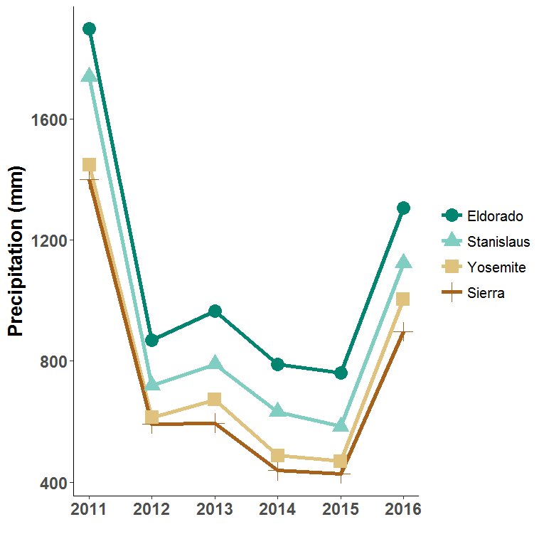
Where has the precipitation been lowest?
Notes:
Are we seeing this in our data? First thing to think about is where is the lowest preciptation/highest water deficit. As you move north to south you can see that precipitation decreases as you move south. So the sierra NF had the highest amounts of water stress (as low as 400 mm of precip per year).

Slide 12
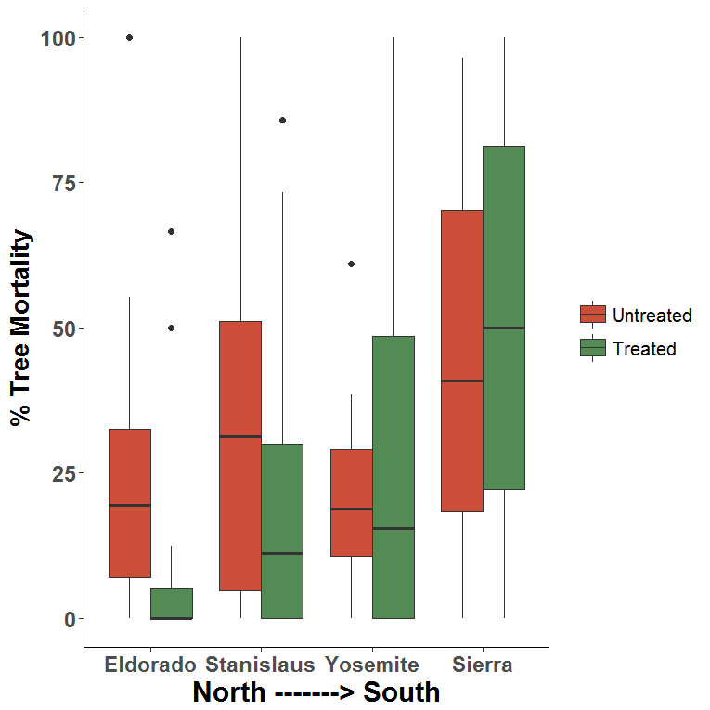
Treatment effectiveness decreases as you move south

Slide 13
Summary
High tree density → more mortality
Low tree density → less mortality
BUT, if water stress is too high density does not matter anymore. Likewise, if density is too high, increased moisture will not compensate for water demand in system.
Gradient in treatment effectiveness from north to south
Treatment only works below certain levels of water stress, but it does work!

Slide 14
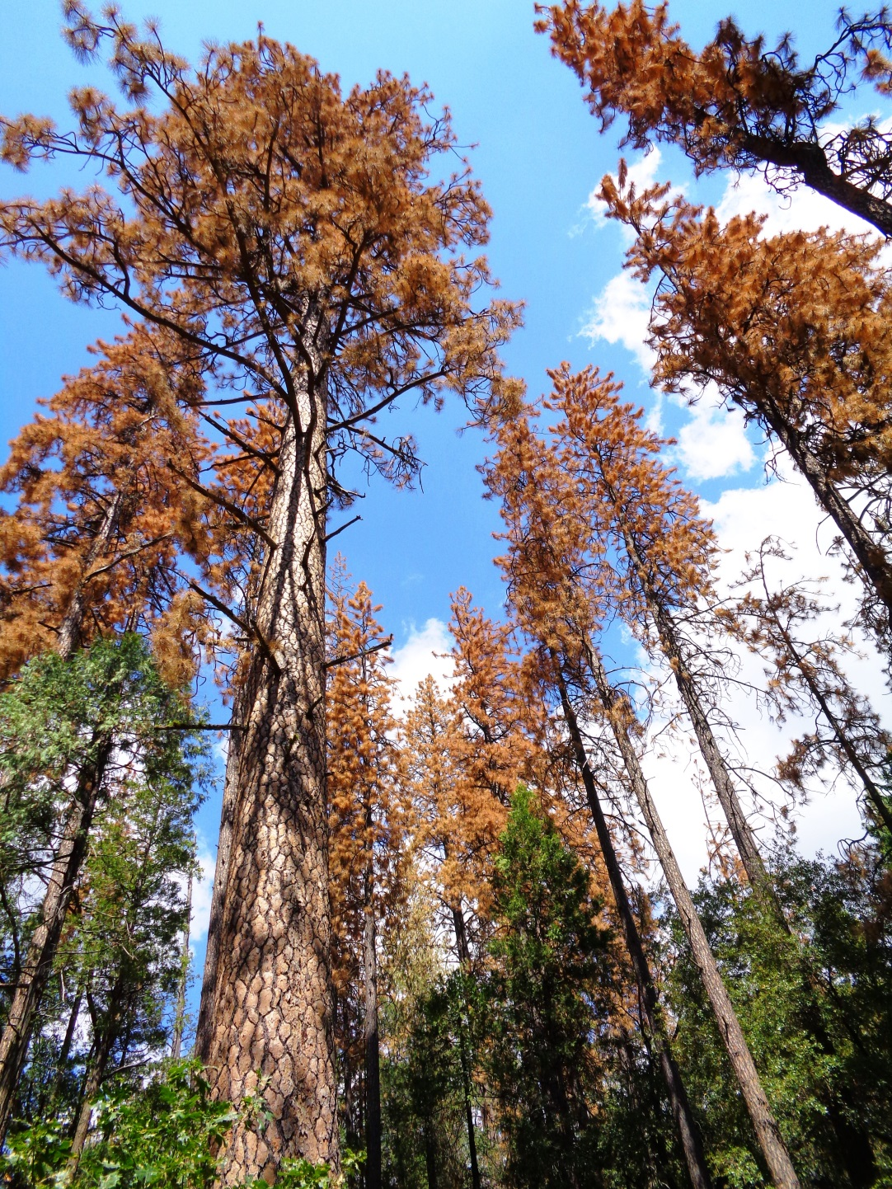
Up Next
Tree cores
Regeneration
Fuels data
Spatial heterogeneity measures

Slide 15
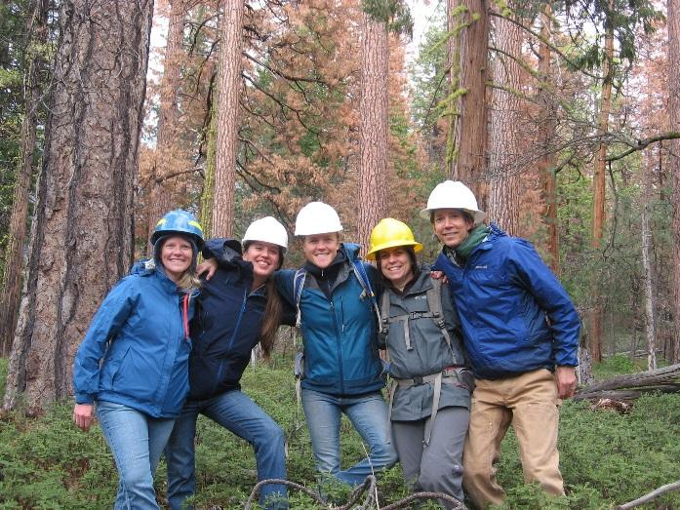
Acknowledgements:
Co-authors: Becky Estes, Shana Gross, Marc Meyer, Amarina Weunschel and Hugh Safford
Collaborators: Jim Thorne, Sheri Smith, Beverly Bualon
Funding sources: Region 5 Forest Health and Protection, UC Davis, USFS Region 5
Field Technicians: Ruthie Schnitt, Chris Preston, Julie Berkey, Sarah Russell

