Slide 1
Inventory of vegetation conditions, forest stand structure and tree regeneration in the Power Fire burn area
Clark Richter & Hugh Safford
ACCG Monitoring and Science Symposium, 2017

Slide 2
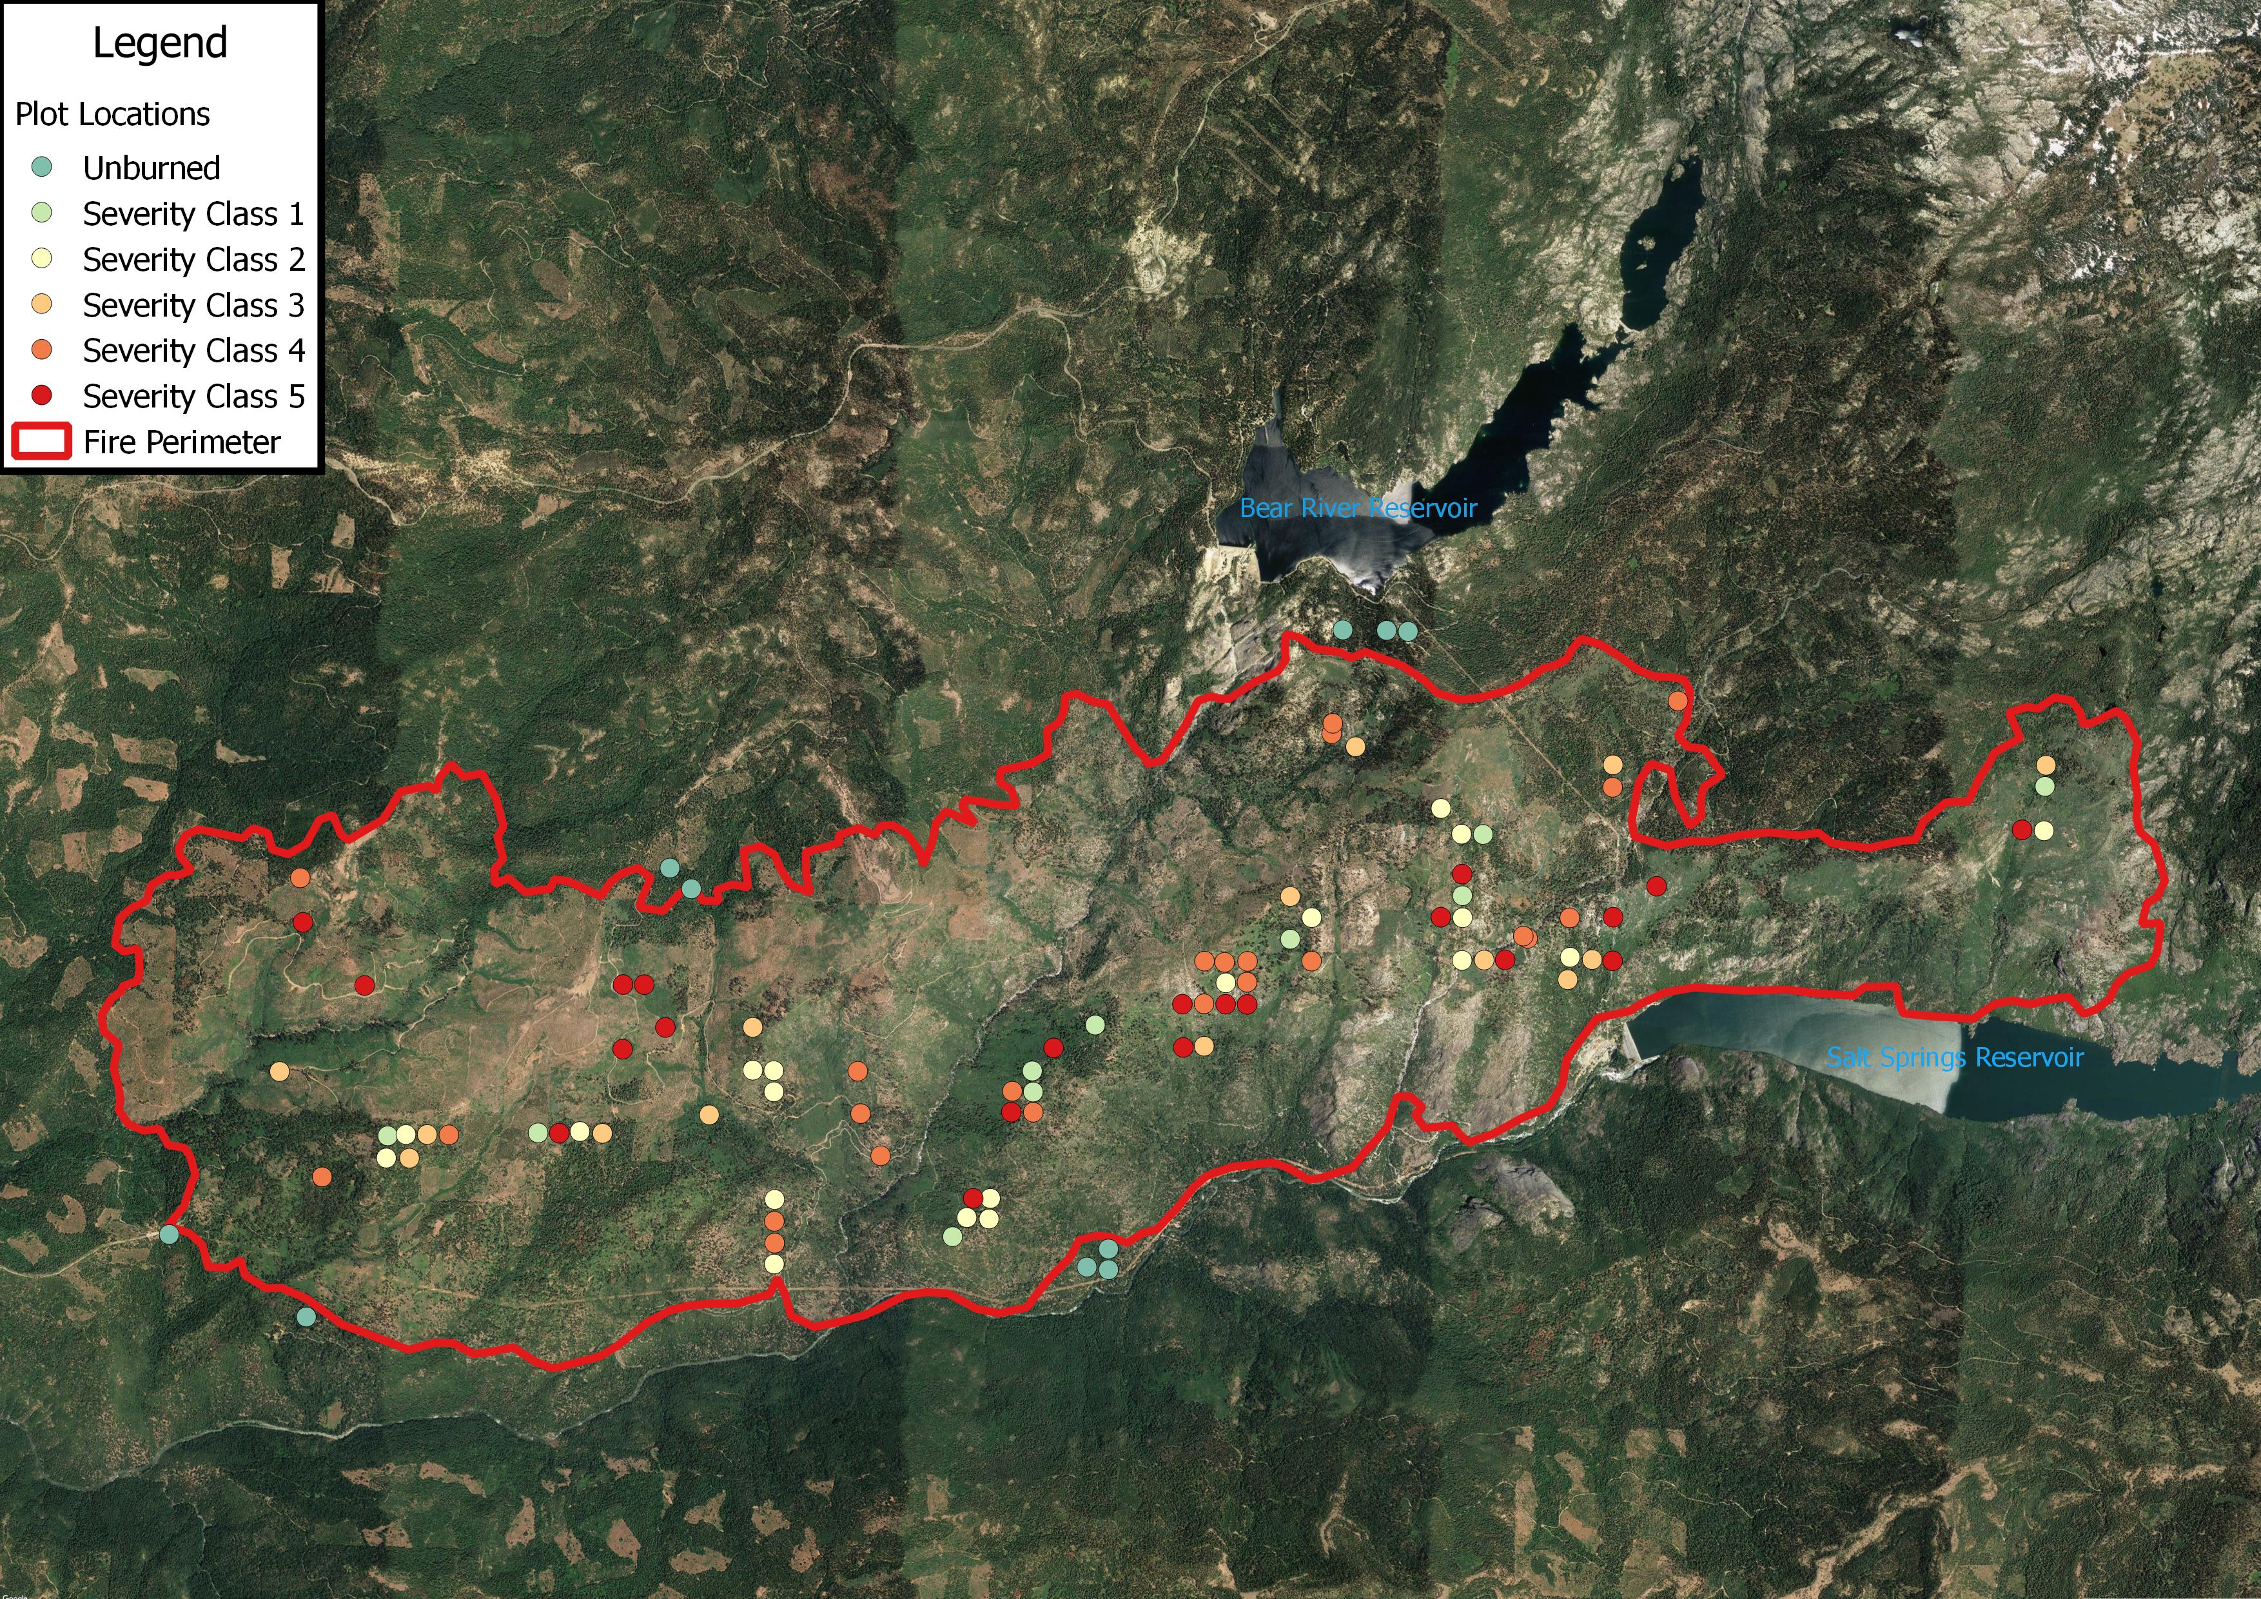
Power Fire, 2004
Eldorado NF – Amador County (south of Highway 88)
17,005 acres burned
118 Total Plots
0 : 11 plots
1 : 13 plots
2 : 23 plots
3 : 21 plots
4 : 26 plots
5 : 24 plots
Surveys conducted the summers of 2013, 2014, 2015

Slide 3
CSE/Regen Methodology
“Extensive” common stand exams & Regeneration plots
Region 5 CSE Protocol: https://www.fs.fed.us/nrm/documents/fsveg/cse_user_guides/R5FG.pdf

Slide 4
CSE/Regen Methodology
USDA Forest Service Common Stand Exams (CSEs)
Three nested sampling zones
60 sq. m –
Regeneration protocol
405 sq. m –
Topographic features
Biotic and abiotic covers
Trees
Fuel loads (Brown, 1974)
809 sq. m -
Species composition
N
W
E
8.74 m
22.7 m
32.1 m
S

Slide 5
Tree regeneration
Average seedling + sapling densities separated by species and fire severity class
Highest in fire severity 1, 3, and unburned classes
Lowest in severity class 2 and the highest severity classes (4 and 5).

Slide 6
Tree regeneration - Shade tolerant : Shade intolerant
Ratio of shade-tolerant to shade intolerant tree species by fire severity class
Shade tolerant tree species:
Abies concolor
Calocedrus decurrens
Shade intolerant species:
Pinus ponderosa
Pinus jeffreyi
Pinus lambertina
Pseudotsuga menziesii

Slide 7
Distance to seed sources
Distance to nearest conifer seed source by fire severity class
Distance to nearest hardwood seed source by fire severity class

Slide 8
Annual growth rates
Tallest Individual | Conifer Seedling Age Classes |  |  |  |  |  | Conifer Saplings
 | 0-3 years |  | 4-6 years |  | 6+ years
 | inches | cm | inches | cm | inches | cm | inches | cm
Average Height | 9.20 | 23.36 | 24.54 | 62.34 | 35.05 | 89.03 | 84.05 | 213.5
Average Last Year’s Growth | 2.88 | 7.32 | 4.32 | 10.97 | 3.51 | 8.91 | 8.69 | 22.08
Average Annual Growth Rate | 1.26 | 3.19 | 2.24 | 5.68 | 3.93 | 9.99 | 6.69 | 17.00

Slide 9
Tree regeneration dynamics
Conifer dynamic comparisons 2009 (n=106) to 2015 (n=118)

Slide 10
Vegetation regeneration & competition
Unburned and low severity: trees that did not die during the fire still dominate
High severity sites: shrubs are the bulk of the overstory cover
Neither trees nor shrubs dominate in moderate severity burns

Slide 11
Vegetation regeneration & competition
Shrub height > seedling height
Large range in height could be due to haphazard light availability

Slide 12
Vegetation regeneration & competition

Slide 13
Surviving trees
Fire Severity Class | Average Live Trees/Acre (Median) | Average Height of Live Trees (Median) |  | Average Live Basal Area/Acre (median) square ft./acre
 |  | ft. | m
0 | 218.00 (185) | 45.78 (31.17) | 13.95 (9.5) | 245.32 (238.88)
1 | 148.18 (140) | 52.22 (50.52) | 15.92 (15.4) | 196.04 (211.52)
2 | 70.91 (55) | 52.11 (41.83) | 15.89 (12.75) | 112.90 (82.87)
3 | 73.33 (60) | 64.09 (54.30) | 19.54 (16.55) | 155.37 (159.16)
4 | 26.67 (20) | 47.52 (32.15) | 14.49 (9.8) | 43.45 (23.12)
5 | 21.67 (20) | 16.00 (14.76) | 4.88 (4.5) | 0.63 (0.23)

Slide 14
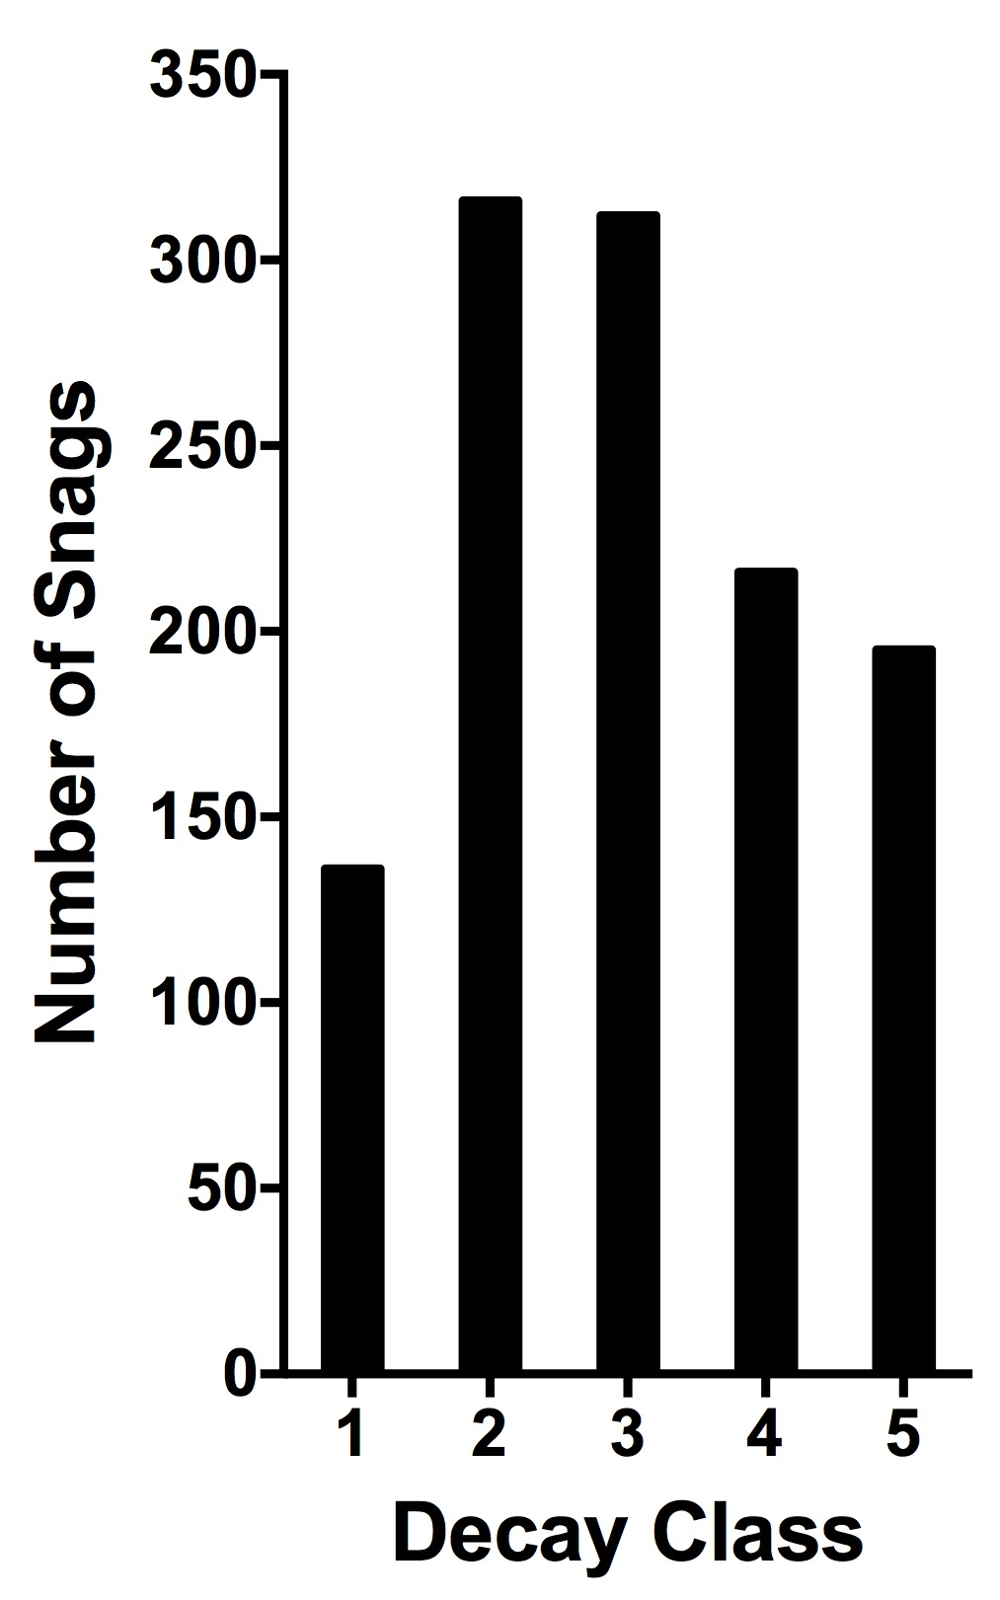
Dead trees/snags

Slide 15
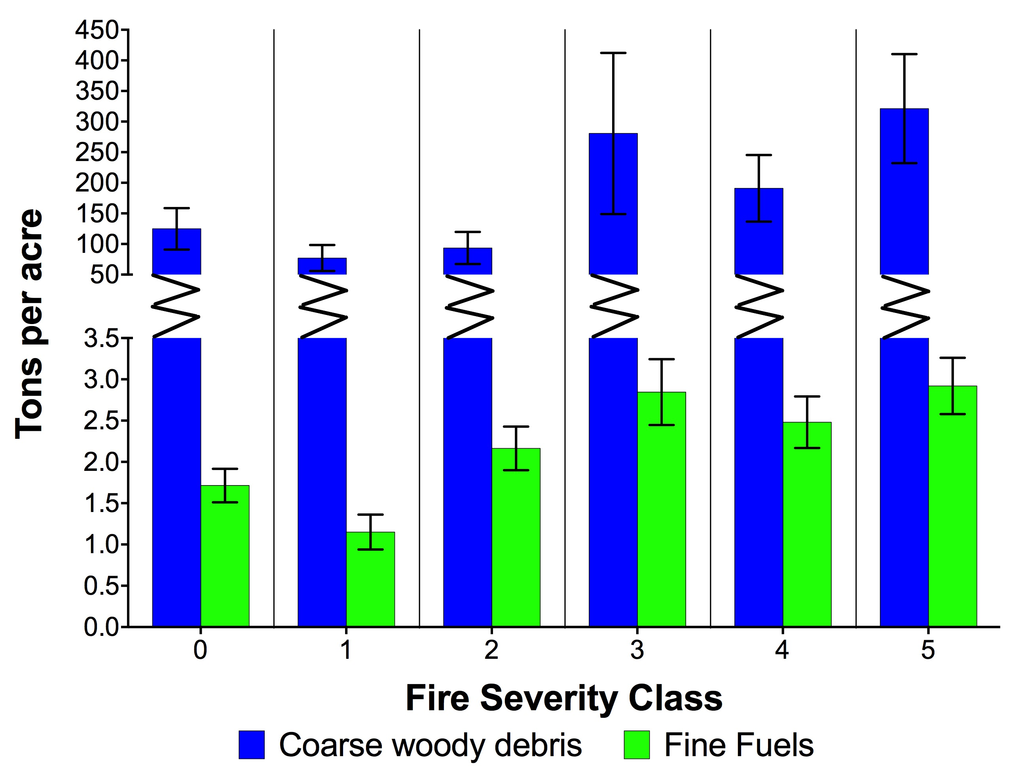
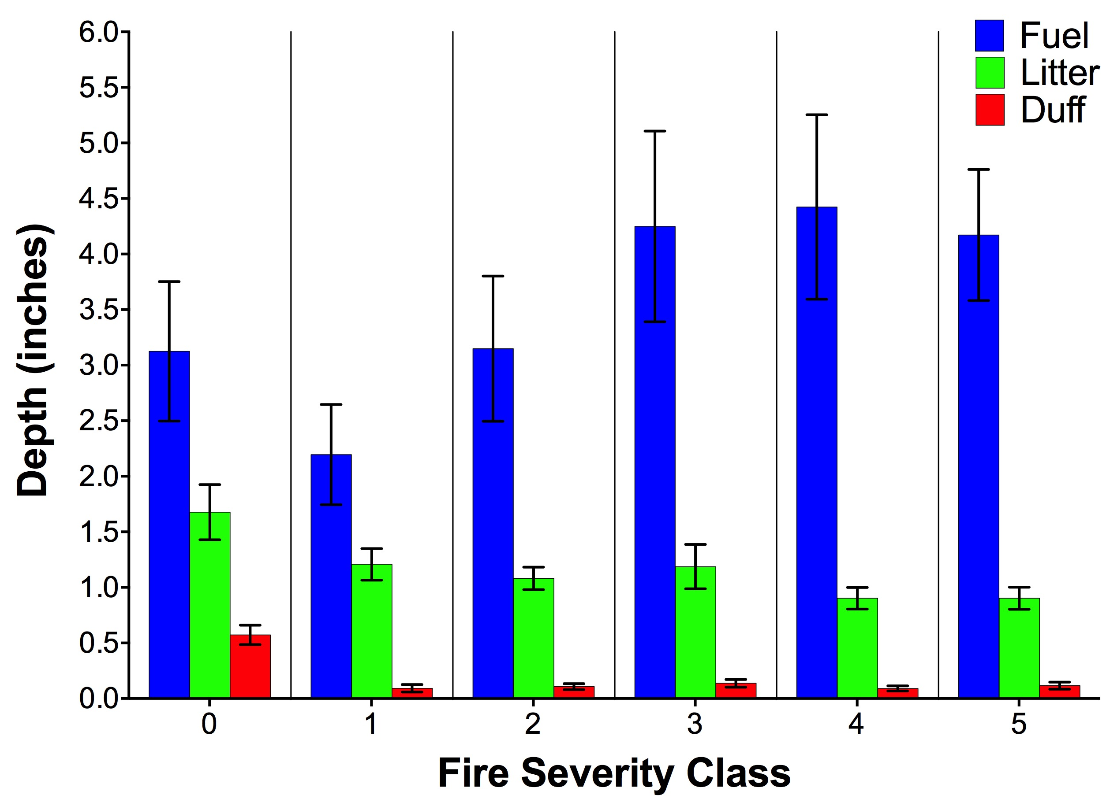
Fuels

Slide 16
Understory richness
Notes:
Analysis of species diversity indices did not reveal any statistically significant trends, but some patterns were observed. Species richness was lower in unburned plots than in any post-fire sites, which we attribute to more canopy cover and shading, thus more stressful (and possibly species filtering) growing conditions. Native species richness peaked in fire severity class 3; however, the native richness values among severity classes were not different enough to be statistically significant. Likewise there was no significance amongst severity classes for exotic plant richness, however there was a trend towards greater exotic plant richness in high severity sites.
In regards to the propose discussion question: Did the status of undesired species change?

Slide 17
Diversity #s & Understory Similarity
Fire Severity Class | Total Species Count | Total Species Richness | Native Species Richness | Exotic Species Richness | Shannon’s Diversity Index | Shannon’s Evenness Index
0 | 115 | 25.36 | 24.27 | 1.09 | 2.08 | 0.67
1 | 116 | 26.31 | 24.85 | 1.46 | 2.09 | 0.65
2 | 131 | 26.30 | 24.78 | 1.52 | 2.04 | 0.63
3 | 155 | 28.95 | 26.74 | 2.21 | 2.09 | 0.63
4 | 140 | 27.77 | 25.46 | 2.31 | 2.03 | 0.61
5 | 144 | 27.83 | 24.75 | 3.08 | 1.93 | 0.59
All plots | 191 | 27.29 | 25.21 | 2.08 | 2.03 | 0.63
More Similar ----------------> Less Similar

Slide 18
Major/key take-aways
1) Shade-intolerant species most abundant in high severity
2) Shade-tolerant most common in unburned and low severity
3) Shrub cover increases -> tree seedling density declined
4) From 2009 -2015:
- Conifer abundance doubled and height increased
- Annual growth rates significantly slowed (drought signal)
5) More coarse woody debris in high severity class.
6) Snag abundance increased with severity class.
7) Moderate severity fire benefits diversity. (IDH)

Slide 19
Acknowledgments
Field Crews
Chris Preston, Jacob Macdonald, Jake Albino, Marcel Safford, Ryan Jacobs, Michelle Rampula, Paul Excoffier
UC Davis
Korie Martinez, Joe Patrocinio, Debbie Davidson, Kevin Welch
USFS
Becky Estes, Shana Gross, Pioneer USFS Station, Camino Dispatch

