Slide 1
Forest structure, health, and fuels monitoring within multiple red fir vegetation management projects
Rebecca Wayman¹ ,Beverly Bulaon² ,Hugh Safford^{1,2}
1. University of California, Davis 2. USDA Forest Service Pacific Southwest Region
Notes:
I’m here to talk to you about a project partially within ACCG (boundary) that involves monitoring of forest treatments within red fir dominated sites. We don’t have any results yet! We’ve only collected pre-treatment data. So I’m not going to talk about the outcome of this monitoring, rather I’m just going to introduce you to what we are doing, and share some pre-treatment characteristics of the sites we are monitoring.

Slide 2
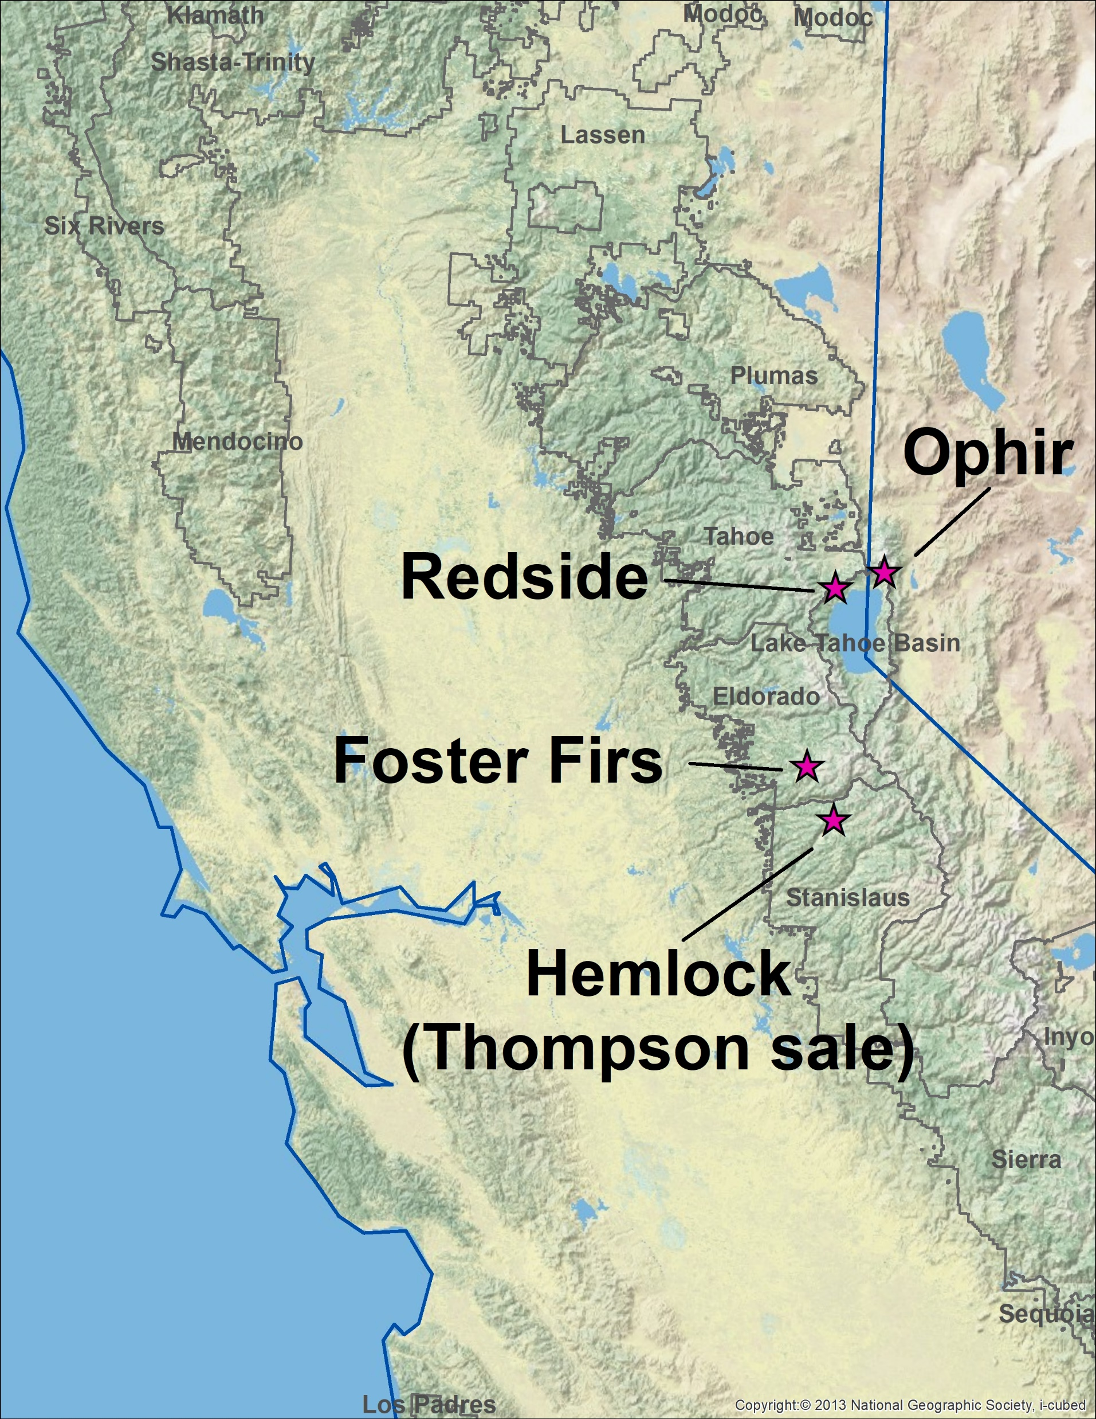
Background and Purpose
sparse information
+
multiple planned projects
=
opportunity to learn something new
Notes:
First, why are we monitoring these stands? Well, there is very sparse information on red fir, and in addition, it hasn’t recently been common to log these stands, so we’re especially lacking information on the ecological effects of thinning in red fir. It came to our attention that several thinning projects were concurrently being planned within red fir dominated forests, so we proposed conducting the same monitoring protocol across those locations with the plan of pooling the datasets for more robust analysis. The ACCG funded the monitoring of two sites, FF and the Thompson sale of the Hemlock project, and the LTBMU funded monitoring on two projects in the Tahoe basin.

Slide 3
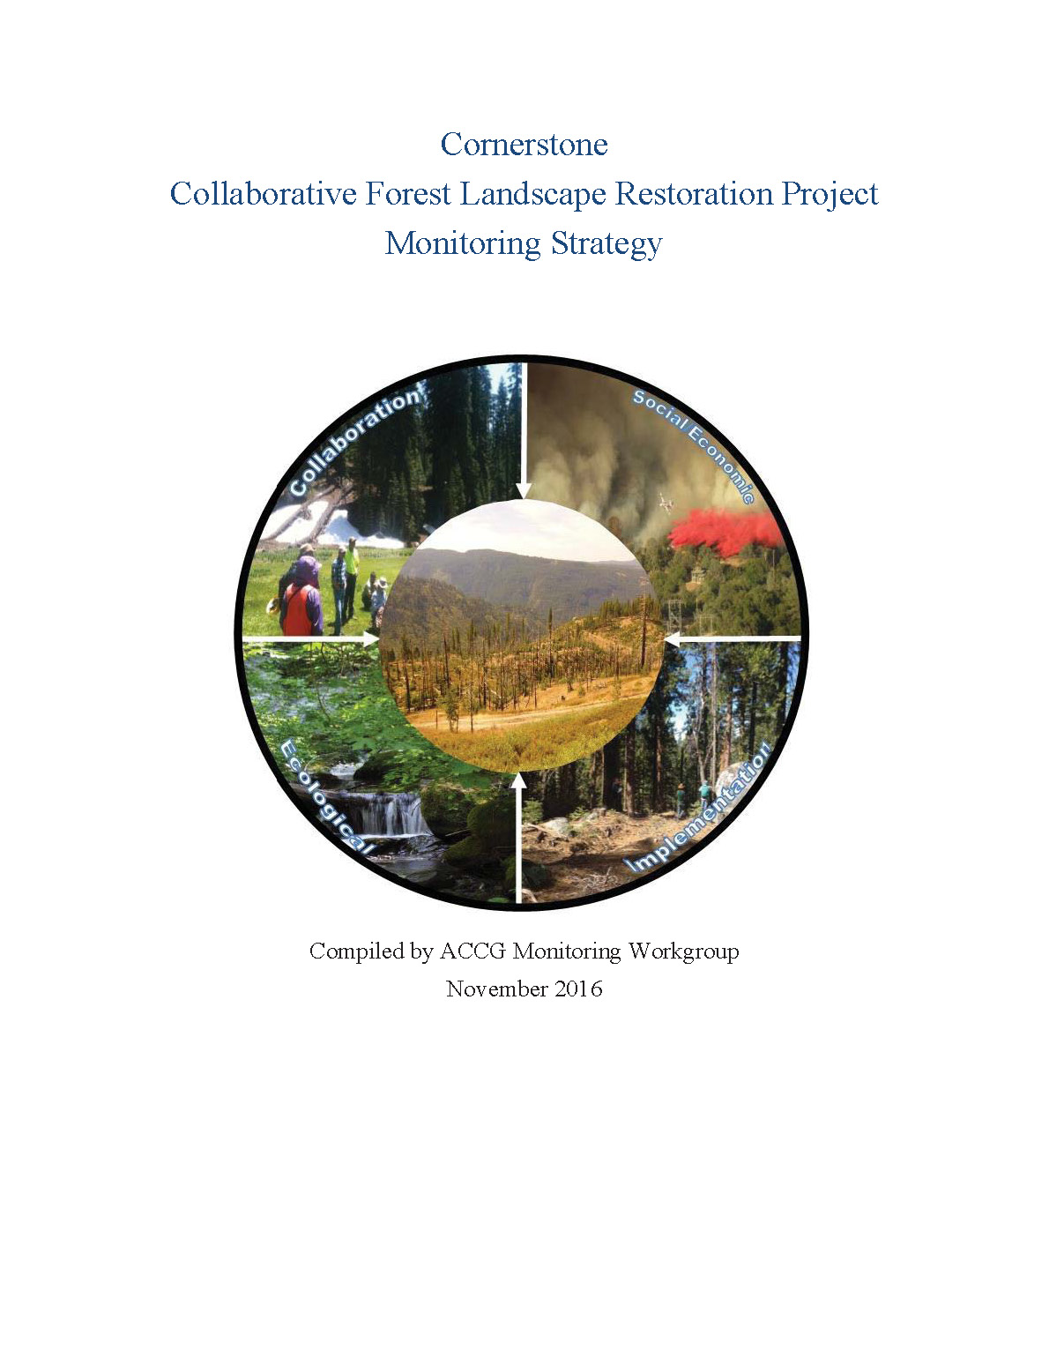
Background and Purpose
Notes:
The Cornerstone CFLRP has a monitoring element built in, specific goals for monitoring laid out, and a budget for that purpose. So we worked closely with Kendall Young and Shana Gross to develop a monitoring protocol that would answer a suite of ecological monitoring questions they had posed in their draft monitoring strategy, in a cost effective manner.

Slide 4
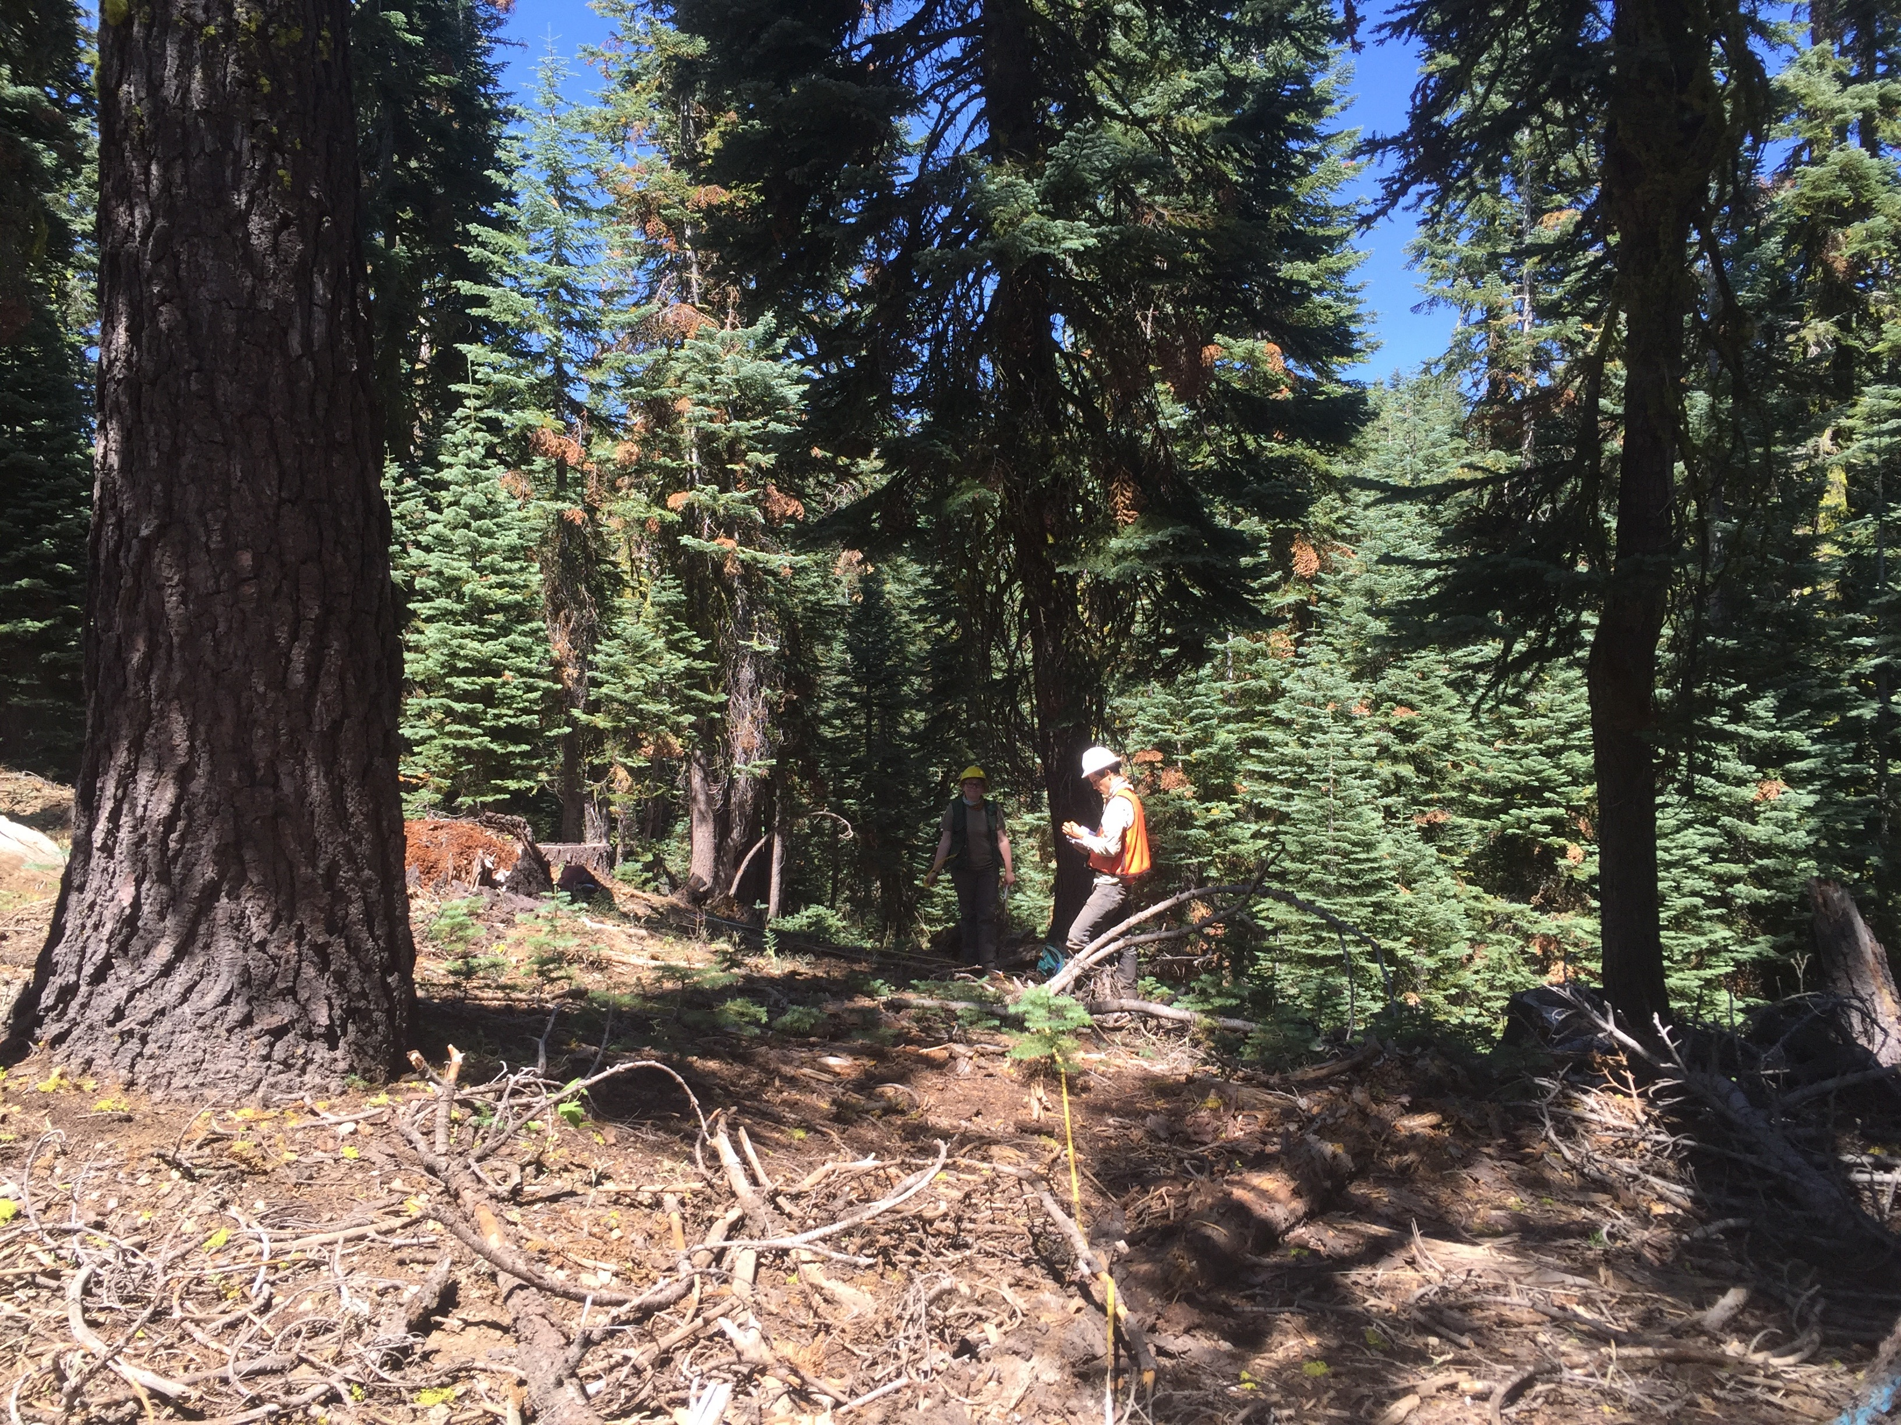
Background and Purpose
Concern over dwarf mistletoe (Arceuthobium abietinum), Cytospora canker (Cytospora abietis), and other pathogens
Foster Firs plot 20, 2016. M. Rampulla
Notes:
One of the other main drivers motivating this project was that Beverly Bulaon, forest entomologist, and Martin Mackenzie, forest pathologist, expressed interest in gathering information on how treatments may affect forest pathogens – red fir dwarf mistletoe and the associated Cytospora canker in particular. So, we used a monitoring protocol developed by Marc Meyer for use in red fir in the southern sierras, and adapted it to the specific priorities of the ACCG and the forest health questions we have.
Before I leave this slide I’ll diverge very briefly into some natural history on these pathogens. You can see here there’s a bit of red flagging on these branches.

Slide 5
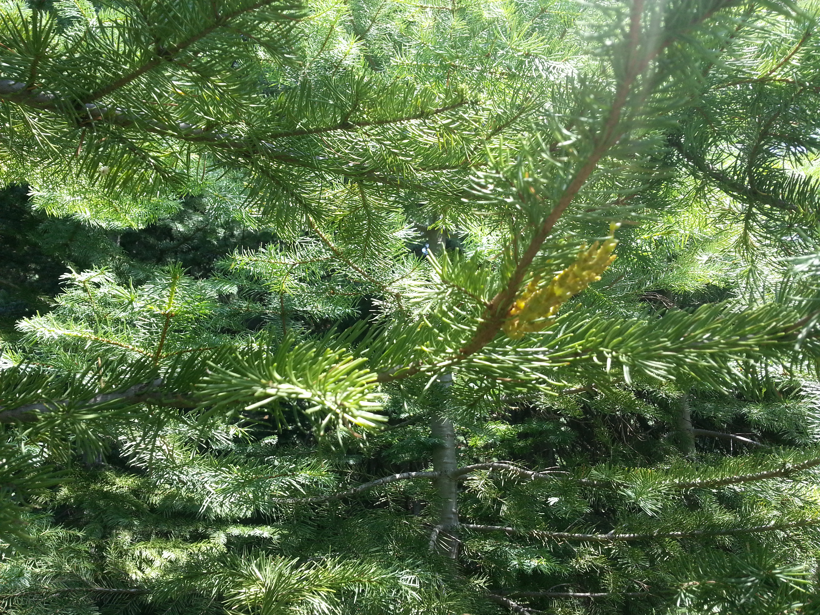
Background and Purpose
Foster Firs 2016. R. Wayman
Red fir dwarf mistletoe
Notes:
Here’s a close-up of the dwarf mistletoe on the branch of a young red fir tree at Foster Firs. You can see the yellow mistletoe and you can also probably tell that it takes a little looking to find this yellowish green plant within the needles – it’s tucked in there but fairly visible once you’re looking.
This plant flowers in late summer. Fruits take a little over a year to mature – so seeds are discharged in Sept and Oct, and they explode out of the plant to sort of launch them for greater dispersal. They usually go 10 or 15 feet but can go farther. They germinate in early spring, but don’t produce seeds for 4 or 5 years. They usually infect one year old branches (not necessarily young trees) because the bark is softer.

Slide 6
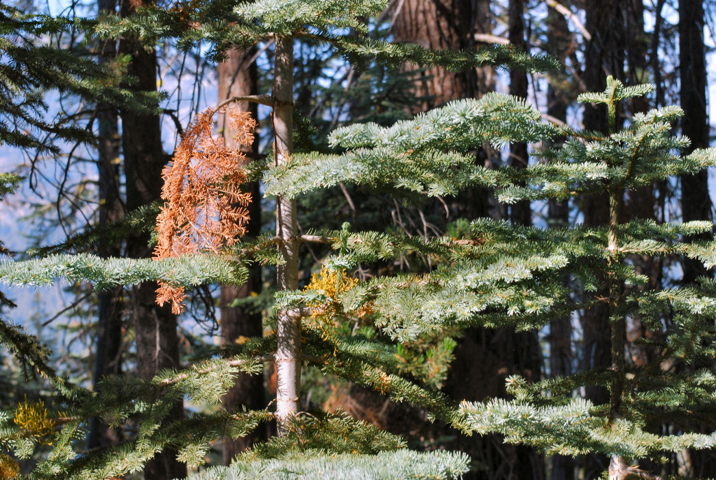
Background and Purpose
Eldorado NF, M. Mackenzie
Red fir dwarf mistletoe and Cytospora canker
Notes:
Once the branch is infected with mistletoe it swells, leaving it vulnerable to infection by the Cytospora canker, which then kills the portion of the branch outward from the infection.

Slide 7
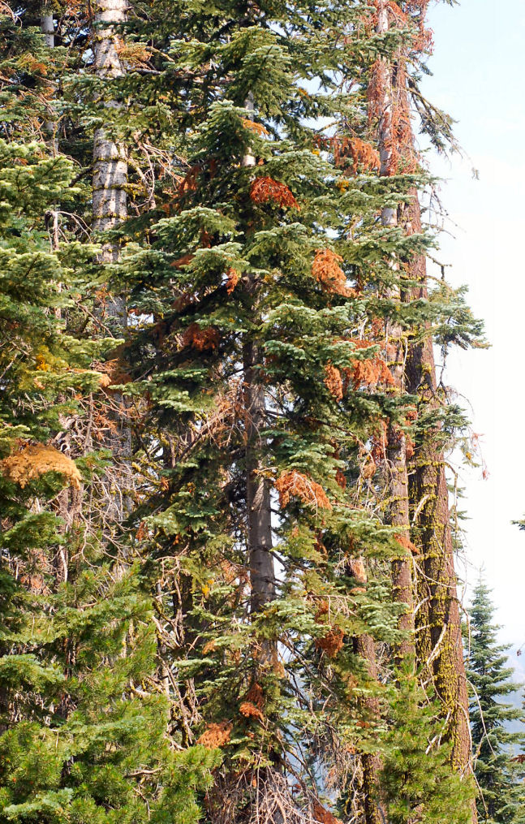
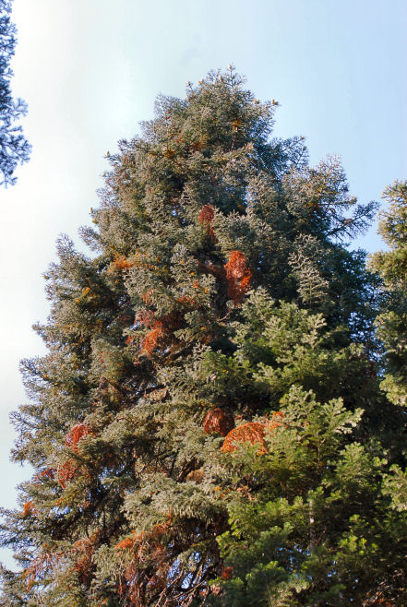
Background and Purpose
Eldorado NF, M. Mackenzie
Eldorado NF, M. Mackenzie
Red fir flagging from Cytospora canker
Notes:
Because dwarf mistletoe and Cytospora are so closely associated, you can generally rely on this red flagging, caused by the Cytospora, to indicate presence of dwarf mistletoe, which is harder to spot, especially from far away or if it’s high up in the tree.
A major reason for monitoring the thinning treatments within areas of mistletoe infestations is to see what effect it may have on rates of DMR infection.
increased distances between trees may inhibit spread if trees are spaced farther than the distance travelled by the projectile seed dispersal, although understory trees in most of these stands are already infected, so this benefit may not show up in the current generation of live trees, and may only come to pass if thinning keeps occurring in the understory so that young trees don’t get infected to begin with.
increased tree species diversity may reduce instance of the pathogen because it is host-specific, so buffers of other tree species may inhibit spread – although planting is not in the treatment plans here and they are not specifically designed for increased conifer diversity.

Slide 8
Project Sites
Notes:
We designed a monitoring protocol that aims to capture dwarf mistletoe/cytospora infestations as well as to answer several monitoring questions posed by the ACCG. Before I go into that, I’ll describe some basics on the sites we monitored. I’ll refer in this talk at times to the ACCG sites, and that refers to these on the Eldorado and Stanislaus NFs, and the Basin sites, which are these north of Lake Tahoe.
There are a few differences between these pairs of sites. The basin sites are on the east slope of the sierra crest, and the ACCG sites are on the west slope. The basin sites are slightly higher elevation: Ophir above 8000, Redside about 8000, FF and H more in the 7200-7600 foot range.
They also have different management histories, although I’m still trying to piece those together. I have some contacts who have information but if anyone else knows who I should talk with to get more details on management history, please let me know later.

Slide 9
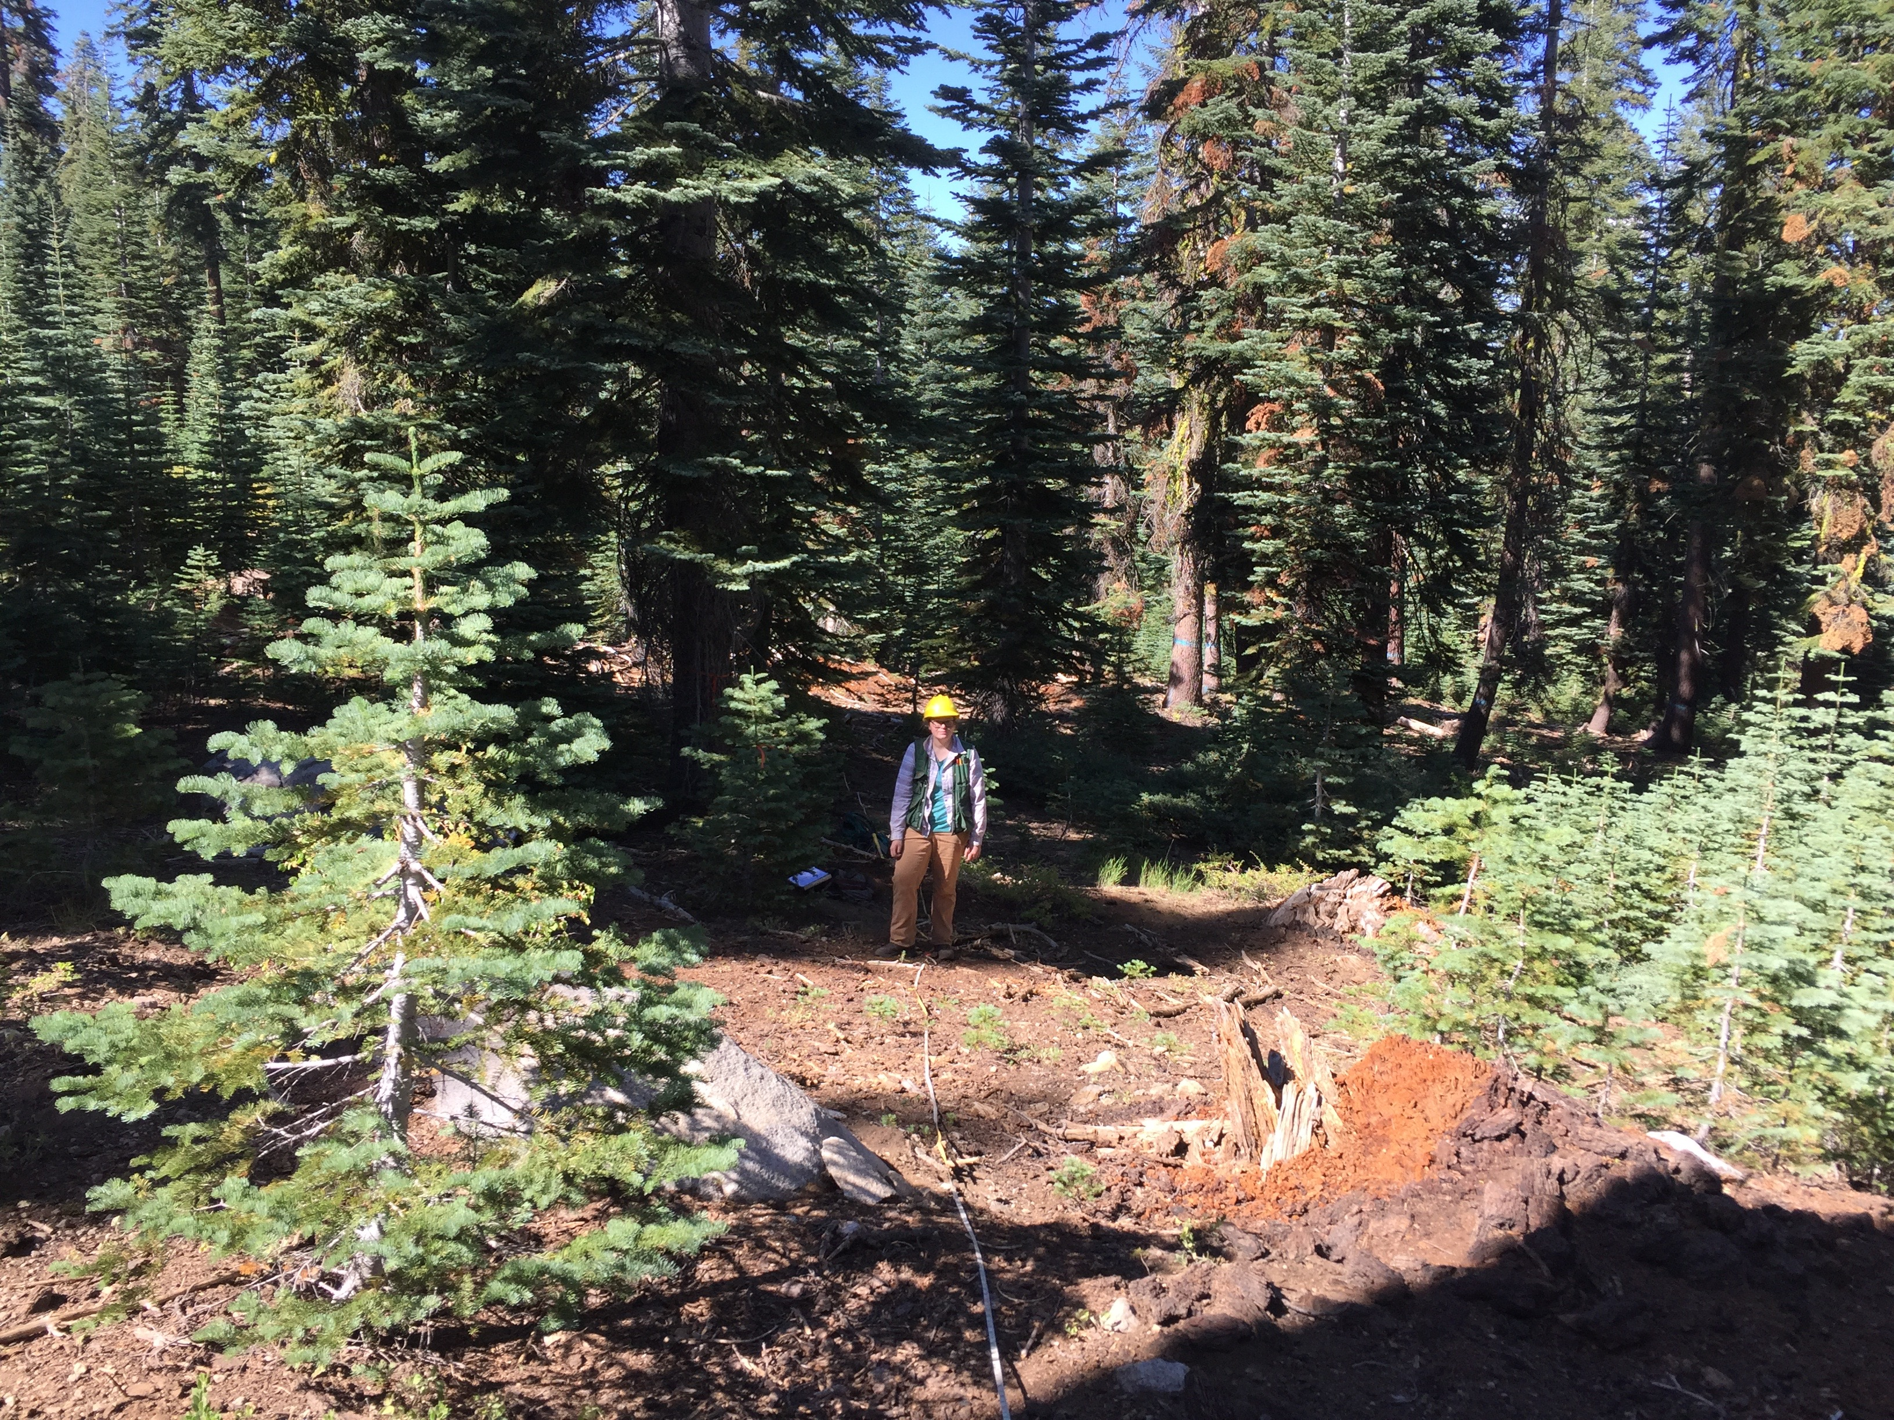
Monitoring Questions
How did treatments affect:
basal area and canopy cover
tree density and species composition
structural diversity, including shrubs
herbaceous plant cover
Foster Firs plot 4, 2016. M. Rampulla
Notes:
The next few slides describe the monitoring questions we seek to answer. This first list covers some questions posed by the ACCG that our protocol should address regarding stand and understory structure and species composition.

Slide 10
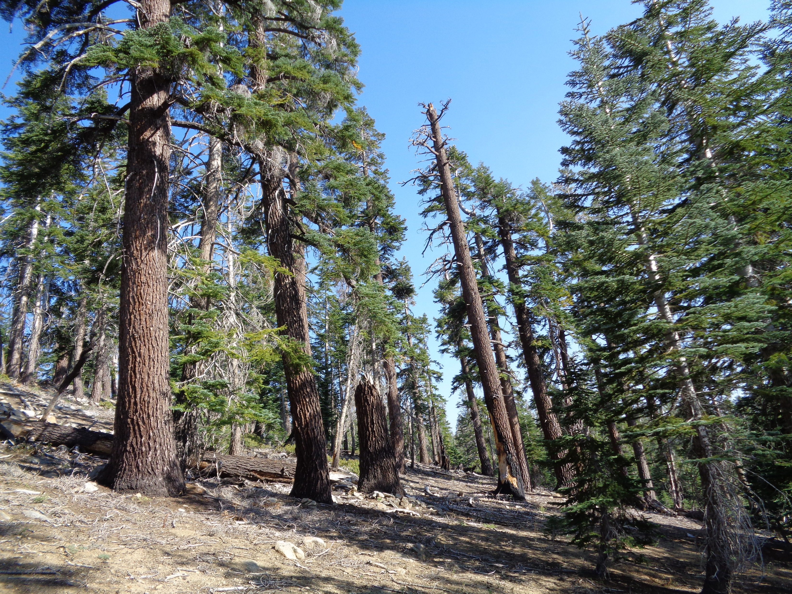
Monitoring Questions
How did treatments affect:
habitat for Mature Sensitive Forest species across projects
snag densities and size classes
large trees and defect trees
M. Meyer 2015
Notes:
These are ACCG monitoring questions that relate to wildlife habitat

Slide 11
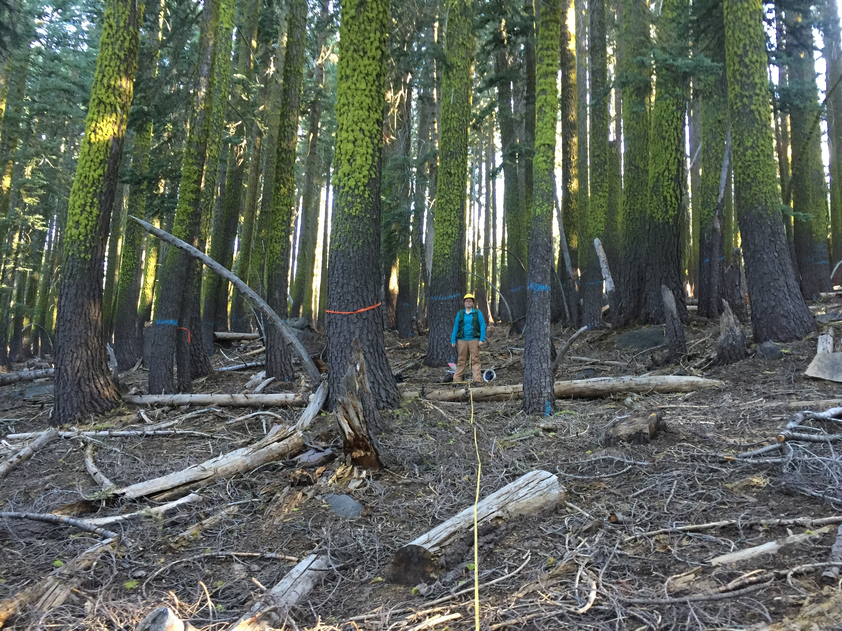
Monitoring Questions
How did treatments affect:
standing and downed fuels
presence of invasive plant species
Foster Firs plot 26, 2016. M. Rampulla
Notes:
Additional questions related to fuels and invasive plants.

Slide 12
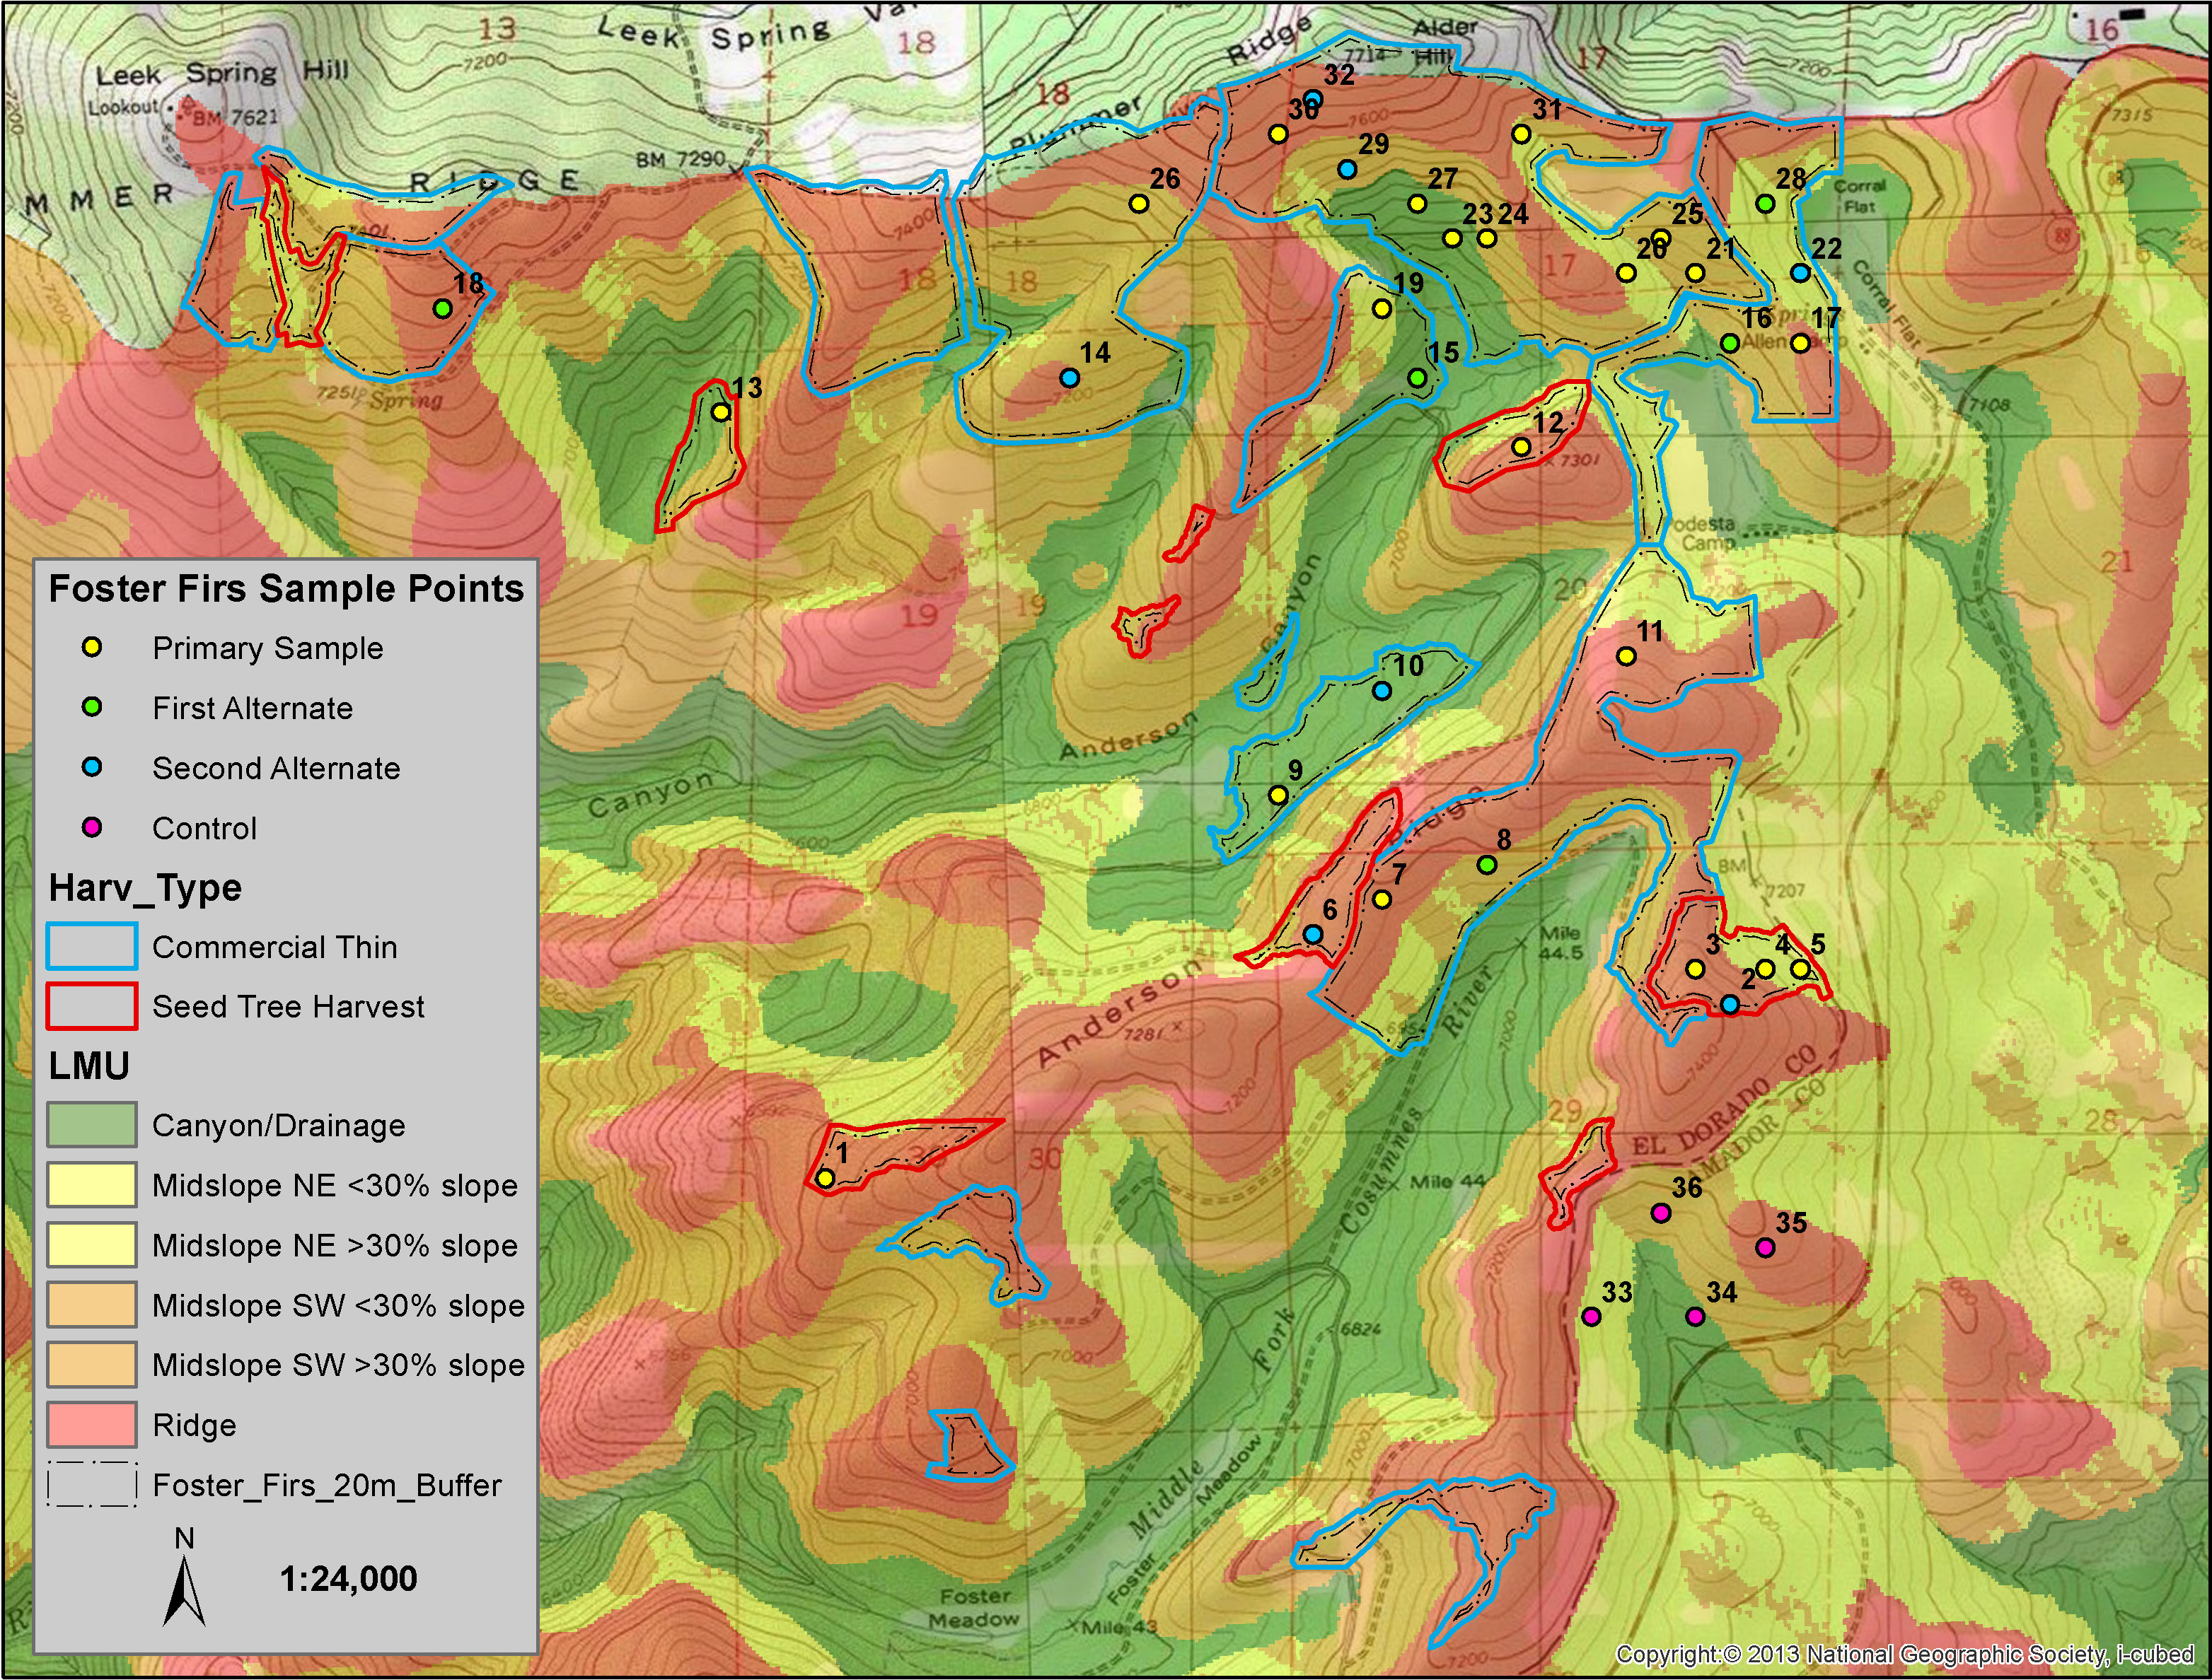
Sampling Methods
Plot stratification:
landscape management unit (LMU)
treatment type
Notes:
Here’s an example of how we stratified our plot selection on the ACCG projects. We didn’t go to the same level of stratification for the Basin sites, partly because they are much smaller and more constrained, and also because they didn’t have multiple treatment types within a project. So being smaller/more constrained meant we just selected a random sample without regards to LMU. Landscape management unit is a way of differentiating the landscape into categories that reflect the growing conditions as driven by slope position and aspect. So here we have:
canyon bottoms and drainages in green
yellows are midslope with NE aspect
oranges are midslope with SW aspect
red represents ridgetops
We stratified by LMU and by treatment type, created a buffer from the treatment edge, and made a random selection across those stratifications from a choice of points on a 100m grid. We also put a grid across suitable control areas outside of planned treatments and randomly selected points from that.

Slide 13
Sampling Methods
Permanent plots:
1000 m^2 (0.1 ha, ~0.25 ac)
61 treatment plots, 14 control plots
Recorded:
stand structure variables
invasive species presence
cover of herbs, shrubs, other ground cover types
Brown’s fuels transects
conifer regeneration by species
forest health metrics
Hemlock plot 1, 2016. M. Rampulla
Notes:
In total, we sampled 75 plots on the 4 projects. Plots were 1000 m^2, and recorded several metrics in these categories

Slide 14
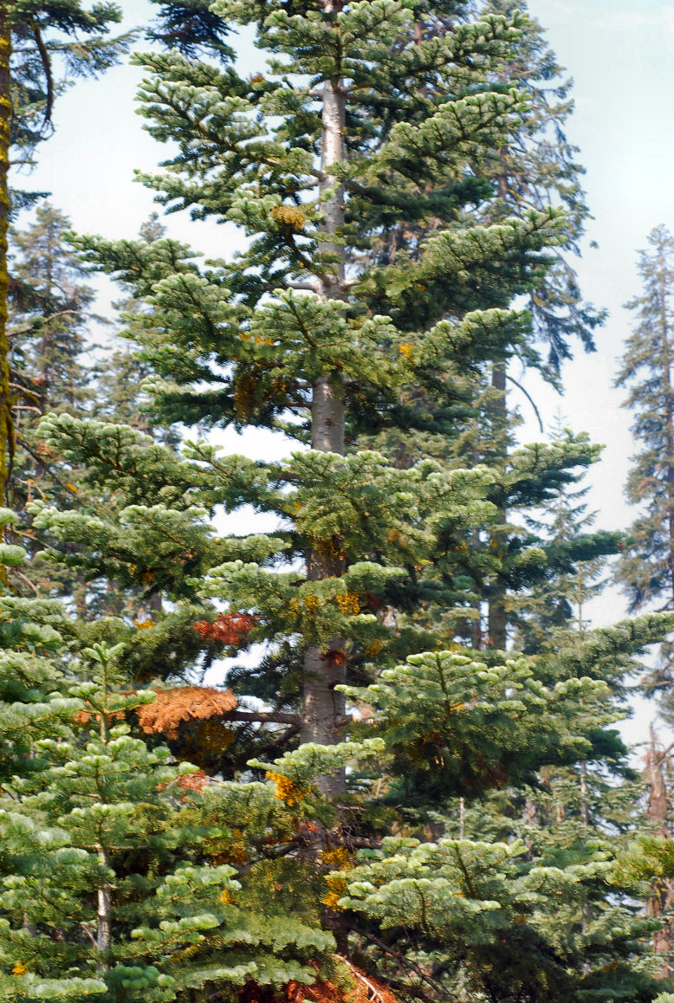
Sampling Methods
Forest Health Metrics:
Dwarf mistletoe rating
Health code (code for things like boring dust from bark beetles, pouch fungus, blister rust, dead top, etc.)
Attack status code for phase of beetle attack
Beetle attack snag code for standing dead trees
Snag decay class
Eldorado NF, M. Mackenzie

Slide 15
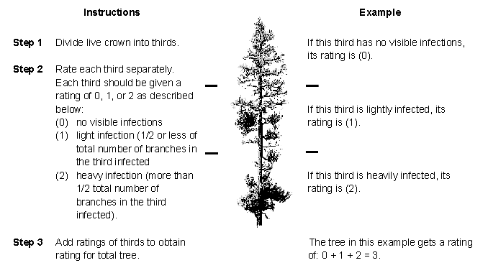
Sampling Methods
6-class dwarf mistletoe rating system (Hawksworth 1977)

Slide 16
Pre-treatment Site Characteristics
Notes:
Take home: lots of red fir

Slide 17
Pre-treatment Site Characteristics
Notes:
Take home: large reduction in basal area is planned

Slide 18
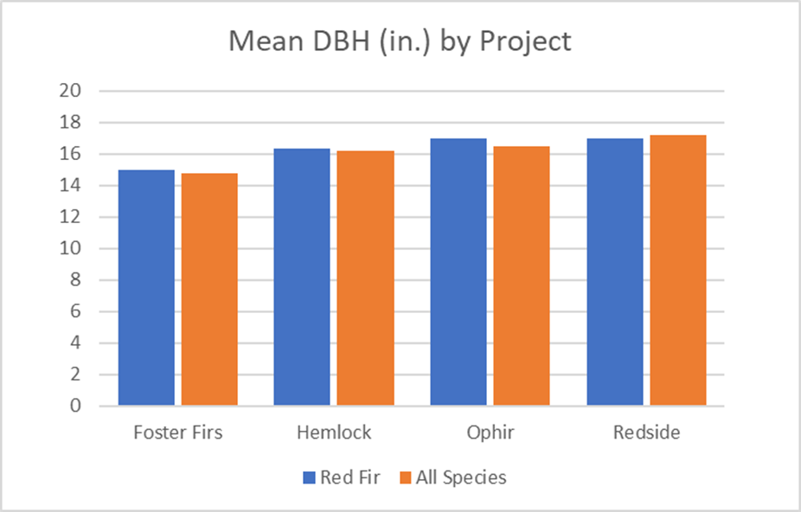
Pre-treatment Site Characteristics
Notes:
Take home: similar mean DBH, but lowest for Foster Firs

Slide 19
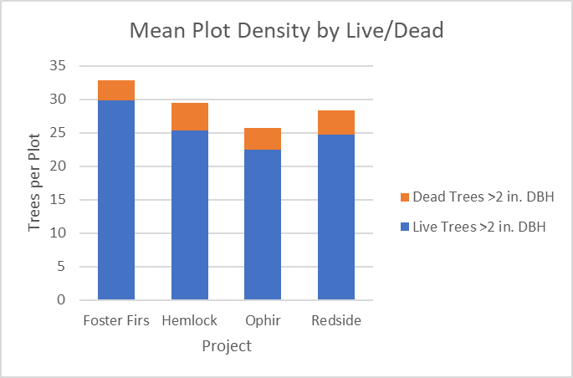
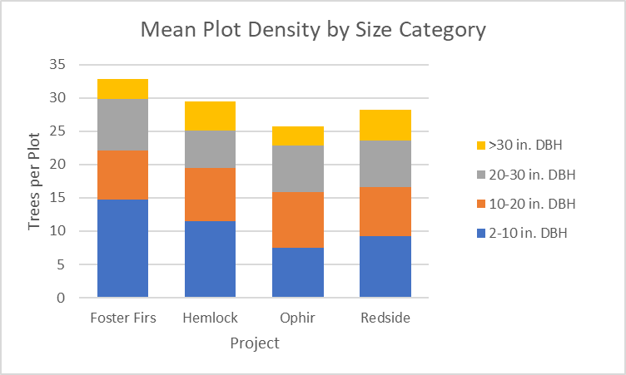
Pre-treatment Site Characteristics
Notes:
Take home: Foster Firs has high density and lots of small trees. Redside has a large proportion of large trees.

Slide 20
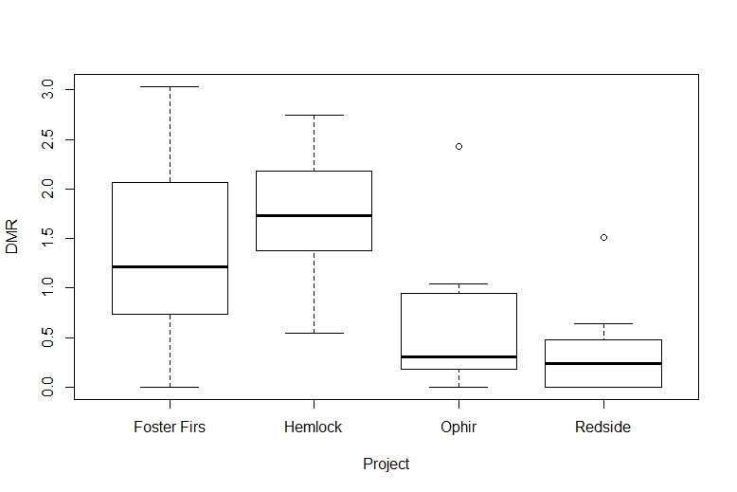
Pre-treatment Site Characteristics
Notes:
Ophir and Redside have significantly lower DMR rating than FF and Hemlock. Several explanations – density, drier east slope sites vs. wetter west slope, could be management history although I don’t have lots of details on that yet.

Slide 21
Thank You
contact: rbwayman@ucdavis.edu
Notes:
I’m happy to talk with any of you about this project, so please feel free to get in touch with me. Thank you!

