Slide 1
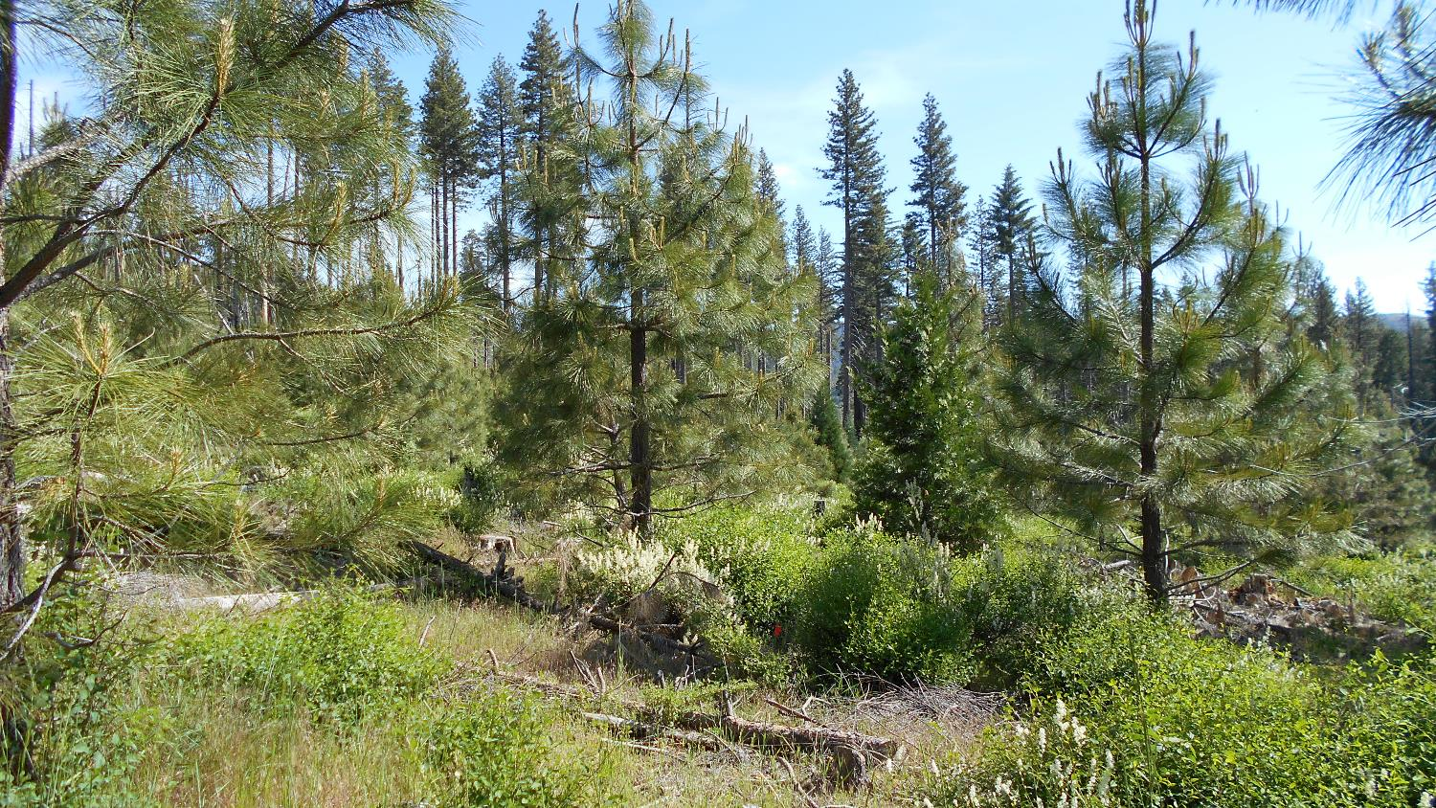
Post-fire management regimes on plantation growth and development: can we find effective tools to quickly restore a resilient forest?
Jianwei Zhang - USDA Forest Service, PSW - Redding, California
Iris Allen, Mukti Subedi, and Steve Chhin – West Virginia University, Morgantown, WV

Slide 2
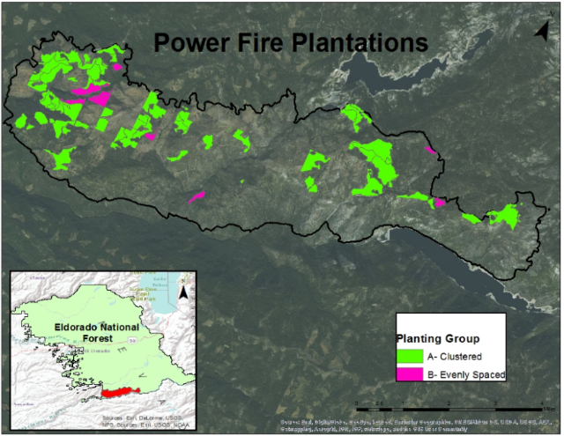
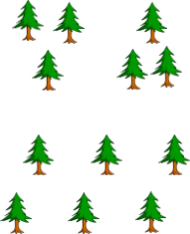
Background
Plantations were established in the high-severity areas of Power Fire in 2004
Planting arrangements:
  A: Clustered arrangement - 2-4 trees ( 6ꞌ x 21ꞌ )
  B: Evenly spaced (10ꞌ or 15ꞌ )
Most plantations have been thinned during last few years

Slide 3
Goals
Compare the effects of planting arrangements (cluster or even-spaced planting) on stand growth and development, understory species structure and composition, microsite condition, fire behavior and soil characteristics
Compare these data with natural regenerated stands aiming to find an effective tool to quickly restore a resilient forest
Model fire behavior in each stand
Model stand growth and dynamics into the future

Slide 4
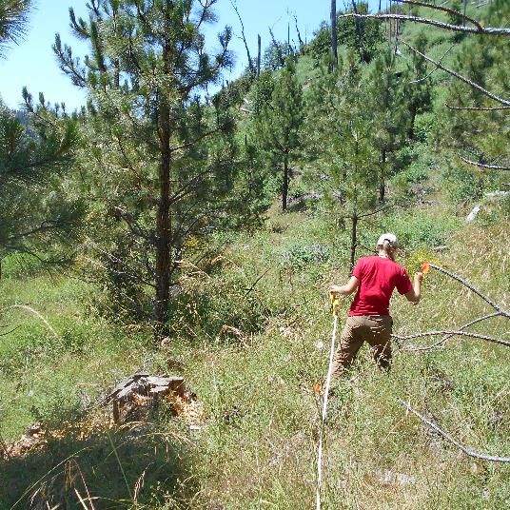
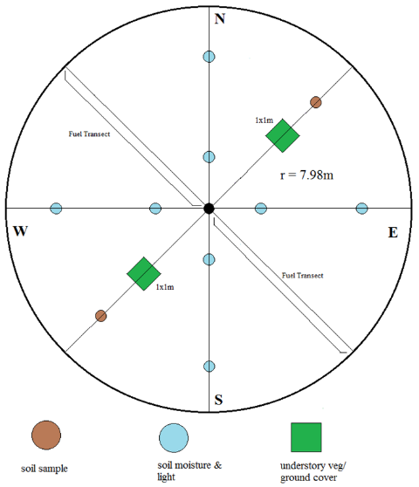
Sampling design
Plantation
  A: Clustered (5 stands – 25 plots)
  B: Evenly Spaced (5 stands – 15 plots)
Natural Regeneration
  Four stands - 20 plots
Measurement variables
  Tree - Species, DBH, Height, Increment core, crown width, height to live crown, etc.
  Understory – Species, Point count, % cover in ground cover plot, etc.
  Microsite – Light, soil moisture and temperature, air temp and relative humidity, etc.

Slide 5
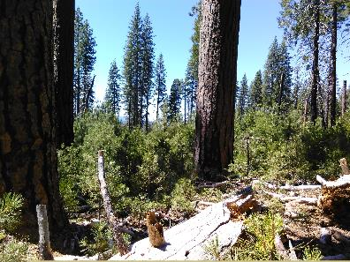
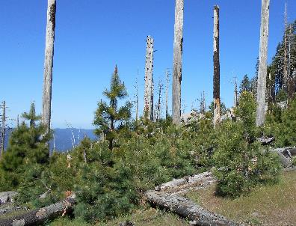
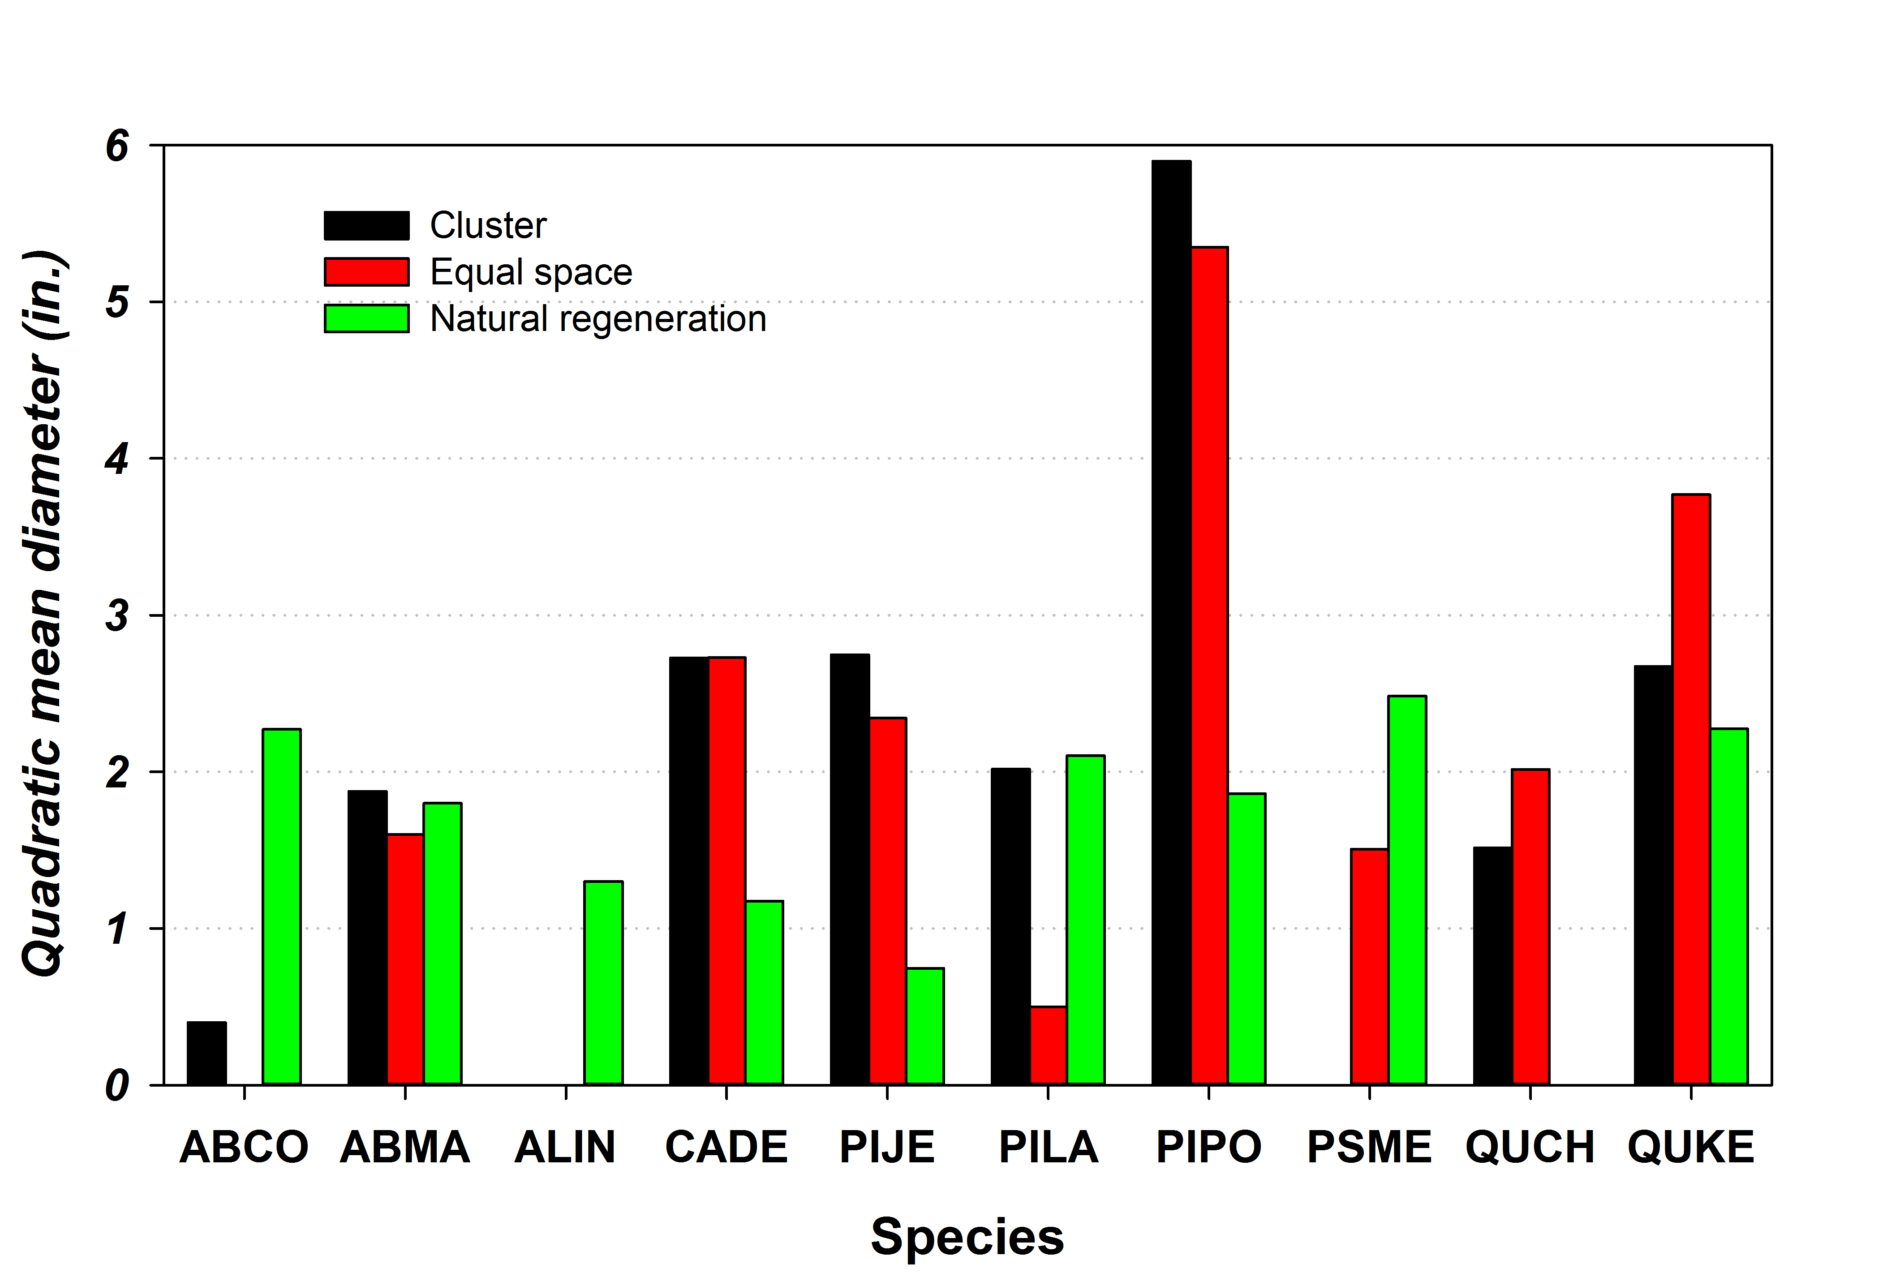
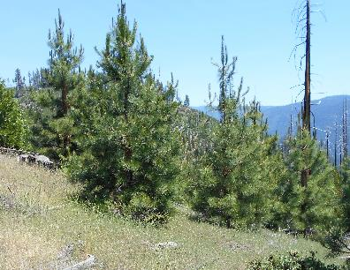
Preliminary Results
Planted trees grew significantly larger than naturally regenerated trees
No difference in DBH was found between the two planting arrangements.

Slide 6
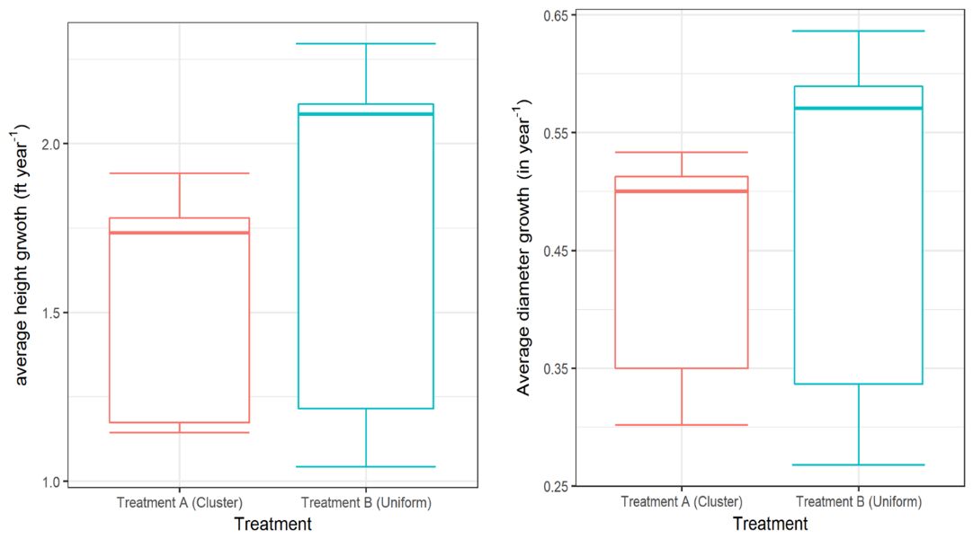
Annual DBH & height growth

Slide 7
Density
Although ponderosa and Jeffery pine dominate both plantations and natural stands, there is abundant natural regeneration for other species, esp. incense-cedar.
  ABCO = Abies concolor
  ABMA = Abies magnifica
  ALIN = Alnus incana
  CADE = Calocedrus decurrens
  PIJE = Pinus jefferyii
  PILA = Pinus lambertiana
  PIPO = Pinus ponderosa
  PSME = Pseudotuga menziesii
  QUCH = Quercus chrysolepis
  QUKE = Quercus kelloggii

Slide 8
TENTATIVE CONCLUSIONS
Plantation provides a better opportunity for restoring a resilient forest faster due to rapid growth and easier ability to thin
Both planting arrangements yielded a similar density after PCT
Plantation can also be managed toward a mixed and uneven-aged forest with abundant natural regeneration of incense-cedar, Douglas-fir, black oak, etc.

Slide 9
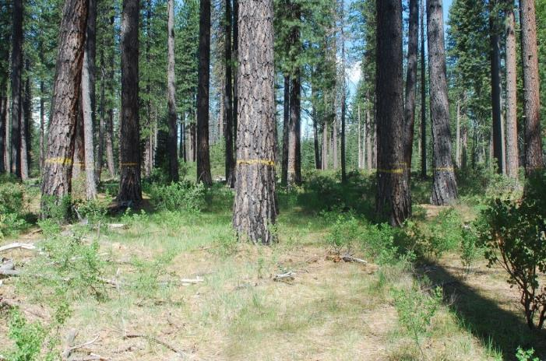
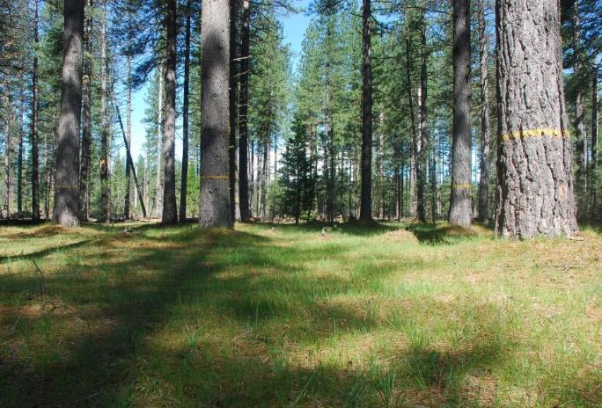
Can we create a resilient forest with our treatments?
Edson Creek Plot
Show Plantation Plot

Slide 10
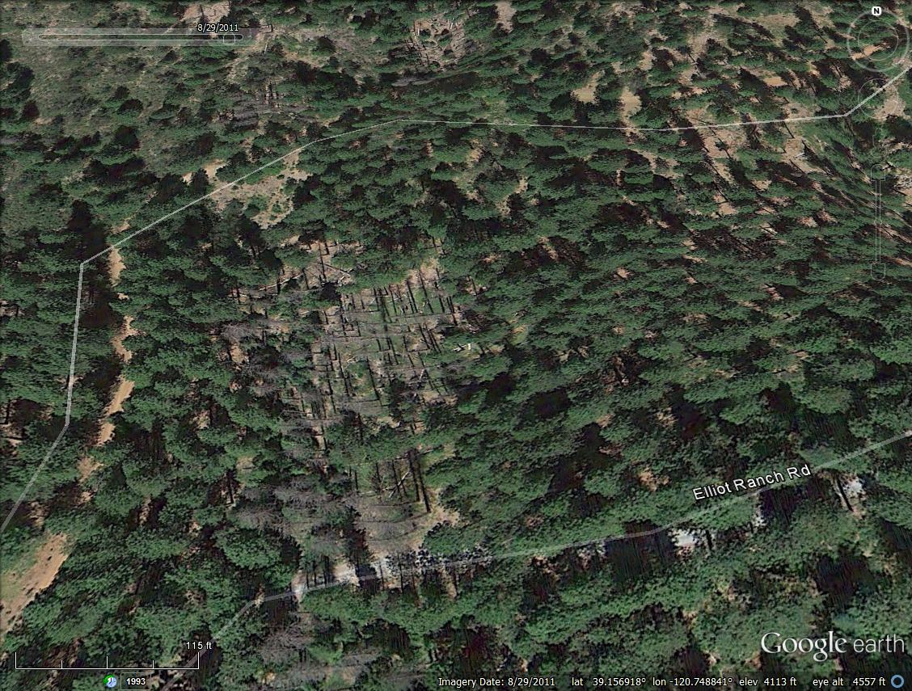
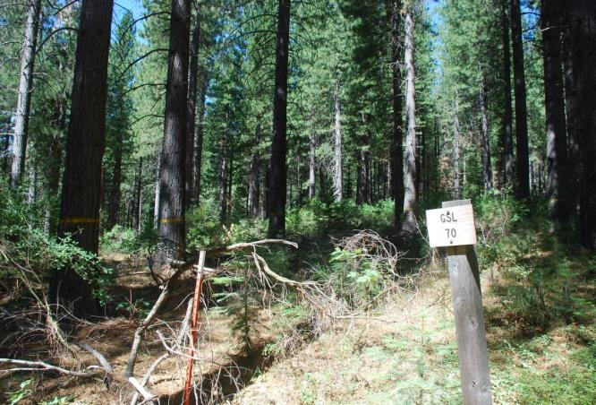
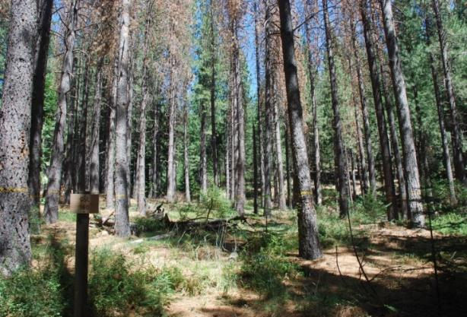
TPA = 40
BA = 150 ft²/ac
TPA = 130
BA = 270 ft²/ac
Notes:
Not only they are the same age, both plots could be side by side. This is from google earth 2011. The pictures were taken in 2009.

Slide 11
Acknowledgements
Jeff Griffin, Bob Carrol, Becky Estes, Shana Gross at Eldorado National Forest
Kaelyn Finley in PSW, Mike Premer and Stephi Dickinson at West Virginia University

