Slide 1
Big Creek Plantation Establishment and Management
Photos and notes from Dinkey LPWG trip on 11-2-16
Big Creek fire (1994) was about 5,600 acres and about half of it was planted using a variety of approaches (i.e., planting density, arrangement, release, follow up maintenance, etc.).
Some highlights of the management approach (in order of application):
Spacing was either 16-18 feet or 20 feet (the wide spacing was to limit need for pre-commercial thinning)
Release was hand (on shrubs that were seeders) or chemical (shrubs that were sprouters)
Three seedlings were planted at each point
Two of three seedlings were cut at years 3-5
Pruning occurred at years 6-10 and removed 2-3 whorls (up to 50% of crown)
First burn was in fall after buds dormant and after pruning
Plan is to apply next disturbance at years 20-25 (that would be about now)
For the Big Creek units, not all of the above were applied in all locations. None of the treatments since planting used mechanical treatment
Trees per acre:
For 20’ x 20’ spacing there would be about 100 planting locations per acre with three trees per location; this yields 300 TPA. Two of the three saplings at each location will be cut at years 2-3 leaving 1 tree per location or about 100 TPA
For a 18’ x 18’ spacing, there are about 133 planting locations with the post-lopping density being 133 TPA
For a 16’ x 16’ spacing, there are about 169 planting locations with the post-lopping density being 169 TPA

Slide 2
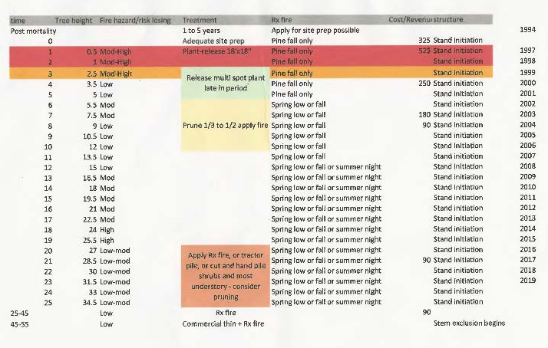
The chart below gives some details about the management practices.

Slide 3
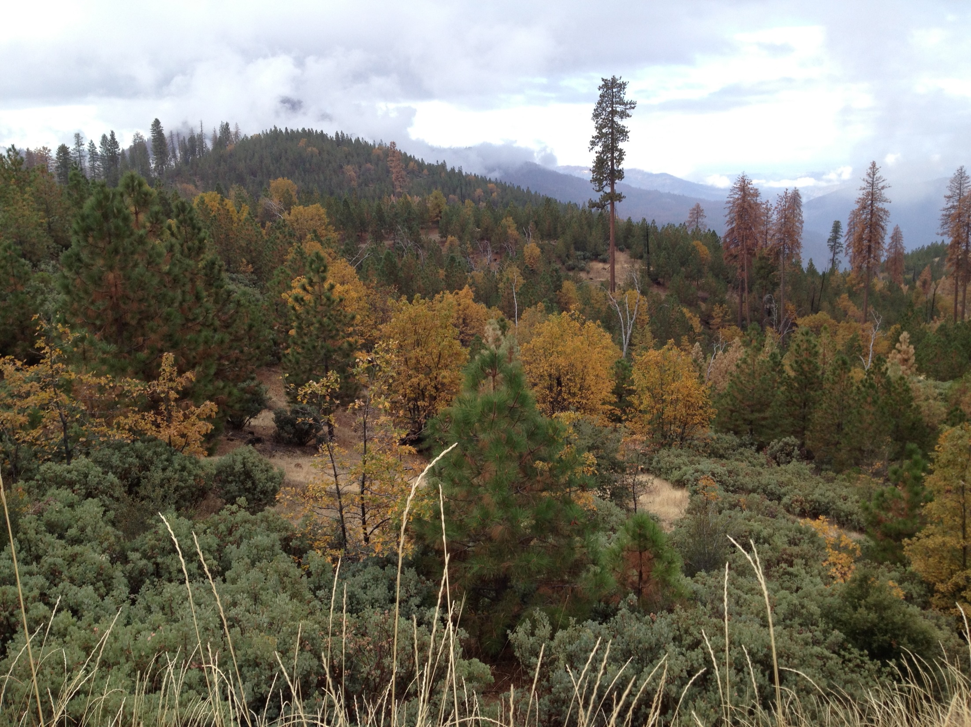
16’ x 16’ or 18’ x 18’ tree spacing
Within 250’ of road tree planting less dense (20’ x 20’ spacing). Shrub cover 20-25 % and more forbs.
Area down slope was hand cut and hand piled, then sprayed– this was done to control Spanish broom.
Just beyond ~75 feet of road – area was thinned and brush cut at year 7 and the slash scattered. The area was pruned at year 9.
Around year 5 to 8 - trees are small enough and few enough that slash was easily incorporated into soil.
The only other treatment was gopher control at year 2.

Slide 4
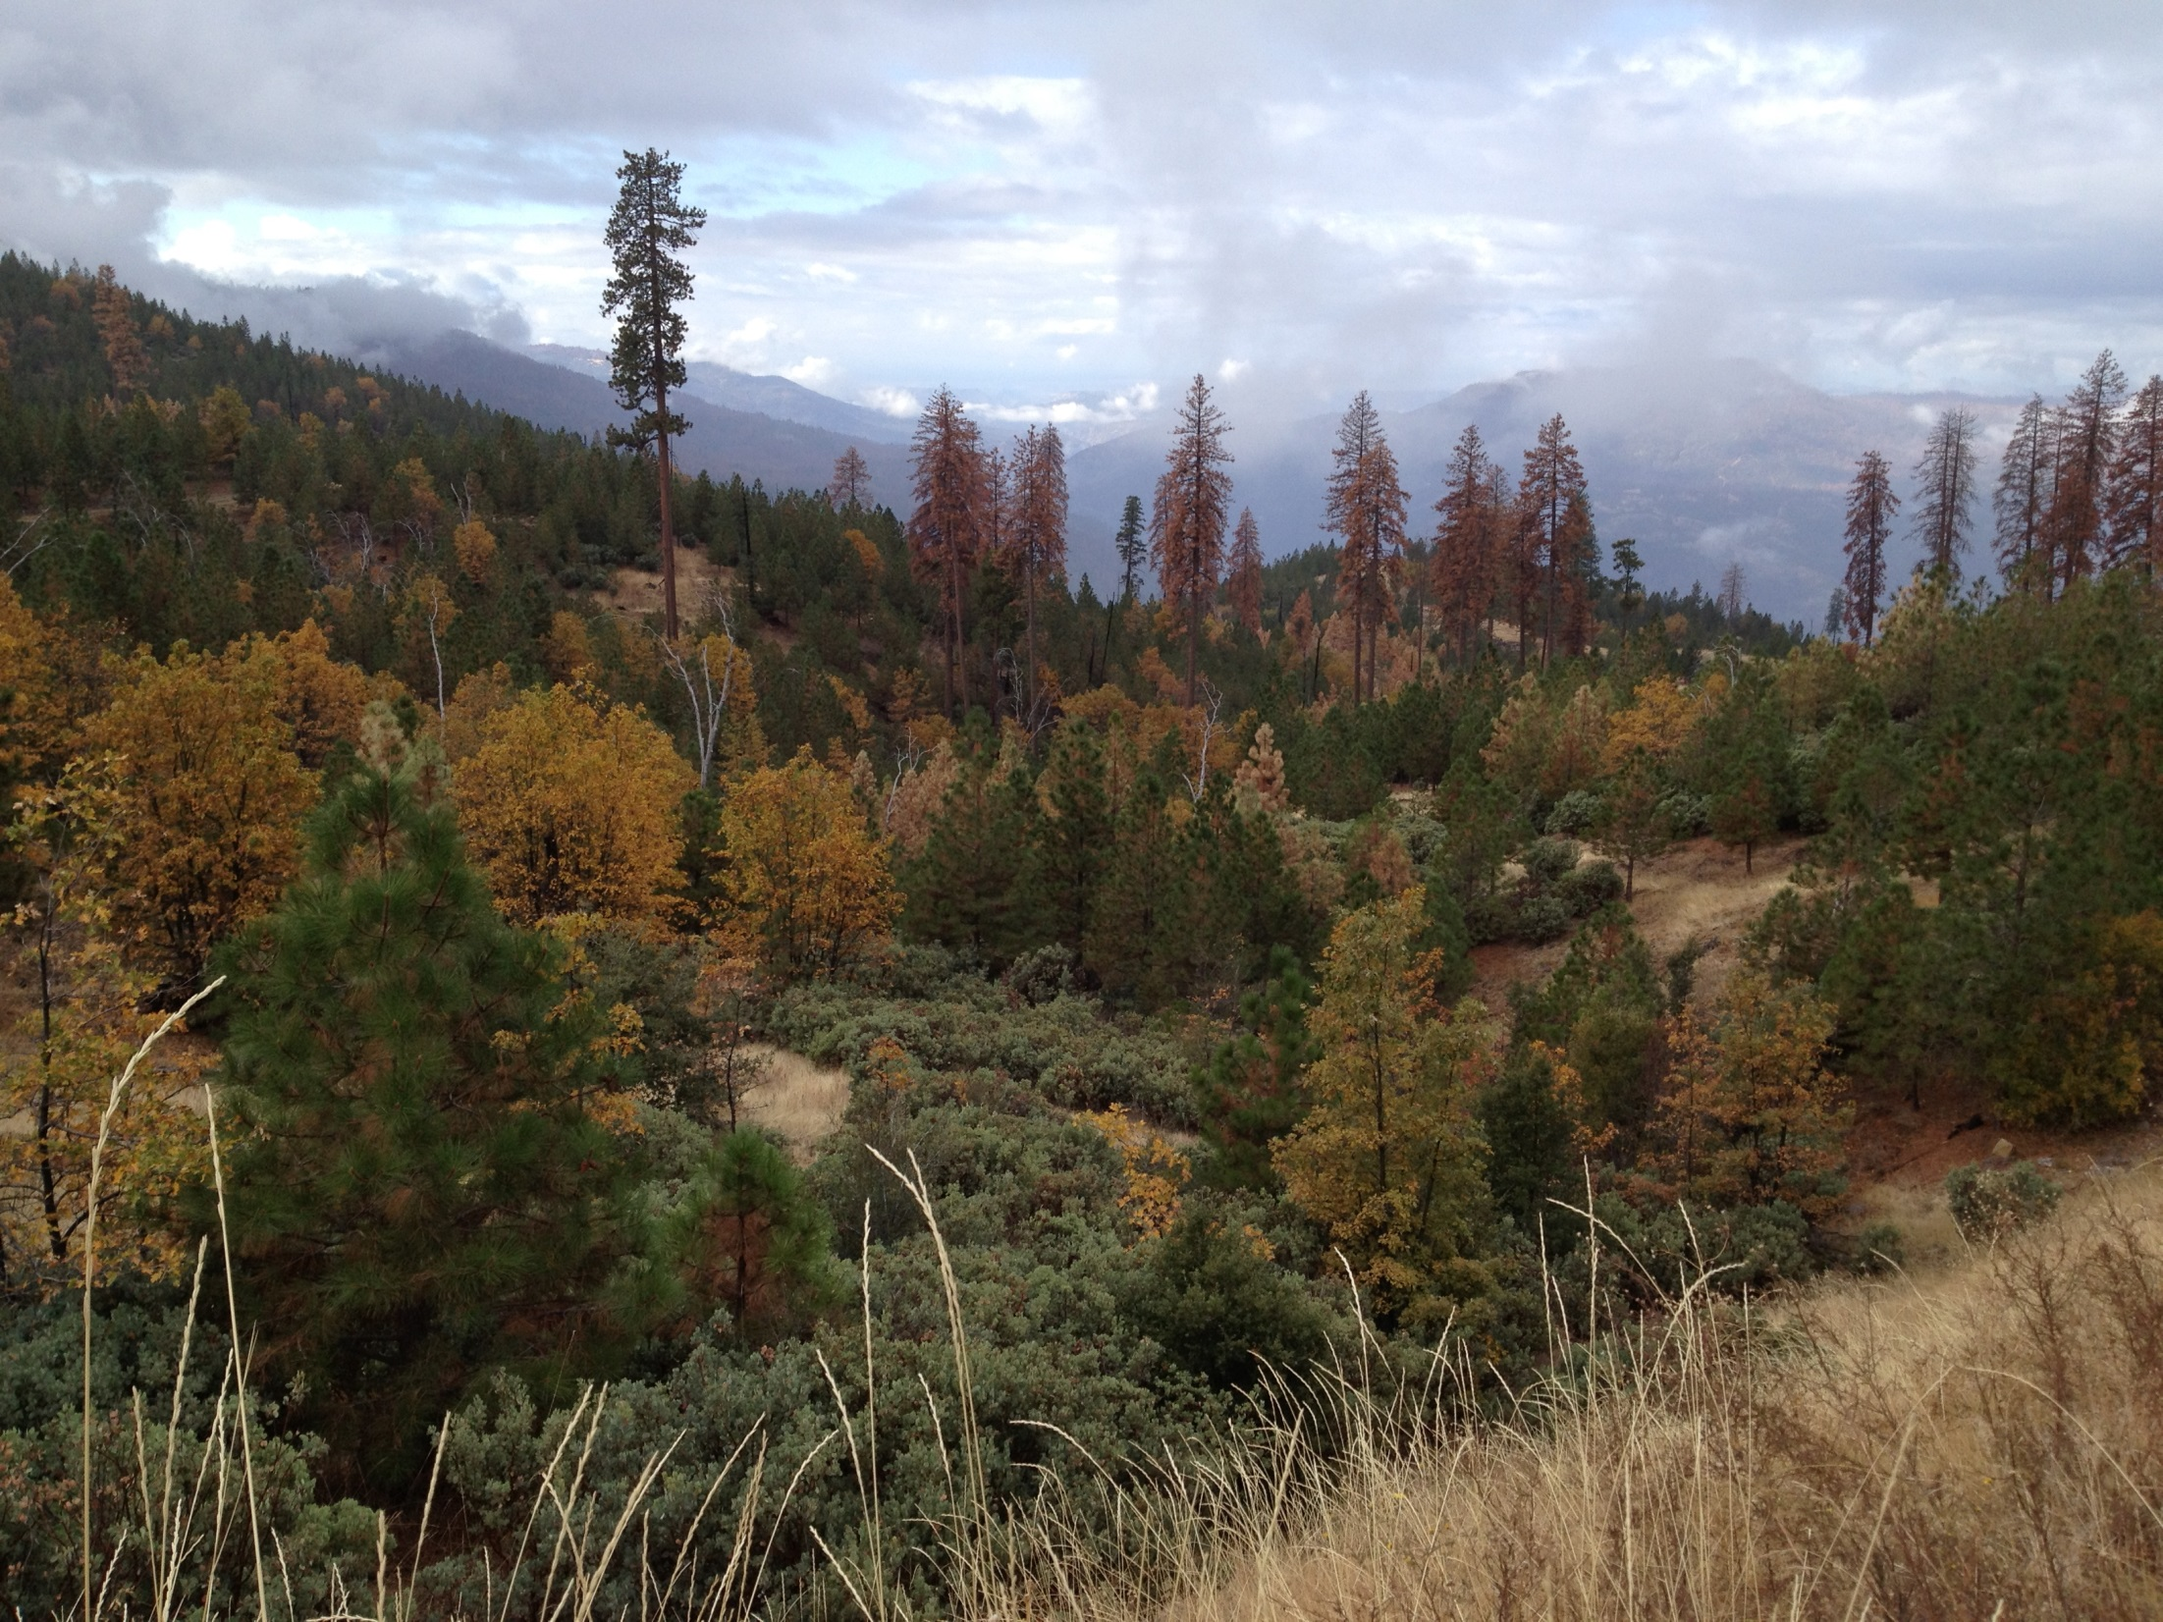
Within 200’ of road tree planting less dense (20’ x 20’ spacing).
Shrub cover 20-25 % and more forbs.
Down slope side of road meant to act as fuel break to stop fire as moves upslope.
This was felt to be resilient to fire and drought now.

Slide 5
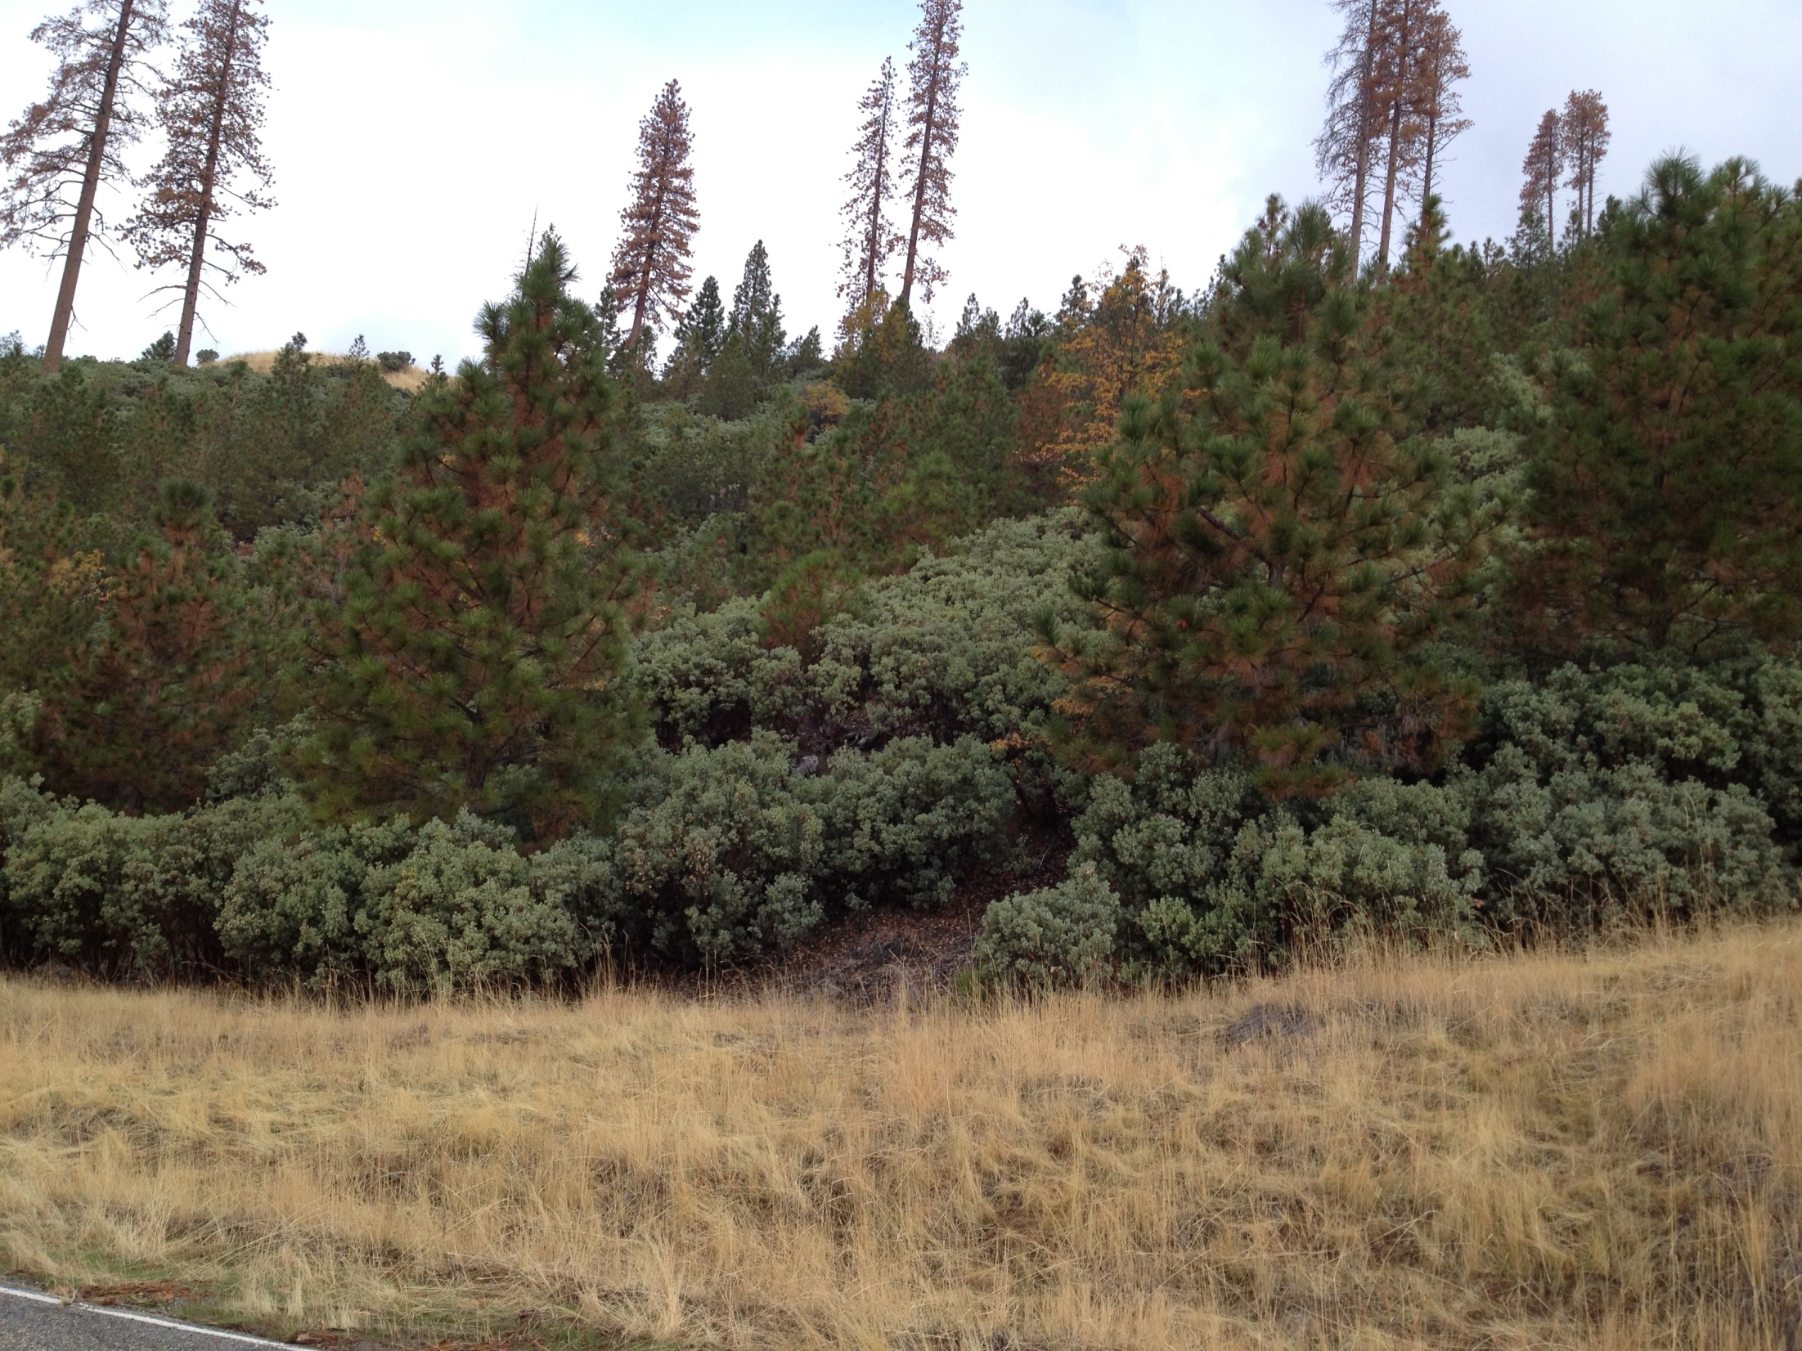
Slope above road only had planting, chemical release, and removal of two of the three trees that were planted in each group.
About 40% shrub now and not much grass.
The feeling was that this much less resistant to fire; would be better if burned at years 10-15

Slide 6
No pictures were take at the next couple of stops
We drove to a couple of spots that were beyond the road we stood on at stop 1. These areas reflected the 16’ x 16’ or 18’ x 18’ foot spacing seen on the far slope in slide 3.
We were in areas where all treatments had occurred. Infill from the seeds produced by the planted trees caused some changes in pattern and made stands less evenly spaced.
Shrub cover was 10-15% with grass/forbs filling in open ground.
The 20 year old trees were about 18-20 feet tall in settings where they were open grown (i.e., the least competition from filling trees).
This area had less shrub than the treated areas upslope and down slope of the road we were on at the first stop.

Slide 7
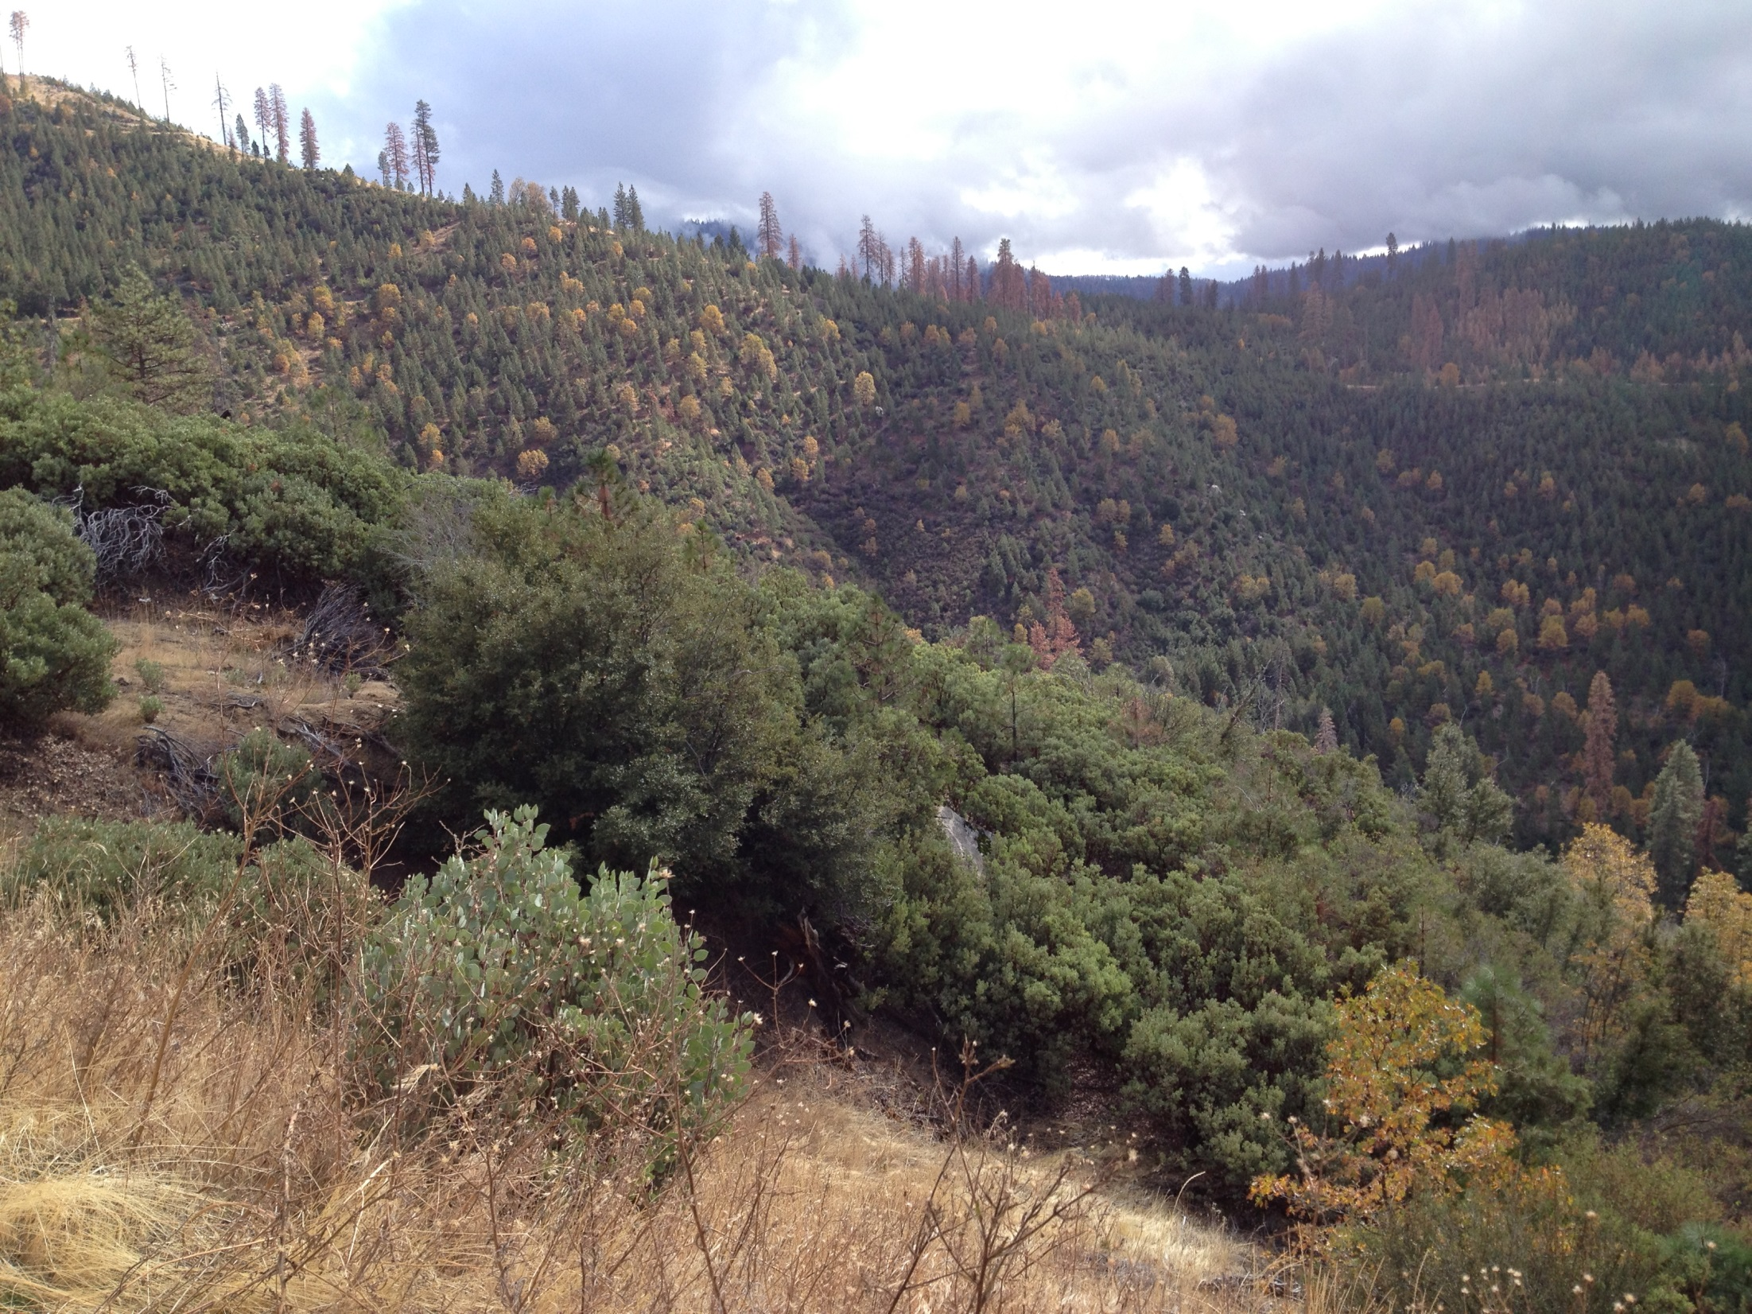
This area had fewer treatments like area upslope of road at first stop (slide 5)
Distant slope we were looking at on first stop (slide 3; 16’ x 16’ or 18’ x 18’ spacing)
All treatments occurred here. Shrub and grass in understory; felt to be resilient to fire and drought.
Trees were denser here; probably did not receive the burning treatment.
Ceanothus field
Foreground received no cultural treatment after wildfire in 1994

Slide 8
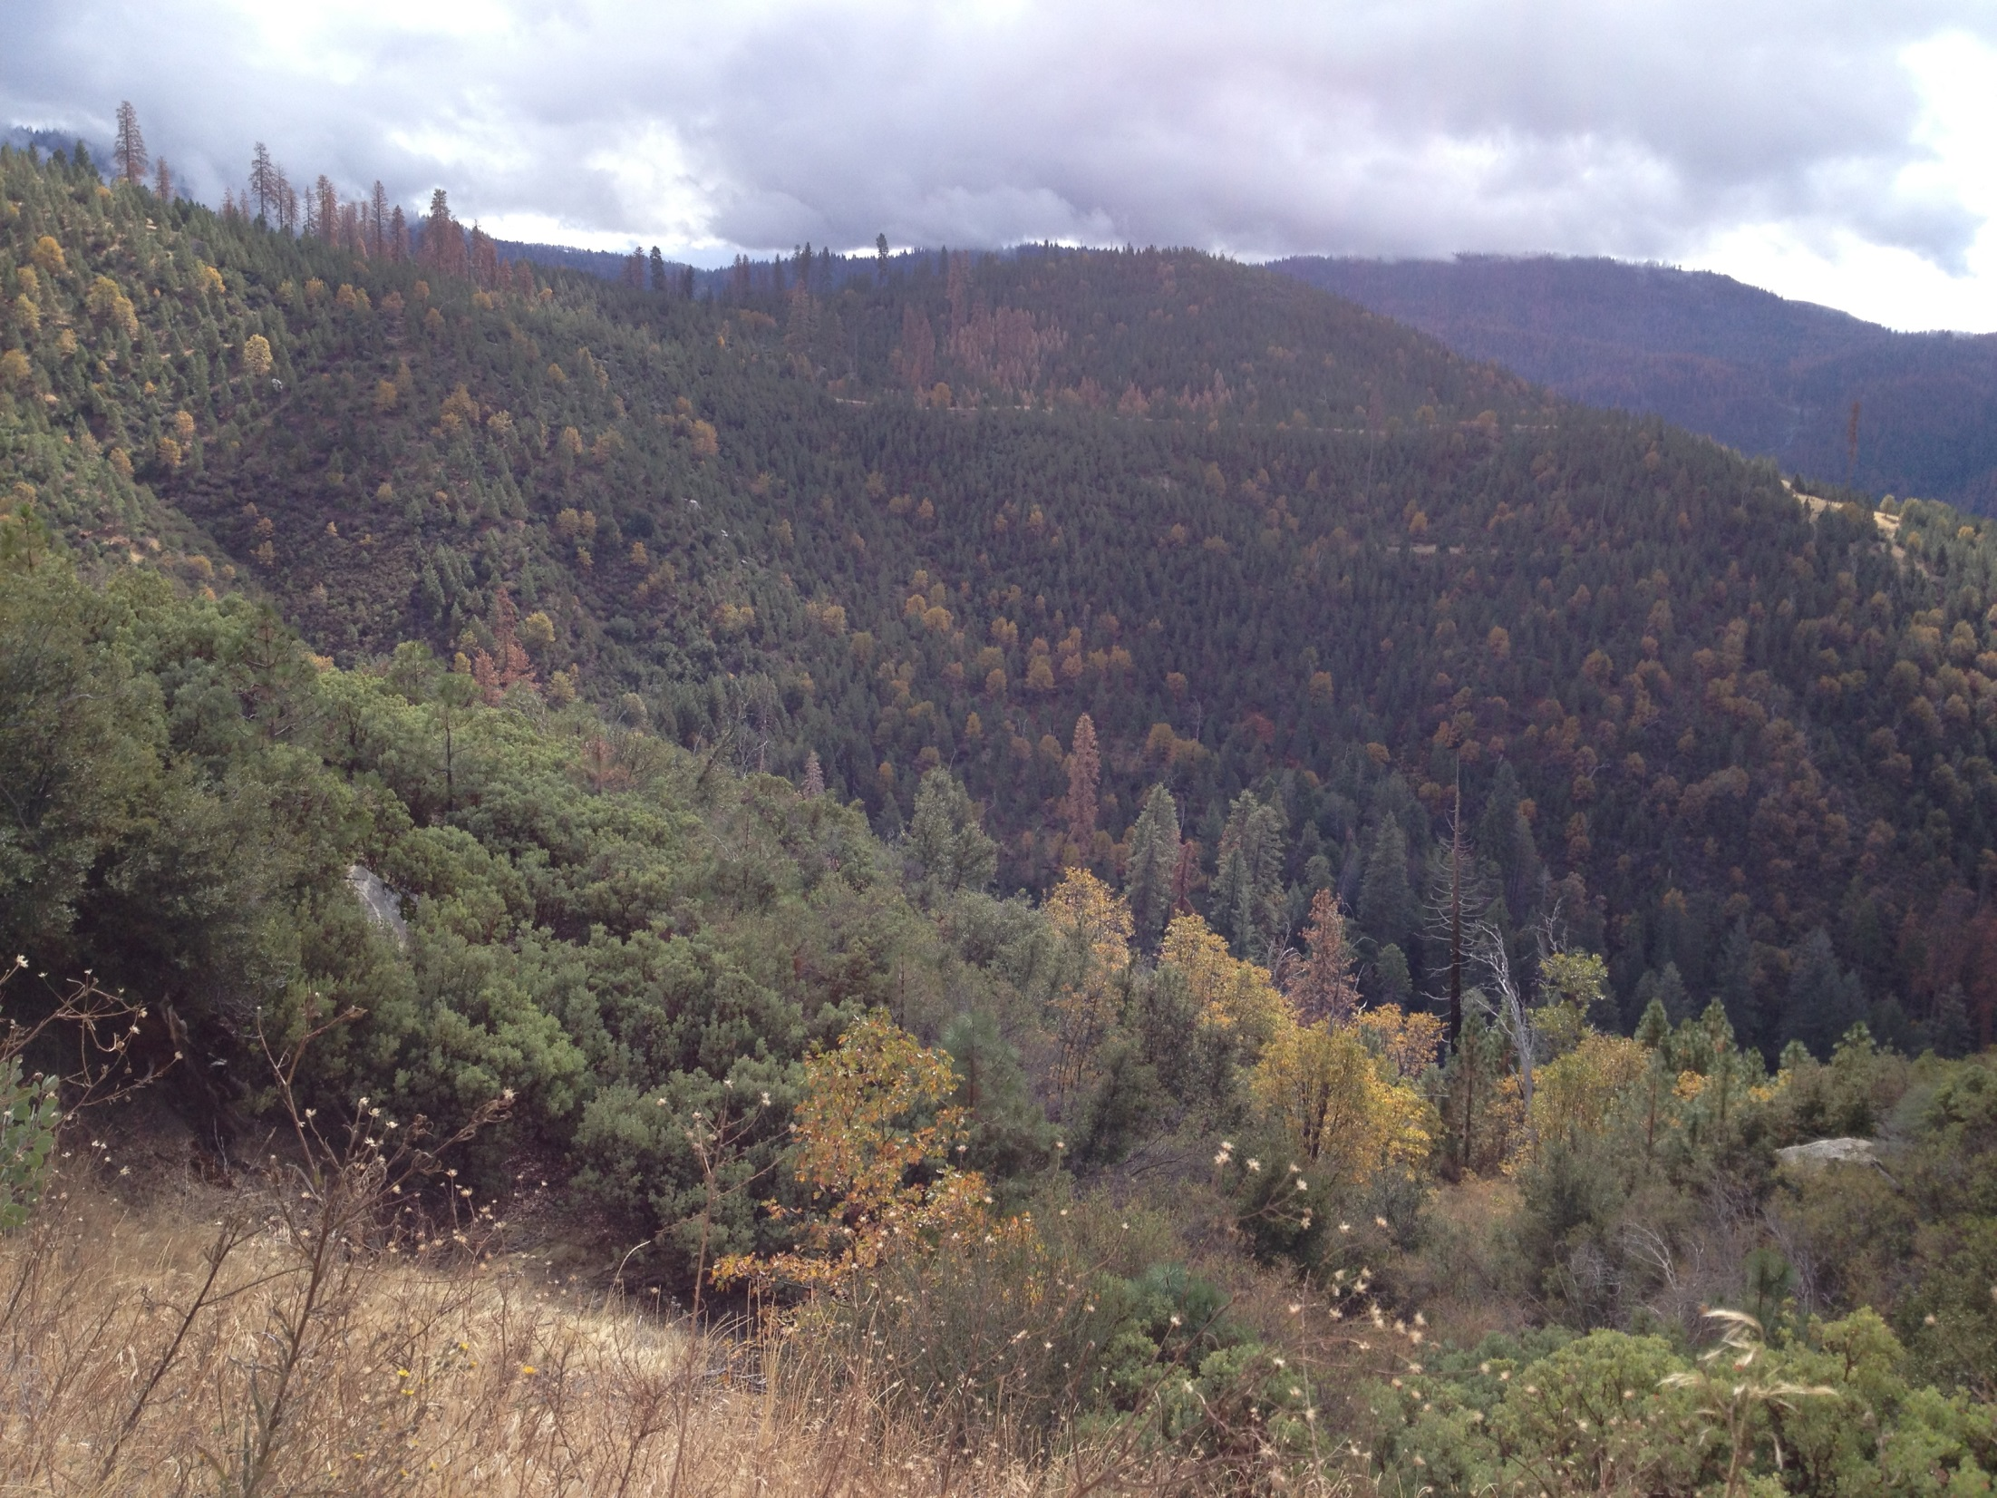
Outbreak of IPS in plantation
Foreground received no cultural treatment after wildfire in 1994

