Slide 1
Designation by Prescription (DxP)
Notes:
Section 8303 of the 2014 Farm Bill authorized, among other things, the use of DxP as a valid method of designating trees or forest products for harvest and removal.
Section 8303 also authorized the use of post harvest cruising or sampling as valid methods to supervise forest resources designated for harvest using DxP.
Direction came in 2015 from the Washington Office outlining the use of designation guides, inspection procedures and acceptance of work criteria to be used in contracts containing DxP.

Slide 2
Introduction to DxP
Notes:
First trial uses of DxP were in done in Oregon and Washington around 2008 (Catherine Creek Forest Restoration Project)
Designation by Description had been used in Region 6 starting in 2005 as a way to incorporate variable density thinning of mature plantations.

Slide 3
Definition
A method for harvest and removal of timber, designating trees for removal by describing the desired end result of the treatment.
E.g., retain 60 square feet of basal area per acre of dominant and co-dominant trees.
(FSH 2409.19-2016-1 sec 60.5)
Notes:
Can include limitations for cutting only trees up to a certain size limit or only cutting certain species.
Can be simple or include more complex elements.

Slide 4
Difference Between DxP and Designation by Description (DxD)
DxP
DxD
A prescription on what forest cover for the designated area should look like after timber harvest.
Individual tree selection “decision-making” has latitude to implement the designation guide.
A method of designating trees for removal by describing trees to be removed based on verifiable characteristics after removal
It is clearer in terms of determining which trees should be removed.
Notes:
Can be blended to incorporate some verifiable characteristics (i.e. removing trees a certain distance form oak or pine)
A true DxD you can determine exactly what trees can and cannot be cut.

Slide 5
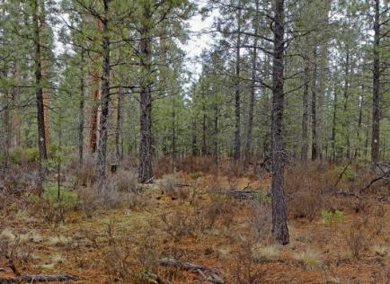
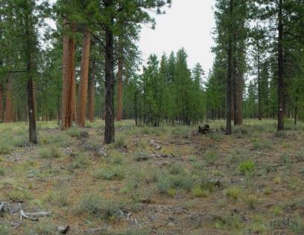
DxP Implementation Example
Before and after pictures where DxP was implemented

Slide 6
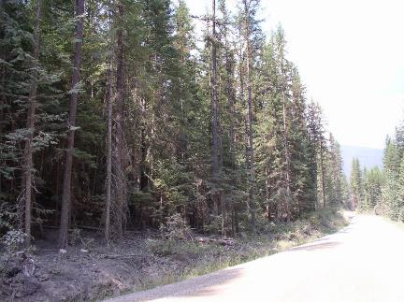
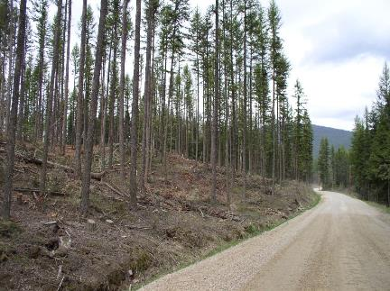
DxD Implementation Example
Two graphics with before and after pictures where DxD was implemented

Slide 7
When to Use DxP
It meets the desired end result in the most cost efficient and effective manner than other designation methods.
If you can measure the outcome from the designation guide to the contract, then DxP can be used on any stand.
Notes:
Although DxP has latitude for what is removed it still must be able to have a measurable outcome.

Slide 8
Digital Prescription Guide
A DPG is digital cutting guide with the intent to aid in the implementation of D x P prescriptions.
It can be used to describe the spatial pattern and types of trees to be removed and augment a written cutting guide.
It is not the marking of trees.
It is not a contract compliance assurance item.

Slide 9
DPG Process
Develop silvicultural prescription.
Develop cutting guide from prescription.
Set up geodatabase based on cutting guide.
Install in handheld tablets using ArcGIS online.
Markers implement cutting guide on tablets (either Android or IOS) using Arc Collector App through designating individual polygons and types of treatments within stand(s).
Post data processing to create layer for installation in harvesters.
Install in harvester in-cab tablet system.
Notes:
Can be used with Lidar data to increase efficiency, using products such as eco objects that delineate the stand into

Slide 10
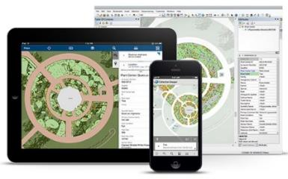
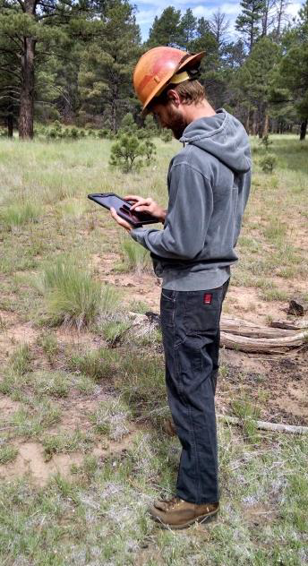
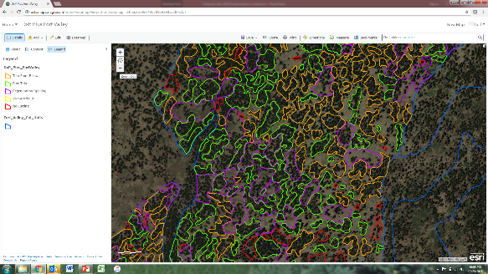
What exactly is DPG?
Arc Collector App

Slide 11
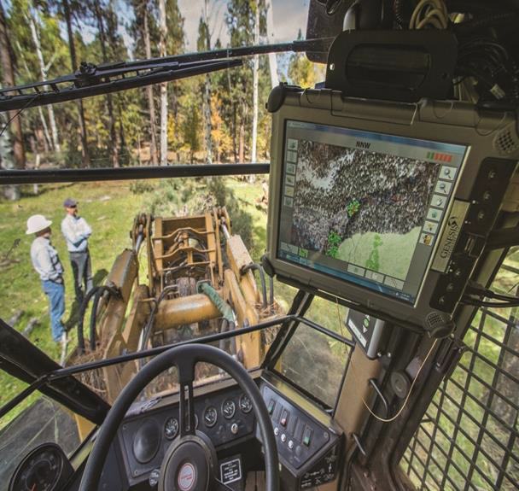
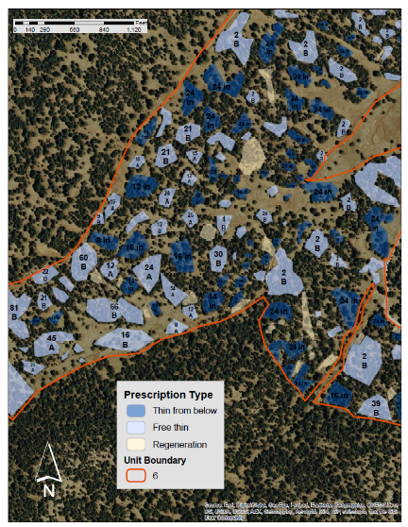
How do Operators use DPG?
Notes:
In-cab tablet technology used by operators near Mormon Lake, AZ to assist with restoration treatments and collect tree harvest data.
DRG input to in-cab tablets for use by operators. A number + a letter indicate the number of trees to leave in a group and whether the diameter distribution should be focused on larger (A) or smaller (B) trees.

Slide 12
Advantages of Using DxP
Contractor has discretion of selecting trees within prescription to be cut to achieve the desired end result.
Efficient and cost effective for sale preparation. Sale administration may be more expensive with DxP over sales that are designated with paint.

Slide 13
Cost and Time Saving-Region 3 Four Forest Restoration Initiative (4FRI)
Fiscal year 2018 had the most acres offered for 4FRI to date, 46,444 acres. Of those acres, 31% were D x P acres (14,236 acres) on 9 out of 29 sales across the 4FRI footprint. Designation by Prescriptions were completed as either standalone D x P or using tablets and the Digital Prescription Guide (DPG).
The table below compares the cost of marking all trees using individual tree marking (ITM) in row 1 versus the cost of implementing D x P with individual tree marking as actually designated in row 2 on the nine sales that were offered utilizing D x P in 2018. The total cost savings was just over $750,000.
 | ACRES | COST/ACRE | TOTAL COST
All trees marked by individual tree mark (ITM) and cruised to tree measurement standard | 19,209 | $58.13 | $1,116,607
4,966 acres of ITM, 9,936 acres of DxP, and 4,300 acres of Digital Prescription Guide and cruised to scaled sale standard | 19,209 | $19.08 | $366,534
Difference |  | $39.05 | $750,073

Slide 14
Cost and Time Saving-Region 3 Four Forest Restoration Initiative (4FRI)
Part of the costs savings is the difference in person days needed to designate a sale, these are displayed in the table below.
 | ACRES | Acres marked per person per day | total person days
All acres ITM marked | 19,209 | 8 | 2,401
As Designated in 2018
4,966 acres of ITM | 4,966 | 8 | 621
9,936 acres of DxP | 9,936 | 0 | 0
4,300 acres of Digital Prescription Guide | 4,300 | 45 | 96
2018 total | 19,202 |  | 716
Difference |  |  | 1,685

Slide 15
DxP and Stewardship Contracting
Can be used when implementing DxP in order to select contractors based on past performance and experience.
Request for proposals can require a technical approach for implementation of DxP as well as a quality control plan.

Slide 16
Risks of Using DxP
Determination of whether an individual tree should or should not be cut may not be absolute.
Complex designation guides increase the potential for disputes over compliance with interpretation of designation guide.
Requires close on-the-ground monitoring by the contract administrator and results in increased administration costs.

Slide 17
DxP Linkage to Forest Service Strategic Plan
Forest Service Strategic Plan has four outcomes:
Sustain our nation's forests and grasslands
Deliver benefits to the public
Apply knowledge globally
Increase the pace and scale of restoration
DxP ties in perfectly to the Strategic Plan
It is efficient and cost effective—accelerates the pace and scale of restoration
Improves our ability to provide products to local economies
Improved efficiency = excelling as a high performing agency

Slide 18
DxP and Forest Products Modernization
The Forest Service wants to be the best at delivering forest products so that we can:
Better meet the goals of supporting jobs
Grow the economy, and
Increase the restoration and health of our forests at an accelerated pace and scale.
DxP aligns with the Forest Service’s product modernization effort
It is efficient and cost effective at sale preparation
Digital prescription guide introduces new technology into forest product delivery

