Slide 1
Reynolds Creek Ecological Restoration
Variable density thinning in natural stands, using GTR-220 (North et al. 2010) and GTR-237 (North 2012)

Slide 2
History
Individual cut tree marked for implementation in 2012
Rim Fire burned through project in 2013
SIR completed in 2015/16 for fire impacts and drought mortality
Finding that the decision was still appropriate to implement
DxP was developed considering fire and mortality effects to previous mark
Notes:
In-cab tablet technology used by operators near Mormon Lake, AZ to assist with restoration treatments and collect tree harvest data.
DRG input to in-cab tablets for use by operators. A number + a letter indicate the number of trees to leave in a group and whether the diameter distribution should be focused on larger (A) or smaller (B) trees.

Slide 3
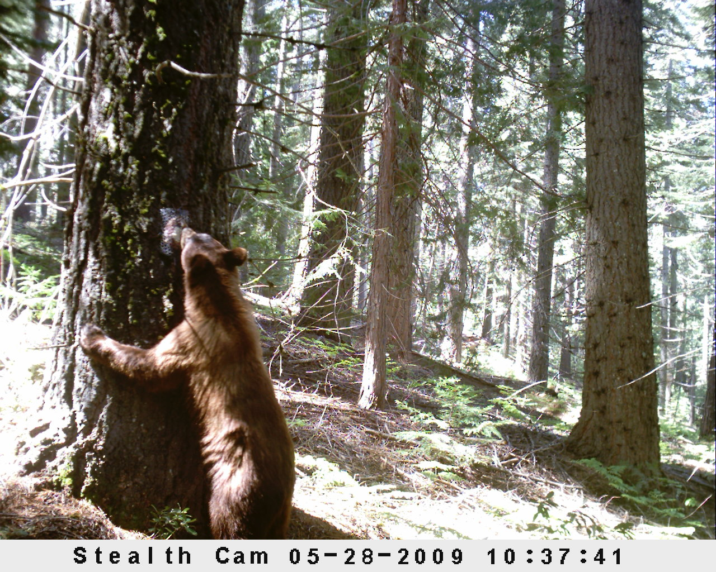
Thin existing aggregations while maintaining a clumpy structure, aggressively thinning around pine and oak to improve survival and possibility of regeneration.
Treatment Focus

Slide 4
Reynolds Creek DxP Synopsis
Apply in the following order…
Cut all suppressed trees, unless growing under or through a decadent oak (large oak with less than 33% live crown).
Cut all intermediate trees with less than 50% crown, unless growing under or through a decadent oak.
Cut all trees (except Sugar Pine) 25 feet from around thrifty black oaks (greater than 11 inch stump and more than 33% live crown).
Cut all true fir and cedar 25 feet from all pine. If pine is more than 60% of BA, then also cut codominant pine to a 25 foot spacing.
Check BA. If over the BA target cut codominant true fir until BA target is reached. Thin from below focusing on cutting trees with mistletoe/insect damage and/or little percent crown.
Leave 3 clumps per acre of 2-5 codominant/dominant trees per clump.
No cutting any trees greater than 30 inches DBH.

Slide 5
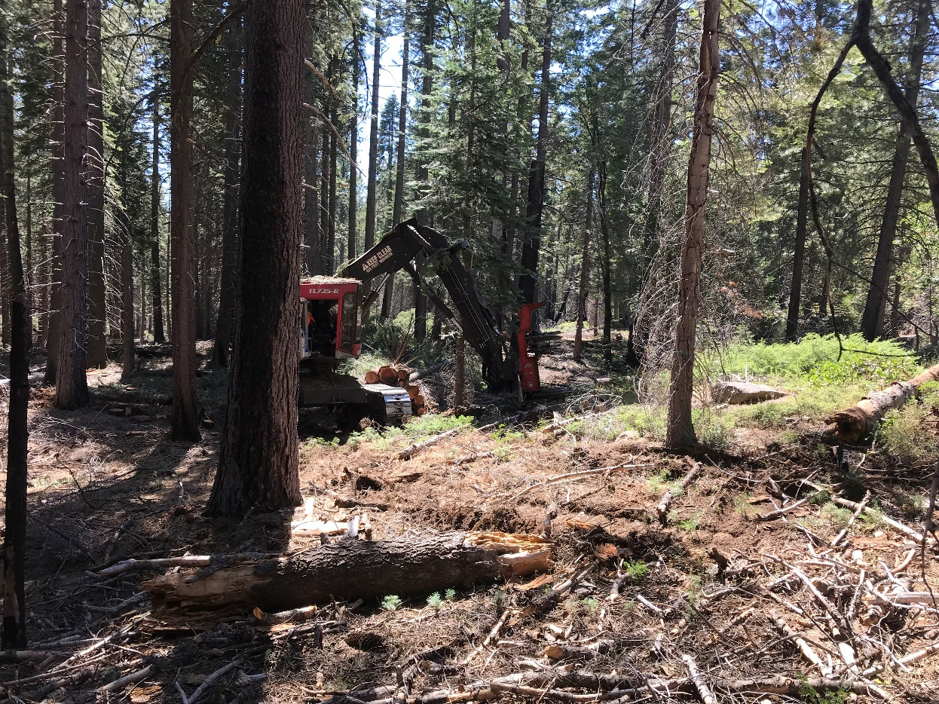
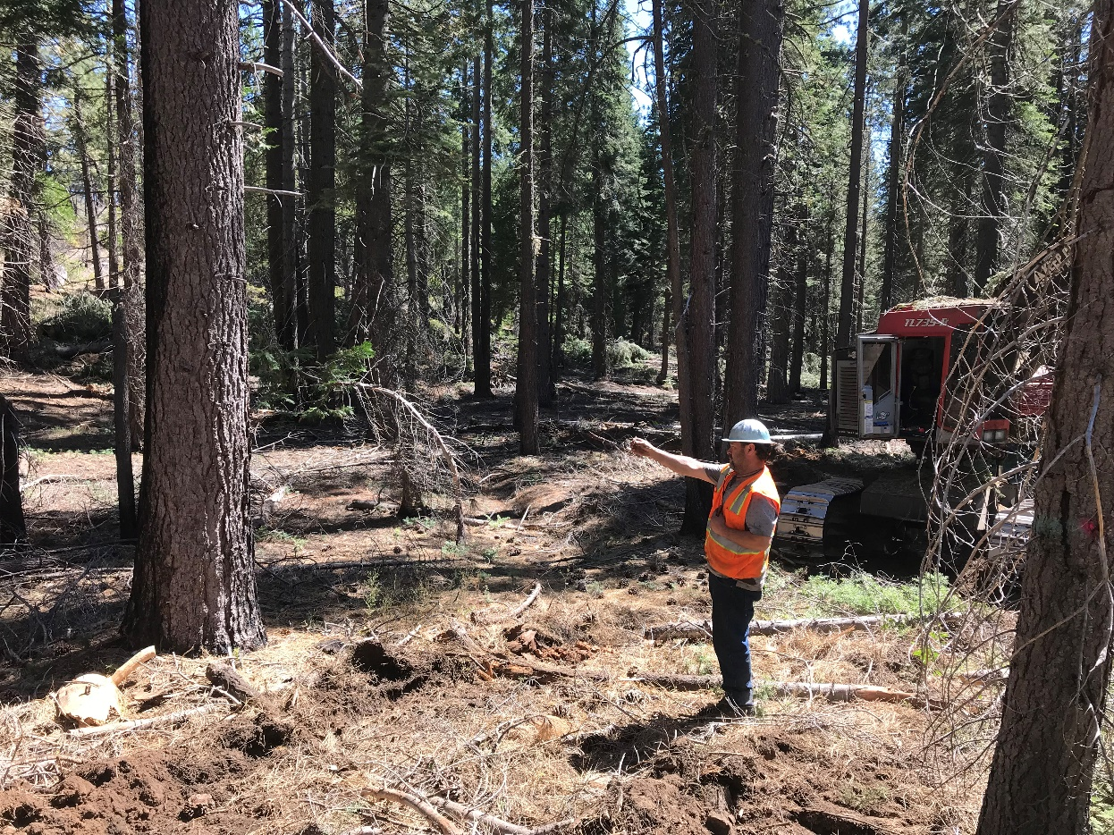

Slide 6
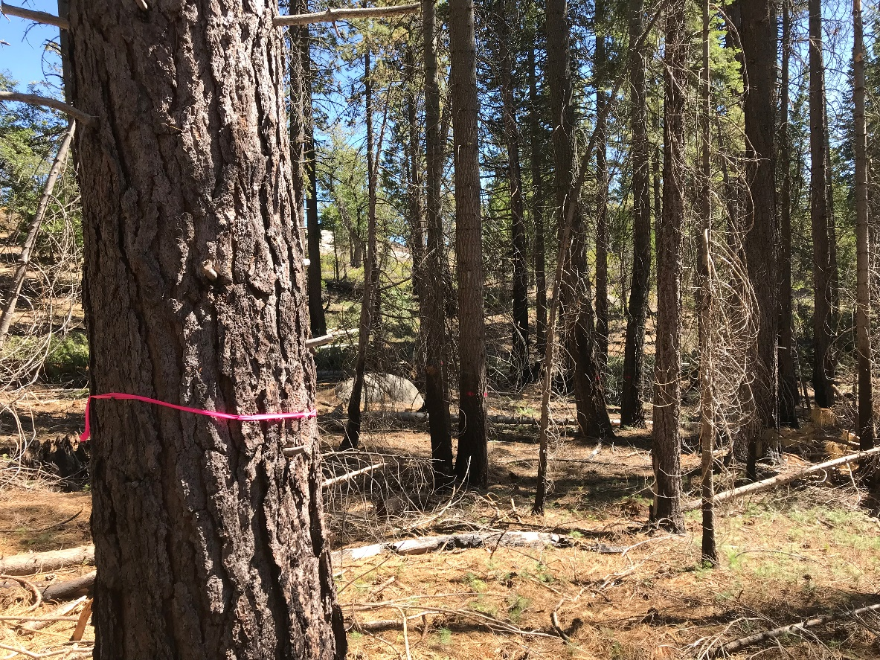
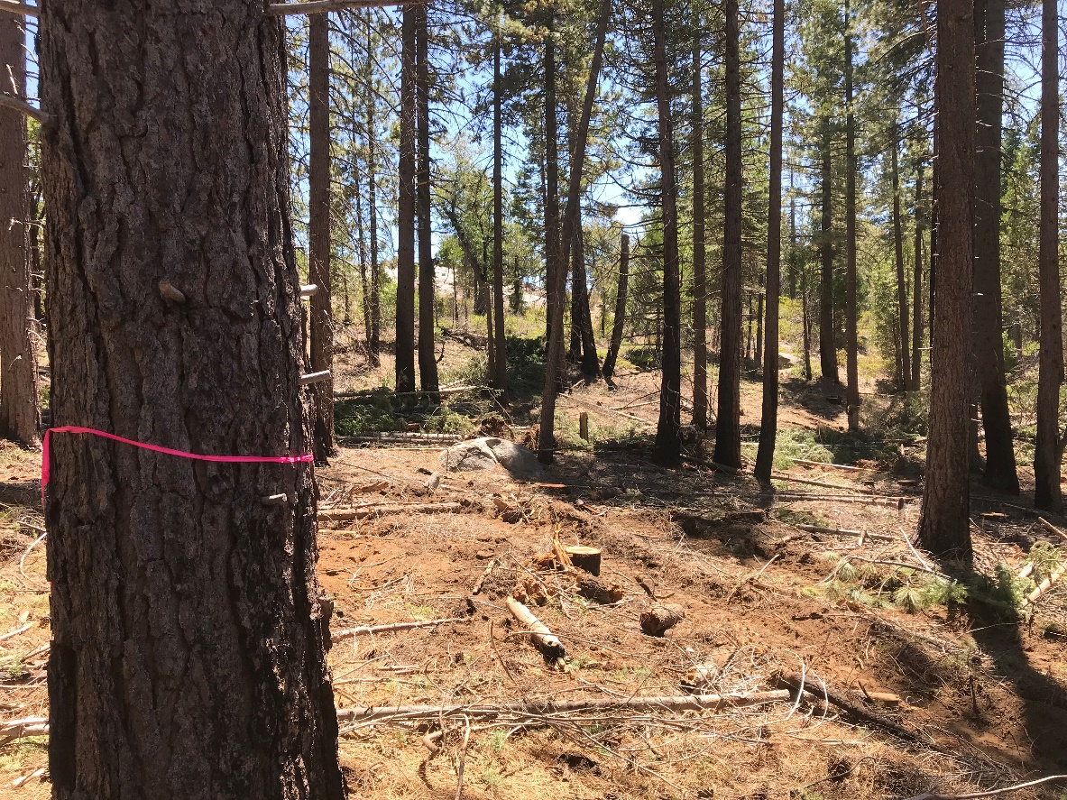
Pre Treatment
Post Treatment

Slide 7
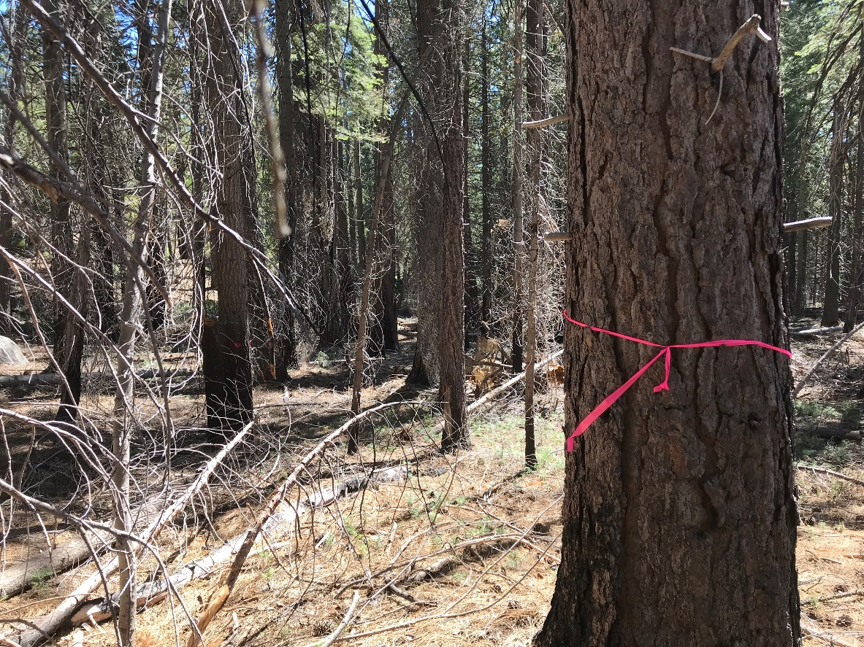
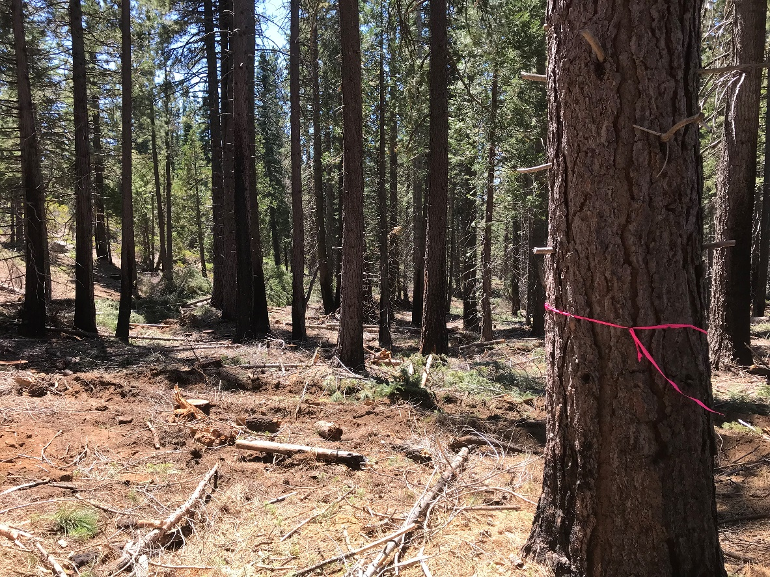
Pre Treatment
Post Treatment

Slide 8
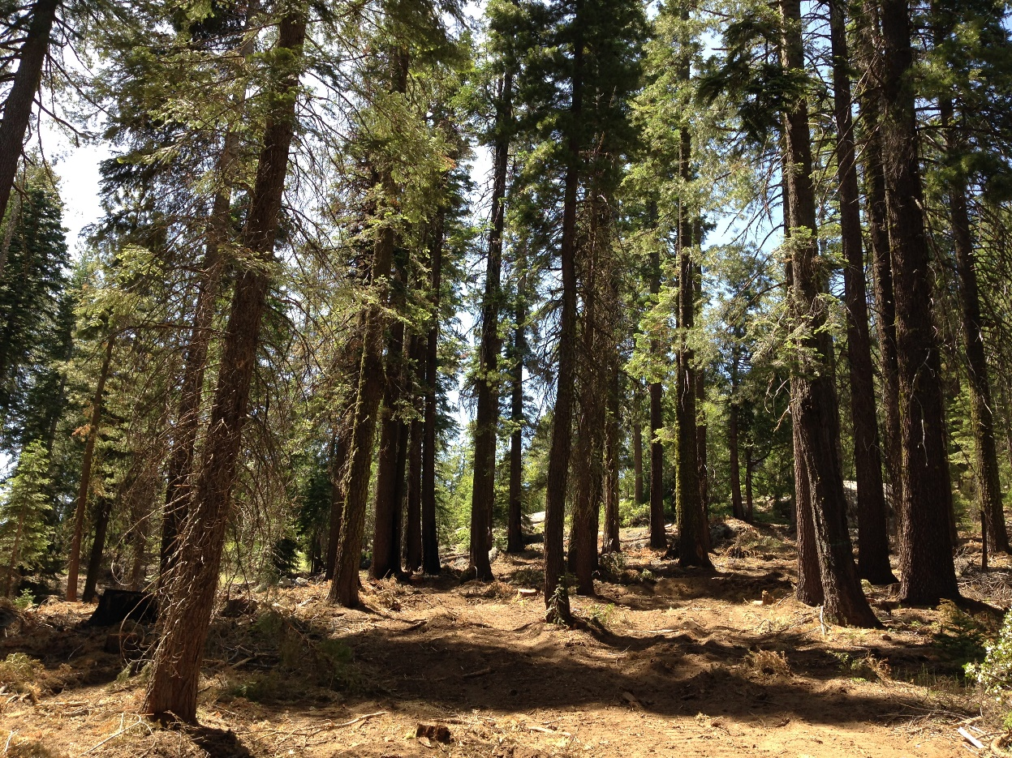
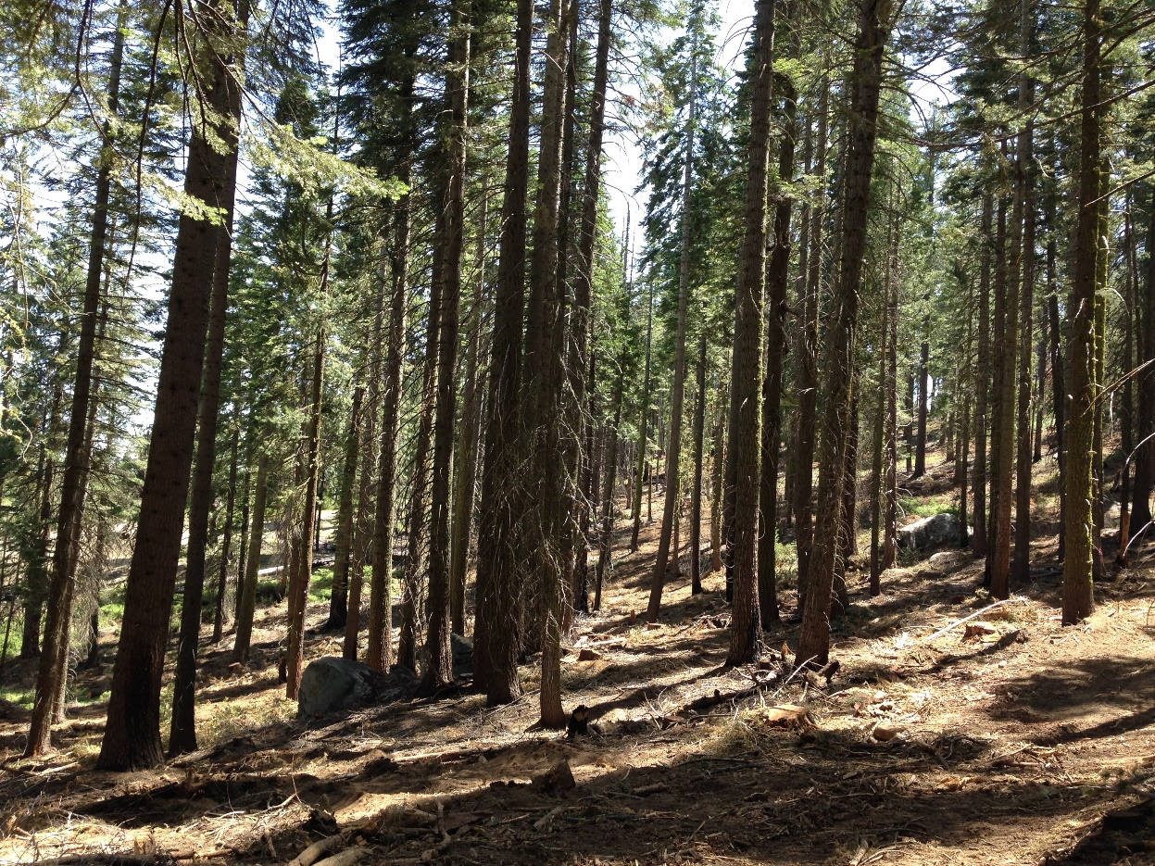
200 ft²/ac Residual Basal Area Post Treatment (Clumpy Structure)

Slide 9
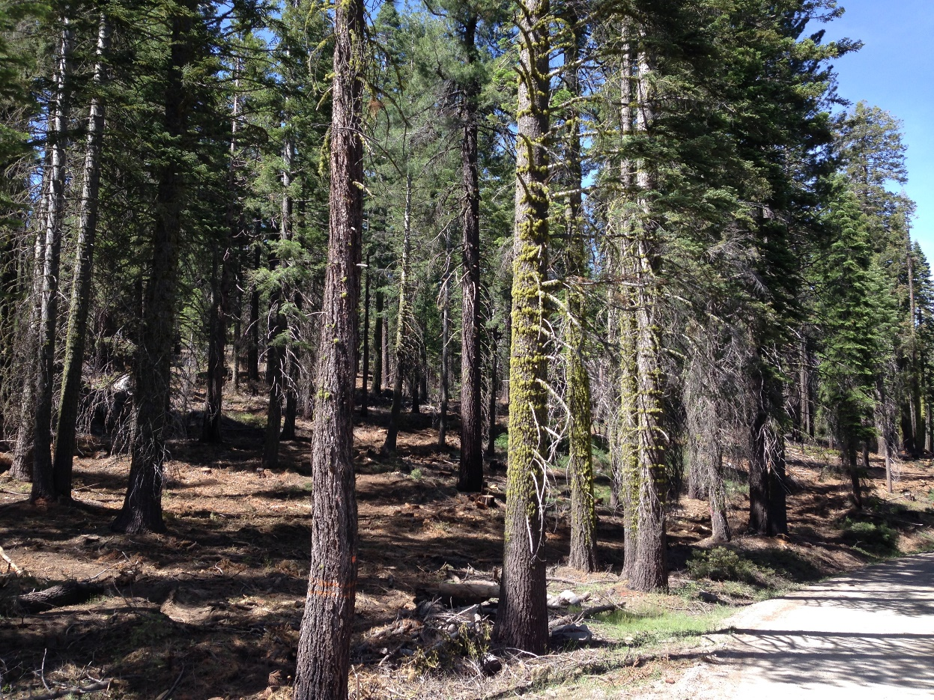
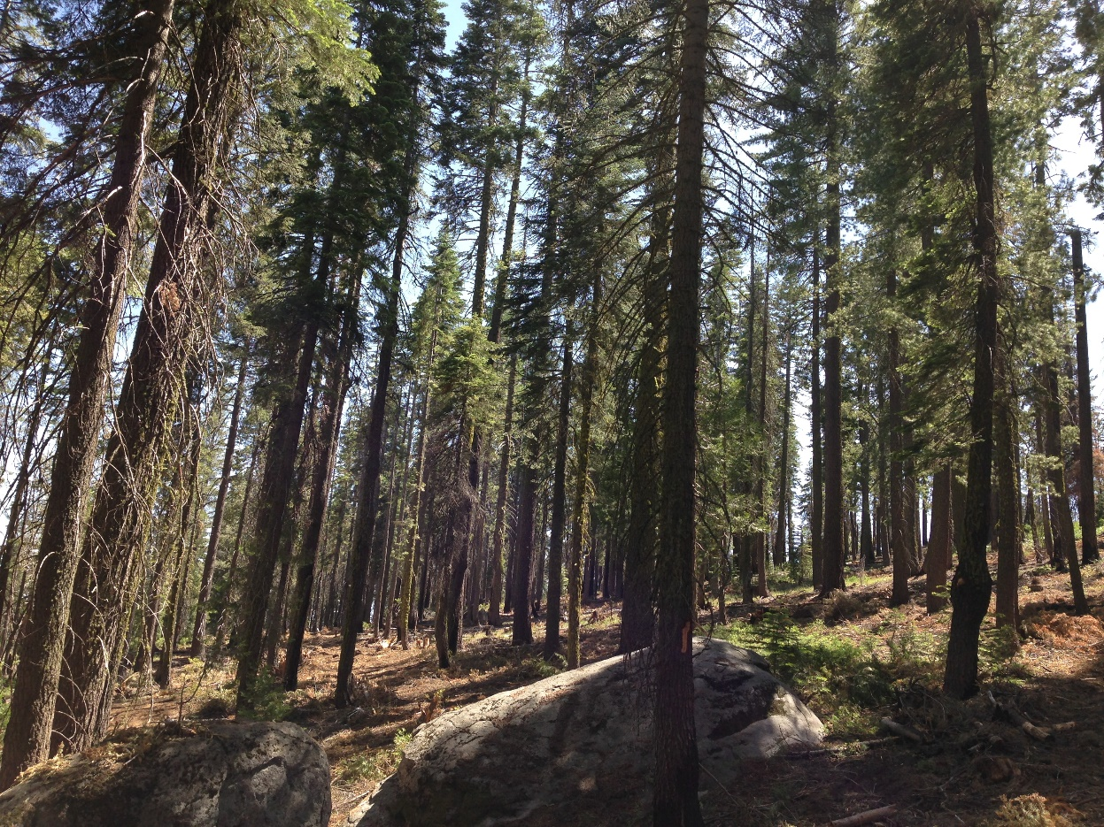
Post Treatment

