Slide 1
Stanislaus NF 5 Year Integrated Program of Work
Process for Identification and Prioritization of Project Areas

Slide 2
Today’s Objective
Outline the process for our collaborators
Receive feedback to help refine process

Slide 3
Notes:
One process feeds the other, LLA is programmatic, POW says where and order of where
Where Implementation tool

Slide 4
Purpose and Need for this Integrated Process
USFS PSW Region Ecological Goal:
“…to retain and restore ecological resilience of the NF lands to achieve sustainable ecosystems that provide a broad range of services…with a pace and scale sufficient to reverse current trends....” (2011)

Slide 5
Purpose and Need for this Integrated Process (con.)
STF Forest Plan Fire and Fuels Management Goals:
reducing threats
reintroducing fire
combined with strategic placement of fuels treatments across broad landscapes (2010, p. 12-13)

Slide 6
Purpose and Need for this Integrated Process (con.)
STF Stewardship and Fireshed Assessment
Completed in 2005
Project areas identified for 2007 - 2011
Old prioritization system is dated, needs renewal, and perform as replicable tool

Slide 7
Background
2016
July -“Forest Service Wildland Fire Activities – Hazardous Fuels Reduction”
2017
August – FSM 5100/Ch 5140 Hazardous Fuels Management
and Prescribed Fire
Notes:
July 2016 – “Forest Service Wildland Fire Activities – Hazardous Fuels Reduction”
Office of Inspector General (OIG) Audit Report
Forest Service lacks consistent, cross agency process for selecting its highest priority hazardous fuels reduction projects for completion based on risk assessment that considers wildfire hazard, exposure, and risk to highly valued resources and assets (HVRAs)
August 2017 – FSM 5100/Chapter 5140 Hazardous Fuels Management and Prescribed Fire
“Utilize the National, Regional, or locally developed landscape level risk assessment process to inform the identification and prioritization of hazardous fuels reduction projects.”

Slide 8
Process
•Geospatial data
Incorporates parts of the national/regional wildfire risk assessment process
Using Highly Valued Resources and Assets (HVRAs)
Coupled with Risk Factors
Identify and prioritize large scale project areas on/near the Stanislaus National Forest

Slide 9
Graphic Illustration of Prioritization process
HVRAs + Risk factors + Operational Considerations = Landscape Prioritization
Operational Considerations
Landscape Prioritization
HVRAs
Risk Factors

Slide 10
Prioritization process
HVRAs + Risk factors + Operational Considerations = Landscape
Prioritization
HVRAs:
Human lives & homes
Wildlife habitat
Power, water, & communication infrastructure
Recreation/administrative infrastructure
Notes:
PODs are derived from HUC6 scale using subject matter experts for operational use

Slide 11
Prioritization process
HVRAs + Risk factors + Operational Considerations = Landscape Prioritization
Risk Factors:
Wildfire behavior
Erosion hazard
Insects and Disease (future threat)
Notes:
PODs are derived from HUC6 scale using subject matter experts for operational use

Slide 12
Prioritization process
HVRAs + Risk factors + Operational Considerations = Landscape Prioritization
Operational Considerations:
Timber locations
Land ownership
Cooperator treatments
STF treatments
Planned treatments
HUC6/POD “containers”
Maintenance treatments
Notes:
PODs are derived from HUC6 scale using subject matter experts for operational use

Slide 13
Sideboards
USFS goals: vegetation management- improve health and vigor of timber stands
Reintroduction of fire into the ecosystem
Community concerns and interests
Consider current tree mortality (both standing and down)
Scale: project areas of approximately 30,000 – 40,000 acres
Pace: STF staff time, planning to treatment timeframes
Notes:
30-40,000 ac is ballpark size of HUC6 sub-watershed (or about 40 sq. miles, or 10,000-40,000 ac.)
This scale is necessary to make significant change on the landscape
Example – 3,000 acres you change/protect a single area for a predictable event, but at large scale you can change wildfire behavior and improve resiliency at landscape scale – for multiple events, or unpredictable events

Slide 14
Developed Process to Date
Identify broad scale parameters to address Forest and Community Concerns
Natural disturbance processes & HVRAs
Identify landscape-scale areas that are most vulnerable to disturbance
Utilize WO/RO/Zone priorities
Increase pace and scale
Increase forest health
Reduce fire risk
2017 update to Forest Service Manual – “utilize landscape level risk assessment process to inform the identification and prioritization of hazardous fuels reduction projects.”
Notes:
August 2017 – FSM 5100/Chapter 5140 Hazardous Fuels Management and Prescribed Fire
“Utilize the National, Regional, or locally developed landscape level risk assessment process to inform the identification and prioritization of hazardous fuels reduction projects.”

Slide 15
Developed Process to Date (con.)
3. Determine what spatial datasets most accurately describe HVRAs and Risk Factors.
Example: Fire Risk – burn probability (FSim Modeling)
4. Analyze data range and relative importance.
Example: Erosion Hazard Rating Model
Example: recreation and infrastructure data

Slide 16
Developed Process to Date (con.)
5. Utilize Landscape-scale areas (HUC6 sub-watersheds, or PODs)
6. Tally intersecting values across the landscape, and then assign a Priority Descriptive Identifier.
7. PODS or HUCs with similar descriptive identifiers may be consolidated into a larger project area.
Notes:
Spatial summary units that were developed and used as part of the regional risk assessments that are bounded by potential fire operation features such as ridges, roads, barren areas or major fuel changes.

Slide 17
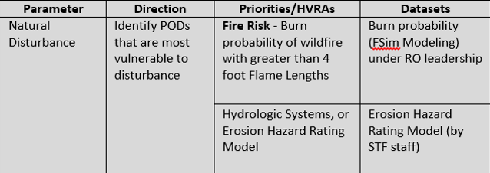
Example of HVRA, Risks, and Operational data

Slide 18
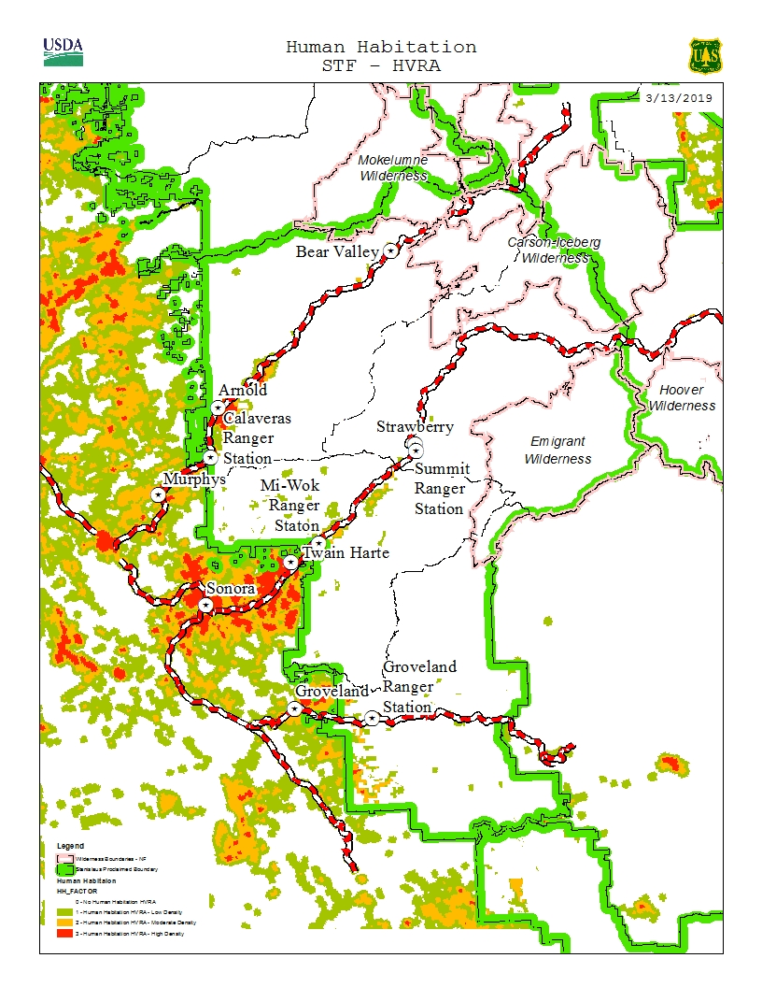
Human Habitation
This is based on housing density, using 2010 Census data.

Slide 19
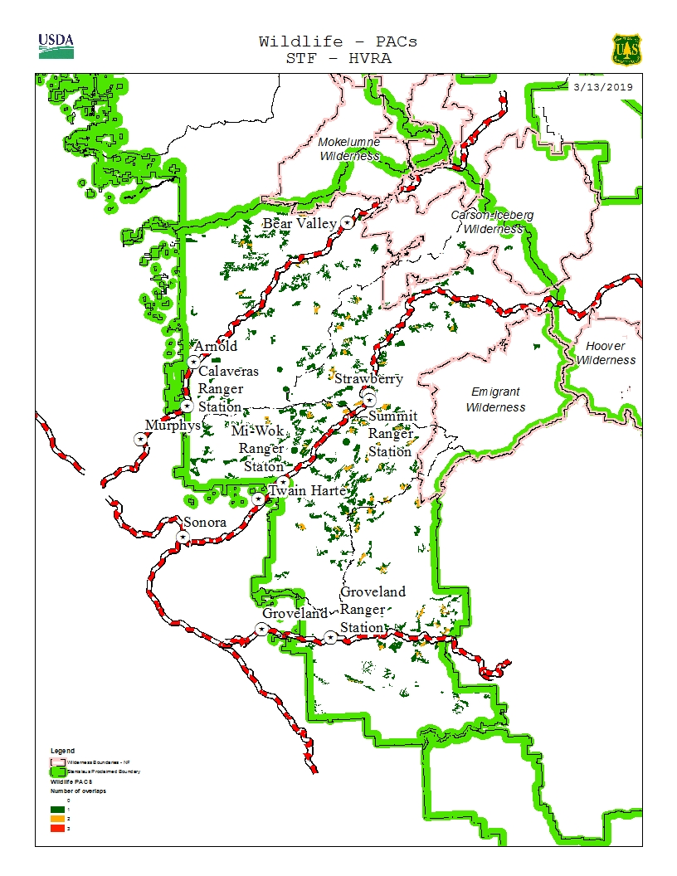
Wildlife Protected Activity Centers (PACs)
CA Spotted Owl
Northern Goshawk
Great Gray Owl

Slide 20
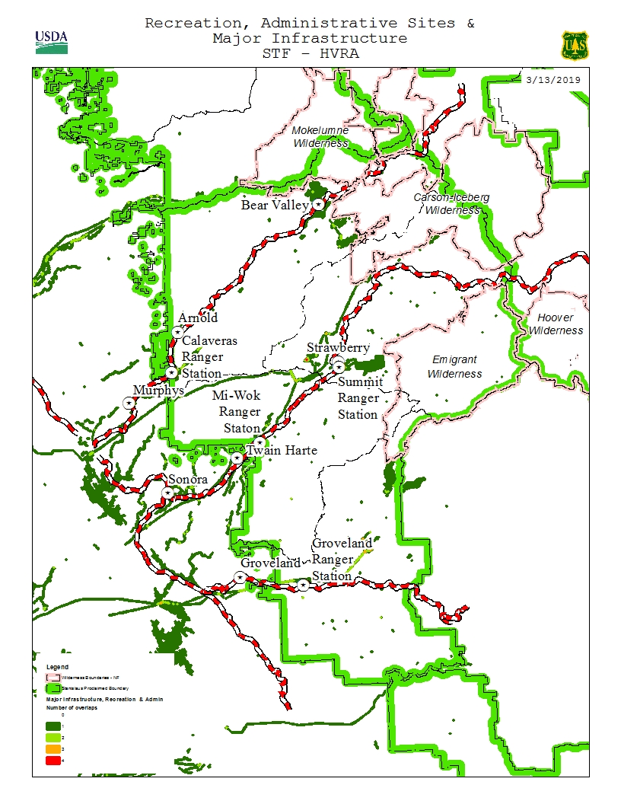
Recreation and Admin Sites, and Major Infrastructure (water, power, and communications)

Slide 21
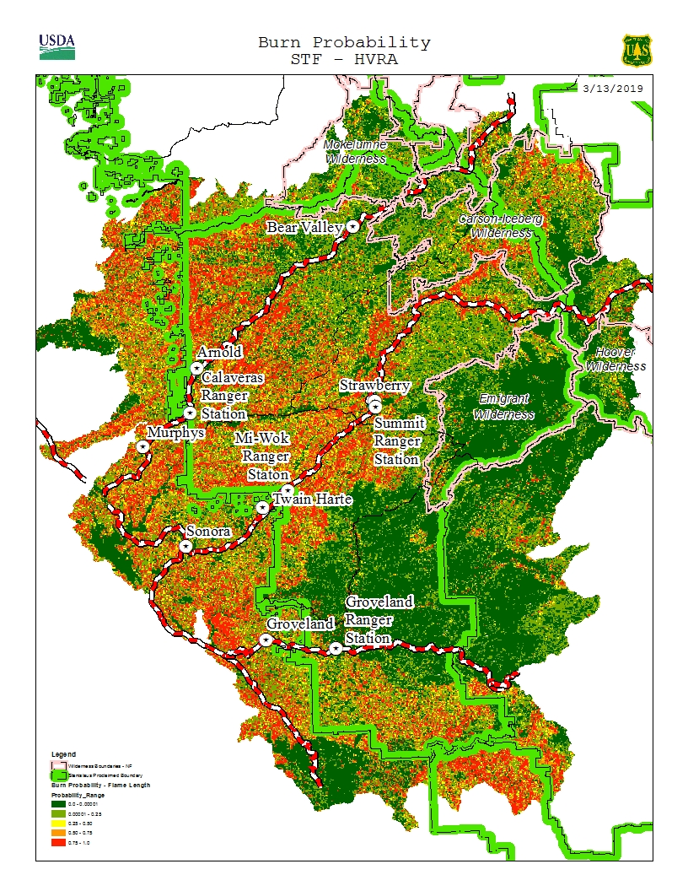
Wildfire Risk & Burn Probability
Probability of 6 foot Flame Lengths (and higher) on a given year, under multiple weather and ignition scenarios
Notes:
Red represents High Risk areas

Slide 22
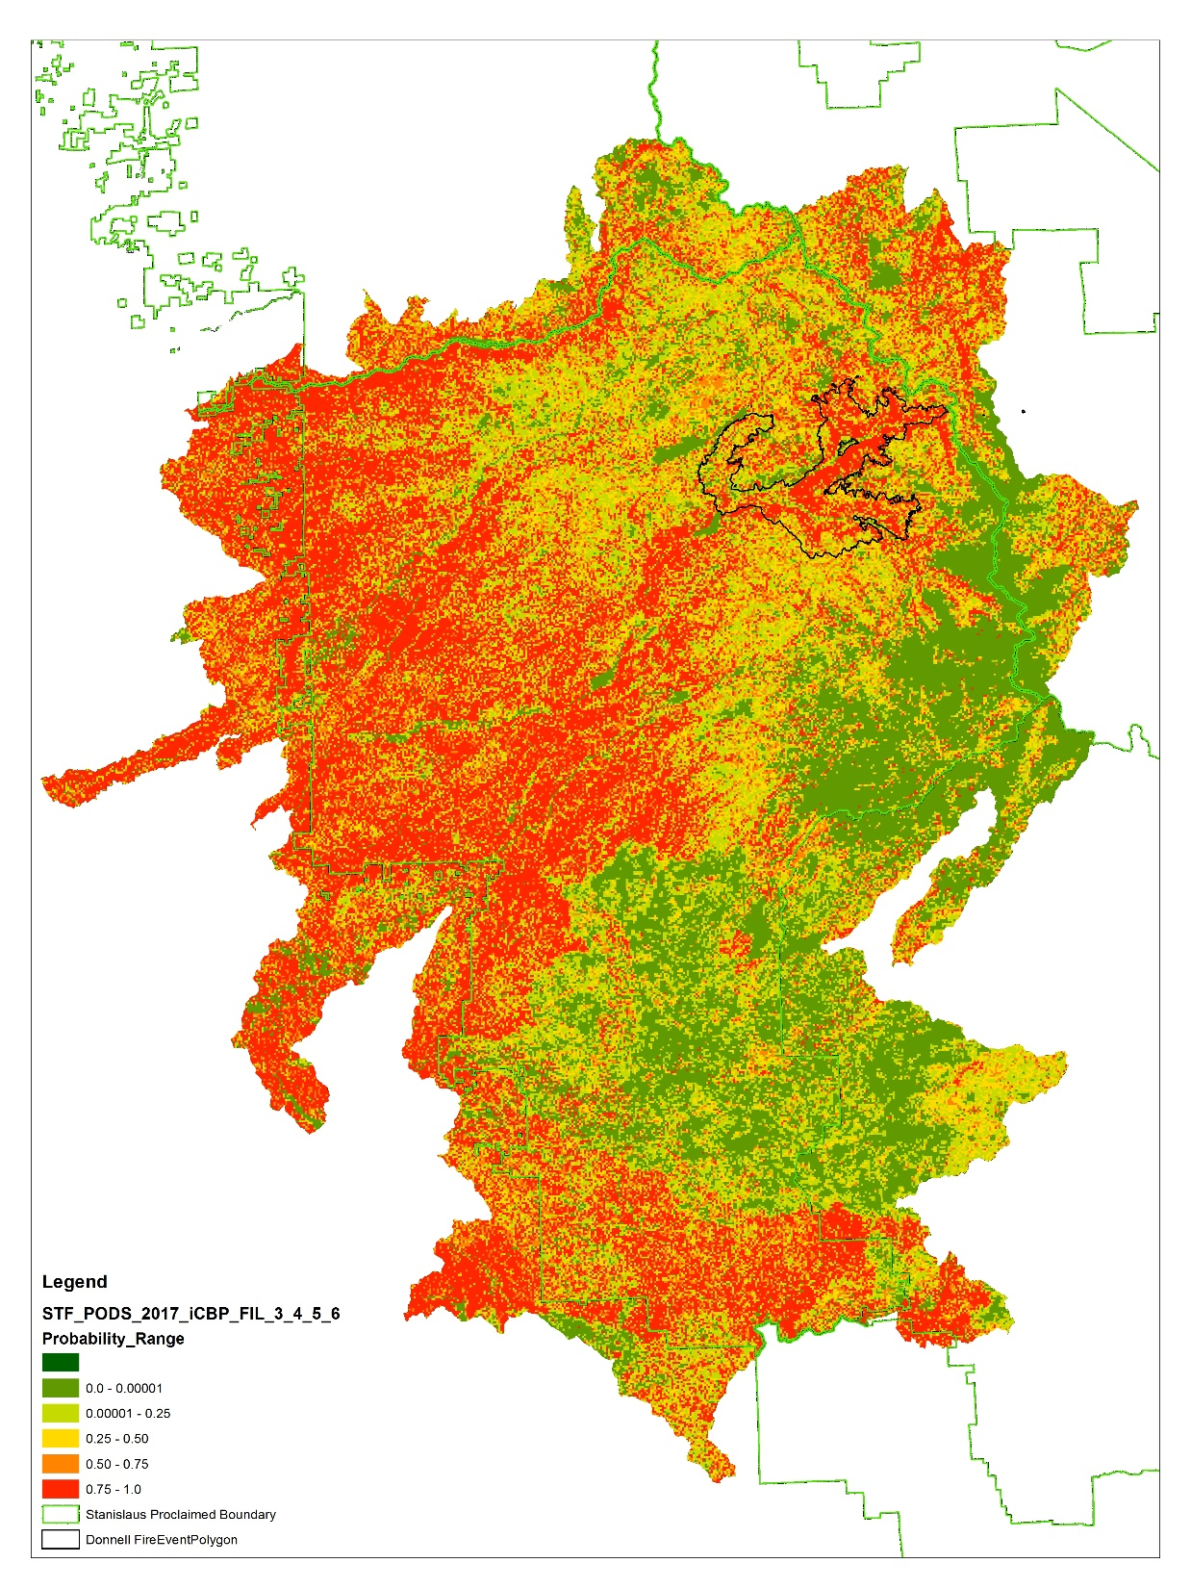
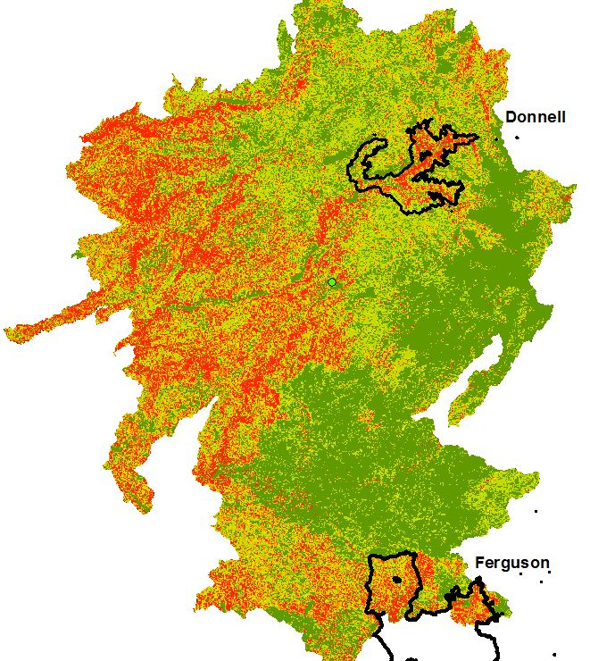
Probability of 6ft Flame Lengths
Probability of 4ft Flame Lengths
Showing 2018 Ferguson and Donnell fire perimeters
Notes:
Burn Probability was modeled in 2018, with 2017 spatial landscape, which incorporated the tree mortality conditions
Ferguson Fire = 96,900ac
Donnell Fire = 36,225ac

Slide 23
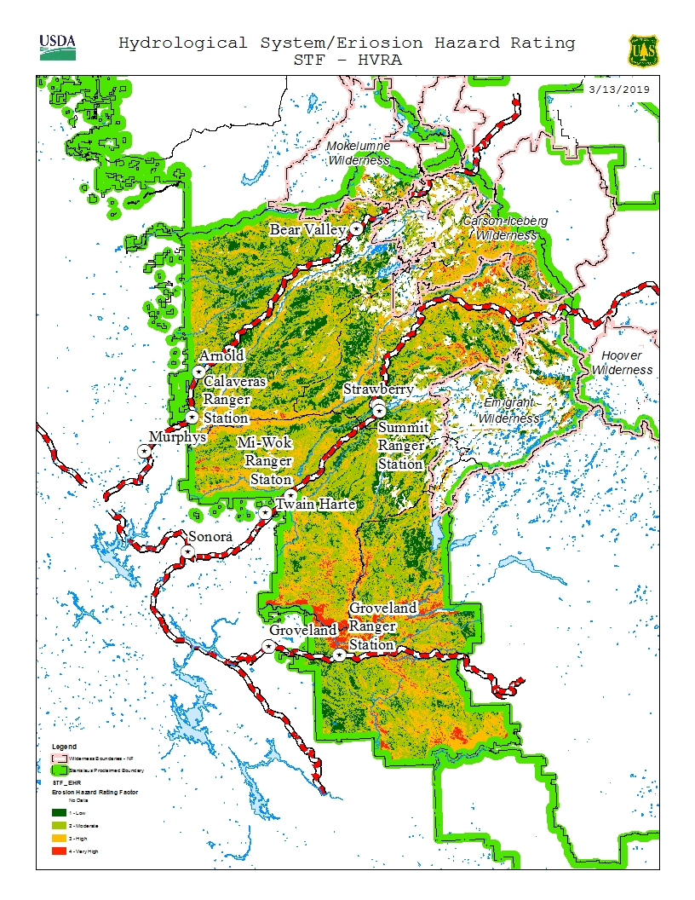
Erosion Hazard Rating Model
Notes:
Shows hazard of erosion for particular soil type when not covered by vegetation.

Slide 24
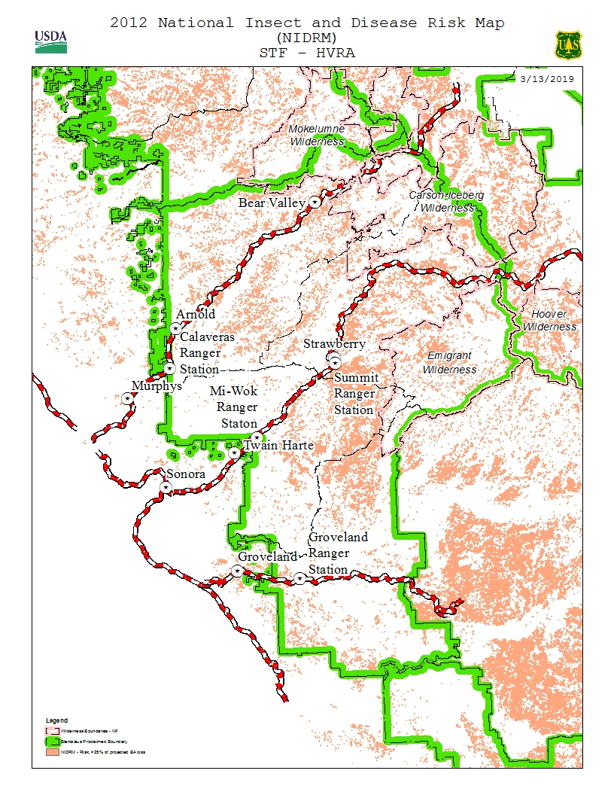
National Insect and Disease Risks
Modeled in 2012, before our 5 year drought fully occurred

Slide 25
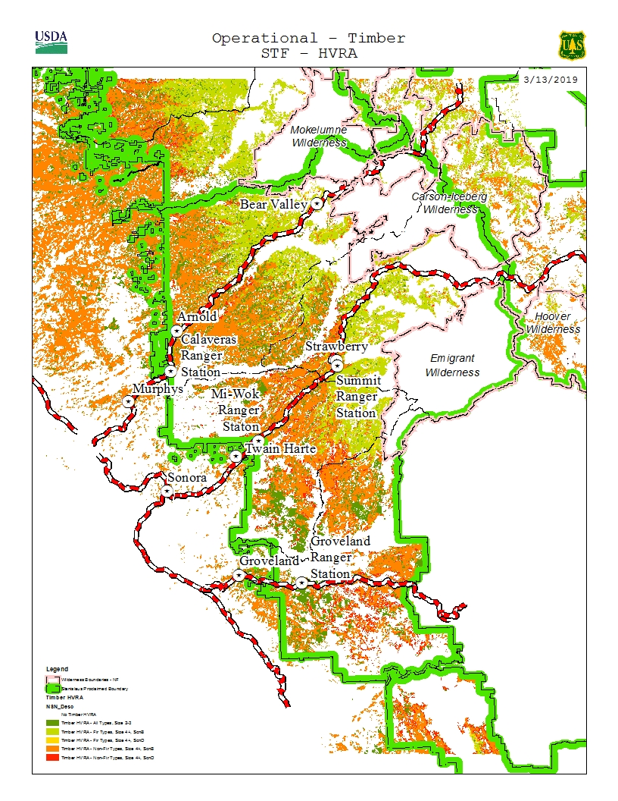
Operational Timber
Dark green is CWHR size class 2 – 3 (1-11 in. DBH)
Light green to red is CWHR size class 4 and above (11 in. and above DBH)
Conifer trees (both fir and pine)
2 scenarios: slope <35% and slope <50% & distance to roads
Notes:
CWHR – California Wildlife Habitat Relationships System – classifies existing vegetation types important to wildlife. Developed to recognize and logically categorize major vegetative complexes at a scale sufficient to predict wildlife –habitat relationships.

Slide 26
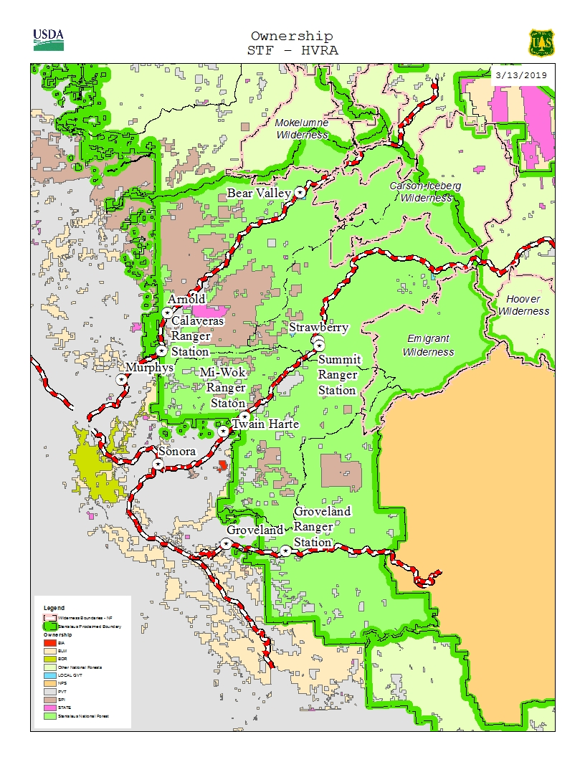
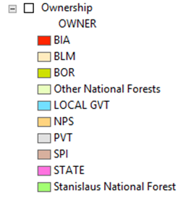
Shared Stewardship and Land ownership

Slide 27
Spatial data in process:
Cooperator treatments
STF treatments
Areas that are planned (been through NEPA process), but not treated yet

Slide 28
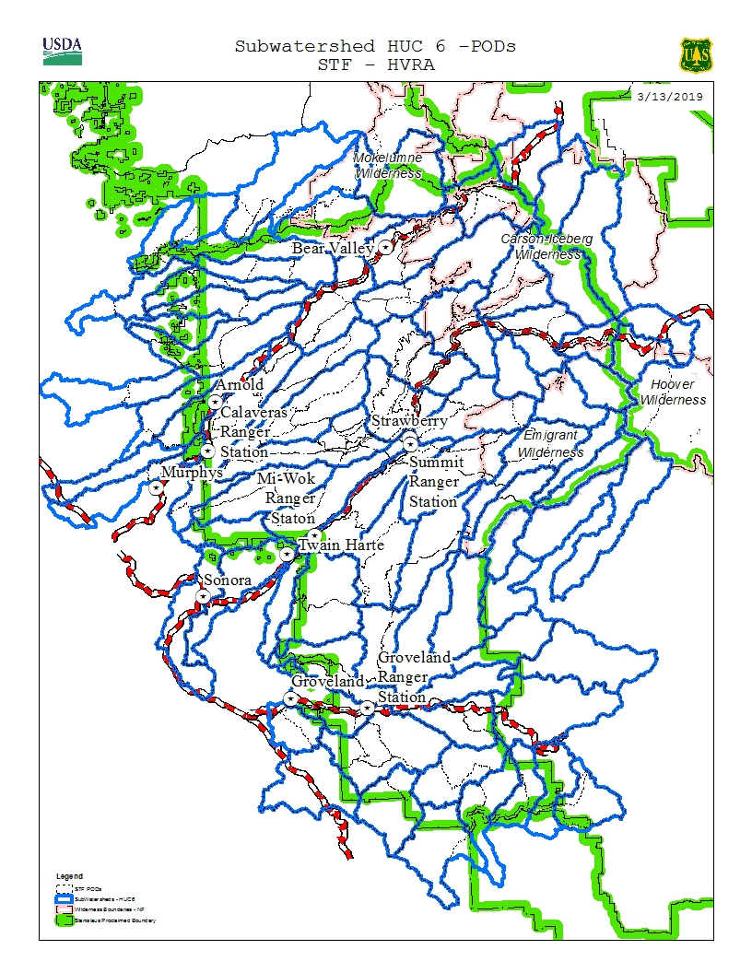
Sub-watersheds (HUC6) and Potential Operational Delineations (PODs)
Notes:
STF area – average HUC6 size is about 21,000 acres.

Slide 29
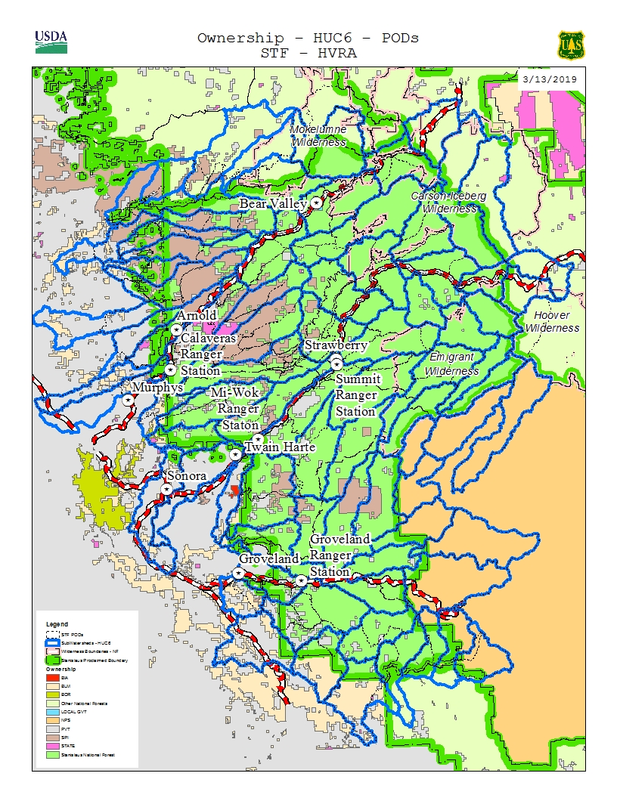
Sub-watersheds (HUC6) and Potential Operational Delineations (PODs) and ownership boundaries

Slide 30
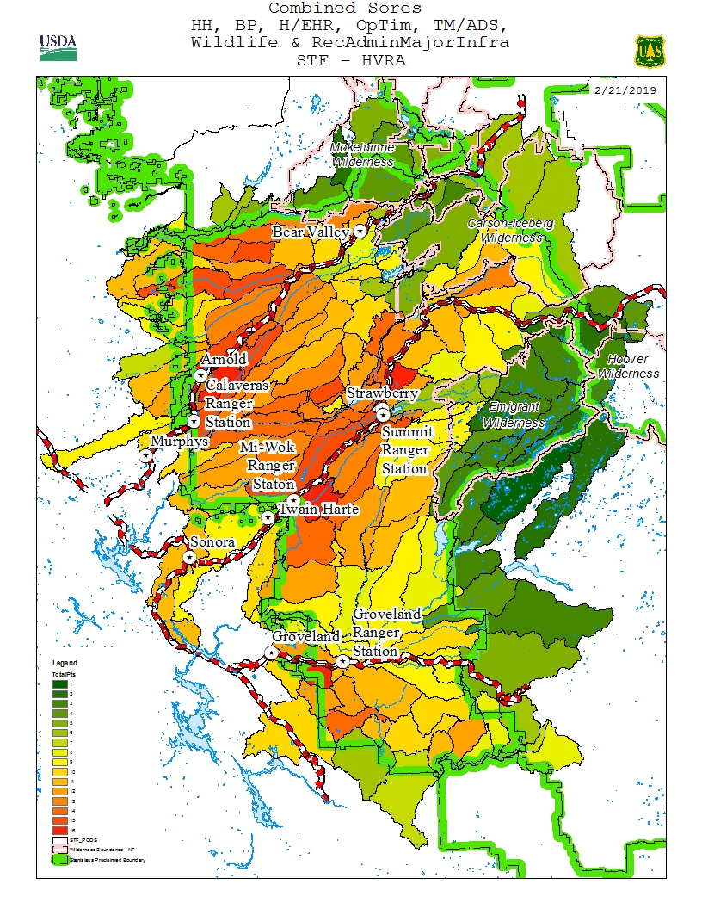
DRAFT Concept Map Summary map using some HVRAs & Risk factors
Goal assess every year
Reevaluate prioritization every 5 years or when large landscape events occur.

Slide 31
Moving Forward
Continue to build & refine 5 yr program of work process
Goal to assess every yr
Reevaluate prioritization every 5 years or when large landscape events occur
Forest Leadership & Specialists review process and determine effectiveness
Incorporate feedback from cooperator involvement/discussions
Reanalyze when updated forest-wide data is available (LIDAR) or as new process steps are developed

Slide 32
What’s Next?
Specialists & collaborators review process, and make comments/suggestions that would enhance the process
Review & consider comments and suggestions
Complete 1st draft of prioritization

Slide 33
Discussion Questions
After viewing the presentation, do you have any general comments regarding the STF 5-Year Integrated POW Prioritization Process?
Should the HVRAs, risk factors, and operational considerations be utilized based on relative importance? If yes, then in your estimation, how should they be considered (please list)?

Slide 34
Discussion Questions (con.)
3. Should the sub-watersheds (HUC6) be used to delineate projects instead of the PODs? Please explain.
4. Are we missing any criteria? Should the missing criteria be added to or replace existing datasets?

Slide 35
Thank you for your time, feedback, and shared stewardship of our public lands. Comments due by May 17, 2019 to: Beck (rebecca.h.johnson@usda.gov) or Carol (carol.ewell@usda.gov)

