Slide 1
UMRWA Forest Projects Plan Presentation & discussion with the ACCG Planning Work Group
Wednesday, February 23RD, 2022

Slide 2
Purpose of the presentation
Engage the ACCG, specifically the Planning Work Group, in UMRWA’s Forest Projects Plan (FPP) Phase 1 with the ultimate goal of achieving consensus support.
Solicit ACCG Planning Work Group input on the FPP Phase 1 as efficiently as possible, with particular emphasis on scope and scale.
Determine method for gaining continued input from the Planning Work Group as Phase 1 develops.

Slide 3
FPP Background
Achieve UMRWA (and ACCG) goal of healthy forests resilient to wildfire and drought, protective of the ecosystem, water quality and the community.
Initiated in 2021 with UMRWA funds and a $200,000 SNC grant.
Ultimate goal is Phase 2, which will be a SERAL-like effort with comprehensive detailed planning and likely an EIS.
First goal of Phase 1 - to get NEPA/CEQA coverage ASAP for mutually agreeable but important ladder fuel and related work for as much priority area as possible by the end of 2022.
Objective is to use the completed Phase 1 NEPA/CEQA to obtain grants and proceed with implementation while the more comprehensive and complex Phase 2 effort is conducted.
Phase 1 actions to date:
Collect background information
Meetings with USFS to refine scope, assemble team, create SPAs
Define project boundary, proposed actions, timeline
Engaging with ACCG

Slide 4
UMRWA Forest Work
Master Stewardship Agreement - 2016
UMRWA’s Role under MSA
Maintain planning, management & financial capabilities
Explore & secure funding
Develop project-specific SPAs with USFS
Develop plans; perform environmental review
Provide personnel/hire contractors to implement projects
UMRWA Forest Projects as Lead Agency
SNF Treatments: Pumpkin Hollow, Black Springs, Cabbage Patch, WCT (4,162 acres)
ENF Road/drainage fixes (58 miles/338 drainage structures)
Mapping Tool Project
8 grant applications; 6 grant awards; 19 contracts
Total secured project funding $5,570,000

Slide 5
Goal Statement
“The goal of the Forest Projects Plan is to provide landscape level fire resilience and forest health to the National Forest lands located in the Mokelumne River watershed.”
Two-phased:
Phase 1. “Mutually agreeable” ladder fuels treatments. >10,000 acres, ASAP.
Phase 2. Landscape scale, thinning of trees >12” dbh and other forest treatment activities requiring more time and resources to analyze and collaboratively plan.
Approach and Strategy
Clear the way for Phase 1 near-term implementation using treatments independent of commercial timber value.
Simultaneously address Phase 2’s more complex but much-needed “revenue producing treatments.”

Slide 6
Purpose and Need
• Reduce and maintain lower ladder fuels to slow the spread and reduce the intensity of future wildfires.
• Reduce fuel loads within late seral/old forest ecosystems, aquatic ecosystems, and aspen stands. Preserve these habitats from loss due to large, high severity wildfire.
Protect special-status species that rely on these habitats such as California spotted owl, northern goshawk, Sierra Nevada yellow-legged frog and Yosemite toad.
• To the extent possible, prepare the landscape for prescribed burning and improve the safety and efficacy of wildfire suppression efforts.
• Protect water quality, wildlife habitat and developed communities within the Wildland Urban Interface (WUI).
• Protect aspen stands from conifer encroachment.
• Work collaboratively with the ACCG to design effective, solutions-oriented treatment activities.
• Build relationships, rapport and set the foundation for Phase 2.

Slide 7
Project Summary
• Mechanical Fuels Reduction
• Hand Thinning Brush and Small Trees
• Pruning
• Prescribed Burning
• Hazard Tree Felling and Removal (for operational safety)
• Aspen Restoration

Slide 8
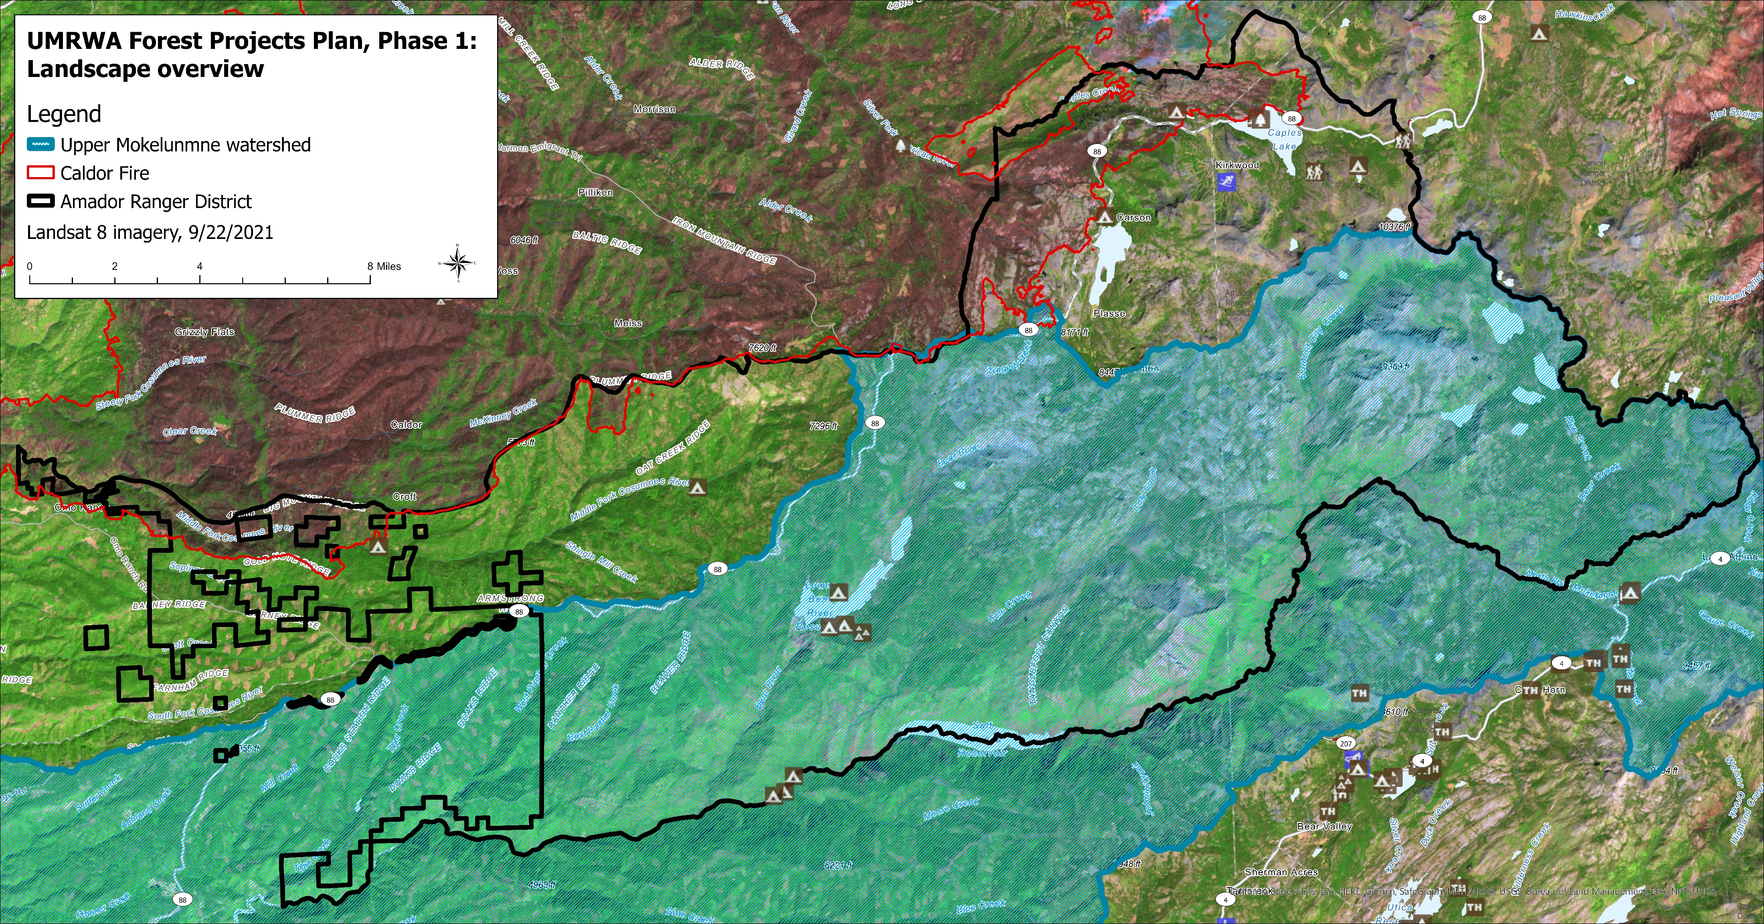
Notes:
Notes: Large wildfire context for project area. Ranger District, watershed, and satellite imagery (for wildlife risk context).

Slide 9
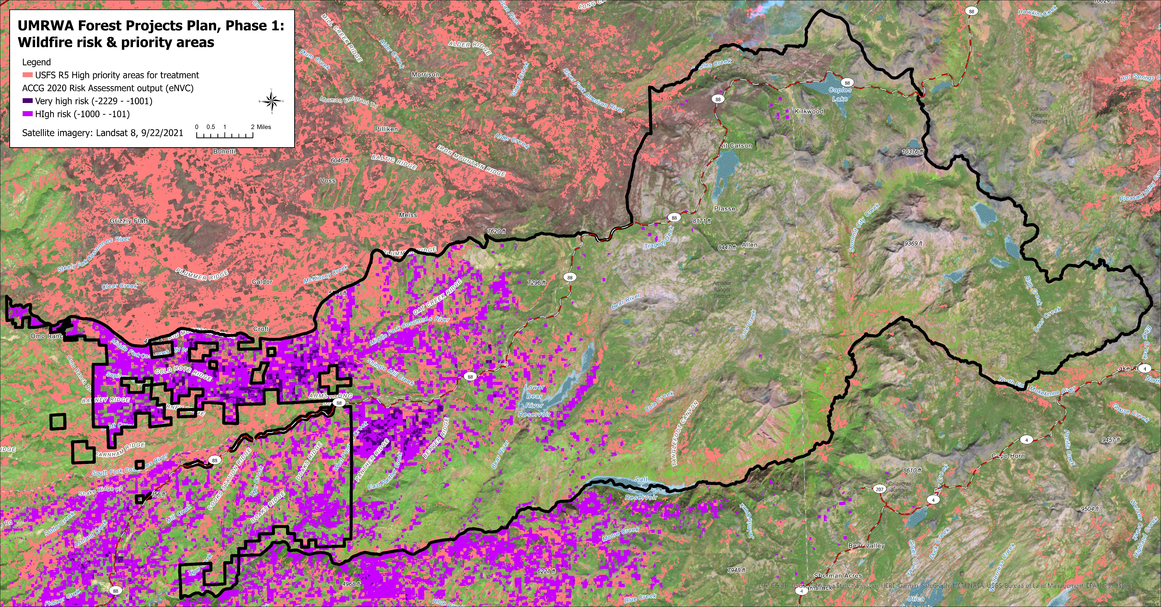
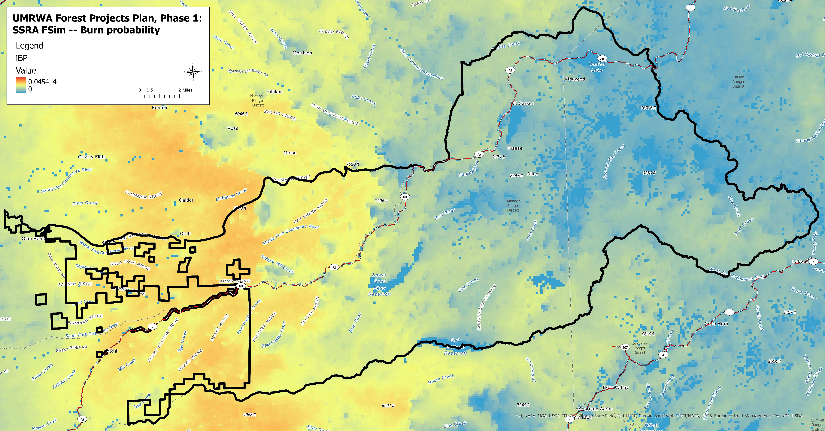
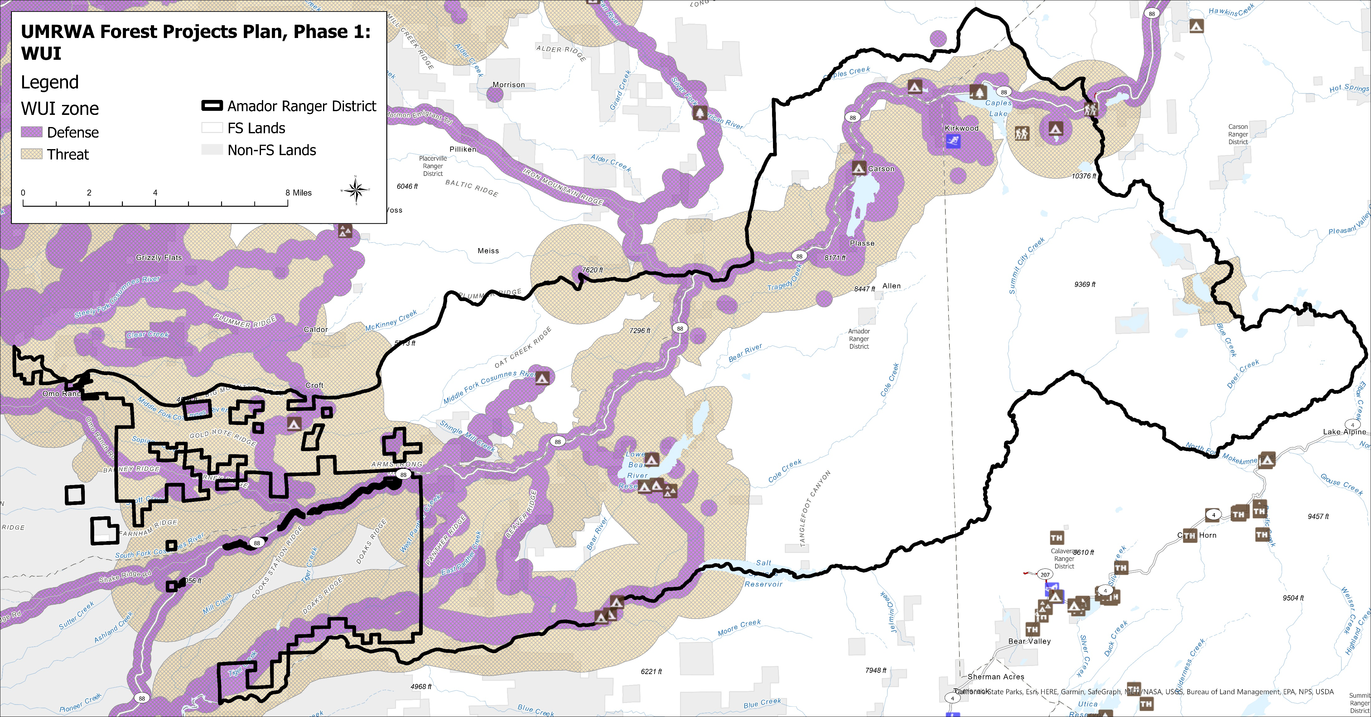
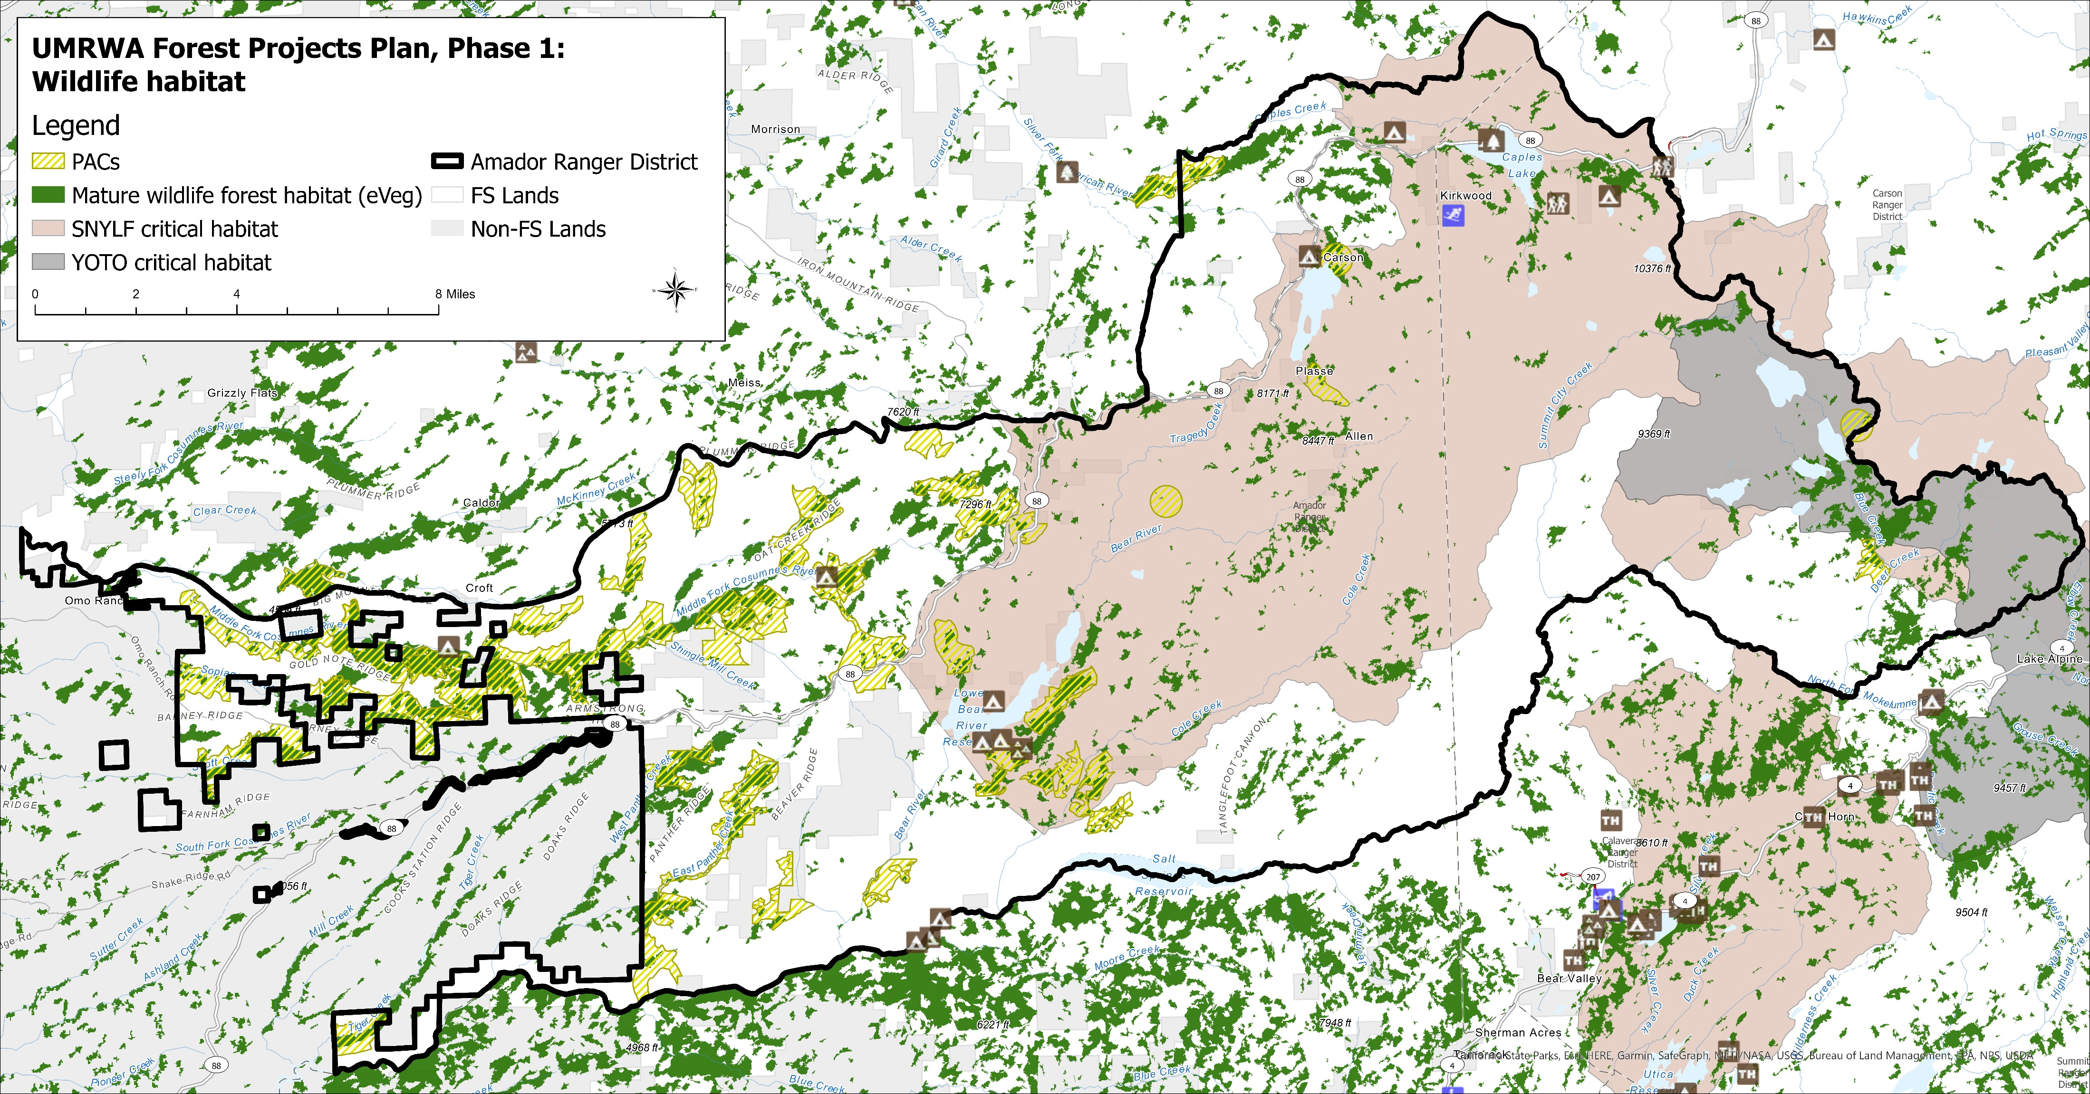
Notes:
Notes: Landscape metrics

Slide 10
Project Boundary & Proposed Activity Criteria
(2) Prescribed burning: locations identified by District Specialists.
(3) Aspen restoration: locations identified by District Biologist.
(4) Mechanical Fuels Reduction: slopes ≤ 40% (tethered mastication for slopes > 40%, locations TBD); adequate Arch survey coverage or areas within the WUI with no Arch survey coverage or unknown survey adequacy in proximity to areas with adequate Arch survey coverage; not in PACs outside WUI; 0.25 miles from road centerline.
(5) Hand Thinning Brush & Small Trees (only): where preceding activities are not feasible or restricted by resource concerns, and where it doesn't conflict with other resource concerns/restrictions.
(1) Project boundary: within Amador Ranger District, outside designated wilderness, FS lands only, and outside the following recent NEPA decisions: Scottiago, Panther, and Power Fire PCT.
(6) Within four preceding proposed activities:
- Pruning
- Hazard Tree Felling and Removal: where identified as an imminent hazard to the project.
---
UMRWA FPP, Phase 1

Slide 11
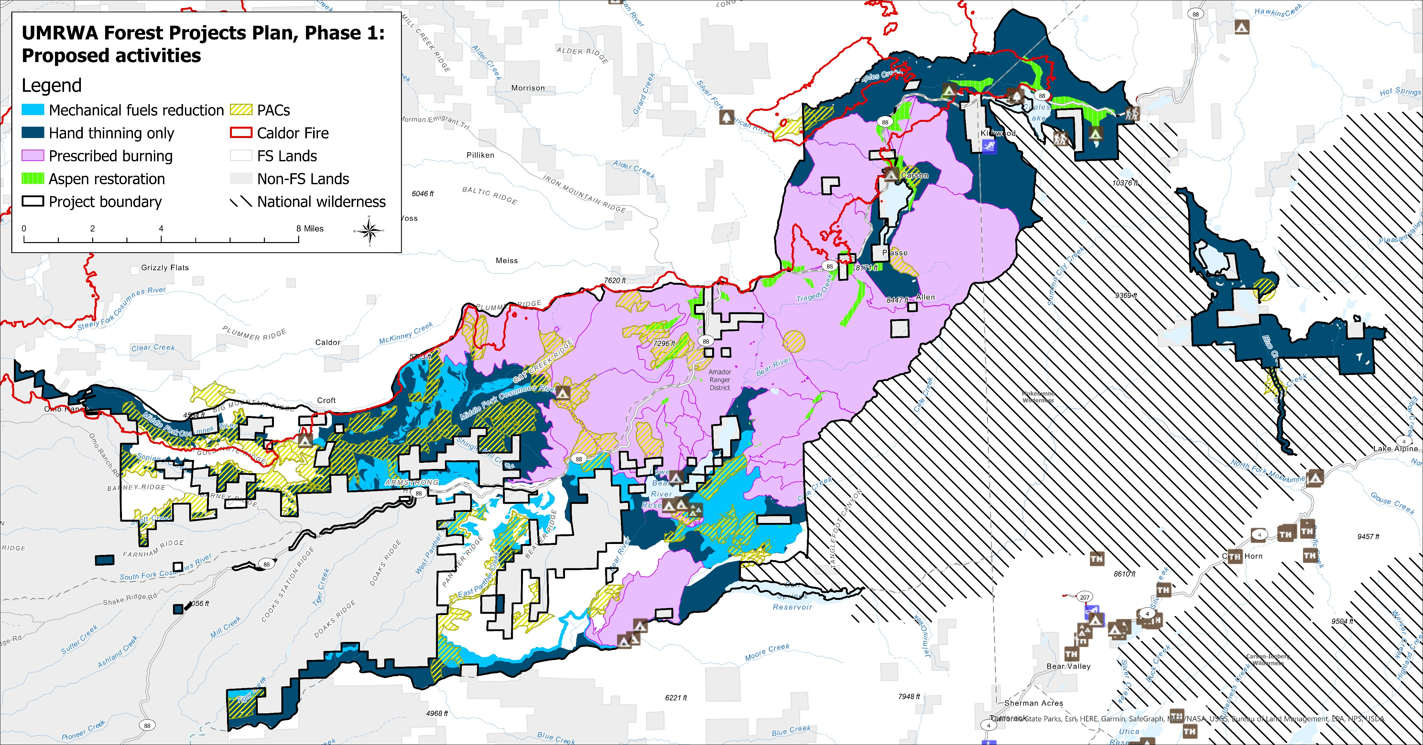
Project boundary & proposed activities map
(coming soon)
Notes:
Notes: Remove map

Slide 12
Proposed Activities
Proposed activity | Estimated acres
Mechanical Fuels Reduction | 9,560
Hand Thinning (only) | 37,872
Prescribed Burning with option of pre-treatments (e.g., mechanical, hand; locations TBD). | 52,668
Aspen Restoration* | 2,315
---
UMRWA FPP, Phase 1
--: Activity is proposed to be performed where applicable and as needed.
*: Some aspen restoration areas would overlap with Prescribed Burning areas.
Note: Hazard Tree Felling & Removal is proposed where trees are identified as an imminent hazard to the project. Pruning locations TBD.

Slide 13
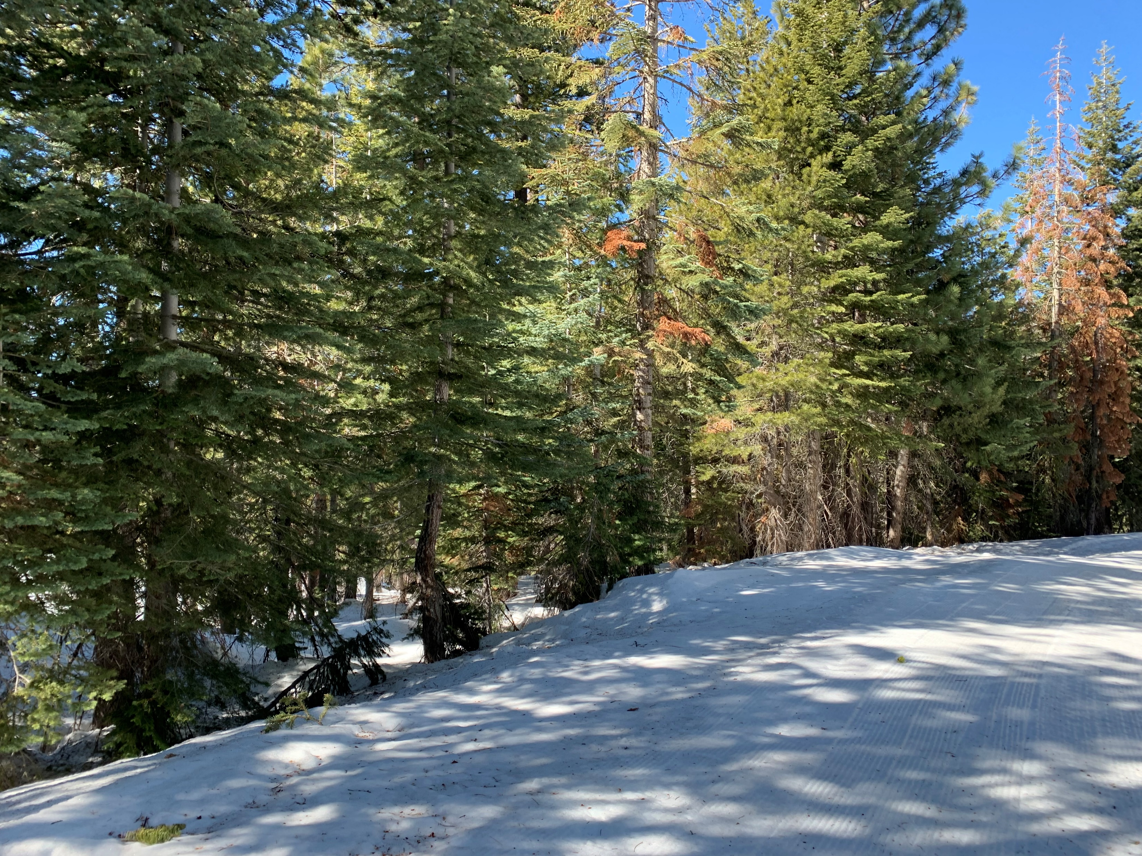
Hazard ladder fuels within the proposed project area
Photo is of roadside ladder fuels in the Foster Meadow Area (photo courtesy of J. Plummer).

Slide 14
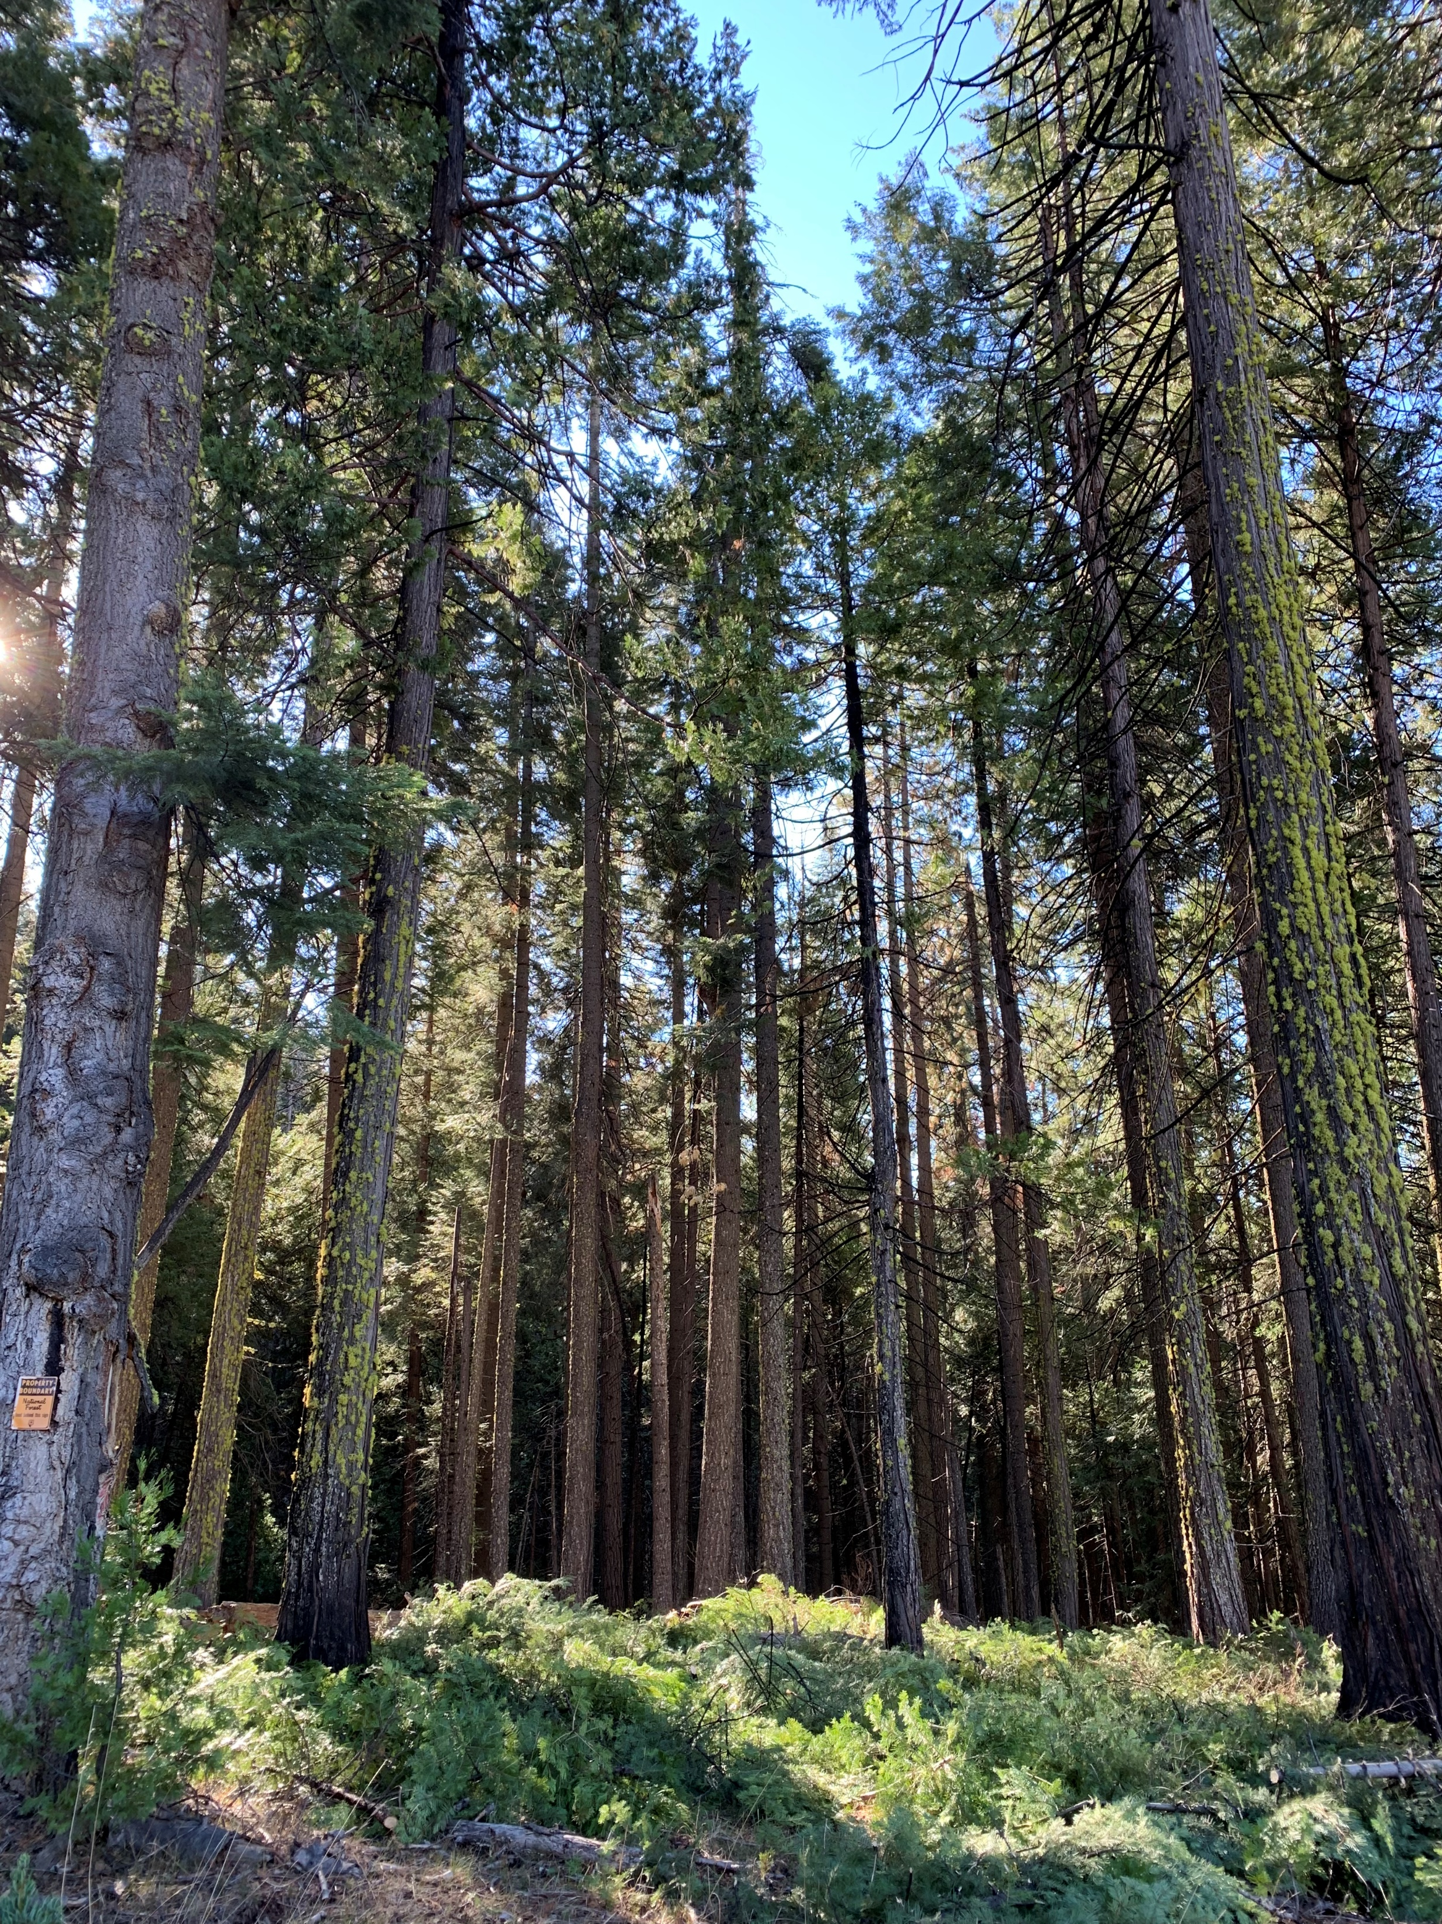
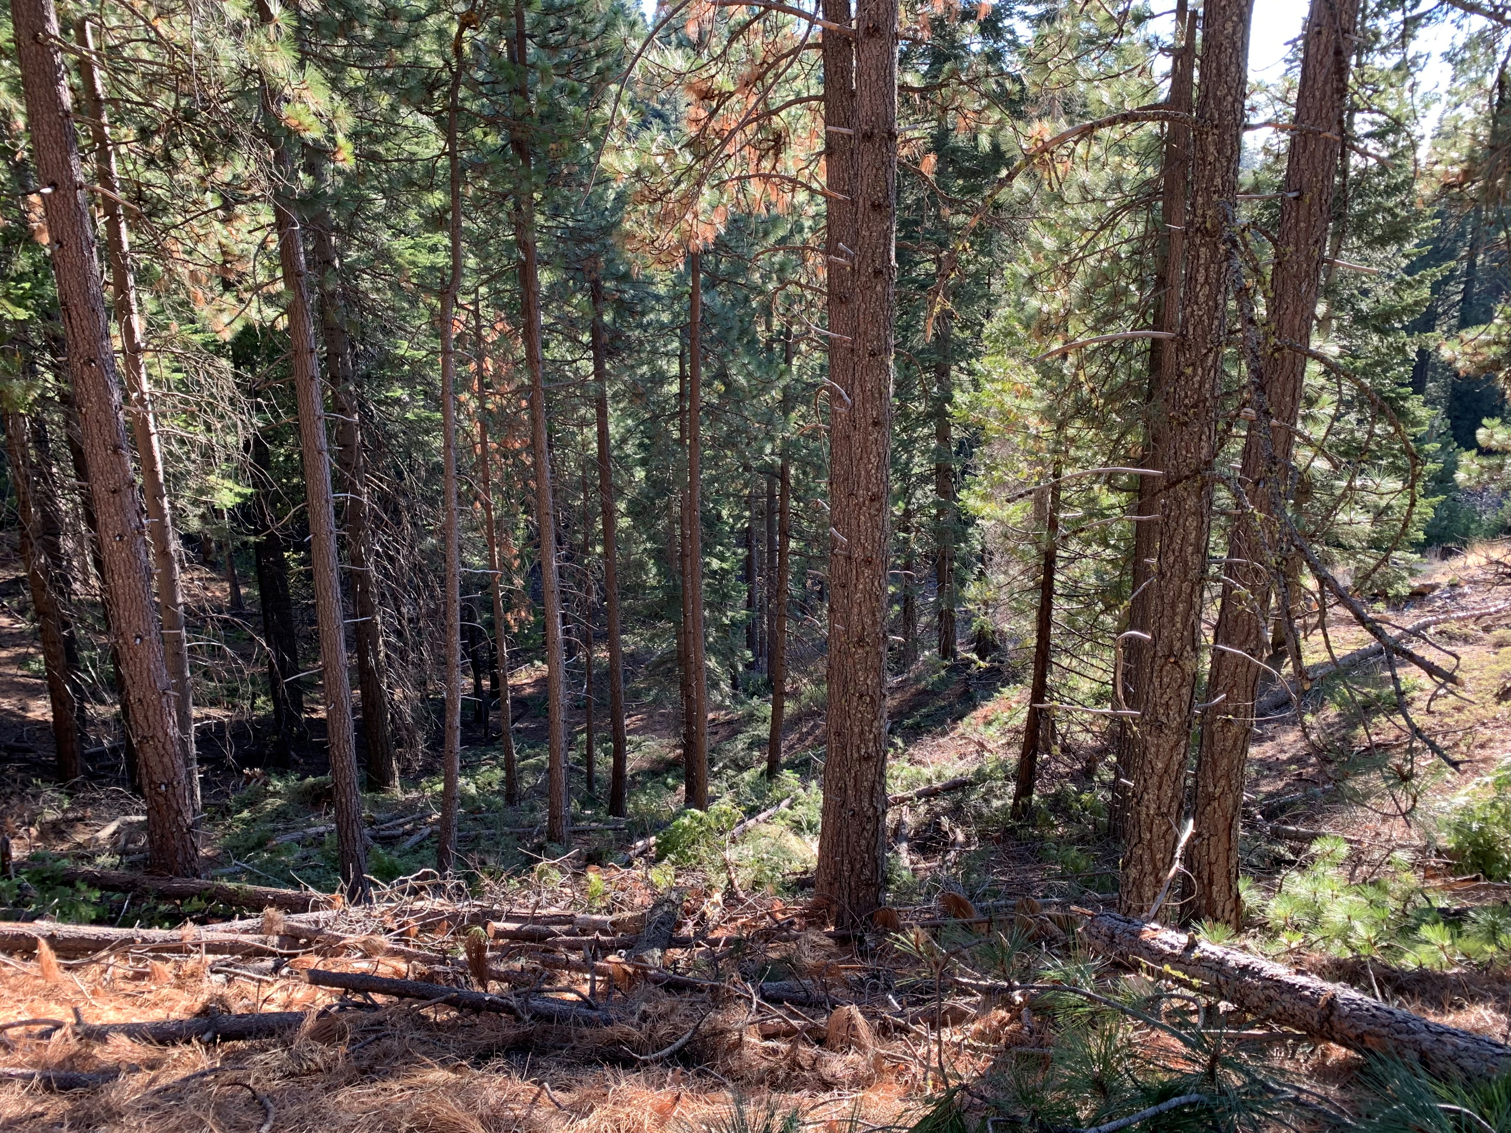
Example outcomes of proposed activities
Hand cut (<10” dbh) and lop/scatter treatment in WUI spotted owl PAC (photo - J. Plummer).
Another example of hand cut (<10” dbh) and lop/scatter treatment in WUI spotted owl PAC. Panther Creek area along federal property line. Showing minimal increase in surface fuel load and great reduction in ladder fuels. (photo - J. Plummer).

Slide 15
Schedule
PHASE 1 TASKS | TIMELINE
Finalize Project Summary and Treatment Area Maps* | TBD
Provide project update to full ACCG | March 16, 2022
Public Scoping | April 15 to May 15, 2022
Sign contracts with resource specialists | May 30, 2022
Initiate archaeological field surveys | June 15, 2022
Compile draft and Final Wildlife Biological Evaluation (BE), Botanical BE and Cultural Resources Reports | June 1, 2022 to September 1, 2022
Achieve consensus support from ACCG | September 21, 2022
If Categorical Exclusion/Decision Memo and CEQA CE Notice of Exemption | Execute October 2022 to December 2022
If Environmental Assessment/Decision Notice | Execute March 1, 2023
*: Continued discussions with ACCG Planning Work Group on refining Phase 1.

Slide 16
Next Steps
Phase 1
• Obtain Planning Work Group input today and determine approach/schedule for continued input.
• Present Phase 1 to full ACCG (after incorporating input and addressing any concerns by the PWG).
• Move on with other tasks on schedule while incorporating input from PWG and ACCG.
Phase 2
• Will incorporate Calaveras Ranger District into the project area.
• Comprehensive Planning Document.
• Will likely include additional forest management actions such as commercial thinning.
• Expected to take approximately two years to complete.

