Slide 1
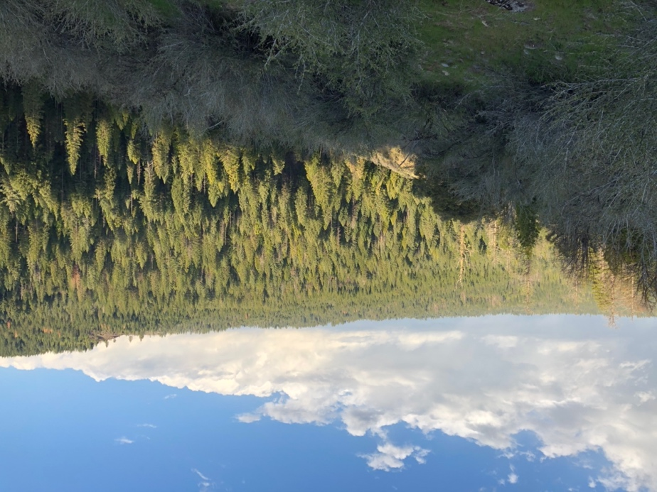
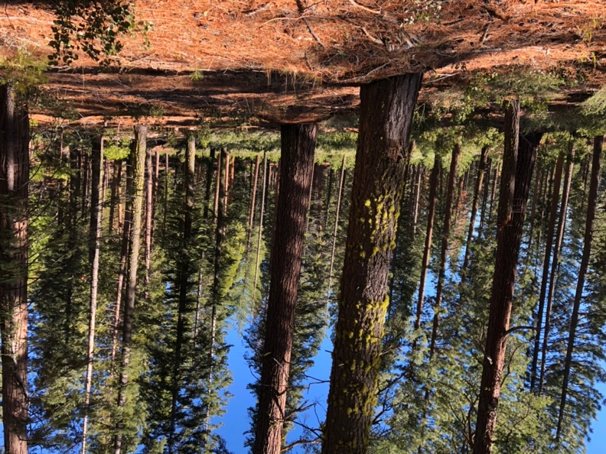
SERAL Project
Points hopefully worth sharing and some lessons learned
Patrick Koepele – Tuolumne River Trust
Katie Wilkinson, Stanislaus National Forest
John Buckley - CSERC
Notes:
John - introduce Katie and Patrick
Ask that except for clarifying questions, please hold questions until we're finished because we have a lot of information to cover.

Slide 2
Basic explanation of YSS - Patrick

Slide 3
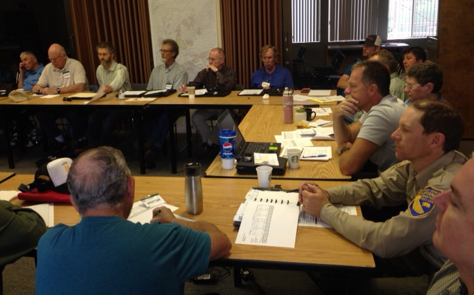
DIFFERENCES IN HOW ACCG AND YSS FUNCTION
ACCG has evolved with an emphasis on facilitation and the process of collaborating together. It functions with four standing work groups and three ad hoc committees. ACCG spent two years developing a highly detailed project development and support process. There are informative presentations most months. ACCG has invested extensive time in striving to develop prioritization tools (SLAWG). Members report out to the full group at meetings. And in keeping with the tone of collaboration, projects or actions are first heard at the Planning Work Group and then later at the General Meeting.
YSS prioritizes getting results done on the ground on narrowly focused areas of agreement. General member meetings are only held six times a year. Most YSS planning and decision-making gets done by the YSS Leadership Team that then networks back to members for input and formal confirmation. YSS has a low level of planned presentations. It prioritizes getting work accomplished, and with that focus, it has extensive experience partnering with Tuolumne County to use a Master Stewardship Agreement to implement forest projects.

Slide 4
What was YSS’s role in creating and promoting the SERAL project?
October 2019 – Barnie Gyant agreed to end the highly controversial giant MOTORM2K Large Landscape Plan to treat 750,000 acres on each of the Stanislaus and Sierra National Forest(s); but he openly challenged the 3 attending stakeholder groups to counter back with what they’d support as an alternative.
November 2019 – The YSS Leadership Team identified our choice of the highest value, highest-at-risk project area and provided a map and a conceptual plan to the Region and to the local Stanislaus Forest staff.
Originally called the ”Bridge Project” by YSS as a bridge between current project planning and much bigger “large landscape” planning, the Stanislaus Forest staff renamed the project the SERAL project – “Social and Ecological Resilience Across the Landscape.”
For many months the YSS Leadership Team then met frequently with the Forest staff to identify the details of which project treatments were desired, where priorities for actions were intended, and whether or not to include a variety of potential “additions” to the large landscape project that were desired by FS leadership.

Slide 5
WHERE IS SERAL?
Centrally located on the Stanislaus National Forest, within the Yosemite Stanislaus Solutions collaborative area and almost entirely to the north and west of Highway 108.
This 118,808-acre project area spans portions of the Calaveras, Mi-Wok, and Summit Ranger Districts.
80% or almost 95,000 acres of the 118,808 acres occur on FS-lands
SERAL project proposed / authorized actions are located only on FS-lands.

Slide 6
What is SERAL?
Planning effort designed to
Restore Forest Resilience
or
Reduce the landscape’s susceptibility to natural
disturbances (insect, disease, drought, wildfire).
Notes:
A planning effort designed to restore forest resilience to natural disturbances.
Put a different way, this effort is designed to reduce the landscape’s susceptibility or vulnerability to natural disturbances such as insect- and disease-, drought-, and as Jason described wildfire.

Slide 7
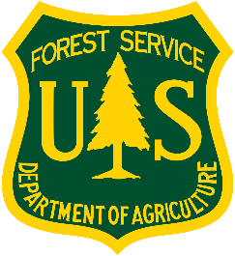
How will we restore landscape conditions?
Increase forest heterogeneity by restoring the proportion of different size and density classes across forested areas
Reduce tree densities.
Increase the relative abundance of fire-tolerant and shade-intolerant trees.
Reduce and maintain low levels of surface and ladder fuels.
Apply or reintroduce fire to the landscape across larger areas, with low severity, more regular intervals
Respond to natural disturbances which result in tree mortality rates exceeding the natural range of variation.
Notes:
So how will we restore landscape conditions and increase resilience?
SERAL aims to….
Increase forest heterogeneity by restoring the proportion of different size and density classes across forested areas to within the natural range of variation.
Reduce tree densities.
Increase the relative abundance of fire-tolerant and shade-intolerant trees.
Reduce and maintain low levels of surface and ladder fuels.
Apply or reintroduce fire to the landscape at larger, more regular intervals to mimic the natural range of fire severity and frequency.
Respond to natural disturbances which result in tree mortality rates exceeding the natural range of variation.

Slide 8
What are the key conservation objectives while restoring forest resilience?
Retain large, old, and structurally diverse trees and snags
CSO habitat
Reduce the spread of invasive non-native weeds from existing or new infestations.
Notes:
While restoring forest resilience we need to ….

Slide 9
What are the social needs while restoring forest resilience?
Provide economic opportunities for local communities (e.g., wood products)
Maintain safe access to public lands and reduce fire threats
Notes:
We need to…..

Slide 10
What actions are proposed to meet the restoration, conservation, and social needs of SERAL?
Forest thinning – via timber harvest, biomass removal, or mastication
Fuel reduction – via mastication, or piling and burning
Fuelbreak Construction – via timber harvest, biomass removal, mastication, or hand thinning, or piling and burning
Prescribed fire – a diversity of treatments
Salvage of dead and dying trees – via timber harvest or biomass removal.
Hazard tree abatement – via timber harvest or felling.
Invasive Weed Control and Eradication – via manual, mechanical, cultural, or chemical methods
Notes:
Simply put, “the usual”
So what are the actions we are proposing to meet all of these needs?

Slide 11
How is SERAL the same or different from past forest projects?
Same –
The types of vegetation management actions proposed
Different –
The scale of the actions we are proposing
Landscape scale objectives driven by NRV-based restoration needs (literature supported)
The sense of urgency to implement treatments and the broad support and resources available to implement the project.
Working collaboratively with YSS from the project’s inception to develop the proposed actions. Their input, broad ranging perspectives, and support have been critical.
The team of scientists and professionals who supported the effort and developed landscape conditions metrics we used to assess both the need for treatment and where treatments are proposed
The use of ForSys, a scenario planning tool which enabled the team to rapidly synthesize the suite of landscape condition metrics to locate and select proposed treatment areas within the project area.
Using Potential wildland fire Operational Delineations (PODS) for implementation prioritization and strategies.
Adopts / Applies the management approaches and conservation strategies presented in the 2019 Conservation Strategy for the CSO in the Sierra Nevada via project-specific forest plan amendments.
Includes some Condition-Based Management Actions
Focused Analysis
Notes:
You will see tonight that we are proposing the same types of vegetation management actions as we have over the past few decades –
What is new about SERAL, however, is the scale of the actions we are proposing,
The sense of urgency to implement treatments and the broad support and resources available to implement the project.
Working collaboratively with YSS to develop the proposed actions
The team of scientists and professionals who supported the effort and developed the landscape conditions metrics that were critical to multiple facets of the planning effort (will discuss more later).
The use of ForSys, which enabled the team to rapidly synthesize the suite of landscape condition metrics to locate and select proposed treatment areas within the project area.
And (PODS) to inform implementation prioritization and strategies.

Slide 12
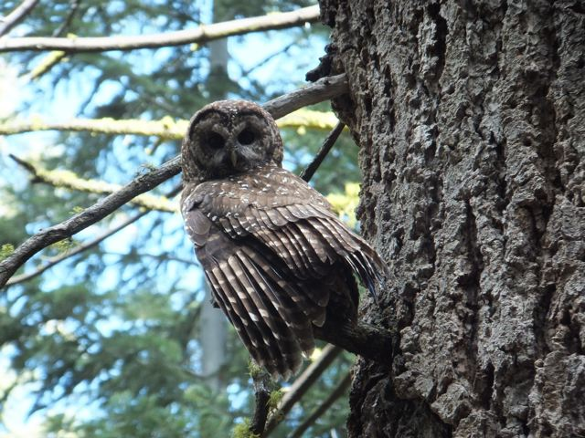
How does the 2019 CA Spotted Owl Conservation Strategy differ from the Framework Owl policies? The spotted owl is a USFS indicator species for other late seral forest habitat wildlife. Initial years of owl science tied suitable owl habitat to maintaining dense forest stands. More recent science now ties owl use of habitat to clumps and patches of tall, large trees.
Logging within 300-acre PACs (2019 policy = 100 acres) YSS – Set 20” dbh limit in PACs
Much higher diameter limits for logging (“up to 40” dbh in certain limited situations)
YSS – only up to 34” dbh for shade-tolerant white fir and incense cedar
and only outside of CSO Territories, and only when a 30” residual tree is left
(plus in Territories, YSS set a limit of 24” dbh for pines, Douglas firs)
• Circular Territories versus amoeba-type layout of best quality habitat
• PAC retirement criteria

Slide 13
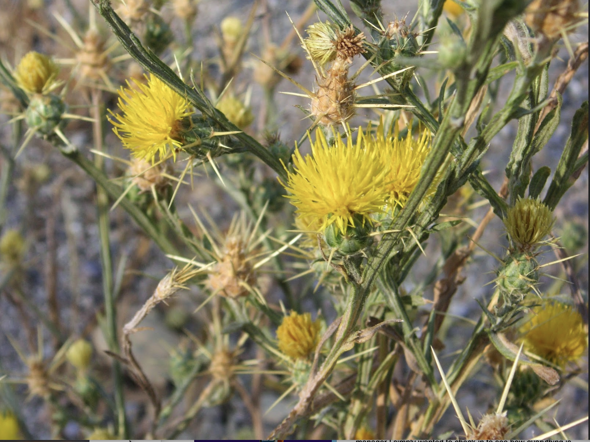
Herbicide use in the SERAL project The issue of herbicide use can be very polarizing. After input from YSS, the Forest Service narrowed its proposed herbicide use in the SERAL project area to primarily aim to treat invasive weeds where currently known populations were already identified. After receiving public comments, the Forest further adapted by choosing to limit herbicide treatments in the SERAL area to a maximum of 285 acres. The USFS also agreed to make herbicides the last choice if alternative treatments are feasible. And most important, herbicides in the vast SERAL project would ONLY be used for invasive weeds, not for fuel breaks or for other vegetation management which greatly increases controversy. Then in response to DEIS comments, the Forest Service dropped the planned use of two of the seven possible herbicides originally listed in the EIS based on public comments objecting to the higher calculated health risk for workers posed by those two herbicides. The key take-away is that herbicide use ended up NOT being a highly controversial issue in the SERAL project because the Forest staff carefully minimized controversy on that issue by responding to public comments and strictly limiting herbicide use to treating invasive, noxious weeds on a relatively small number of acres.

Slide 14
Summary of the SERAL planning process
Scoping – July 2020 30-day comment period, 22 comment letters from 21 entities
Virtual Public Meeting – August 2020, 70+ attendees
DEIS December 2021, 45-day comment period, 23 unique letters and 38-form letters.
Virtual Public Meeting - Two in January 2021, 75+ attendees
FEIS NOA February 2021
ROD-1 Signed - March 2021
Administrative Review (Objection Periods) – ROD-2: February 2021, 45-day objection period
ROD-3: March 2021, 45-day objection period
(We’ll explain more about the three different Record of Decision docments in later slides.)

Slide 15
Types of Comments Received
Comment Topic | Cause and Effect | Addressed
Forest Thinning | A. Forest thinning will reduce habitat quality of CSO habitat. | Analysis Issue 1A
 | B. Forest thinning within CSO PACs is not necessary to increase landscape resilience. | Analysis Issue 1B
 | C. Forest thinning DBH limits will impact the project’s ability to effectively reduce stand densities. | Analysis Issue 3A
 | D. Allowing trees greater than 30-inches DBH to be cut and removed is not necessary to increase landscape resilience. | Analysis Issue 3B
 | E. Forest thinning DBH limits will impact the project’s ability to provide timber (wood product) to local and regional communities and the ability to implement the proposed treatments. | Analysis Issue 4
 | F. Forest thinning and fuel reduction treatments may impact the characteristics of eligible wild and scenic river segments and diminish their eligibility for future designation. | Analysis Issue 5
Project-Specific Forest Plan Amendments | A. Delineating a circular territory rather than home range core areas could result in an insufficient quantity and quality of owl habitat conserved and protected | Analysis Issue 6A
 | B. Retiring owl PACs based on lack of occupancy will lessen protections for owls compared to current management direction. | Analysis Issue 6B
 | C. Allowing habitat quality reduction in up to 1/3 of a PAC will lessen protections for owls compared to current management direction. | Analysis Issue 6C
Herbicides | The use of herbicides to treat non-native invasive weeds may affect human health and the health and diversity of other native species. | Analysis Issue 8
Salvage | The proposed salvage of insect-, disease-, drought-, and wildfire-killed trees lacks the site-specificity necessary to assess the potential impacts to the environment. | Alternative Modifications and Analysis Issue 9
Temporary Roads | The construction of temporary roads that are not properly decommissioned lead to erosion, unauthorized cross-country travel by wheeled motor vehicles, and introduction of noxious weeds. | Alternative Modifications and Analysis Issue 10

Slide 16
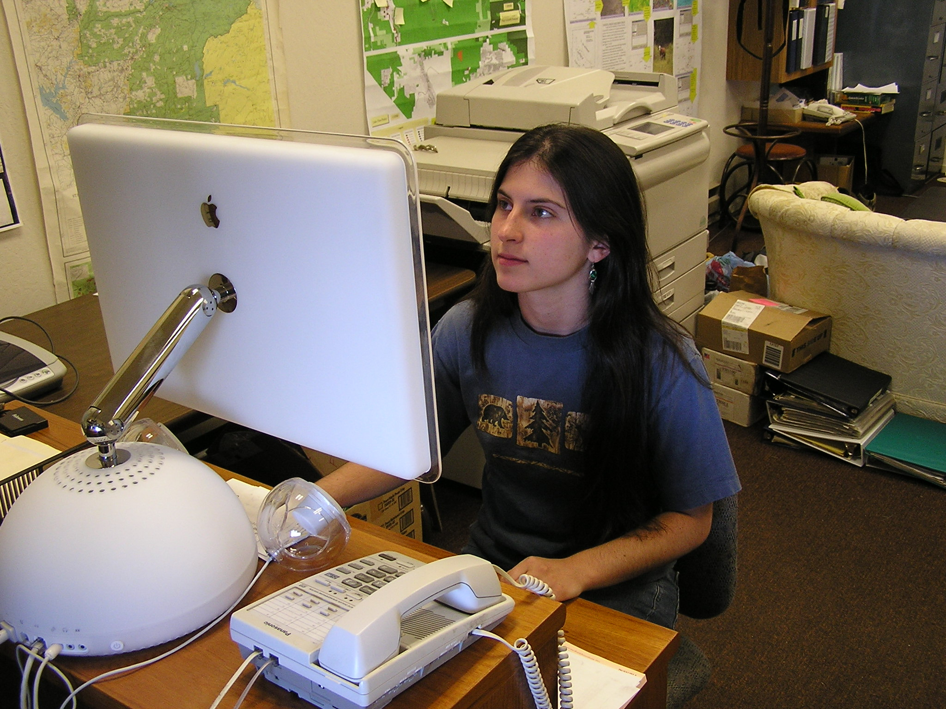
What changes were made to the Project based upon public comments and objections during the planning process?
Scoping and DEIS: Herbicide use areas refined
Scoping: Salvage action areas, constraints, and requirements updated
DEIS: Retention of CWHR 5D/5M in CSO PACs via min. canopy cover requirement
FEIS / ROD: Retention of CWHR 5D/5M in CSO Territories via min. canopy cover requirement (outside of exemption area)
FEIS/ROD: CSO PAC and Territory desired condition assessment and individual PAC/Territory analysis added.
ROD: Decision rationale supplemented and expanded.
Multiple Decisions were prepared (Further explained next few slides)

Slide 17
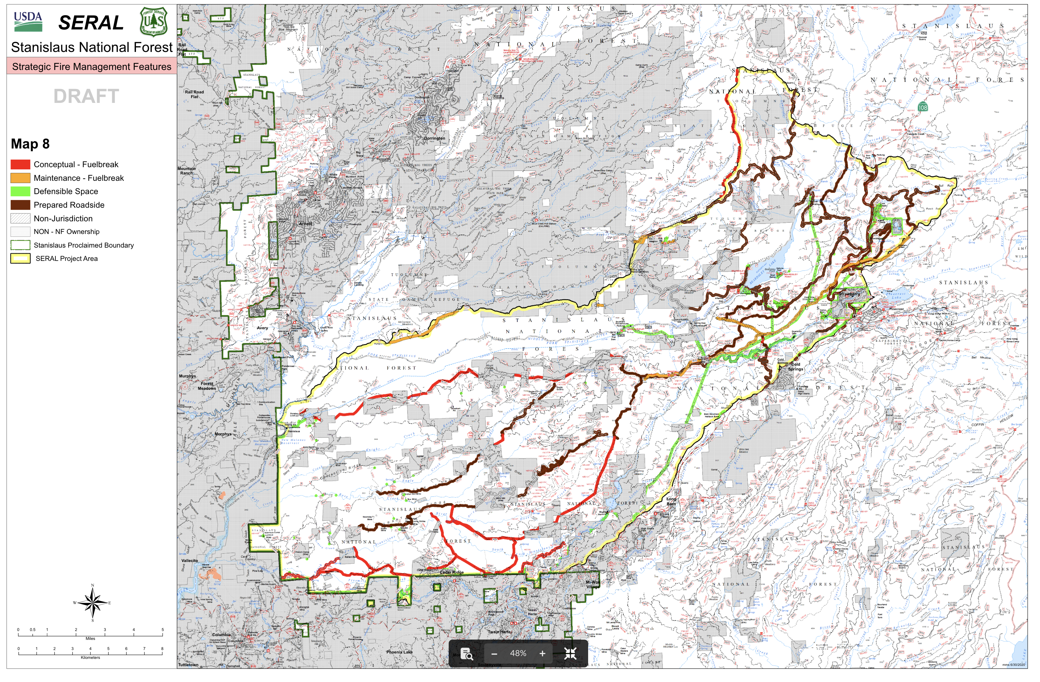
The three separate SERAL “Record of Decisions” (RODs) were based on differing potential for controversy, objections, and litigation delays.
The first SERAL ROD authorized the fuel breaks that the Forest staff judged to be most pivotal for protecting communities.
Out of all the fuel breaks shown on the map, this ROD only authorized work for strictly non-commercial treatments in the five PODs closest to communities. And because there were no public comments submitted specifically opposing this work; it was deemed non-controversial.
The fuel break work on the 6,000+ acres is in the process of starting…

Slide 18
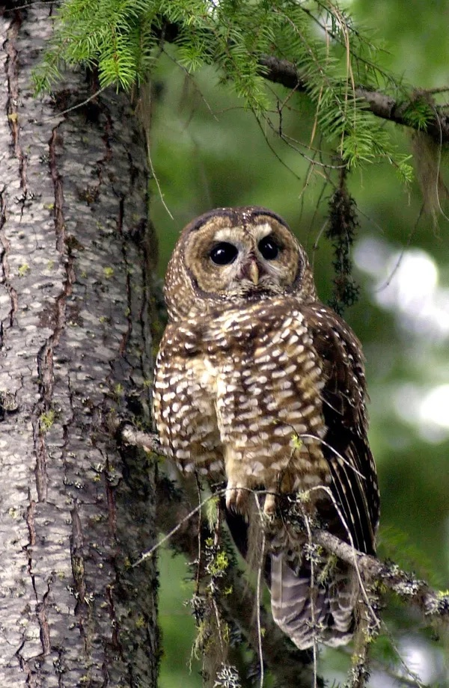
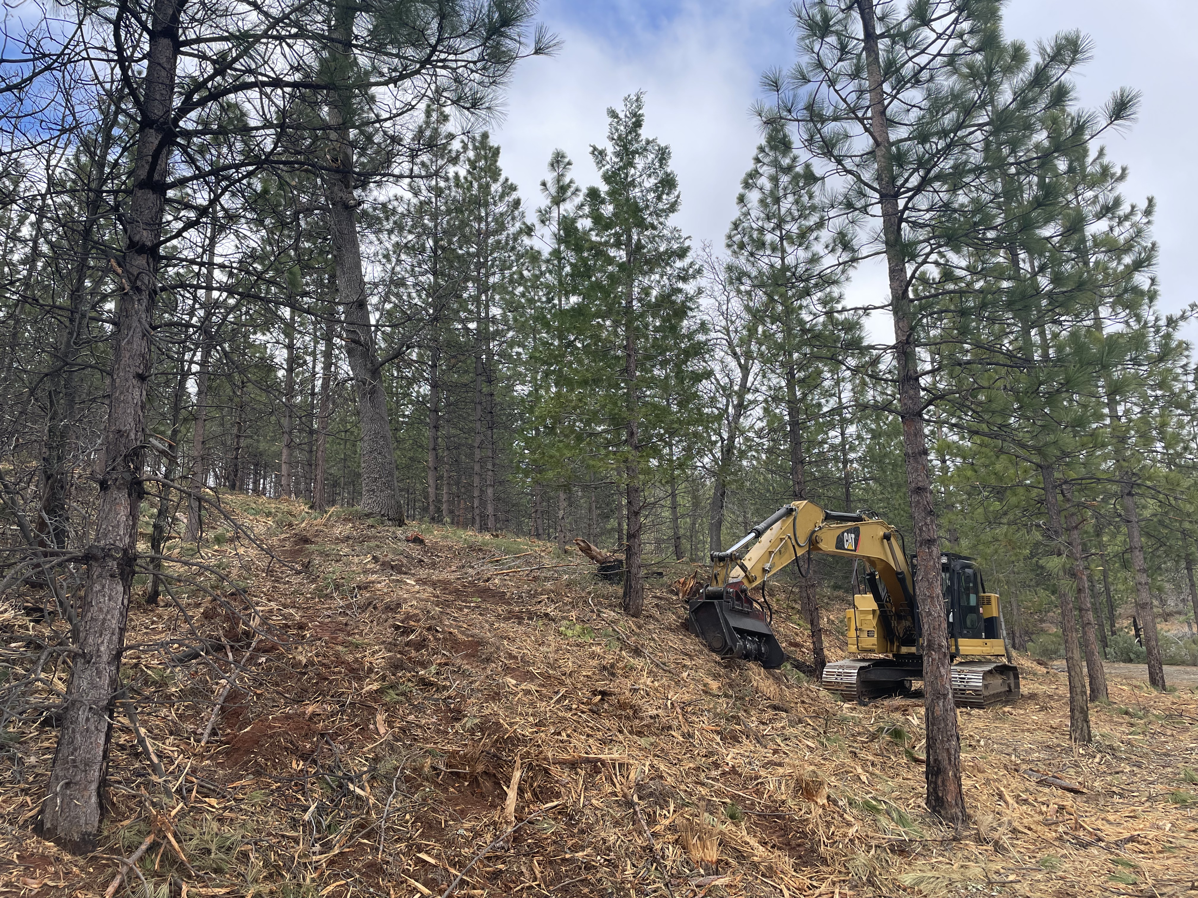
The main SERAL project is authorized by the second ROD
38,000 acres of forest thinning and mechanical fuel reduction treatments
231 acres of herbicide use solely to treat invasive weeds + 54 acres “where discovered”
71,000 acres of prescribed burning (most after logging or other treatments)
Road reconstruction and temporary road construction
Forest Plan Amendments for new policies for CA Spotted owl

Slide 19
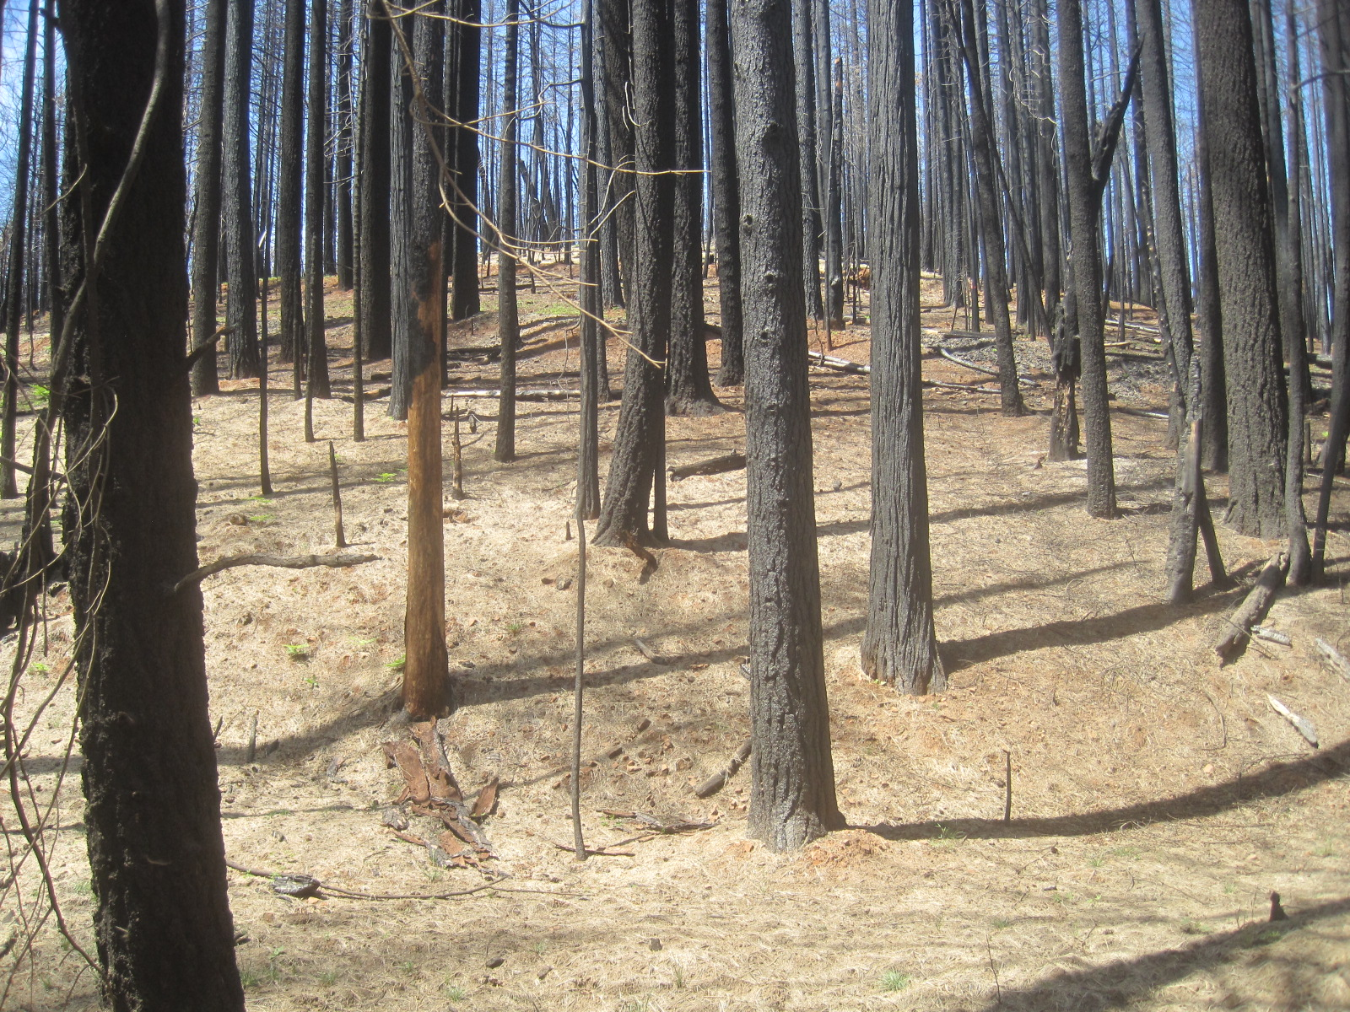
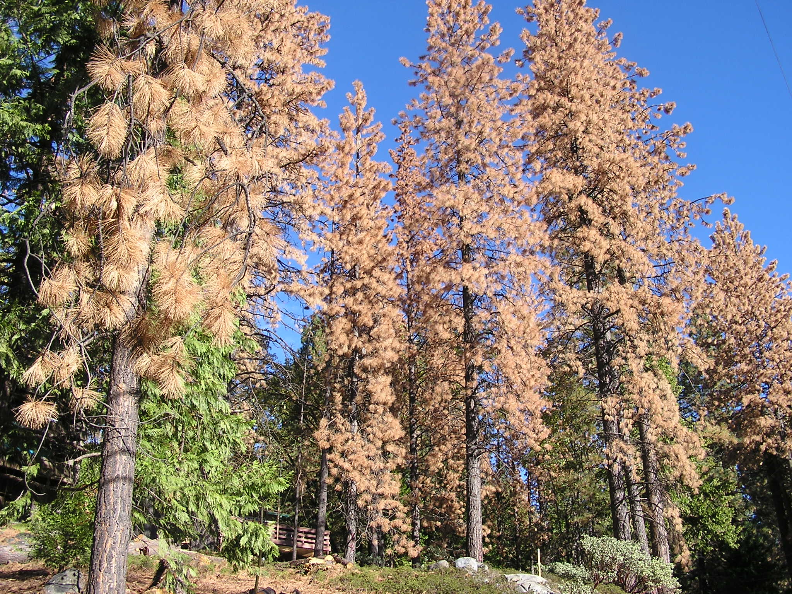
The third SERAL ROD is for the approval of the condition-based set of treatments.
It was expected that this third ROD could result in the most appeals (Objections) filed against it, since condition-based management is untested in the Region and relies on the highest level of trust in the agency. In the SERAL project, it authorizes salvage logging of a certain amount of dead trees due to fire, drought, or bark beetles, plus some temporary roads associated with the salvage treatments.

Slide 20
Were Objections filed? ROD-1: No Objections ROD-2: 7 Objection Letters, other letters of support ROD-3: 3 Objection Letters, other letters of support Objection Issues ROD-2 (No surprises): 1. Habitat Quality Reduction in CSO habitat 2. Circular CSO territory delineations, desired condition, 3. Methodology used to assess restoration needs 4. Adoption of some aspects of the CSO Strategy Objection Issues ROD-3 (No surprises) 1. Lack of site-specificity related to the salvage actions and temporary road construction needs 2. Use of condition-based management

Slide 21
Objection Review Process
Identify Issues, suggested remedies and record citation (2 weeks)
The Regional Office led the objection review identification of instructions or suggestions (1 week)
Objection Resolution Meeting and Prep (1 week)
Identify feasible remedies and additional engagement with objectors (3 weeks)
5. Update FEIS and Record of Decision (2 weeks)

Slide 22
What is the potential for delay if any lawsuits are filed and a stay (Injunction) is sought?
Complaint Filed – No delay
Complaint Filed with temporary restraining order or injunction granted – delay could be years.
ROD-2 Objection Review – No violations of law, regulation, or policy

Slide 23
Funding – a key to any project Patrick

Slide 24
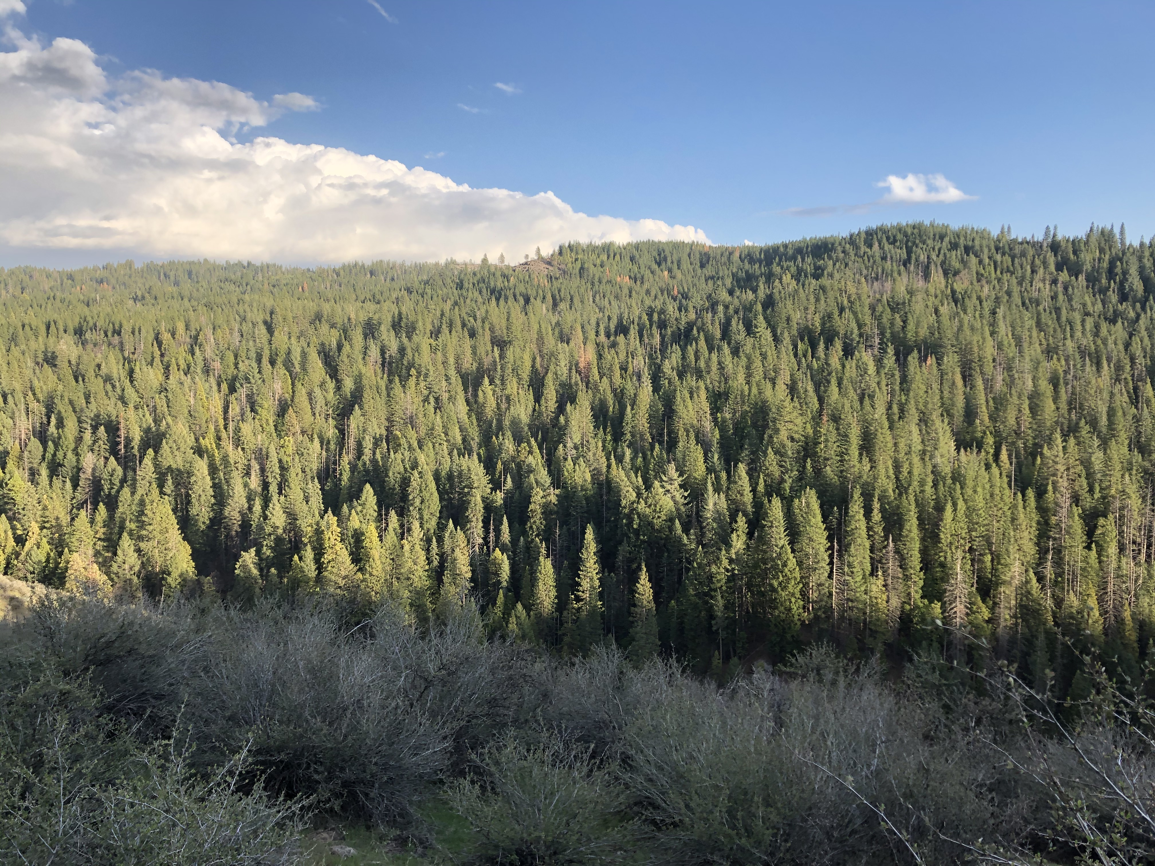
What are some of the lessons learned?
Large projects can end up being more even
complicated and challenging than envisioned.
Examples: Getting landscape level field surveys done prior to NEPA analysis is a huge amount of work, contracting, etc.
Simply needing to accurately define or survey boundary lines on the ground between USFS and private lands has now been found to be a huge need that will rely upon contractors, etc. at a cost of $3,000,000 or more.
Identifying which acres on a hillside need thinning or mechanical fuel reduction treatments is one thing, but then trying at a vast scale to attempt to actually figure out where the layout of skid trails can get equipment from roads to scattered treatment areas or how to make clusters of forest treatments economically feasible are just two quick examples of many, many challenges.
(Plus, some roads have been found to be impassible for heavy equipment transport trucks, etc.)

Slide 25
Applying new policies, modeling, etc. in a large landscape project may mean that more planning time is required, and more controversy may be created. On the other hand, testing new approaches or applying new science is needed for forest project planning to evolve.
Examples
Spotted owl policy changes were supposedly revised by the Region in 2019, but no Forest had stepped up to amend its Forest Plan to revise any Forest’s owl policies and to test the revisions.
PODs and computer modeling of treatment effects are just two of numerous new analysis approaches that may either be deemed non-controversial or may instead be judged to be threats to the values of certain interests.
The costs for giant projects are giant. As just noted by Patrick, between YSS and the Forest Service, many, many millions of dollars of archeological, wildlife, rare plant, and other field surveys had to be done before any SERAL plan could even be prepared for planning. The expected costs for implementing SERAL are far beyond the “extra” $55 million that has been awarded to the Stanislaus Forest for work that includes the SERAL project area.
And despite the best laid plans, the unexpected can upset everything. (A Caldor Fire can mean area mills won’t take green sawlogs for possibly two years, or something else (massive tree mortality, etc.) can suddenly shift priorities.

Slide 26
Reasons why SERAL moved successfully from an idea to a plan to a decision-ready NEPA project
For many years now, YSS has worked with 100% consensus support and absolutely no internal debates. Having perceived opponents sharing the YSS leadership roles has worked amazingly well. State agencies, federal officials, the media, and even the local Forest staff have been able to consistently see that highly diverse stakeholder interests can put aside personal agendas or organizational preferences to instead collectively work together on areas of agreement. That has led to a strong track record of success for YSS.
That success by YSS was also built by taking incremental steps such as building/adding staff capacity for TRT and the County… having the County and TRT become well-experienced in contracts and in understanding the limited capacity of the local region’s workforce…. and also by gaining experience in administering a few thousand acres of treatments before aiming for 50,000 or 70,000 acres.
All of this effort is aimed at assuring that YSS’s SERAL project is actually “additive” to the Forest’s normal level of work, rather than just substituting for what the Forest would do otherwise. If the SERAL plan doesn’t result in far more acres being treated each year than would otherwise be done normally by the Forest, that won’t meet the intent of YSS.
Questions?

