Slide 1
For Amador Calaveras Consensus Group Planning Work Group October 26, 2022 Richard Sykes, Executive Officer Karen Quidachay, NEPA ID Team Leader Representing the Upper Mokelumne River Watershed Authority FOCUS: Request Letter of Support for UMRWA Forest Projects Plan Phase 1

Slide 2
Goals for today’s presentation* & discussion
Recap of Phase 1 proposed activities.
Review key draft decision elements (e.g., specialist report major findings & status of USFWS consultation).
Review key planning & implementation next steps.
Review draft letter of support.
Seek consensus recommendation from work group for Phase 1 decision & future implementation.
*Will take questions from work group throughout presentation.

Slide 3
Summary of UMRWA/ACCG Meetings for Forest Projects Plan Phase 1
April 28, 2021 – Initial Presentation
February 23, 2022 – Planning Work Group
March 16, 2022 – ACCG Project Presentation
March 23, 2022 – Planning Work Group
April 5, 2022 – Pre-Public Scoping Small Group Meeting
August 17, 2022 – Schedule Update
August 24, 2022 – Planning Work Group
October 26, 2022 - Planning Work Group

Slide 4
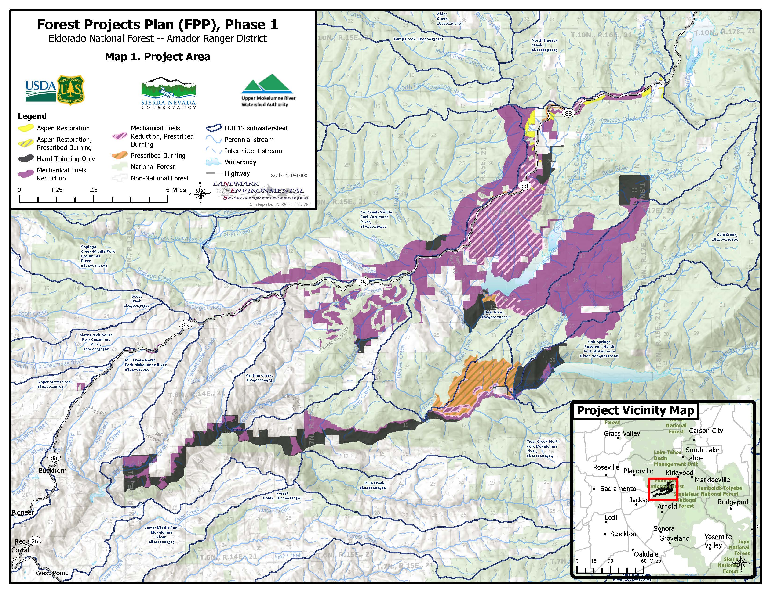
Notes:
Does not include inventoried roadless areas, wilderness areas or areas covered by recent NEPA decisions.

Slide 5
Forest Projects Plan (Phase 1) Activities and Acreage
TREATMENT ACTIVITIY | ACREAGE
Mechanical Fuels Reduction | 14,537
Mechanical Fuels Reduction, Prescribed Burning | 4,715
Prescribed Burning | 1,888
Aspen Restoration | 172
Aspen Restoration, Prescribed Burning | 22
Hand Thinning Only | 4,337
TOTAL ACREAGE | 25,671
Notes:
Please bring up revised comments in Decision Memo in response to John Buckley.

Slide 6
ACCG Member Changes to Proposed Action
ACCG MEMBER COMMENT | INITIAL DRAFT PROPOSED ACTION | RESPONSE TO ACCG COMMENTER/CURRENT PROPOSED ACTION
Project too big | >100,000 acres | 25,671 acres
Less hand treatments | Hand treatments proposed throughout entire project area | Hand thinning only treatments limited to areas where there is no other option due to steep slopes or regulatory limitations (e.g., inside PACs)
Maximize mechanical treatments | Mechanical treatments were limited due to lack of funding for arch field surveys. | UMRWA received funding from SNC/CalFire to conduct arch field surveys in all areas where mechanical treatments are feasible.
Limit tethered mastication | Number of acres not identified. | Limited number of acres proposed for tethered mastication
Limit timeframe for implementation to 10 years | Not defined in public review draft. | UMRWA and other USFS partners aim to implement project within 10 years.*
Eliminate/define aspen stands | Not defined in public review draft. | Aspen stand/scope dramatically reduced
Notes:
*Prescribed burning to be implemented by USFS.
**Aspen restoration in upper Mokelumne will be addressed in detail by a different project funded by Wildlife Conservation Board and potentially also in FPP Phase 2. Under these projects, aspen stands will be clearly defined.

Slide 7
Status of USFWS Consultation
Consultation with the United States Fish and Wildlife Service was initiated on August 15, 2022.
It was determined that formal consultation would be the best path forward due to potential impacts from prescribed burning activities.
UMRWA anticipates the consultation process will be completed by November 11, 2022 and USFWS will compile Conservation Measures for the protection of federally listed species.

Slide 8
Summary Conclusions of NEPA Project Record Reports
NAME OF REPORT | SUMMARY CONCLUSIONS
Biological Assessment (BA) USFWS Consultation This report analyzed the probability for adverse effects to federally listed species. | Federally listed species in project area; 1. Sierra Nevada yellow-legged frog (SNYLF) 2. California red-legged Frog (CRLF) Proposed for listing; 3. Foothill yellow-legged frog (FYLF). The BA concluded that the project will have no effect on CRLF. For FYLF and SNYLF, potential impacts to suitable habitat will be minimal because the project is designed to retain riparian vegetation and other habitat features in the vicinity of aquatic habitats. However, while prescribed burns will be excluded from within 50 feet of aquatic habitats, including those known to be occupied by FYLF or SNYLF; fire will be allowed to back into the riparian areas. Therefore, there remains some potential for FYLF/SNYLF along occupied streams to be affected by this activity. The BA concluded that the prescribed burning activities of the project may adversely affect individual FYLF and SNYLF. The BA also concluded that the project may result in a short-term reduction in habitat suitability within upland and dispersal habitat within critical habitat but will not result in adverse modification or destruction of Primary Constituent Elements within approximately 916 acres of SNYLF Critical Habitat Subunit ELD-1.
Terrestrial Wildlife and Aquatic Resources Biological Evaluation | This document analyzes the potential effects of the Project on Forest Service Sensitive (TES). The report concluded that with implementation of the project Design Criteria the project will not affect or is unlikely to result in a trend toward federal listing for the species analyzed.

Slide 9
Summary Conclusions of NEPA Project Record Reports
NAME OF REPORT | SUMMARY CONCLUSIONS
Botanical Resources Biological Evaluation | The report concluded that with implementation of the project Design Criteria the project will have no effect or is not likely to lead to a trend toward federal listing for any plant species. The report concludes that with incorporation of Design Criteria IP1 through IP5, the risk of spreading and/or introducing noxious weeds will be low within forested habitats, and moderate within chaparral habitats.
Cultural Resources Management Report | 4,980 acres were field surveyed for archeological resources. 57 cultural resource sites have been identified within the project area. Cultural resources will be protected by flagging and avoiding sites during project implementation. The CRM Report concluded the project will not result in adverse effects to historic properties.
Management Indicator Species (MIS) Report | This report evaluated and disclosed the impacts of the project on the habitat of the thirteen MIS. The report concludes that the effects of the project on the habitat of these MIS is minimal and will not alter the existing trend in the habitat, nor will it lead to a change in the distribution of MIS.
Migratory Bird Report/Bald Eagle | The Migratory Bird Report concludes that the project actions will provide long-term net benefits to migratory birds by increasing habitat diversity and sustainability.

Slide 10
Key Steps Remaining
Letter of Support from ACCG (November 16, 2022)
Execute Decision Memo (First Week December)
Complete CEQA Compliance (January 27, 2023 – UMRWA Board Meeting)
Notes:
Karen talking points – PRC Section 4799.05(d) is AKA Senate Bill 901.

Slide 11
Phase 1 – Implementation Next Steps
Complete Implementation Action Plan: Jan-Feb 2023.
Conduct pre-field flagging and surveys for implementation of CalFire Project ($5 million grant award).
Bidding/Procurement: May/June 2023
Award Contracts: July 2023.
Implement Project: Approximately 2000+ acres of hand and mastication treatments to be implemented from July/August 2023 to 2025.
Apply for SNC Grant (est. $4.3 million)
SNC Landscape Assessment Block Grant Possibility

Slide 12
To ACCG, USFS and Project Supporters……
For Your Time, Energy, Efforts, Support….
THANK YOU!!

