Slide 1
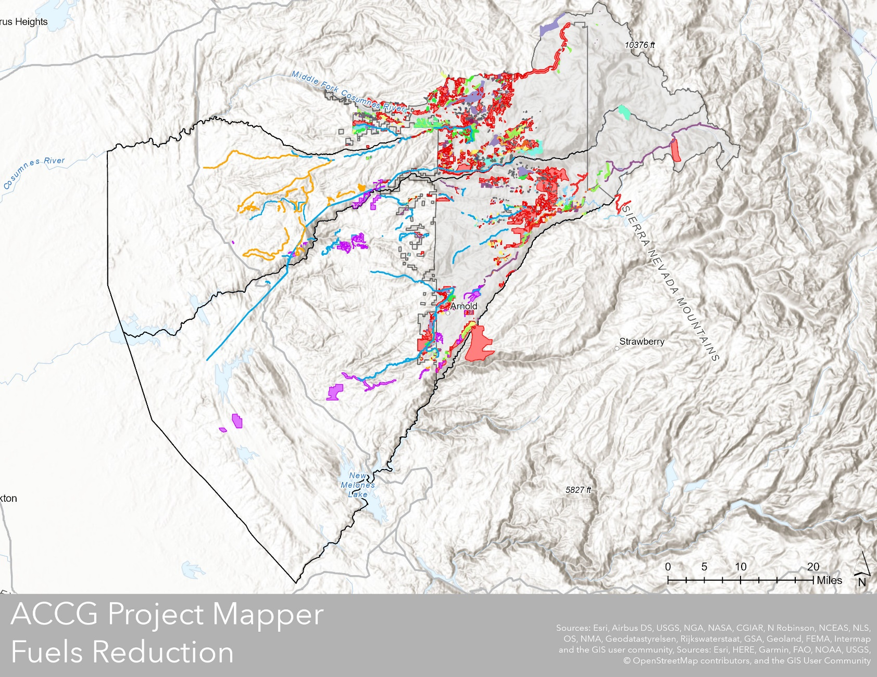
ACCG Project Mapper & Prioritization Tool
Megan Layhee
Consultant
Landmark Environmental, UMRWA
megan.layhee1@gmail.com

Slide 2
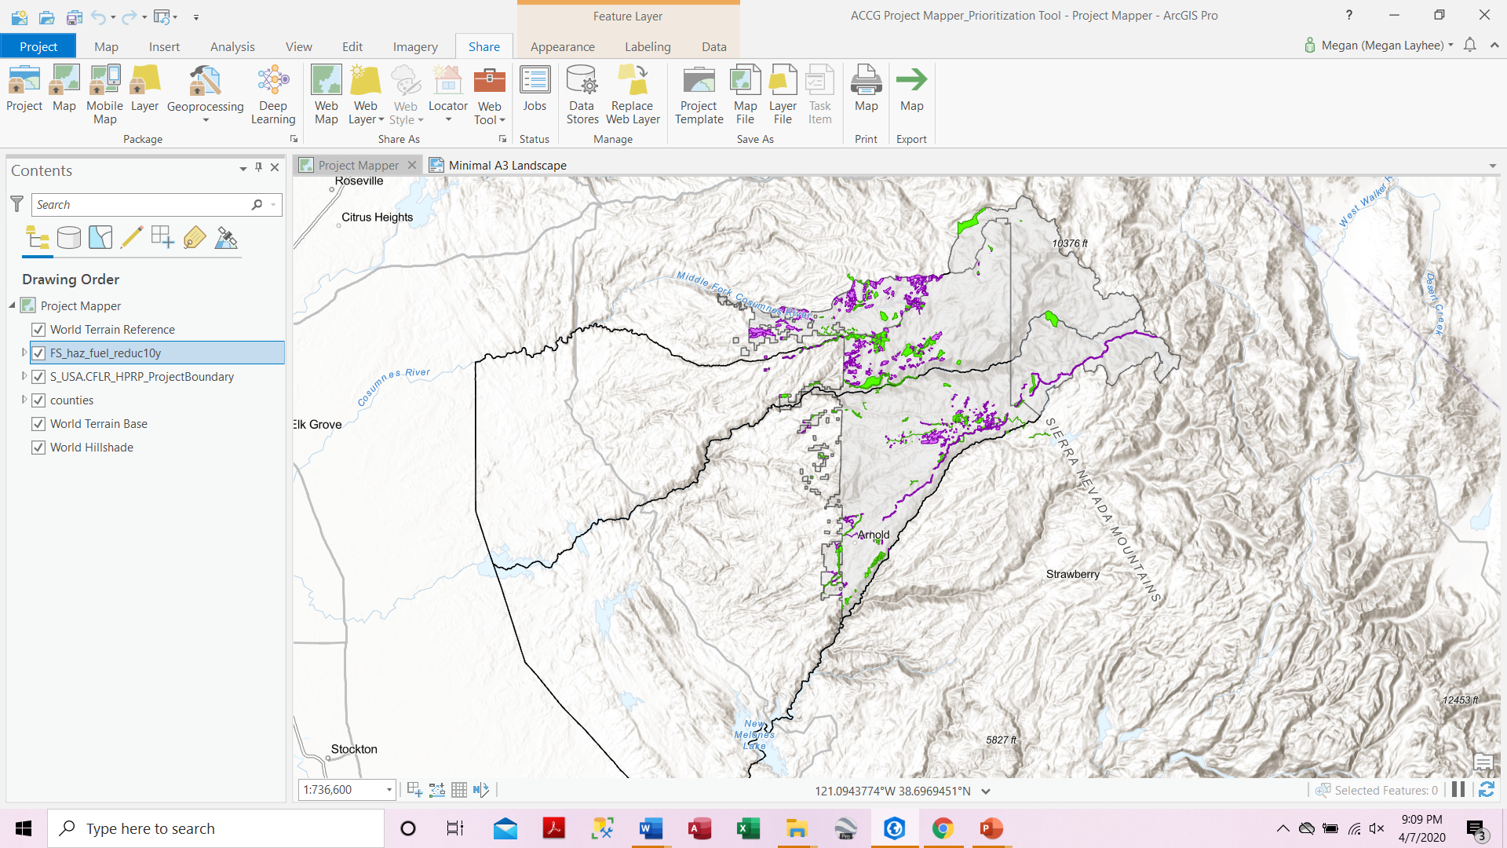
Project Goal: ACCG Project Mapper
Fuels Reduction Projects
Completed
In progress
Funding awarded

Slide 3
Project goal: Prioritization Tool
Communities
Fire Threat
Environment
Prioritize ACCG landscape to identify where future fuels reduction work is needed
Develop criteria
Obtain and rank data
Define areas (e.g., PODS)
Perform simulation modeling
City/town boundaries
Public facilities
Roads
Power lines
LIDAR
Aerial imagery
Veg data
Severity models
Evacuation routes
Critical habitat
Wild & Scenic
designations

Slide 4
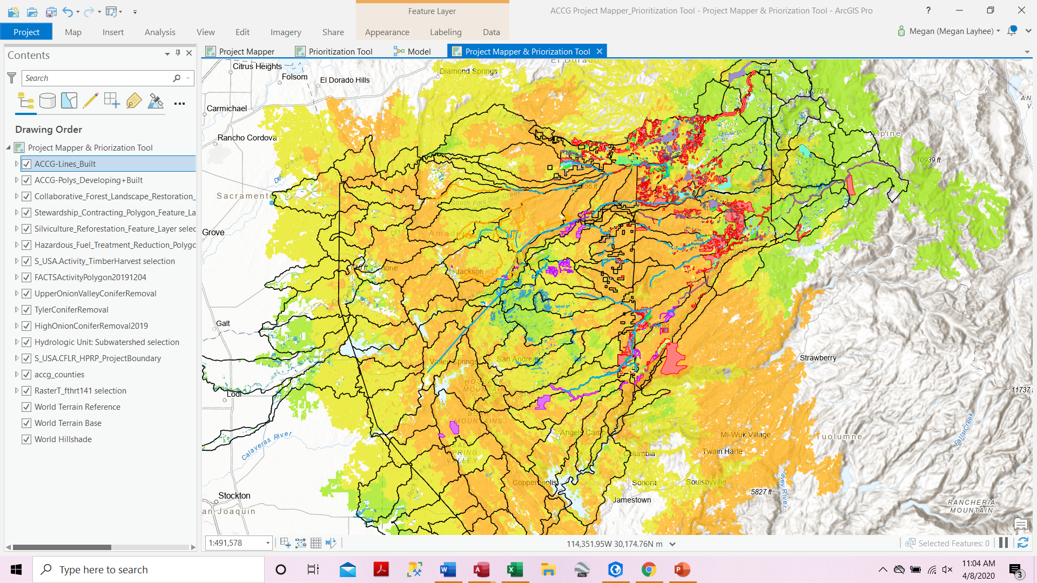
Project Goal: Prioritization Tool
Define priority areas within ACCG landscape

Slide 5
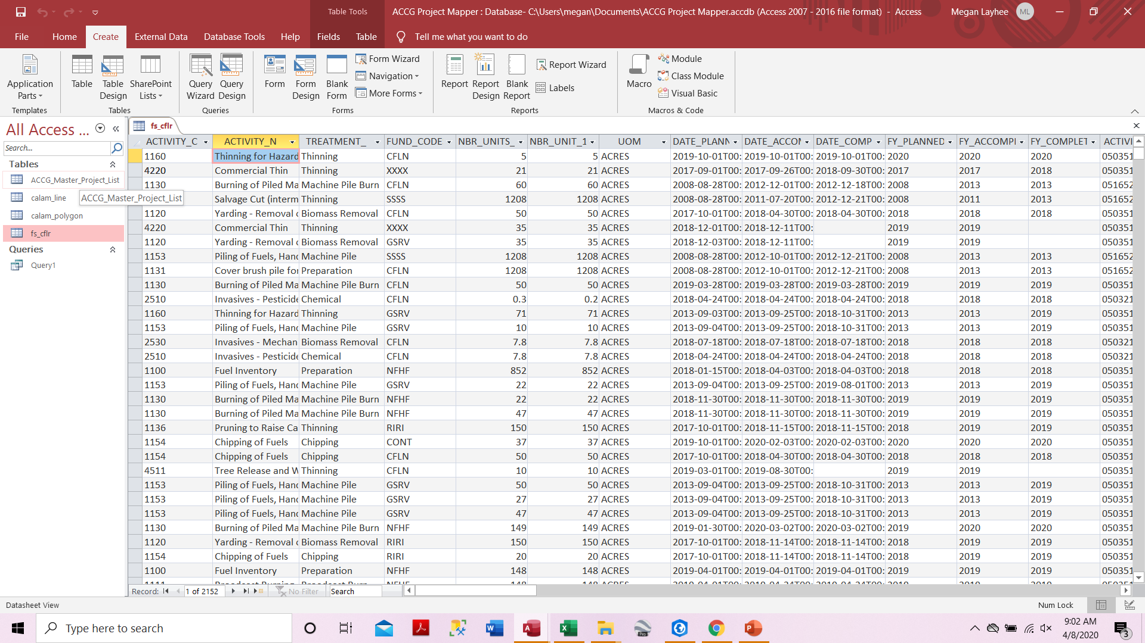
OTHER DELIVERABLES
User-friendly Data Library
Priority Fuels Reduction Project List
Mapper/Tool Handbook
How-to Workshops

Slide 6
PROCESS
Project Mapper/ Prioritization Tool Development
Meet with SLAWG & Planning WG
Final mapper/ tool approval by PWG & SLAWG
Finalize data library; priority project list; handbook
Hold how-to workshops for ACCG members
Mapper/Tool Refinement
Publish georeferenced pdf map to ACCG website
Present at General ACCG Meeting
Spring
2020
Nov-Dec
2020
Summer
2020
Late
summer
2020
Fall
2020

Slide 7
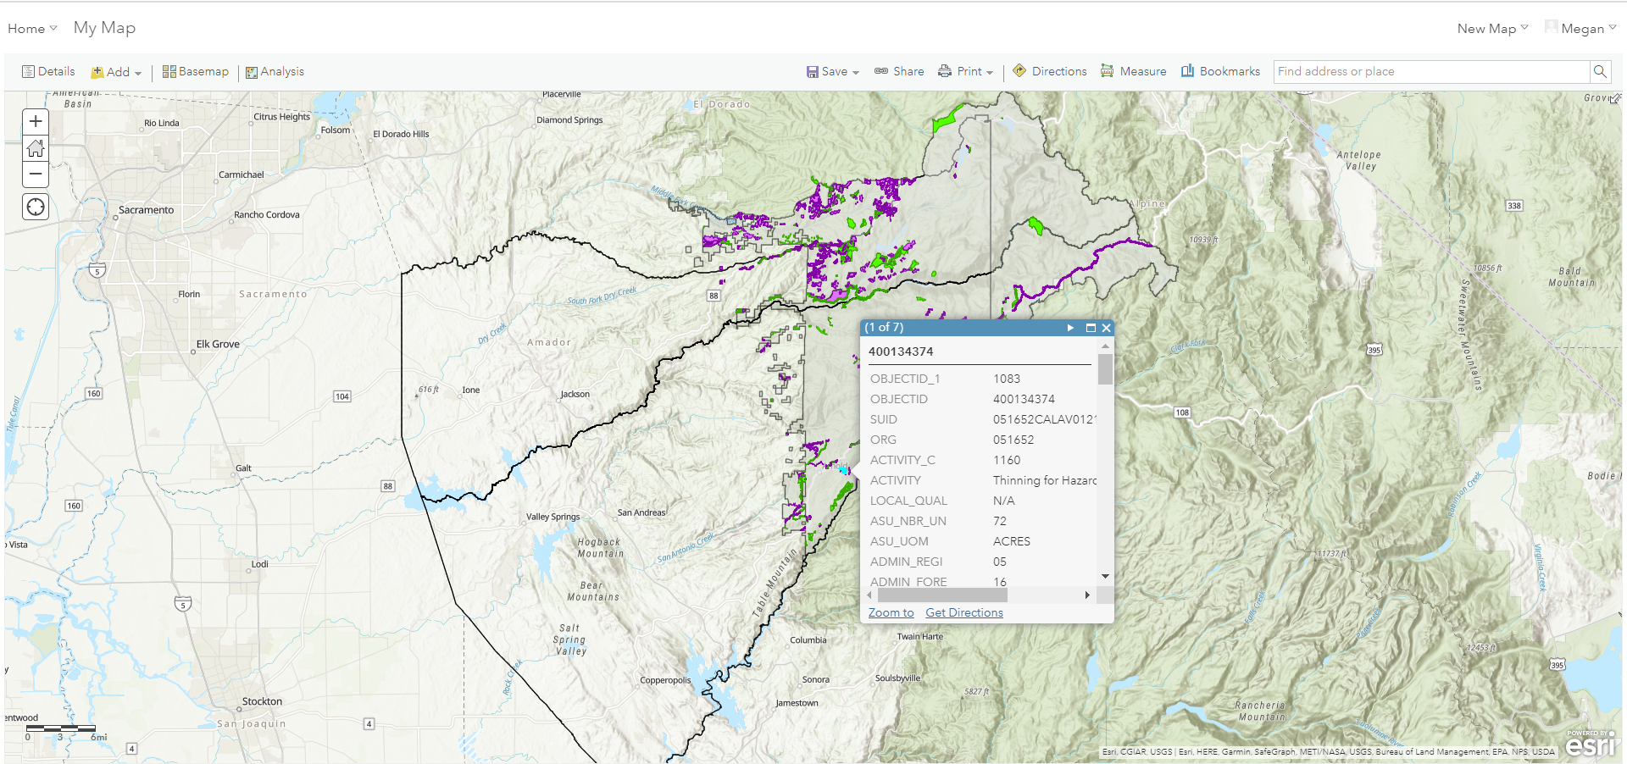
Future Directions
Move to an ArcGIS Online Platform for accessibility
Apply mapper/tool to ACCG projects beyond fuels reduction

