Slide 1


Amador-Calaveras Consensus Group
Socioeconomic Monitoring
Hilary Sanders, Kyle Rodgers, Jonathan Kusel
September 2019

Slide 2
purpose
To establish a baseline of socioeconomic conditions in the area local to the Cornerstone CFLR, and to assess the socioeconomic impacts the Cornerstone Project has had in that area.
Notes:
CFLRs require socioeconomic benefit and monitoring. The baseline creates a comparison point for future monitoring.

Slide 3
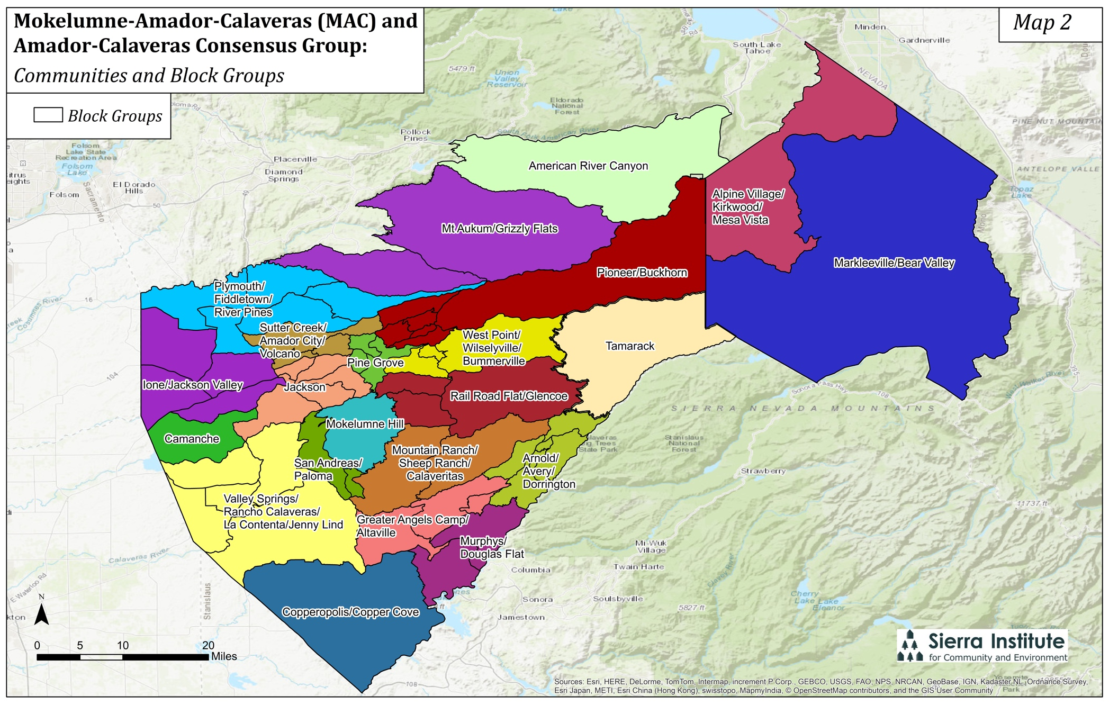
Study Area
Notes:
Shows study area. Focused our analysis on the communities shown here, which were determined by the group. These are areas that tend to shop in the same places, attend the same schools and community events, and culturally identify together. This gives us a much more detailed analysis that looking at the county level and so we are better able to pinpoint effects.

Slide 4
Methods
Quantitative Data
  Demographic Data
  Contractor Survey
Qualitative Data
  Community Capacity Workshop
  Interviews
  Contractor Survey
Notes:
For monitoring, we use a four pronged approach to provide a comprehensive picture of both broader socioeconomic conditions and forestry-related outcomes, and to triangulate to understand relationships between findings. Quantitative demographic data and the community capacity workshop primarily establishes a baseline socioeconomic condition and provides context for the activities of the CFLR, while the contractor survey provides some insight into local contracting and interviews capture more direct effects of the Cornerstone Project.

Slide 5
Demographic context

Slide 6
Demographic context
Notes:
Percent population change, with 0 being in the middle. California has been declining slightly but remains positive. Amador and Calaveras Counties are a little more volatile, but both see a declining trend starting around 2001 and dropping into population decline right around the Recession. The population in Amador reaches a more extreme low but then recovers while Calaveras has maintained a pretty steady slightly negative population change.

Slide 7
Demographic context
Notes:
Percent of the population that is within an age bracket for males and females. This population diagram indicates high populations of older people, which is consistent with interviewees perceptions that there are high populations of retirees in both Amador and Calaveras Counties.

Slide 8
Demographic context
Notes:
High populations of retirees presents forest management challenges. Older people may be unable to care for their land properly and people retiring here from the Bay Area and elsewhere may not know how to manage their land. This increases fire risk overall, and they may need more assistance in the event of a fire. On the other hand, there is high volunteerism among retirees, contributing to the community in a variety of areas, including forestry. In ACCG retired RPFs and other professionals contribute knowledge and skills and bring in considerable amounts of grant money

Slide 9
Demographic context
Notes:
These next two graphs show the percentage of households for seasonal use. There isn’t a lot of change between 2013 and 2017. Proportions are relatively low in Amador with the exception of Pioneer/Buckhorn.

Slide 10
Demographic context
Notes:
In Calaveras, proportions are higher overall with the percentage of second homes at 90% in one community, around 65% in another, and close to 20% in three more. High proportions of households for seasonal, recreational, and occasional use have an impact on communities’ capacity both positively and negatively. Wealthy second home owners bring money in to local businesses seasonally, and may contribute knowledge and skills. However they may not invest in the physical and social capital of the community in a sustained way.

Slide 11
Demographic context
Notes:
This graph shows the unemployment rate in both counties as well as the state unemployment rate. Overall, the two counties tend to have higher peaks of unemployment and greater seasonal variation than the state average. The counties also took longer to recover after the Recession than the state on average. In the 90s Calaveras county had higher unemployment than Amador County but they are now more similar.

Slide 12
Demographic context
CA
Notes:
Many communities in both counties have high proportions of people not in the labor force, which includes retirees. For reference, the percent of people not in the labor force in the state of California is about 36%. Every community in both counties is above this average, with Camanche being the closest.

Slide 13
Demographic context
CA
Notes:
In Calaveras County, the proportions tend to be higher. Most communities have over half of their population not in the labor force. However, communities with high proportions of people not in the labor are not the same communities as those with high proportions of retirees, so these data capture people who have dropped out of the labor force for one reason or another.

Slide 14
Demographic context
Notes:
Free and Reduced Price Meal Enrollment is based on parental employment and income, so is a good indicator of poverty levels. Enrollment is between 40% and 70% in Amador County and has been increasing is half of schools and decreasing in half of schools.

Slide 15
Demographic context
Notes:
In Calaveras County rates tend to be higher. It is also perhaps one of the clearest indicators of the hardships caused by the Butte Fire as enrollment went to 100% in the school year following the fire in four schools nearest the fire footprint. These were also some of the schools that were in the poorest areas to begin with and supports the perspective we heard from some interviewees that the areas hardest hit by the fire were already struggling and has further hurt recovery. School enrollment did not change very much during this time, so changes could reflect a change in economic status rather than a change in population. However, it could also be that roughly the same number of people moved out and in around the same time.

Slide 16
Forest-specific findings

Slide 17
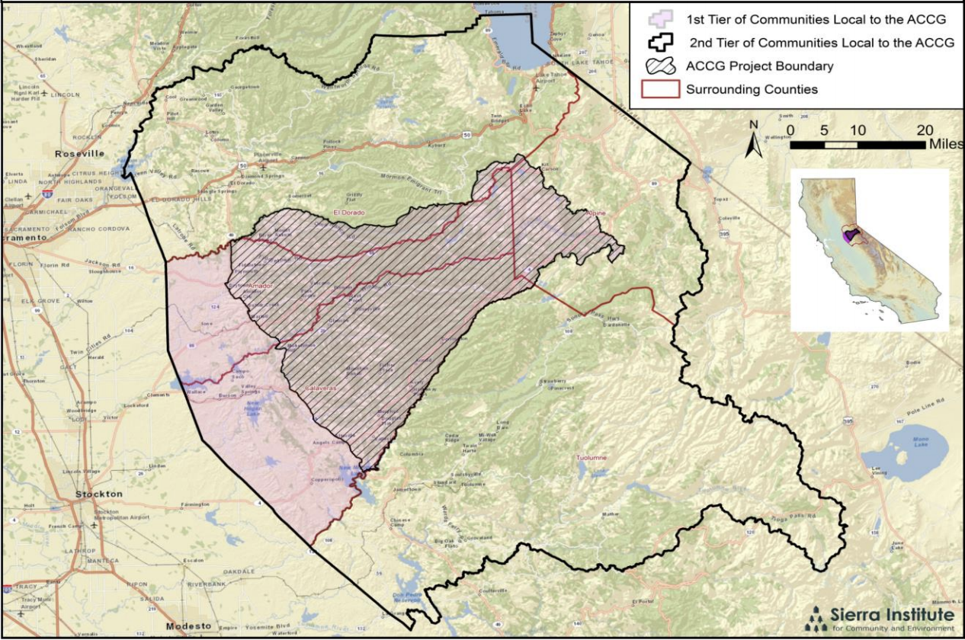
Contractor Survey
Obtained list of active contractors in CFLR area
Up to three phone calls made to each contractor
Surveys completed over the phone or online
All surveys in Spring 2019
15 responses (50%)
Focus Areas:
  Recent Business Experiences
  Small-Diameter Wood
  Forest Service Contracting
  Wildfire
2
5
8
Notes:
Another method of data collection was a survey of contractors who have worked in the CFLR area in the past three years. We obtained a list of contractors. Up to three attempts were made to contact each contractor and most were complete over the phone with a few complete online. We surveyed 15 contractors of 30 contacted for a response rate of 50%. The survey focused on recent business experiences, small diameter wood, forest service contracting, and the effects of wildfire. We haven’t done a contractor survey in previous monitoring, and we think it was a good addition because it really helped us get at the characteristics of contractors and the kinds of issues they are working through.

Slide 18
Contractor Survey
5
8
2
Notes:
This map was developed by Sierra Institute and ACCG in an effort to define the local area for the purpose of better understanding what local contracting means and the sphere of influence of the ACCG. We surveyed 2 contractors in the 1st tier, 5 in the 2nd tier, and 8 outside of the local area.

Slide 19
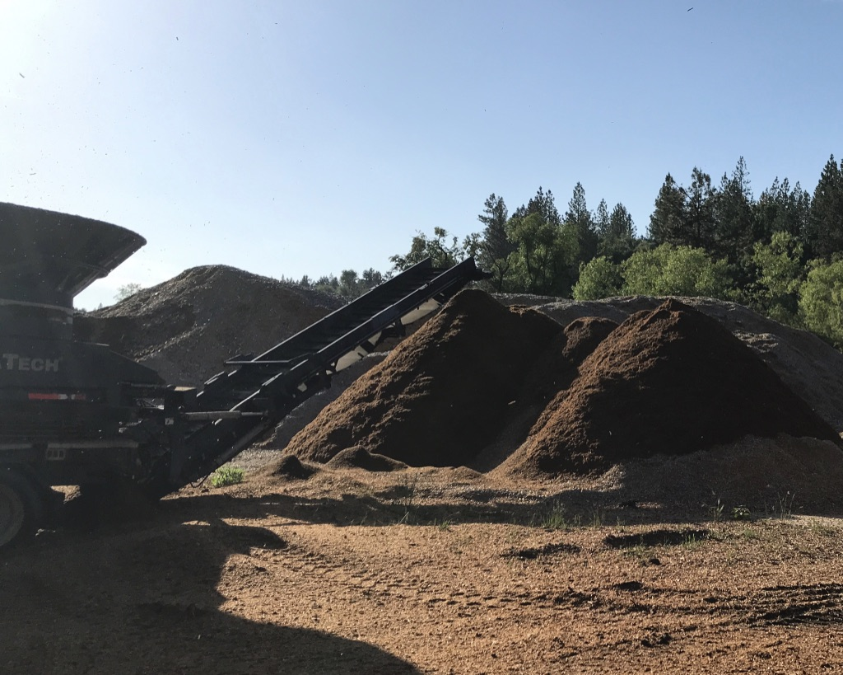
Contractor Survey
Small- diameter wood utilization
Notes:
Most of the contractors surveyed said they deal with small diameter wood in some way, whether harvesting or processing, but very few said it was a profitable part of their business. Some mentioned they thought there was opportunity for it to be profitable if infrastructure was available.

Slide 20
Contractor survey
Best Value Contracting
5
8
2
Notes:
Both contractors within the 1st tier local said they have not won a contract on the basis of best value, while most outside the 1st tier local said they have. Note that this is based entirely on the perception of the contractor.

Slide 21
Contractor survey
Effects of Wildfire
Notes:
All contractors reported that fire has had a positive impact on their business, primarily by providing salvage work opportunities and increasing public support for forest restoration activities. Many but not all contractors reported that wildfire has had a negative impact on their business. The reduced availability of Forest Service staff managing existing contracts was the most impactful, while the reduced ability to plan for the future, the reduced availability of a workforce, and having a fire burn through a contract area also negatively impacted contractors. Another effect many contractors brought up was the reduced number of days they are able to work due to fire and smoke.

Slide 22
Butte fire and cannabis

Slide 23
Butte fire and cannabis
Butte Fire
  Reduced social capital
  Dead trees remaining present continued fire hazard
  An “eye-opener”
Cannabis
  Change in social dynamics
  Caused a bubble of economic benefit that burst after the ban
Notes:
Although both occurred primarily outside of ACCG boundaries, they have broader socioeconomic impacts that interact with and may obscure socioeconomic impacts of the Cornerstone Project. A common sentiment among interviewees was that the Butte Fire was an eye-opener. It brought forest management issues into the public eye and increased support for forest restoration. Cannabis also affected social capital. Many interviewees said it reduced social capital because growers had guns and aggressive dogs and changed the dynamic of many neighborhoods. Others pointed to an economic benefit of having young people patronizing businesses and more children in the schools. However, after Calaveras County banned cannabis cultivation, the bubble of economic benefit burst.

Slide 24
Cornerstone Outcomes

Slide 25
Capacity of Partners
“It’s definitely brought some people together...those guys weren’t working together at all, they met through the ACCG basically... I think it’s been very beneficial to the organizations that do work to be able to better coordinate their work.”
“Without ACCG, we would not be doing literally millions of dollars of work on our watersheds.”
Notes:
One of the most notable and concrete achievements is that the collaborative has brought groups together in the same room and built some level of trust and agreement among people who would never have worked together previously. Working together has also helped built partner capacity, which allows them to do more work. One notable example is the CalAm Forestry Team, which has brought in quite a bit of grant funding to do related work.

Slide 26
Local Workforce
The ACCG had initially expected “zero to three companies to show up” for bid tours at a project site, and a recent project ended up with 22 companies on the site visit.
“I think with all the money coming in for forest work we’re going to have more people going back to work in the woods you know, which is a good thing. But you know, how quickly that’s going to happen is really hard to know.”
Notes:
Another outcome we heard from interviewees is that ACCG is beginning to rebuild a local workforce based on forest restoration work. The estimated job creation in the CFLR annual reports will be included in the final monitoring report. Anecdotally, we heard that more local contractors are bidding for local work.
ACCG is putting money into the industry which is creating opportunities.

Slide 27
Local Contracting
Agency partners remain divided in how they look at best value, with some acknowledging the benefits of processes that “get the community back into the game, spread money throughout the area, and make life better,” while others opt for a lowest bid contract award.
“There's still what seem to be higher opportunities, better opportunities, if they could work out the details of what really is best value, and how to move that forward.”
Notes:
From interviews, we learned that local contracting has been an ongoing conversation over the group’s life. There is potential for continued work in this area.

Slide 28
Highlights
Socioeconomic context by community
  Easily replicated for future monitoring
Contractor survey
Butte Fire and Cannabis
Cornerstone Outcomes
  Partner capacity, workforce capacity, and local contracting

