Slide 1
For Amador Calaveras Consensus Group November 18, 2020 Karen Quidachay and Patricia Ferrell Landmark Environmental, Inc. Representing the Upper Mokelumne River Watershed Authority FOCUS: Procurement and Implementation Lessons Learned

Slide 2
Overview of UMRWA and the MSA
UMRWA is a Joint Powers Authority (JPA) formed in 2000 to address mutual interests regarding:
Water quality
Water supply
Natural resources
8-member Board of Directors
Supported by a part-time Executive Officer, Landmark Environmental, and Member Agency in-kind support
Member Agencies
Alpine County
Alpine County Water Agency
Amador County
Amador Water Agency
Jackson Valley Irrigation District
Calaveras County
Calaveras County Water District
Calaveras Public Utilities District
East Bay MUD
Notes:
pat

Slide 3
Overview of UMRWA and the Master Stewardship Agreement (MSA)
Signed in May 2016; Describes UMRWA’s and USFS’s interests
Focuses on Collaborative Forest Landscape Restoration Project
Delineates UMRWA’s role and responsibilities:
Maintain planning, management and financial capabilities
Explore project funding opportunities and apply for grants
Work w/USFS to develop Supplemental Project Agreements (SPAs)
Fulfill CEQA requirements for SPA projects
Provide qualified personnel & contractors to implement SPAs
Assign representative to coordinate w/USFS and manage UMRWA contractors
Notes:
pat

Slide 4
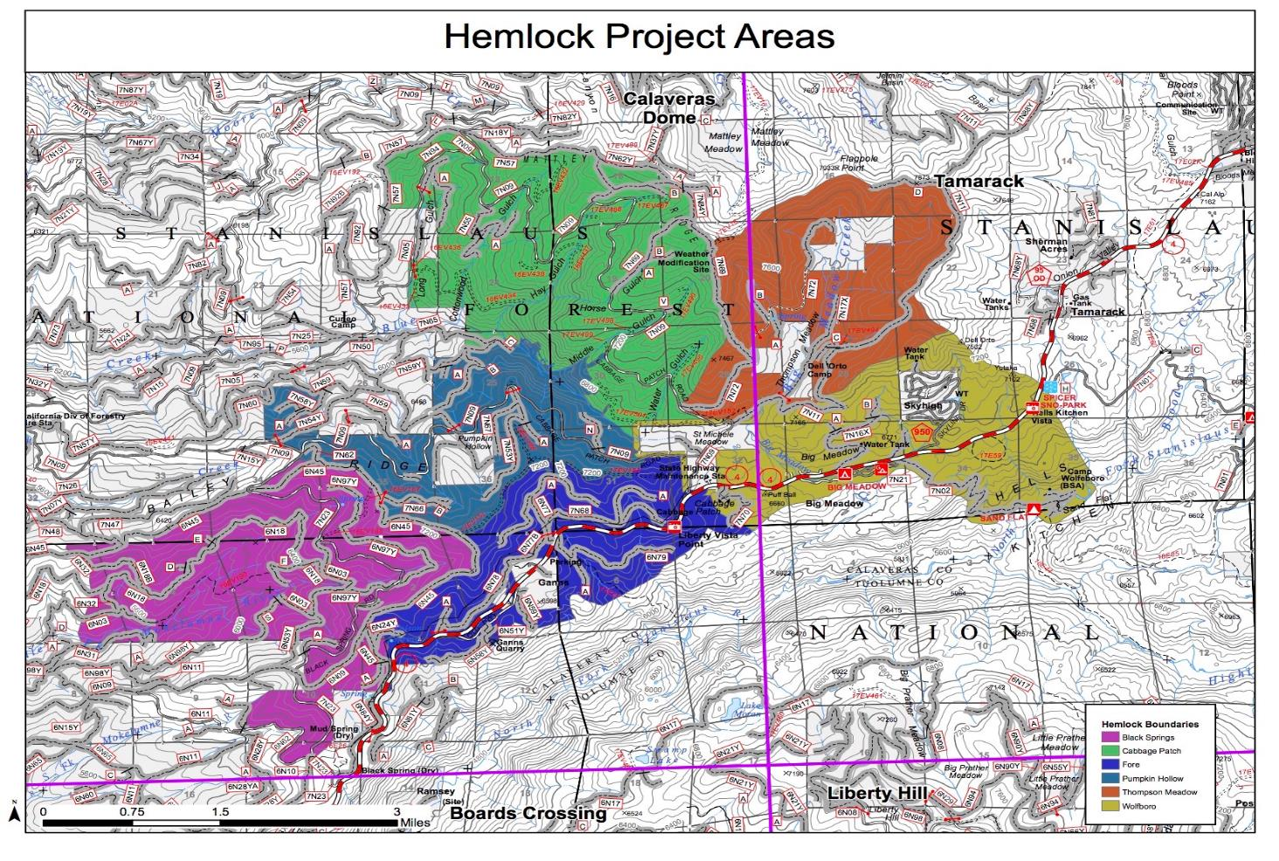
Overview of UMRWA and the MSA
Notes:
pat

Slide 5
Overview of UMRWA Projects Funded through the MSA
Implementing Three Hemlock Projects in the Stanislaus National Forest (SNF) Funded by SNC:
Pumpkin Hollow (2017 through 2019): 927.5 acres
Mastication
Hand thinning small trees
Road maintenance
Mechanical thinning
Cabbage Patch/Fore (2018 through 2020): 467.2 acres
Hand thinning small trees 182 acres
Mastication 285.2 acres
Black Springs/West Calaveras Thin (2019 through 2021): 1200+ acres
Hand thinning small trees 812.2 acres
Mastication 416.4 acres
Notes:
pat

Slide 6
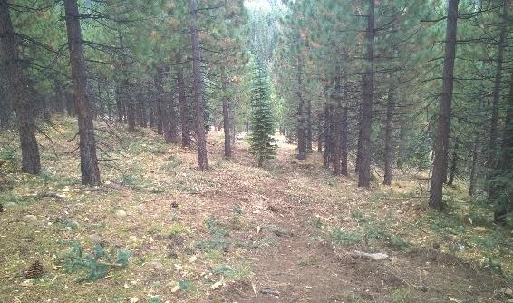
Procurement and Implementing Projects
UMRWA prepares/solicits RFP (30 day response time)
RFP based on SPA specifications
RFP responses scored/ranked in accordance Evaluation Criteria (including 5% advantage for local companies)
Selection Committee (UMRWA & USFS) recommends award to best qualified (price & non-price criteria)
UMRWA Board of Directors makes award
UMRWA enters into “General Services Agreement” (Contract) with selected contractor
UMRWA administers contract with USFS oversight of completed work
Notes:
pat

Slide 7
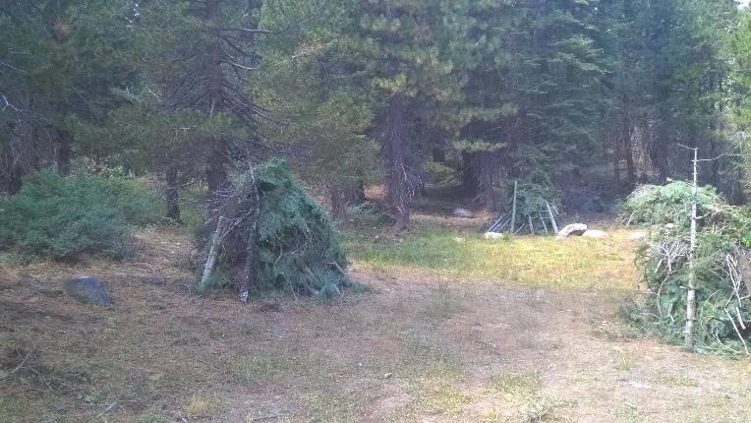
UMRWA General Services Agreement
UMRWA General Services Agreement:
Contract between UMRWA and selected Contractor
Includes UMRWA’s general contracting provisions and specific provisions based on USFS contracts, agreements and specifications
UMRWA’s Role: oversight and administration of contract and grant agreements
Forest Service Role: ensuring UMRWA meets the terms of the Stewardship Agreement with USFS
Notes:
pat

Slide 8
UMRWA General Services Agreement
Scope of Work and Project Map: work descriptions and requirements; map with units, streams, roads, etc.
Insurance Requirements and Certificates
Payment Terms and Procedures
General Requirements: general provisions related to changes, workmanship, termination, etc.
Specifications for Operations: standard and specific USFS provisions for resource protection and operations (fire, streams, cultural resources, weed prevention, etc.)
Contractor’s RFP Response: becomes part of contract
Notes:
pat

Slide 9
Lessons Learned for Achieving Successful Outcomes
Ensure full Partner and USFS collaboration on project design and specifications
Ensure responsive/effective support by USFS staff responsible for stewardship mgmt.
Avoid Partner taking on marginal timber removal projects
Conduct annual Partner & USFS 'lessons learned’ meeting.
Honor fundamental roles: Partner works for FS, contractors work for Partner
Maintain clearly defined and documented roles and delegations of authorities
Ensure clear and timely performance of field tasks and work acceptance (to facilitate timely Contractor payments)
Notes:
Pat & John; 2nd bullet referring to lack of responsiveness by USFS staff for invoices & other communication.

Slide 10
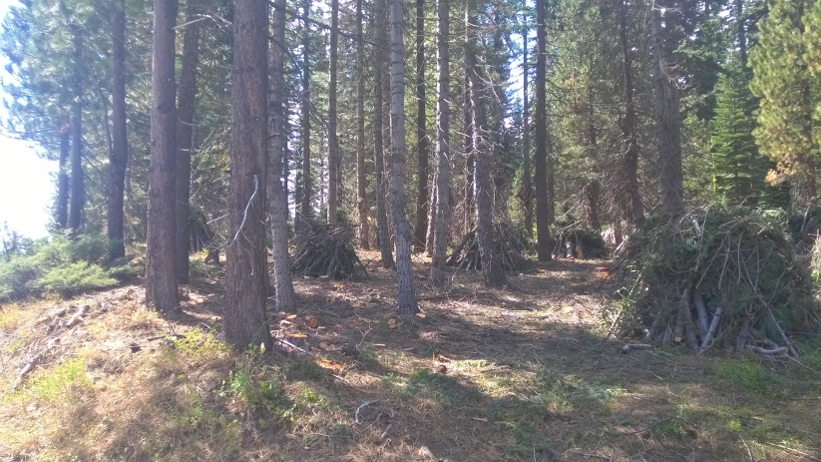
Recommendations
Establish performance guidelines for evaluating Partner support provided by assigned USFS staff
Project development process must ensure Partner involved in design, layout, and SPA specifications
Partner should have suitably experienced staff familiar with types of projects and specifications
Negotiate and document Partner and USFS roles for project administration, and expectations
Establish procedure and assign authority for project changes/modifications, and resolving disputes
Ensure day to day project administration performed by qualified Partner inspector
Notes:
John; Example of hand pile locations & covering; Expand on authorities between FS and Partner; sometimes FS reluctant to let go; who on FS side has final authority for resolving disputes? Lack of responsiveness by FS Enterprise staff in responding to partner requests and invoices for payment

Slide 11
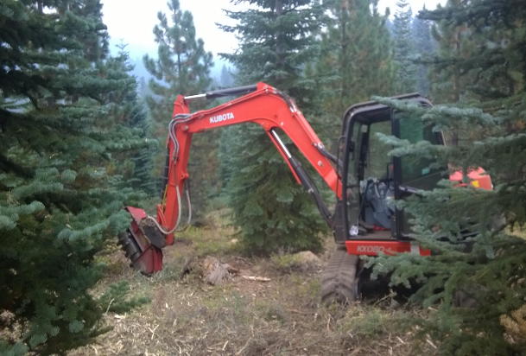
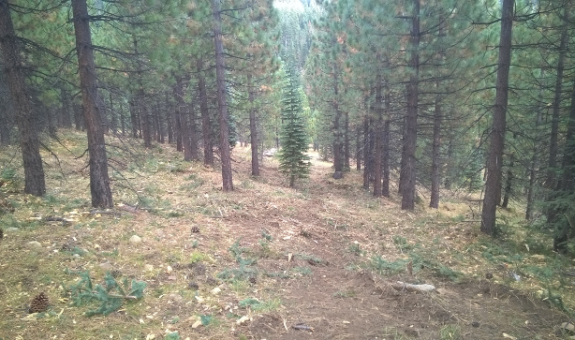
Recommendations
Jointly determine and conduct required pre-implementation surveys
Specifically assign contractor coordination/direction responsibility to Partner inspector
Pre-determine FS role and timeframe for accepting work (need quick turn-around for approvals)
Include critical understandings and FS & Partner performance requirements in SPA Agreement
Notes:
john

