Slide 1
ACCG Hemlock Planning area Field TRip
September 22, 2020
Stanislaus National Forest, Calaveras Ranger District
By Rich Farrington, Upper Mokelumne River Watershed Authority, UMRWA

Slide 2
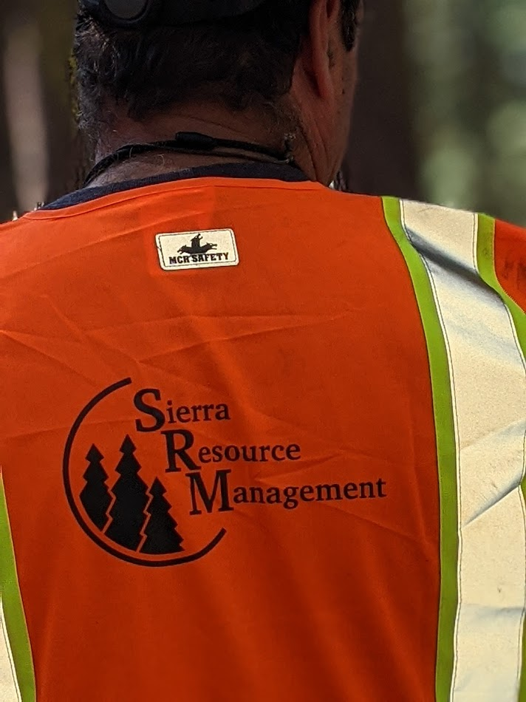
Participants
ACCG Planning WG Members:
Rich Farrington
Randy Hanvelt
Carinna Robertson
Ben Solvesky
Stanislaus NF Staff :
Brian McCrory (Contracting Officer)
Brady McElroy (Project Inspector) and
Diana Fredlund (Public Information Officer)
Contractors:
John Quidachay (UMRWA Forester)
Sierra Resource Management Contractor Co-owner Mike Albrecht and 4 employees

Slide 3
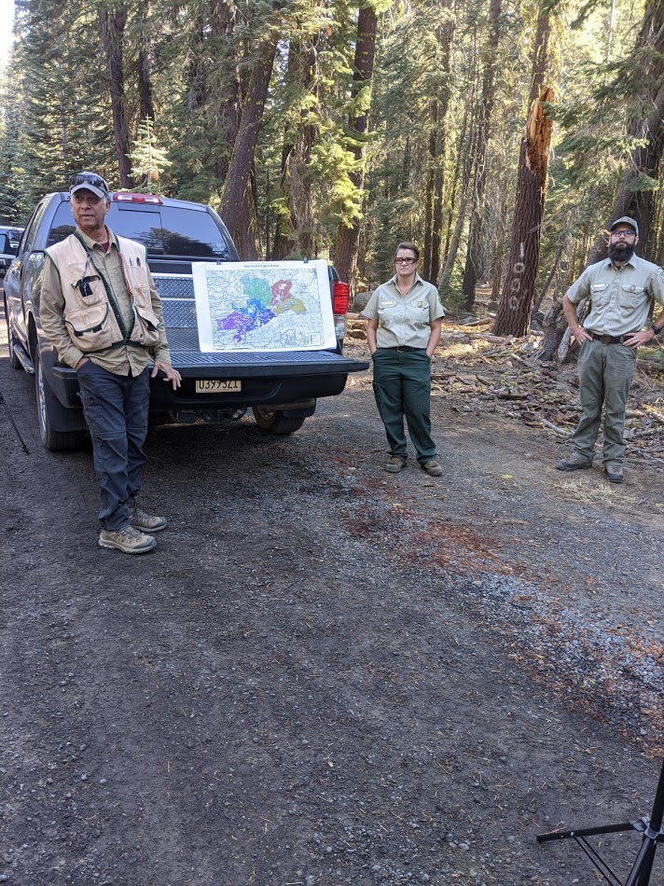
Stop 1. Overview of field trip.
John Quidachay, UMRWA Forester, Carinna Robertson, USFS Calaveras RD, Brian McCrory Stanislaus, NF Contracting Officer, talk about the 9,000 ac Hemlock planning area. Different contract areas are shown in colors. About 6,000 ac will be cleared after forest management by burning or piling and burning. Burning after the work was not a goal in the Environmental Assessment.

Slide 4
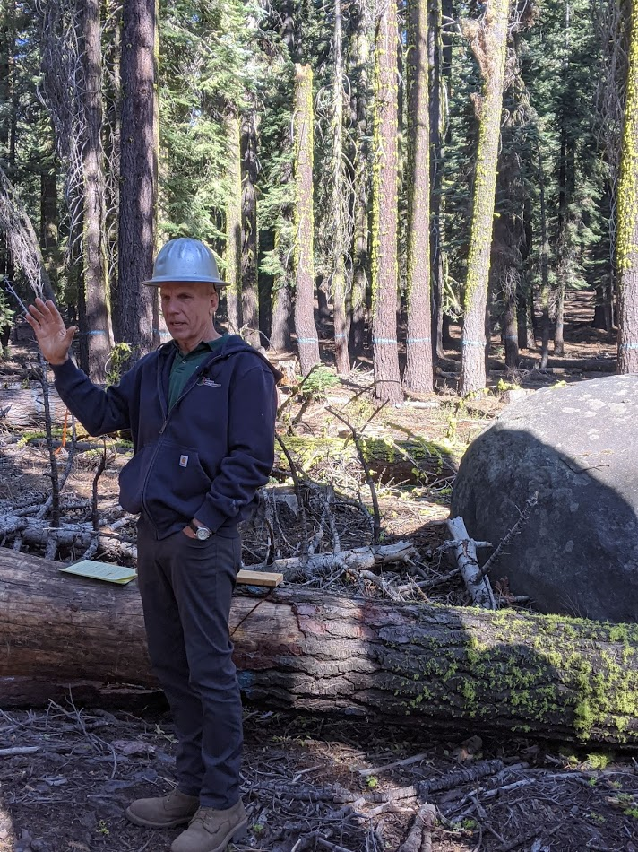
Stop 2. Trees Marked by USFS Blue Paint.
Mike Albrecht of Sierra Resource Management talked about one season of field work by the USFS required normally to mark trees for cutting.

Slide 5
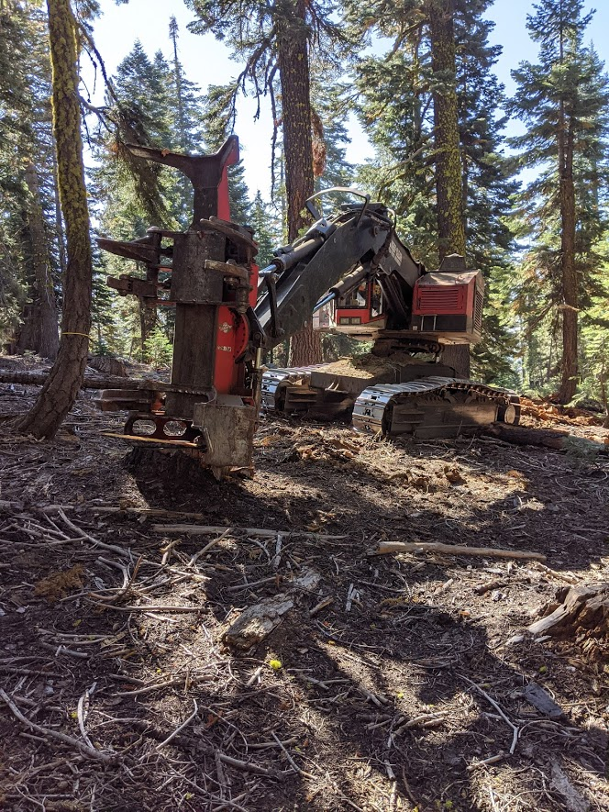
Stop 3. Feller Buncher.

Slide 6
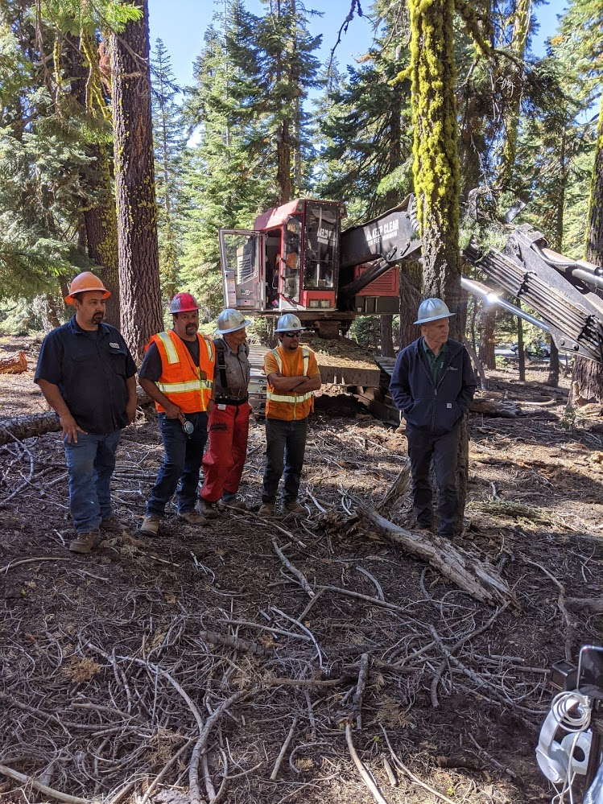
Mike Albrecht, Contractor and crew. Feller Buncher operator is 2nd from the left. A faller is third from the left.

Slide 7
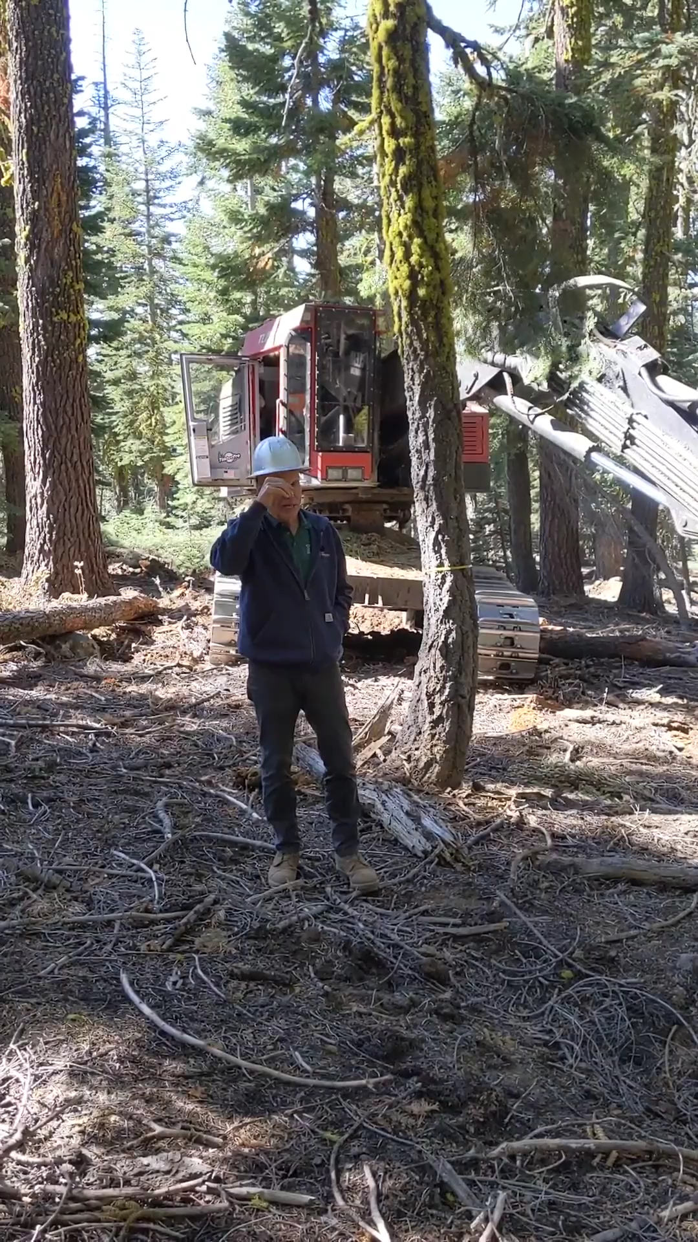
Video: Mike Albrecht explaining how DxP works (Designation By Prescription). Mike said they like DxP and it is the future. Doing it this way usually cuts one year off preparing the project. The Feller Buncher can operate on up to 40% slopes easily and could cut up to a 24” tree and bunch. It can cut up to a 30” tree without stacking.

Slide 8
Feller Bunch demo of Designation by Prescription cutting and stacking logs for delimbing.

Slide 9
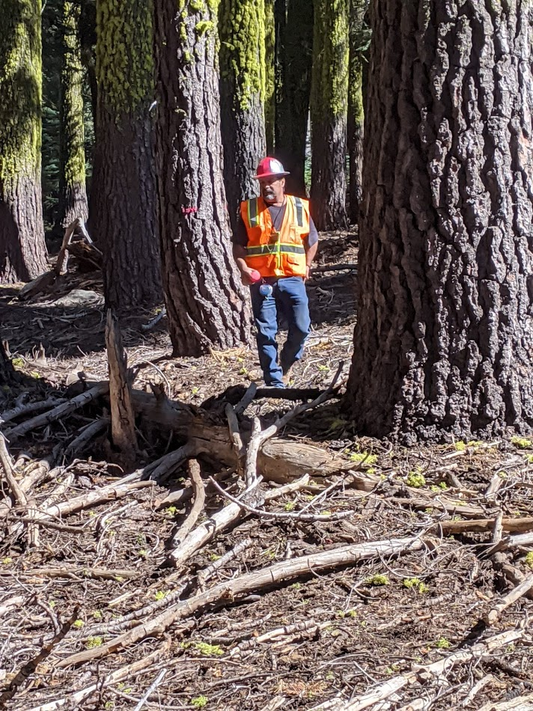
Feller Operator marked 2 trees after cutting 5 trees to meet the prescription (reduce the basal area from around 250 sq. ft/ac to 160 sq ft/ac).

Slide 10
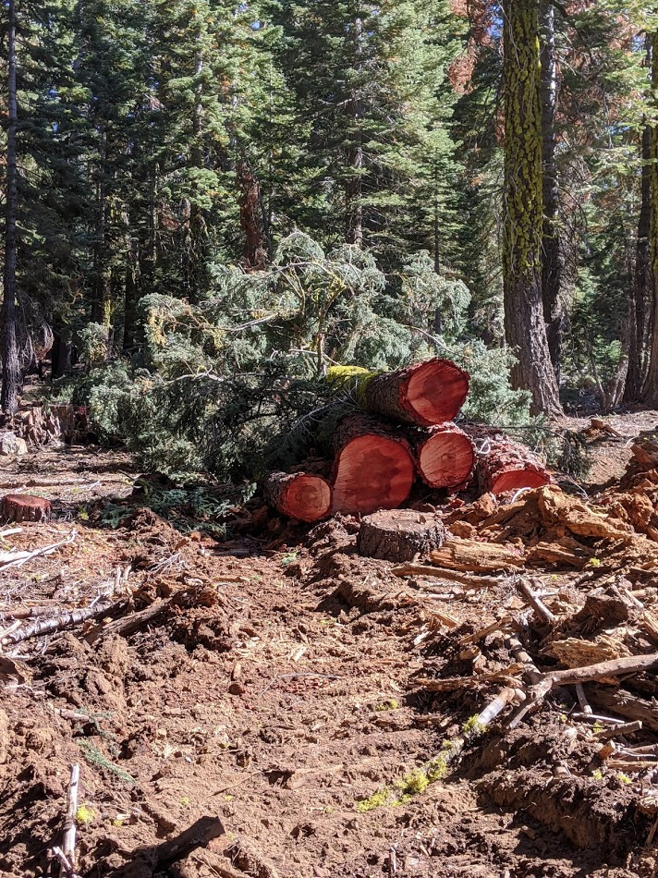
Log bunch
Trees cut and stacked by Feller Buncher to be dragged to the Delimber by rubber tired skidder.

Slide 11
The Faller cut one tree in the time it took for the Feller Buncher to cut and stack five trees. It would take the faller about 1-2 hours to buck and delimb one tree. The Delimber could do 5 trees in about 15 minutes.

Slide 12
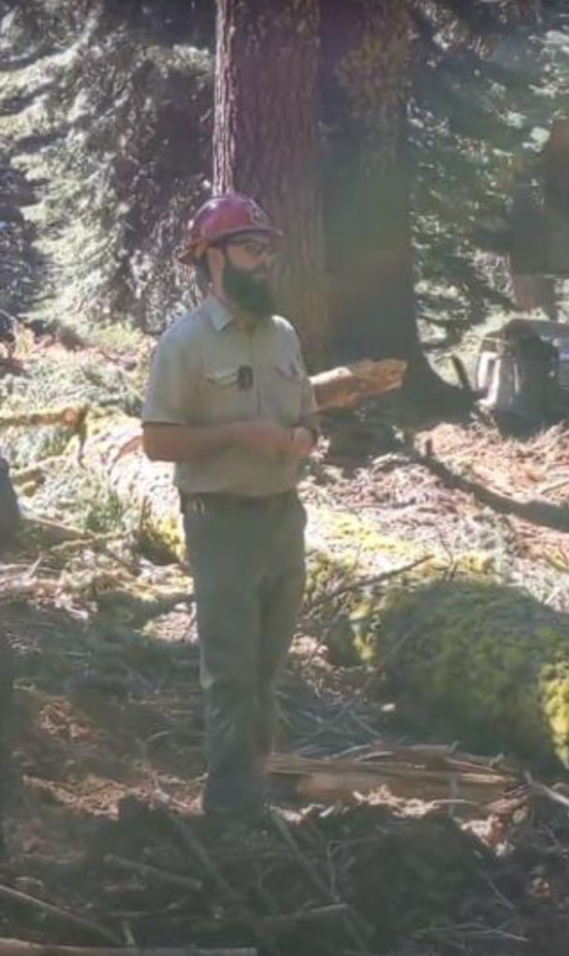
Brian McCrory, Stanislaus NF Contracting officer, explaining DxP authority from Congress & how gaps can be marked separately.

Slide 13
Stop 4: Delimber Demonstration.

Slide 14
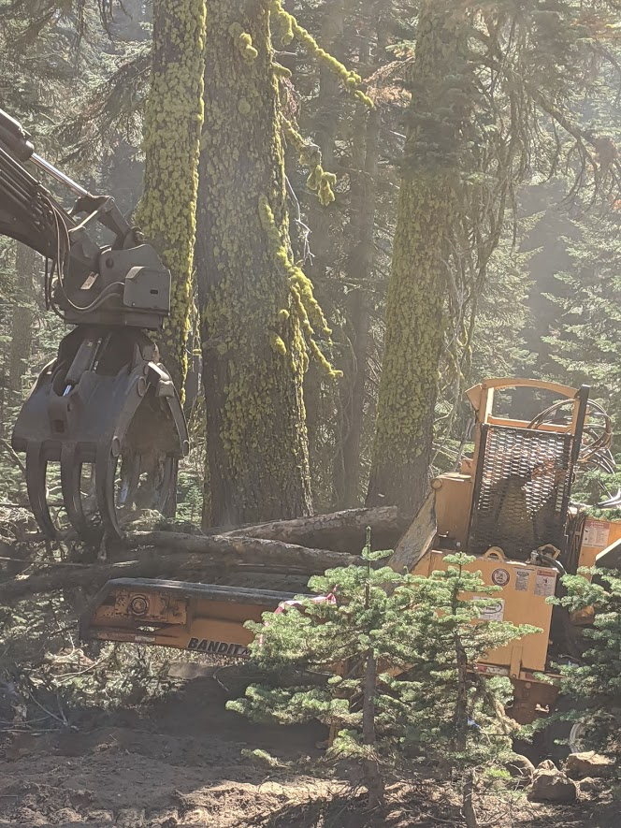
Stop 5
Loading Slash into a Chipper for haul to a Biomass Plant funded by excess funds from the Stewardship Contract.

Slide 15
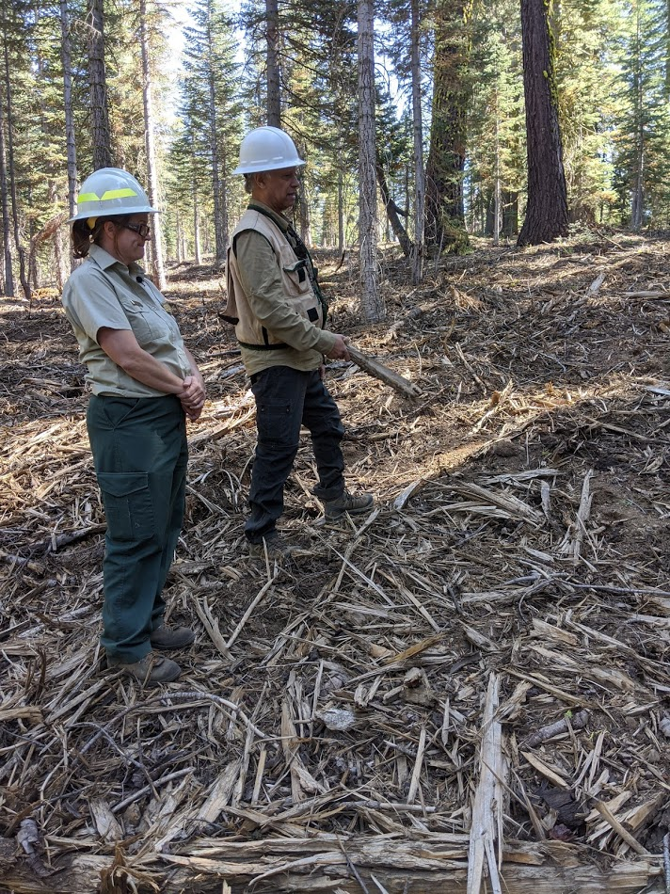
StoP 6
Masticated (shredded) brush & trees in a 30 year old plantation explained by Carinna Robertson USFS and John Quidachay UMRWA. The mastication work was subsidized by funding from SNC and contracted by UMRWA. The adjacent stand will be thinned like other stands and will create excess funds that the Forest has used to decommission an old high impact road and they will restore a meadow.

