Slide 1
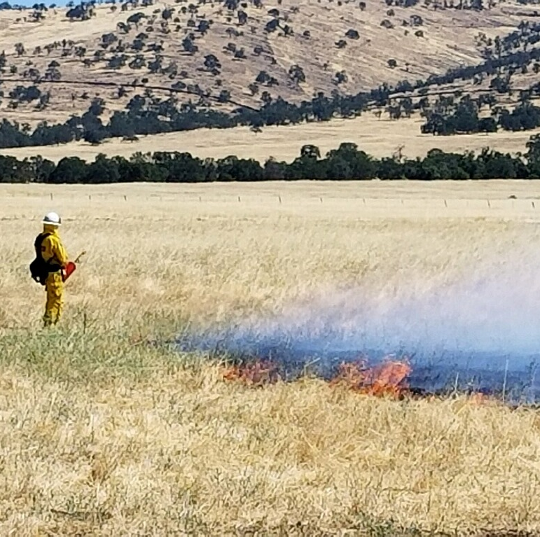
Amador-Calaveras Consensus Group
January 20th, 2021
Ken Pimlott
CAL FIRE Director, retired

Slide 2
Nearly 85 million acres classified as wildlands in CA
CAL FIRE responsible for protecting 31 million acres – almost entirely private
Includes forest, range and chaparral covered lands
CAL FIRE protects through:
Fire Protection Program
Resource Management Programs
Vegetation Management

Slide 3
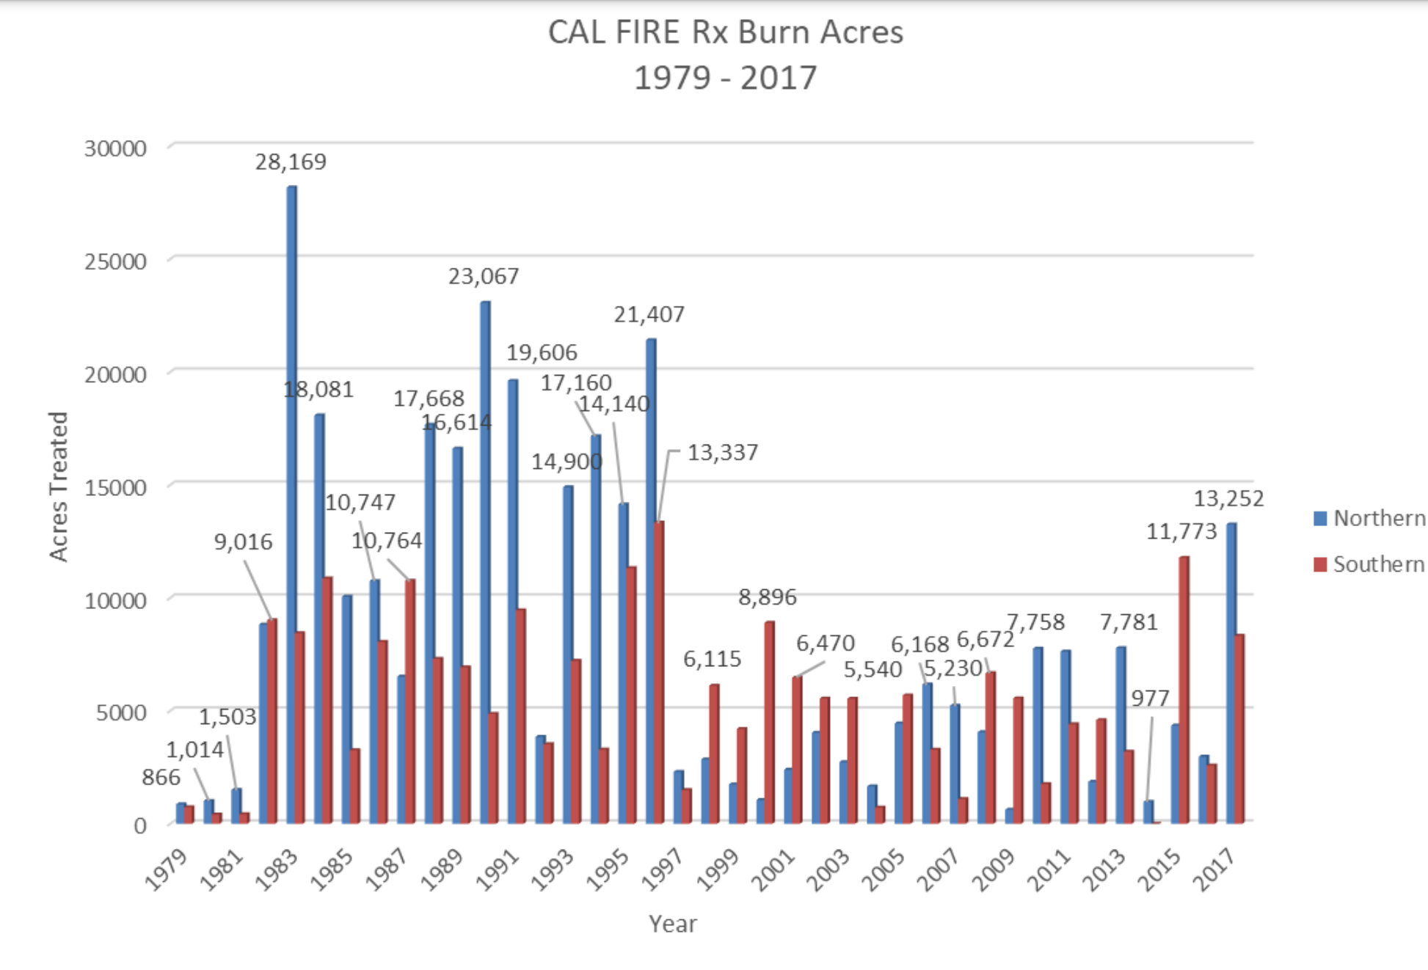
CAL FIRE Vegetation Management Program Accomplishments

Slide 4
Barriers to burning
Cumbersome Environmental Review
Narrow burn windows
Social license/public support
Liability associated with escaped burns
Longer and more intense fire seasons
Limited resource capacity/availability
Burn Complexity
Agency stereotypes

Slide 5
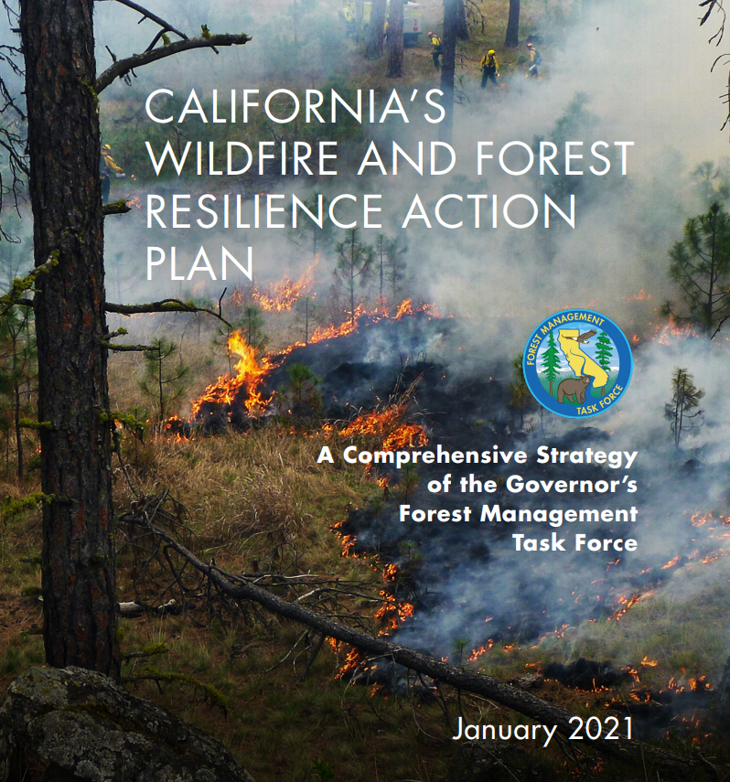
Goals and Solutions
CA Wildfire and Forest Resilience Action Plan
CA Vegetation Treatment Program EIR
Partnerships

Slide 6
Christopher Dow
Sierra Pacific Industries – RPF #3012
South Sierra Vegetation Management Specialist

Slide 7
Background
B.S. CSU Chico, Biology, 2008
2008 Happened…
2010-2012 PSW Research Station – Davis with Dr. Brandon Collins and Gary Roller (RPF)
2012-2014 Master of Forestry, UC Berkeley. Studied and worked with Scott Stephens, Brandon Collins, Anu Kramer, Sasha Berleman, Kate Wilkin, and Danny Fry.
2016 Published “Incorporating resource protection constraints in an analysis of landscape fuel-treatment effectiveness in the northern Sierra Nevada, CA, USA” CB Dow, BM Collins, SL Stephens; Environmental Science
Currently working on additional research into combining even-aged management mixed with fuel breaks.

Slide 8
Sierra Pacific Industries – AVMS South Sierra
Fuels treatments, modification, and maintenance
Coordinate landscape planning for fuels treatments with public and private ownerships
Coordinate Vegetation Management Program burns for AEU and TCU prescribed burn treatments
In addition, former president of the California Licensed Foresters Association, and current Board Member

Slide 9
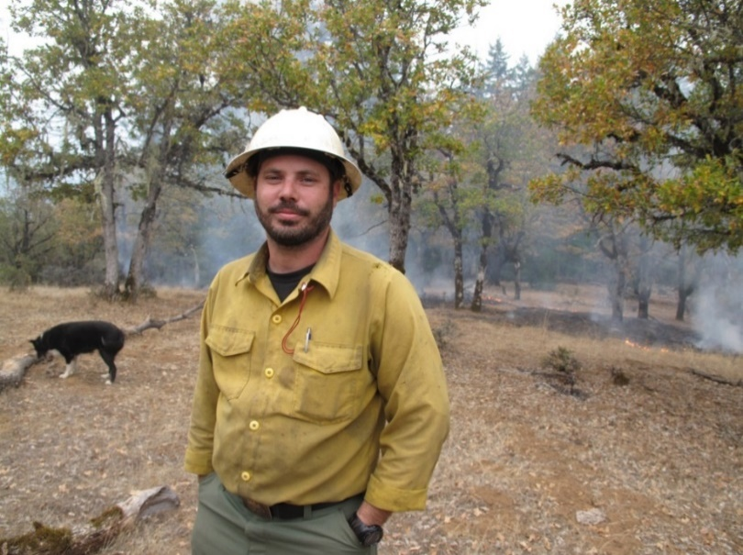
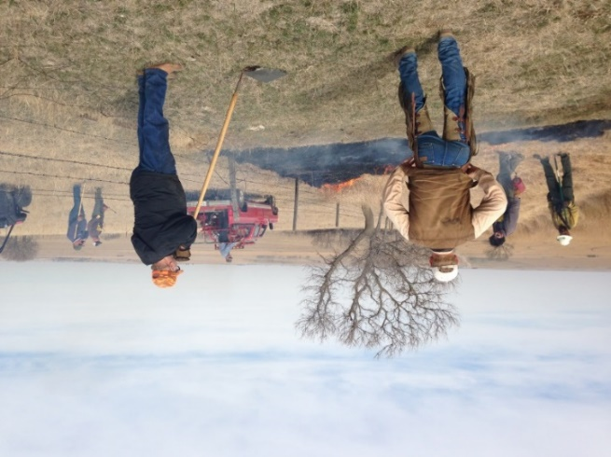
Small family forest landowners
How can they use prescribed fire?
How many are there?
Contractor
87,000 private landowners with >/ 10 acres of forest
Cal Fire Vegetation
Management Program
(VMP)
Collaborative
19 million acres (57%) federal agencies
< 1 million acres (3%) State and local
14 million acres (40%) private
5 million acres industrial timber companies
9 million acres individuals where 90% own < 50 acres
Prescribed Burn Association
Do It Yourself

Slide 10
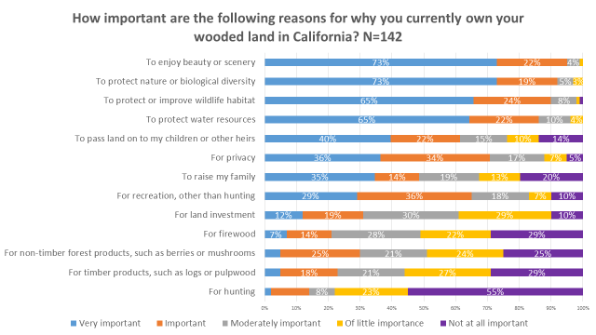
Few own forest land for timber products

Slide 11
Burning substantial acres on private lands is possible

Slide 12
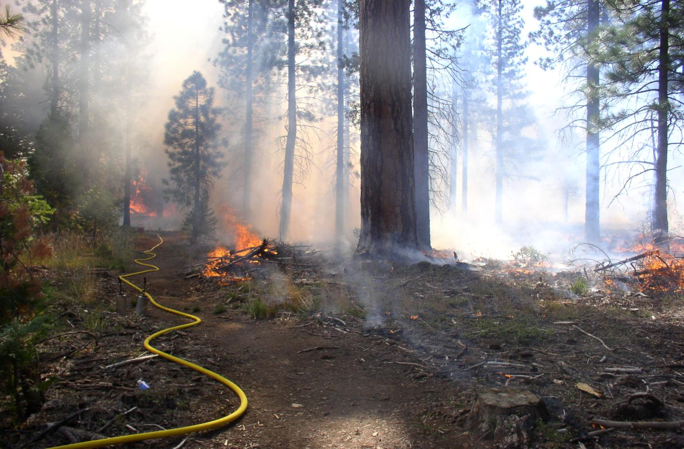
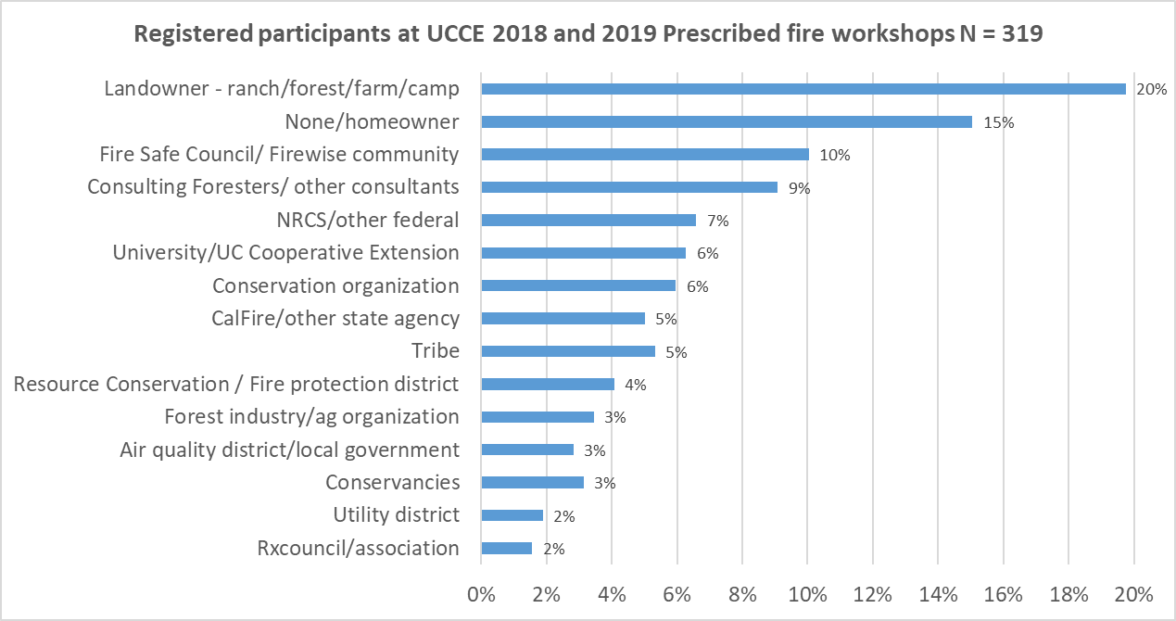
Started Sierra based Rx workshop series in 2018
Hosted spring and fall workshops
One day classroom session
One day participating in Rx burn
Cover fire ecology, options for Rx burning, how to, regulations
Challenge is finding locations for burns and getting CalFire permit, and now Covid restrictions
Webinars in spring 2020
Transition to video series with winter burn this year
Contact: Susie Kocher, Forestry Advisor, sdkocher@ucanr.edu

Slide 13
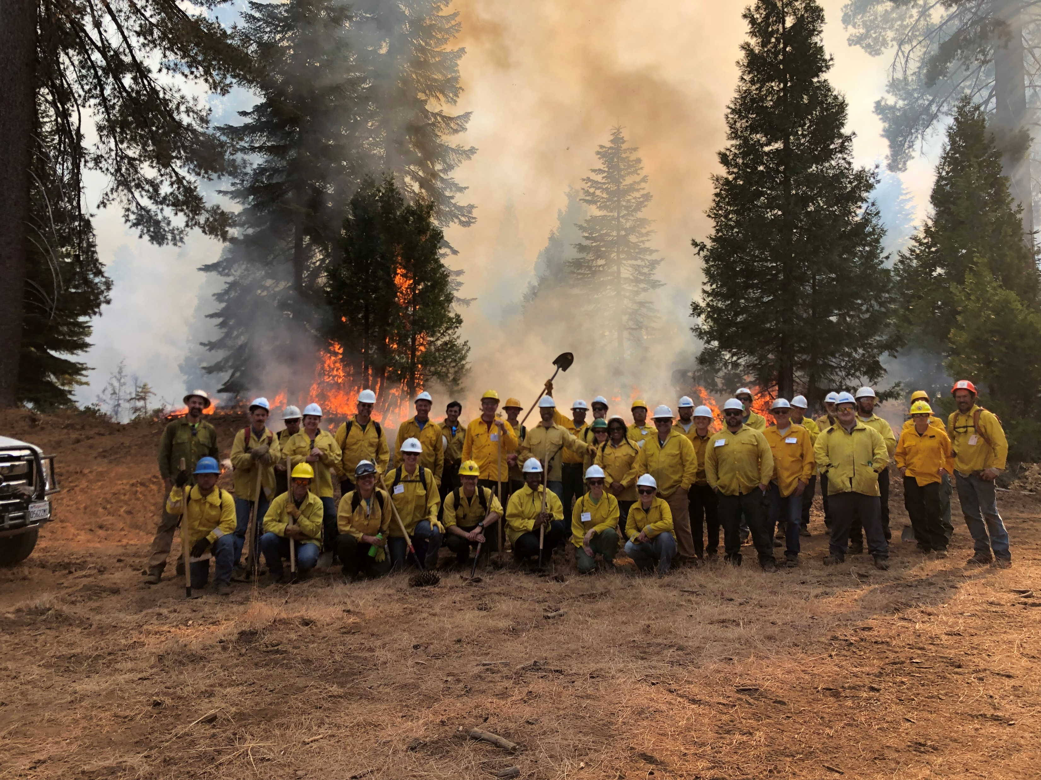
After workshop, participants wanted to burn with:
Prescribed Burn Association (PBA): 63%
CalFire Vegetation Management Plan (VMP): 49%
NRCS/ EQIP: 46%
Family: 36%
Contractor: 24%
November 2019 burn crew of workshop participants at Southern California Edison’s Shaver Lake property

