Slide 1
Strategic Landscape Assessment Work Group: GIS Tools
Megan Layhee
meganl.chips@gmail.com
ACCG General Meeting
02.17.2021

Slide 2
Products
Fuels Reduction Project Inventory Database
Wildfire Risk Assessment
Project Identification Process
ArcGIS Pro Workflows
Interactive Online Map

Slide 3
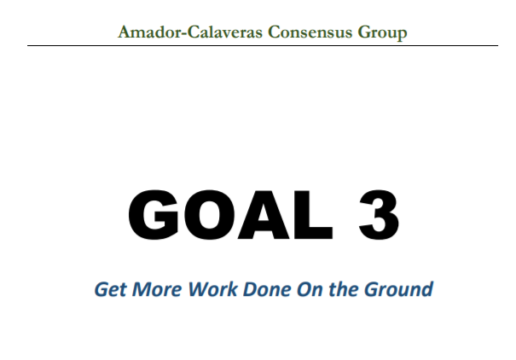
Purpose & need
Conduct an all-lands landscape assessment within ACCG footprint
Relevance: provide a roadmap for future projects, identify needs, and aid in project planning

Slide 4
Process
SLAWG
Planning WG
GIS Product Development

Slide 5
Framework
ASSETS
Compile and rank HVRAs (high-valued resources and assets) within the following broad HVRA categories: Communities, Infrastructure, Wildlife/Ecosystems, Economic Assets, and Watersheds.
RISK
Use flame-length class probability and burn probability estimates (USFS R5 FSim outputs) and ranked HVRAs to determine where assets are most at risk within the ACCG landscape (GTR-315, Effects Analysis).
PROJECT PRIORITY LIST
Locate and prioritize areas for future fuels reduction project work within the ACCG landscape (Prioritization Tool) based on the information gathered above.
PROJECT INVENTORY
Compile completed (w/maintenance status), in-progress and planned fuels reduction or stand structure altering projects within the ACCG landscape into an interactive map (Project Mapper).

Slide 6
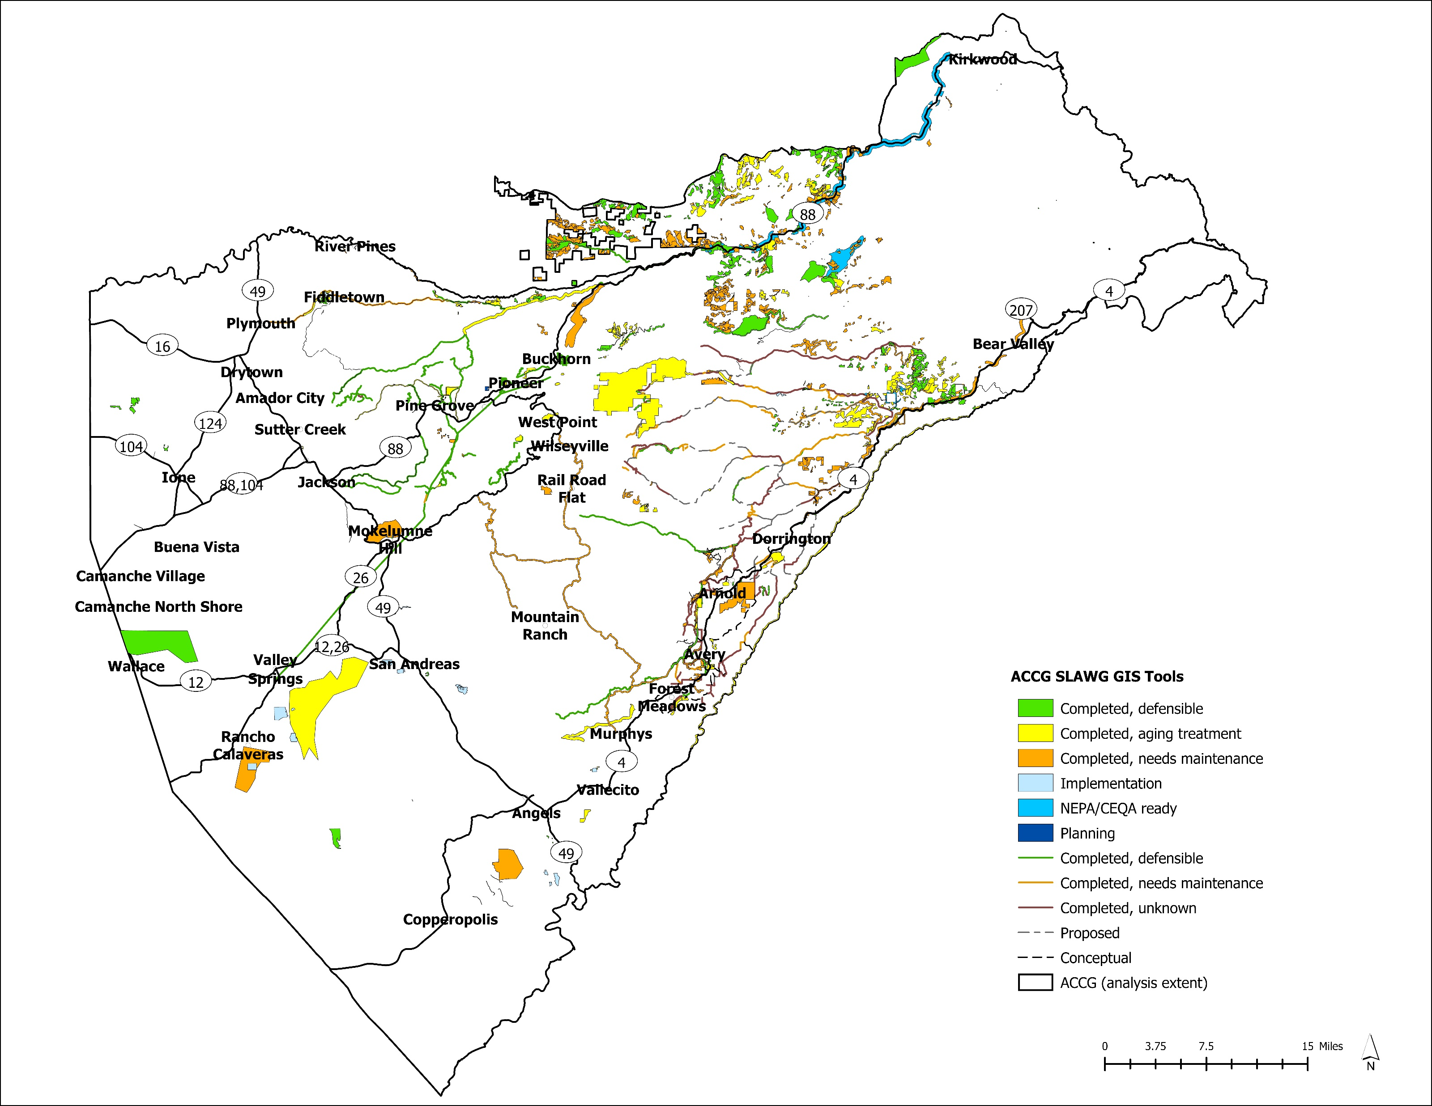
Project inventory
Fuels reduction activities
Project status
Maintenance status
Interactive & online
Automated workflows for database maintenance

Slide 7
Framework
ASSETS
Compile and rank HVRAs (high-valued resources and assets) within the following broad HVRA categories: Communities, Infrastructure, Wildlife/Ecosystems, Economic Assets, and Watersheds.
RISK
Use flame-length class probability and burn probability estimates (USFS R5 FSim outputs) and ranked HVRAs to determine where assets are most at risk within the ACCG landscape (GTR-315, Effects Analysis).
PROJECT PRIORITY LIST
Locate and prioritize areas for future fuels reduction project work within the ACCG landscape (Prioritization Tool) based on the information gathered above.
PROJECT INVENTORY
Compile completed (w/maintenance status), in-progress and planned fuels reduction or stand structure altering projects within the ACCG landscape into an interactive map (Project Mapper).

Slide 8
High-valued Resources & Assets (HVRAs & Sub-HVRAs)
Communities
Infrastructure
Major Evacuation Routes (Highways)
Wildlife/ Ecosystems
USFWS Listed Sp. Critical Habitat
Economic Assets: Timber Resources
Census Populated Places
Mature Wildlife Habitat for Spotted Owl, goshawk, marten (within species ranges)
Power plants
Gov./Rec/Fire Facilities
Communication Sites
Watersheds
Erosion Potential
Transmission lines
Fir (≥ 6" dbh, w/operational constraints)
Non-fir (Pine/ Mixed Conifer/ Mixed Conifer-Hardwood; ≥ 6" dbh, w/operational constraints)
Water infrastructure
Forests 2 Faucets Drinking Water Importance Scores
Veg type (trees, shrub, herbaceous)
CAL FIRE WUI
USFS WUI
Immature Wildlife Habitat
FS Erosion Hazard Rating)

Slide 9
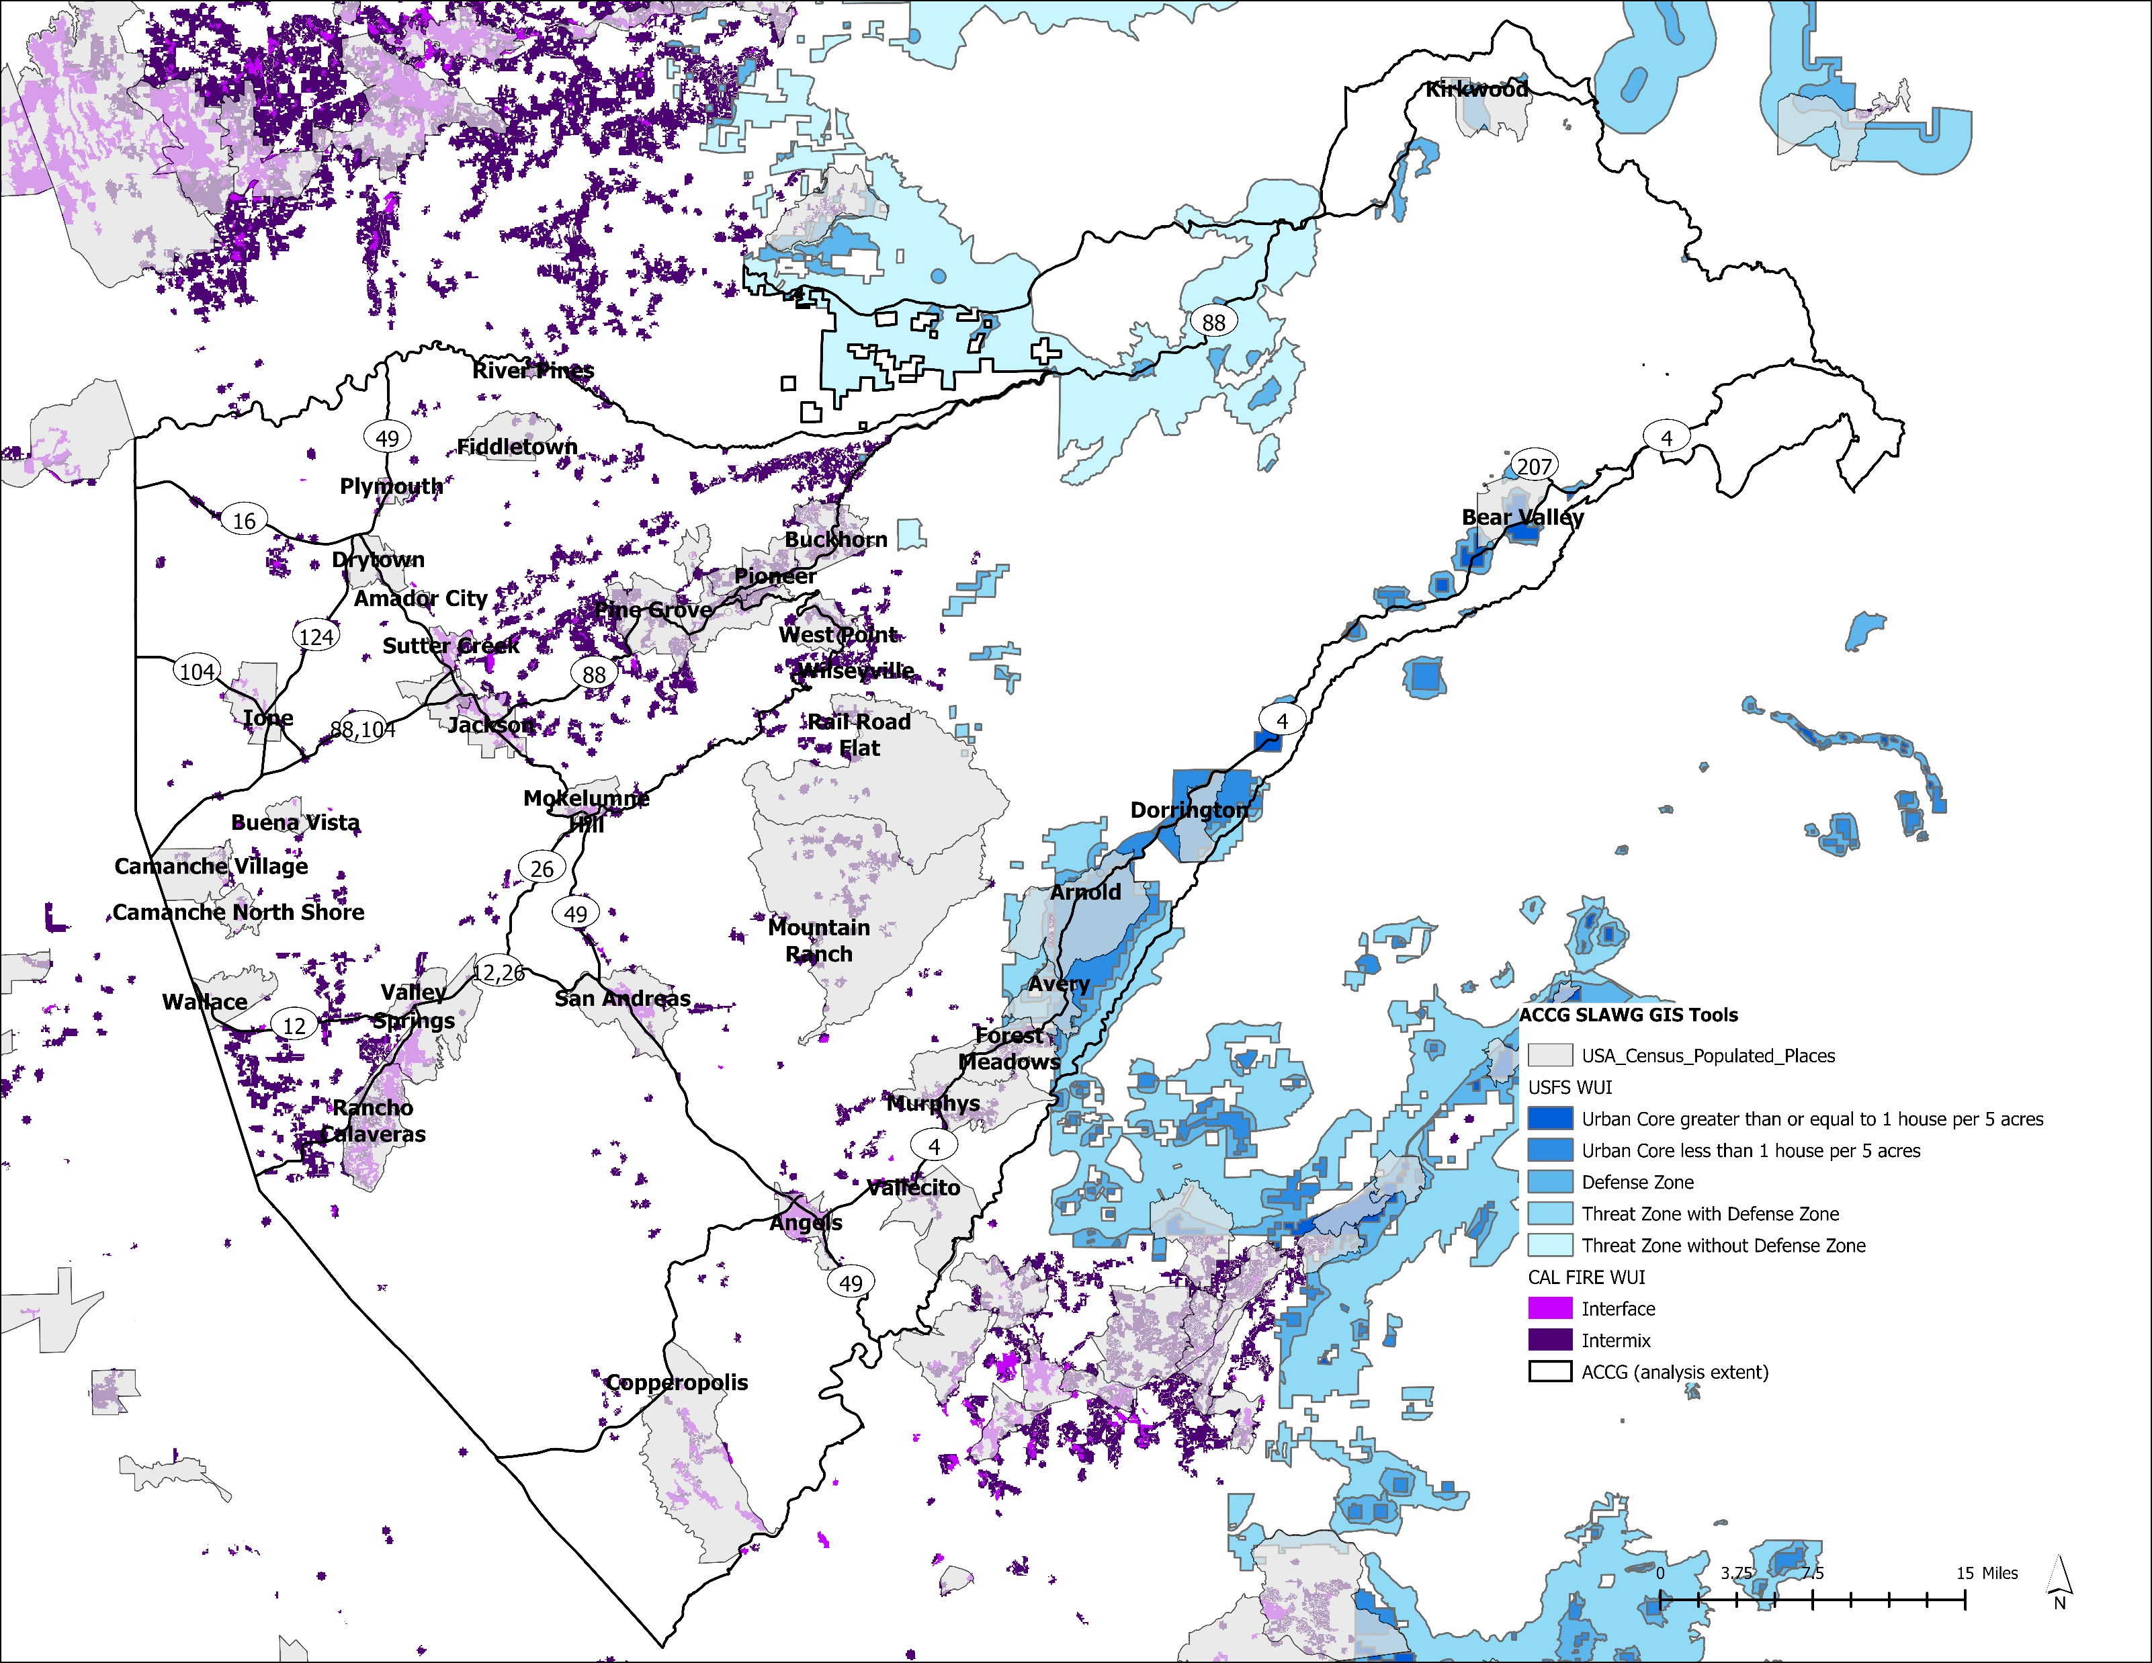
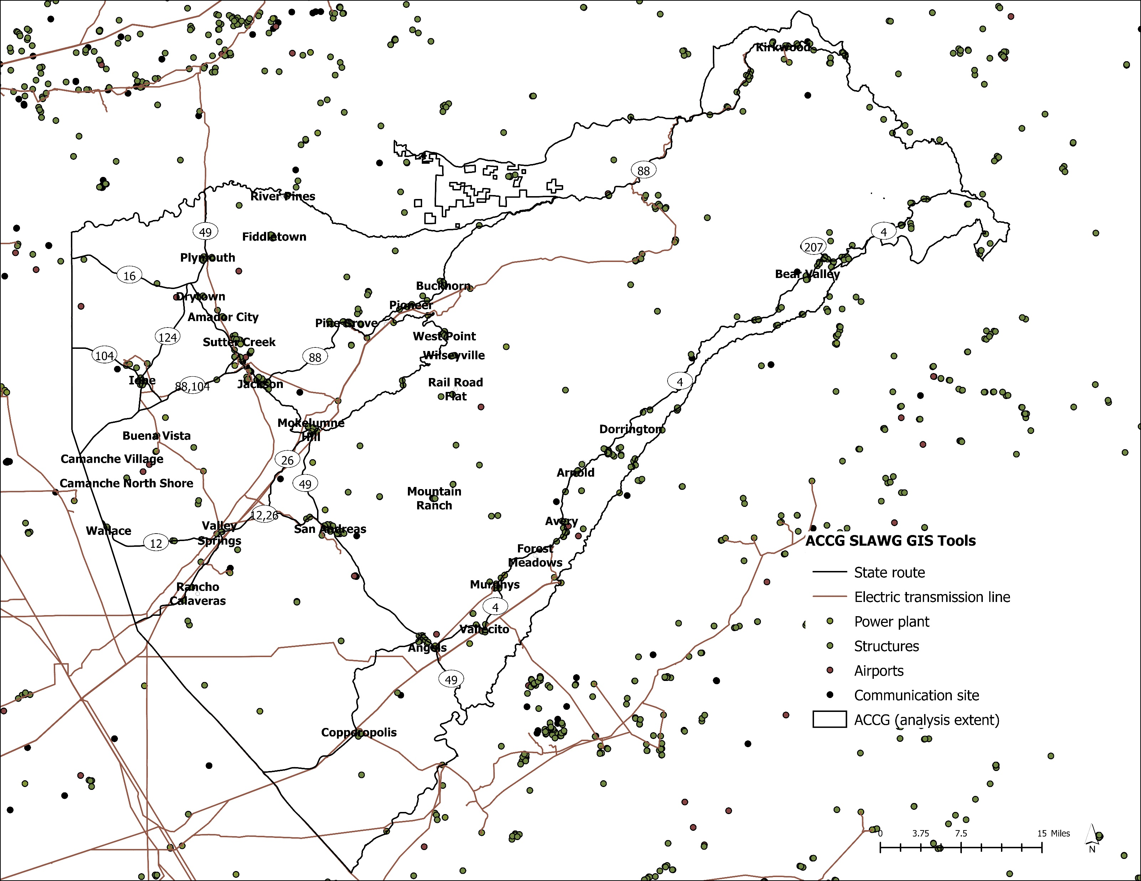
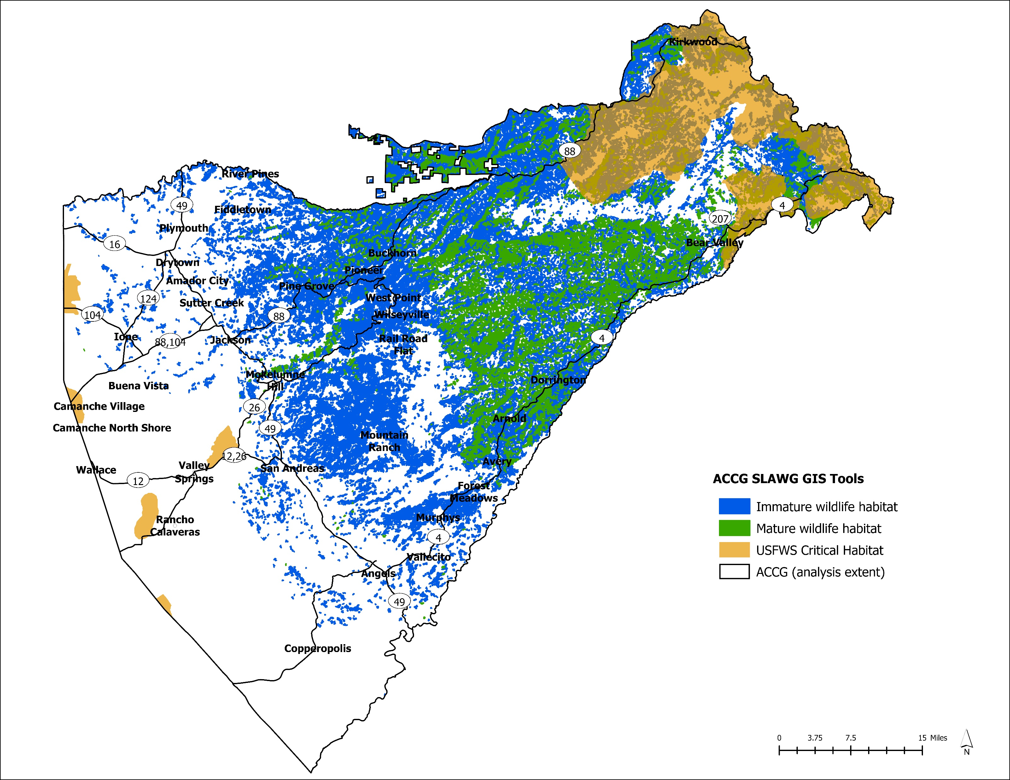
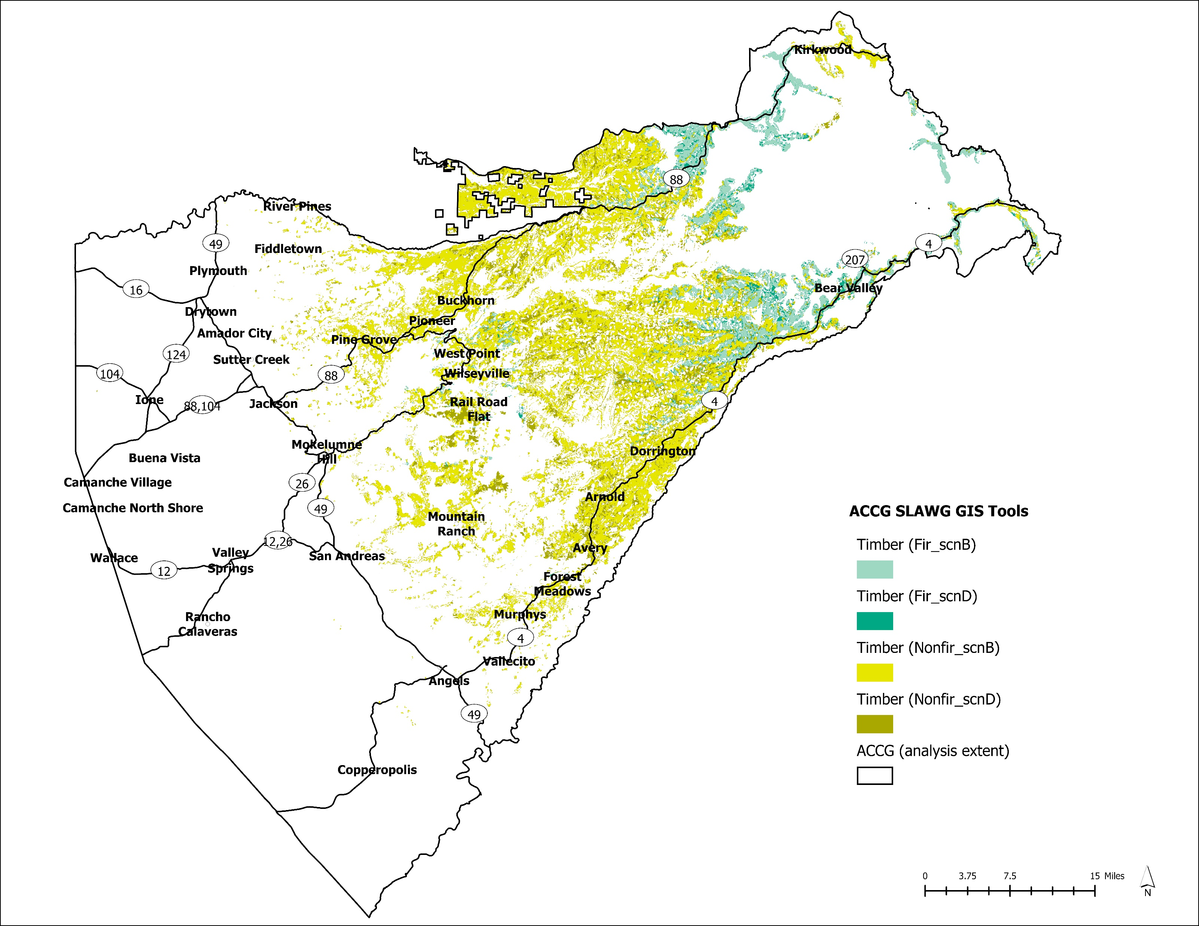
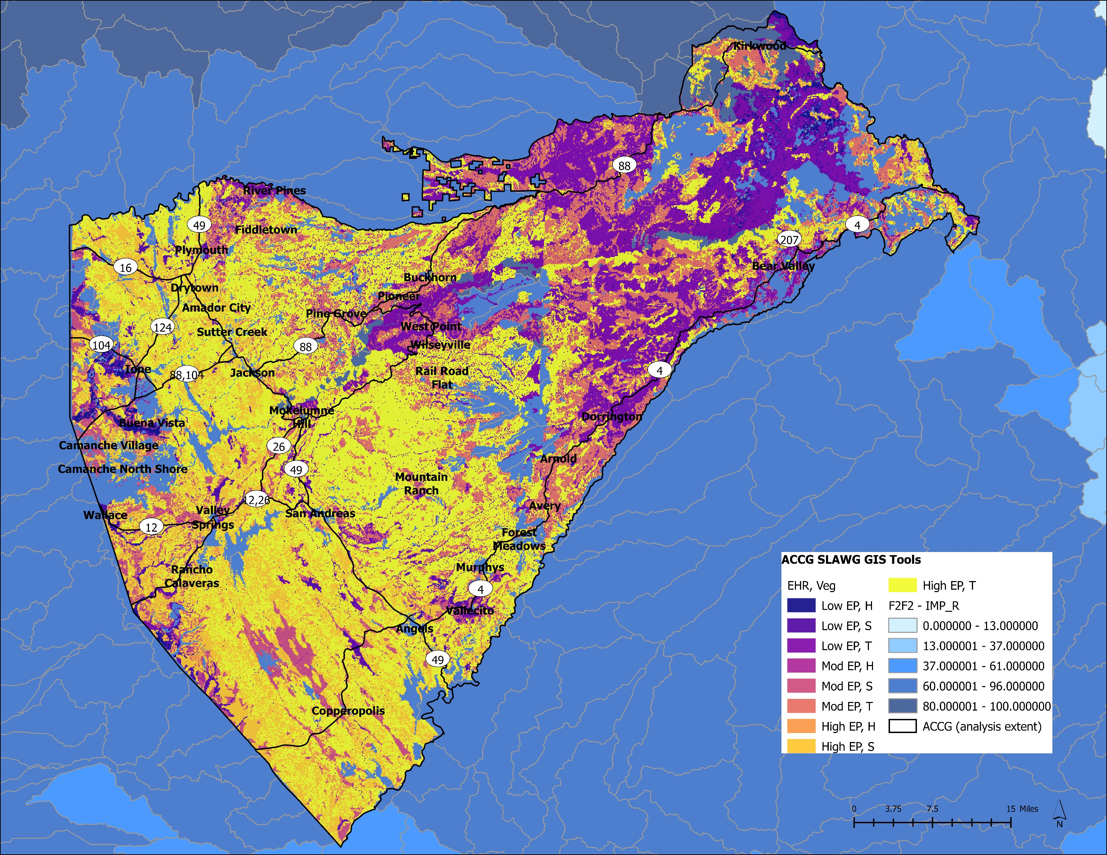

Slide 10
Framework
ASSETS
Compile and rank HVRAs (high-valued resources and assets) within the following broad HVRA categories: Communities, Infrastructure, Wildlife/Ecosystems, Economic Assets, and Watersheds.
RISK
Use flame-length class probability and burn probability estimates (USFS R5 FSim outputs) and ranked HVRAs to determine where assets are most at risk within the ACCG landscape (GTR-315, Effects Analysis).
PROJECT PRIORITY LIST
Locate and prioritize areas for future fuels reduction project work within the ACCG landscape (Prioritization Tool) based on the information gathered above.
PROJECT INVENTORY
Compile completed (w/maintenance status), in-progress and planned fuels reduction or stand structure altering projects within the ACCG landscape into an interactive map (Project Mapper).

Slide 11
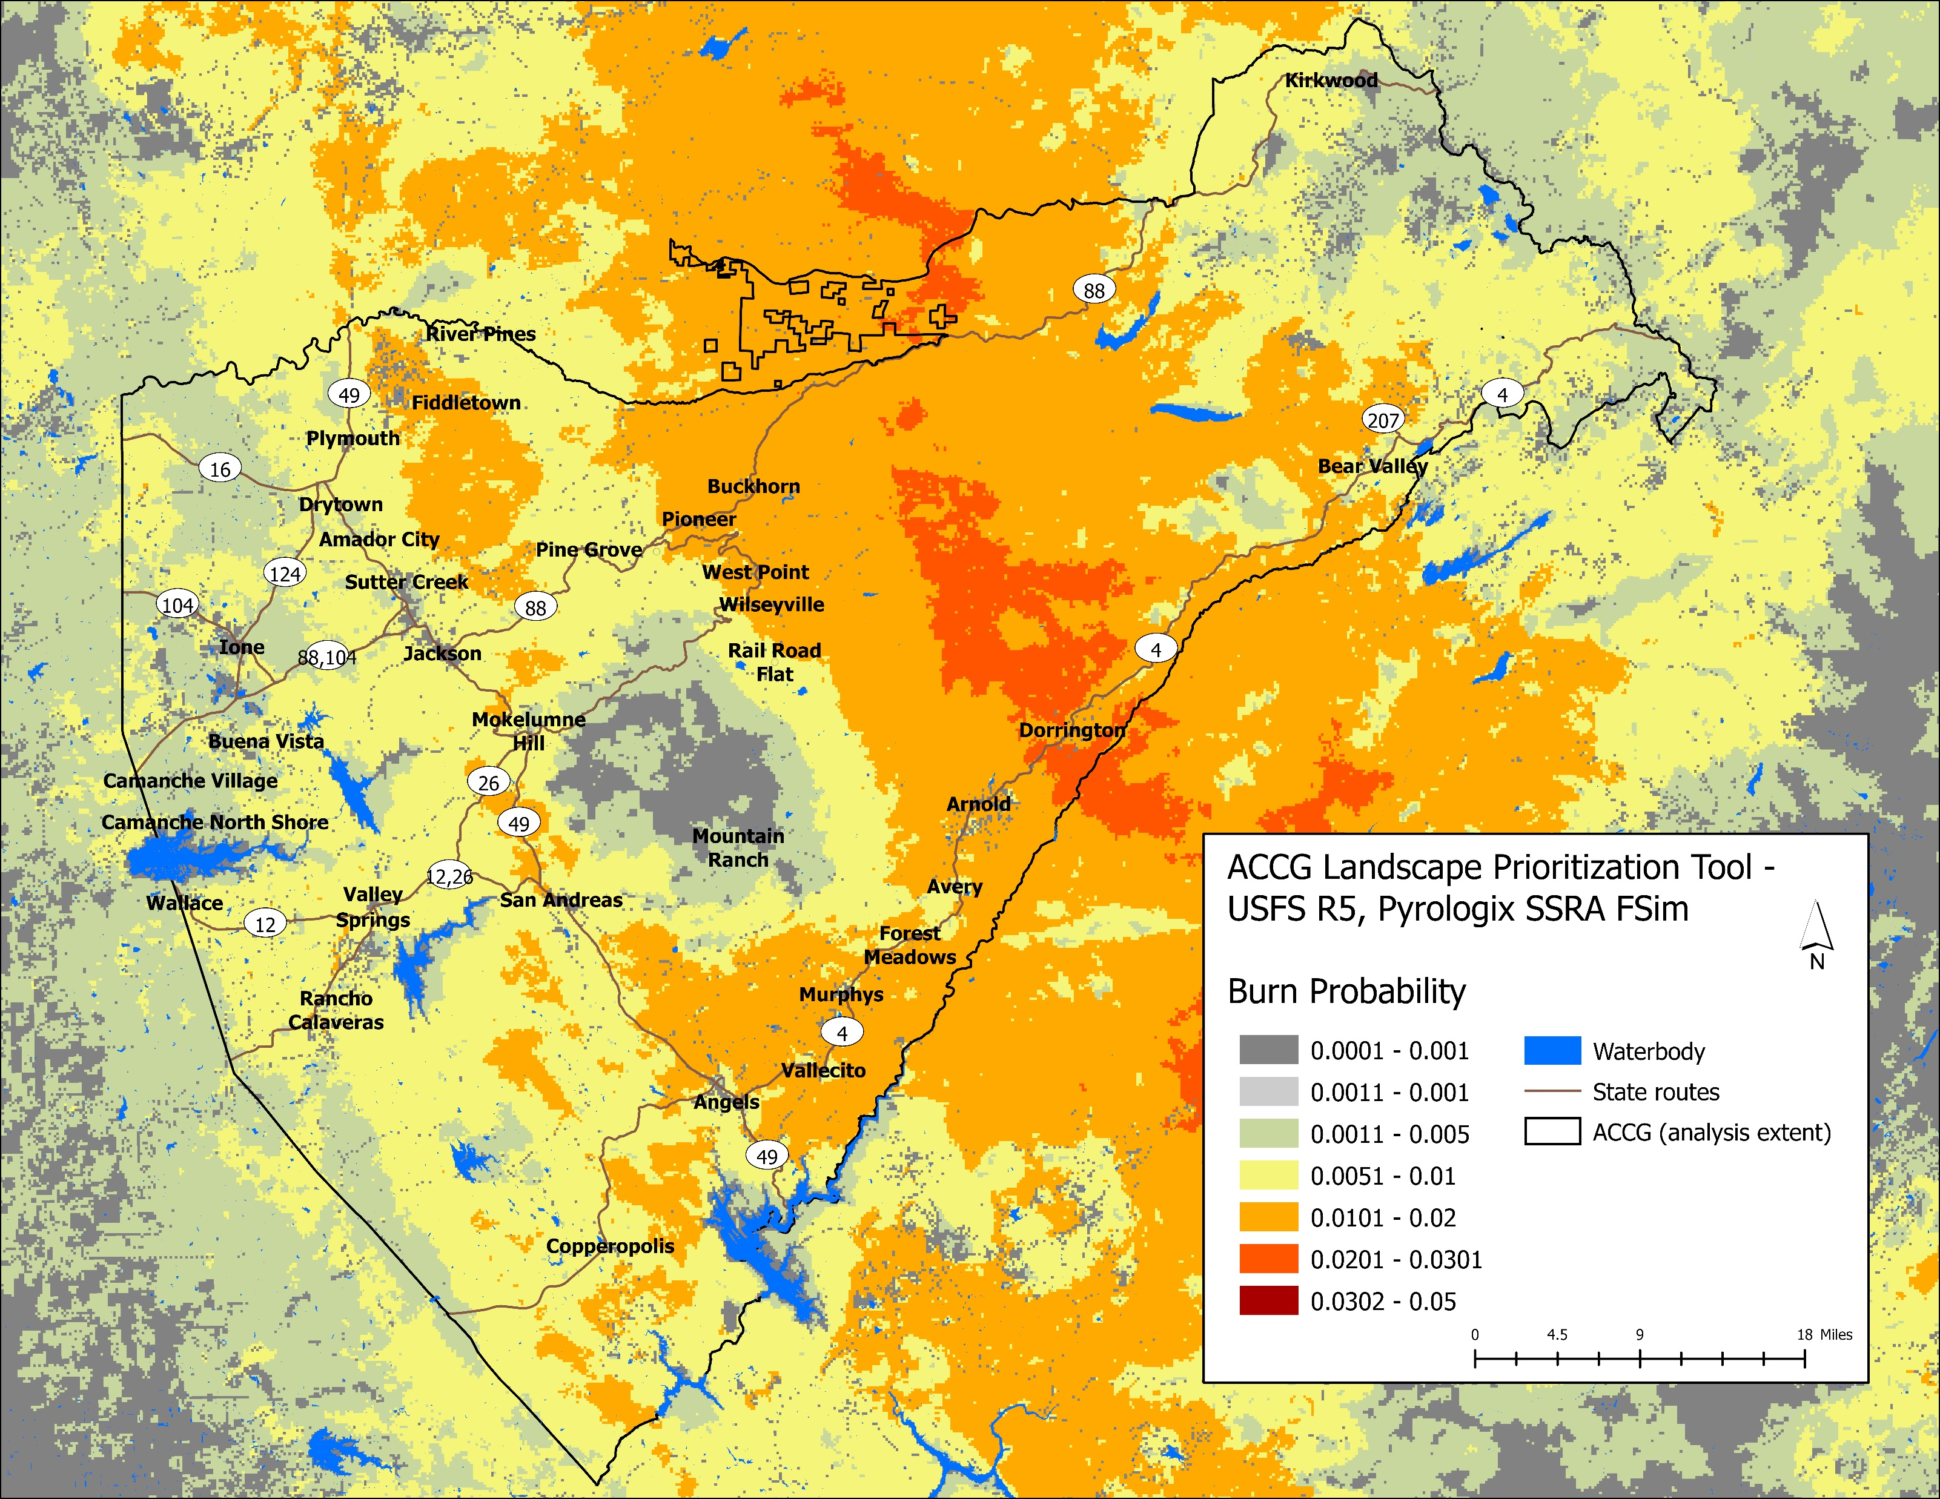
Quantitative risk assessment
Likelihood: Burn Probability
Intensity: Predicted Flame Length
Source: GTR-315 (QRA), R5 SSRA FSim (Modeled wildfire)

Slide 12
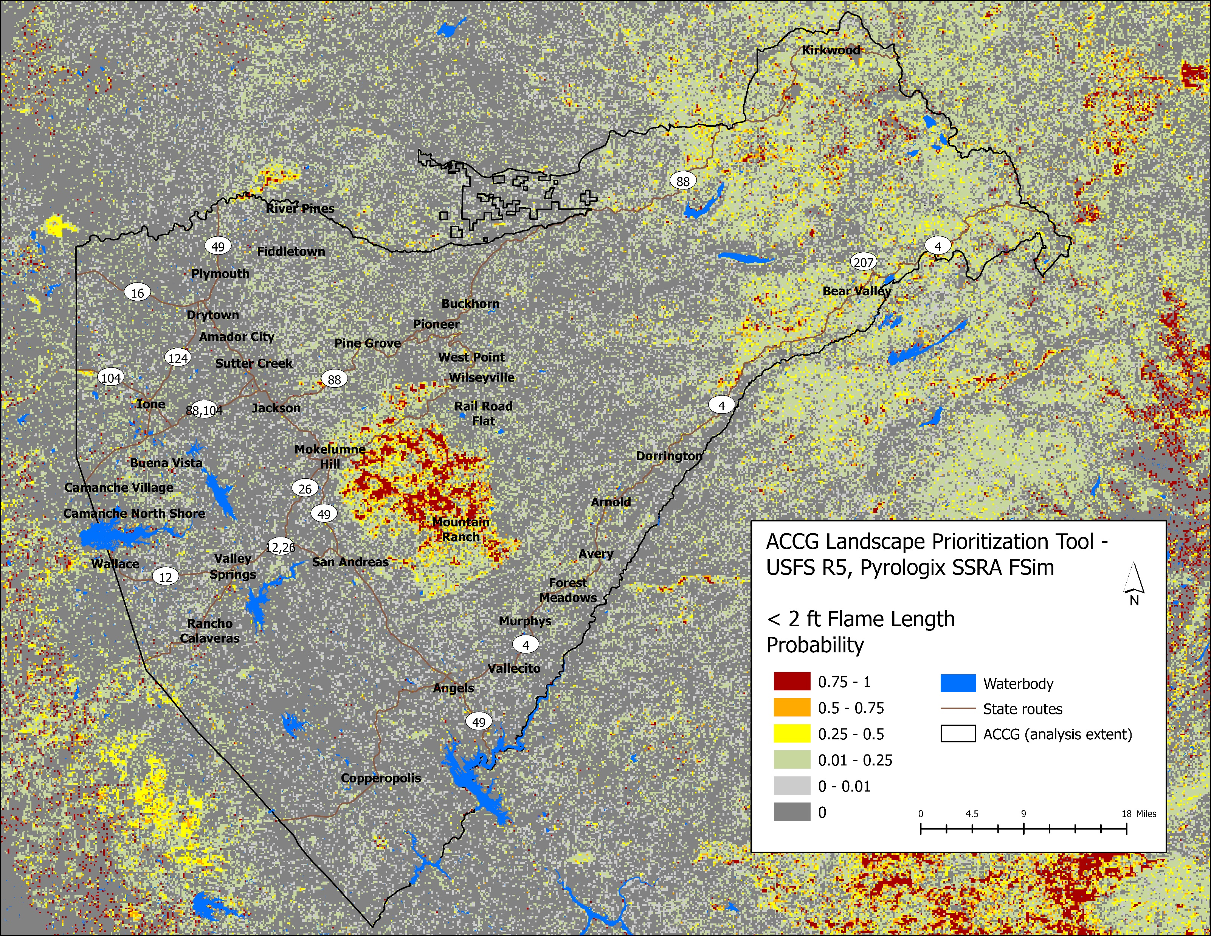
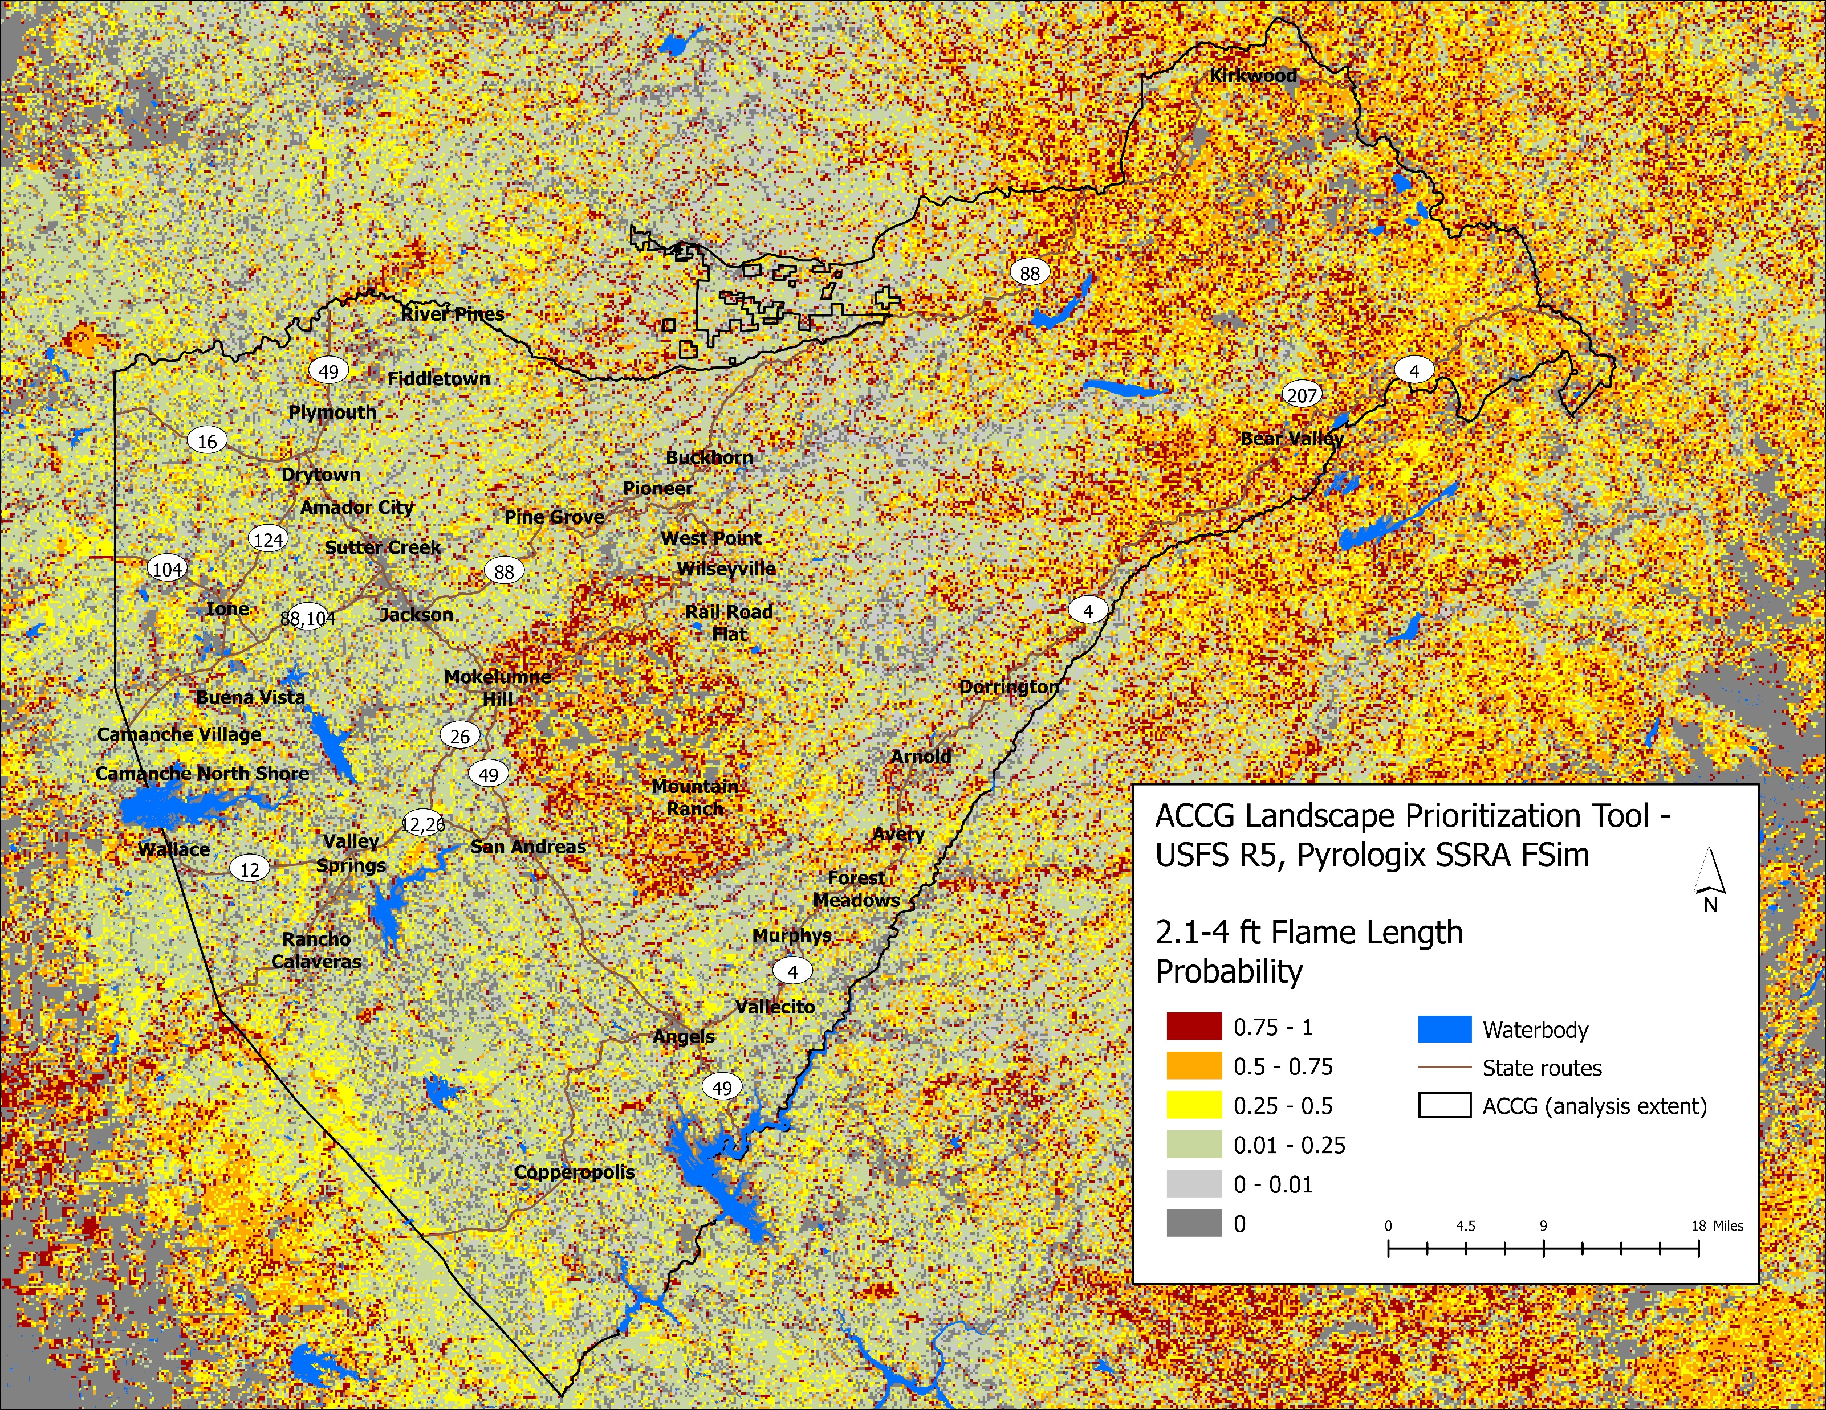
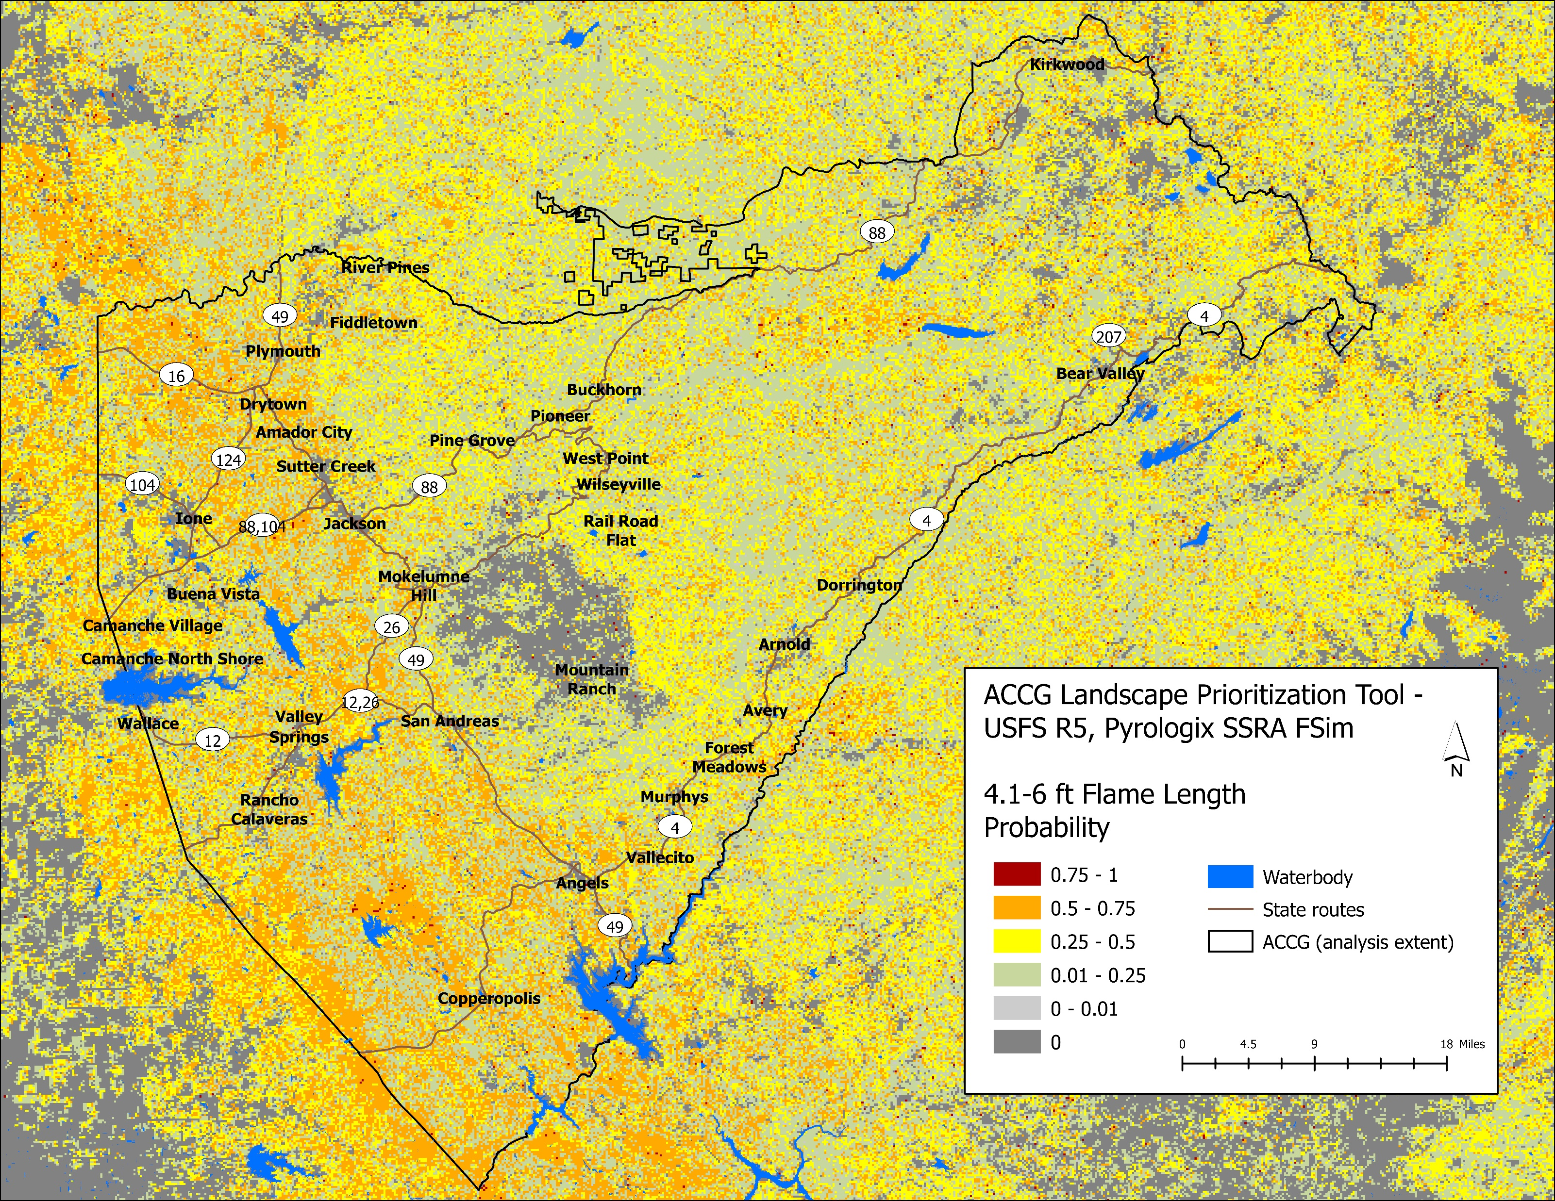
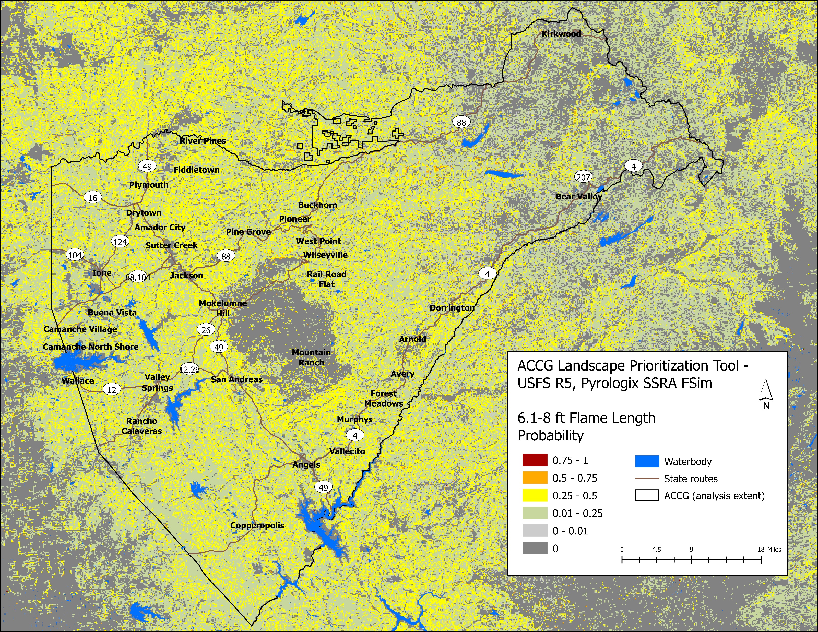
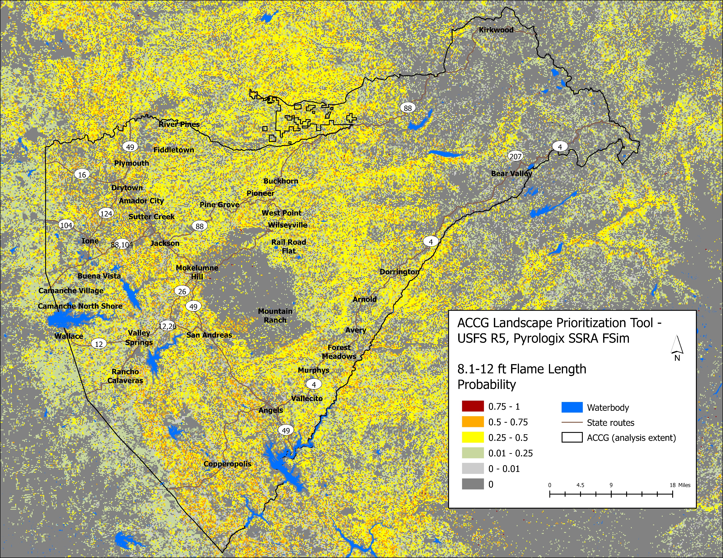
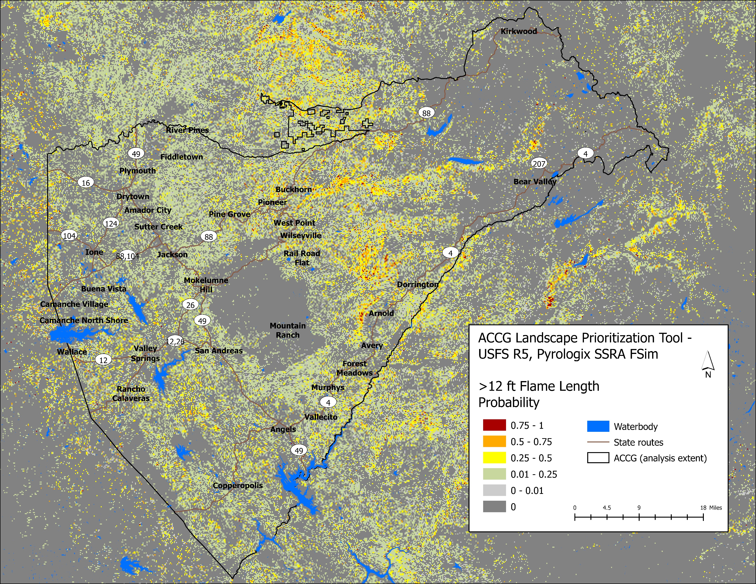
FIL 1: ≤ 2 ft Flame Length
FIL 2: 2.1-4 ft Flame Length
FIL 3: 4.1-6 ft Flame Length
FIL 4: 6.1-8 ft Flame Length
FIL 5: 8.1-12 ft Flame Length
FIL 6: >12 ft Flame Length

Slide 13
Assets & Risk: Communities HVRA

Slide 14
Assets & Risk: Wildlife/ecosystems HVRA

Slide 15
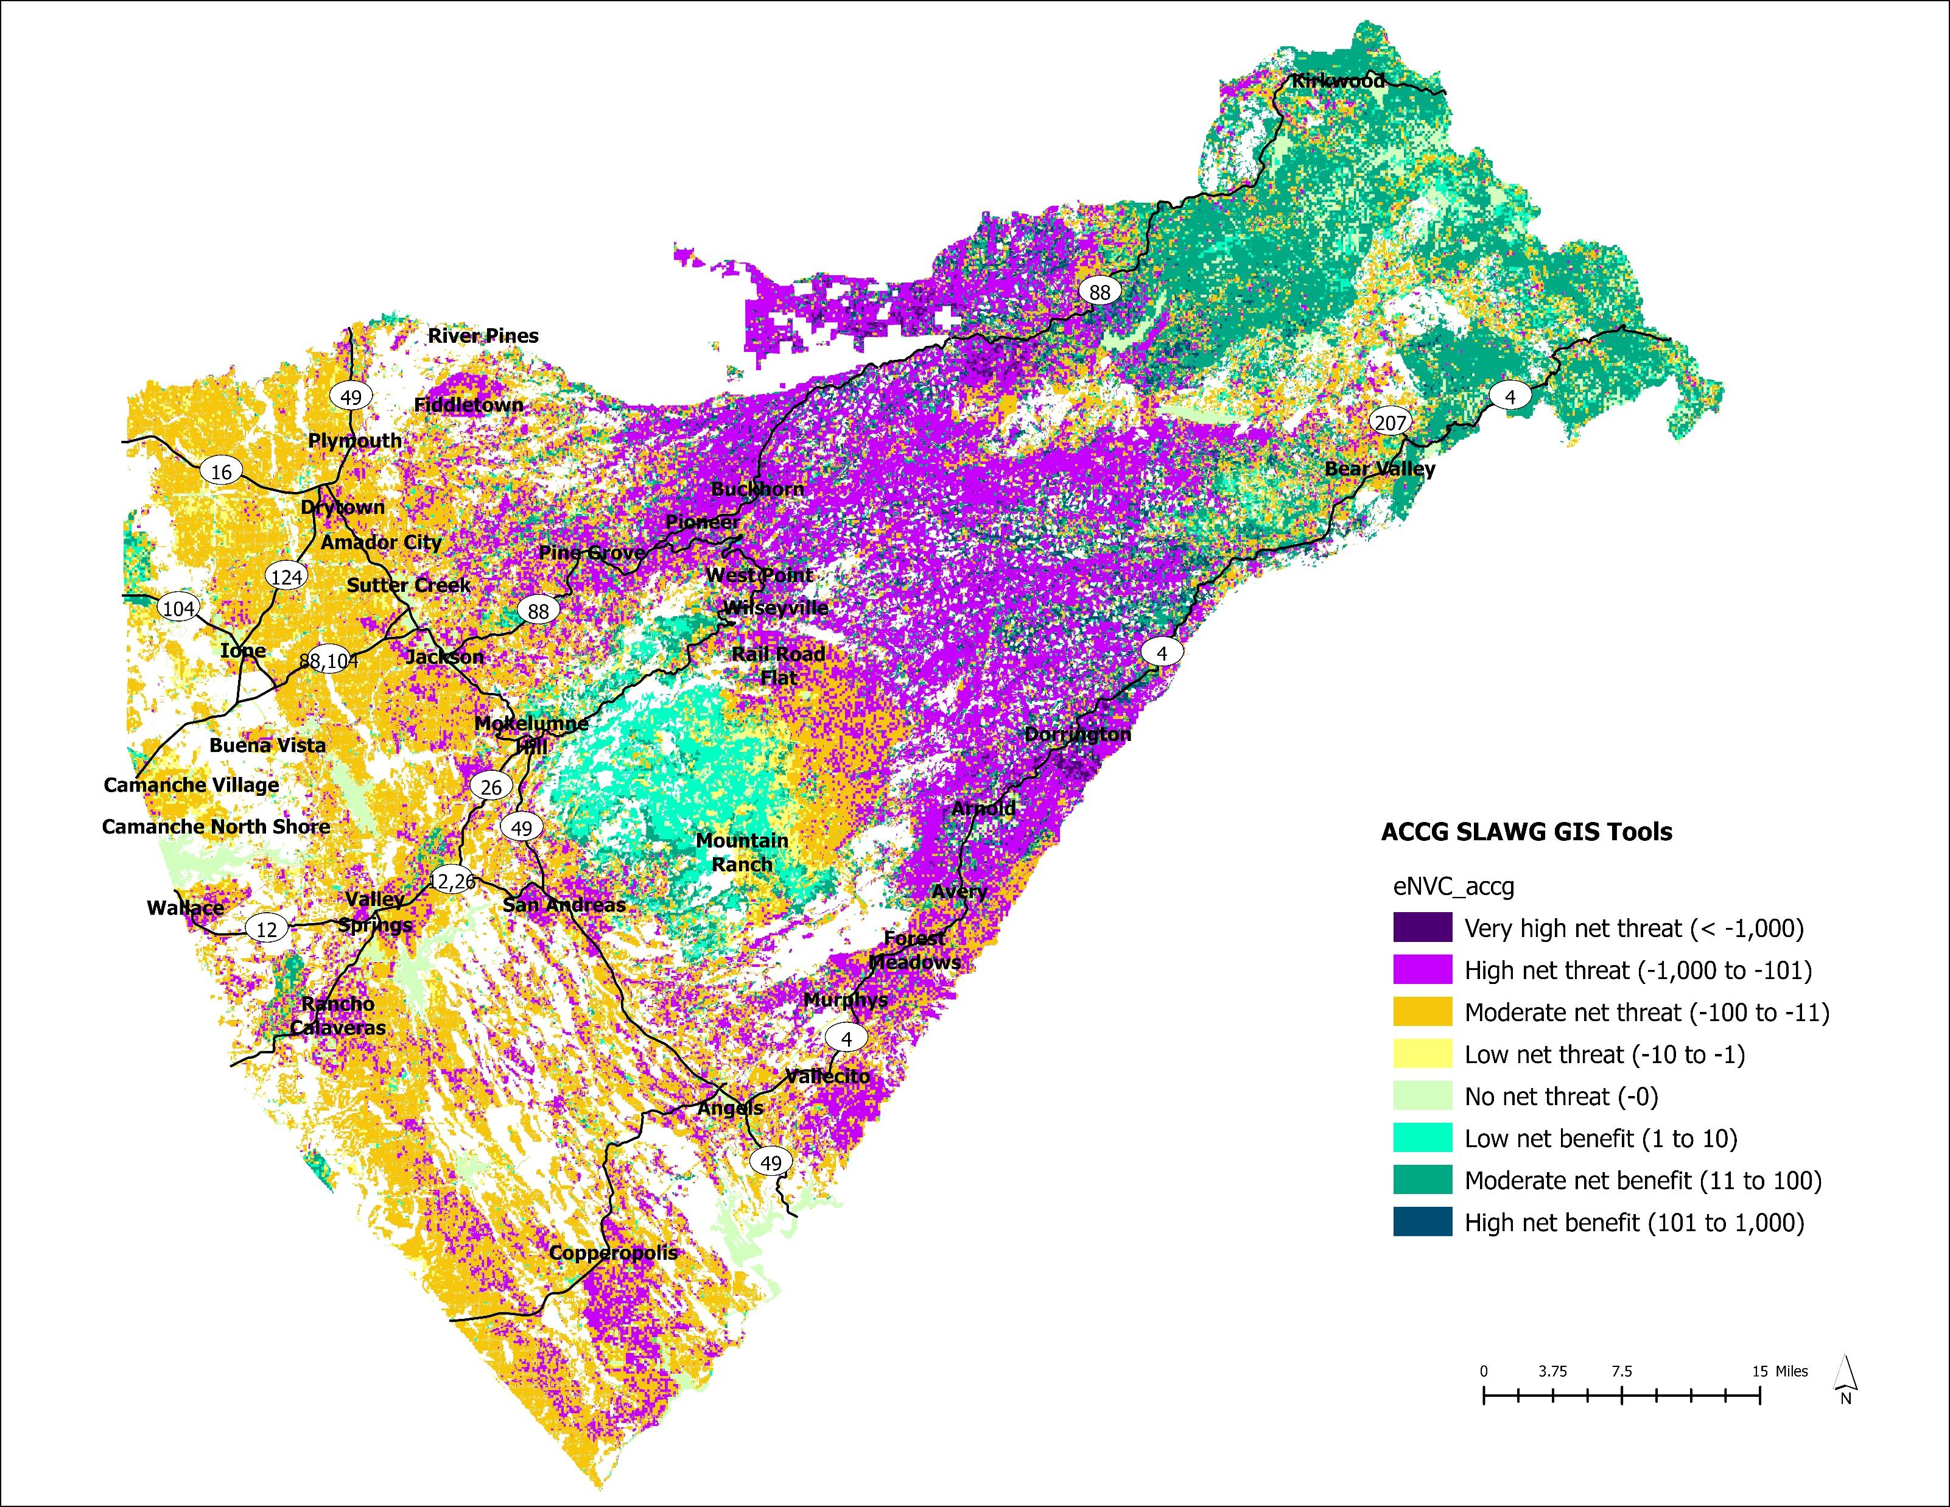
Quantitative risk assessment: net value change
Net threat
purples, orange, yellow
No net threat/benefit
light green
Net benefit
Green, dark greens

Slide 16
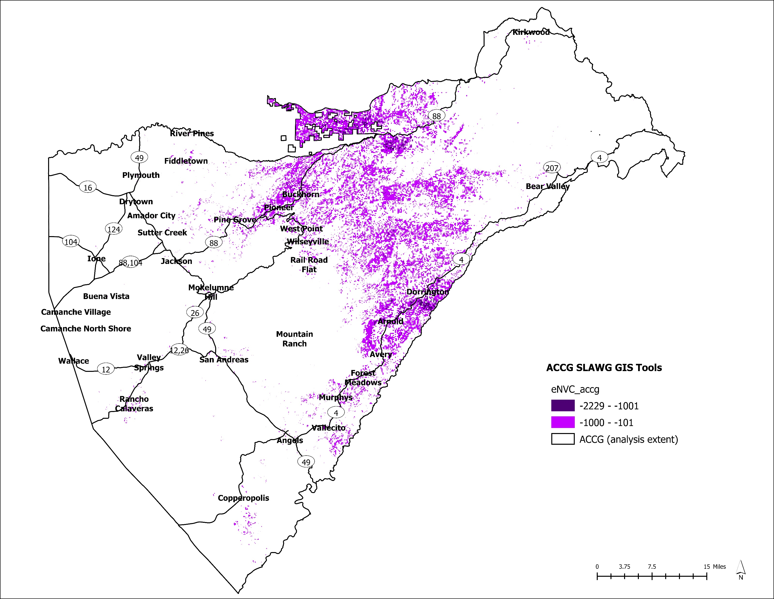
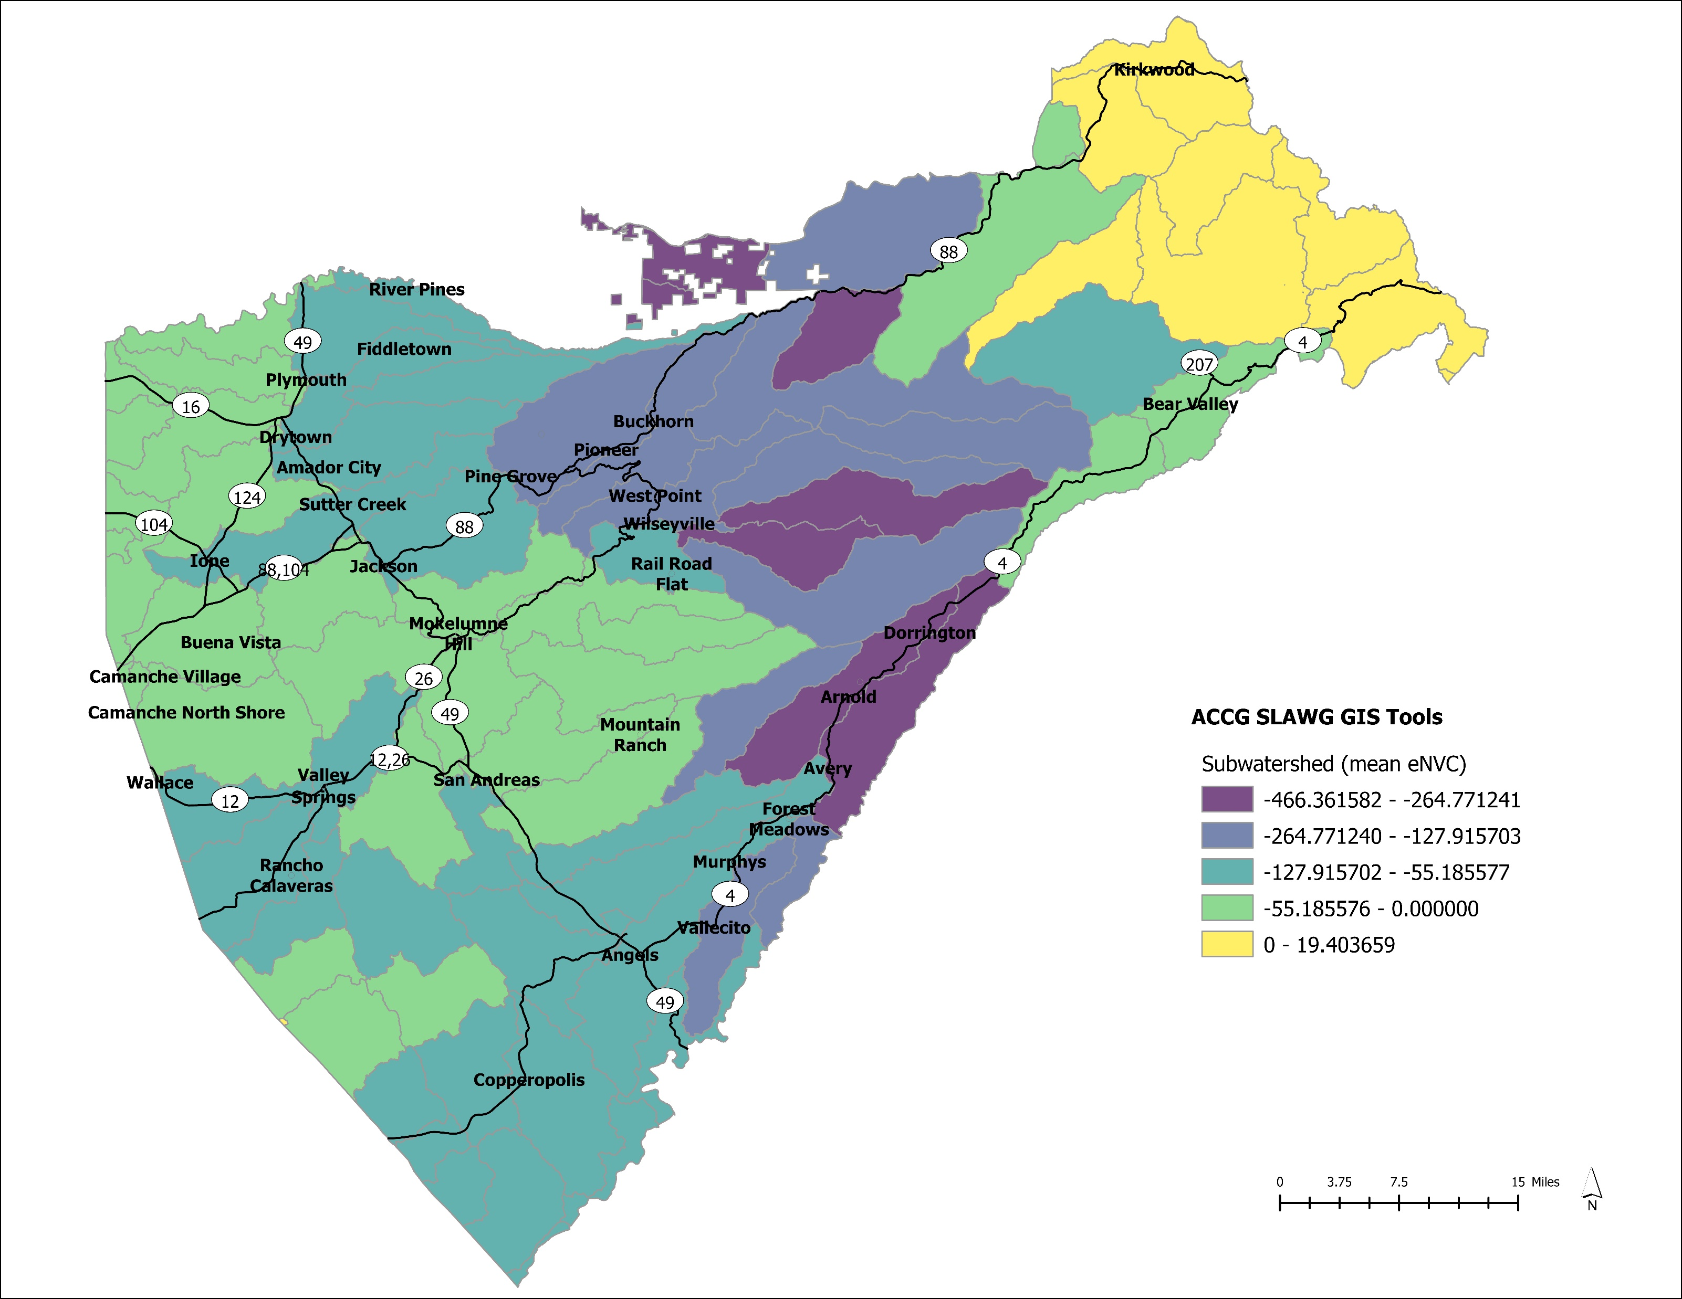
Quantitative risk assessment: High wildfire risk areas

Slide 17
Framework
ASSETS
Compile and rank HVRAs (high-valued resources and assets) within the following broad HVRA categories: Communities, Infrastructure, Wildlife/Ecosystems, Economic Assets, and Watersheds.
RISK
Use flame-length class probability and burn probability estimates (USFS R5 FSim outputs) and ranked HVRAs to determine where assets are most at risk within the ACCG landscape (GTR-315, Effects Analysis).
PROJECT PRIORITY LIST
Locate and prioritize areas for future fuels reduction project work within the ACCG landscape (Prioritization Tool) based on the information gathered above.
PROJECT INVENTORY
Compile completed (w/maintenance status), in-progress and planned fuels reduction or stand structure altering projects within the ACCG landscape into an interactive map (Project Mapper).

Slide 18
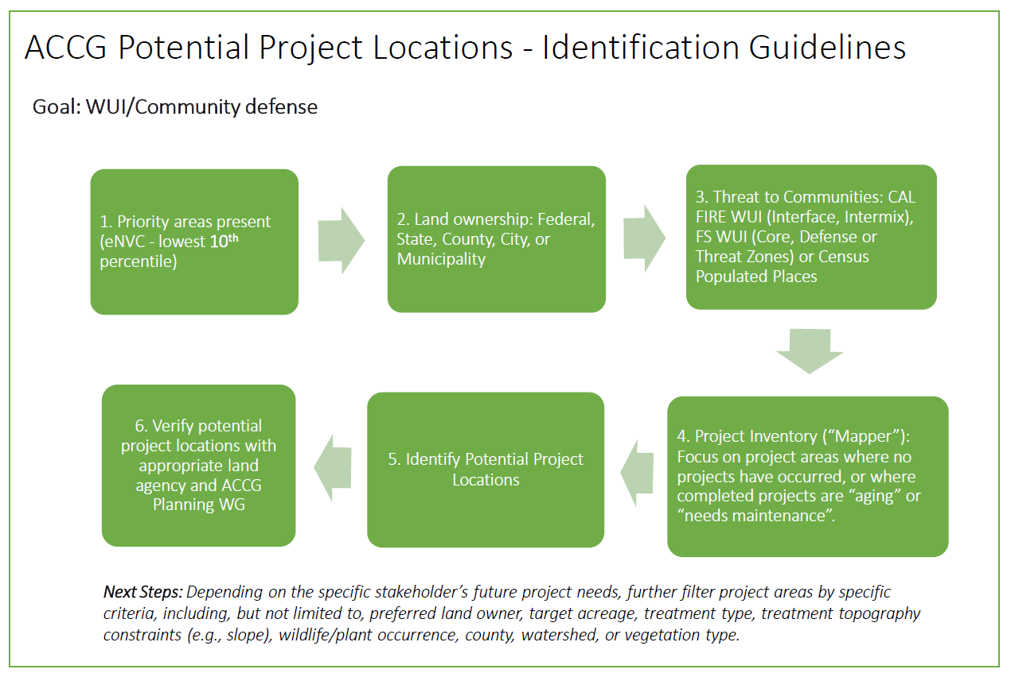
Project identification & prioritization options
Project Identification Framework: Community defense
In-need of maintenance projects
Shovel-ready projects
Focused assessment: SLAWG Tools + aerial imagery, LIDAR…
Future potential options: Further GIS Tool development

Slide 19
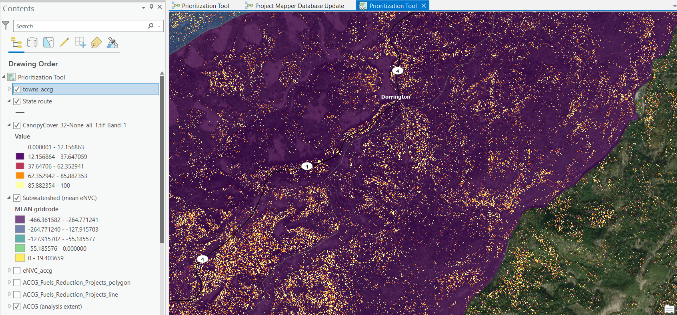
Project identification & prioritization options
Project Identification Framework: Community defense
In-need of maintenance projects
Shovel-ready projects
Focused assessment: SLAWG Tools + aerial imagery, LIDAR…
Future potential options: Further GIS Tool development

Slide 20
Online ACCESS TO PRODUCTS
ACCG Website: https://acconsensus.org/work-groups/slawg/
Questions: meganl.CHIPS@gmail.com

