Slide 1
MONITORING QUESTIONS: CHIPS Arnold-Avery Hazardous Fuels Reduction & Fuel Break Maintenance Project
March 10th, 2021
Presentation to ACCG Monitoring Work Group
Megan Layhee meganl.chips@gmail.com

Slide 2
Project specs
Jurisdiction: Calaveras RD, SPI, private parcels
Size: ~888 acres
Duration: present-Feb. 2024

Slide 3
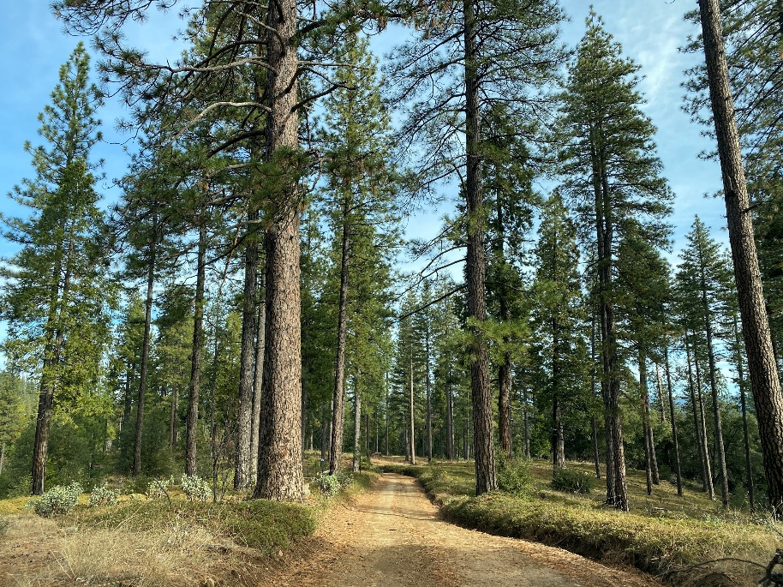
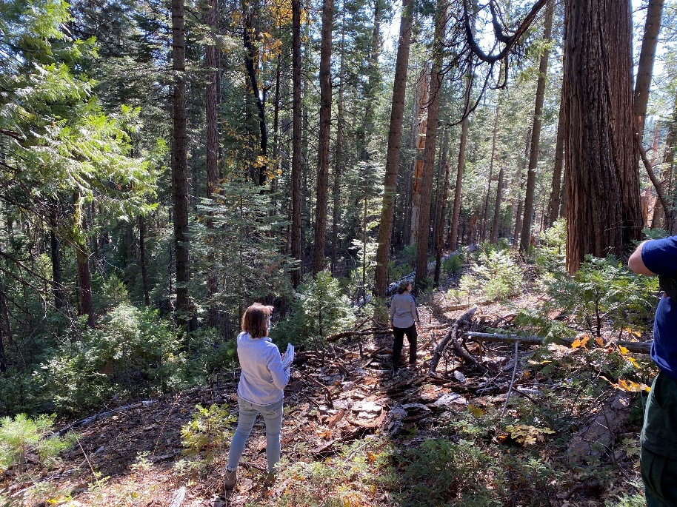
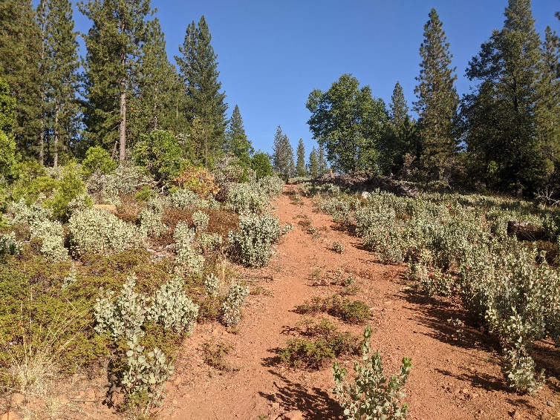
Project treatments
Private Parcel Fuelbreak maintenance/ construction units
FS Fuelbreak maintenance/ construction units
FS Fuels reduction Units
~506 acres
Live brush & tree (≤10” dbh) removal to 20x20-ft spacing, conifer & hardwood retention specs
All snags
Mechanical piles (for later burning by FS)
Hand thin, chip and/or pile (> 35% slopes)
Protected areas: LOPs, stream/SAF buffers, Arc sites, sensitive soil units
~312 acres
Live brush & tree (≤10” dbh) removal to 20x20-ft spacing, conifer & hardwood retention specs
All snags w/exception of 4 snags per acre
Mechanical piles (for later burning by FS)
Hand thin, chip and/or pile (> 35% slopes)
Protected areas: LOPs, stream/SAF buffers, Arc sites
~69 acres
Live brush & trees (≤10” dbh) to 20 to 30-ft spacing, conifer & hardwood retention specs
All snags
Hand thin/lop & scatter (> 40 % slopes)
Protected areas: stream buffers

Slide 4
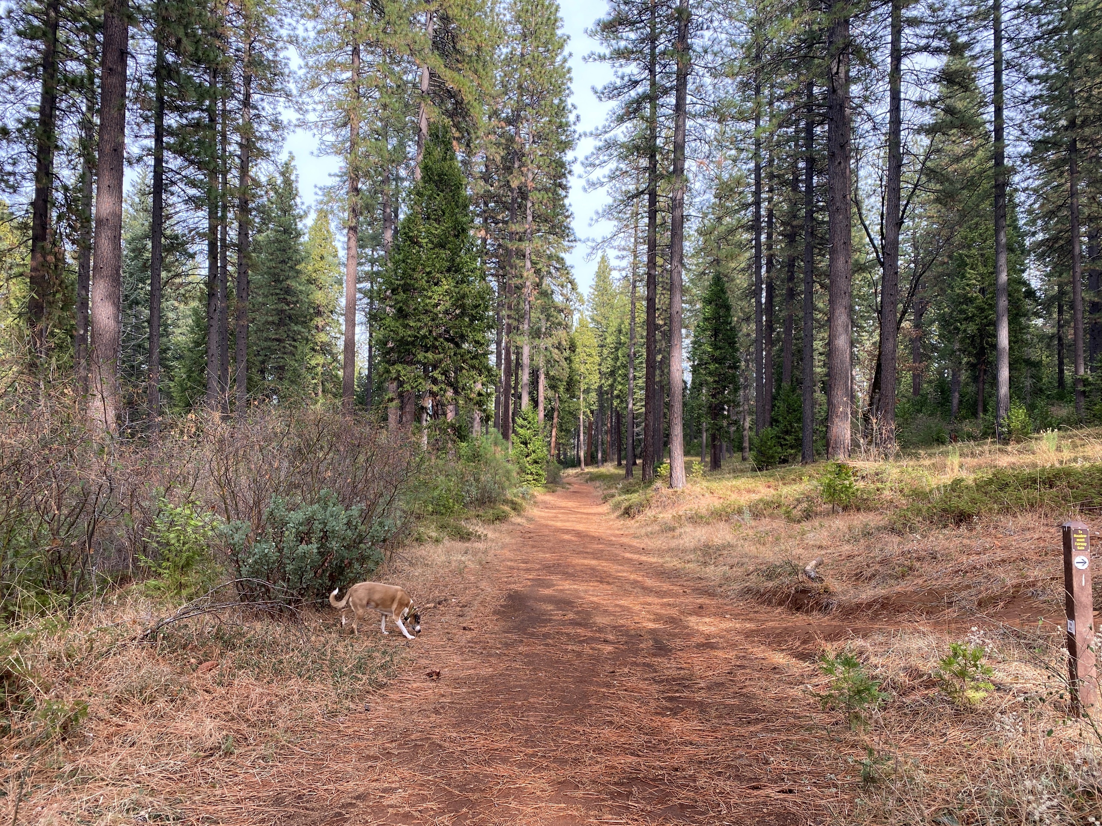
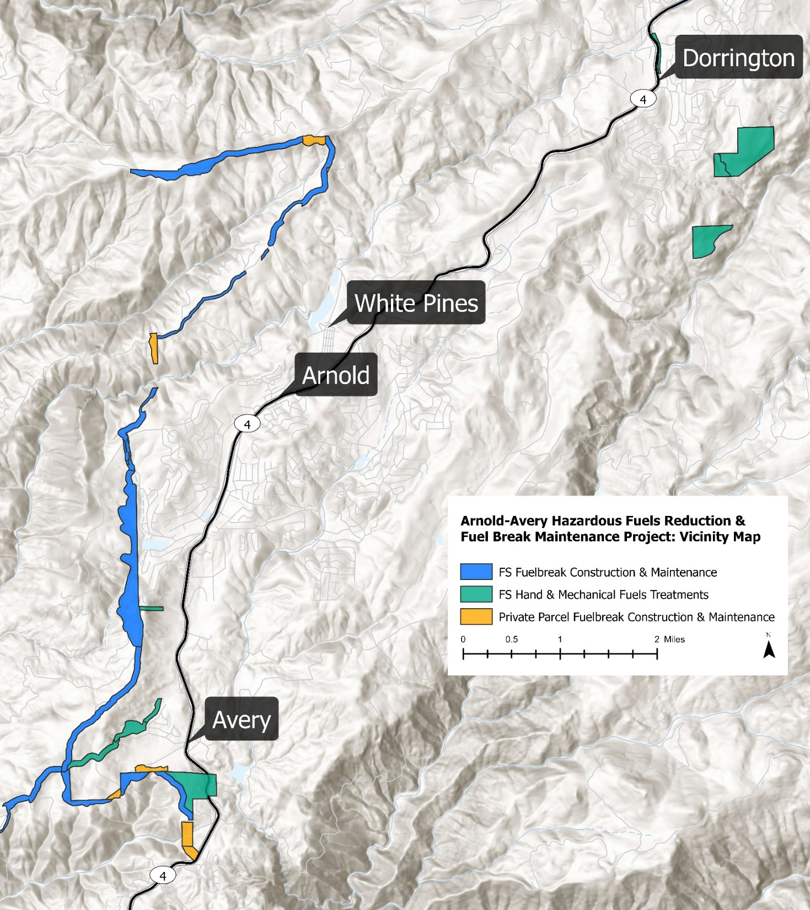
FS fuelbreak Units
construction
Maintenance

Slide 5
Fuel treatment data gaps
Efficacy of FBs
treatment design (size or intensity)
treatment type (mechanical, hand, mechanical + Rx fire*)
Treatment effect on ecological & social factors (see table to right, Kalies & Kent 2016)
*Rx Fire not part of CHIPS project implementation, FS has in-kind Rx fire treatments planned in project area.

Slide 6
relevant Monitoring strategy questions
Ecological Effectiveness Monitoring
Implementation Monitoring
Community Type | Monitoring Question | Monitoring Indicators | Monitoring Method
Fire and Fuels | How did fuel treatments meet the project goals and objectives? | Acres Treated, Fuel loading, height to live crown, Mortality, Canopy bulk density | Fuel Loading Surveys, Photo Points
Conifer Forest | How did treatments affect the tree density and species composition in all size classes? | Basal area, Trees per acre/density by size class and species | Vegetation Surveys
Soils | Are levels of detrimental soil disturbance and erosion increasing or decreasing with project treatments? | Abundance, Distribution/Extent | Rill Monitoring
Invasive Species | Are target invasive plants spreading throughout the Cornerstone area? | Number of invasive plants | Invasive Plant Surveys
Cultural Resources | Did restoration and conservation actions protect cultural resources from disturbance? | ? | ?
Was the project implemented as planned? (Num1, Obj 10.2)
Collaboration Monitoring
Was the collaborative successful at streamlining implementation and increasing pace and scale? (Q 2, Corn Obj 10.1-10.2)
Are the projects being implemented a higher quality than baseline? (Q 3, Corn Obj 10.1-10.2)
How effective is the collaboration in engaging the community interests to effectively increase trust and partnerships related to forest restoration practices? (Q 4, Corn Obj 10.1-10.2)
Socio-Economic Monitoring
What are the effects of the individual project in providing work for local forest contractors? (Q 9.3, Corn Obj 6)

