Slide 1
For Amador Calaveras Consensus Group Planning Group Meeting April 28, 2021 Richard Sykes, Executive Officer Karen Quidachay, Program Director Representing the Upper Mokelumne River Watershed Authority FOCUS: Upper Mokelumne Forest Projects Plan

Slide 2
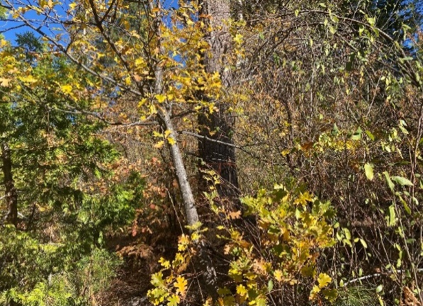
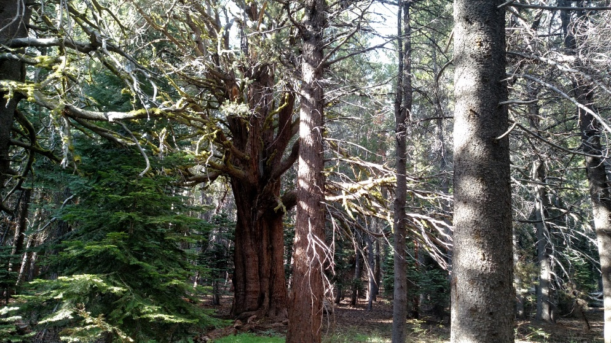
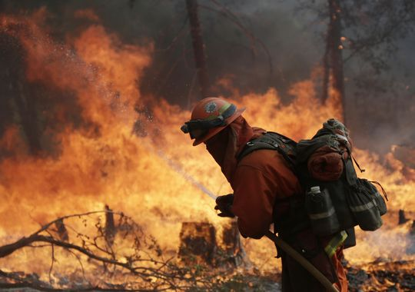
Urgent Need for Treatment
NASA states, “To put the carbon dioxide emissions from wildfires into perspective, September 2020 data from the Global Fire Emissions Database show that California wildfires in 2020 generated more than 91 million metric tons of carbon dioxide. That’s roughly 30 million metric tons more carbon dioxide emissions than the state emits annually from power production. (The Climate Connections of a Record Fire Year in the U.S. West – Climate Change: Vital Signs of the Planet (nasa.gov)).
Notes:
Karen’s notes: These photos depict dense growth on Amador and Calaveras Ranger Districts. We want to avoid catastrophic wildfires and protect wildland fire fighters.

Slide 3
Overview of UMRWA
UMRWA is a Joint Powers Authority (JPA) formed in 2000 to address mutual interests regarding:
Water quality
Water supply
Natural resources
8-member Board of Directors
Supported by a part-time Executive Officer, Landmark Environmental, and Member Agency in-kind support
Member Agencies
Alpine County
Alpine County Water Agency
Amador County
Amador Water Agency
Jackson Valley Irrigation District
Calaveras County
Calaveras County Water District
Calaveras Public Utilities District
East Bay MUD
Notes:
Karen

Slide 4
Forest Projects Plan – Background
This Project aims to:
Reduce the risk of catastrophic wildfires on as much ground as possible.
Prioritize locations of forest health projects.
Prepare NEPA/CEQA-ready fuels treatment projects as quickly as possible.
Prepare the upper Mokelumne watershed for substantial grant opportunities.
Continue to help contractors and local economy maintain and build capacity.
Notes:
Karen’s notes: All projects are within the National Forest, Amador and Calaveras Ranger Districts.
Grant funding has been or is expected to be allocated by the State for forest health/wildfire prevention projects over the next 5 years and beyond, consistent with the recent Wildfire and Forest Resilience Action Plan.

Slide 5
Forest Projects Plan – Background
Important Facts:
Grants preparedness means NEPA/CEQA-ready.
Number of eligible NEPA/CEQA-ready fuels treatment projects in the Mokelumne watershed is severely limited.
What is this project?
Landscape level, NEPA/CEQA planning project, minimum 10,000 acres
Phase 1 Focus - projects that can be implemented as soon as possible to take advantage of current funding opportunities and continue to help local contractors maintain and build capacity
Phase 2 Focus – Covers a much bigger area and includes areas that require more evaluation and time to complete planning.
Notes:
Karen’s notes: These grant programs give preference and priority to projects with completed NEPA/CEQA.
minimum 10,000-acres,

Slide 6
The FPP and ACCG’s Guidance Documents?
Phase 1, UMWRA proposes treatment types considered by ACCG guidance documents to be “mutually agreeable”.
Phase 2, UMWRA proposes treatment types considered by ACCG guidance documents to be primarily “mutually agreeable” with some “mostly agreeable”.
Notes:
Phase 2 treatments modeled after Prather-Medusa EA which is considered a successful planning project. There may be some specific areas where it is considered in the best interest of forest habitat to prescribe removal of fuels up to 30 inches dbh. The purpose and need for these treatments will be described in the EA.

Slide 7
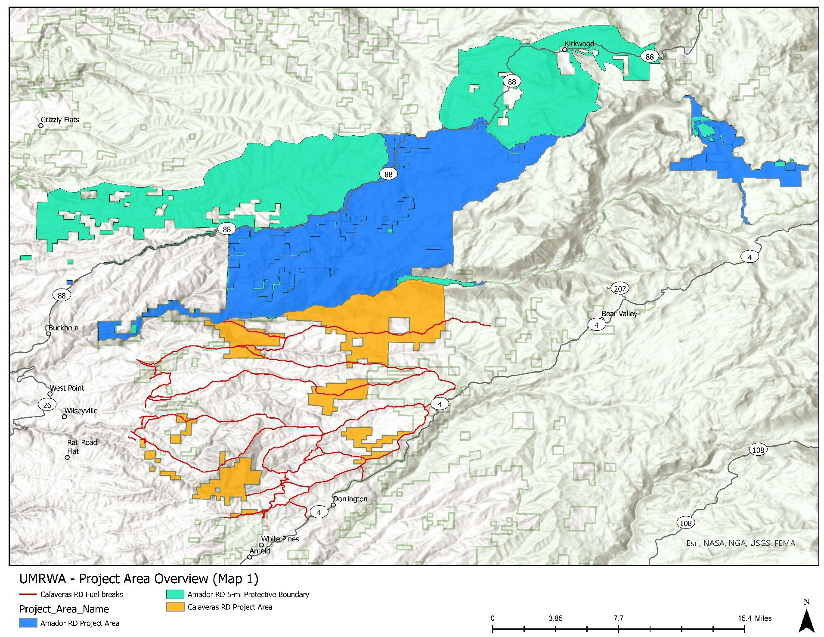
Project Area Overview
Notes:
Possible help from Megan

Slide 8
Overview of Forest Projects Plan Proposed Phase 1 Treatment Types
The proposed FPP utilizes the ACCG GIS Mapping Tool to identify priority areas that are most in need of fuels treatments and require the least amount of time consuming and costly field surveys (e.g., areas previously field surveyed for sensitive biological organisms).
Amador Ranger District
Mastication
Hand thinning small trees
Fuel breaks and thinning treatments that don’t substantially alter the habitat as defined by Sierra Nevada Forest Plan Amendment (requires fewer field surveys/analysis)
Aspen restoration
Meadow restoration
Prescribed burning (to be implemented by FS)
Calaveras Ranger District
Primarily focused on Phase 2. Field surveys to be initiated ASAP (depending on funding).
Notes:
Karen/Richard with help from Carinna and Jesse

Slide 9
Overview of Forest Projects Plan Proposed Phase 2 Treatment Types
Calaveras Ranger District
Fuels treatment types will be modeled after Prather-Medusa NEPA Environmental Assessment (includes fuel treatments allowed under the Sierra Nevada Forest Plan Amendment).
Aim to cover large landscape – as much of the watershed as possible.
Plan is for use of facilitated scope development including stakeholder sub-committee group to include ACCG members.
Amador Ranger District
Primarily focused on Phase 1/to be determined.
Notes:
Richard with help from Carinna and Jesse

Slide 10
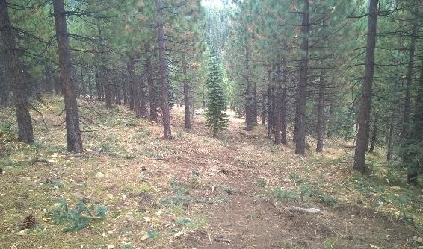
NEPA and CEQA Compliance
Please note, as the NEPA lead agency the Forest Service will determine NEPA compliance requirements. As the CEQA lead agency UMRWA will determine CEQA compliance requirements.
Amador Ranger District
NEPA compliance is expected to be completed under a CE/Decision Memo (36 CFR § 220.6).
CEQA Compliance is expected to be completed under a statutory exemption (PRC Section 4799.05(d)
Calaveras Ranger District
NEPA compliance is expected to be completed under an CE/Decision Memo (36 CFR § 220.6) and possibly an EA.
CEQA Compliance is expected to be completed under a statutory exemption (PRC Section 4799.05(d).
Notes:
Karen talking points – PRC Section 4799.05(d) is AKA Senate Bill 901 which was recertified in mid-April 2021).

Slide 11
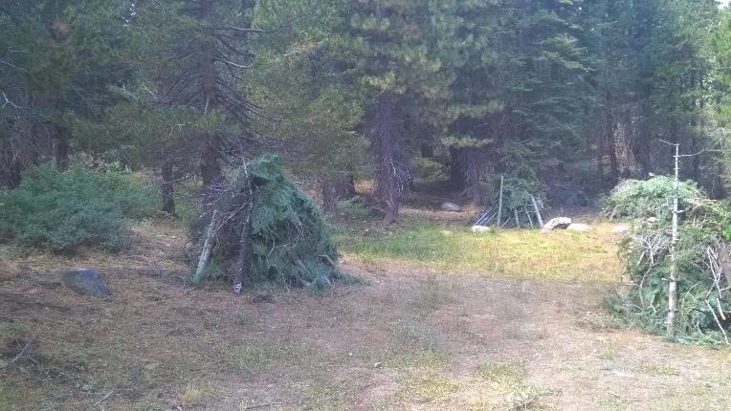
Phase 1 - Schedule and Timing
UMRWA aims to complete the NEPA/CEQA process on 5,000 to 10,000 acres within 6 months to one year (starting from grant agreement execution).
These acres will likely fall under a NEPA CE/Decision Memo and will not substantially alter the existing habitat but will protect existing habitat from wildfire to the extent possible.
This NEPA/CEQA clearance will allow eligibility for implementation funding as-soon-as-possible.
Notes:
Karen/Richard to introduce and need help from Chuck and Jesse.

Slide 12
Phase 2 Schedule and Timing
Phase 2 will begin as soon as funding is secured.
Completion is expected to take 2 to 3 years.
Expect to provide regular updates to the ACCG Planning Committee and seek full ACCG support for the projects and NEPA/CEQA.
Plan is for use of facilitated scope development including stakeholder group that will include many ACCG members.
Aim is to cover large landscape – 50,000 acres or more.
Notes:
Richard

Slide 13
Status of Budget and Grant Applications
UMRWA has committed $50,000 towards the FPP plus the costs to prepare grant applications.
On February 1, 2021 UMRWA submitted a grant application to the Sierra Nevada Conservancy. UMRWA anticipates the SNC staff will recommend a $200,000 Award at the June 2021 SNC Board Meeting.
On February 19, 2021, UMRWA submitted a grant application to the CDFW for $472,000 in Prop 1 grant funding. UMRWA’s application was one of 128 submitted requesting a combined $178M with about $285M available. UMRWA awaits a decision from CDFW.
UMRWA intends to apply for additional funding from CalFire for a Forest Restoration planning/implementation grant for up to $5 million. Grant application is due May 19, 2021.
UMRWA anticipates additional funding committed over time from the Forest Service. UMRWA anticipates substantial support from the USFS for archeological and biological surveys as well as forestry and fuels management.
Notes:
Karen; 5th bullet is just a starting point and we expect additional financial support in the coming years.

Slide 14
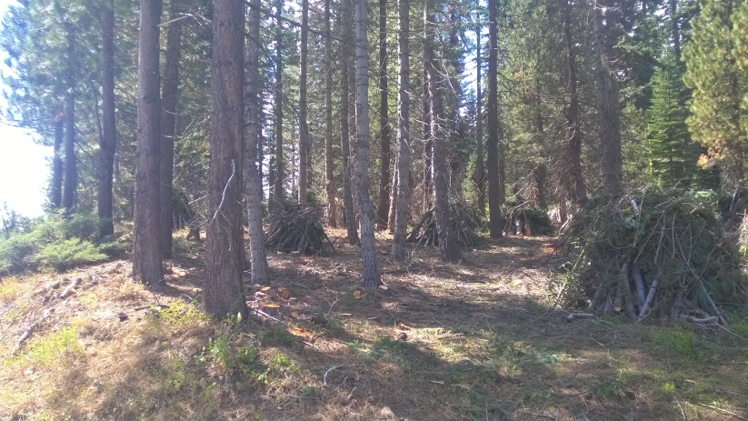
What we Need from ACCG?
We seek to inform ACCG of our efforts and receive regular feedback.
At this time, UMRWA is looking for general support for the overall goals and intentions of this proposed project.
We will communicate clearly, remain transparent and will keep all stakeholders and interested parties apprised of our efforts. We request the groups patience and understanding of our tight timeline and limited budgets.
A Letter of Support for the CalFire grant application is appreciated if it can be accomplished in the timeframe allowed.
Notes:
Richard and Karen; Provide ample time for question and answers.

