Slide 1
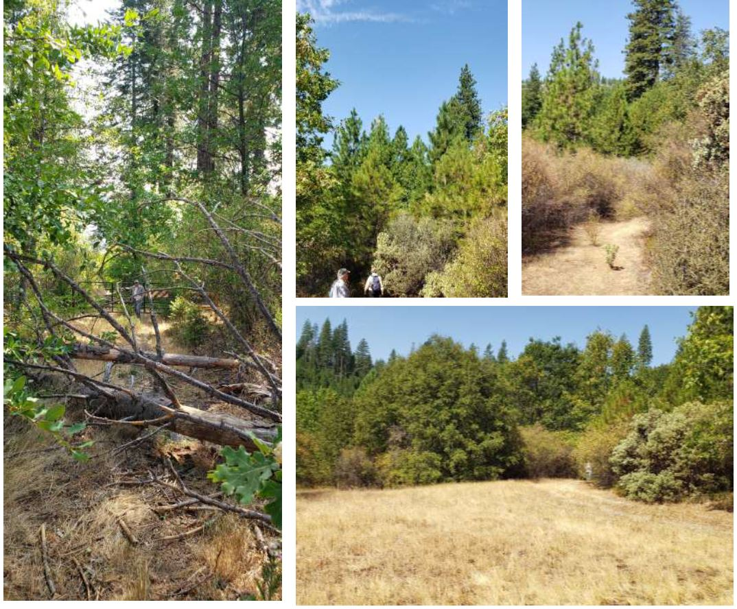
McKays Strategic Fuelbreak
A collaborative project with the Calaveras County Resource Conservation District (RCD), Calaveras Amador Forestry Team (Cal Am Team) and the USFS

Slide 2
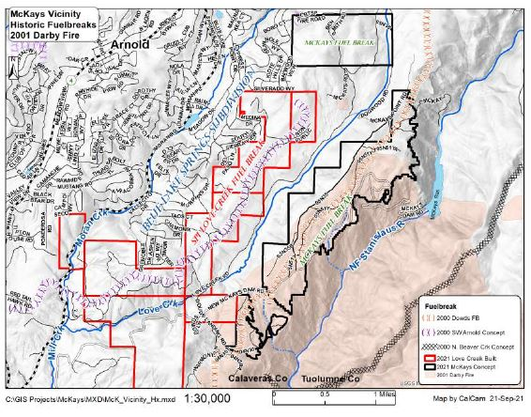
McKays Strategic Fuelbreak
Project Goal
Protect the Hwy 4
  communities against wildfire
Project Objectives
Restore the historic Mckays fuelbreak (1088 acres)
To extend and connect the multi-jurisdictional cooperative fuelbreak
Notes:
Just a little background – Mckays is highlighted in black has been actively managed since 1995.
Brown Darby EIS includes 17,000
Treatments – included hand thinning, prescribed fire, mastication, biomass removal, commercial thinning and salvage logging
In recent years we’ve tried tried to maintain the fuelbreak

Slide 3
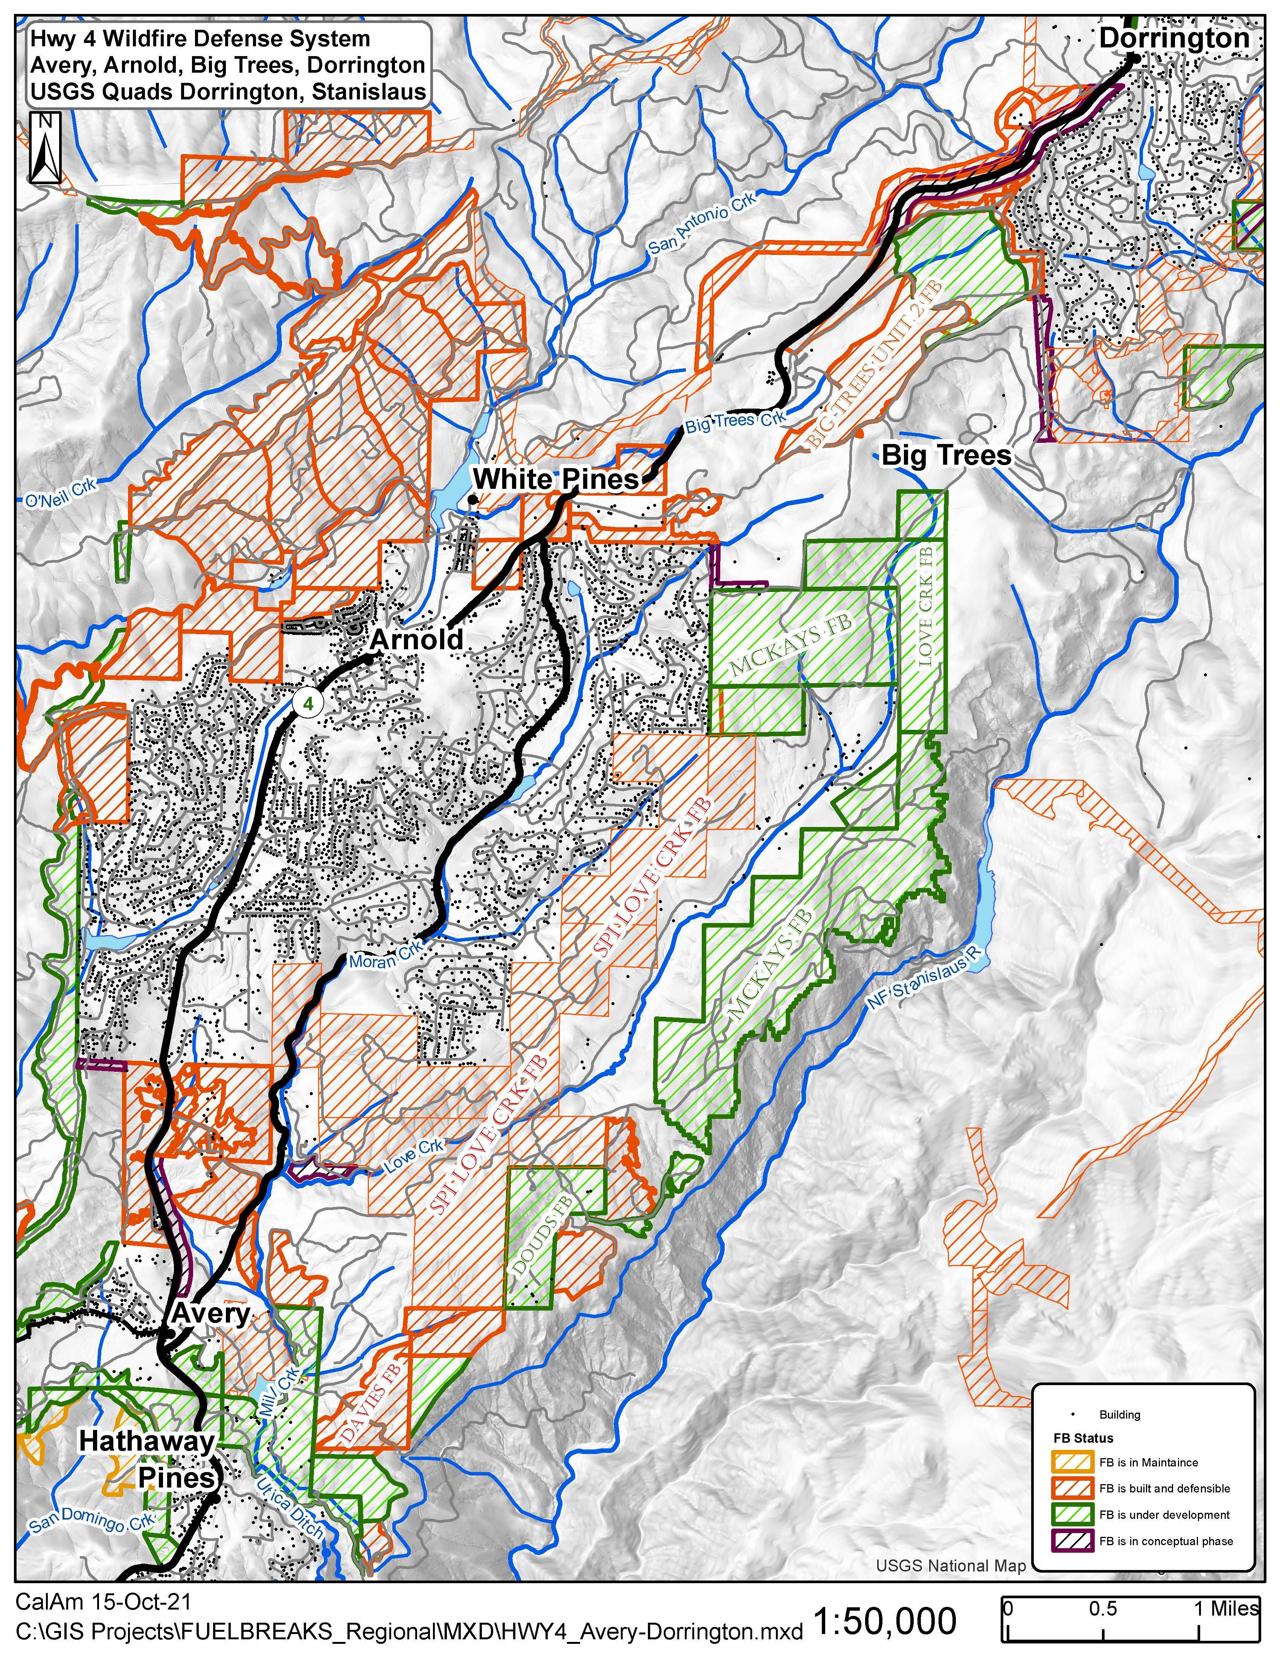
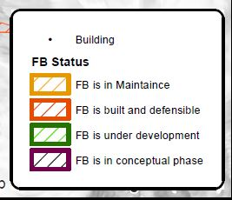
Highway 4 Wildfire Defense System
 | Acres
Owner | Concept | Under Development | Built & Defensible | Total
FS, CCWD, Private | 706 | 4,055 | 3,661 | 8,422
SPI | 194 | 237 | 2,473 | 2,904
TOTALS | 900 | 4,292 | 6,134 | 11,326
20 Miles of Fuelbreak from Vallecito to Camp Connell
Hwy 4 Fuelbreak Status

Slide 4
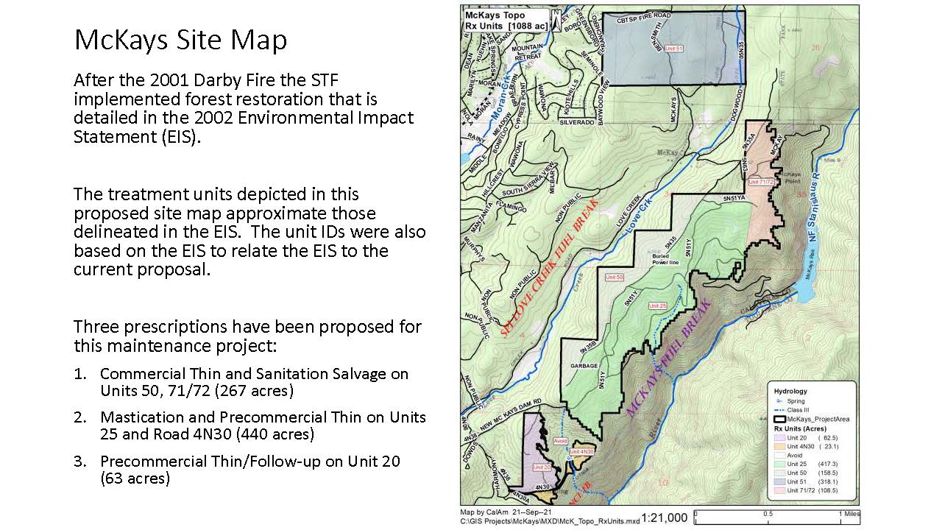
The main treatments that have been proposed for this maintenance project:
Mastication, precommercial thinning, biomass removal and salvage.

Slide 5
McKays Strategic Fuelbreak
General Project Area:
Elevation Range: 3700-4480 feet
Acres: 1088
Treatments: Mastication, Precommercial Thinning, Biomass Removal, Salvage
Aspect: Ridgetop, Southeast and Northwest
Slopes: Flat on center ridgeline to 55%. Project Area is <40% slope.
Roads: McKays Dam Road
Equipment Capability/Limitations: None – borrow pit in Section 3 provides large equipment base
Landings: Multiple
Watercourses: Multiple swales and two intermittent (Class III) drainages
Existing Conditions:
Overcrowded Sierra mixed conifer stand
  High-density ground and ladder fuels
Overstory
  Ponderosa pine
  Sugar pine
  Incense Cedar
  white fir
Midstory
  Black and Live oak
  Bigleaf Maple
  Dogwood
  red alder
Understory
  Deer brush
  White & Green leaf manzanita
  poison oak
  bear clover
Noxious weeds: Yellow Star Thistle

Slide 6
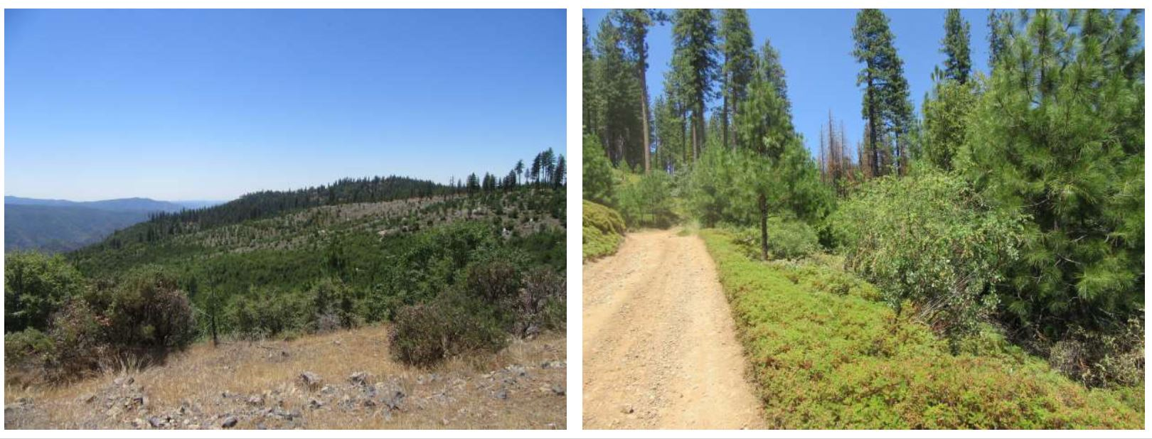
McKays Strategic Fuelbreak

Slide 7
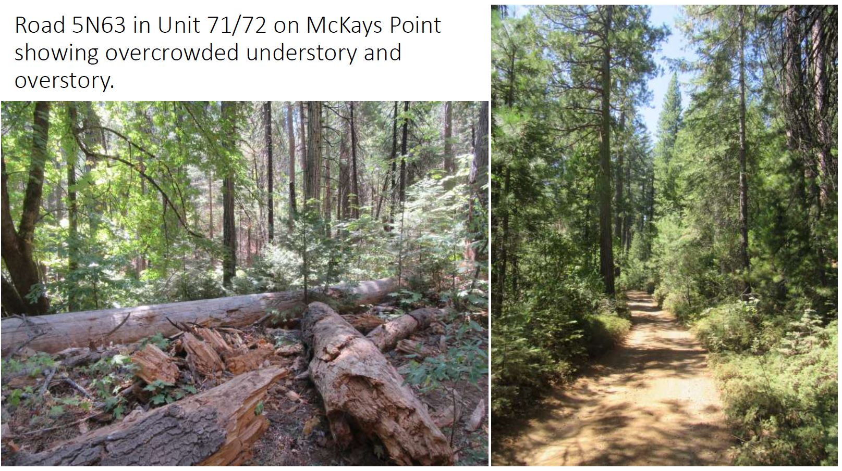
McKays Strategic Fuelbreak

Slide 8
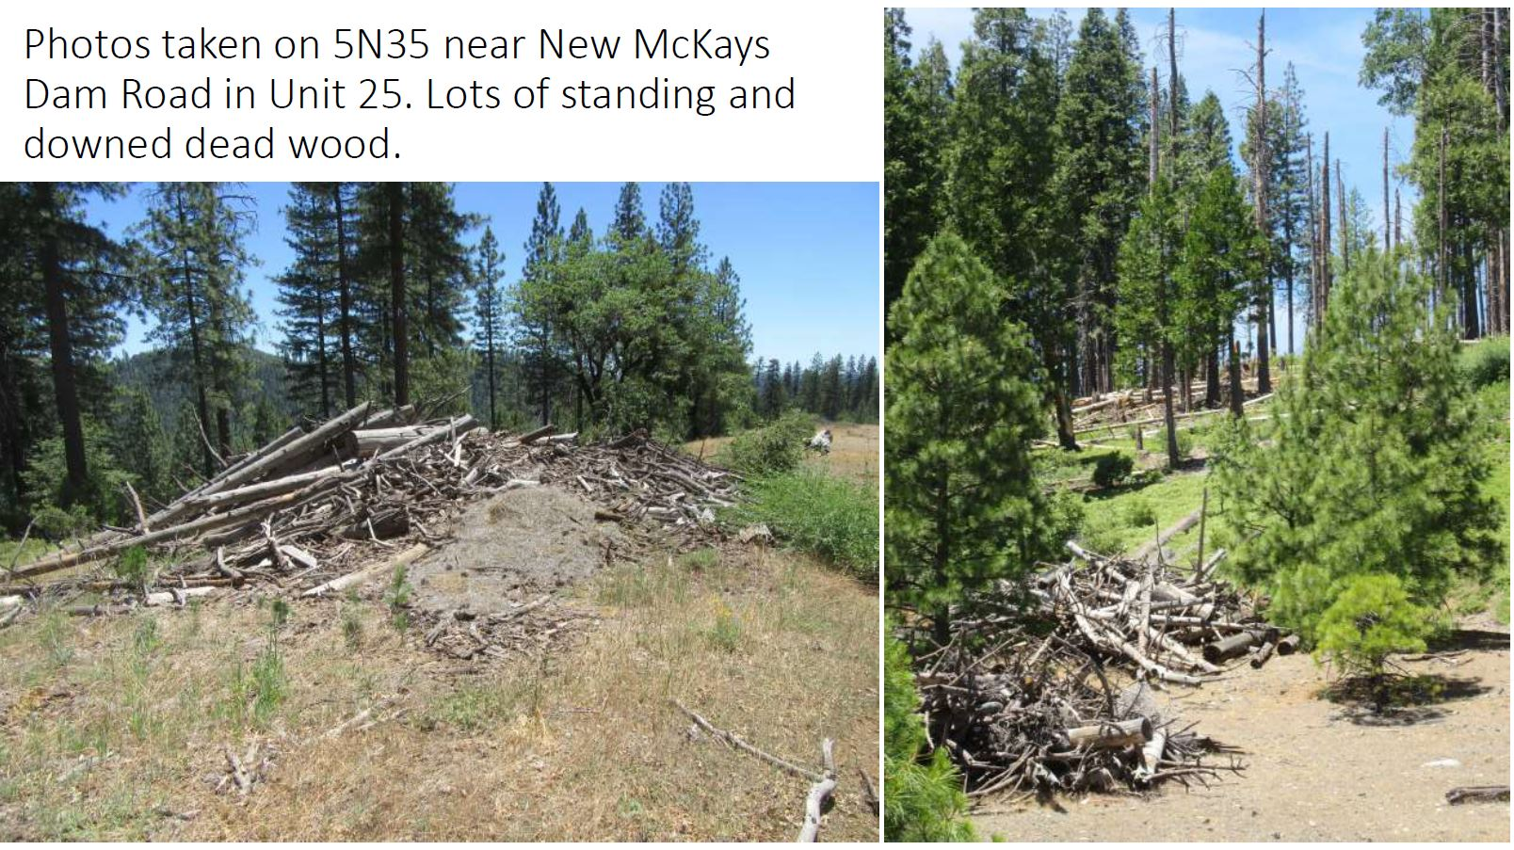
McKays Strategic Fuelbreak

Slide 9
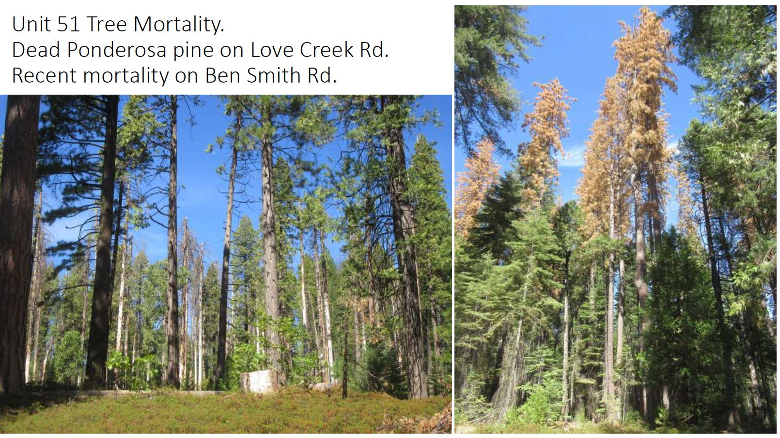
McKays Strategic Fuelbreak

Slide 10
Questions?

