Slide 1
Summary of the Forest Projects Plan January 19, 2022 Richard Sykes Karen Quidachay Megan Layhee Presented to the Amador Calaveras Consensus Group
Notes:
Richard: Intro --
UMRWA 4-year history of forest health projects, but at point NEPA coverage cornerstone work is complete (other than harvest projects). UMRWA want to expand and needs 1) projects with NEPA coverage and 2) clear plan at large scale with priorities and a strategy
UMRWA’s plan is to work with ACCG, Planning Workgroup and other stakeholders throughout.

Slide 2
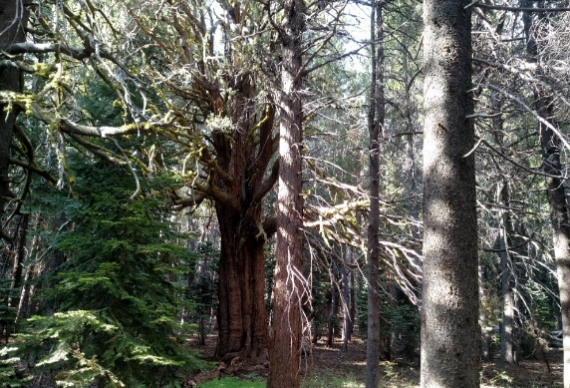
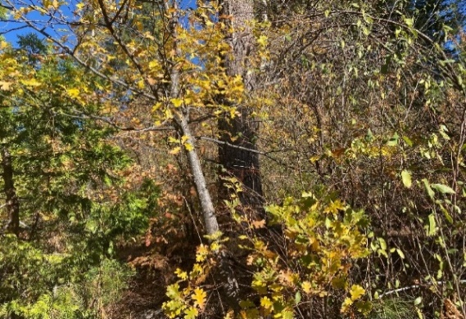
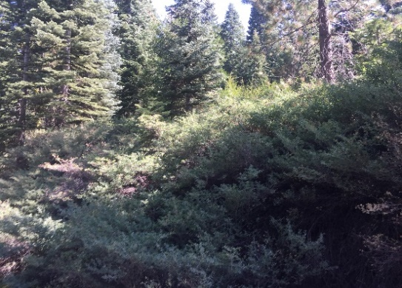
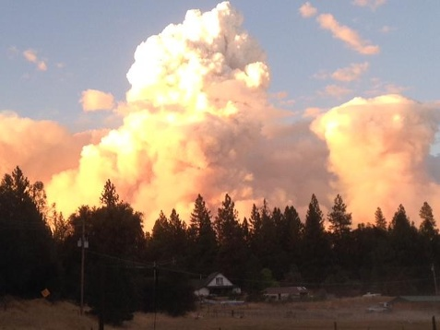
This Project aims to:
Improve forest health and habitat and reduce the risk of wildfires on as much ground as possible in the Mokelumne watershed.
Prioritize locations of forest health projects.
Prepare NEPA/CEQA-ready fuels treatment projects as quickly as possible.
Prepare the upper Mokelumne watershed for substantial grant opportunities.
Continue to help contractors and local economy maintain and build capacity.
Notes:
Karen’s notes: All projects are within the National Forest, Amador and Calaveras Ranger Districts.
Grant funding has been or is expected to be allocated by the State for forest health/wildfire prevention projects over the next 5 years and beyond, consistent with the recent Wildfire and Forest Resilience Action Plan.

Slide 3
Forest Projects Plan – Background
Our Strategy and Approach:
Landscape level, NEPA/CEQA planning project, in two phases:
Phase 1 Focus - treatments that can be implemented as soon as possible, and are independent of commercial timber value. These treatments are designed to take advantage of current grant funding opportunities on a fast-track.
Phase 2 Focus – Covers a much bigger area and includes areas that require more evaluation and time to complete planning.
Notes:
Karen’s notes: These grant programs give preference and priority to projects with completed NEPA/CEQA.
minimum 10,000-acres,

Slide 4
Overview of Forest Projects Plan Proposed Phase 1 Treatment Types
The proposed FPP utilizes the ACCG GIS Mapping Tool to identify priority areas that are most in need of fuels treatments and require the least amount of time consuming and costly field surveys (e.g., areas previously field surveyed for archaeological resources).
Amador Ranger District
Mastication (to the extent possible, slopes up to 40%)
Hand thinning small trees
Fuel breaks and thinning treatments that don’t substantially alter the habitat as defined by Sierra Nevada Forest Plan Amendment (requires fewer field surveys/analysis)
Aspen/meadow restoration
Prescribed burning (to be implemented by FS)
Calaveras Ranger District
Mastication (to the extent possible, slopes up to 40%)
Primarily focused on Phase 2.
Notes:
Richard with help from Carinna and Jesse
Amador – appears to have a number of projects that are simple with regards to NEPA (require less analysis)
Calaveras – needs surveys and analysis for projects, longer time frame

Slide 5
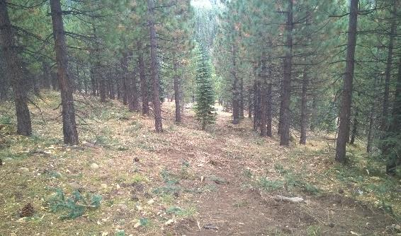
NEPA and CEQA Compliance
As the NEPA lead agency, the Forest Service will determine NEPA compliance requirements. As the CEQA lead agency, UMRWA will determine CEQA compliance requirements.
Phase 1
NEPA compliance is expected to be completed under a CE/Decision Memo or Environmental Assessment (36 CFR § 220.6).
CEQA Compliance is expected to be completed under a statutory exemption (PRC Section 4799.05(d)
Phase 2
NEPA compliance is expected to be completed under an EA or EIS.
CEQA Compliance is expected to be completed under a statutory exemption (PRC Section 4799.05(d).
Notes:
Karen talking points – PRC Section 4799.05(d) is AKA Senate Bill 901 which was recertified in mid-April 2021).

Slide 6
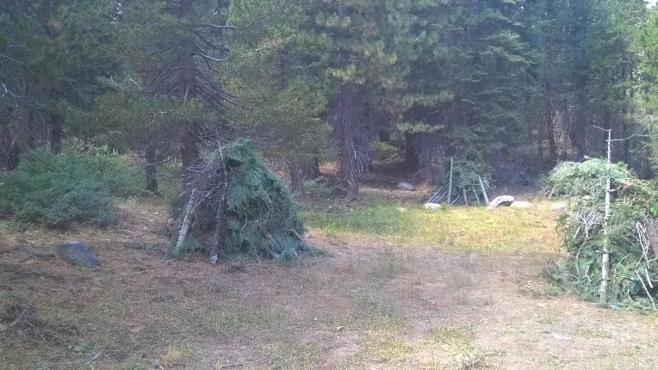
Phase 1 - Schedule and Timing
UMRWA aims to complete the NEPA/CEQA process on a minimum 10,000 acres this fall or winter. Target Date September 2022 for a CE/DM and February 2023 for an EA.
Notes:
Karen/Richard to introduce and need help from Chuck and Jesse.

Slide 7
Phase 2 Schedule and Timing
Phase 2 will builds on Phase 1 as will proceed as fast as funding allows. With funding completion is expected to take 2 to 3 years.
Expect to provide regular updates to the ACCG Planning Committee and seek full ACCG support for the plan and projects and NEPA/CEQA.
Plan is for use of facilitated scope development including stakeholder group that will include many ACCG members.
Aim is to cover large landscape – 100,000 acres or more.
Notes:
Richard

Slide 8
Status of Budget and Grant Applications
UMRWA has committed $100,000 towards the FPP plus the costs to prepare grant applications.
On June 22, 2021 UMRWA executed a grant agreement with the Sierra Nevada Conservancy for $200,000.
UMRWA has verbal approval for an additional $300,000 from SNC for Phase 1 (application submitted 12/28/2021).
UMRWA intends to apply for additional funding from CalFire for a Forest Health Grant for about $5 million for planning/implementation.
So far the US Forest Service has committed $135,000. UMRWA anticipates substantial support from the USFS for archeological and biological surveys as well as forestry and fuels management for Phase 2.
UMRWA continues to search for additional grant funding opportunities.
Notes:
Richard; 5th bullet is just a starting point and we expect additional financial support in the coming years.

