Slide 1
UMRWA Forest Projects Plan
ACCG Planning Work Group
Wednesday, March 23, 2022

Slide 2
Purpose of today’s discussion
Review and discuss major input/feedback received to-date from the ACCG.
Discuss the scale of Phase 1.
Discuss potential framework for treatment area prioritization.
Get any additional input on Phase 1.
Discuss next steps.

Slide 3
ACCG Feedback
Goal statement:
updated language to make clear that larger trees (up to 30” dbh) may be removed in aspen stands and that these aspen stand treatments are non-commercial restoration efforts, not focused on commercial thinning.
Proposed action:
Several modifications and additions made based on feedback received, refer to the revised proposed action.
One comment received that we will discuss today – detailing the framework used for treatment area prioritization.
Phase 1 scale:
Potential controversy over too large of a project area, and what the appropriate project size should be for the environmental documentation type (e.g., CE).

Slide 4
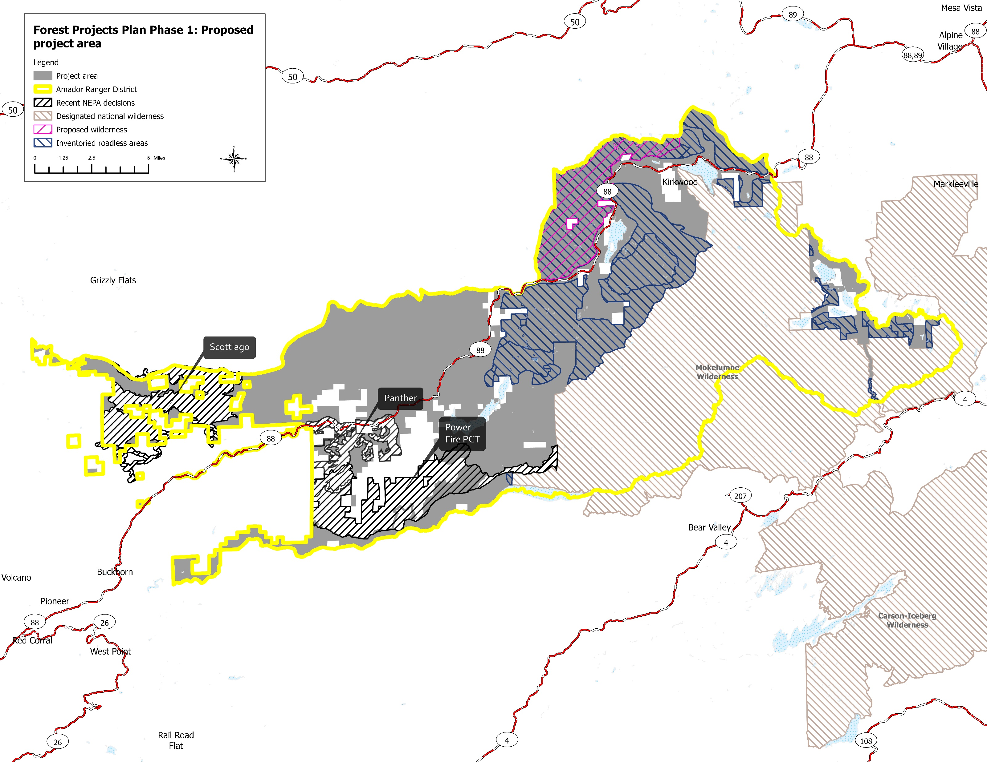
Proposed project area = 101,176 ac
-- Target project area: entire Amador RD, outside private inholdings & designated wilderness, & generally outside of the following recent NEPA decisions- Scottiago, Panther, Power Fire Pre-commercial Thin. Project area does overlap inventoried roadless (35% of project area) & proposed wilderness areas (9%), & is within 3 HUC-8 watersheds and 4 counties.
-- Goal: provide max planning coverage for flexibility in where fuels reduction treatments are implemented, for Rx burning and hand thinning treatments in particular. Realizing FS capacity may increase considerably in the coming years (e.g., Forest Resilience Initiative).
Notes:
Notes: Remove map

Slide 5
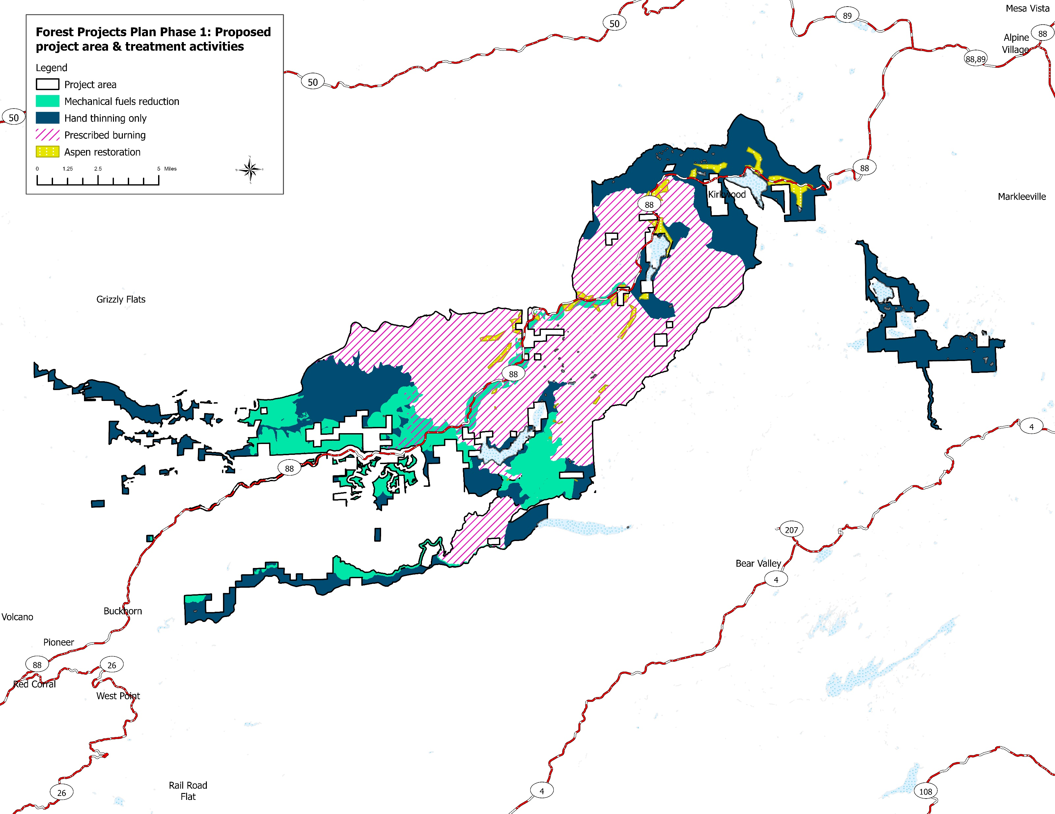
Proposed treatment activities
Treatment activity | Estimated acres
Mechanical fuels reduction* (33%ª, 67%^{b}) | 11,513
Mechanical fuels reduction* (20%ª, 80%^{b}), prescribed burning | 3,014
Hand thinning only | 35,913
Prescribed burning** | 48,421
Aspen restoration | 1,082
Aspen restoration, prescribed burning | 1,233
Total project acres | 101,176
*: Hand thinning will be utilized in these areas wherever mechanical fuels reduction treatments are determined to not be suitable based on field reconnaissance.
**: Hand thinning, as a pre-treatment to Rx burning, is an option in these areas.
ª: Confirmed Arch survey coverage = adequate Arch survey coverage.
^{b}: Conditional Arch survey coverage = Arch survey adequacy is unknown at this time or area is lacking Arch survey coverage.

Slide 6
Proposed treatment area prioritization framework
Mechanical fuels reduction: refer to handout 07 (e.g., WUI, wildfire risk, LiDAR-derived canopy and ladder fuel metrics).
Hand thinning: prioritization has not occurred, identified anywhere on the district where no other treatment type was proposed. Potentially prioritize based on framework used for MFR.
Prescribed burning: FS specialist direction.
Aspen restoration: FS specialists identified approximate stand locations using spatial analyses and expert knowledge. (Note: spatial and field-based aspen assessment on the district to occur pending WCB grant award).
*Also, engage with ACCG Planning WG on framework.

Slide 7
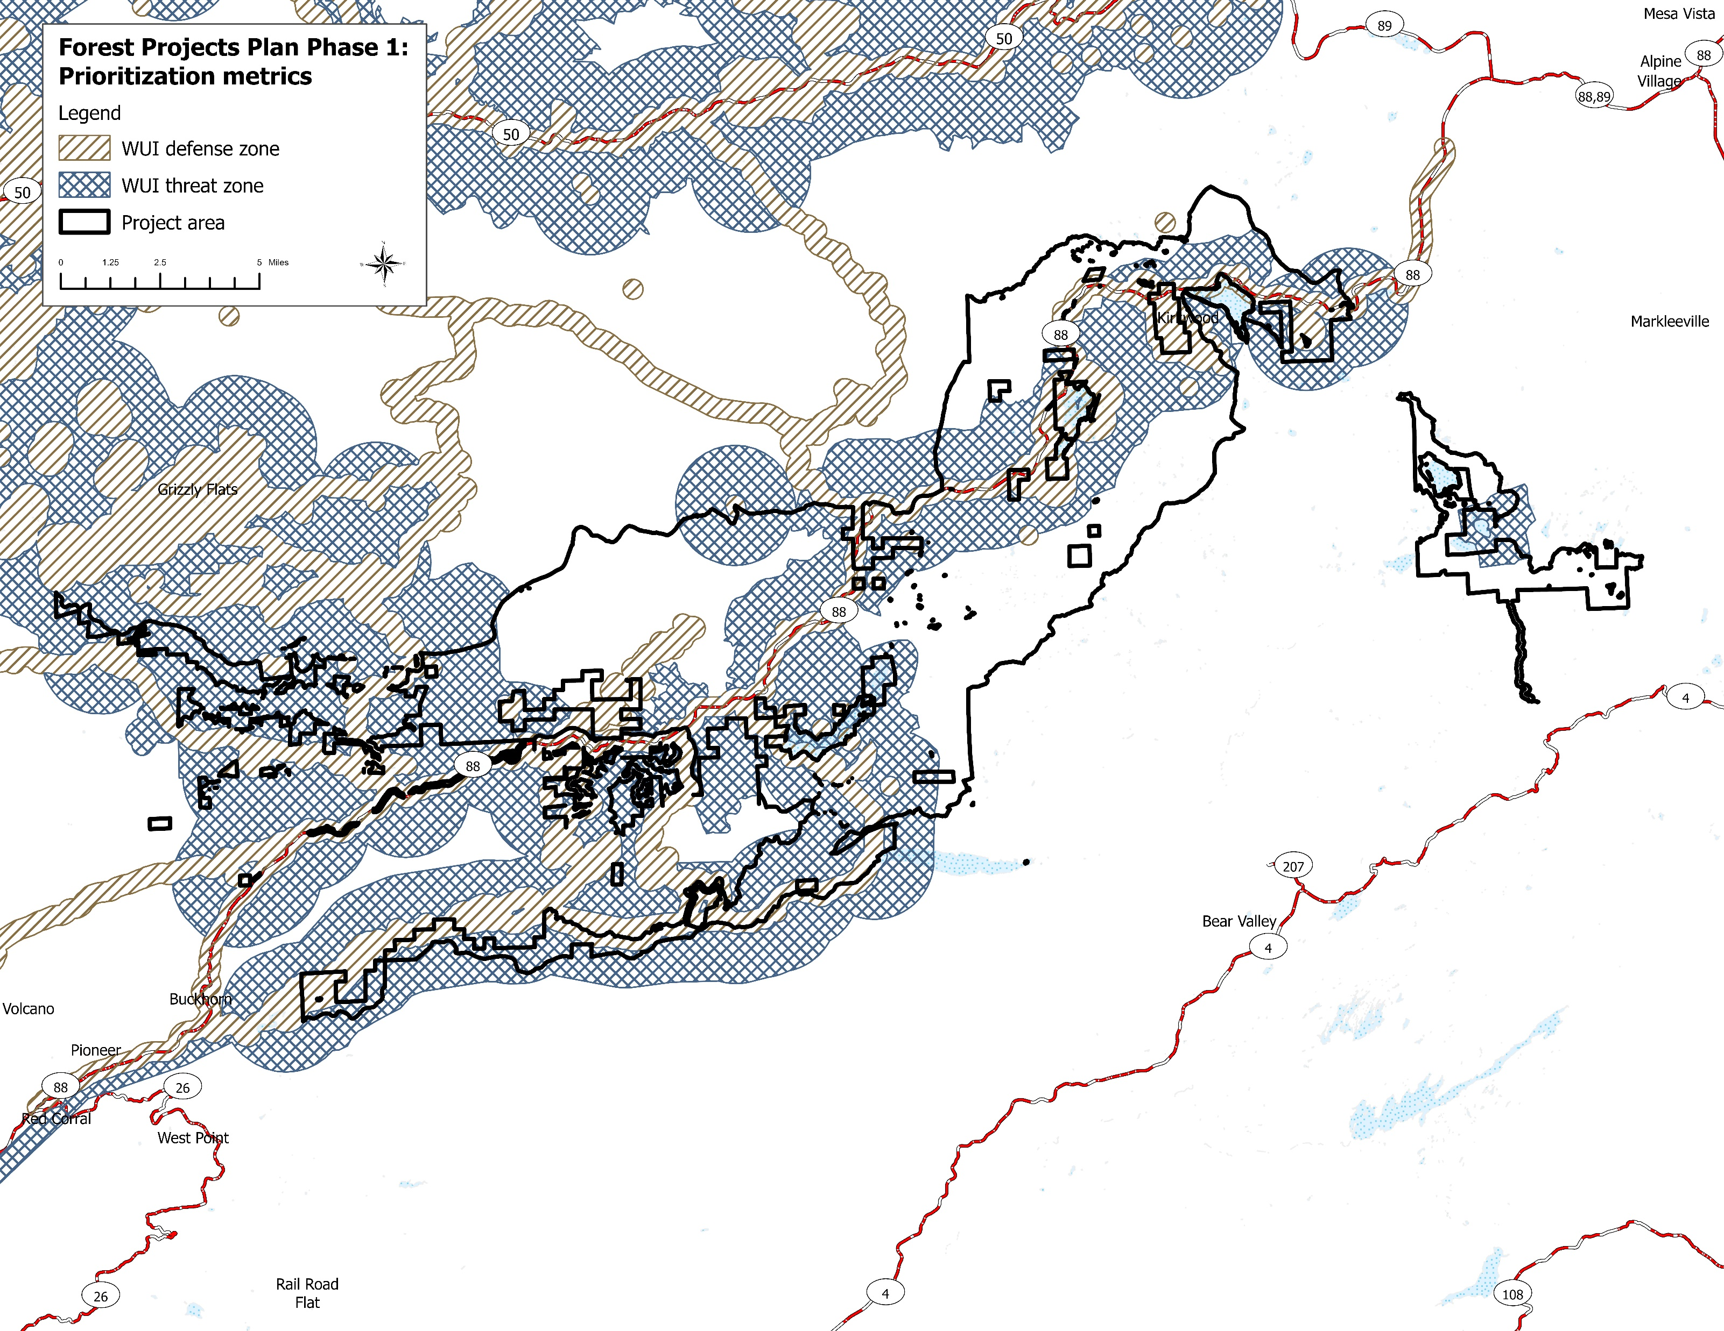
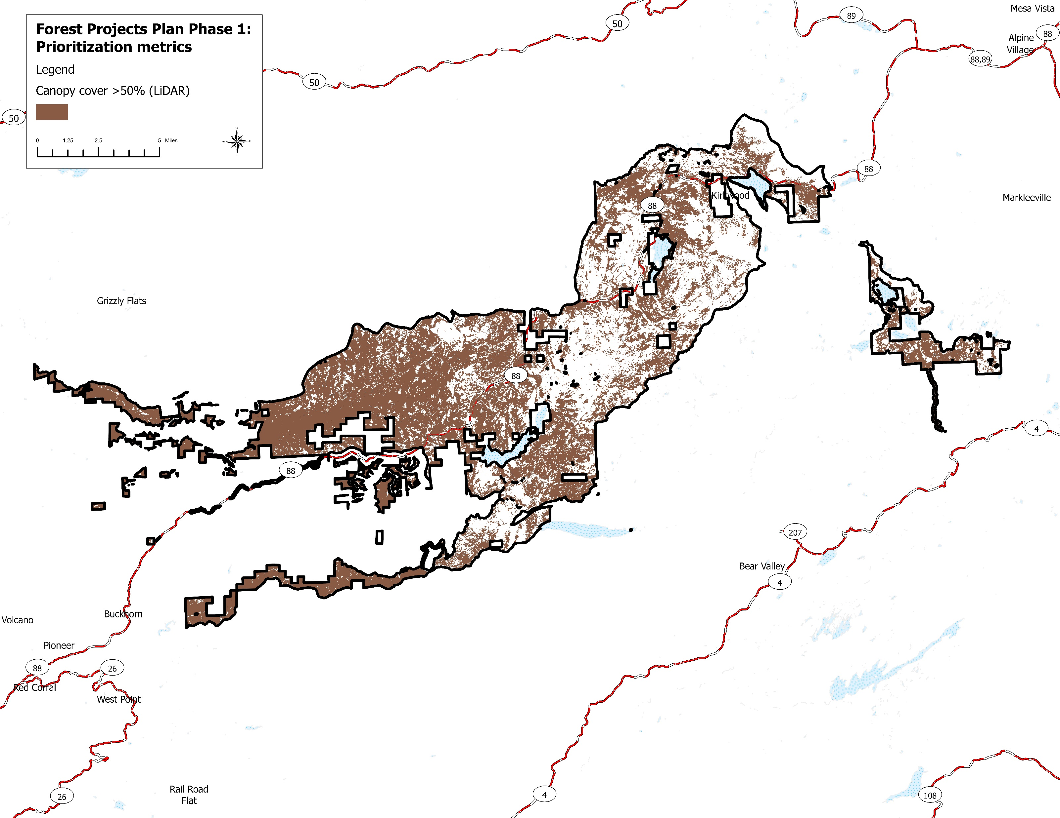
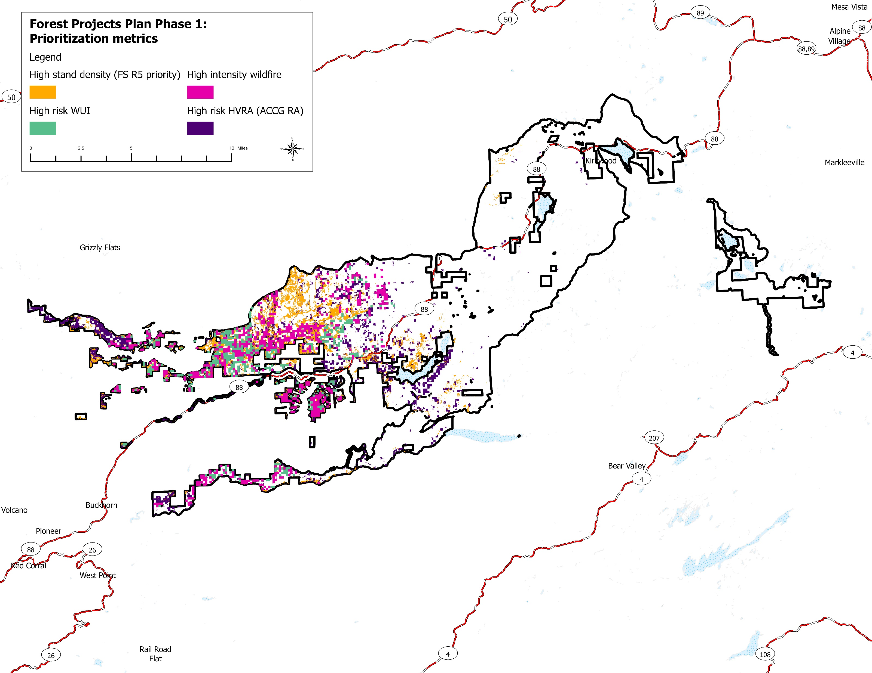
Percent canopy cover (LiDAR)
WUI zones
*Note: LiDAR products still pending from UW, Forest Resilience Lab: % canopy cover by stratum (1-2m, 2-4m, 4-8m), canopy base height, basal area, TAOs per hectare, resilience departure index.
High risk areas
Notes:
Notes: Remove map

Slide 8
Schedule
PHASE 1 TASKS | TIMELINE
Finalize Proposed Action and Treatment Area Maps for Public Scoping | March 25, 2022
Public Scoping | April 15 to May 15, 2022
Sign contracts with resource specialists | May 30, 2022
Initiate archaeological field surveys | June 15, 2022
Compile draft and Final Wildlife Biological Evaluation (BE), Botanical BE and Cultural Resources Reports | June 1, 2022 to September 1, 2022
Achieve consensus support from ACCG* | September 21, 2022
If Categorical Exclusion/Decision Memo and CEQA CE Notice of Exemption | Execute October 2022 to December 2022
If Environmental Assessment/Decision Notice | Execute March 1, 2023
*: Continued engagement with ACCG Planning Work Group on Phase 1 prior to this date.

