Slide 1
Eldorado National Forest Resilience Strategy
Introduction to ACCG
Jeff Marsolais
ENF Forest Supervisor
Randy Striplin
Resources Staff Officer
18 May 2022

Slide 2
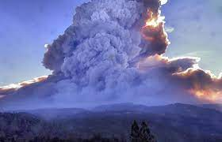
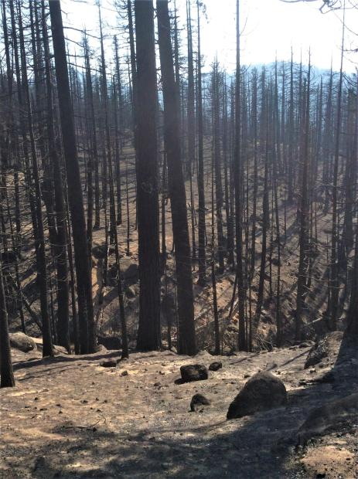
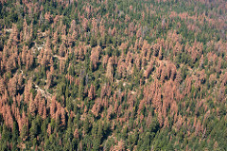
Background and Introduction
The situation
The consensus — scientific, political, collaborative
The urgency — delay only defers the imminent
The big picture — holistic approach
Caldor Fire, photo from: https://www.mtdemocrat.com/news/structures-destroyed-caldor-fire-grows-to-6500-acres/
Central Sierra tree mortality, photo from USDA Forest Service
Caldor Fire high severity, photo from InciWeb
Notes:
Last few years conditions seemed to have accelerated bad wildfire outcomes
National, regional, state, and local level efforts to ramp up pace and scale:
The National Cohesive Wildland Fire Management Strategy
Forest Service Wildfire Crisis Strategy
California’s Wildfire And Forest Resilience Action Plan
the California Stewardship Agreement and
the California Fire MOU
How many more similar fire seasons can the forests take?
Big fast fires. Millions of trees killed by drought and beetles within a few years. We must act fast and act big—commensurate with the threat

Slide 3
VIEW THROUGH THE DESIRED OUTCOMES LENS
FORESTWIDE RESILIENCE
WUI
Infrastructure
Watersheds
Habitat
Ecosystem Services
…
…
…
The constraints are still there, but the vision of the end state is not obscured by them.
Desired Outcomes
Identify needs and problems →Find solutions
What Do We Need To Get This Done? → GO GET THAT STUFF
When viewed through the lens of constraints, the end state is limited.
Areas of high strategic value may go untreated, compromising efforts.
Notes:
Jeff asks us to first perceive the desired end state—what is a resilient ENF?
The constraints are still there,
The main points is to first see the desired end states. Find way to work thru the constraints to get the end state
Many of the dots we need to connect have areas with constraints in between them.

Slide 4
VISION
Through collaboration with partners, adjacent landowners, and the science community, resilience is established and maintained across all ecosystems on the Eldorado National Forests and surrounding lands.
Notes:
This is the vision statement from the draft

Slide 5
GOALS AND OBJECTIVES--A goal is an achievable outcome that is generally broad and long-term while an objective defines measurable actions to achieve the overall goal.
GOALS
OBJECTIVES
Provide for firefighter safety and fire-resilient communities.
Restore and maintain sustainable landscape that protect values at risk including communities, infrastructure, ecosystems services, habitat, watersheds, and economic drivers.
Reduce the threat and impact of high-intensity wildland fires to ecological, cultural, and public benefits such as wildlife habitat, clean water, water storage, jobs, private and federal timberlands, recreation opportunities and many others for the public we serve.
Establish and provide for long-term maintenance of ecosystems resilient to climate change, high-intensity wildfire and other stressors.
Successfully and collaboratively implement resilience treatments and maintain resilient conditions at scales commensurate to the scale of the problem (tens of thousands of acres per year).
Manage wildfires while minimizing risk to firefighters, the public and natural resources.
Increase partnership involvement, efficiency, and effectiveness.
Work with partners to identify shared priority areas, including cross-boundary needs, using the information about areas of high risk for community exposure, and information about risks to other values and priorities identified by partners.
Compartmentalize the landscape into management units using natural features and treatments to facilitate timely, risk-based wildland fire (planned and unplanned ignitions) management decision making.
Connect past treatments together into a network of strategic treatments organized by potential operation delineations (PODs). Wildfire and other disturbance footprints will be leveraged as strategic treatments and included in the network when and where possible.
Network of strategic treatments will be maintained into the future, and maintenance will be part of project planning.
Prioritize specific treatments to protect public safety and high values at risk, including natural resource values.
Include medium- and long-term maintenance treatments, including prescribed fire, in NEPA decisions.
Implement approved NEPA projects within 5 years.
Plan larger scales, forming large landscape planning units (e.g. resilience blocks), utilizing existing authorities, as well as ability to adopt new authorities and processes as they become available.
Develop long-term capacity to manage the increased level and complexity of work, including expectation of expanded use of fire.
Use the best available science and information to identify, filter, prioritize, and design treatments. This will include assessment of where human caused ignitions are likely, as well as where natural ignitions are probable.
Incorporate climate change adaptation strategies where appropriate
Notes:
These are pasted from the current draft strategy
Early comments suggest we tie the goals to the TCSI 10 pillars of resilience
Then, refine the objectives so that progress toward goal achievement can be measured

Slide 6
GOALS AND OBJECTIVES
GOALS
OBJECTIVES
Actions/steps taken to achieve the goals
SMART Objectives:
Specific
Measurable
Achievable
Relevant
Time-bound
Notes:
Goals related to 10 pillars
All 10? ---TBD
Once we get goals aligned with the pillars
Then refine the objectives so that progress toward goal achievement can be measured
Using best available science and data –TCSI, ACCEL, which have metrics for the pillars

Slide 7
COMPONENTS
Resilience Blocks and Potential Operational Delineations
Implementation Plans
Risk-Based Management
Staffing and Equipment
Partnerships
Large-scale Disturbances
Plus, a living appendix—learn along the way and adapt
Notes:
Resilience blocks are planning units
PODS are potential operational delineations—strategically containerize the landscape (fire, rx, conditions, values)
The strategy is high-level and general. The implementation plans will give the details
All actions are based on sound risk-based management
We understand without help, we cannot do it with what we currently have—people, equipment, partners, funding
Caldor Fire response actions to consider the forest-wide strategy

Slide 8
Strategy
Implementing Existing NEPA
Identification of next priority projects
NEPA Planning
Implementing New Decisions
Notes:
The strategy lays out phases
Start implementing what’s ready
Use science to determine what should be next priority--collaboration
Plan and implement next priorities

Slide 9
Questions

