Slide 1
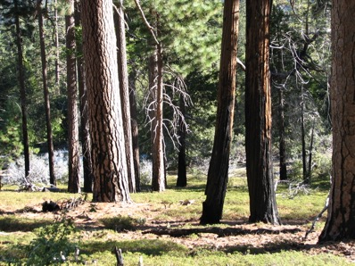
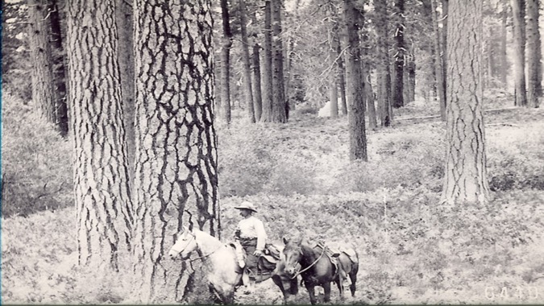
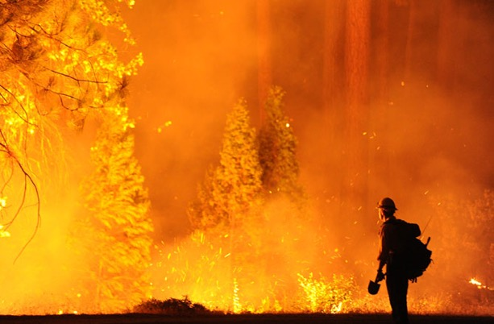
Operational resilience in western US frequent-fire forests
North, M.P., R.E. Tompkins, A.A. Bernal, B.M. Collins, S.L. Stephens, and R.A. York. 2022. Operational resilience in western US frequent-fire forests. Forest Ecology and Management 507: 120004.

Slide 2
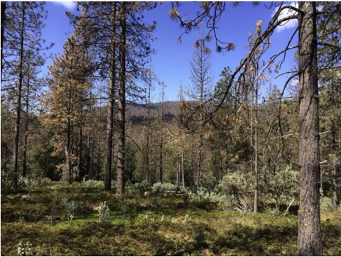
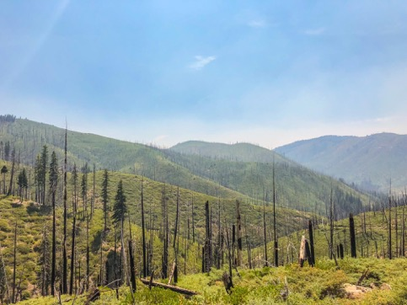
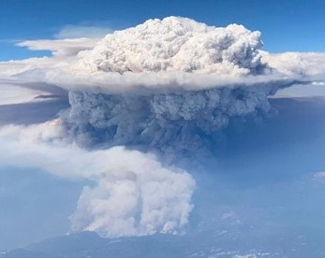
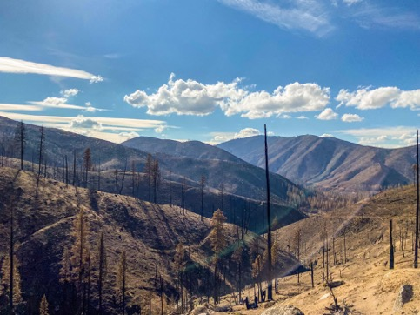
21st Century Story of Change: Loss at the Landscape Level
Lights Creek in 2018, eleven years after 2007 Moonlight fire
Drought/beetle mortality ➔high fuel loading
plume conditions
extreme fire behavior
Fettig et al 2019
Lights Creek after the 2021 Dixie Fire reburn
From Cain Ecology Text
US Forest Service
Photo: Kathryn Low, UC Berkeley
Compounding disturbances
➔ hysteresis

Slide 3
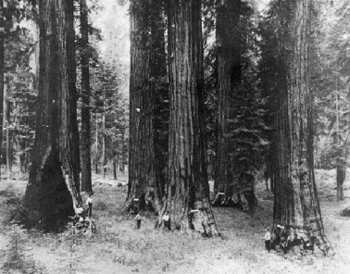
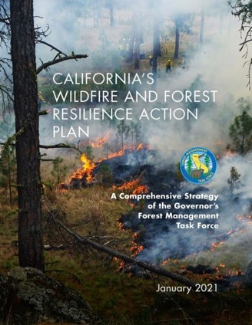
Forest resilience and its “baggage”
Treatments use to be designed to restore pre-European conditions
But changing climate and disturbance regimes ➔ emphasize
on resilience (2012 USFS Forest Planning Rule, CA Task Force)
However, resilience has been difficult to define: confusion
over types (engineering, silvicultural or ecological resilience),
scale (tree, ecosystem, landscape), terms (resistance, response, resilience), and variability between ecosystems
“a [malleable] term that facilitates communication across disciplinary borders by creating shared vocabulary… (bridging) the gap between science and policy” (Brand and Jax 2007)
Can a malleable term, lacking precision really be an effective measure of forest conditions?

Slide 4
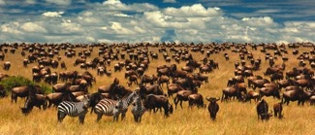
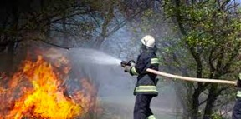
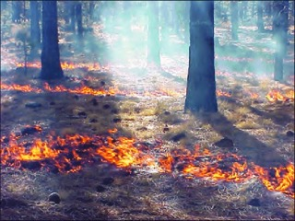
X
More precise, measurable definition of resilience is possible using ecological concepts and context
Fire is similar to herbivory: consumers control ecosystem biomass and species composition
When predators are scarce ➔little plant competition because herbivores proliferate, limiting plant growth more than resources
In the absence of suppression (like scarce predators), fire is frequent, limiting tree density more than resource availability (i.e., water, light, and nutrients)➔ significantly reducing competition
Forest appears ‘understocked’
Early CA survey “Suppression of the young growth has always been one of the serious results of fires…The land does not carry more than 35 per cent of the quantity of timber it is capable of supporting” (Leiberg 1902)
X

Slide 5
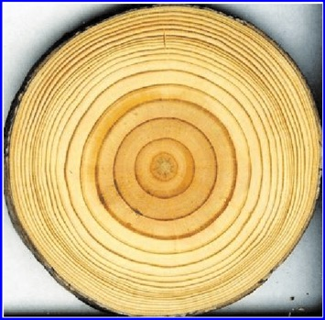
Context: Frequent-fire forests may not be adapted to stress ‘presses’ such as competition
In fire’s absence, live tree density and biomass accumulate➔ competition for growth resources➔ reduced tree vigor
Inter-tree competition creates chronic growth reductions➔ increased tree susceptibility to stress and mortality
FF forests can resist stress ‘pulses’ (fire, pests), but not well adapted to internal (competition) stress ‘presses’
This may explain why some restoration studies in dense, fire-suppressed forests have recorded mortality of long-lived trees following minor, recent stresses such as thinning small neighboring trees or re-introduction of low-intensity fire
Competition reduces radial growth

Slide 6
Difference between resistance and resilience
Resistance (i.e., minimize change) is a measure of persistence when exposed to a specific stress
With its emphasis on retaining overstory trees, fuels reduction is primarily a resistance treatment
Resilience is a broader community-level response, where a stressed ecosystem retains its essential structure and composition.
Resilience is a measure of the forest’s adaptability to a range of stresses and reflects ecosystem functional integrity.
Obligatory cup and ball schematic
Hypothesis
Resilience treatments need to restore tree vigor by creating the very low densities characterized by little resource competition that sustained frequent-fire forests.

Slide 7
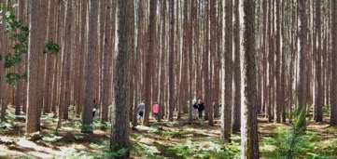
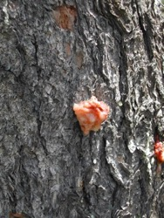
If resilience is about restoring minimal competition, can we make it operational?
Absolute stand density index (SDI) is a measure that combines the number of trees per acre and their size to assess total forest biomass
Relative SDI assesses how a local stand compares to a maximum amount of biomass that can be supported for a particular forest type, expressed as a percentage of that maximum
When there is little competition, trees grow rapidly and have high vigor, which is their best defense against stresses such as fire, drought, bark beetles and climate change
A forest at maximum biomass
Vigorous growth supports tree defense against bark beetles: pitch blob has entombed beetle

Slide 8
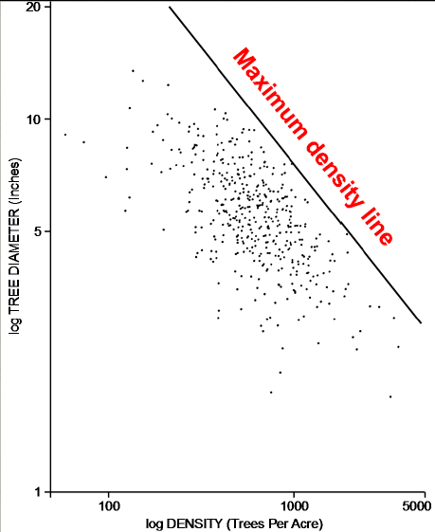
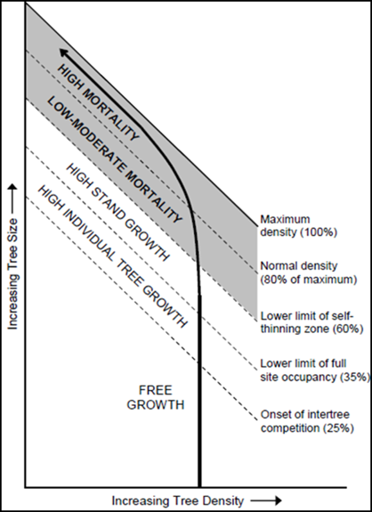
ECOLOGICAL IMPORTANCE OF RELATIVE STAND DENSITY: CHARACTERIZING COMPETITION & GROWTH
i.e. “Carrying capacity”
a.k.a SDI_{max}
From Powell, 1999
Competition Thresholds
From Powell, 1999
Stand Density Index (Reinecke 1933)
Drew & Flewelling 1979 & Long 1985

Slide 9
Testing of this Resilience Concept
with Historical Data
1911 timber inventories in the Stanislaus (left) and Sequoia (right) N.F.s
(Collins et al. 2015 & Stephens et al. 2015)
Total of 644, Quarter-Quarter sections covering over 24,000 acres
Belt transects 1-2 chains x 20 chains
5-10% sample intensity
All conifer trees > 6.0 inches (note: hardwoods not tallied)
2011 forest conditions assessed with USFS F3 data: FIA, FVS, & FastEmap. (Huang et al 2018)
The circle indicates approximate location for this 1941 photo. Note the large clump of pines in the photo center and the surrounding ingrowth, showing how forest conditions are starting to transition from historical to contemporary conditions.

Slide 10
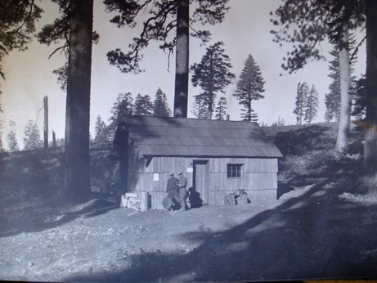
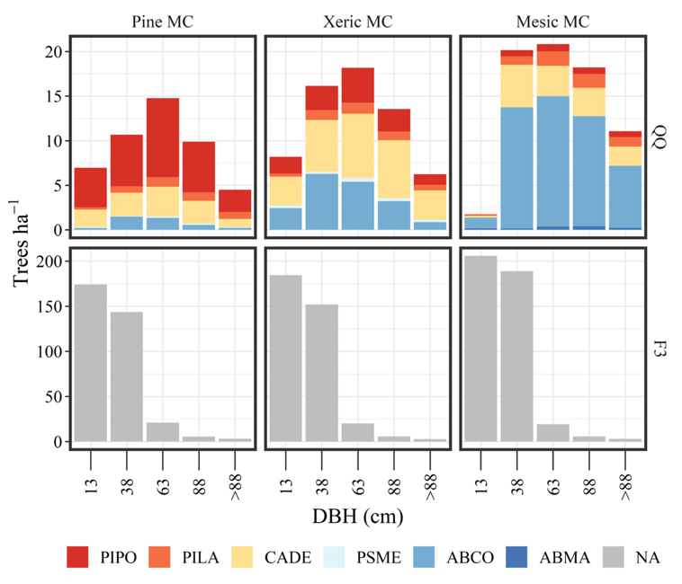
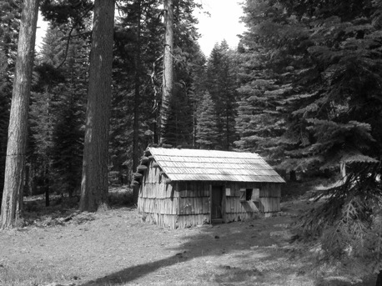
Change in Forest Conditions from 1911 to 2011
8
6
4
2
29 st/ac
28 in
Density
Avg.
dia.
19 st/ac
30 in
25 st/ac
26 in
Range = 8
1911
Trees/ac
1911
80
60
40
20
140 st/ac
14 in
148 st/ac
14 in
171 st/ac
13 in
Bear Creek R.S., Plumas NF
70% of stems within the box
2005
2011
Range = 80!
5 15 26 36 >36
5 15 26 36 >36
5 15 26 36 >36
Midpoint DBH (in)

Slide 11
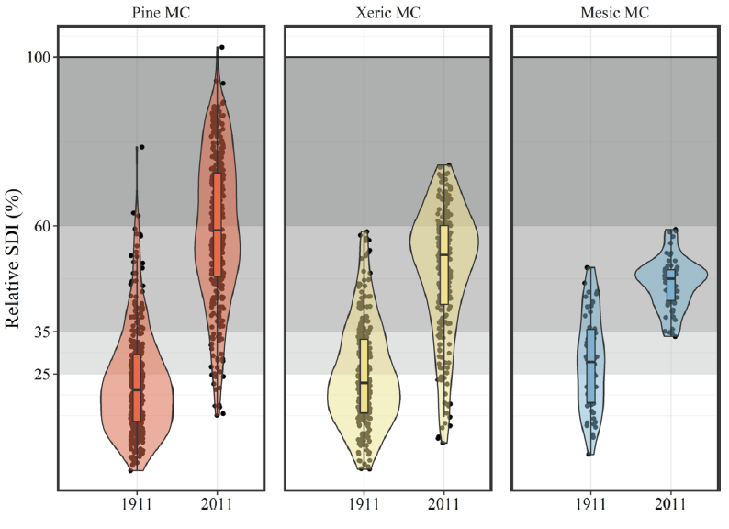
RELATIVE DENSITY ECOLOGICAL THRESHOLDS OF COMPETITION
Zone of Imminent Mortality
Full Site Occupancy
(a.k.a. full competition)
Onset of Competition
(a.k.a. partial competition)
Free of Competition
(a.k.a. Free Growth)

Slide 12
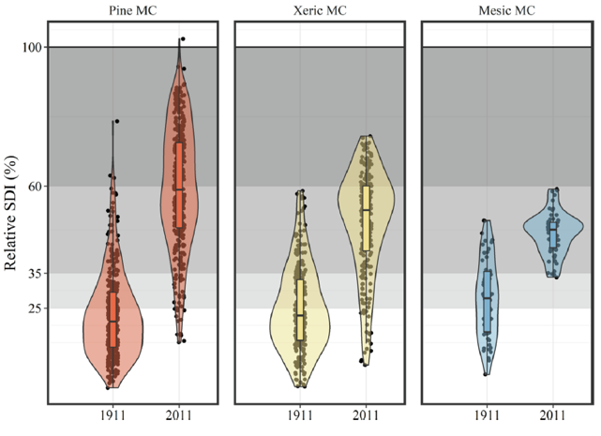
SHIFTS IN THE COMPETITIVE ENVIRONMENT RELATIVE DENSITY AS A RESILIENCE METRIC
In historic Forests (1911): 73-85% of stands were below full occupancy (free of competition or partial competition)
In contemporary Forests (2011): 82-95% of stands were in full competition or in the zone of imminent mortality

Slide 13
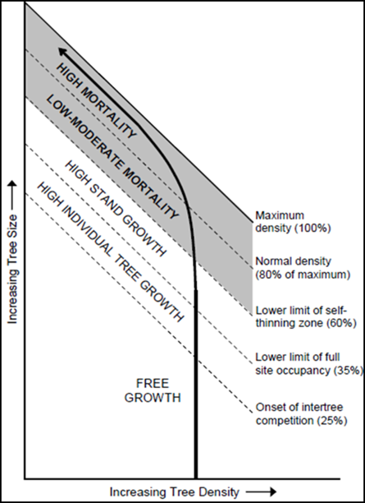
SO WHAT? MANAGEMENT & POLICY IMPLICATIONS: TARGETS BASED ON COMPETITIVE ENVIRONMENT
Competition is the driver of how forest stands are currently managed, when thinning occurs, and which trees are favored due to their size
Implications:
Relative SDI of 35% should be a maximum not a minimum
Using relative SDI_{max} >60%, Region 5 would treat only 48%, 25% and 0% of our contemporary pine, xeric &mesic mixed-conifer types.
Treatments to minimize competition would be much more extensive: 96%, 91% and 100% of the three forest types.

Slide 14
MANAGEMENT& POLICY IMPLICATIONS: PRACTICE & POLICY MAY NOT BE WELL ALIGNED WITH RESTORATION
Fuels reduction (a resistance approach) may not be sufficient for resilience to other stresses (i.e., drought, bark beetles)
Greater intensity of initial harvest needed in far departed stands
Favor individual large tree growth over total stand growth
Widespread wildlife habitat minimum canopy covers >40% may not promote large tree resilience

Slide 15
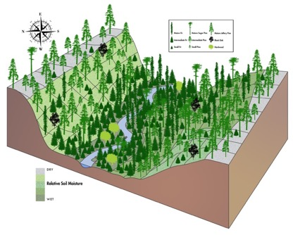
Using SDI: Flexibility, but not a license for even spacing
Relative SDI values had a range of 14-39%
Provides flexibility for denser forests (i.e., owl habitat) on wetter sites and more open forest on drier, steeper sites
Reducing competition does not equate to planting and thinning treatments that maximize regular tree spacing
More complex spatial pattern combining individual trees, clumps of trees and openings (i.e., ICO), essential for greater resistance and resilience to high-severity fire and drought*
Retain hardwoods for species diversity and because
they are under represented in current forests
Forest density & composition in sync with topographic moisture availability
ICO pattern in Yosemite NP
*Koontz, M.J., M.P. North, C.M. Werner, S.E. Rick and A.M. Latimer. 2020. Local forest structure variability increases resilience to wildfire in dry western U.S. coniferous forests. Ecology Letters 23: 483-494.

Slide 16
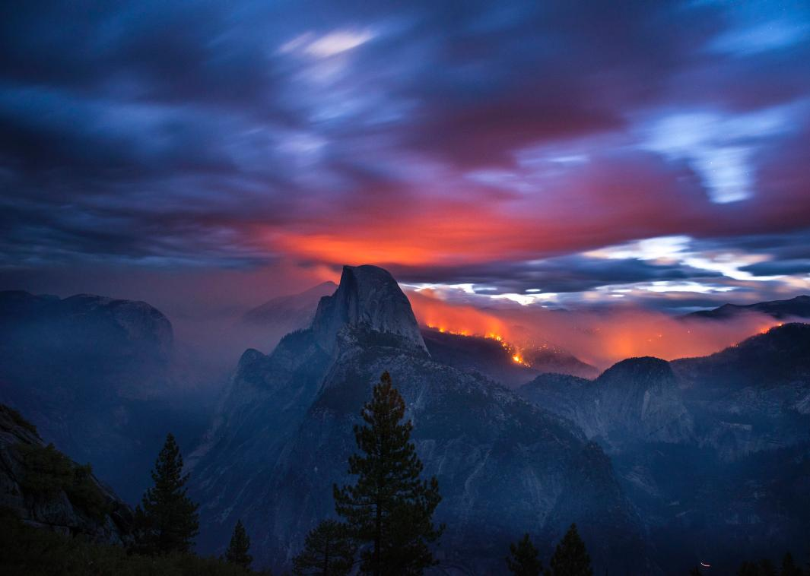
Questions?
Malcolm North, USFS PSW Research Station & Dept of Plant Sciences, UC Davis mnorth@ucdavis.edu
Lab website: http://northlab.faculty.ucdavis.edu/

