Slide 1
Panther Fuels Reduction and Forest Health
1. Ridgetop/road fuel breaks
2. Connects with UMRWA FPP Phase 1

Slide 2
Panther Fuels Reduction and Forest Health
SOPA April 2013
Field Trip 1 (ACCG) June 2015
Comment Period Feb 2016
Field Trip 2 (ACCG) Nov 2016
Final EA May 2017
Public Scoping identified Herbicide as an Issue
Use of Herbicide may lead to Impacts to Human Health and the Environment
* Use of Herbicide limited to 250 feet from the center of major ridgeways
and 75 feet from center of selected roads.
* Exposure scenarios of Acute and Cumulative exposures were analyzed
and found to be less than the EPA levels of concern (low health risk).

Slide 3
Panther Fuels Reduction and Forest Health
Follow-Up Treatments Approved
1. Targeted Grazing (Goats or Sheep)
2. Prescribed Fire
3. Mechanical Removal
4. Hand Tool Removal
5. Application of Herbicide

Slide 4
Panther Fuels Reduction and Forest Health
Follow-Up Treatments Approved
1. Targeted Grazing (Goats or Sheep)
- No Market Exists, Competing Grazing Rights
2. Prescribed Fire
3. Mechanical Removal
4. Hand Tool Removal
5. Application of Herbicide

Slide 5
Panther Fuels Reduction and Forest Health
Follow-Up Treatments Approved
1. Targeted Grazing (Goats or Sheep)
- No Market Exists, Competing Grazing Rights
2. Prescribed Fire
- Red Card Personnel in high demand during fire season
3. Mechanical Removal
4. Hand Tool Removal
5. Application of Herbicide

Slide 6
Panther Fuels Reduction and Forest Health
Follow-Up Treatments Approved
1. Targeted Grazing (Goats or Sheep)
- No Market Exists, Competing Grazing Rights
2. Prescribed Fire
- Red Card Personnel in high demand during fire season
3. Mechanical Removal
- Cost Prohibitive ($2,000.00 per acre)
4. Hand Tool Removal
5. Application of Herbicide

Slide 7
Panther Fuels Reduction and Forest Health
Follow-Up Treatments Approved
1. Targeted Grazing (Goats or Sheep)
- No Market Exists, Competing Grazing Rights
2. Prescribed Fire
- Red Card Personnel in high demand during fire season
3. Mechanical Removal
- Cost Prohibitive ($2,000.00 per acre)
4. Hand Tool Removal
- Capacity, Cost Prohibitive
5. Application of Herbicide

Slide 8
Panther Fuels Reduction and Forest Health
Follow-Up Treatments Approved
1. Targeted Grazing (Goats or Sheep)
- No Market Exists, Competing Grazing Rights
2. Prescribed Fire
- Red Card Personnel in high demand during fire season
3. Mechanical Removal
- Cost Prohibitive ($2,000.00 per acre)
4. Hand Tool Removal
- Capacity, Cost Prohibitive
5. Application of Herbicide
- Available, Cost Effective ($400.00 per acre)

Slide 9
Panther Fuels Reduction and Forest Health
Proposed Addition to Areas Eligible for Herbicide
1. Allow Application of Herbicide up to 500 feet from the centerline of major ridgeways
2. Allow Application of Herbicide up to 150 feet from the center of selected roads
Estimated equal or lesser effect:
Areas with greater than 60% canopy cover naturally suppress understory/brush
Stand density increases further from the road
Herbicide focused on areas with undesired growth (unshaded areas)
Map is an authorized area, actual application in the field is a portion thereof.

Slide 10
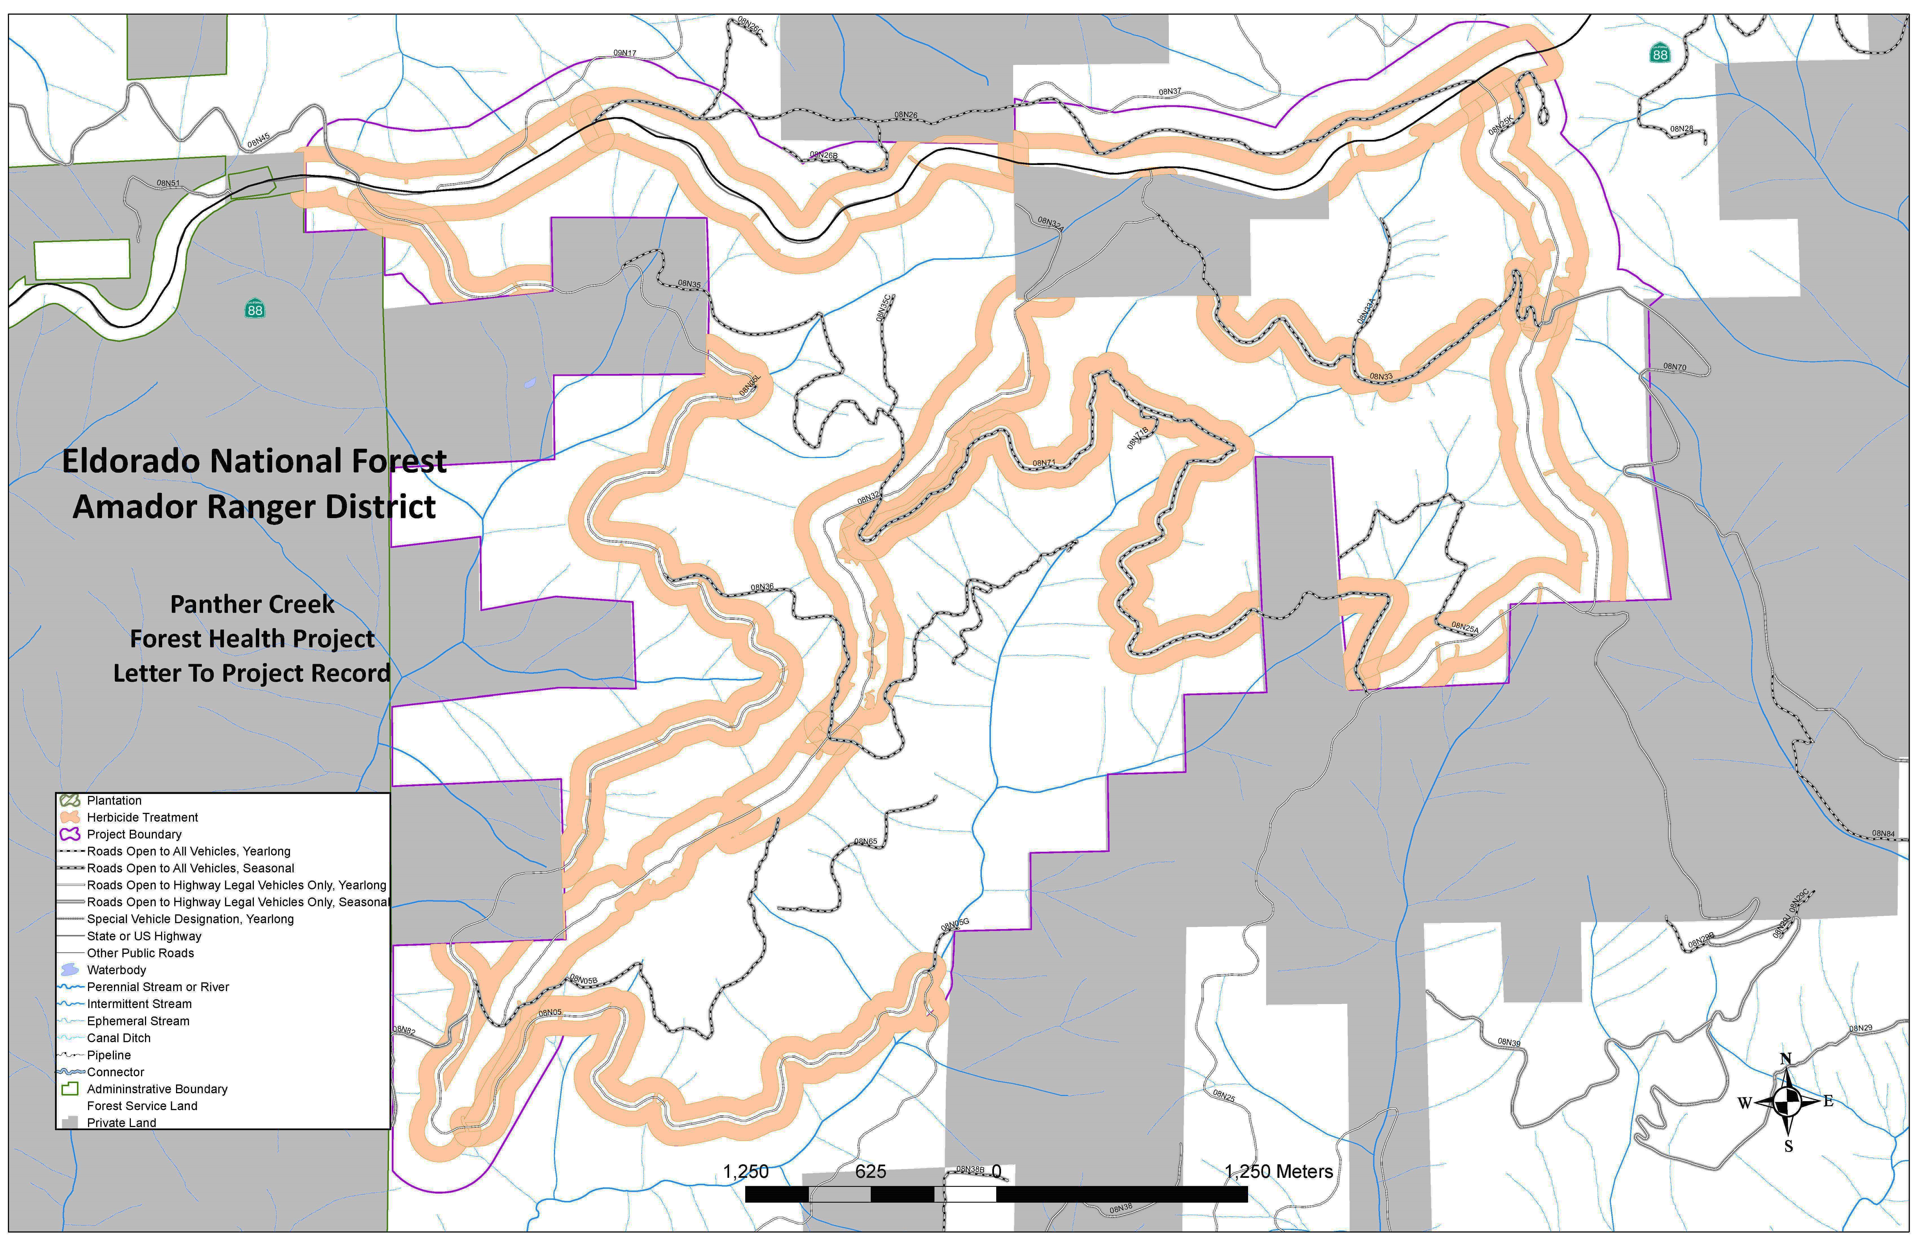
Panther Fuels Reduction and Forest Health

Slide 11
Panther Fuels Reduction and Forest Health
Proposed Addition to Areas Eligible for Herbicide
Effects Analysis and Public Scoping Documented in a Supplemental Information Report (SIR)
    FSH 1909.15, Chapter 10, Section 18.1 - Review and Documentation of New Information Received After Decision Has Been Made.
    If new information or changed circumstances relating to the environmental impacts of a proposed action come to the attention of the responsible official after a decision has been made and prior to completion of the approved program or project, the responsible official should review the information carefully to determine its importance. Consideration should be given to whether or not the new information or changed circumstances are within the scope and range of effects considered in the original analysis.
    If, after an interdisciplinary review and consideration of new information within the context of the overall program or project, the responsible official determines that a correction, supplement, or revision to an environmental document is not necessary, implementation should continue.
    Document the results of the interdisciplinary review in the appropriate program or project file. This documentation is sometimes called a supplemental information report (SIR) and should conclude with whether or not a correction, supplement, or revision is needed, and if not, the reasons why.

Slide 12
Panther Fuels Reduction and Forest Health
Proposed Addition to Areas Eligible for Herbicide
Effects Analysis and Public Scoping Documented in a Supplemental Information Report (SIR)
    FSH 1909.15, Chapter 10, Section 18.4 - Reconsideration of Decisions Based on Environmental Assessment and Finding of No Significant Impact.
    Supplement or revise an EA if the interdisciplinary review of new information or changed circumstances indicates that changes in the EA are needed to address environmental concerns that have a bearing on the action or its impacts.

Slide 13
Panther Fuels Reduction and Forest Health
Proposed Addition to Areas Eligible for Herbicide
Effects Analysis and Public Scoping Documented in a Supplemental Information Report (SIR)
    FSH 1909.15, Chapter 10, Section 11 - Conduct Scoping
    The methods and degree of the scoping effort undertaken for a given project vary depending on scope and complexity of the project.
    Except where required by statute or regulations, the responsible official may adjust or combine the various steps of the process outlined in this chapter to aid in the understanding of the proposed action and identified issues.
    FSH 1909.15, Chapter 10, Section 11.1 - Organize Scoping Effort
    The NEPA requires a systematic, interdisciplinary approach to ensure integrated application of the natural and social sciences and the environmental design arts in any planning and decision making that affects the human environment.

Slide 14
Panther Fuels Reduction and Forest Health
Proposed Addition to Areas Eligible for Herbicide
Effects Analysis and Public Scoping Documented in a Supplemental Information Report (SIR)
1. New Information
A. Bipartisan Infrastructure Law (2021) Section 40806
- Authorizes Fuel Breaks up to 1,000 feet wide
- Explicitly authorizes use of herbicide
- Indication of Leaders Intent
2. Changed Conditions
B. Recent History of Extreme Fire Behavior
C. Sustained Preparedness Level (PL-4 and PL-5)
D. FS Staffing Capacity
E. Planned/Desired Conditions do not match Current/Foreseeable Conditions
F. Market Conditions/Availability of Follow-Up Treatments

Slide 15
Panther Fuels Reduction and Forest Health
Proposed Addition to Areas Eligible for Herbicide
Effects Analysis and Public Scoping Documented in a Supplemental Information Report (SIR)
ACCG is invited to make a recommendation on the proposed addition
Feedback will be documented in the SIR
If review of the NI or CC identifies a need for supplementation,
a revised FONSI and DN will be drafted.
Implication: Moving Forward - Fuel Break Maintenance Tools
Caldor Fire Restoration Project EIS
UMRWA FPP Phase 2 EIS
* Network Of Fuel Breaks along Potential Operational Delineations (PODs)

