Slide 1
Ultra-Early Detection of Wildfires
Notes:
Our mission is to help in the fight against climate change with an ultra-early warning system for wildfires.

Slide 2
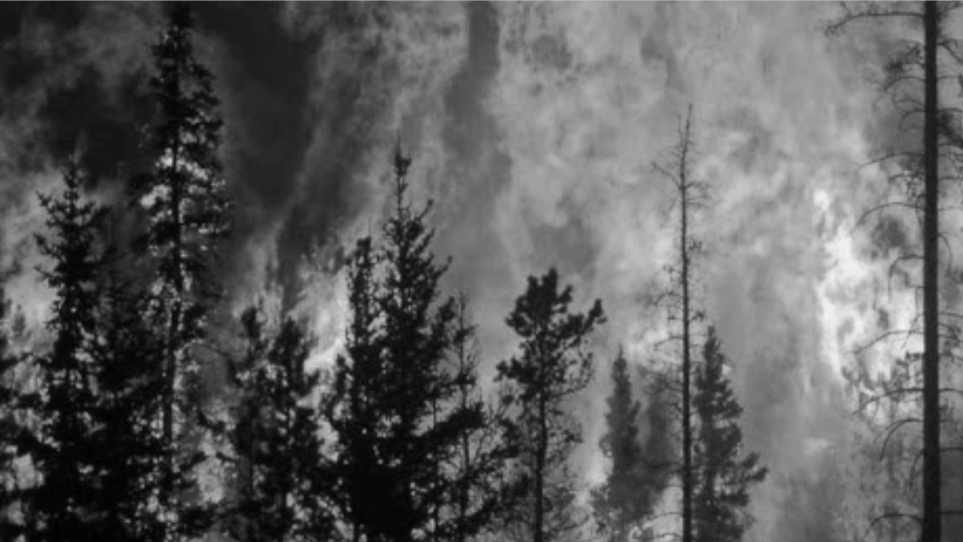
Impact of Wildfires
Wildfires cause
20%
of global CO2 emissions
Human induced
80%
of wildfires
Biodiversity loss
> 3 billion
animals killed
Financial damages
$140 billion
global economic loss
Notes:
Wildfires cause up to 20% of global CO2 emissions, the same amount that traffic (all cars, aeroplanes and ships combined) put into the air. Since as humans, we are responsible for about 80% of wildfires, it’s also our responsibility to stop them. Wildfires have a devastating impact on biodiversity with more than 3 billion animals killed and they cause more than $140 billion of economic losses each year.

Slide 3
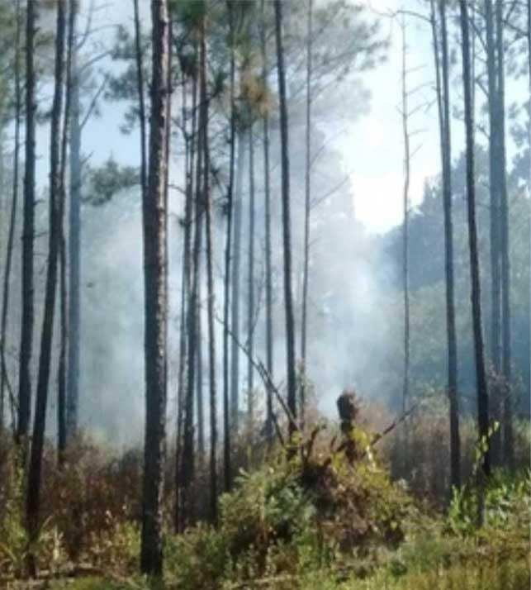
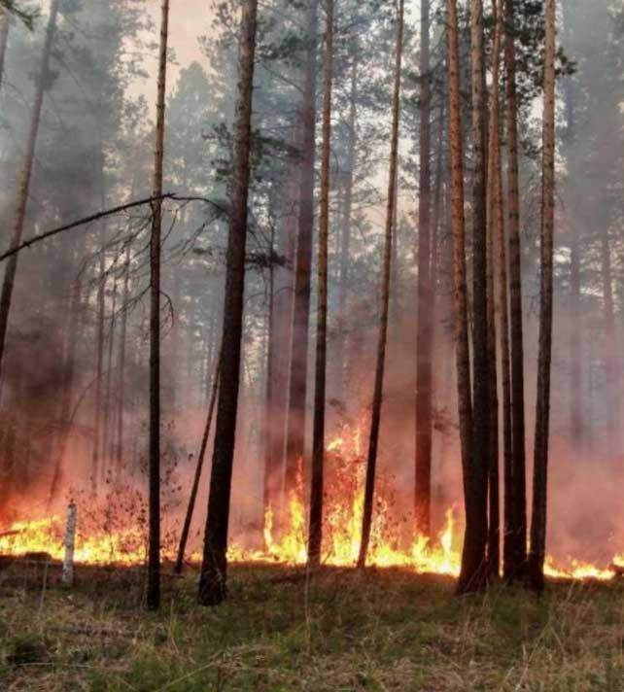
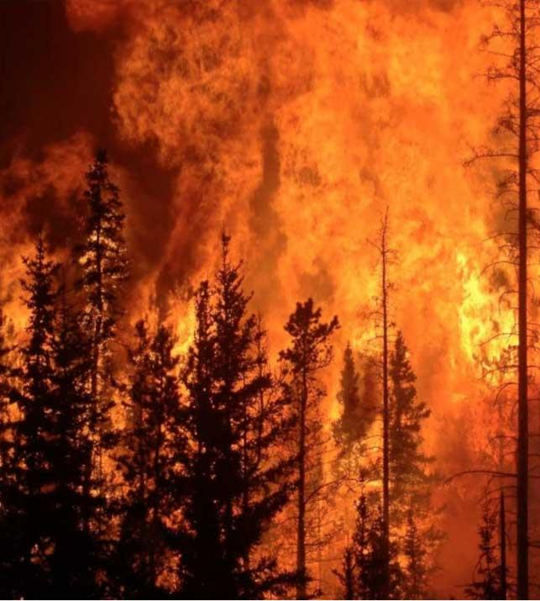
Time is of the Essence
Dryad
Camera
Satellite
damage
1-60min
1-3h
6h+
Smoldering
Open Fire
Spreading
time
Notes:
Existing systems aiming to tackle wildfires are relying on satellites or cameras placed in the forest. However, these systems can take hours or even days to detect a fire. By the time the firefighters arrive at the scene, the fire has often grown too large and can no longer be contained. Dryad aims to detect wildfires within the first 60 minutes after someone throws a cigarette and enable firefighters to extinguish the fire before it spreads out of control.

Slide 4
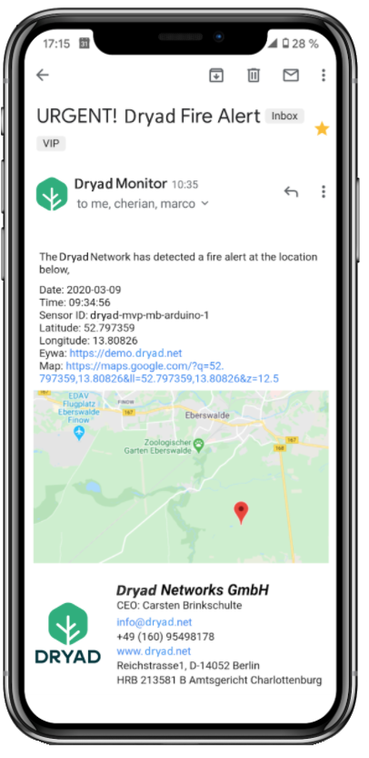
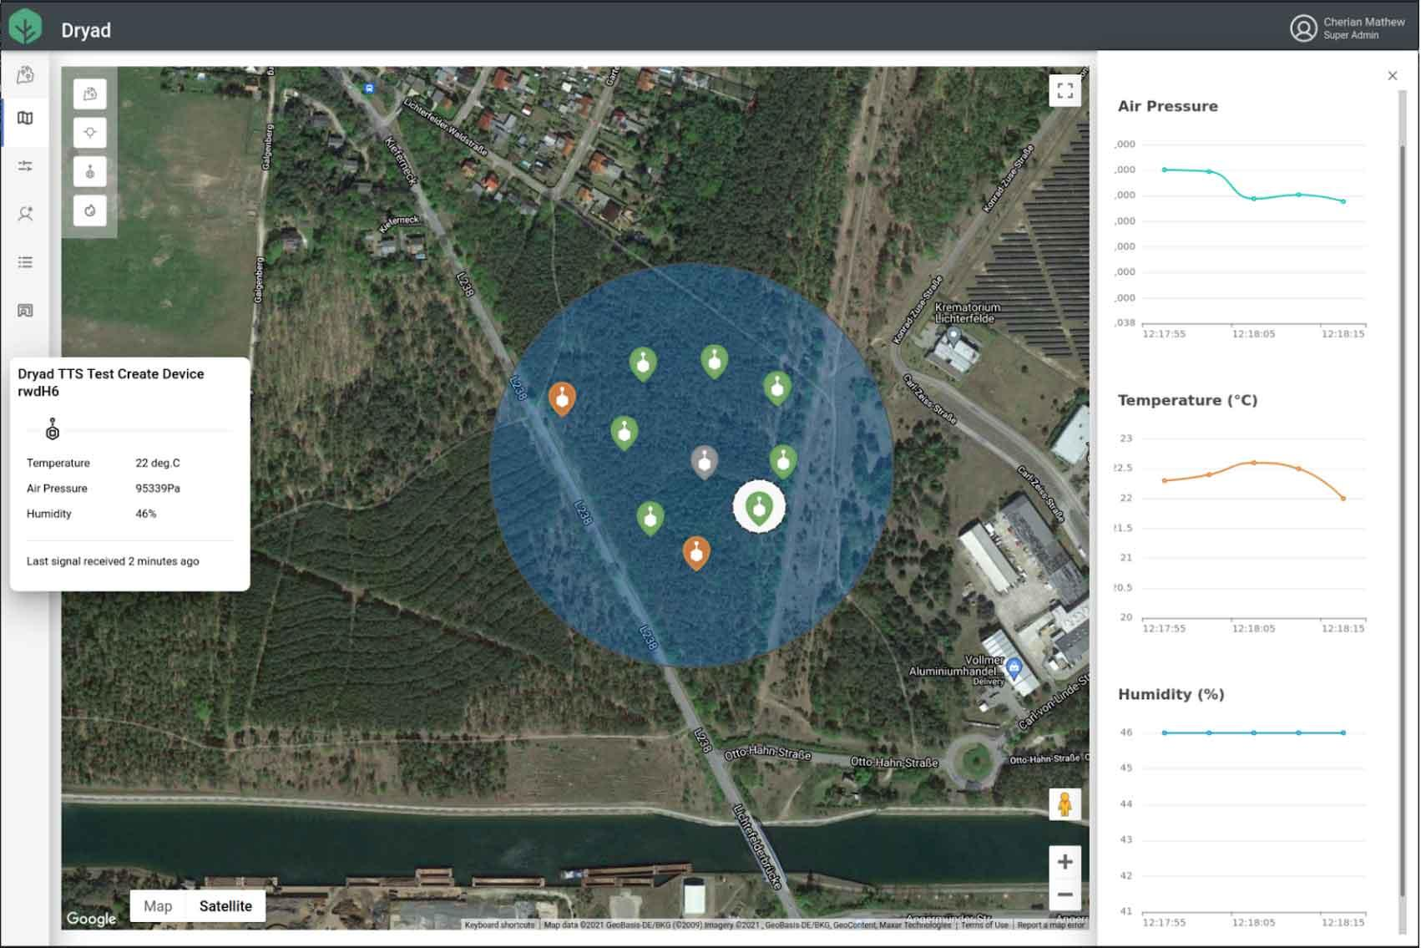
Silvanet™ Protecting the Forest
Ultra-Early Detection
Large area monitoring
Real time warning
Reliable prevention
Benefits
Immediate reaction
Damage control

Slide 5
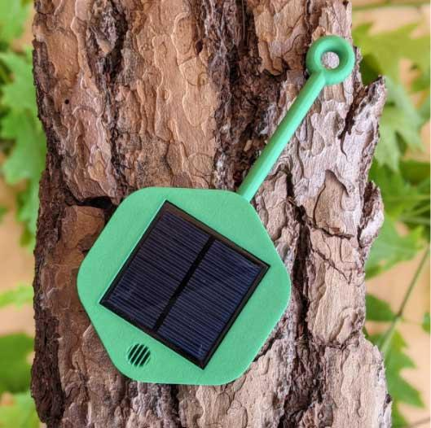
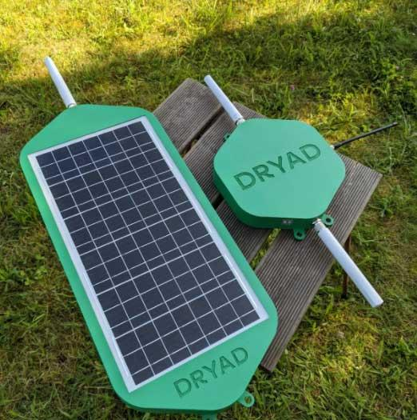
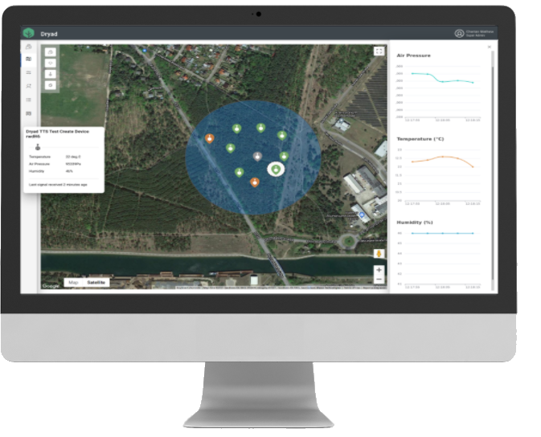
Dryad Silvanet™
Sensor
Gateways
Monitoring
Solar-powered gas sensors detect wildfires within first 60 minutes.
Distributed LoRa Gateways provide a large-scale mesh network infrastructure.
Device management, monitoring and alerting.
Four PCT patent applications pending
Notes:
We do this by placing solar-powered sensors directly into the forest, which use ultra-sensitive gas sensors to monitor the composition of the air and detect a fire with embedded artificial intelligence. The sensors then send an alert signal over our large-scale IoT mesh network. Data is being collected and monitored at our cloud monitoring platform which sends out alerts in case of a detected fire.

Slide 6
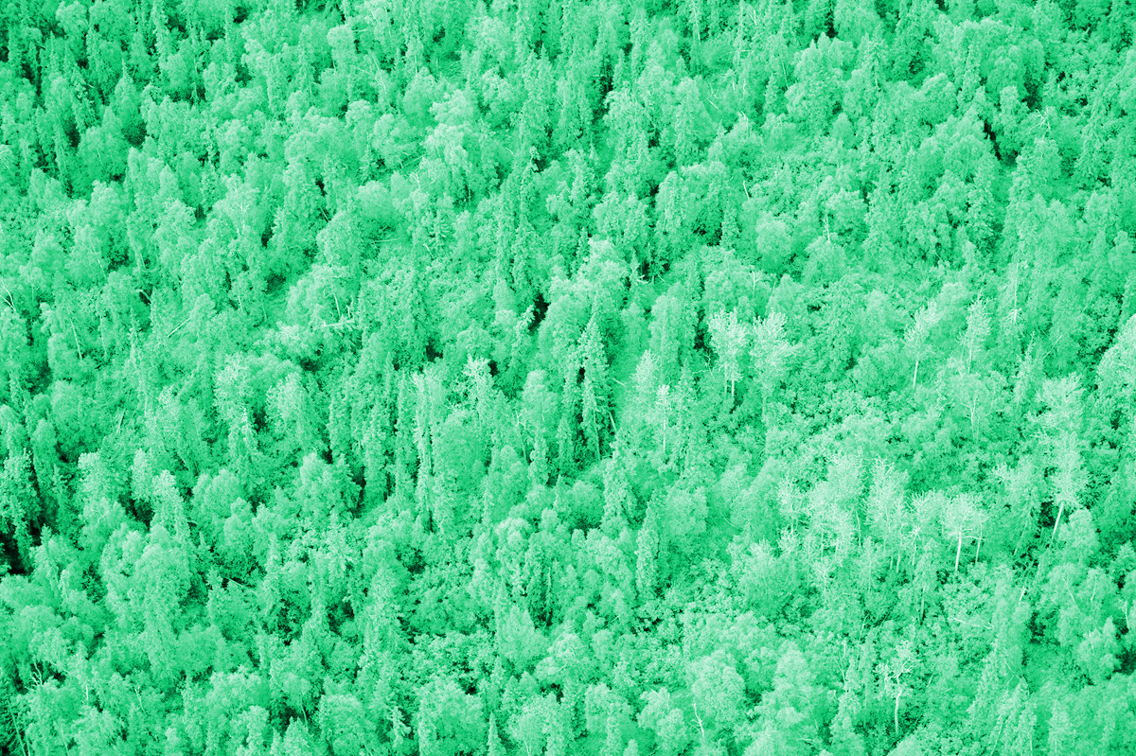
Large-Scale IoT Mesh Network for Forestry
Mesh Gateway 2
Sensor 1
Sensor 4
Border Gateway 1
Sensor 2
Sensor 3
Sensor 5
Mesh Gateway 1
Mesh Gateway 3
Border Gateway 2
Cloud Platform
Wireless / LoRa
Internet / Cloud
Notes:
In our target are of the forest, we cannot rely on mobile network operator coverage, so we are installing our own wireless network infrastructure. A key innovation of the Silvanet system is the solar-powered mesh network architecture, which enables large-scale, off-grid deployments.

Slide 7
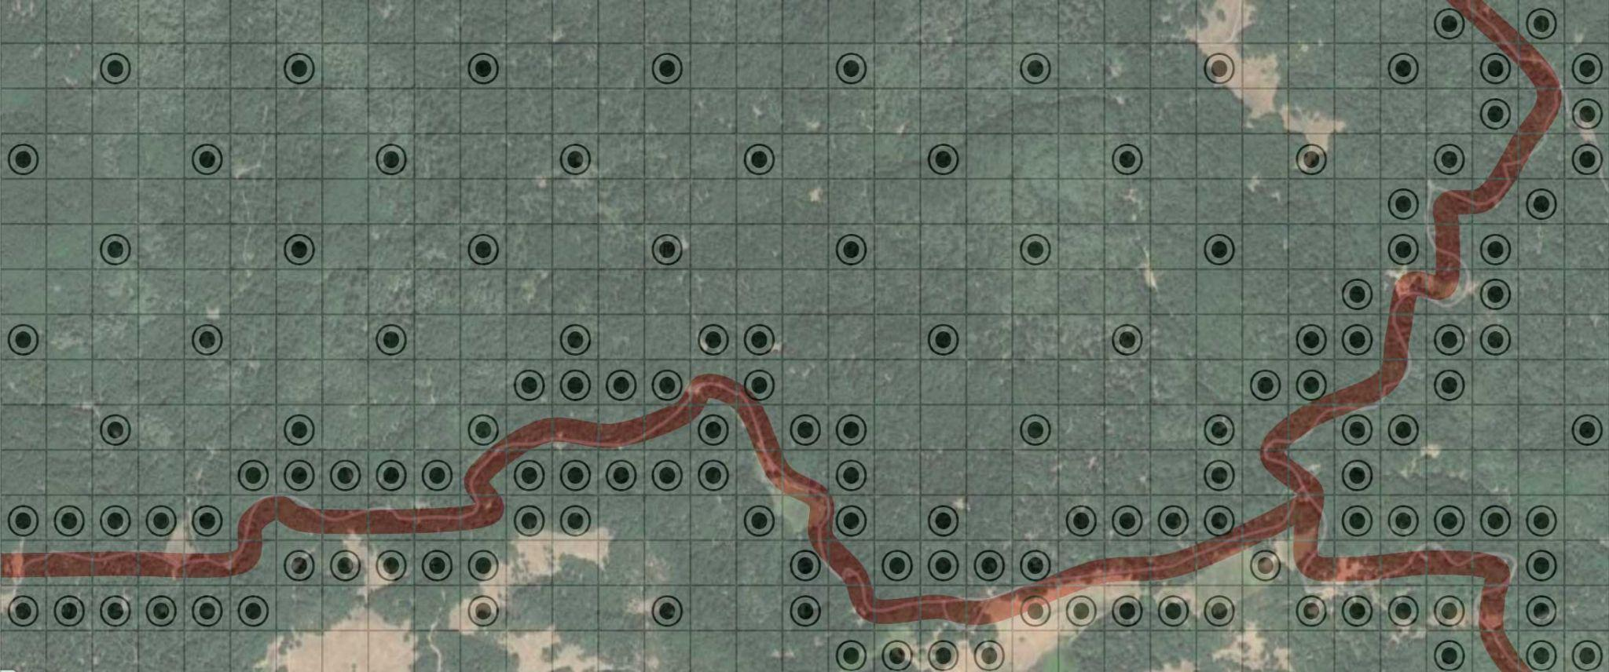
Optimizing Wildfire Sensor Deployments
Sparse deployment of sensors in remote locations
1,500m
Dense deployment in of sensors high-risk areas
3,500m
130 sensors for 525 ha = 0.24 sensors / ha
Dense deployments (roads, campsites, etc): 0.7 / ha
Sparse deployments (remote locations): 0.1 / ha
Average of 0.2 sensors per hectare

Slide 8
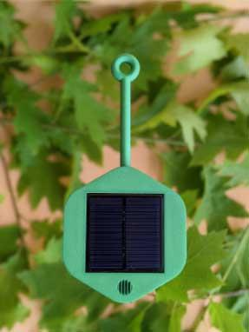
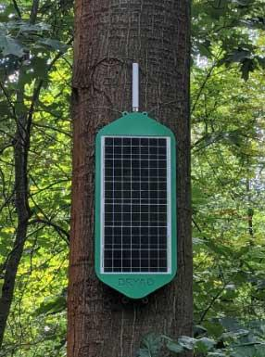
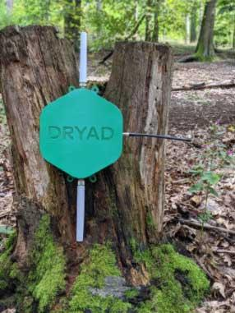
Suggested Retail Pricing
Sensor
Mesh Gateway
Border Gateway
Hardware:
Service (15%):
Hardware:
Service (15%):
Hardware:
Service (15%):
€90
€14
€575
€87
€849
€128
Annual service fees includes access to analytics platform and alerting Average: 0.2 sensors per hectare (0.7 sensors per ha for high-risk, 0.1 per ha for remote deployments)
Note: (1) Volume discount: >10,000 devices: 15%, >100,000 devices: 25%

Slide 9
Deployment Stages
Pilot
Live
1
2
Small
Large
Objective: | Demonstrating core functionality and basic scalability of the system.
Duration: | 2-4 Months
Criteria: | Scalability, mesh network, detect controlled fires.
Objective: | Live, large-scale deployment across the target forest.
Duration: | 10-15 years
Criteria: | Detect real wildfires caused by accident / arson / recklessness,
System:
400 Sensors
System:
2000+ Sensors
5 Mesh Gateways
30+ Mesh Gateways
1 Border Gateway
2+ Border Gateways

Slide 10
Example Pilot Deployment
Mesh
Mesh
Mesh
Mesh
Mesh
Border

Slide 11
Use-Cases, Benefits & Roadmap
Ultra-Early Fire Detection
Roadmap: Forest Monitoring
Protects assets and prevents financial damages
Dramatically reduces costs of firefighting
Reduces insurance payments
Saves human and wildlife
Sensor / Device | Function
Fuel moisture sensor | Determine fire risk level
Sap flow | Tree water consumption
Soil moisture sensor | Measure water reservoir
Dendrometer | Measure tree growth
Chainsaw detector | Prevent illegal logging
2-way Pager | Chat for forest workers
Notes:
Our initial focus is on ultra-early detection of wildfires which can dramatically reduce the cost of firefighting, and protect from loss of forest and financial damages. As we are establishing a generic IOT network infrastructure, we are planning to expand into health and growth monitoring helping forest owners to more efficiently manage their forests based on data from our sensor network. Our business model is based on hardware sales and a recurring platform access fee.

Slide 12
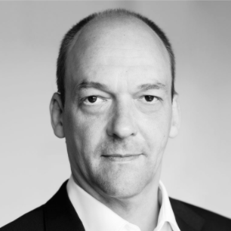
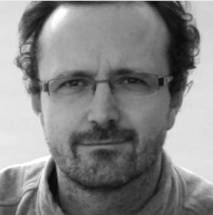
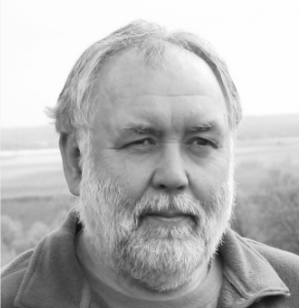
Dryad Team
Experienced team covering business, technology, marketing and science
Carsten Brinkschulte
Marco Bönig
Eike Marx
Daniel Hollos
Cherian Mathew
Dr. Jürgen Müller
Ben Banerjee
Management, Technical and Corporate Strategy, Marketing & Sales
Hardware Development Lead
Financial Planning, Corporate Strategy
Embedded Software Lead
Cloud and Analytics Software Lead
Research and Scientific Advice, Strategic Partnerships
SVP Worldwide Sales
Serial entrepreneur (3 exits) with 20 years experience in mobile network infrastructure. Previously Movirtu, Core Network Dynamics, 7 years running AIM-listed Synchronica
Seasoned expert in RF-hardware and custom design of electronic solutions, patent for energy harvesting in smart-home products
Experienced CFO, investment banking & VC background. Previously Movirtu, Blackberry, Morgan Stanley, Arma Partners. PhD Nanotech/ Optoelectronics
Senior Embedded Systems and Mesh Network Software Engineer with 10+ years experience in embedded system design and development
16+ years of experience in software architecture, design and development in both industry and academia with a focus on cloud based data analysis systems
Until recently leader of department of forest ecology Thünen-Institute of Forest Ecosystems. Developed INPRIWA, a prototype for early forest fire detection
Until recently Partner and head of sales TME at Infosys. Previously, global sales head at Wipro Technologies and VP worldwide sales at Synchronica
Notes:
Dryad has been started by a team of 7 co-founders. Personally, I have 20 years experience in telecommunications with 4 startups and 3 successful exits. Our management team includes seasoned experts in hardware and software development as well as research, finance and B2B sales.

Slide 13
Notes:
Thank you for listening and please join us in our mission to save the world’s forests and contribute in the fight against climate change.

Slide 15
Roadmap and Vision
Forest Ozone, water consumption, tree growth and health
Water Temperature, O2 concentration, flow speed and water levels
Digital Twin
Communication 2-way pager, SOS button, anti-theft alarm
Climate Ozone, CO2, NOX, VOC levels, wind speed, humidity and temperature
Adjacent Verticals
Geographic Expansion
1
2
Additional Sensors
4
5
3

Slide 16
Competitive Analysis
Cameras
Satellite
Constellation
Technology | Ground Sensors and Network | Ground Cameras (circulating 360°) | 1 HEO Satellite (Highly Elliptical Orbit), 600km, IR | 100 HEO Nanosatellites, IR cameras
Smoldering fire | ✅ | ⛔ | ⛔ | ⛔
Open fire | ✅ | ✅ | ✅ | ✅
Temperature | ✅ | ⛔ | ✅ | ✅
Humidity | ✅ | ⛔ | ⛔ | ⛔
Ozone | ✅ | ⛔ | ⛔ | ⛔
Soil Moisture | ✅ | ⛔ | ⛔ | ⛔
Sap flow | ✅ | ⛔ | ⛔ | ⛔
Tree Growth | ✅ | ⛔ | ⛔ | ⛔
Carbon Footprint | Low | Low | High | High
Pros | Ultra-early fire detection (within minutes during smoldering phase). Provides forest health data. | Can detect smoke plumes from afar, up to 16km radius. | Covers large area.
 |  |  | Ultra-High resolution IR camera system. | Possible data processing in space to avoid high transmission costs and delay.
Cons | Large number of (inexpensive) sensors required. | Does not work at night (relies on visual recognition of smoke plume). Can detect fires only if a large smoke plume is visible. | Can take hours to detect fire. IR resolution limited from space. Clouds impact images. Ultra-high resolution cameras limited by military regulation. Images sent to ground for processing causes delay and cost.
 |  |  | Takes 90 min to circle earth, not geostationary. Satellite launch expensive, high CO2 emissions. | Large number of satellites. Expensive to deploy. High CO2 emissions from rocket launches.
Dryad is complementary to Camera and Satellite-based Fire Detection Systems.
Dryad can detect forest fires at smoldering phase, within minutes.
Dryad monitors and analyzes forest health data, which can’t easily be measured from the distance.

Slide 17
Comparing Ecosystems
Ecosystem | LoRa | Sigfox | MIOTY | NB-IOT
Technology | LPWAN (spread-spectrum) | LPWAN (binary phase-shift keying) | LPWAN (telegram splitting) | WAN (LTE-based)
Main Licensor | Semtech | Sigfox | Fraunhofer, TI | 3GPP
Standardization | LoRa Alliance | Sigfox | MIOTA Alliance | GSMA
Available Since | 2012 | 2010 | 2020 | 2016
Status | Millions of sensors, 137 live operator networks | Millions of sensors, 50 live networks | Pilot Installations only, no live operators or devices available | 142 operators live (NB-IOT and LTE-M combined)
Alliance Members | 500 | Proprietary | 6 | 370
Private Networks | Yes | No | Yes | No
Spectrum | 868Mhz (Europe), 915MHz (USA), 433MHz (Asia) | 868 MHz (Europe), 915 MHz (USA), 433 MHz (Asia, LatAm) | 868 MHz (Europe) | Europe: 1800, 900, 800 MHz, USA: 1700, 700, 850 MHz
Max. Throughput | 50 kbps | 100 bps | Unclear (claims high)? | 200 kbps
Real. Throughput | 100 bytes / minute | 12 bytes / minute | Unclear (claims high)? | 50-70 kbps
FOTA | Yes | No | Unclear | Yes
Battery life | 2-5 years (1200 mAh) | 1-2.5 years (2400 mAh) | Up to 20 years (Battery?) | Up to 10 years (2400 mAh)
Range | < 20km | < 40km | < 15km | < 10km
Pricing | Free | €9 per device / year @ 2 messages / day | Free? (No info) | €1.7/SIM/Month + Data
Certified Products | 176 | 866 | - | Few
Pros | Established and thriving ecosystem of many chipset manufacturers, sensor and gateway vendors as well as operators. Operator and private networks supported. Backend by operators or private networks. LoRaWAN protocol open source. No limit of max. Messages per day. | Good support by Sigfox as it controls the backend of all live networks globally. | Telegram splitting prevents message collision, decreasing error packet rates, better handling of interference than other LPWAN protocols. ETSI (TS-UNB) Compliant. Supports mobility up to 120km. Substantially improved battery life. | Live networks of many operators worldwide. Reliable operation - no spectrum interference as it uses licensed spectrum of operators. 1600 bytes payload.
Cons | Limited support for mobility. Payload limited to 243 bytes. Uses free spectrum, subject to interference. | Backend dependent on Sigfox. Limited support for mobility. Limited network coverage in rural areas, spotty coverage in USA, Norway, Sweden, No coverage in Africa, Asia. Protocol proprietary to Sigfox. Payload limited to 12 bytes. Maximum of 140 messages / day. Uses free spectrum, subject to interference. | New, unproven protocol with no existing ecosystem and no live installations. May take several years to establish the standard. Uses free spectrum, subject to interference | Costly for large number of devices. Dependency on network coverage by operators (no private networks). German coverage good, but blind spots in forests. Rural network coverage in USA limited. Sparse network coverage in Asia, South America and Africa. Does not support mobility.
NB-IOT depends on operators, lack of coverage in rural areas and costly.
Sigfox depends on a single operator (Sigfox), its network coverage is limited in rural areas, no FOTA.
MIOTY is a promising technology, but very early stage (no products, no live deployments).
LoRa is the best choice with an established ecosystem, support for private networks and no license cost.

Slide 18
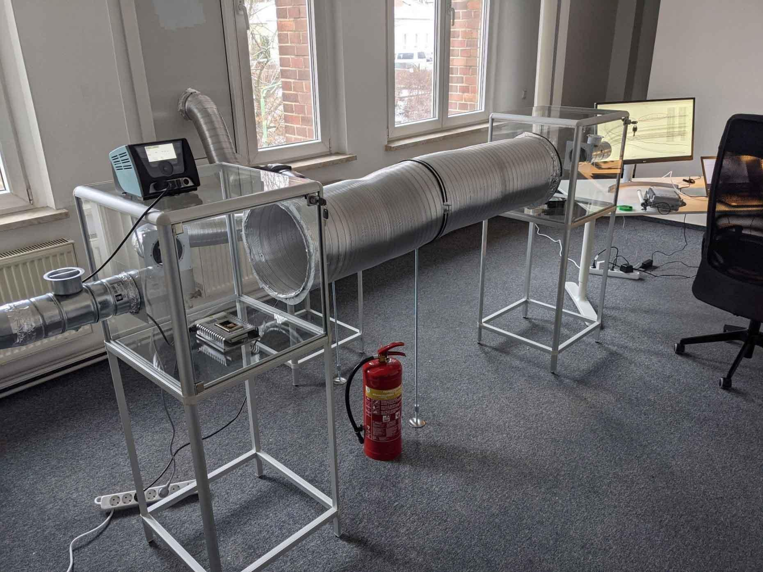
Artificial Intelligence
Training Lab
Samples from target forest
Heated to 320 degrees
VOC / Gas emitted from the material
Sensors are trained to detect the specific smell of the forest

Slide 19
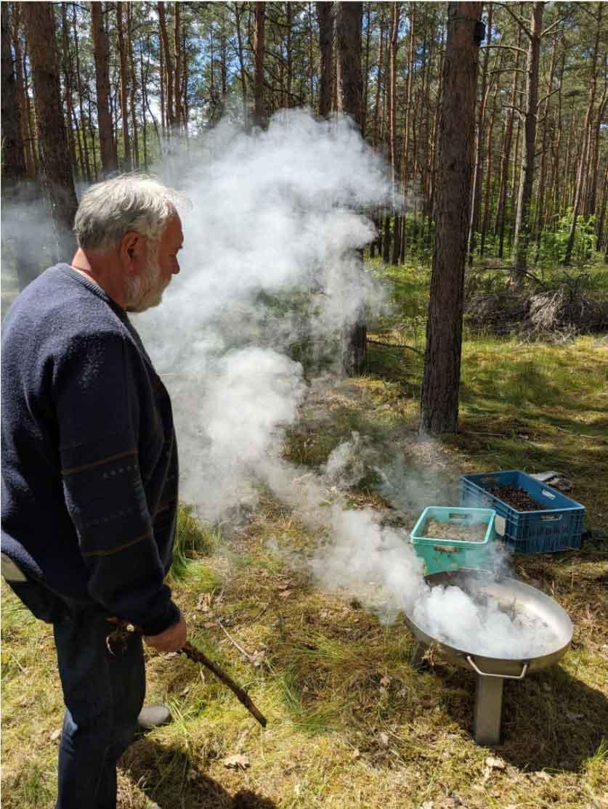
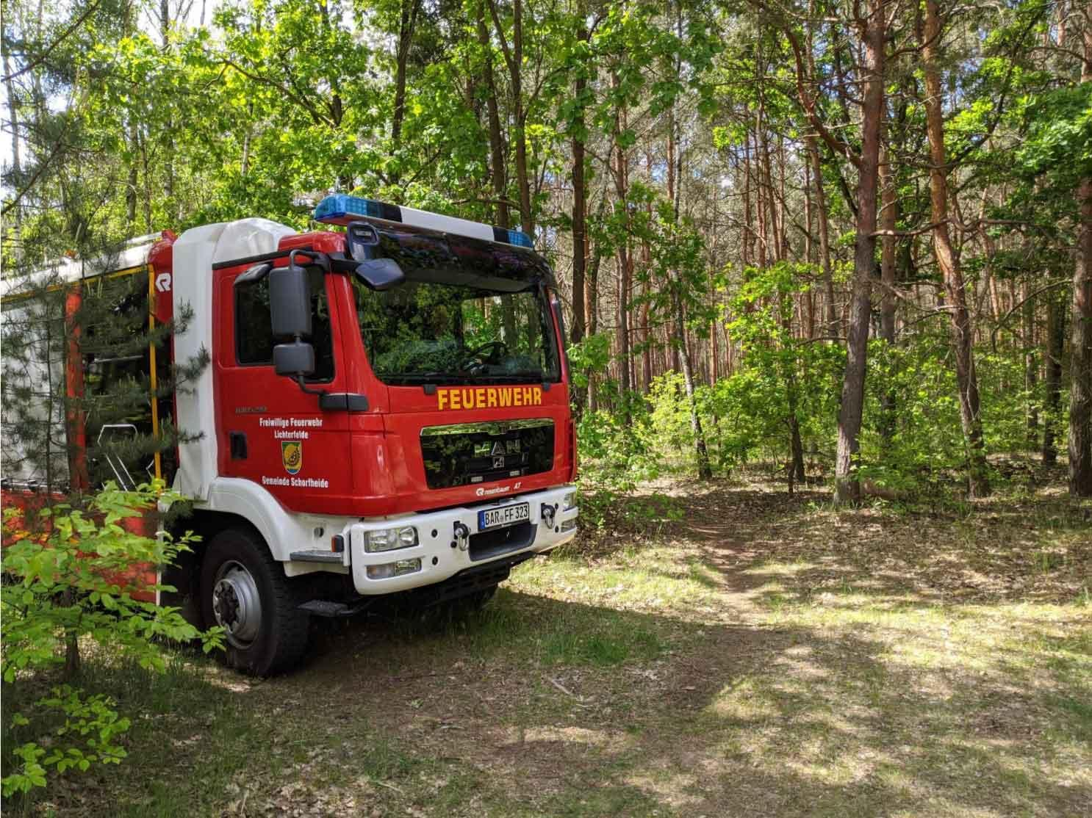
Real-world testing in the forest

Slide 20
Roadmap | Silvanet Gen-1 | Gen-2 | Gen-3 | Vision
Date | Q1/2022 | Q4/2022 | 2023 | 2024-25
Scope | Fire Detection | Fire Detection | Fire Detection, Health Monitoring | Environmental Monitoring
Geography | Europe, US, Australia | Worldwide | Worldwide | Worldwide
Scale | 20 sq km, 3 Gateways, 20 Sensors | 500+ sq km, 50+ Gateways, 1000+ Sensors | 500+ sq km, 50+ Gateways, 1000+ Sensors | Country-Wide
Sensor | PCB, Solar Powered | OptimizedAntenna | Fireball (Air-Drop, temp. harvesting) | OEM (White Label, Licensing to 3rd parties)
 | Gas sensor (Air) | Certification (FCC, CE, LoRaWAN) | Fuel Moisture Sensor (Ultra-Sonic) | Communications (2-Way Pager)
 | Temp, Humidity, Pressure (Air) | Dryad AI Library | Soil Moisture (3rd party, Humidity) | Safety (Illegal Logging, Panic)
 | Firmware Update Over The Air (FOTA) |  | Dendrometer (3rd party, Tree Growth) | Air Quality (Ozone, CO2, NOX, VOC)
 | STM MCU |  | Sap Flow (3rd party, Water Consumption)
Border Gateway | PCB, Solar Powered | STM MCU | 3rd party sensors | OEM (White Label, Licensing to 3rd parties)
 | LoRa, LTE-M, Ethernet, Satellite | Power-over-Ethernet (PoE) | Custom Antenna
 | Firmware Update Over The Air (FOTA) |  | BasicStation (CUS)
Mesh Gateway | PCB, Solar Powered | STM MCU | 3rd party sensors | OEM (White Label, Licensing to 3rd parties)
 | Simple LoRa Mesh | Improved LoRa Mesh | Custom Antenna
 | Firmware Update Over The Air (FOTA)
Cloud Platform | User Management | Multi-Tenancy | 3rd party sensors | OEM (White Label, Licensing to 3rd parties)
 | Device Management | API | Auto Device Positioning | Analytics, Artificial Intelligence
 | Deployment Planning |  | 3rd party data (Weather, Satellite) | Fire Risk Analysis

Slide 21
Deployment Options
Forest Workers
Drone/ Parachutes
Helicopter/ Parachutes
1
2
3
Managed Forests
Natural Forests
Amazonas, Asia
Medium Size
Large-Size, Inaccessible
Very Large, Inaccessible

