Slide 1
Woody Feedstock Aggregation Pilot Program Central Sierra Nevada
Project Manager: Mariposa County Resource Conservation District
In partnership with TSS Consultants
Funded by State of California Office of Planning and Research (OPR)

Slide 2
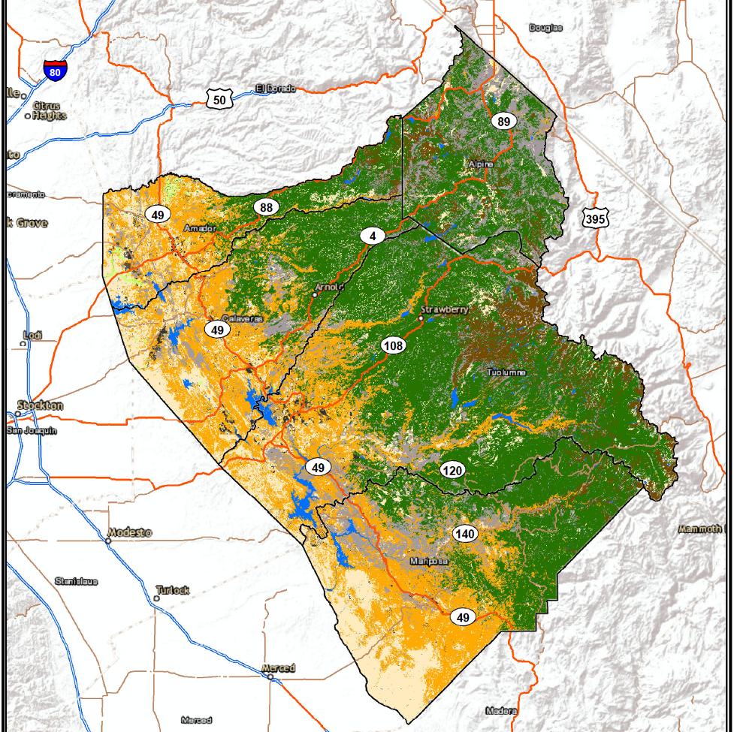
Central Sierra Study Area
Alpine
Amador
Calaveras
Tuolumne
Mariposa

Slide 3
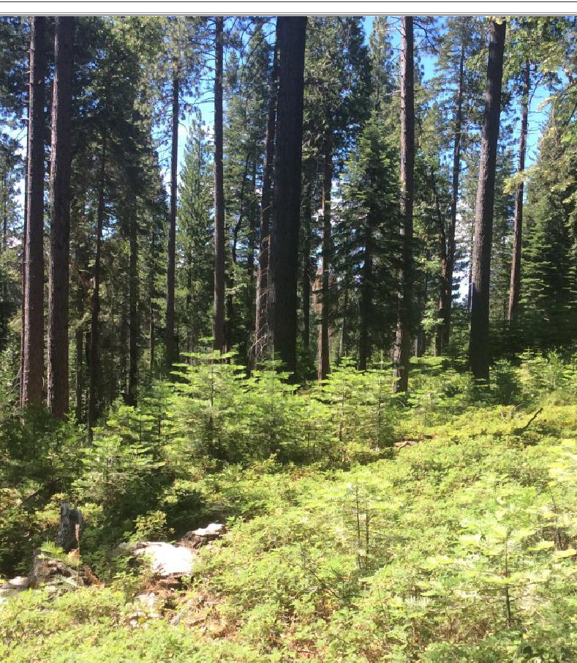
Program Objectives
Identify opportunities for utilization of byproducts generated from forest restoration and fuels reduction activities.
Encourage small business incubation where innovative commercial-scale businesses can develop and thrive

Slide 4
Key Metrics Shared
Biomass market analysis and supply availability within the CSSA.
Forecasted amount of available biomass in CSSA
Current market demand for biomass feedstock sourced from within the CSSA.
Future feedstock sources and risks - including competition from other facilities.
Workforce and Feedstock supply infrastructure, including current barriers to market entry for contractors
Demand for a new wood products campus within the CSSA with industry stakeholders.

Slide 5
Value Added Wood Products Opportunities
Wood fuel pellets
Fuel bricks
Fire logs
Decorative bark
Decorative chip
Hog fuel
Firewood
Post and pole
Small-scale sawmill
Lumber kiln
Biochar (Slow pyrolysis)
Mild pyrolysis (torrefaction)

Slide 6
Candidate Sites

Slide 7
Toyon Site

Slide 8
Mariposa Site

Slide 9
Pioneer Site

Slide 10
Final Report Published March 2024
Questions or comments?
Contact: Jason Smith, Feedstock Analyst
Emal: jasonbsmith@tssconsultants.com

