Slide 1
Request for ACCG Letter of Support Forest Projects Plan (FPP) Monitoring UMRWA Grant Application to CAL FIRE Forest Health Research Program (FHRP)
Megan Layhee, UMRWA
ACCG General Meeting
March 17th, 2024

Slide 2
FPP Monitoring Program Overview
Need: Magnitude of FPP Phase 1 and Phase 2 projects warrants a comprehensive monitoring program
Progress to-date:
UMRWA coordinates regularly with the ACCG Monitoring Work Group.
Drafted preliminary scope of work, deliverables and budget of the FPP Monitoring Program and Monitoring Coordinator.
Pending SNC RFFCP Round 3 funds ($86,400, anticipated to receive in Spring 2024) to bring on Monitoring Coordinator to develop FPP Monitoring Program Strategy and monitoring funding plan.
Need additional grant funding to implement the monitoring program.

Slide 3
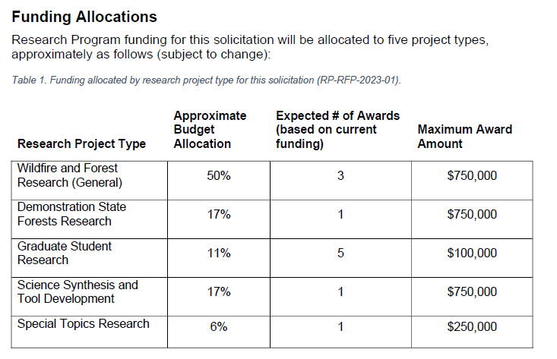
CAL FIRE CCI Forest Health Research Program (FHRP) FY 2023-24
Concept Proposal submitted in Jan.
Invited to submit full application
Full application due by: April 17th
Funds requested: $245,861
Grant duration: July 2024-March 2029
Project Type: Special Topics Research
Development, implementation, or systematic review of ecological monitoring efforts related to vegetation treatments.

Slide 4
CAL FIRE Proposal Key Points
FPP Monitoring Program Framework: ACCG Monitoring Strategy with guidance from other sources.
ACCG’s Monitoring Strategy be reevaluated, led by Monitoring coordinator.
Monitoring questions that address multiple spatial scales.
Field-based monitoring network within Phase 1, Phase 2 landscapes, may utilize existing ACCG Monitoring network plots.
Non-field based data, tools (e.g., remote-sensed data, RRKs, Planscape) to address certain monitoring questions, and field calibration of those data, tools.
TEK principles, cultural-related vegetation treatment assessment (Phase 2).
Develop ArcGIS online platform to enhance and support the understanding, collection, management, sharing and use of the monitoring data.
https://arcg.is/4LDTj

Slide 5
FPP Monitoring Program Team
Team member(s) | Roles, Responsibilities
Monitoring Coordinator | Develop FPP Monitoring Program Strategy (SNC RFFCP R3) Oversee, coordinate field monitoring Data management, analysis, grant reporting, ArcGIS Online platform Regularly interface with ACCG Monitoring Work Group
Field Supervisor | Oversee field crews Assist with data management and analysis
Field Crews (x2) | Perform field monitoring
PI/Project Manager (Megan Layhee) | Project oversight
Co-PI (match) (Becky Estes) | Project oversight Technical expertise
ACCG Monitoring Group (match) | Project oversight Technical expertise

